Slide 1
Network Layer: Overview; Distance Vector Protocols
Qiao Xiang
https://qiaoxiang.me/courses/cnns-xmuf21/index.shtml
11/30/2021
This deck of slides are heavily based on CPSC 433/533 at Yale University, by courtesy of Dr. Y. Richard Yang.

Slide 2
Outline
Admin and recap
Network overview
Network control-plane
Routing

Slide 3
Admin
Lab assignment 3 and 4 due today

Slide 4
Recap: BW Allocation Framework
Forward engineering: systematically design
objective function
distributed alg to achieve objective
Science/reverse engineering: what do TCP/Reno, TCP/Vegas achieve?
Objective | Allocation (x1, x2, x3)
TCP/Reno | 0.26 | 0.74 | 0.74
TCP/Vegas | 1/3 | 2/3 | 2/3
Max throughput | 0 | 1 | 1
Max-min | ½ | ½ | ½
Max sum log(x) | 1/3 | 2/3 | 2/3
Max sum of -1/(RTT² x) | 0.26 | 0.74 | 0.74

Slide 5
Recap: Derive Objective Function
NBS axioms
Pareto optimality
symmetry
invariance of linear transformation
independence of irrelevant alternatives
NBS solution
the rate allocation point is the feasible point which maximizes
x₂
R
s
T
x₁
Notes:
The second two enforce consistency across scenarios

Slide 6
Recap: Derive Alg (Strong Dual Theorem)
f(x) concave
g(x) linear
S is a convex set
f(x)
q₁
q₂
S
q₃
D(q) is called the dual; q (>= 0) are called prices in economics
g(x)

Slide 7
Recap: Primal-Dual Decomposition of Network-Wide Resource Allocation
SYSTEM(U):
USER_{f}:
NETWORK:

Slide 8
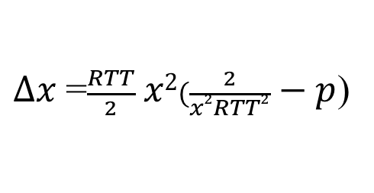
TCP/Reno Dynamics
$∆x$=$\frac{RTT}{2} x2(\frac{2}{x2RTT2} − p$)

Slide 9
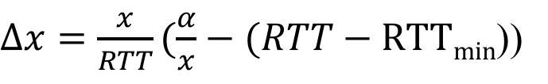
TCP/Vegas Dynamics
$∆x=\frac{x}{RTT}(\frac{α}{x}−(RTT−RTTmin$))

Slide 10
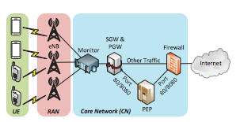
Summary
Many aspects of TCP can be studied, for example
TCP under wireless (LTE)
Multipath TCP
…
10

Slide 11
Outline
Admin and recap
Network overview

Slide 12
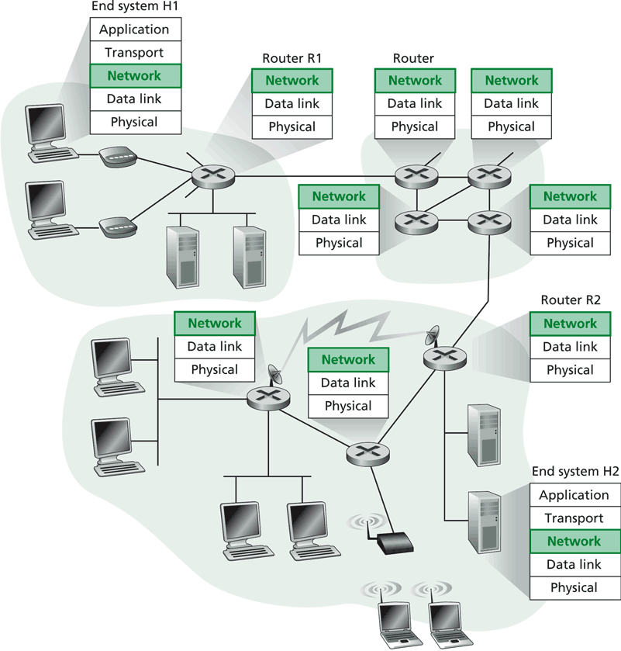
Network Layer
Transport packet from source to dest.
Network layer in every host, router
Basic functions:
inter-networking (e.g., fragmentation/assembly)
routing (determine route(s) taken by packets of a flow), and forwarding (move the packets along the route(s))

Slide 13
Current Internet Network Layer
Network layer functions:
Transport layer
Routing protocols
path selection
e.g., RIP, OSPF, BGP
Control protocols
error reporting e.g. ICMP
Control protocols
- router “signaling” e.g. RSVP
Network
layer
Network layer protocol (e.g., IP)
addressing conventions
packet format
packet handling conventions
forwarding
Link layer
physical layer

Slide 14
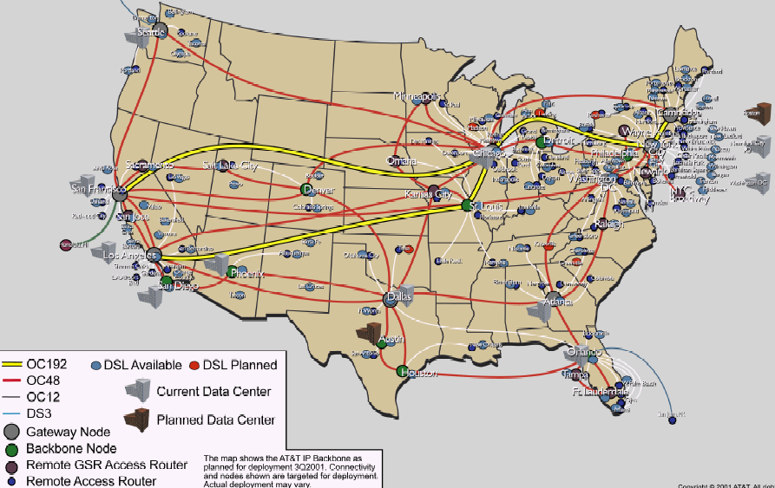
Routing: Overview
Routing
Goal: determine “good” paths
(sequences of routers) thru
networks from source to dest.
Graph abstraction for the routing problem:
graph nodes are routers
graph edges are physical links
links have properties: delay, capacity, $ cost, policy
5
B
3
C
2
5
A
2
1
F
3
1
2
D
E
1

Slide 15
Network Layer: Complexity Factors/Objectives
For network providers
efficiency of routes
policy control on routes
scalability
For users: quality of services
guaranteed bandwidth?
preservation of inter-packet timing (no jitter)?
loss-free delivery?
in-order delivery?
Users and network may interact

Slide 16
Network Layer Quality of Service
Network
Architecture
Internet
ATM
ATM
ATM
ATM
Service
Model
best effort
CBR
VBR
ABR
UBR
Guarantees ?
Congestion
feedback
no (inferred
via loss/delay)
no
congestion
no
congestion
yes
no
Bandwidth
none
constant
rate
guaranteed
rate
guaranteed
minimum
none
Loss
no
yes
yes
no
no
Order
no
yes
yes
yes
yes
Timing
no
yes
yes
no
no
Internet model being extended: Intserv, Diffserv
multimedia networking
ATM: Asynchronous Transfer Mode; CBR: Constant Bit Rate; V: Variable; A: available; U: User

Slide 17
Routing Design Space
- Robustness
- Optimality
- Simplicity
Routing has a large design space
who decides routing?
source routing: end hosts make decision
network routing: networks make decision
how many paths from source s to destination d?
multi-path routing
single path routing
what does routing compute?
network cost minimization
QoS aware
will routing adapt to network traffic demand?
adaptive routing
static routing
…

Slide 18
Routing Design Space: User-based, Multipath, Adaptive
- Robustness
- Optimality
- Simplicity
Routing has a large design space
who decides routing?
source routing: end hosts make decision
network routing: networks make decision
how many paths from source s to destination d?
multi-path routing
single path routing
what does routing compute?
network cost minimization
QoS aware
will routing adapt to network traffic demand?
adaptive routing
static routing
…

Slide 19
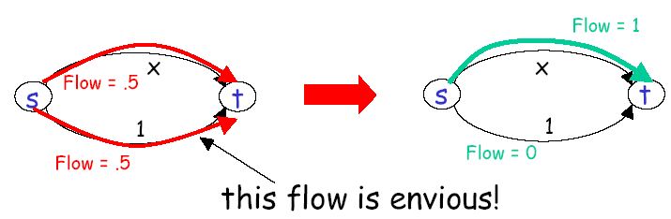
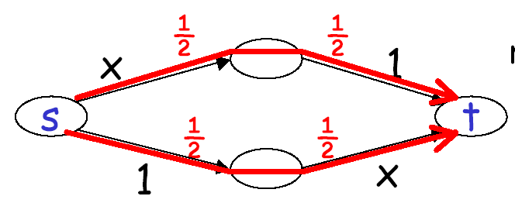
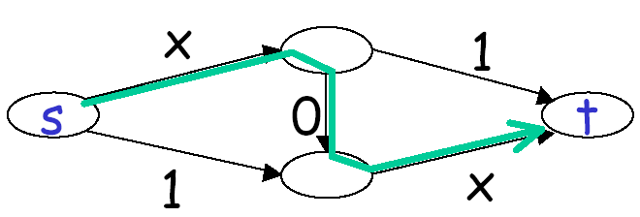
User Optimal, Multipath, Adaptive
User optimal: users pick the shortest routes (selfish routing)
Braess’s paradox

Slide 20
Price of Anarchy
For a network with linear latency functions
total latency of user (selfish) routing for given traffic demand ≤ 4/3
total latency of network optimal routing for the traffic demand

Slide 21
Price of Anarchy
For any network with continuous, non-decreasing latency functions → total latency of user (selfish) routing for given traffic demand ≤ total latency of network optimal routing for twice traffic demand

Slide 22
Routing Design Space: Internet
- Robustness
- Optimality
- Simplicity
Routing has a large design space
who decides routing?
source routing: end hosts make decision
network routing: networks make decision
- (applications such as overlay and p2p are trying to bypass it)
what does routing compute?
network cost minimization (shortest path)
QoS aware
how many paths from source s to destination d?
multi-path routing
single path routing (with small amount of multipath)
will routing adapt to network traffic demand?
adaptive routing
static routing (mostly static; adjust in larger timescale)
…

Slide 23
Basic Formulation
Assign link weights
Compute shortest path
5
B
3
C
2
5
A
2
1
F
3
1
2
D
E
1

Slide 24
Assigning Link Weight: Dynamic Link Costs
Assign link costs to reflect current traffic
Link costs reflect current traffic intensity
0
D
0
0
D
0
A
1
1+e
2+e
0
0
C
A
1+e
1
C
0
e
0
0
B
B
1
1
D
e
t=1
t=0
D
D
A
C
0
0
0
2+e
A
2+e
C
A
0
0
C
1+e
1
1
B
1
0
e
1
B
1+e
B
e
t=3
t=2
Solution: Link costs are a combination of current traffic intensity (dynamic) and topology (static). To improve stability, the static topology part should be large. Thus less sensitive to traffic; thus non-adaptive.

Slide 25
Example: Cisco Proprietary Recommendation on Link Cost
Link metric:
metric = [K1 * bandwidth⁻¹ + (K2 * bandwidth⁻¹) / (256 - load) + K3 * delay] * [K5 / (reliability + K4)]
By default, k1=k3=1 and k2=k4=k5=0. The default composite metric for EIGRP, adjusted for scaling factors, is as follows:
BW_{min} is in kbps and the sum of delays are in 10s of microseconds.
EIGRP : Enhanced Interior Gateway Routing Protocol

Slide 26
Example: EIGRP Link Cost
The bandwidth and delay for an Ethernet interface are 10 Mbps and 1 ms, respectively.
The calculated EIGRP BW metric is as follows:
256 × 10⁷/BW = 256 × 10⁷/10,000
= 256 × 10000
= 256000
5
B
3
C
2
5
A
2
1
F
3
1
2
D
E
1

Slide 27
Outline
Admin and recap
Network overview
Network control plane
Routing
Link weights assignment
Routing computation
Distributed distance vector protocols

Slide 28
Distance Vector Routing
5
3
Setting: static (positive) costs assigned to network links
The static link costs may be adjusted in a longer time scale: this is called traffic engineering
Goal: distributed computing to compute the shortest path from a source to a destination
Based on the Bellman-Ford algorithm (BFA)
Conceptually, runs for each destination separately
Look ahead
Although few (e.g., RIP) use basic distance vector, it is a foundation for many other protocols
We also use the study to acquire another basic set of techniques to understand distributed protocols
B
C
2
5
A
2
1
F
3
1
2
D
E
1

Slide 29
Distance Vector Routing: Basic Idea
At node i, the basic update rule
where
- d_{i} denotes the distance estimation from i to the destination,
- N(i) is set of neighbors of node i, and
- d_{ij} is the distance of the direct link from i to j
destination
j
i

Slide 30
Outline
Admin and recap
Network overview
Network control plane
Routing
Link weights assignment
Routing computation
distributed distance vector protocols
synchronous Bellman-Ford (SBF)

Slide 31
Synchronous Bellman-Ford (SBF)
7
B
1
C
A
8
2
10
Nodes update in rounds:
there is a global clock;
at the beginning of each round, each node sends its estimate to all of its neighbors;
at the end of the round, updates its estimation
E
D
2
A
B
E
C
D

Slide 32
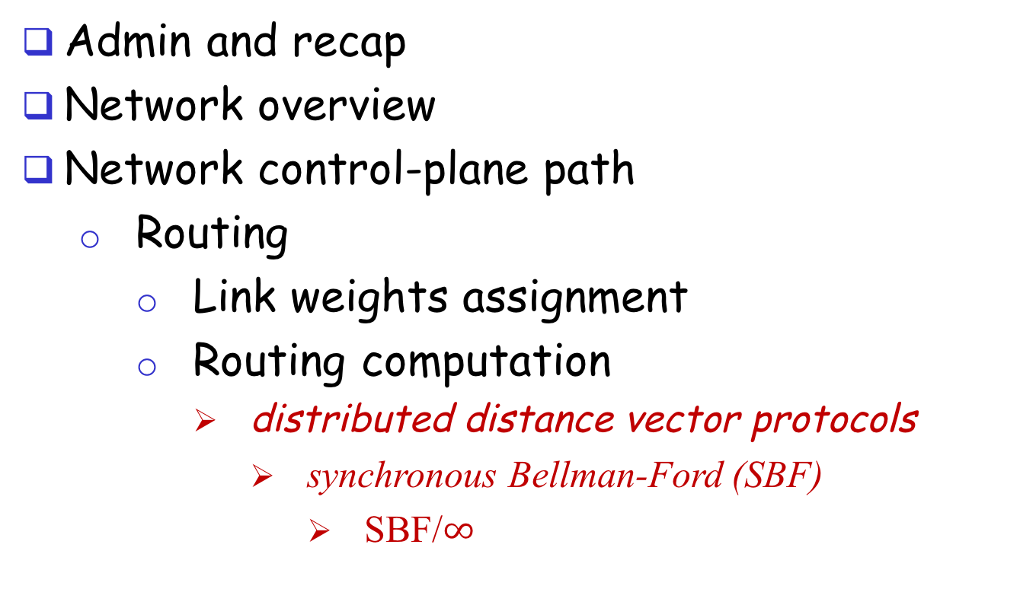
Outline
Admin and recap
Network overview
Network control-plane path
Routing
Link weights assignment
Routing computation
distributed distance vector protocols
synchronous Bellman-Ford (SBF)
SBF/$∞$

Slide 33
SBF/$∞$
7
B
1
C
A
8
2
10
E
D
2
Initialization (time 0):

Slide 34
Example
B
1
C
7
A
8
2
10
Consider D as destination; d(t) is a vector consisting of estimation of each node at round t
E
D
2
A B C E D
d(0)
$∞$ $∞$ $∞$ $∞$ 0
d(1)
$∞$ $∞$ 2 2 0
d(2)
12 3 2 2 0
d(3)
10 3 2 2 0
d(4)
10 3 2 2 0
Observation: d(0) $≥$ d(1) $≥$d(2) $≥$d(3) $≥$ d(4) =d*

Slide 35
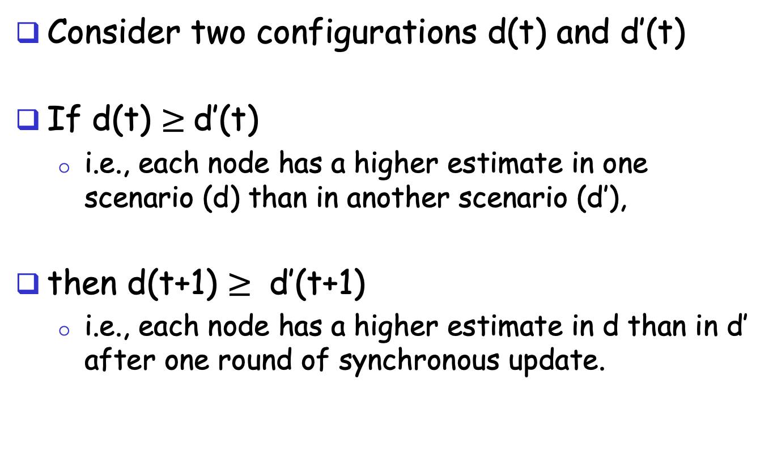
A Nice Property of SBF: Monotonicity
Consider two configurations d(t) and d’(t)
If d(t) $≥$d’(t)
i.e., each node has a higher estimate in one scenario (d) than in another scenario (d’),
then d(t+1) $≥$ d’(t+1)
i.e., each node has a higher estimate in d than in d’ after one round of synchronous update.

Slide 36
Correctness of SBF/$∞$
Claim: d_{i}(h) is the length L_{i}(h) of a shortest path from i to the destination using ≤ h hops
base case: h = 0 is trivially true
assume true for ≤ h, i.e., L_{i}(h)= d_{i}(h), L_{i}(h-1)= d_{i}(h-1), …

Slide 37
Correctness of SBF/$∞$
consider ≤ h+1 hops:
since d_{i}(h) ≤ d_{i}(h-1)

Slide 38
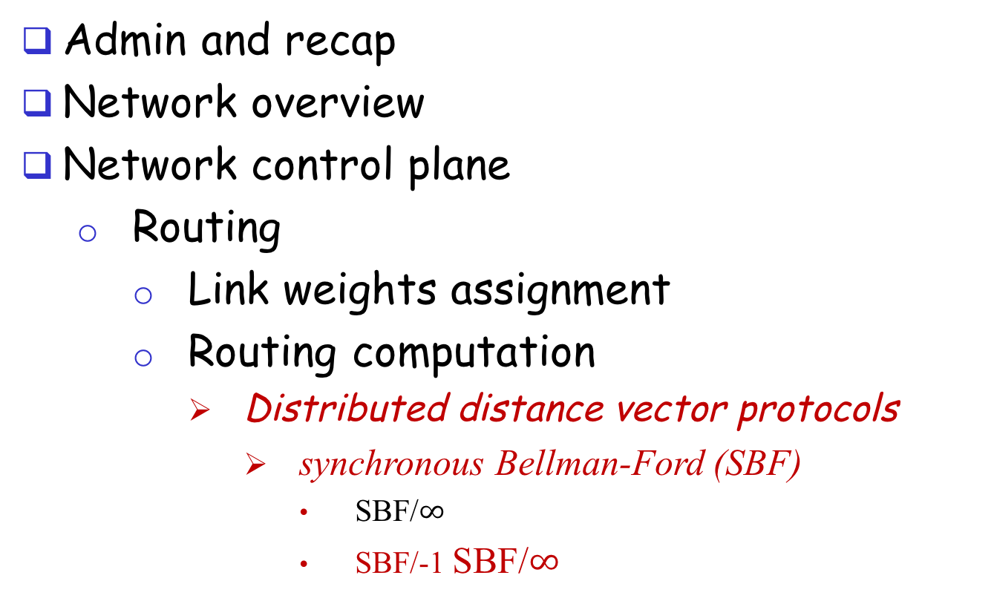
Outline
Admin and recap
Network overview
Network control plane
Routing
Link weights assignment
Routing computation
Distributed distance vector protocols
synchronous Bellman-Ford (SBF)
SBF/$∞$
SBF/-1 SBF/$∞$

Slide 39
SBF at another Initial Configuration: SBF/-1
7
B
1
C
A
8
2
10
E
D
2
Initialization (time 0):

Slide 40
Example
B
1
C
7
A
8
2
10
Consider D as destination
E
D
2
A B C E D
d(0)
-1 -1 -1 -1 0
d(1)
6 0 0 2 0
d(2)
7 1 1 2 0
d(3)
8 2 2 2 0
d(4)
9 3 3 2 0
d(5)
10 3 3 2 0
d(6)
10 3 3 2 0
Observation: d(0) $≤$d(1) $≤$d(2) $≤$d(3) $≤$ d(4) $≤$ d(5) = d(6) = d*

Slide 41
Correctness of SBF/-1
SBF/-1 converges due to monotonicity
Remaining question:
Can we guarantee that SBF/-1 converges to shortest path?

Slide 42
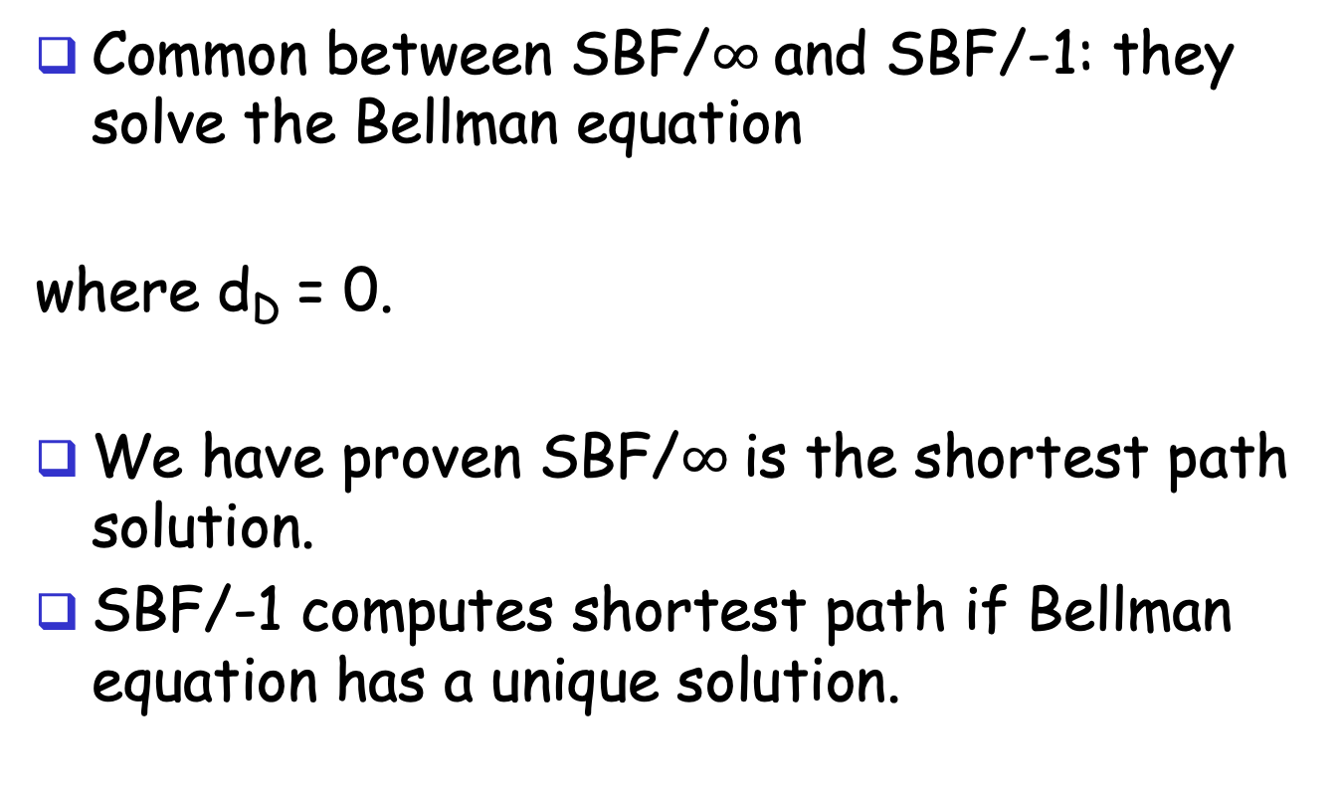
Correctness of SBF/-1
Common between SBF/$∞$and SBF/-1: they solve the Bellman equation
where d_{D} = 0.
We have proven SBF/$∞$is the shortest path solution.
SBF/-1 computes shortest path if Bellman equation has a unique solution.

Slide 43

Uniqueness of Solution to BE
Assume another solution d, we will show that d = d*
case 1: we show d $≥$d*
Since d is a solution to BE, we can construct paths as follows: for each i, pick a j which satisfies the equation; since d* is shortest, d $≥$ d*
3
2
7
B
1
C
1
1
Dest.
10
A
8
2
10
E
D
1
1
2
2

Slide 44
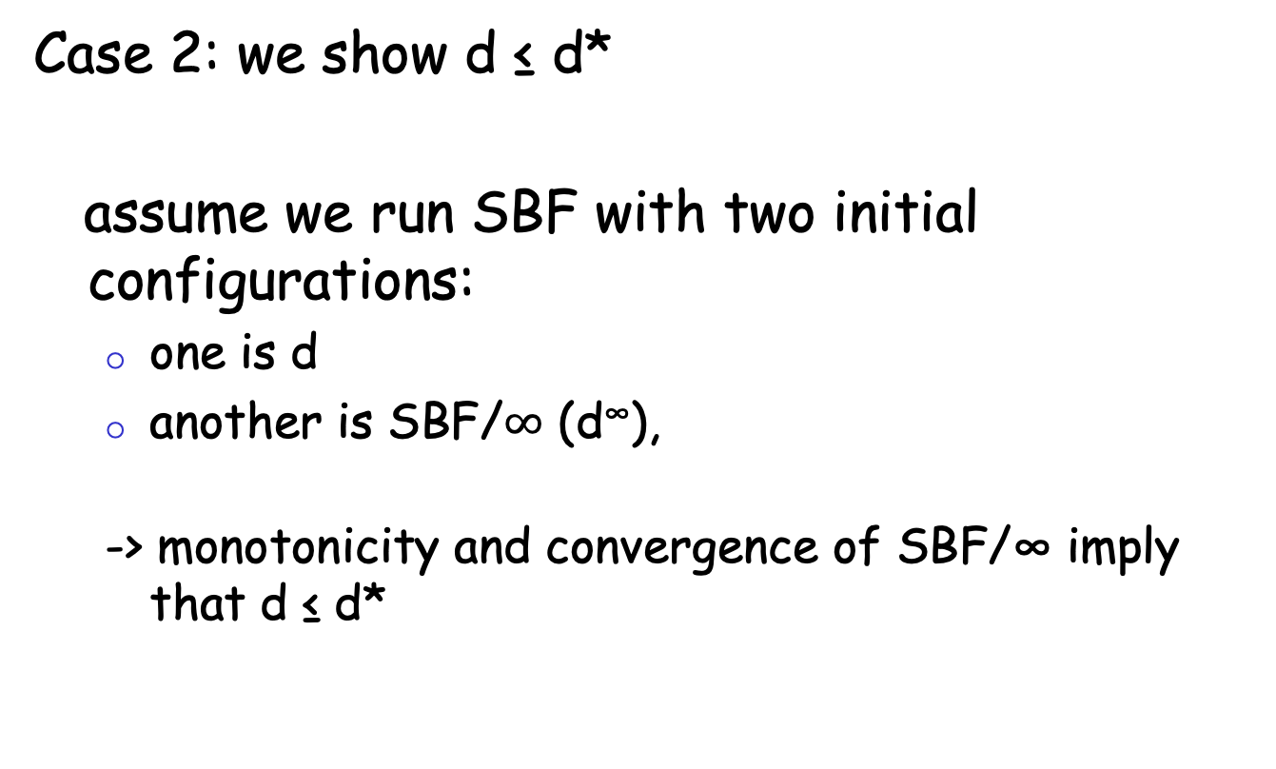
Uniqueness of Solution to BE
Case 2: we show d ≤ d*
assume we run SBF with two initial configurations:
one is d
another is SBF/$∞$ (d∞),
-> monotonicity and convergence of SBF/∞ imply that d ≤ d*

Slide 45
Discussion
Will SBF converge under other non-negative initial conditions?
Problems of running synchronous BF?

Slide 46
Outline
Admin and recap
Network overview
Network control plane
Routing
Link weights assignment
Routing computation
Distributed distance vector protocols
synchronous Bellman-Ford (SBF)
asynchronous Bellman-Ford (ABF)

Slide 47
Asynchronous Bellman-Ford (ABF)
No notion of global iterations
each node updates at its own pace
Asynchronously each node i computes
using last received value d^{i}_{j} from neighbor j.
Asynchronously node j sends its estimate to its neighbor i:
We assume that there is an upper bound on the delay of estimate packet
Notes:
Ti infinite
T^i_j infinite

Slide 48
ABF: Example
B
1
C
7
A
8
2
Below is just one step! The protocol repeats forever!
10
E
D
2
distance tables from neighbors
computation
E’s
distance table
distance table E sends to its neighbors
d ()
A
B
C
D
A B D
A B D
A: 10
B: 8
C: 4
D: 2
E: 0
E
0 7 $∞$
10 15 $∞$
A: 10
7 0 $∞$
17 8 $∞$
B: 8
destinations
$∞$ 1 2
$∞$ 9 4
D: 4
$∞ ∞$ 0
$∞ ∞$ 2
D: 2
10 8 2

Slide 49
Asynchronous Bellman-Ford (ABF)
ABF will eventually converge to the shortest path
links can go down and come up – but if topology is stabilized after some time t and connected, ABF will eventually converge to the shortest path !

Slide 50
ABF Convergence Proof Complexity: Complex System State
j
i
What is system state?
Notes:
There are three types of distance estimates from node i:
d_i: current distance estimate at node i
- d^j_i: last d_i that neighbor j received
- d^j_i: d_i that are in transit to neighbor j

Slide 51
System State
three types of distance state from node j:
d_{j}: current distance estimate state at node j
- d^{i}_{j}: last d_{j} that neighbor i received
- d^{i}_{j}: those d_{j} that are still in transit to neighbor i
dj
d^{i}_{j}
d^{i}_{j}
d_{i}

Slide 52
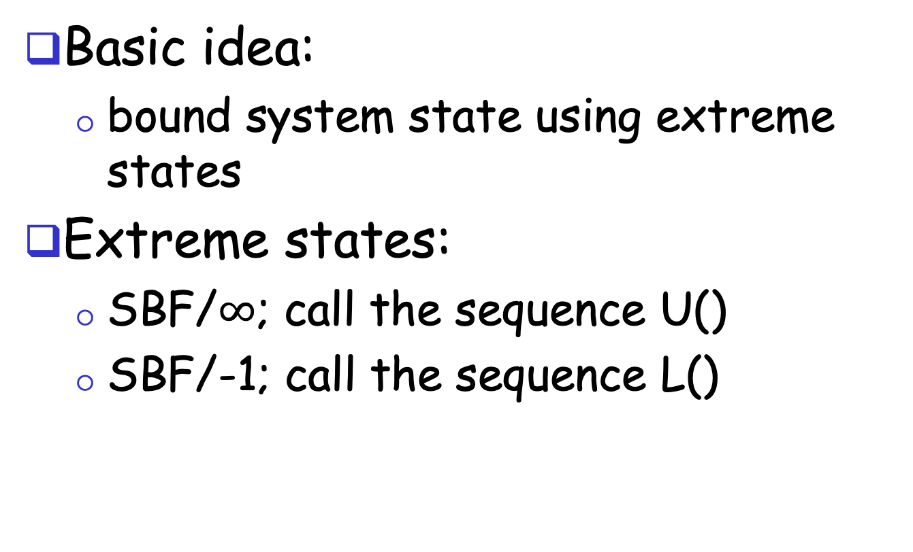
ABF Convergence Proof: The Sandwich Technique
Basic idea:
bound system state using extreme states
Extreme states:
SBF/$∞$; call the sequence U()
SBF/-1; call the sequence L()
Notes:
The state includes di, di_j, and messages containing di_j

Slide 53
ABF Convergence
Consider the time when the topology is stabilized as time 0
U(0) and L(0) provide upper and lower bounds at time 0 on all corresponding elements of states
L_{j} (0) ≤ d_{j} ≤ U_{j} (0) for all d_{j} state at node j
L_{j} (0) ≤ d^{i}_{j} ≤ U_{j} (0)
L_{j} (0) ≤ update messages d^{i}_{j} ≤ U_{j} (0)
Notes:
The state includes di, di_j, and messages containing di_j

Slide 54
ABF Convergence
d_{j}
after at least one update at node j: d_{j} falls between L_{j} (1) ≤ d_{j} ≤ U_{j} (1)
d^{i}_{j} :
eventually all d^{i}_{j} that are only bounded by L_{j} (0) and U_{j} (0) are replaced with in L_{j}(1) and U_{j}(1)
dj
d^{i}_{j}
d^{i}_{j}
d_{i}
Notes:
The state includes di, di_j, and messages containing di_j

Slide 55
Asynchronous Bellman-Ford: Summary
Distributed
each node communicates its routing table to its directly-attached neighbors
Iterative
continues periodically or when link changes, e.g. detects a link failure
Asynchronous
nodes need not exchange info/iterate in lock step!
Convergence
in finite steps, independent of initial condition if network is connected

Slide 56
Summary: Distributed Distance-Vector
Tool box: a key technique for proving convergence (liveness) of distributed protocols: monotonicity and bounding-box (sandwich) design
Consider two configurations d(t) and d’(t):
if d(t) <= d’(t), then d(t+1) <= d’(t+1)
Identify two extreme configurations to sandwich any real configurations

