Slide 1
Network Applications: Load Balancing among Homogeneous Servers; Application Overlays (P2P)
Qiao Xiang
https://qiaoxiang.me/courses/cnns-xmuf21/index.shtml
11/4/2021
This deck of slides are heavily based on CPSC 433/533 at Yale University, by courtesy of Dr. Y. Richard Yang.

Slide 2
Outline
Admin and recap
Multi-servers
Basic issues
Load direction
DNS (IP level)
Load balancer/smart switch (sub-IP level)
Application overlays (distributed network applications) to
scale bandwidth/resource (BitTorrent)

Slide 3
Admin
Assignment three status and questions?
Midterm exam 1: Thursday next week (i.e., Nov. 11)
cover from lecture 1 to lecture 16 (the one on Nov. 9)

Slide 4
Recap: Direction Mechanisms
App
DNS name1
DNS name2
- cname
- hierarchy
IP1
IP2
IPn
Cluster1 in US East
Cluster2
in US West
Cluster2
in Europe
Smart switch/LB - NAT rewrite - Direct reply - NLB
Load
balancer
Proxy as a mechanism for replica content consistency
Load
balancer
proxy
servers
4

Slide 5
VIP Clustering
Goals
server load balancing
failure detection
access control filtering
priorities/QoS
request locality
transparent caching
L4: TCP
L7: HTTP
SSL
etc.
virtual IP addresses (VIPs)
smart switch
Clients
What to switch/filter on?
L3 source IP and/or VIP
L4 (TCP) ports etc.
L7 URLs and/or cookies
L7 SSL session IDs
server array

Slide 6
Load Balancer (LB): Basic Structure
RIP1
S=client
D=VIP
Server1
S=client
D=VIP
VIP
RIP2
Client
LB
Server2
RIP3
Server3
Problem of the basic structure?

Slide 7
Problem
S=client
D=VIP
Client to server packet has VIP as destination address, but real servers use RIPs
if LB just forwards the packet from client to a real server, the real server drops the packet
reply from real server to client has real server IP as source -> client will drop the packet
state: listening
address: {RealIP.6789, *:*}
completed connection queue: C1; C2 sendbuf:
recvbuf:
state:
address: {VIP:6789, 198.69.10.10.1500}
sendbuf:
recvbuf:
…
state:
address: {RealIP:6789, 198.69.10.10.1500}
sendbuf:
recvbuf:
…
server
client

Slide 8
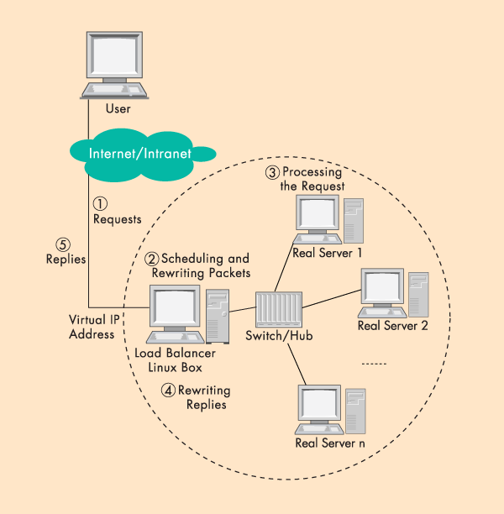
Solution 1: Network Address Translation (NAT)
LB does rewriting/ translation
Thus, the LB is similar to a typical NAT gateway with an additional scheduling function
Load Balancer

Slide 9
Example Virtual Server via NAT

Slide 10
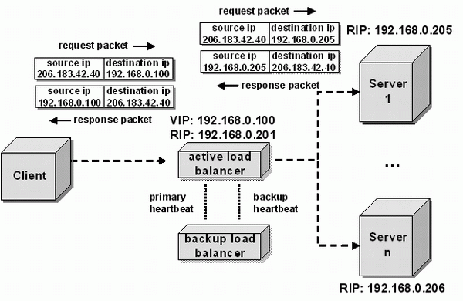
LB/NAT Flow

Slide 11
LB/NAT Flow

Slide 12
LB/NAT Advantages and Disadvantages
Advantages:
Only one public IP address is needed for the load balancer; real servers can use private IP addresses
Real servers need no change and are not aware of load balancing
Problem
The load balancer must be on the critical path and hence may become the bottleneck due to load to rewrite request and response packets
Typically, rewriting responses has more load because there are more response packets

Slide 13
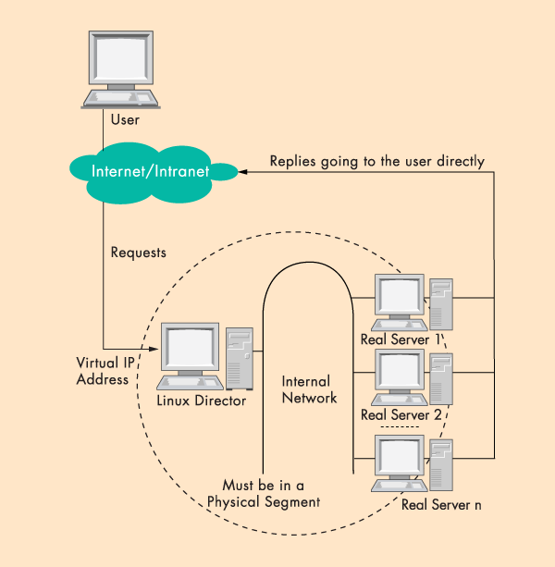
Goal: LB w/ Direct Reply
load
balancer
Connected
by a single switch

Slide 14
LB with Direct Reply: Implication
VIP
Server1
VIP
Client
LB
Server2
Server3
Direct reply
Each real server uses VIP as its IP address
Address conflict: multiple devices w/ the same IP addr

Slide 15
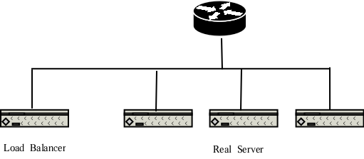
Why IP Address Matters?
VIP
Each network interface card listens to an assigned MAC address
A router is configured with the range of IP addresses connected to each interface (NIC)
To send to a device with a given IP, the router needs to translate IP to MAC (device) address
The translation is done by the Address Resolution Protocol (ARP)

Slide 16
ARP Protocol
ARP is “plug-and-play”:
nodes create their ARP tables without intervention from net administrator
A broadcast protocol:
Router broadcasts query frame, containing queried IP address
all machines on LAN receive ARP query
Node with queried IP receives ARP frame, replies its MAC address

Slide 17
ARP in Action
S=client
D=VIP
Router R
VIP
- Router broadcasts ARP broadcast query: who has VIP?
- ARP reply from LB: I have VIP; my MAC is MAC_{LB}
- Data packet from R to LB: destination MAC = MAC_{LB}

Slide 18
LB/DR Problem
Router R
VIP
VIP
VIP
VIP
ARP and race condition:
When router R gets a packet with dest. address VIP, it broadcasts an Address Resolution Protocol (ARP) request: who has VIP?
One of the real servers may reply before load balancer
Solution: configure real servers to not respond to ARP request

Slide 19
LB via Direct Routing
The virtual IP address is shared by real servers and the load balancer.
Each real server has a non-ARPing, loopback alias interface configured with the virtual IP address, and the load balancer has an interface configured with the virtual IP address to accept incoming packets.
The workflow of LB/DR is similar to that of LB/NAT:
the load balancer directly routes a packet to the selected server
the load balancer simply changes the MAC address of the data frame to that of the server and retransmits it on the LAN (how to know the real server’s MAC?)
When the server receives the forwarded packet, the server determines that the packet is for the address on its loopback alias interface, processes the request, and finally returns the result directly to the user

Slide 20
LB/DR Advantages and Disadvantages
Advantages:
Real servers send response packets to clients directly, avoiding LB as bottleneck
Disadvantages:
Servers must have non-arp alias interface
The load balancer and server must have one of their interfaces in the same LAN segment
Considered by some as a hack, not a clean architecture

Slide 21
Example Implementation of LB
An example open source implementation is Linux virtual server (linux-vs.org)
Used by
www.linux.com
sourceforge.net
wikipedia.org
More details on ARP problem: http://www.austintek.com/LVS/LVS-HOWTO/HOWTO/LVS-HOWTO.arp_problem.html
Many commercial LB servers from F5, Cisco, …
More details please read chapter 2 of Load Balancing Servers, Firewalls, and Caches

Slide 22
Problem of the Load Balancer Architecture
Server1
S=client
D=VIP
VIP
Client
LB
Server2
Server3
One major problem is that the LB becomes a single point of failure (SPOF).

Slide 23
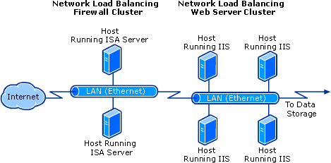
Solutions
Redundant load balancers
E.g., two load balancers (a good question to think offline)
Fully distributed load balancing
e.g., Microsoft Network Load Balancing (NLB)

Slide 24
Microsoft NLB
No dedicated load balancer
All servers in the cluster receive all packets
Key issue: one and only one server processes each packet
All servers within the cluster simultaneously run a mapping algorithm to determine which server should handle the packet. Those servers not required to service the packet simply discard it.
Mapping (ranking) algorithm: computing the “winning” server according to host priorities, multicast or unicast mode, port rules, affinity, load percentage distribution, client IP address, client port number, other internal load information
http://technet.microsoft.com/en-us/library/cc739506%28WS.10%29.aspx

Slide 25
Discussion
Compare the design of using Load Balancer vs Microsoft NLB

Slide 26
Recap: Direction Mechanisms
App
DNS name1
DNS name2
IP1
IP2
IPn
Cluster1 in US East
Cluster2
in US West
Cluster2
in Europe
Rewrite
Direct reply
Fault tolerance
Load
balancer
Load
balancer
proxy
servers

Slide 27
Outline
Admin and recap
Single, high-performance network server
Multiple servers
Overview
Basic mechanisms
Example: YouTube (offline read)

Slide 28
You Tube
http://video.google.com/videoplay?docid=-6304964351441328559#
02/2005: Founded by Chad Hurley, Steve Chen and Jawed Karim, who were all early employees of PayPal.
10/2005: First round of funding ($11.5 M)
03/2006: 30 M video views/day
07/2006: 100 M video views/day
11/2006: acquired by Google
10/2009: Chad Hurley announced in a blog that YouTube serving well over 1 B video views/day (avg = 11,574 video views /sec )

Slide 29
Pre-Google Team Size
2 Sysadmins
2 Scalability software architects
2 feature developers
2 network engineers
1 DBA
0 chefs

Slide 30
YouTube Design Alg.
while (true) { identify_and_fix_bottlenecks(); drink(); sleep(); notice_new_bottleneck(); }

Slide 31
YouTube Major Components
Web servers
Video servers
Thumbnail servers
Database servers

Slide 32
YouTube: Web Servers
Components
Netscaler load balancer; Apache; Python App Servers; Databases
Python
Web code (CPU) is not bottleneck
JIT to C to speedup
C extensions
Pre-generate HTML responses
Development speed more important
NetScaler
Apache
Web
servers
Python
App Server
Databases

Slide 33
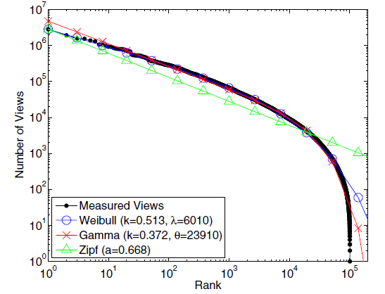
YouTube: Video Popularity
See “Statistics and Social Network of YouTube Videos”, 2008.

Slide 34
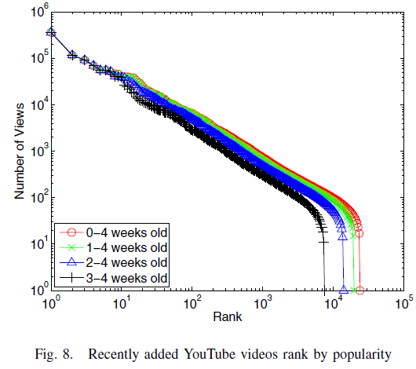
YouTube: Video Popularity
How to design a system to handle highly skewed distribution?
See “Statistics and Social Network of YouTube Videos”, 2008.

Slide 35
YouTube: Video Server Architecture
Tiered architecture
CDN servers (for popular videos)
Low delay; mostly in-memory operation
YouTube servers (not popular 1-20 per day)
CDN
Most popular
YouTube Colo 1
Request
Others
YouTube Colo N

Slide 36
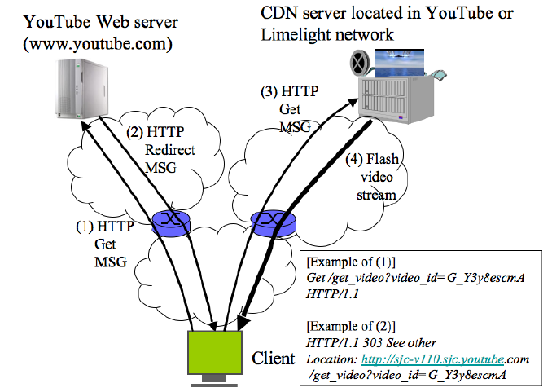
YouTube Redirection Architecture
YouTube servers

Slide 37
YouTube Video Servers
Each video hosted by a mini-cluster consisting of multiple machines
Video servers use the lighttpd web server for video transmission:
Apache had too much overhead (used in the first few months and then dropped)
Async io: uses epoll to wait on multiple fds
Switched from single process to multiple process configuration to handle more connections

Slide 38
Thumbnail Servers
Thumbnails are served by a few machines
Problems running thumbnail servers
A high number of requests/sec as web pages can display 60 thumbnails on page
Serving a lot of small objects implies
lots of disk seeks and problems with file systems inode and page caches
may ran into per directory file limit
Solution: storage switched to Google BigTable

Slide 39
Thumbnail Server Software Architecture
Design 1: Squid in front of Apache
Problems
Squid worked for a while, but as load increased performance eventually decreased: Went from 300 requests/second to 20
under high loads Apache performed badly, changed to lighttpd
Design 2: lighttpd default: By default lighttpd uses a single thread
Problem: often stalled due to I/O
Design 3: switched to multiple processes contending on shared accept
Problems: high contention overhead/individual caches

Slide 40
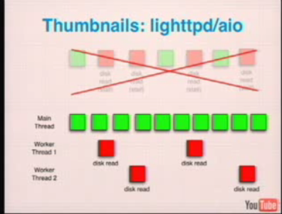
Thumbnails Server: lighttpd/aio

Slide 41
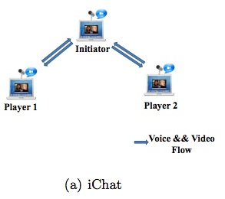
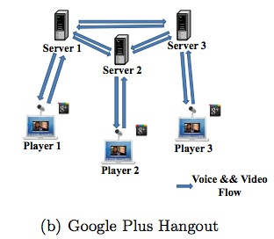
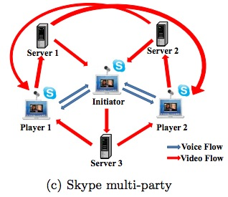
Example Server Systems
http://eeweb.poly.edu/faculty/yongliu/docs/imc12.pdf

Slide 42
Scalability of Server-Only Approaches
origin
DNS
edge. servers
C₀
client 1
client 2
client n
client 3

Slide 43
Outline
Admin and recap
Multiple servers
Application overlays
potential

Slide 44
An Upper Bound on Scalability
Idea: use resources from both clients and the server
Assume
need to achieve same rate to all clients
only uplinks can be bottlenecks
What is an upper bound on scalability?
server
C₀
C₁
client 1
C_{n}
C₂
C₃
client 2
client n
client 3

Slide 45
The Scalability Problem
Maximum throughput
R = min{C₀, (C₀+ΣC_{i})/n}
The bound is theoretically approachable
server
C₀
C₁
client 1
C_{n}
C₂
C₃
client 2
client n
client 3

Slide 46
Theoretical Capacity: upload is bottleneck
R = min{C₀, (C₀+ΣC_{i})/n}
Assume c₀ > (C₀+ΣC_{i})/n
Tree i: server → client i: c_{i} /(n-1) client i → other n-1 clients
Tree 0: server has remaining c_{m} = c0 – (c1 + c2 + … cn)/(n-1) send to client i: c_{m}/n
c₀
c_{i} /(n-1)
c_{n}
c_{i}
c₁
c₂
C₀
c_{m} /n
C_{n}
C₁
C₂
C_{i}

Slide 47
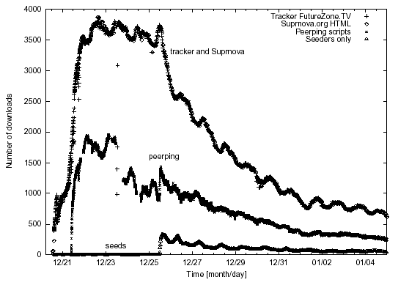
Why not Building the Trees?
servers
C₀
C₁
client 1
C_{n}
C₂
C₃
client 2
client n
Clients come and go (churns): maintaining the trees is too expensive
Each client needs N connections
client 3

Slide 48
Server+Host (P2P) Content Distribution: Key Design Issues
Robustness
Resistant to churns and failures
Efficiency
A client has content that others need; otherwise, its upload capacity may not be utilized
Incentive: clients are willing to upload
Some real systems nearly 50% of all responses are returned by the top 1% of sharing hosts
servers
C₀
C₁
client 1
C_{n}
C₂
C₃
client 2
client n
client 3

Slide 49
Discussion: How to handle the issues?
Robustness
Efficiency
Incentive
servers/ seeds
C₀
C₁
client 1
C_{n}
C₂
C₃
client 2
client n
client 3

Slide 50
Example: BitTorrent
A P2P file sharing protocol
Created by Bram Cohen in 2004
Spec at bep_0003: http://www.bittorrent.org/beps/bep_0003.html

Slide 51
BitTorrent: Lookup
HTTP GET MYFILE.torrent
MYFILE.torrent
webserver
http://mytracker.com:6969/
S3F5YHG6FEB
FG5467HGF367
F456JI9N5FF4E
…
user

Slide 52
Metadata (.torrent) File Structure
Meta info contains information necessary to contact the tracker and describes the files in the torrent
URL of tracker
file name
file length
piece length (typically 256KB)
SHA-1 hashes of pieces for verification
also creation date, comment, creator, …

Slide 53
Tracker Protocol
Communicates with clients via HTTP/HTTPS
Client GET request
info_hash: uniquely identifies the file
peer_id: chosen by and uniquely identifies the client
client IP and port
numwant: how many peers to return (defaults to 50)
stats: e.g., bytes uploaded, downloaded
Tracker GET response
interval: how often to contact the tracker
list of peers, containing peer id, IP and port
stats

Slide 54

Tracker Protocol
webserver
user
“register”
list of peers
ID1 169.237.234.1:6881
ID2 190.50.34.6:5692
ID3 34.275.89.143:4545
…
ID50 231.456.31.95:6882
tracker
…
Peer 50
Peer 1
Peer 2

Slide 55
Robustness and efficiency: Piece-based Swarming
Divide a large file into small blocks and request block-size content from different peers (why?)
If do not finish downloading a block from one peer within timeout (say due to churns), switch to requesting the block from another peer
Block: unit of download
File
Block: 16KB

Slide 56
Detail: Peer Protocol
(Over TCP)
Peers exchange bitmap representing content availability
bitfield msg during initial connection
have msg to notify updates to bitmap
to reduce bitmap size, aggregate multiple blocks as a piece
BitField/have
BitField/have
Remote Peer
Local Peer
0
1
0
1
Piece 256KB
Incomplete Piece

Slide 57

Peer Request
http://www.bittorrent.org/beps/bep_0003.html
If peer A has a piece that peer B needs, peer B sends interested to A
unchoke: indicate that A allows B to request
request: B requests a specific block from A
piece: specific data
1.interested/ 3. request
2. unchoke/ 4. piece

Slide 58
Key Design Points
request:
which data blocks to request?
unchoke:
which peers to serve?
1.interested/ 3. request
2. unchoke/ 4. piece

Slide 59
Request: Block Availability
Request (local) rarest first
achieves the fastest replication of rare pieces
obtain something of value

Slide 60
Block Availability: Revisions
When downloading starts (first 4 pieces): choose at random and request them from the peers
get pieces as quickly as possible
obtain something to offer to others
Endgame mode
defense against the “last-block problem”: cannot finish because missing a few last pieces
send requests for missing pieces to all peers in our peer list
send cancel messages upon receipt of a piece

Slide 61
BitTorrent: Unchoke
Periodically (typically every 10 seconds) calculate data-receiving rates from all peers
Upload to (unchoke) the fastest
constant number (4) of unchoking slots
partition upload bw equally among unchoked
1.interested/ 3. request
2. unchoke/ 4. piece
commonly referred to as “tit-for-tat” strategy

Slide 62
Optimistic Unchoking
Periodically select a peer at random and upload to it
typically every 3 unchoking rounds (30 seconds)
Multi-purpose mechanism
allow bootstrapping of new clients
continuously look for the fastest peers (exploitation vs exploration)

Slide 63
BitTorrent Fluid Analysis
Normalize file size to 1
x(t): number of downloaders (also known as leechers) who do not have all pieces at time t.
y(t): number of seeds in the system at time t.
λ: the arrival rate of new requests.
μ: the uploading bandwidth of a given peer.
c: the downloading bandwidth of a given peer, assume c ≥ μ.
θ: the rate at which downloaders abort download.
γ: the rate at which seeds leave the system.
η: indicates the effectiveness of downloader sharing, η takes values in [0, 1].

Slide 64



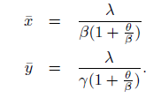
System Evolution
Solving steady state:
Define
"Modeling and Performance Analysis of BitTorrent-Like Peer-to-Peer Networks", SIGCOMM'04
https://conferences.sigcomm.org/sigcomm/2004/papers/p444-qiu1.pdf

Slide 65

System State
Q: How long does each downloader stay as a downloader?
λ
Key take-away: not scaling inverse with system size (x)
New requests comes, new bandwidth also comes

