Slide 1
Network Transport Layer: Transport Reliability: Sliding Windows; Connection Management; TCP
Qiao Xiang
https://qiaoxiang.me/courses/cnns-xmuf21/index.shtml
11/11/2021
This deck of slides are heavily based on CPSC 433/533 at Yale University, by courtesy of Dr. Y. Richard Yang.

Slide 2
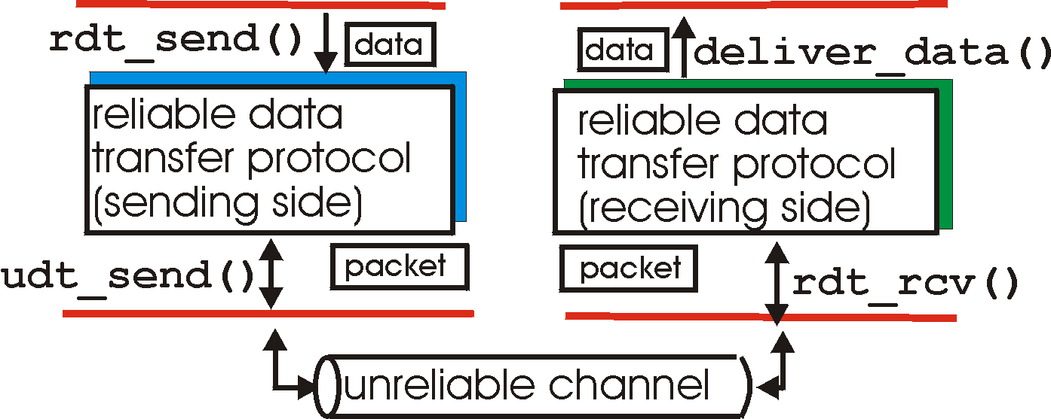
Recap: Reliable Data Transfer Context
rdt_send(): called from above, (e.g., by app.)
deliver_data(): called by rdt to deliver data to upper
send
side
receive
side
udt_send(): called by rdt,
to transfer packet over
unreliable channel to receiver
rdt_rcv(): called from below; when packet arrives on rcv-side of channel

Slide 3
Recap: rdt2.0: Reliability allowing only Data Msg Corruption
rdt_send(data)
snkpkt = make_pkt(data, checksum)
udt_send(sndpkt)
receiver
rdt_rcv(rcvpkt) &&
isNAK(rcvpkt)
Wait for data
Wait for ACK or NAK
rdt_rcv(rcvpkt) &&
corrupt(rcvpkt)
udt_send(sndpkt)
udt_send(NAK)
rdt_rcv(rcvpkt) && isACK(rcvpkt)
Λ
Wait for data
sender
rdt_rcv(rcvpkt) &&
notcorrupt(rcvpkt)
extract(rcvpkt,data)
deliver_data(data)
udt_send(ACK)
3

Slide 4
Recap: Rdt2.0 Analysis
sender
receiver
data (n)
Execution traces of rdt2.0: {data^ NACK}* data deliver ACK
waiting for N/ACK
NACK
data (n)
ACK
waiting for data
data (n+1)

Slide 5
Recap: rdt2.1b: Reliability allowing Data/Control Msg Corruption
Guess garbled feedback as NAK
sender
Fix wrong guess by checking seq#
receiver
5

Slide 6
Protocol Analysis using (Generic) Execution Traces Technique
Issue: how to systematically enumerate all potential execution traces to understand and verify correctness
A systematic approach to enumerating exec. traces is to compute joint sender/receiver/channels state machine
sender state: waiting for n
receiver state: waiting for n
snd->rcv channel state
rcv d_{n} _{del}
s_{n} r_{n+1} - ACK
…
rcv>snd channel state
w_{n} r_{n} - -
snd d_{n}
s_{n} r_{n} d_{n} -
rcv d^_{n}
s_{n} r_{n} - NAK
…
6
Notes:
{data(n)^ NACK|NACK^}* data(n) deliver
ACK^ data(n)
ACK^ data(n)^ XXXX

Slide 7
Recap: Protocol Analysis using (Generic) Execution Traces Technique
r d_{n}
deliv
s ACK
r ACK
s d_{n}
w_{n} r_{n} - -
s_{n} r_{n} d_{n} -
s_{n} r_{n+1} - ACK
W_{n+1} r_{n+1} - -
r NAK| r NAK^ s d_{n}
r d_{n}^ s NAK
r d_{n}
s ACK
r ACK^
s d_{n}
s_{n} r_{n} - NAK
s_{n} r_{n+1} d_{n} -
r NAK| r NAK^
s d_{n}
r d_{n}^
s NAK
s_{n} r_{n+1} - NAK
Execution traces of rdt2.1b are all that can be generated by the finite state machine above.
7
Notes:
{data(n)^ NACK|NACK^}* data(n) deliver
ACK^ data(n)
ACK^ data(n)^ XXXX

Slide 8
Recap: Protocol Analysis using State Invariants
first
time
rcvs
ack 0
W1: wait for data with seq. 1
S1: sending data with seq. 1
w0
s0
w1
s1
w2
s2
w3
sender
w0
w1
w2
w3
receiver
State invariant:
- When receiver’s state is waiting for seq #n, sender’s state can be sending either seq#n-1or seq#n, and only either #n or #n-1 packets can arrive
first
time
rcvs 0

Slide 9
rdt2.1c: Sender, Handles Garbled ACK/NAKs: Using 1 bit (Alternating-Bit Protocol)
rdt_send(data)
sndpkt = make_pkt(0, data, checksum)
udt_send(sndpkt)
rdt_rcv(rcvpkt) &&
( corrupt(rcvpkt) ||
isNAK(rcvpkt) )
Wait for call 0 from above
Wait for ACK or NAK
udt_send(sndpkt)
rdt_rcv(rcvpkt)
&& notcorrupt(rcvpkt)
&& isACK(rcvpkt)
rdt_rcv(rcvpkt)
&& notcorrupt(rcvpkt)
&& isACK(rcvpkt)
Λ
Λ
Wait for ACK or NAK 1
Wait for
call 1 from above
rdt_rcv(rcvpkt) &&
( corrupt(rcvpkt) ||
isNAK(rcvpkt) )
rdt_send(data)
udt_send(sndpkt)
sndpkt = make_pkt(1, data, checksum)
udt_send(sndpkt)

Slide 10
rdt2.1c: Receiver, Handles Garbled ACK/NAKs: Using 1 bit
rdt_rcv(rcvpkt) && notcorrupt(rcvpkt)
&& has_seq0(rcvpkt)
extract(rcvpkt,data)
deliver_data(data)
sndpkt = make_pkt(ACK, chksum)
udt_send(sndpkt)
rdt_rcv(rcvpkt) && (corrupt(rcvpkt)
rdt_rcv(rcvpkt) && (corrupt(rcvpkt)
sndpkt = make_pkt(NAK, chksum)
udt_send(sndpkt)
sndpkt = make_pkt(NAK, chksum)
udt_send(sndpkt)
Wait for
0 from below
Wait for
1 from below
rdt_rcv(rcvpkt) &&
not corrupt(rcvpkt) &&
has_seq1(rcvpkt)
rdt_rcv(rcvpkt) &&
not corrupt(rcvpkt) &&
has_seq0(rcvpkt)
sndpkt = make_pkt(ACK, chksum)
udt_send(sndpkt)
sndpkt = make_pkt(ACK, chksum)
udt_send(sndpkt)
rdt_rcv(rcvpkt) && notcorrupt(rcvpkt)
&& has_seq1(rcvpkt)
extract(rcvpkt,data)
deliver_data(data)
sndpkt = make_pkt(ACK, chksum)
udt_send(sndpkt)

Slide 11
rdt2.1c: Summary
Sender:
state must “remember” whether “current” pkt has 0 or 1 seq. #
Receiver:
must check if received packet is duplicate
state indicates whether 0 or 1 is expected pkt seq #

Slide 12
rdt2.2: a NAK-free protocol
Same functionality as rdt2.1c, using ACKs only
Instead of NAK, receiver sends ACK for last pkt received OK
receiver must explicitly include seq # of pkt being ACKed
Duplicate ACK at sender results in same action as NAK: retransmit current pkt

Slide 13
rdt2.2: Sender, Receiver Fragments
rdt_send(data)
sndpkt = make_pkt(0, data, checksum)
udt_send(sndpkt)
rdt_rcv(rcvpkt) &&
( corrupt(rcvpkt) ||
isACK(rcvpkt,1) )
Wait for call 0 from above
Wait for ACK 0
udt_send(sndpkt)
sender FSM
fragment
rdt_rcv(rcvpkt)
&& notcorrupt(rcvpkt)
&& isACK(rcvpkt,0)
rdt_rcv(rcvpkt) &&
(corrupt(rcvpkt) ||
has_seq1(rcvpkt))
Λ
Wait for
0 from below
receiver FSM
fragment
sndpkt= make_pkt(ACK,1, chksum)
udt_send(sndpkt)
rdt_rcv(rcvpkt) && notcorrupt(rcvpkt)
&& has_seq0(rcvpkt)
extract(rcvpkt,data)
deliver_data(data)
sndpkt = make_pkt(ACK,0, chksum)
udt_send(sndpkt)

Slide 14
Outline
Admin and review
Reliable data transfer
perfect channel
channel with bit errors
channel with bit errors and losses

Slide 15
rdt3.0: Channels with Errors and Loss
New assumption: underlying channel can also lose packets (data or ACKs)
checksum, seq. #, ACKs, retransmissions will be of help, but not enough
Q: Does rdt2.2 work under losses?
Approach: sender waits “reasonable” amount of time for ACK
requires countdown timer
retransmits if no ACK received in this time
if pkt (or ACK) just delayed (not lost):
retransmission will be duplicate, but use of seq. #’s already handles this
receiver must specify seq # of pkt being ACKed

Slide 16
rdt3.0 Sender
rdt_send(data)
rdt_rcv(rcvpkt) &&
( corrupt(rcvpkt) ||
isACK(rcvpkt,1) )
sndpkt = make_pkt(0, data, checksum)
udt_send(sndpkt)
start_timer
udt_send(sndpkt)
rdt_rcv(rcvpkt)
Λ
Λ
Wait for
call 0 from above
Wait for ACK0
timeout
udt_send(sndpkt)
start_timer
rdt_rcv(rcvpkt)
&& notcorrupt(rcvpkt)
&& isACK(rcvpkt,1)
rdt_rcv(rcvpkt)
&& notcorrupt(rcvpkt)
&& isACK(rcvpkt,0)
stop_timer
stop_timer
Wait for ACK1
Wait for
call 1 from above
timeout
udt_send(sndpkt)
start_timer
rdt_rcv(rcvpkt)
rdt_send(data)
Λ
rdt_rcv(rcvpkt) &&
( corrupt(rcvpkt) ||
isACK(rcvpkt,0) )
sndpkt = make_pkt(1, data, checksum)
udt_send(sndpkt)
start_timer
Λ

Slide 17
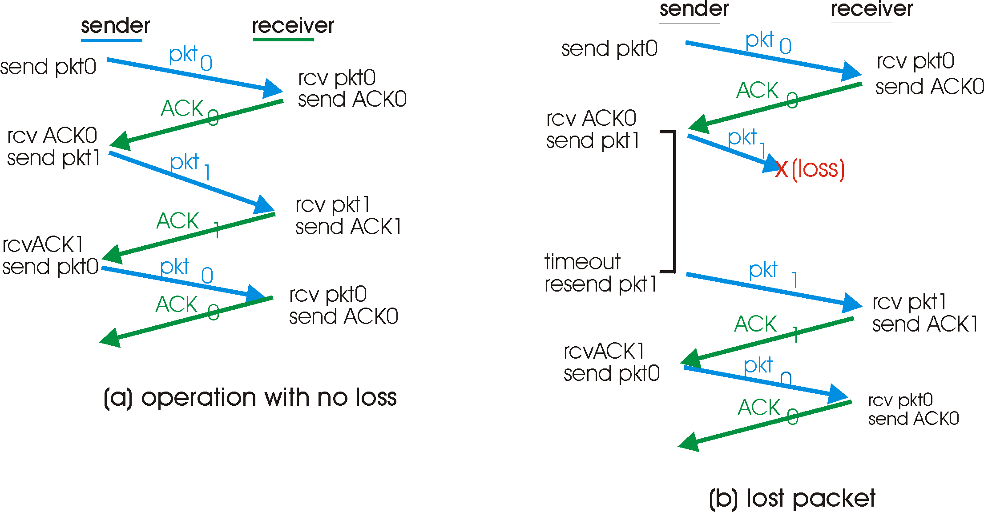
rdt3.0 in Action

Slide 18
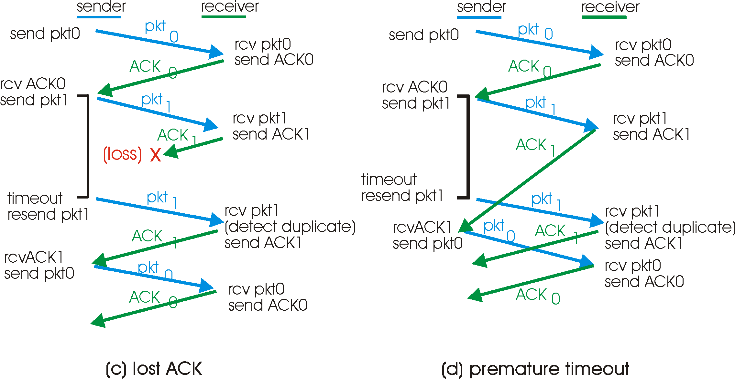
rdt3.0 in Action
Question to think about: How to determine a good timeout value?
Home exercise: What are execution traces of rdt3.0? What are some state invariants of rdt3.0?

Slide 19
rdt3.0: Protocol Analysis using State Invariants
sender
receiver
data 0 (n-1)
waiting for 0 (n-1)
State consistency:
When receiver’s state is waiting n, the state of the sender is either sending for n-1 or sending for n
When sender’s state is sending for n, receiver’s state is waiting for n or n + 1
ACK for 0 (n-1)
sending 0 (n-1)
data 0 (n-1)
waiting for 1
(n)
ACK for 0 (n-1)
data 1 (n)
sending 1 (n)
waiting for 0 (n+1)

Slide 20
rdt3.0: Stop-and-Wait Performance
sender
receiver
first packet bit transmitted, t = 0
last packet bit transmitted, t = L / R
first packet bit arrives
RTT
last packet bit arrives, send ACK
ACK arrives, send next
packet, t = RTT + L / R
What is U_{sender}: utilization – fraction of time link busy sending?
Assume: 1 Gbps link, 15 ms e-e prop. delay, 1KB packet
20

Slide 21
Performance of rdt3.0
rdt3.0 works, but performance stinks
Example: 1 Gbps link, 15 ms e-e prop. delay, 1KB packet:
T
=
L (packet length in bits)
8kb/pkt
transmit
=
= 8 microsec
R (transmission rate, bps)
10**9 b/sec
1KB pkt every 30 msec -> 33kB/sec thruput over 1 Gbps link
network protocol limits use of physical resources !

Slide 22
A Summary of Questions
How to improve the performance of rdt3.0?
What if there are reordering and duplication?
How to determine the “right” timeout value?
22

Slide 23
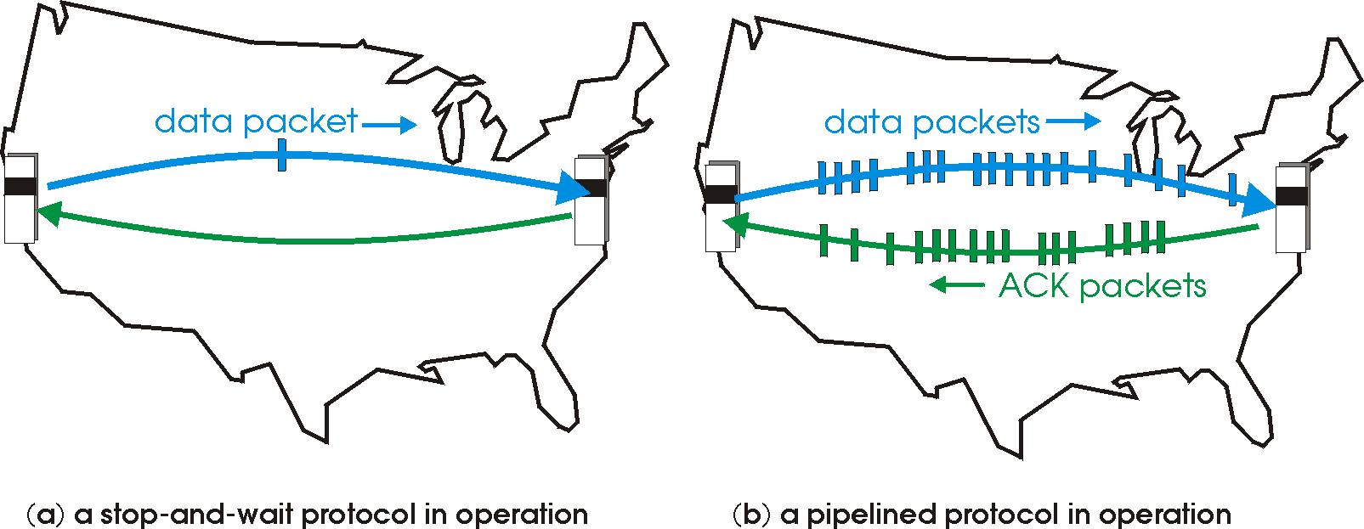
Sliding Window Protocols: Pipelining
Pipelining: sender allows multiple, “in-flight”, yet-to-be-acknowledged pkts
range of sequence numbers must be increased
buffering at sender and/or receiver
23
Notes:
Two generic forms of pipelined protocols: go-Back-N, selective repeat

Slide 24
Pipelining: Increased Utilization
sender
receiver
first packet bit transmitted, t = 0
last bit transmitted, t = L / R
first packet bit arrives
RTT
last packet bit arrives, send ACK
last bit of 2nd packet arrives, send ACK
last bit of 3rd packet arrives, send ACK
ACK arrives, send next
packet, t = RTT + L / R
increase utilization
by a factor of 3!
Question: a rule-of-thumb window size?
24

Slide 25
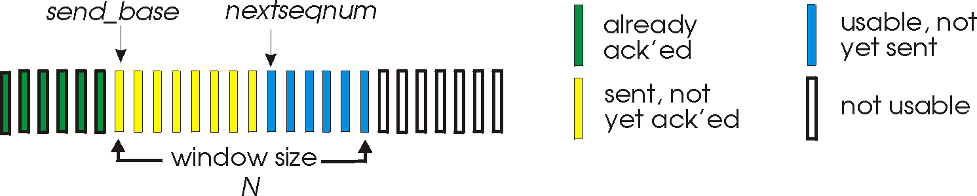
Realizing Sliding Window: Go-Back-n
Sender:
k-bit seq # in pkt header
“window” of up to W, consecutive unack’ed pkts allowed
W
ACK(n): ACKs all pkts up to, including seq # n - “cumulative ACK”
note: ACK(n) could mean two things: I have received upto and include n, or I am waiting for n
timer for the packet at base
timeout(n): retransmit pkt n and all higher seq # pkts in window
25

Slide 26
GBN: Sender FSM
rdt_send(data)
if (nextseqnum < base+W) {
sndpkt[nextseqnum] = make_pkt(nextseqnum,data,chksum)
udt_send(sndpkt[nextseqnum])
if (base == nextseqnum) start_timer
nextseqnum++
} else
block sender
Λ
base=1
nextseqnum=1
timeout
start_timer
udt_send(sndpkt[base])
udt_send(sndpkt[base+1])
…
udt_send(sndpkt[nextseqnum-1])
Wait
rdt_rcv(rcvpkt)
&& corrupt(rcvpkt)
rdt_rcv(rcvpkt) &&
notcorrupt(rcvpkt)
if (new packets ACKed) {
advance base;
if (more packets waiting) send more packets
}
if (base == nextseqnum)
stop_timer
else
start_timer for the packet at new base
26

Slide 27
GBN: Receiver FSM
default
udt_send(sndpkt)
rdt_rcv(rcvpkt)
&& notcurrupt(rcvpkt)
&& hasseqnum(rcvpkt,expectedseqnum)
Λ
Wait
extract(rcvpkt,data)
deliver_data(data)
sndpkt = make_pkt(expectedseqnum,ACK,chksum)
udt_send(sndpkt)
expectedseqnum++
expectedseqnum=1
sndpkt =
make_pkt(expectedseqnum,ACK,chksum)
Only state: expectedseqnum
out-of-order pkt:
discard (don’t buffer) -> no receiver buffering!
re-ACK pkt with highest in-order seq #
may generate duplicate ACKs
27

Slide 28
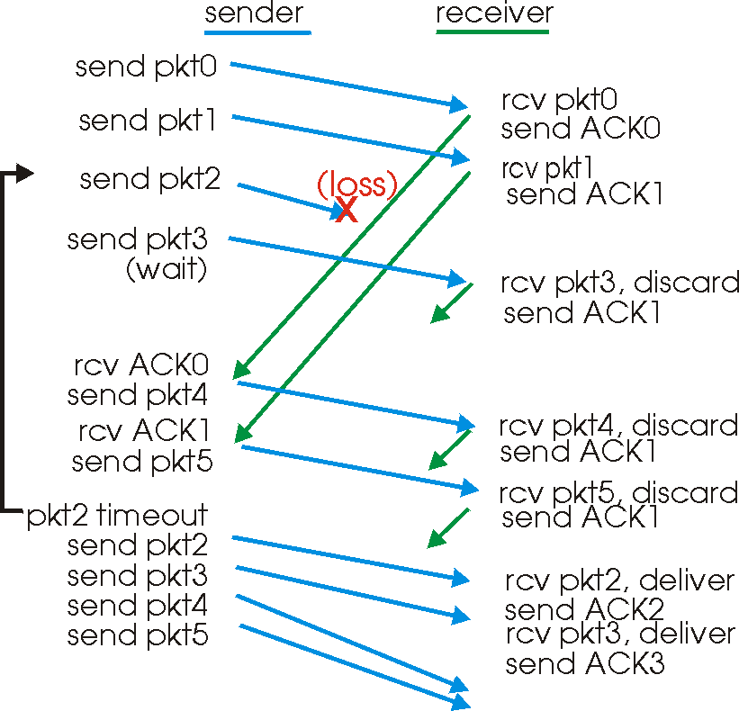
GBN in Action
window
size = 4
28

Slide 29
Analysis: Efficiency of Go-Back-n
Assume window size W
Assume each packet is lost with probability p
On average, how many packets do we send for each data packet received?
29

Slide 30
Selective Repeat
Sender window
Window size W: W consecutive unACKed seq #’s
Receiver individually acknowledges correctly received pkts
buffers out-of-order pkts, for eventual in-order delivery to upper layer
ACK(n) means received packet with seq# n only
buffer size at receiver: window size
Sender only resends pkts for which ACK not received
sender timer for each unACKed pkt
30

Slide 31
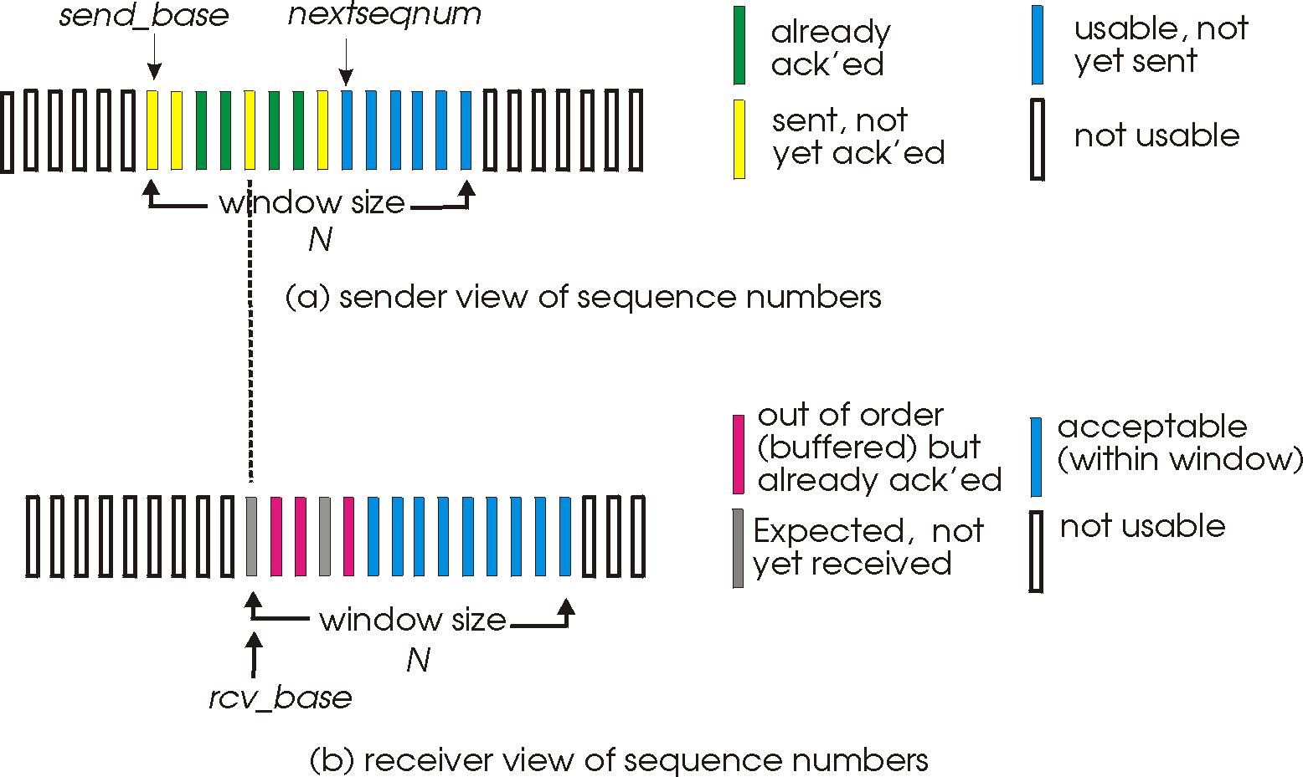
Selective Repeat: Sender, Receiver Windows
W
W
31

Slide 32
Selective Repeat
sender
receiver
data from above :
unACKed packets is less than window size W, send; otherwise block app.
timeout(n):
resend pkt n, restart timer
ACK(n) in [sendbase,sendbase+W-1]:
mark pkt n as received
update sendbase to the first packet unACKed
pkt n in [rcvbase, rcvbase+W-1]
send ACK(n)
if (out-of-order) mark and buffer pkt n else /*in-order*/
deliver any in-order packets
otherwise:
ignore
32

Slide 33
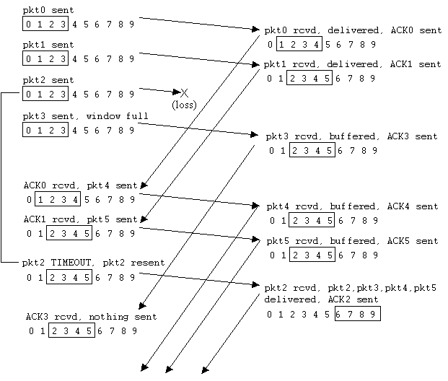
Selective Repeat in Action
33

Slide 34
Discussion: Efficiency of Selective Repeat
Assume window size W
Assume each packet is lost with probability p
On average, how many packets do we send for each data packet received?
34

Slide 35
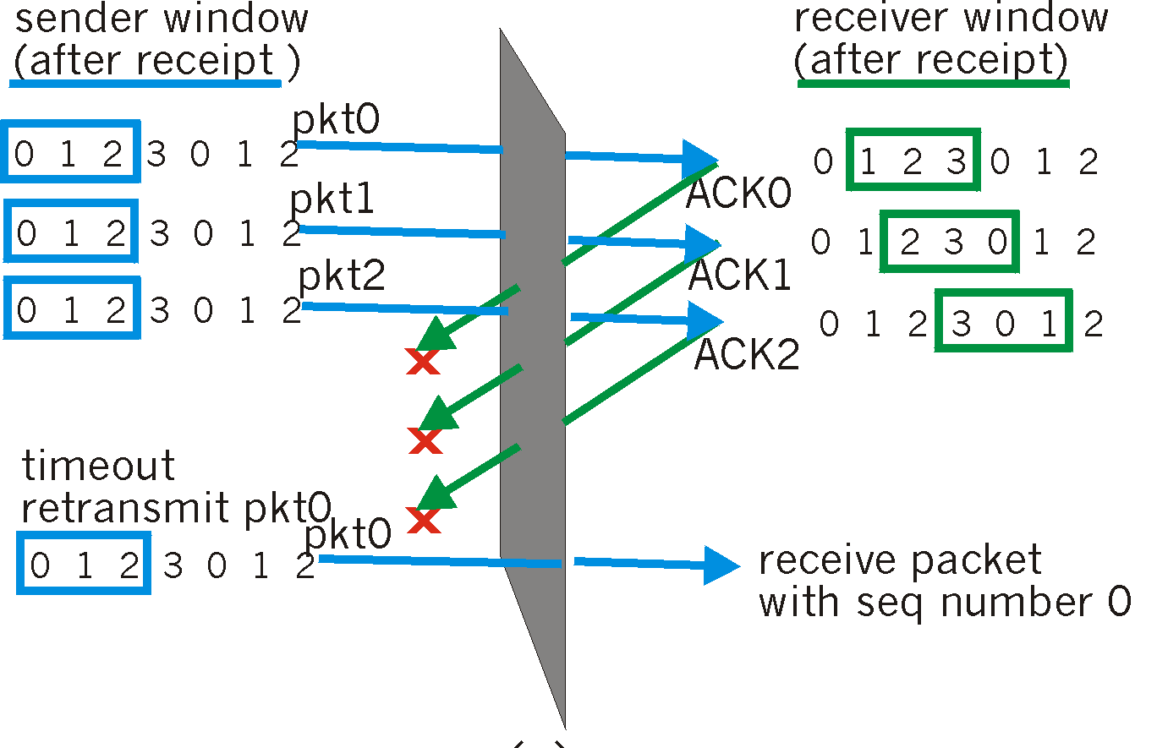
Selective Repeat: Seq# Ambiguity
Example:
seq #’s: 0, 1, 2, 3
window size=3
Error: incorrectly passes duplicate data as new.
35

Slide 36
State Invariant: Window Location
Go-back-n (GBN)
Selective repeat (SR)
sender window
receiver window
sender window
receiver window
36

Slide 37
Q: what relationship between seq # size and window size?
Window Location
Go-back-n (GBN)
Selective repeat (SR)
sender window
receiver window
sender window
receiver window
37

Slide 38
Sliding Window Protocols: Go-back-n and Selective Repeat
 | Go-back-n | Selective Repeat
data bandwidth: sender to receiver (avg. number of times a pkt is transmitted)
ACK bandwidth (receiver to sender)
Relationship between M (the number of seq#) and W (window size)
Buffer size at receiver
Complexity
Less efficient
More efficient
More efficient
Less efficient
M > W
M ≥ 2W
1
W
Simpler
More complex
p: the loss rate of a packet; M: number of seq# (e.g., 3 bit M = 8); W: window size
38

Slide 39
Question: What is Initial Seq#?
sender
receiver
data 0
accept
ACK for 0
39

Slide 40
Question: What is Initial Seq#?
sender
receiver
data 0 (transfer $1000 to B)
accept
ACK for 0 (n)
data 0 (transfer $1000 to B)
accept?
40
Notes:
a sender should not reuse a seq# before it is sure the packet has left the network

Slide 41
Outline
Admin and Recap
Reliable data transfer
perfect channel
channel with bit errors
channel with bit errors and losses
sliding window: reliability with throughput
connection management
41

Slide 42
Three Way Handshake (TWH) [Tomlinson 1975]
Host A
Host B
SYN(seq=x)
notify initial seq#. Accept?
ACK(seq=x), SYN(seq=y)
think of y as a challenge
ACK(seq=y)
accept data only after
verified y is bounced back
x is the init. seq
DATA(seq=x+1)
SYN: indicates connection setup
Notes:
Syn(seq=x) could be duplicate or malicious

Slide 43
Scenarios with Duplicate Request/SYN Attack
Host A
Host B
SYN(seq=x)
accept?
ACK(seq=x), SYN(seq=y)
no such request
REJECT(seq=y)
reject

Slide 44
Scenarios with Duplicate Request/SYN Attack
Host A
Host B
SYN(seq=x)
accept?
ACK(seq=x), SYN(seq=y)
no such request
ACK(seq=z)
reject
REJECT(seq=y)

Slide 45
Make “Challenge y” Robust
To avoid that “SYNC ACK y” comes from reordering and duplication
for each connection (sender-receiver pair), ensuring that two identically numbered packets are never outstanding at the same time
network bounds the life time of each packet
a sender will not reuse a seq# before it is sure that all packets with the seq# are purged from the network
seq. number space should be large enough to not limit transmission rate
Notes:
Add QUIC design: QUIC uses a cryptographic handshake
Servers
front-end servers, which collectively handle billions of requests a day from web browsers and mobile apps across a wide range of services.
On the client side, we have deployed QUIC in
Chrome,
our mobile video streaming YouTube app, and in the
Google Search app on Android
TCP connections commonly incur at least one round-trip delay of connection setup time before any application data can be sent, and TLS adds two round trips to this delay

Slide 46
Connection Close
Why connection close?
so that each side can release resource and remove state about the connection (do not want dangling socket)
client
server
init. close
release
resource?
I am done. Are you done too?
close
I am done too. Goodbye!
release
resource?
close
release
resource?

Slide 47
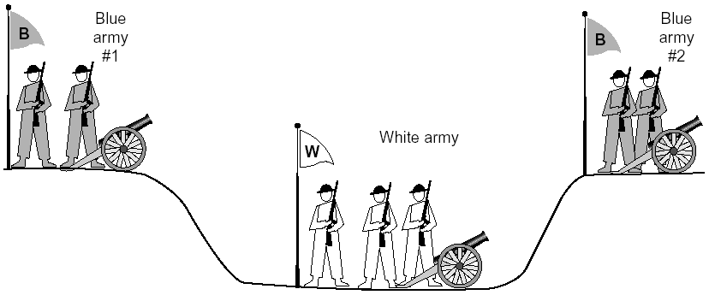
General Case: The Two-Army Problem
The gray (blue) armies need to agree on whether or not they will attack the white army. They achieve agreement by sending messengers to the other side. If they both agree, attack; otherwise, no. Note that a messenger can be captured!

Slide 48
Four Way Teardown
Host A
Host B
propose close A->B
close
FIN
A->B closed
ACK
close
propose close B->A
A->B closed
FIN
ACK
can retransmit the ACKif its ACK is lost
timed wait
closed
all states removed
closed
all states removed

Slide 49
Outline
Admin and Recap
Reliable data transfer
TCP reliability

Slide 50
TCP: Overview RFCs: 793, 1122, 1323, 2018, 2581
Point-to-point reliability: one sender, one receiver
Flow controlled and congestion controlled

Slide 51
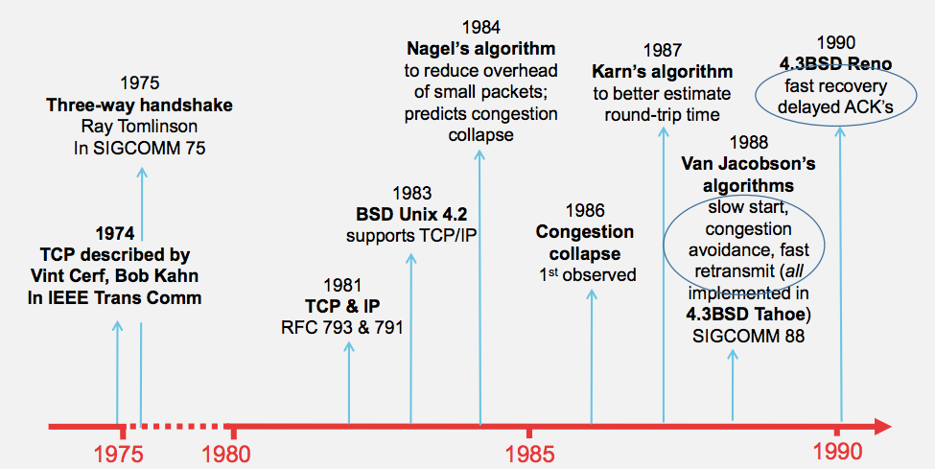
Evolution of TCP
Source: http://webcourse.cs.technion.ac.il/236341/Winter2015-2016/ho/WCFiles/Tutorial10.pdf

Slide 52
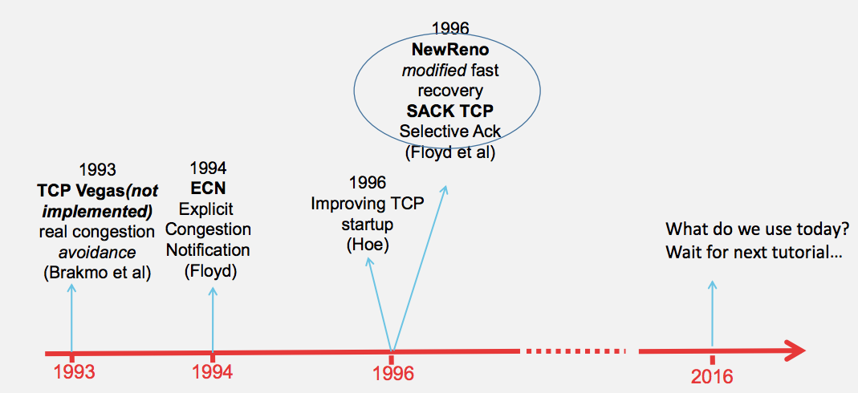
Evolution of TCP
multiple versions
Source: http://webcourse.cs.technion.ac.il/236341/Winter2015-2016/ho/WCFiles/Tutorial10.pdf

Slide 53
TCP Reliable Data Transfer
Connection-oriented:
connection management
setup (exchange of control msgs) init’s sender, receiver state before data exchange
close
Full duplex data:
bi-directional data flow in same connection
A sliding window protocol
a combination of go-back-n and selective repeat:
send & receive buffers
cumulative acks
TCP uses a single retransmission timer
do not retransmit all packets upon timeout

Slide 54
TCP Segment Structure
32 bits
URG: urgent data
(generally not used)
counting
by bytes
of data
(not segments!)
source port #
dest port #
sequence number
ACK: ACK #
valid
acknowledgement number
head
len
not
used
U
rcvr window size
A
P
R
S
PSH: push data now
(generally not used)
F
flow control
checksum
ptr urgent data
RST, SYN, FIN:
connection management
(reset, setup teardown
commands)
Options (variable length)
application
data
(variable length)
Also in UDP

Slide 55
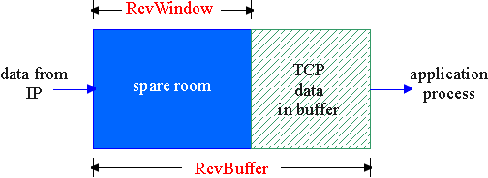
Flow Control
flow control
sender won’t overflow
receiver’s buffer by
transmitting too much,
too fast
receive side of a connection has a receive buffer:
speed-matching service: matching the send rate to the receiving app’s drain rate
app process may be slow at reading from buffer

Slide 56
TCP Flow Control: How it Works
source port #
dest port #
sequence number
acknowledgement number
head
len
not
used
U
A
rcvr window size
P
R
S
F
checksum
ptr urgent data
spare room in buffer
= RcvWindow
Options (variable length)
application
data
(variable length)

Slide 57
TCP Seq. #’s and ACKs
Seq. #’s:
byte stream “number” of first byte in segment’s data
ACKs:
seq # of next byte expected from other side
cumulative ACK
Host A
Host B
User
types
‘C’
Seq=42, ACK=79, data = ‘C’
host ACKs
receipt of
‘C’, echoes
back ‘C’
Seq=79, ACK=43, data = ‘C’
host ACKs
receipt
of echoed
‘C’
Seq=42, ACK=80
time
simple telnet scenario

Slide 58
Fast Retransmit
Problem: Timeout period often relatively long:
long delay before resending lost packet
Detect lost segments via duplicate ACKs
sender often sends many segments back-to-back
if segment is lost, there will likely be many duplicate ACKs
If sender receives 3 ACKs for the same data, it supposes that segment after ACKed data was lost:
resend segment before timer expires

Slide 59
Triple Duplicate Ack
Packets
1
2
3
4
5
6
7
Acknowledgements (waiting seq#)
2
3
4
4
4
4

Slide 60
Fast Retransmit:
event: ACK received, with ACK field value of y
if (y > SendBase) {
…
SendBase = y
if (there are currently not-yet-acknowledged segments)
start timer
…
}
else {
increment count of dup ACKs received for y
if (count of dup ACKs received for y = 3) {
resend segment with sequence number y
…
a duplicate ACK for
already ACKed segment
fast retransmit

Slide 61
TCP: reliable data transfer
00 sendbase = initial_sequence number agreed by TWH
01 nextseqnum = initial_sequence number by TWH
02 loop (forever) {
03 switch(event)
04 event: data received from application above
05 if (window allows send)
06 create TCP segment with sequence number nextseqnum
06 if (no timer) start timer
07 pass segment to IP
08 nextseqnum = nextseqnum + length(data) else put packet in buffer
09 event: timer timeout for sendbase
10 retransmit segment
11 compute new timeout interval
12 restart timer
13 event: ACK received, with ACK field value of y
14 if (y > sendbase) { /* cumulative ACK of all data up to y */
15 cancel the timer for sendbase
sendbase = y
if (no timer and packet pending) start timer for new sendbase
while (there are segments and window allow)
sent a segment;
18 }
19 else { /* y==sendbase, duplicate ACK for already ACKed segment */
20 increment number of duplicate ACKs received for y
21 if (number of duplicate ACKS received for y == 3) {
22 /* TCP fast retransmit */
23 resend segment with sequence number y
24 restart timer for segment y
25 }
26 } /* end of loop forever */
Simplified
TCP
sender

Slide 62
TCP Receiver ACK Generation [RFC 1122, RFC 2581]
Event at Receiver
Arrival of in-order segment with
expected seq #. All data up to
expected seq # already ACKed
Arrival of in-order segment with
expected seq #. One other
segment has ACK pending
Arrival of out-of-order segment
higher-than-expect seq. # .
Gap detected
Arrival of segment that
partially or completely fills gap
TCP Receiver Action
Delayed ACK. Wait up to 500ms
for next segment. If no next segment,
send ACK
Immediately send single cumulative
ACK, ACKing both in-order segments
Immediately send duplicate ACK,
indicating seq. # of next expected byte
Immediate send ACK, provided that
segment starts at lower end of gap

Slide 63
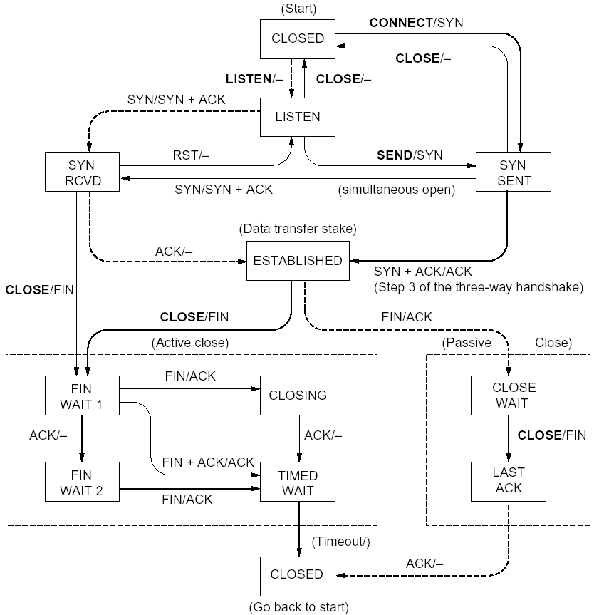
%netstat -t -a
CLOSED
SYN SENT
CLOSED
SYN
LISTEN
SYN RCVD
SYN/ACK
ESTABLSIHED
ACK
ESTABLSIHED
ESTABLSIHED
ESTABLSIHED
FIN WAIT 1
FIN
CLOSE WAIT
ACK
LAST ACK
FIN WAIT 2
FIN
TIME WAIT
ACK

Slide 64
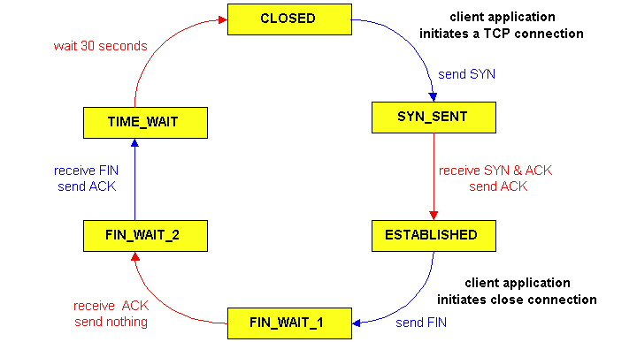
TCP Connection Management
CLOSED
SYN SENT
CLOSED
TCP lifecycle: init SYN/FIN
SYN
SYN RCVD
SYN/ACK
ESTABLSIHED
ACK
ESTABLSIHED
ESTABLSIHED
FIN WAIT 1
FIN
CLOSE WAIT
ACK
LAST ACK
FIN WAIT 2
FIN
TIME WAIT
ACK
http://dsd.lbl.gov/TCP-tuning/ip-sysctl-2.6.txt

Slide 65
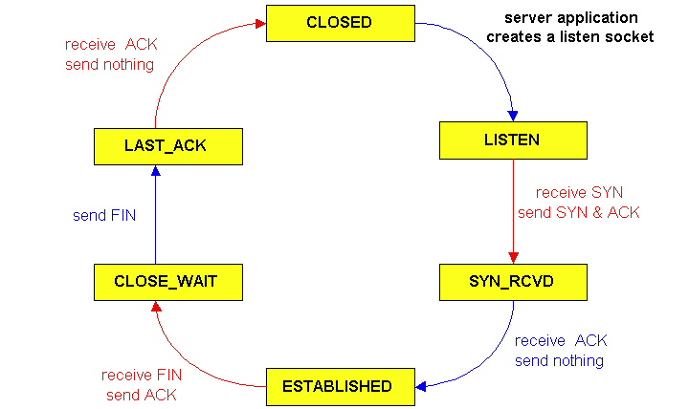
TCP Connection Management
CLOSED
SYN SENT
CLOSED
SYN
TCP lifecycle: wait for SYN/FIN
SYN RCVD
SYN/ACK
ESTABLSIHED
ACK
ESTABLSIHED
ESTABLSIHED
FIN WAIT 1
FIN
CLOSE WAIT
ACK
LAST ACK
FIN WAIT 2
FIN
TIME WAIT
ACK

