Slide 1
Network Applications: HTTP/1.0/1.1/2; High-Performance Server Design (Per Thread)
Qiao Xiang
https://qiaoxiang.me/courses/cnns-xmuf21/index.shtml
10/19/2021

Slide 2
Outline
Admin and recap
HTTP/1.0
Basic design
Dynamic content
HTTP “acceleration”
Network server design

Slide 3
Admin
HTTP server assignment (part 1) to be posted later today
Plagiarism is NOT allowed in any assignment
Discussion and reading are encouraged, but copying is NOT!
If you reuse others' (e.g., classmates, friends, Stackoverflow, CSDN) code as part of your solution, please mark it in comments.

Slide 4
Recap: FTP
A stateful protocol
state established by commands such as
USER/PASS, CWD, TYPE
Multiple TCP connections
A control connection
Data connections
Two approaches: PORT vs PASV
GridFTP: concurrent data connections; block data transfer mode
FTP
client
FTP
server
USER xxx
PASS xxx
CWD home
PORT clientip:cport
RETR index.html
Server initiates TCP data connection
server:20 clientip:cport
Notes:
A: someone (either server or client) needs to pick a new port

Slide 5
Recap: HTTP
Wide use of HTTP for Web applications
Example: RESTful API
RESTful design
http://www.ics.uci.edu/~fielding/pubs/dissertation/rest_arch_style.htm
http://docs.oracle.com/javaee/6/tutorial/doc/giepu.html
WebMail
WebApp…
HTTP
TCP
UDP
Ethernet
Wireless
Cable/DSL

Slide 6
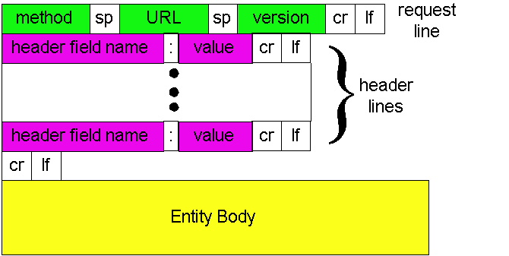
Recap: HTTP
C-S app serving Web pages
message format
request/response line, header lines, entity body
simple methods, rich headers
message flow
stateless server, thus states such as cookie and authentication are needed in each message

Slide 7
Recap: Basic HTTP/1.0 Server
create ServerSocket(6789)
connSocket = accept()
It does not have to be a static file
read request from connSocket
Map URL to file
Read from file/ write to connSocket
close connSocket

Slide 8
Outline
Admin and recap
HTTP/1.0
Basic design
Dynamic content

Slide 9
Dynamic Content Pages
There are multiple approaches to make dynamic web pages:
Embed code into pages (server side include)
http server includes an interpreter for the type of pages
Invoke external programs (http server is agnostic to the external program execution)
E.g., Common Gateway Interface (CGI)
http://www.cs.yale.edu/index.shtml
http://www.cs.yale.edu/cgi-bin/ureserve.pl
http://www.google.com/search?q=Yale&sourceid=chrome

Slide 10
Example SSI
See programming/examples-java-socket/BasicWebServer/ssi/index.shtml, header.shtml, …
Notes:
https://httpd.apache.org/docs/2.2/howto/ssi.html

Slide 11
Example SSI
See programming/examples-java-socket/BasicWebServer/ssi/index.shtml, header.shtml, …
To enable ssi, need configuration to tell the web server (see conf/apache-htaccess)
https://httpd.apache.org/docs/2.2/howto/htaccess.html (Server Side Includes example)
Notes:
https://httpd.apache.org/docs/2.2/howto/ssi.html

Slide 12
CGI: Invoking External Programs
Two issues
Input: Pass HTTP request parameters to the external program
Output: Redirect external program output to socket

Slide 13
Example: Typical CGI Implementation
Starts the executable as a child process
Passes HTTP request as environment variables
http://httpd.apache.org/docs/2.2/env.html
CGI standard: http://www.ietf.org/rfc/rfc3875
Redirects input/output of the child process to the socket

Slide 14
Example: CGI
Example:
GET /search?q=Yale&sourceid=chrome HTTP/1.0
setup environment variables, in particular $QUERY_STRING=q=Yale&sourceid=chrome
start search and redirect its input/output
https://docs.oracle.com/javase/7/docs/api/java/lang/ProcessBuilder.html

Slide 15
Example
https://httpd.apache.org/docs/2.2/howto/htaccess.html (CGI Example)
http://172.28.229.215/BasicWebServer/cgi/price.cgi?appl
#!/usr/bin/perl -w
$company = $ENV{'QUERY_STRING'};
print "Content-Type: text/html\r\n";
print "\r\n";
print "<html>";
print "<h1>Hello! The price is ";
if ($company =~ /appl/) {
my $var_rand = rand();
print 450 + 10 * $var_rand;
} else {
print "150";
}
print "</h1>";
print "</html>";
Notes:
https://httpd.apache.org/docs/2.2/howto/htaccess.html

Slide 16
Client Using Dynamic Pages
See ajax.html and wireshark for client code example
http://172.28.229.215/BasicWebServer/cgi/ajax.html

Slide 17
Discussions
What features are missing in HTTP that we have covered so far?

Slide 18
HTTP: POST
If an HTML page contains forms or parameter too large, they are sent using POST and encoded in message body

Slide 19
HTTP: POST Example
POST /path/script.cgi HTTP/1.0
User-Agent: MyAgent
Content-Type: application/x-www-form-urlencoded
Content-Length: 15
item1=A&item2=B
Example using nc: programming/examples-java-socket/BasicWebServer/nc/

Slide 20
Stateful User-server Interaction: Cookies
client
server
Goal: no explicit application level session
Server sends “cookie” to client in response msg
Set-cookie: 1678453
Client presents cookie in later requests
Cookie: 1678453
Server matches presented-cookie with server-stored info
authentication
remembering user preferences, previous choices
usual http request msg
usual http response +
Set-cookie: #
usual http request msg
Cookie: #
cookie-
specific
action
usual http response msg
usual http request msg
Cookie: #
cookie-
specific
action
usual http response msg

Slide 21
Authentication of Client Request
client
server
Authentication goal: control access to server documents
stateless: client must present authorization in each request
authorization: typically name, password
Authorization: header line in request
if no authorization presented, server refuses access, sends
WWW-authenticate:
header line in response
usual http request msg
401: authorization req.
WWW-authenticate:
usual http request msg
+ Authorization:line
usual http response msg
usual http request msg
+ Authorization:line
usual http response msg
time
Browser caches name & password so
that user does not have to repeatedly enter it.

Slide 22
Example: Amazon S3
Amazon S3 API
http://docs.aws.amazon.com/AmazonS3/latest/API/APIRest.html

Slide 23
HTTP as the Thin Waist
WebMail
WebApp…
HTTP
TCP
UDP
Ethernet
Wireless
Cable/DSL

Slide 24
Protocol Flow of Basic HTTP/1.0
>= 2 RTTs per object:
TCP handshake --- 1 RTT
client request and server responds --- at least 1 RTT (if object can be contained in one packet)
TCP SYN
TCP ACK
TCP/ACK; HTTP GET
base page
TCP SYN
TCP ACK
TCP/ACK; HTTP GET
image 1
Notes:
Typical approaches to reduce latency:
parallel TCP connections
persistent HTTP
cache and conditional GET

Slide 25
Outline
Admin and recap
HTTP/1.0
HTTP “acceleration”

Slide 26
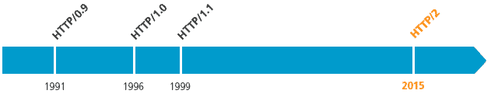
Substantial Efforts to Speedup Basic HTTP/1.0
Reduce the number of objects fetched [Browser cache]
Reduce data volume [Compression of data]
Header compression [HTTP/2]
Reduce the latency to the server to fetch the content [Proxy cache]
Remove the extra RTTs to fetch an object [Persistent HTTP, aka HTTP/1.1]
Increase concurrency [Multiple TCP connections]
Asynchronous fetch (multiple streams) using a single TCP [HTTP/2]
Server push [HTTP/2]

Slide 27
Browser Cache and Conditional GET
client
server
Goal: don’t send object if client has up-to-date stored (cached) version
client: specify date of cached copy in http request
If-modified-since: <date>
server: response contains no object if cached copy up-to-date:
HTTP/1.0 304 Not Modified
http request msg
If-modified-since: <date>
object
not
modified
http response
HTTP/1.0
304 Not Modified
http request msg
If-modified-since: <date>
object
modified
http response
HTTP/1.1 200 OK
…
<data>

Slide 28
Web Caches (Proxy)
Goal: satisfy client request without involving origin server
origin
server
Proxy
server
http request
http request
client
http response
http response
http request
http request
http response
http response
client
origin
server

Slide 29
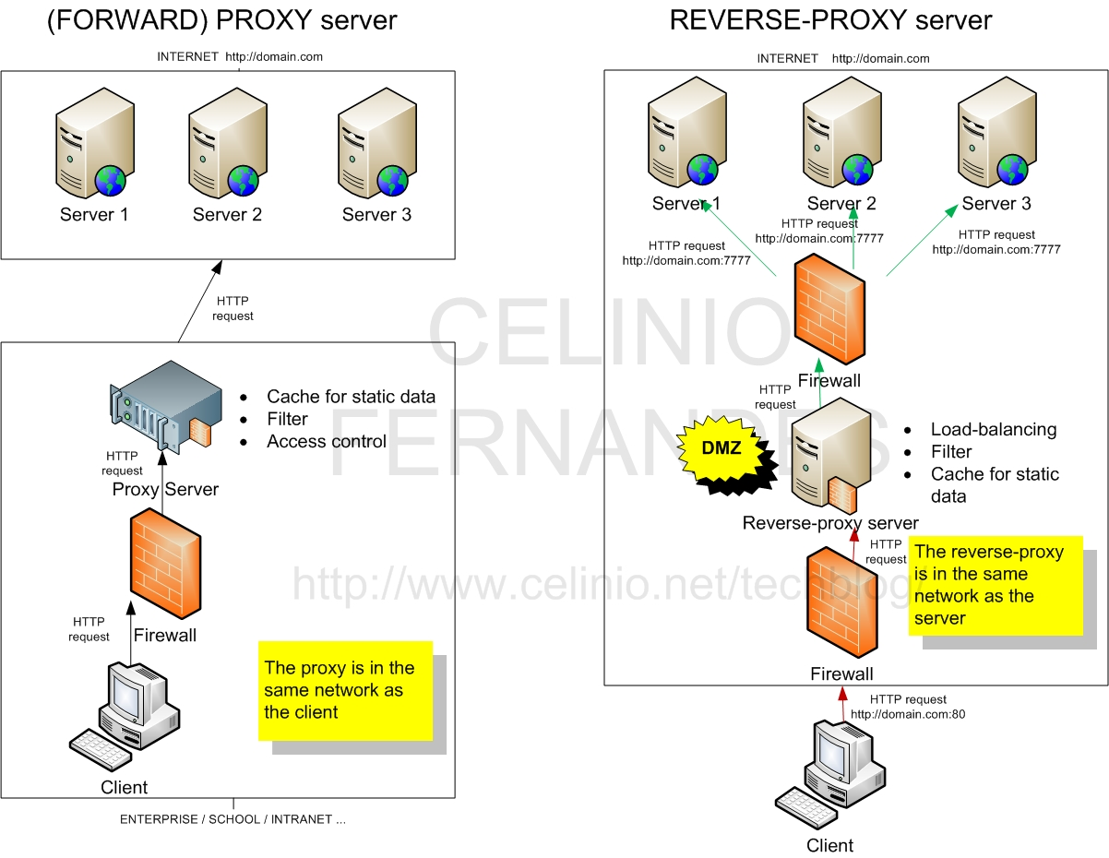
Two Types of Proxies
http://www.celinio.net/techblog/?p=1027
Typically in the same network as the client
Typically in the same network as the server

Slide 30
Benefits of Forward Proxy
origin
servers
Assume: cache is “close” to client (e.g., in same network)
smaller response time: cache “closer” to client
decrease traffic to distant servers
link out of institutional/local ISP network often is bottleneck
public
Internet
1.5 Mbps
access link
institutional
network
10 Mbps LAN
institutional
cache

Slide 31
No Free Lunch: Problems of Web Caching
The major issue of web caching is how to maintain consistency
Two ways
pull
Web caches periodically pull the web server to see if a document is modified
push
whenever a server gives a copy of a web page to a web cache, they sign a lease with an expiration time; if the web page is modified before the lease, the server notifies the cache

Slide 32
HTTP/1.1: Persistent (keepalive/pipelining) HTTP
HTTP/1.0 allows a single request outstanding, while HTTP/1.1 allows request pipelining
On same TCP connection: server parses request, responds, parses new request, …
Client sends requests for all referenced objects as soon as it receives base HTML
Benefit
Fewer RTTs
See Joshua Graessley WWDC 2012 talk: 3x within iTunes

Slide 33
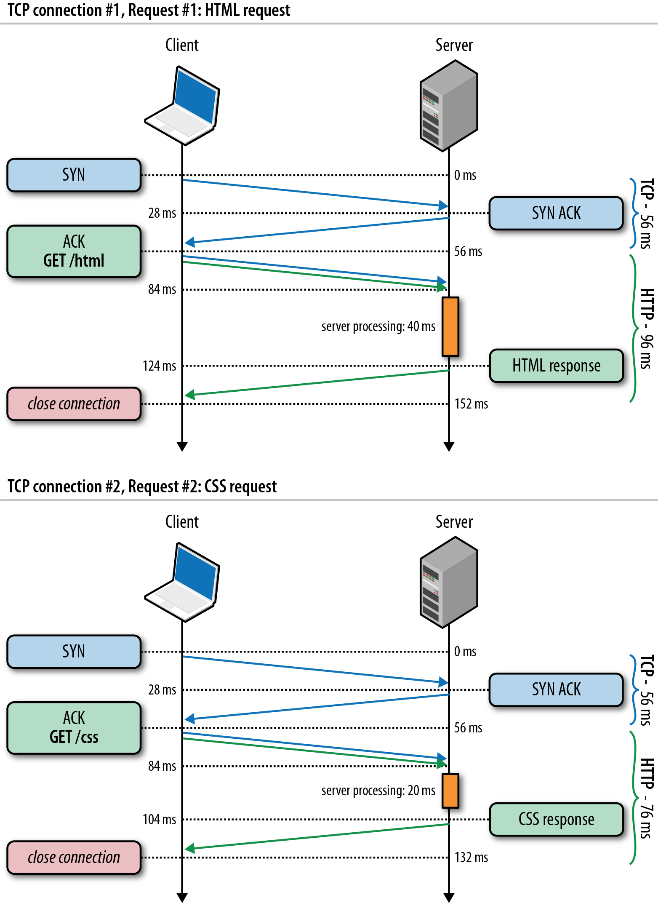
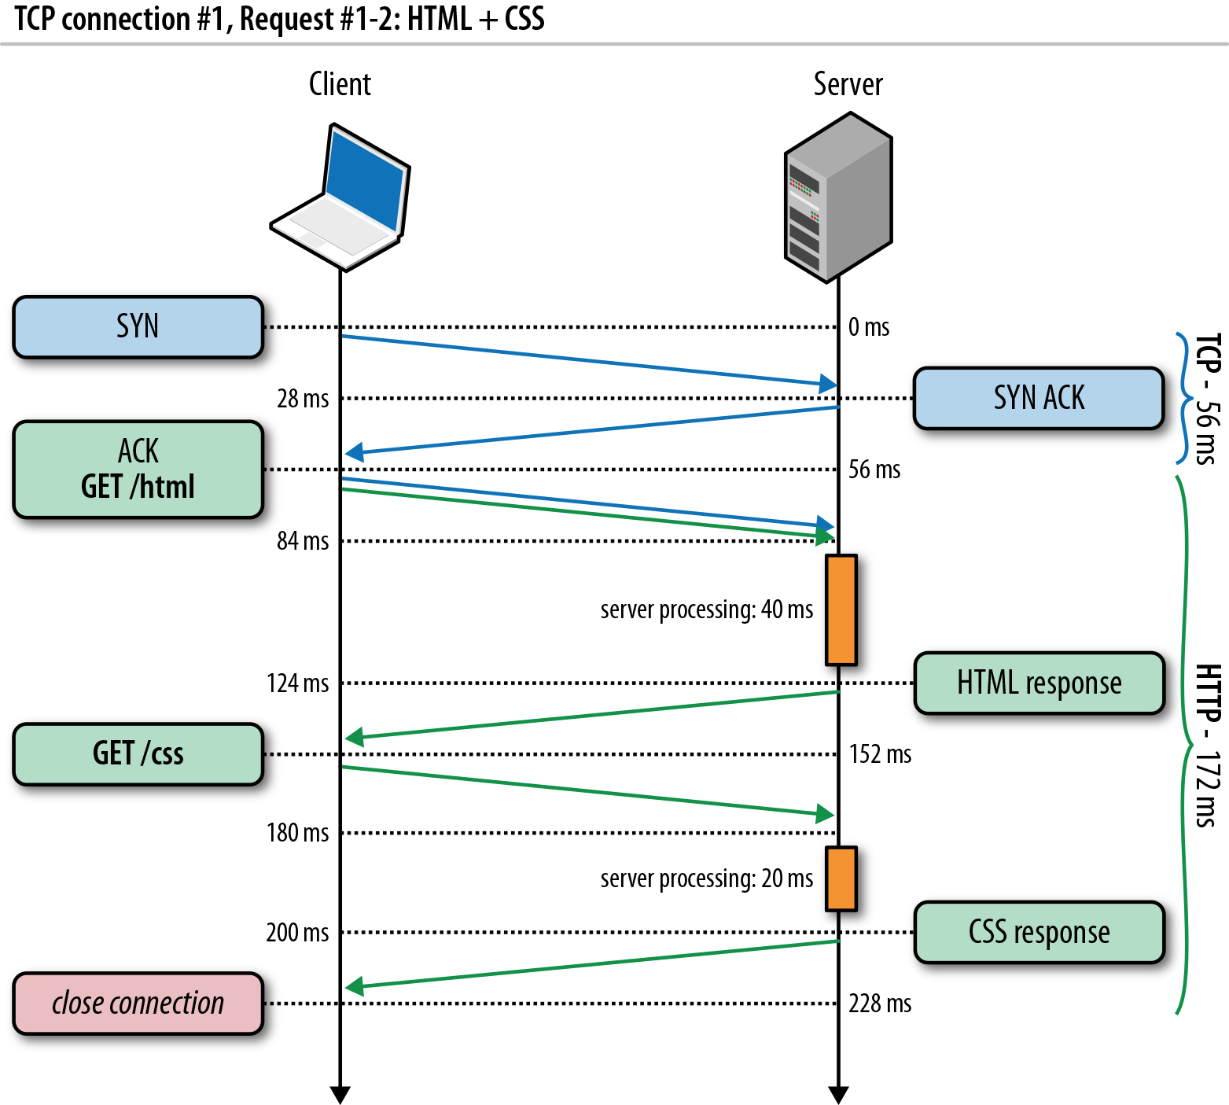
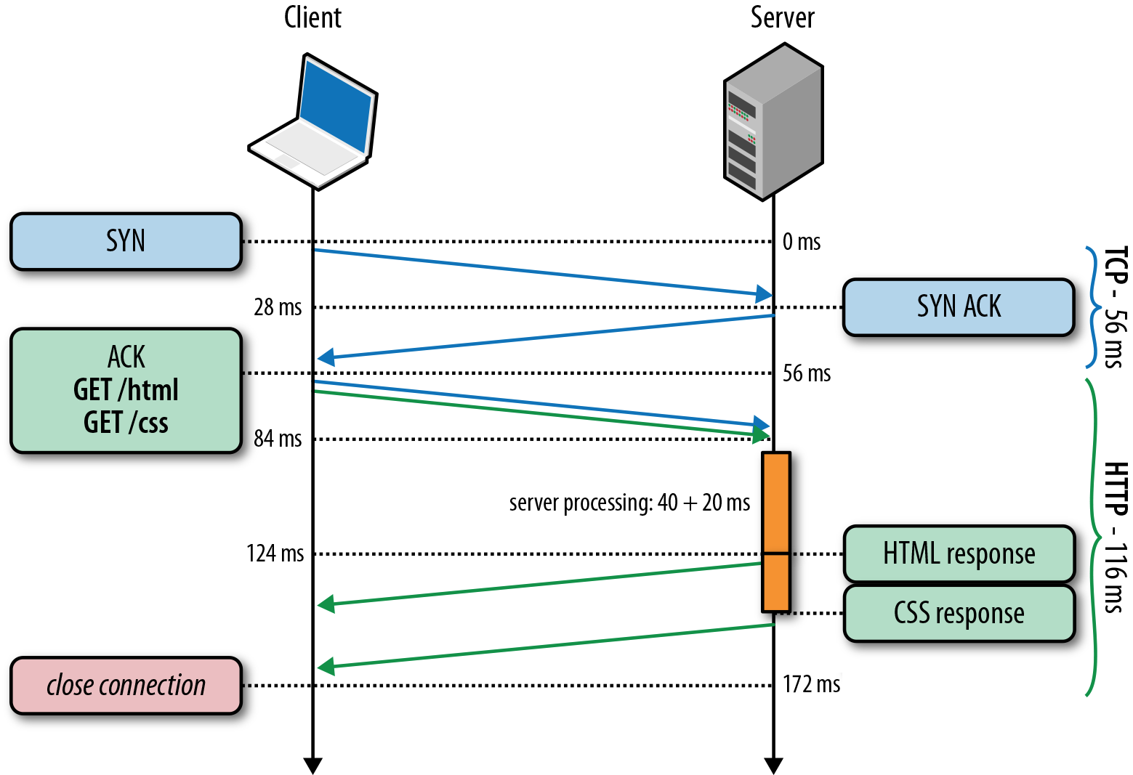
HTTP/1.0, Keep-Alive, Pipelining
Is this the best we can do?
Source: http://chimera.labs.oreilly.com/books/1230000000545/ch11.html
Notes:
https://httpd.apache.org/docs/2.2/howto/ssi.html

Slide 34
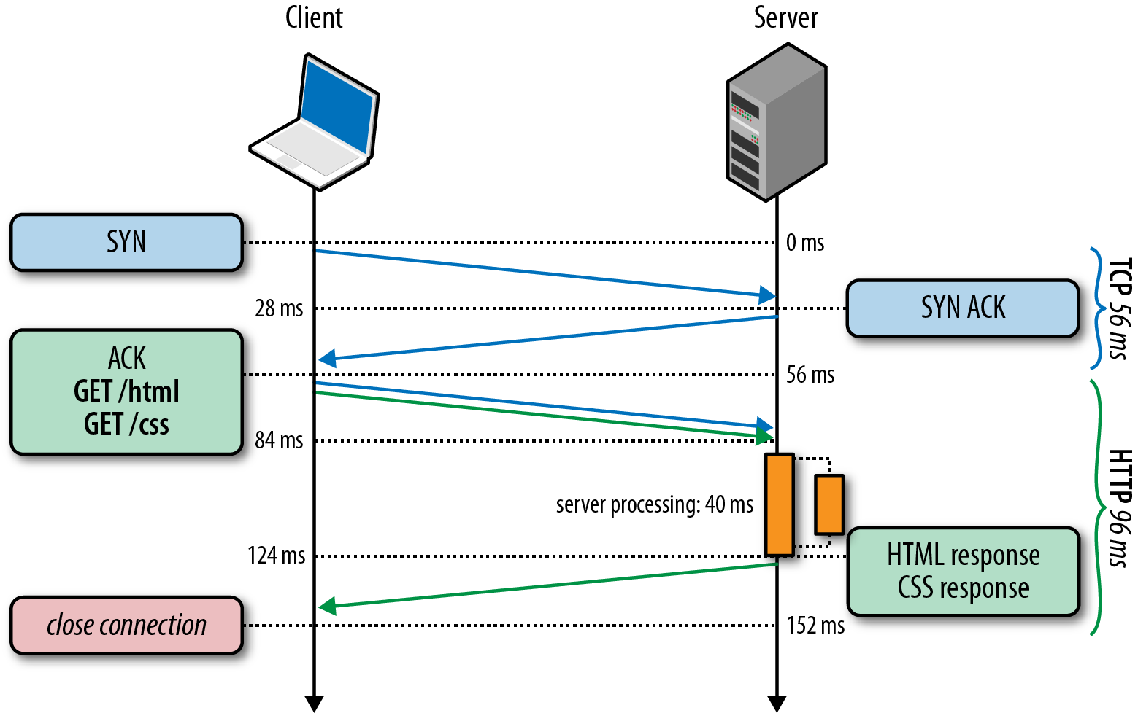
HTTP/2 Basic Idea: Remove Head-of-Line Blocking in HTTP/1.1
Data flows for sequential to parallel: two requests must be concurrent.
Demo: https://http2.akamai.com/demo
Source: http://chimera.labs.oreilly.com/books/1230000000545/ch11.html
Notes:
https://httpd.apache.org/docs/2.2/howto/ssi.html

Slide 35
Observing HTTP/2
export SSLKEYLOGFILE=/tmp/keylog.txt
Start Chrome, e.g.,
Mac: /Applications/Google Chrome.app/Contents/MacOS/Google Chrome
Ubuntu: firefox
Visit HTTP/2 pages, such as https://http2.akamai.com
Wireshark:
Mac: Wireshark -> preferences -> protocol -> TSL
(pre)-master-secret log file name
Ubuntu: edit -> perferences -> protocol -> SSL
(pre)-master-secret log file name

Slide 36
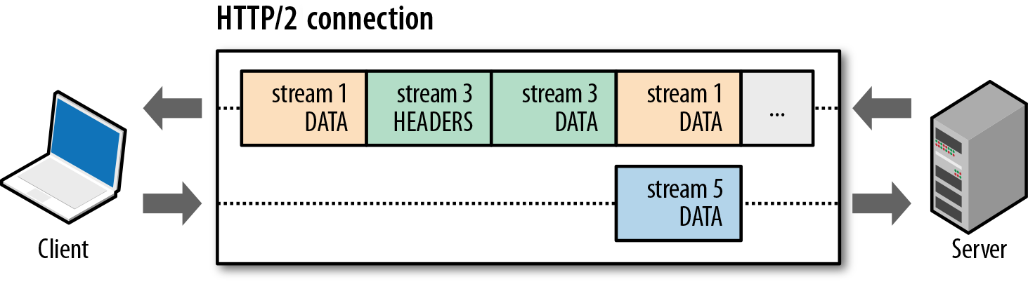
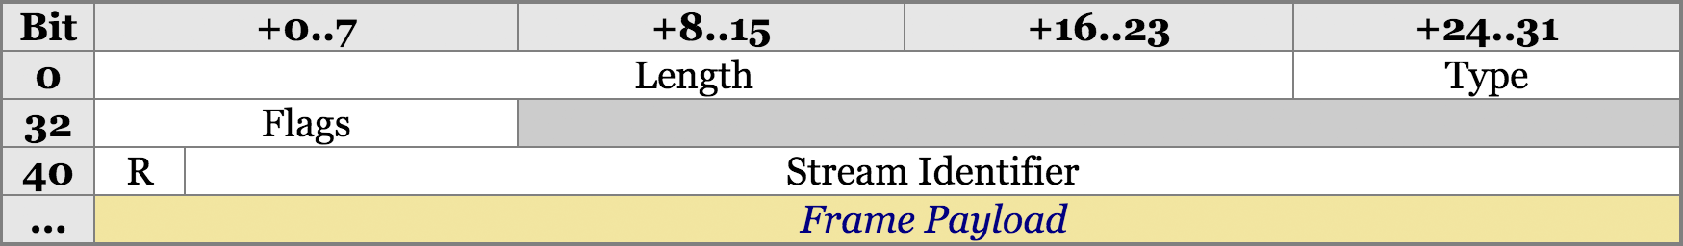
HTTP/2 Design: Multi-Streams
HTTP/2 Binary Framing
https://hpbn.co/http2/
https://tools.ietf.org/html/rfc7540

Slide 37
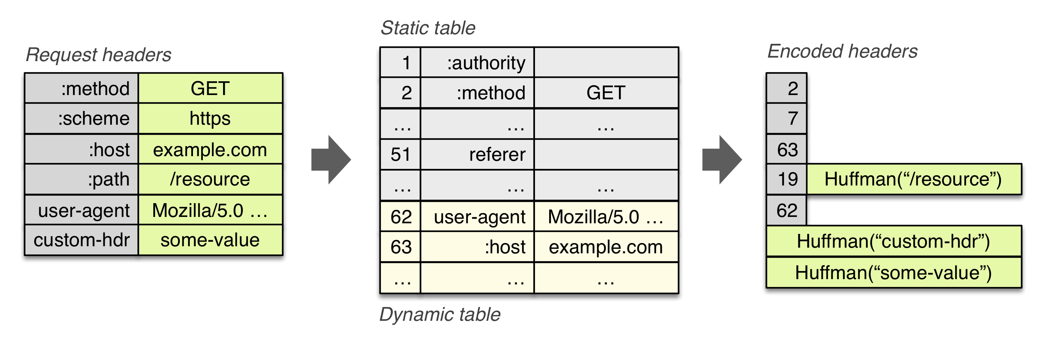
HTTP/2 Header Compression

Slide 38
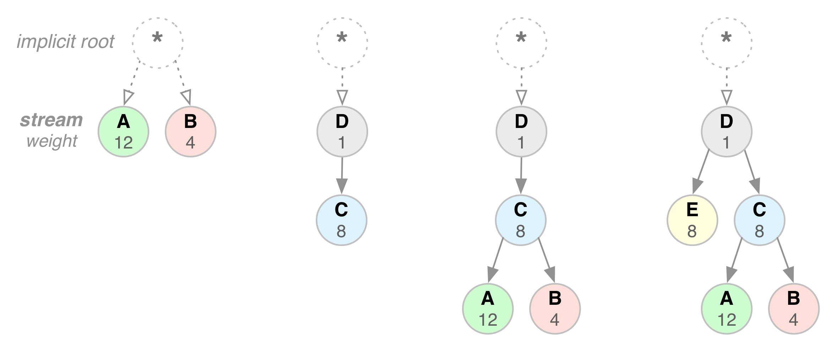
HTTP/2 Stream Dependency and Weights

Slide 39
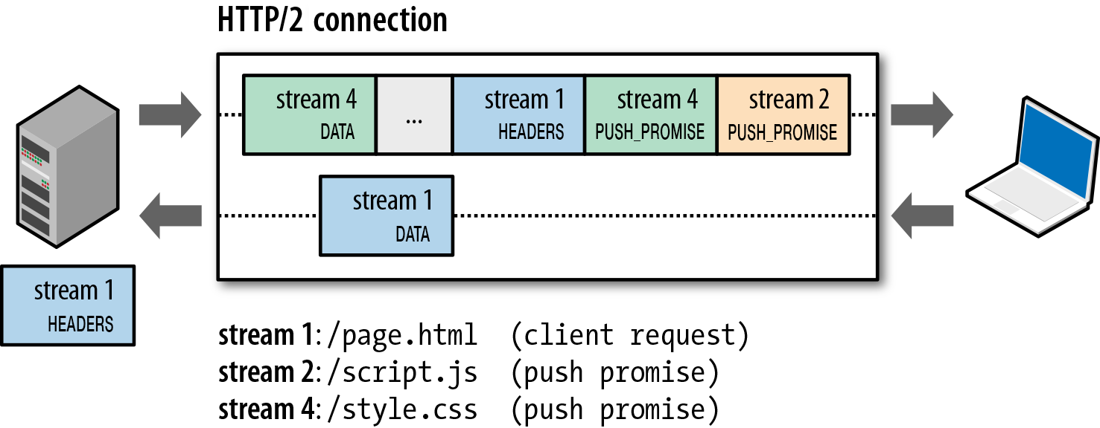
HTTP/2 Server Push

Slide 40
Outline
Admin and recap
HTTP/1.0
HTTP “acceleration”
Network server design

Slide 41
WebServer Implementation
create ServerSocket(6789)
128.36.232.5 128.36.230.2
TCP socket space
state: listening
address: {*.6789, *.*}
completed connection queue: sendbuf:
recvbuf:
connSocket = accept()
read request from connSocket
state: established
address: {128.36.232.5:6789, 198.69.10.10.1500}
sendbuf:
recvbuf:
read local file
state: listening
address: {*.25, *.*}
completed connection queue:
sendbuf:
recvbuf:
write file to connSocket
close connSocket
Discussion: what does each step do and how long does it take?

Slide 42
Demo
Try TCPServer
Start two TCPClient
Client 1 starts early but stops
Client 2 starts later but inputs first

Slide 43
Server Processing Steps
Accept Client
Connection
Read
Request
may block
waiting on
network
may block
waiting on
disk I/O
Find
File
Send
Response Header
Read File
Send Data

Slide 44
Writing High Performance Servers: Major Issues
Many socket and IO operations can cause a process to block, e.g.,
accept: waiting for new connection;
read a socket waiting for data or close;
write a socket waiting for buffer space;
I/O read/write for disk to finish

Slide 45
Goal: Limited Only by Resource Bottleneck
CPU
DISK
Before
NET
CPU
DISK
After
NET

Slide 46
Outline
Admin and recap
HTTP/1.0
HTTP “acceleration”
Network server design
Overview
Multi-thread network servers

Slide 47
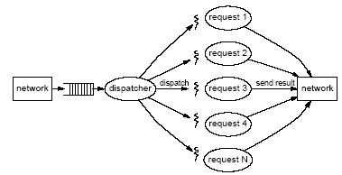
Multi-Threaded Servers
Motivation:
Avoid blocking the whole program (so that we can reach bottleneck throughput)
Idea: introduce threads
A thread is a sequence of instructions which may execute in parallel with other threads
When a blocking operation happens, only the flow (thread) performing the operation is blocked

Slide 48
Background: Java Thread Model
Every Java application has at least one thread
The “main” thread, started by the JVM to run the application’s main() method
Most JVMs use POSIX threads to implement Java threads
main() can create other threads
Explicitly, using the Thread class
Implicitly, by calling libraries that create threads as a consequence (RMI, AWT/Swing, Applets, etc.)

Slide 49
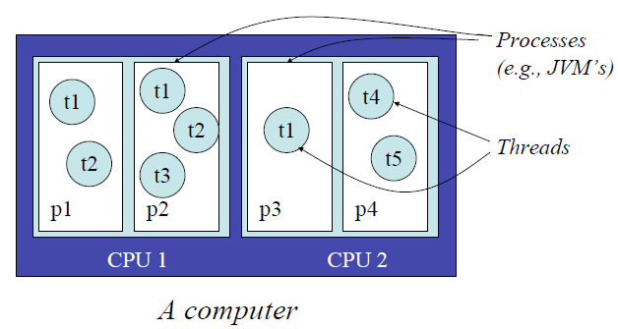
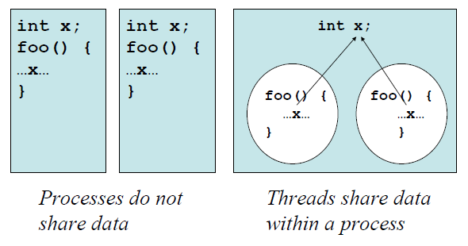
Thread vs Process

Slide 50
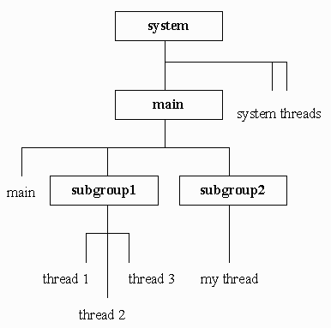
Background: Java Thread Class
Threads are organized into thread groups
A thread group represents a set of threads activeGroupCount();
A thread group can also include other thread groups to form a tree
Why thread group?
http://java.sun.com/javase/6/docs/api/java/lang/ThreadGroup.html

Slide 51
Creating Java Thread
Two ways to implement Java thread
Extend the Thread class
Overwrite the run() method of the Thread class
Create a class C implementing the Runnable interface, and create an object of type C, then use a Thread object to wrap up C
A thread starts execution after its start() method is called, which will start executing the thread’s (or the Runnable object’s) run() method
A thread terminates when the run() method returns
http://java.sun.com/javase/6/docs/api/java/lang/Thread.html

Slide 52
Option 1: Extending Java Thread
class PrimeThread extends Thread { long minPrime; PrimeThread(long minPrime) { this.minPrime = minPrime; } public void run() { // compute primes larger than minPrime . . . } }
PrimeThread p = new PrimeThread(143);
p.start();

Slide 53
Option 1: Extending Java Thread
class RequestHandler extends Thread { RequestHandler(Socket connSocket) { // … }
public void run() { // process request } …
}
Thread t = new RequestHandler(connSocket); t.start();

Slide 54
Option 2: Implement the Runnable Interface
class PrimeRun implements Runnable { long minPrime; PrimeRun(long minPrime) { this.minPrime = minPrime; } public void run() { // compute primes larger than minPrime . . . } }
PrimeRun p = new PrimeRun(143);
new Thread(p).start();

Slide 55
Example: a Multi-threaded TCPServer
Turn TCPServer into a multithreaded server by creating a thread for each accepted request

Slide 56
Per-Request Thread Server
main() { ServerSocket s = new ServerSocket(port); while (true) {
Socket conSocket = s.accept();
RequestHandler rh = new RequestHandler(conSocket); Thread t = new Thread (rh);
t.start(); }
main thread
thread starts
thread starts
class RequestHandler implements Runnable { RequestHandler(Socket connSocket) { … }
public void run() {
//
} }
thread ends
thread
ends
Try the per-request-thread TCP server: TCPServerMT.java

Slide 57
Summary: Implementing Threads
class RequestHandler extends Thread { RequestHandler(Socket connSocket) { … }
public void run() { // process request } …
}
Thread t = new RequestHandler(connSocket); t.start();
class RequestHandler implements Runnable { RequestHandler(Socket connSocket) {
…
}
public void run() {
// process request
} …
}
RequestHandler rh = new RequestHandler(connSocket); Thread t = new Thread(rh); t.start();

Slide 58
Modeling Per-Request Thread Server: Theory
λ
0
1
k
k+1
N
(k+1)μ
p0
p1
pk
pk+1
pN
Welcome Socket Queue

Slide 59
Problem of Per-Request Thread: Reality
High thread creation/deletion overhead
Too many threads → resource overuse → throughput meltdown → response time explosion
Q: given avg response time and connection arrival rate, how many threads active on avg?

Slide 60

Background: Little’s Law (1961)
For any system with no or (low) loss.
Assume
mean arrival rate λ, mean time R at system, and mean number Q of requests at system
Then relationship between Q, λ, and R:
R, Q
λ
Example: XMU admits 3000 students each year, and mean time a student stays is 4 years, how many students are enrolled?
Notes:
Proof of Little’s Law:

Slide 61
Little’s Law: Proof
arrival
A
3
2
1
t
time

Slide 62
Discussion: How to Address the Issue

