Slide 1
Statistical Multiplexing; Layered Network Architecture; End-to-end Arguments
Qiao Xiang
https://qiaoxiang.me/courses/cnns-xmuf21/index.shtml
09/23/2021
This deck of slides are heavily based on CPSC 433/533 at Yale University, by courtesy of Dr. Y. Richard Yang.

Slide 2
Outline
Admin. and recap
A taxonomy of communication networks
Layered network architecture

Slide 3
Admin.
Readings from the textbook and additional suggested readings
All are highly recommended
Some are marked as required
Assignment one is linked on the schedule page
Oct. 14, in class or by email to the instructor

Slide 4
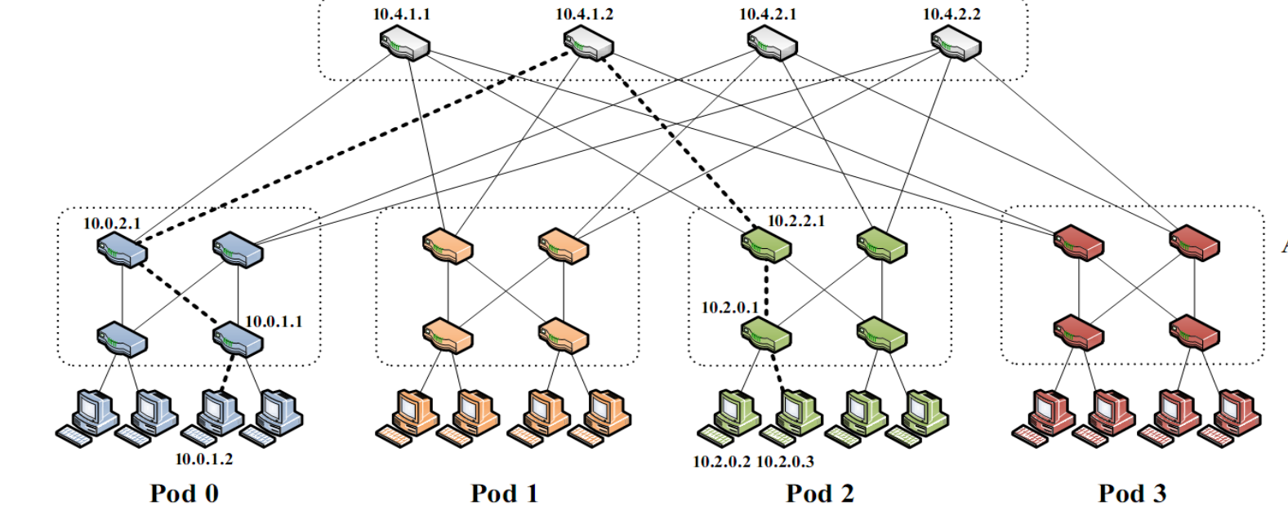
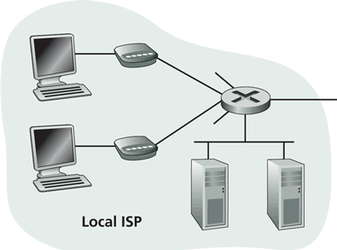
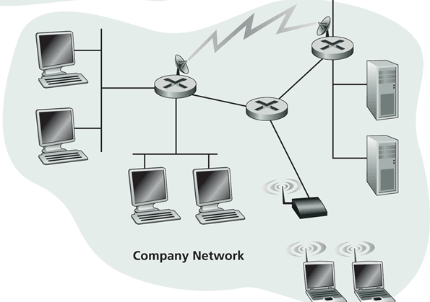
Recall: Internet Physical Infrastructure
Residential access, e.g.,
Cable, Fiber, DSL, Wireless
ISP
Backbone ISP
ISP
The Internet is a network of networks
Each individually administrated network is called an Autonomous System (AS)
~ 58000 ASes; Avg 5.7 hops; (http://bgp.potaroo.net/as2.0/bgp-active.html)
data center
Campus access, e.g.,
Ethernet, Wireless

Slide 5

Recap: Challenges - Scale
“Developers who have worked at the small scale might be asking themselves why we need to bother when we could just use some kind of out-of the-box solution. For small-scale applications, this can be a great idea. We save time and money up front and get a working and serviceable application. The problem comes at larger scales—there are no off-the-shelf kits that will allow you to build something like Amazon... There’s a good reason why the largest applications on the Internet are all bespoke creations: no other approach can create massively scalable applications within a reasonable budget.”
http://www.evontech.com/symbian/55.html

Slide 6
Recap: Challenges - General Complexity
Complexity in highly organized systems arises primarily from design strategies intended to create robustness to uncertainty in their environments and component parts.
Scalability is robustness to changes to the size and complexity of a system as a whole.
Evolvability is robustness of lineages to large changes on various (usually long) time scales.
Reliability is robustness to component failures.
Efficiency is robustness to resource scarcity.
Modularity is robustness to component rearrangements.
David Meyer

Slide 7

Recap: Challenges – Distributed vs Centralized
Distributed computing is hard, e.g.,
FLP Impossibility Theorem
Arrow’s Impossibility Theorem
Achieved good design for only few specific tasks (e.g., state distribution, leader election). Hence, a trend in networking is Software Defined Networking, which is a way of moving away from generic distributed computing, by focusing on utilizing the few well-understood primitives, in particular logically centralized state.

Slide 8
Recap: A Taxonomy of Comm. Networks
Basic question: how are data (the bits) transferred through communication networks?
communication networks
switched networks
broadcast networks
circuit-switched networks (e.g. telephone, GSM)
packet-switched networks (e.g. Internet)

Slide 9
Outline
Admin. and recap
A taxonomy of communication networks
circuit switched networks

Slide 10
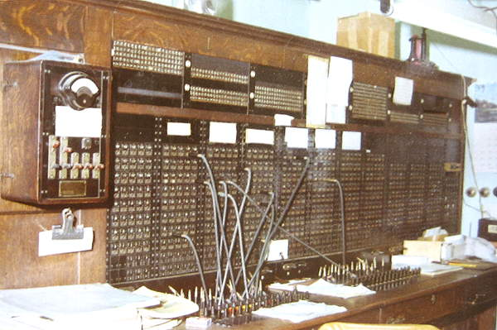
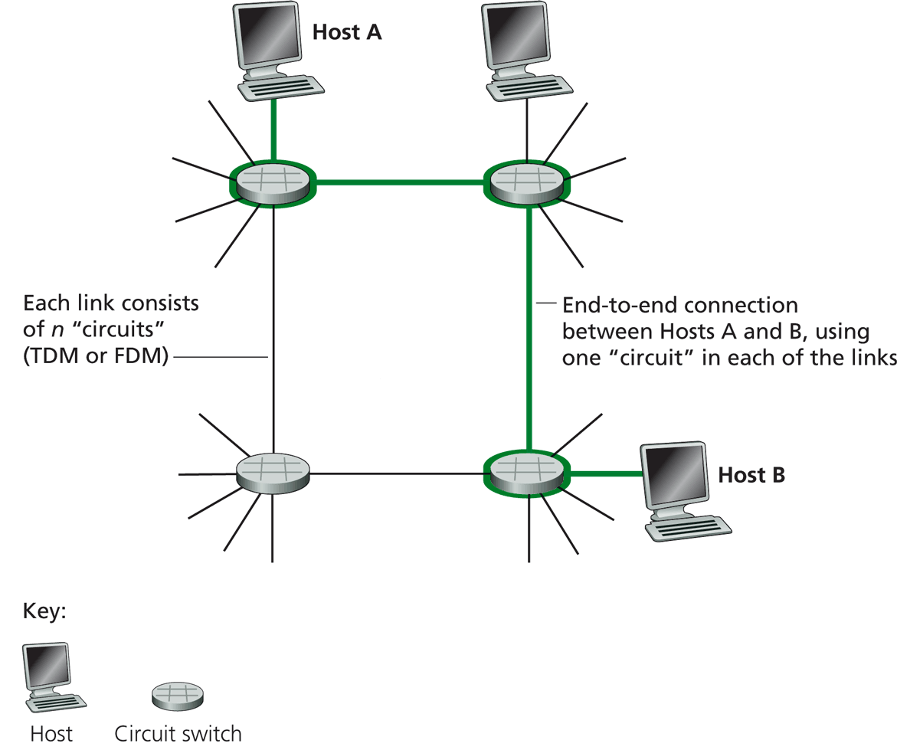
Circuit Switching
Each link has a number of “circuits”
sometime we refer to a “circuit” as a channel or a line
An end-to-end connection reserves one “circuit” at each link
First commercial telephone switchboard was opened in 1878 to serve the 21 telephone customers in New Haven
Notes:
http://www.classicrotaryphones.com/new-england-operators2_big.jpg

Slide 11
Circuit Switching: The Process
Three phases
circuit establishment
data transfer
circuit termination

Slide 12
Timing Diagram of Circuit Switching
Host A
Host B
Node 1
Node 2
processing delay at Node 1
DATA
propagation delay
from A to Node 1
circuit establishment
propagation delay
from B To A
data transmission
circuit termination

Slide 13
Delay Calculation in Circuit Switched Networks
Propagation delay: delay for the first bit to go from a source to a destination
Propagation delay:
d = length of physical link
s = propagation speed in medium (~2x10⁵ km/sec)
prop. delay: d/s
DATA

Slide 14
Delay Calculation in Circuit Switched Networks
Transmission delay: time to pump data onto link at line rate
Transmission delay:
R = reserved bandwidth (bps)
L = message length (bits)
d/s
DATA
trans. delay = L/R

Slide 15
An Example
Propagation delay
suppose the distance between A and B is 4000 km, then one-way propagation delay is:
Transmission delay
suppose your iphone reserves a one-slot HSCSD channel
each HSCSD frame can transmit about 115 kbps
a frame is divided into 8 slots
then the transmission delay of using one reserved slot for a message of 1 Kbits:

Slide 16
An Example (cont.)
Suppose the setup message is very small, and the total setup processing delay is 200 ms
Then the delay to transfer a message of 1 Kbits from A to B (from the beginning until host receives last bit) is:
DATA
20 + 200
20
20
70

Slide 17
Outline
Admin. and recaps
A brief introduction to the Internet: past and present
Challenges of Internet networks and apps
A taxonomy of communication networks
circuit switched networks
packet switched networks

Slide 18
Packet Switching
Each end-to-end data flow (i.e., a sender-receiver pair) divided into packets
Packets have the following structure:
header and trailer carry control information (e.g., destination address, check sum)
where is the control information for circuit switching?
At each node the entire packet is received, processed (e.g., routing), stored briefly, and then forwarded to the next node; thus packet-switched networks are also called store-and-forward networks. On its turn, a packet uses full link bandwidth
Header
Data
Trailer

Slide 19
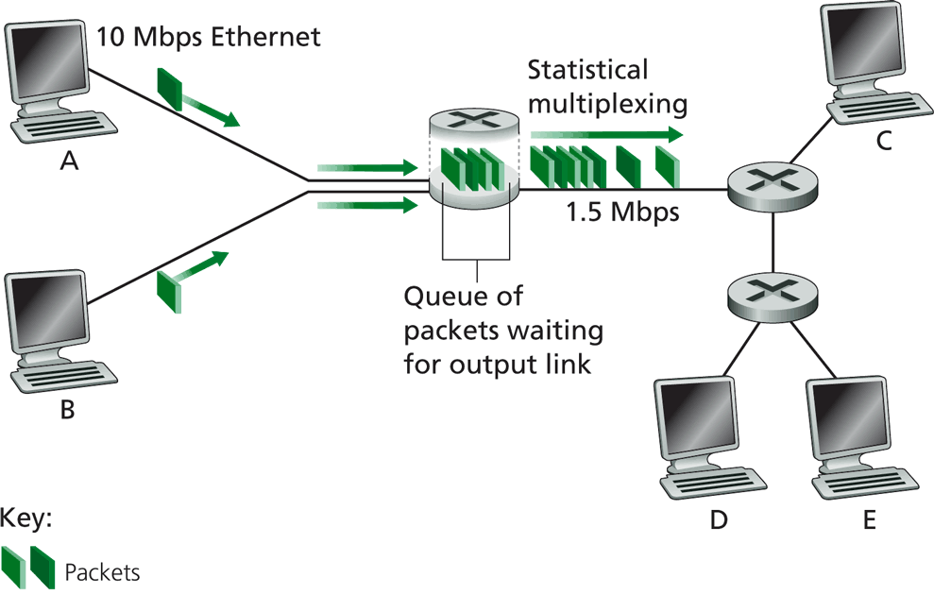
Packet Switching

Slide 20
Inside a Packet Switching Router
An output queueing switch
incoming links
node
outgoing links
Memory

Slide 21
Outline
Admin. and recaps
A brief introduction to the Internet: past and present
Challenges of Internet networks and apps
A taxonomy of communication networks
circuit switched networks
packet switched networks
circuit switching vs. packet switching

Slide 22

Packet Switching vs. Circuit Switching
The early history of the Internet was a heated debate between Packet Switching and Circuit Switching
the telephone network was the dominant network
Need to compare packet switching with circuit switching

Slide 23
Circuit Switching vs. Packet Switching
 | circuit switching | packet switching
resource usage | use a single partition bandwidth | use whole link bandwidth
reservation/setup | need reservation (setup delay) | no reservation
resource contention | busy signal (session loss) | congestion (long delay and packet losses)
charging | time | packet
header | no per-pkt header | per packet header
fast path processing | fast | per packet processing

Slide 24
Circuit Switching vs. Packet Switching
 | circuit switching | packet switching
resource usage | use a single partition bandwidth | use whole link bandwidth
reservation/setup | need reservation (setup delay) | no reservation
resource contention | busy signal (session loss) | congestion (long delay and packet losses)
charging | time | packet
header | no per-pkt header | per packet header
fast path processing | fast | per packet processing

Slide 25


Key Issue to be Settled
A key issue: what is the efficiency of resource partition?
Tool used to analyze the issue: queueing theory
Some basic results of queueing theory can be quite useful in many systems settings
5G
10G
5G
Notes:
10M bps link and 10 flows: partition into 10 1 Mbps or

Slide 26
Outline
Admin. and recaps
A brief introduction to the Internet: past and present
Challenges of Internet networks and apps
A taxonomy of communication networks
circuit switched networks
packet switched networks
circuit switching vs. packet switching
M/M queues and statistical multiplexing

Slide 27
Queueing Theory
Strategy:
model system state
if we know the fraction of time that the system spends at each state, we can get answers to many basic questions: how long does a new request need to wait before being served?
System state changes upon events:
introduce state transition diagram
focus on equilibrium: state trend neither growing nor shrinking (key issue: how to define equilibrium)
Our approach: We are not interested in extremely precise modeling, but want quantitative intuition

Slide 28
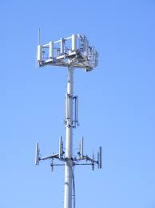
Warm up: Analysis of Circuit-Switching Blocking (Busy) Time
Assume a link has only a finite number of N circuits
Objective: compute the percentage of time that a new session (call) is blocked
Analogy in a more daily-life scenario?
Key parameters?
Notes:
Key input parameters?

Slide 29
Analysis of Circuit-Switching Blocking (Busy) Time
Consider a simple arrival pattern
client requests arrive at a rate of λ (lambda/second)
service rate: each call takes on average 1/μ second
Arrival and service patterns: memoryless (Markovian)
During a small interval Δt, the number of expected new arrivals is: λΔt
During a small interval Δt, the chance (fraction) of a current call finishes is: μΔt
This model is also called an M/M/N model

Slide 30
Analysis of Circuit-Switching Blocking (Busy) Time: State
system state: # of busy lines
0
1
k
k+1
N
p0
p1
pk
pk+1
pN
Q: How to characterize equilibrium?

Slide 31
Equilibrium = Time Reversibility [Frank Kelly]
=
Statistically cannot distinguish
=
=
state
Play the sequence backwards
k+1
k
time

Slide 32
Analysis of Circuit-Switching Blocking (Busy) Time: Sketch
system state: # of busy lines
λ
0
1
k
k+1
N
(k+1)μ
p0
p1
pk
pk+1
pN
at equilibrium (time resersibility) in one unit time: #(transitions k → k+1) = #(transitions k+1 → k)

Slide 33
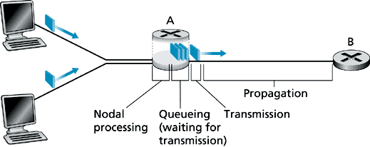
Queueing Analysis: Packet Switching Delay
Four types of delay at each hop
nodal processing delay: check errors & routing
queueing: time waiting for its turn at output link
transmission delay: time to pump packet onto a link at link speed
propagation delay: router to router propagation
The focus is on queueing and transmission delay
system state?

Slide 34
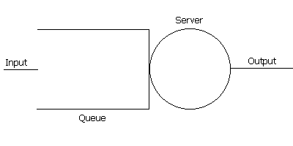
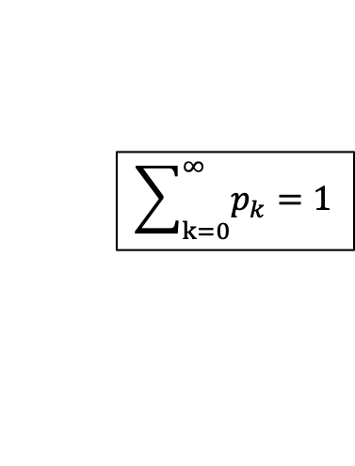
Packet Switching Delay
system state: #packets in queue
λ
0
1
k
k+1
N
μ
p0
p1
pk
pk+1
at equilibrium (time reversibility) in one unit time: #(transitions k → k+1) = #(transitions k+1 → k)
$$\sum_{k=0}^{∞}{p_{k}}=1$$

Slide 35
Summary: Queueing Theory
Model system state
Introduce state transition diagram
Focus on equilibrium: state trend neither growing nor shrinking

Slide 36




Example
Assume requests (packets) come in at a rate of one request per 50 ms
Each request (packet) takes on average 20 ms
What is the fraction of time that the system is empty?
What is the chance that a packet newly arrived needs to wait for 3 early packets?
$λ$=1/50ms =20/s
$1/μ$=20 ms, $μ$=50/s
$$P_{0}$$
$$P_{3}$$
Notes:
Rau = 2/3
(1-2/3)(2/3)^3 = 1/3 * 8/27 = 8/84 = 10%

Slide 37
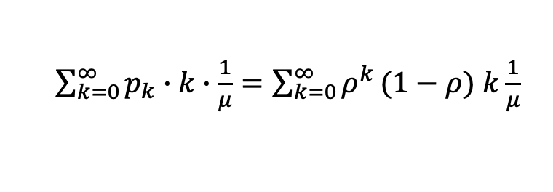
Analysis of Delay (cont’)
λ
0
1
k
k+1
μ
Average queueing delay:
Transmission delay:
Queueing + transmission:
$\sum_{k=0}^{∞}{p_{k}}∙k∙\frac{1}{μ}=\sum_{k=0}^{∞}{ρ^{k}}(1−ρ)$ $k\frac{1}{μ}$

Slide 38
Delay
For a demo of M/M/1, see: http://www.dcs.ed.ac.uk/home/jeh/Simjava/queueing/mm1_q/mm1_q.html

Slide 39
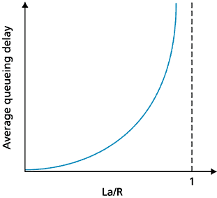
Queueing Delay as a Function of Utilization
Assume:
R = link bandwidth (bps)
L = packet length (bits)
S = L / R
a = average packet arrival rate (pkt/sec)
ρ ~ 0: average queueing delay small
ρ -> 1: delay becomes large
ρ > 1: more “work” arriving than can be serviced, average delay infinite !
ρ

Slide 40

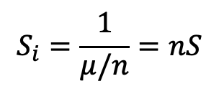
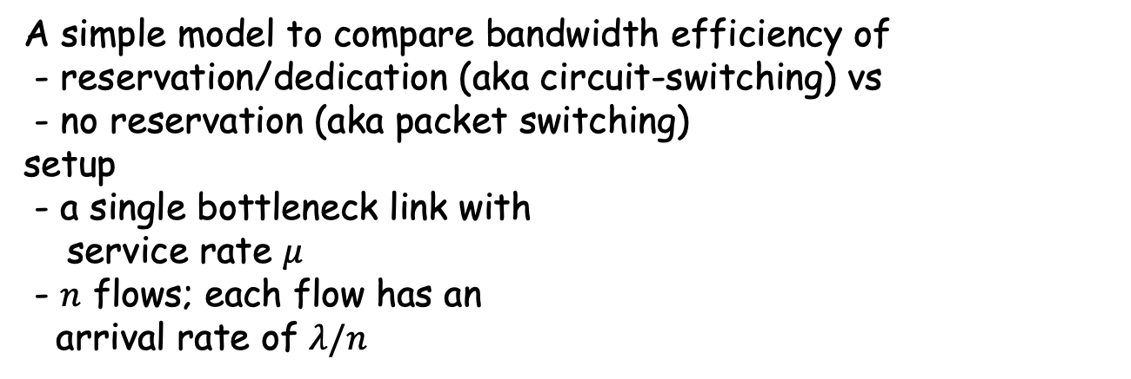
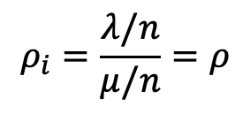
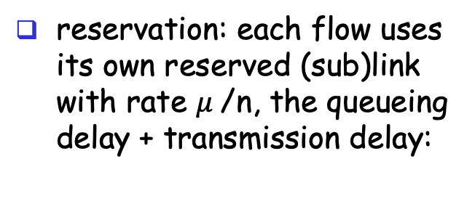
Statistical Multiplexing
A simple model to compare bandwidth efficiency of
- reservation/dedication (aka circuit-switching) vs
- no reservation (aka packet switching) setup
- a single bottleneck link with
service rate $μ$
- $n$ flows; each flow has an arrival rate of $λ/n$
no reservation: all arrivals into the single link, the queueing delay + transmission delay:
reservation: each flow uses its own reserved (sub)link with rate $μ$/n, the queueing delay + transmission delay:
For each flow i:
$$ρ_{i}=\frac{λ/n}{μ/n}=ρ$$
$$S_{i}=\frac{1}{μ/n}=nS$$

Slide 41
Summary: Packet Switching vs. Circuit Switching
Advantages of packet switching over circuit switching
most important advantage of packet-switching over circuit switching is statistical multiplexing, and therefore more efficient bandwidth usage
Disadvantages of packet switching
potential congestion: packet delay and high loss
protocols needed for reliable data transfer, congestion control
it is possible to guarantee quality of service (QoS) in packet-switched networks and still gain statistical multiplexig, but it adds much complexity
packet header overhead
per packet processing overhead

Slide 42
Outline
Admin. and recap
A taxonomy of communication networks
circuit switched networks
packet switched networks
circuit switching vs. packet switching
datagram and virtual circuit packet switched networks

Slide 43
A Taxonomy of Packet-Switched Networks According to Routing
Two types of packet switching
datagram network
each packet of a flow is switched independently
virtual circuit network:
all packets from one flow are sent along a pre-established path (= virtual circuit)

Slide 44
Datagram Packet Switching
Commonly when we say packet switching we mean datagram switching
Example: IP networks
Each packet is independently switched
each packet header contains complete destination address
receiving a packet, a router looks at the packet’s destination address and searches its current routing table to determine the possible next hops, and pick one
Analogy: postal mail system
Notes:
Disadvantages: routes may change during session
Advantage: routers do not keep any state about a flow;
thus, network architecture is
robust
scalable

Slide 45
Datagram Packet Switching
Host C
Host A
Host D
Node 1
Node 2
Node 3
Node 5
Host B
Node 7
Host E
Node 6
Node 4

Slide 46
Timing Diagram of Datagram Switching
Host A
Host B
Node 1
Node 2
Packet 1
propagation
delay from
Host A to
Node 1
transmission
time of Packet 1
at Host A
Packet 2
Packet 1
Packet 3
Packet 2
Packet 3
Packet 1
Packet 2
Packet 3

Slide 47
Virtual-Circuit Packet Switching
Example: Multiple Label Packet Switching (MPLS) in IP networks
Hybrid of circuit switching and datagram switching
fixed path determined at virtual circuit setup time, remains fixed thru flow
Implementation:
each packet carries a short local, tag (virtual-circuit (VC) #); tag determines next hop
Incoming VC# | Outgoing Interface | QoS
12 | 2
16 | 3
20 | 3
…

Slide 48
Virtual-Circuit Switching
Host C
Host A
Host D
Node 1
Node 2
Node 3
Node 5
Host B
Node 7
Host E
Node 6
Node 4

Slide 49
Virtual-Circuit Packet Switching
Three phases
VC establishment
Data transfer
VC disconnect

Slide 50
Timing Diagram of Virtual-Circuit Switching
Host 1
Host 2
Node 1
Node 2
propagation delay
between Host 1
and Node 1
VC
establishment
Packet 1
Packet 2
Packet 1
Packet 3
Packet 2
Packet 3
Packet 1
data
transfer
Packet 2
Packet 3
VC
termination

Slide 51
Discussion: Datagram Switching vs. Virtual Circuit Switching
What are the benefits of datagram switching over virtual circuit switching?
What are the benefits of virtual circuit switching over datagram switching?
Notes:
What advantages do virtual circuit have over datagram?
can treat different flows differently, if flows setup its desired treatment
Guarantees in-sequence delivery of packets
However: Packets from different virtual circuits may be interleaved

Slide 52
Summary of the Taxonomy of Communication Networks
communication network
switched network
broadcast communication
circuit-switched network
packet-switched network
datagram network
virtual circuit network

Slide 53
Summary of Progress
We have seen the hardware infrastructure, the basic communication scheme, a next key question is how to develop the software system.

Slide 54
Outline
Admin. and recap
A taxonomy of communication networks
Layered network architecture
what is layering?
why layering?
how to determine the layers?
ISO/OSI layering and Internet layering

Slide 55
What is Layering?
A technique to organize a networked system into a succession of logically distinct entities, such that the service provided by one entity is solely based on the service provided by the previous (lower level) entity.
Application
Application
Transport
Transport
Network
Network
Network
Datalink
Datalink
Datalink
Physical
Physical
Physical
Physical medium

Slide 56
Outline
Admin. and recap
A taxonomy of communication networks
Layered network architecture
what is layering?
why layering?

Slide 57
Why Layering?
Networks are complex !
many “pieces”:
hardware
hosts
routers
links of various media
software
applications
infrastructure
Dealing with complex systems: explicit structure allows identification of the relationship among a complex system’s pieces
layered reference model for discussion
Modularization eases maintenance, updating of system:
change of implementation of a layer’s service transparent to rest of system, e.g., changes in routing protocol doesn’t affect rest of system

Slide 58
An Example: No Layering
Application
Telnet
FTP
HTTP
Transmission
Media
Ether-net
Fiber
optic
Wireless
No layering: each new application has to be re-implemented for every network technology !

Slide 59
An Example: Benefit of Layering
Introducing an intermediate layer provides a common abstraction for network technologies
Application
Telnet
FTP
HTTP
Transport
& Network
Transmission
Media
Ethernet
Fiber
optic
Wireless

Slide 60
ISO/OSI Concepts
ISO – International Standard Organization
OSI – Open System Interconnection
Service – says what a layer does
Interface – says how to access the service
Protocol – specifies how the service is implemented
a set of rules and formats that govern the communications between two or more peers

Slide 61
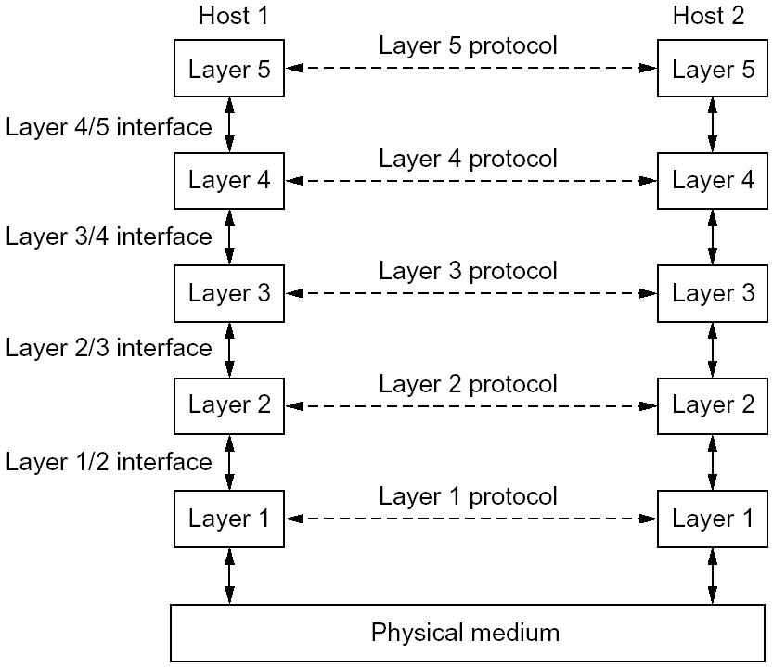
An Example of Layering

Slide 62
An Example of Layering

Slide 63
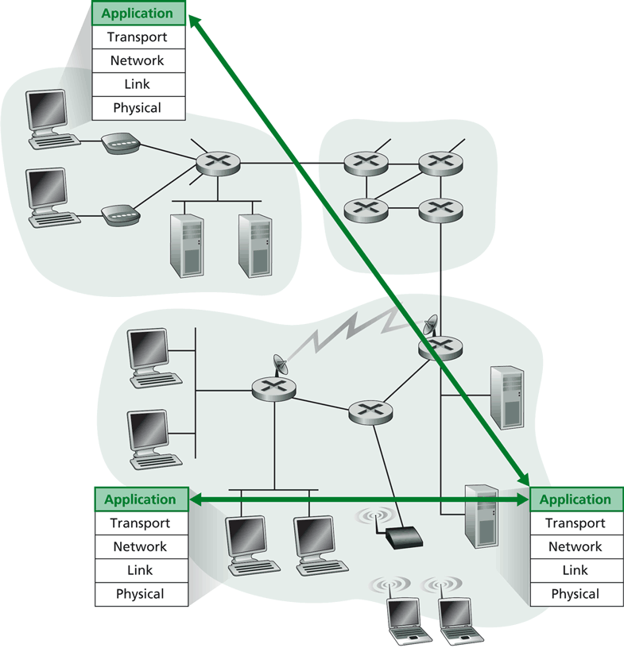
Layering -> Logical Communication
E.g.: application
provide services to users
application protocol:
send messages to peer
for example, HELO, MAIL FROM, RCPT TO are messages between two SMTP peers

Slide 64
Layering: Logical Communication
data
application
transport
network
link
physical
transport
E.g.: transport
Trans. msg for app
Transport protocol
add control info to form “segment”
send segment to peer
wait for peer to ack receipt; if no ack, retransmit
ack
network
link
physical
application
transport
network
link
physical
data
data
application
transport
network
link
physical
application
transport
network
link
physical
transport

Slide 65
Layering: Physical Communication
data
application
transport
network
link
physical
network
link
physical
application
transport
network
link
physical
data
application
transport
network
link
physical
application
transport
network
link
physical

Slide 66
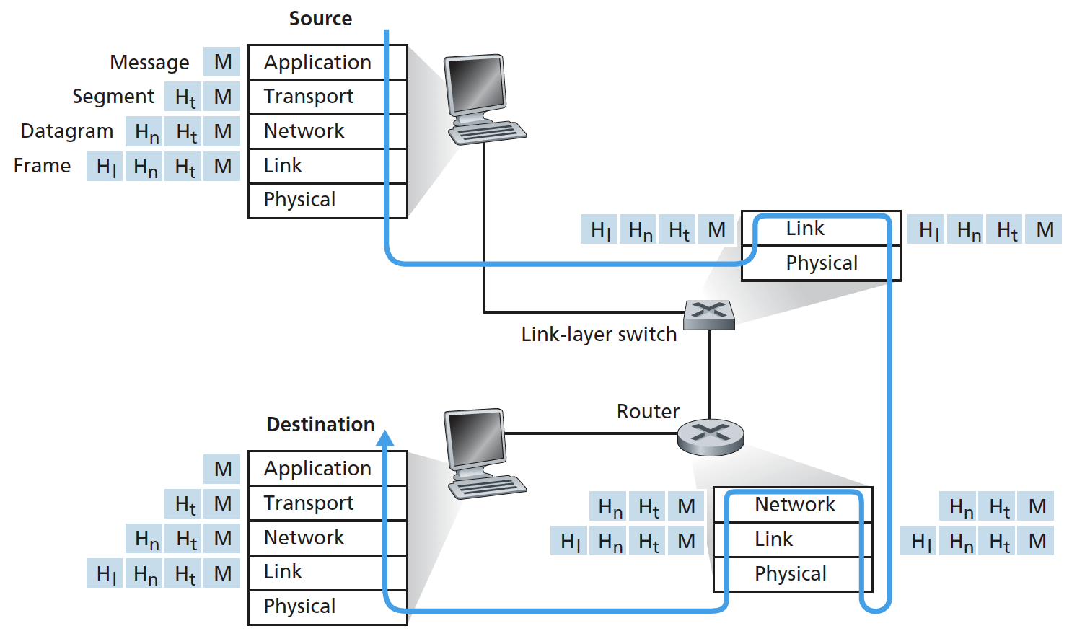
Protocol Layering and Meta Data
Each layer takes data from above
adds header (meta) information to its peer to create new data unit
passes new data unit to layer below

Slide 67
Packet as a Stack in a Layered Architecture
Application
Application
Transport
Transport
Network
Network
Network
Datalink
Datalink
Datalink
Physical
Physical
Physical
Physical medium

Slide 68
Key design issue:
How do you divide functionalities among the layers?

Slide 69
Outline
Review
A taxonomy of communication networks
Layered network architecture
what is layering?
why layering?
how to determine the layers?

Slide 70
The End-to-End Arguments
The function in question can completely and correctly be implemented only with the knowledge and help of the application standing at the endpoints of the communication systems. Therefore, providing that questioned function as a feature of the communications systems itself is not possible.
J. Saltzer, D. Reed, and D. Clark, 1984

Slide 71
What does the End-to-End Arguments Mean?
The application knows the requirements best, place functionalities as high in the layer as possible
Think twice before implementing a functionality at a lower layer, even when you believe it will be useful to an application

Slide 72
Example: Where to Provide Reliability ?
S
A
R
L2
L2
L1
L1
L1
Solution 1: the network (lower layer L1) provides reliability, i.e., each hop provides reliability
Solution 2: the end host (higher layer L2) provides reliability, i.e., end-to-end check and retry

Slide 73
What are Reasons for Implementing Reliability at Higher Layer ?
The lower layer cannot completely provide the functionality
the receiver has to do the check anyway !
Implementing it at lower layer increases complexity, cost and overhead at lower layer
shared by all upper layer applications → everyone pays for it, even if you do not need it
The upper layer
knows the requirements better and thus may choose a better approach to implement it
S
A
R
L2
L2
L1
L1
L1
Notes:
First point: L1 may first ack and then crash; then the function fails; if L2 crash; the application crashes also->fate sharing

Slide 74
Are There Reasons Implementing Reliability at Lower Layer ?
Improve performance, e.g., if high cost/delay/… on a local link
improves efficiency
reduces delay
Share common code, e.g., reliability is required by multiple applications
S
A
R
L2
L2
L1
L1
L1
Notes:
S to A: San francisco to Yale router
A to R: Yale router to a wireless laptop (e.g., 10% success rate)

Slide 75
Summary: End-to-End Arguments
If a higher layer can do it, don’t do it at a lower layer -- the higher the layer, the more it knows about the best what it needs
Add functionality in lower layers iff it
(1) is used by and improves performance of a large number of (current and potential future) applications,
(2) does not hurt (too much) other applications, and
(3) does not increase (too much) complexity/overhead
Practical tradeoff, e.g.,
allow multiple interfaces at a lower layer (one provides the function; one does not)
Notes:
Issue: does not reduce complexity/cost
upper layer needs to be developed for all interfaces

Slide 76
Examples
We used reliability as an example
Assume two layers (L1: network; L2: end-to-end). Where may you implement the following functions?
security (privacy of traffic)
quality of service (e.g., delay/bandwidth guarantee)
congestion control (e.g., not to overwhelm network links or receiver)
S
A
R
L2
L2
L1
L1
L1

Slide 77
Example
Consider the presence service in a social networking system: shows which contacts are online (e.g., skype)
implementing by end user’s host app or through a third party service?
A
B
L2
L2
L1

Slide 78

Challenges
Challenges to build a good (networking) system: find the right balance between:
end-to-end arguments
reuse, interoperability, implementation effort
(apply layering concepts)
performance
No universal answer: the answer depends on the goals and assumptions!

Slide 79
Discussion: Limitations of Layered Architecture

Slide 80
Backup Slides

Slide 81
The Design Philosophy of the DARPA Internet

Slide 82
Goals
. Connect different networks
Survivability in the face of failure
Support multiple types of services
Accommodate a variety of networks
Permit distributed management of resources
Be cost effective
Permit host attachment with a low level of effort
Be accountable

Slide 83
Survivability in the Face of Failure: Questions
What does the goal mean?
Why is the goal important?
How does the Internet achieve this goal?
Does the Internet achieve this goal (or in what degree does the Internet achieve this goal)?

Slide 84
Survivability in the Face of Failure
Continue to operate even in the presence of network failures (e.g., link and router failures)
as long as the network is not partitioned, two endpoints should be able to communicate…moreover, any other failure (excepting network partition) should be transparent to endpoints
Decision: maintain state only at end-points (fate-sharing)
eliminate the problem of handling state inconsistency and performing state restoration when router fails
Internet: stateless network architecture

Slide 85
Support Multiple Types of Service: Questions
What does this goal mean?
Why is the goal important?
How does the Internet achieve this goal?
Does the Internet achieve this goal (or in what degree does the Internet achieve this goal)?

Slide 86
Support Multiple Types of Service
Add UDP to TCP to better support other types of applications
e.g., “real-time” applications
This was arguably the main reason for separating TCP and IP
Provide datagram abstraction: lower common denominator on which other services can be built: everything over IP
service differentiation was considered (remember ToS?), but this has never happened on the large scale (Why?)

Slide 87
Support a Variety of Networks: Questions
What does the goal mean?
Why is this goal important?
How does the Internet achieve this goal?
Does the Internet achieve this goal (or in what degree does the Internet achieve this goal)?

Slide 88
Support a Variety of Networks
Very successful
because the minimalist service; it requires from underlying network only to deliver a packet with a “reasonable” probability of success
…does not require:
reliability
in-order delivery
The mantra: IP over everything
Then: ARPANET, X.25, DARPA satellite network..
Now: ATM, SONET, WDM…

Slide 89
Other Goals
Permit distributed management of resources
Be cost effective
Permit host attachment with a low level of effort
Be accountable

