Slide 1
Network Applications: High-performance Server Design: Nonblocking Servers; Operational Analysis;
Qiao Xiang
https://qiaoxiang.me/courses/cnns-xmuf21/index.shtml
10/28/2021
This deck of slides are heavily based on CPSC 433/533 at Yale University, by courtesy of Dr. Y. Richard Yang.

Slide 2
Outline
Admin and recap
High performance servers
Thread design
Asynchronous design
Overview
Multiplexed (selected), reactive programming
Asynchronous, proactive programming (asynchronous channel + future/completion handler)
Operational analysis
Multi-servers

Slide 3
Admin
Lab assignment 2 due today
Midterm exam date and location:
Nov. 11, 4:40-6:20pm, G-105

Slide 4
Recap: Thread-Based Network Servers
Why: blocking operations; threads (execution sequences) so that only one thread is blocked
How:
Per-request thread
problem: large # of threads and their creations/deletions may let overhead grow out of control
Thread pool
Design 1: Service threads compete on the welcome socket
Design 2: Service threads and the main thread coordinate on the shared queue
polling (busy wait)
suspension: wait/notify

Slide 5
Recap: Program Correctness Analysis
Safety
consistency
app requirement, e.g., Q.remove() is not on an empty queue
Liveness (progress)
main thread can always add to Q
every connection in Q will be processed
Fairness
For example, in some settings, a designer may want the threads to share load equally

Slide 6
Recap: Multiplexed, Reactive Server Architecture
Handle Accept
Handle Read
Handle Write
Accept
Readable
Writable
Event Dispatcher
Program registers events (e.g., acceptable, readable, writable) to be monitored and a handler to call when an event is ready
An infinite dispatcher loop:
Dispatcher asks OS to check if any ready event
Dispatcher calls (multiplexes) the registered handler of each ready event/source
Handler should be non-blocking, to avoid blocking the event loop

Slide 7
Recap: Main Abstractions
Main abstractions of multiplexed IO:
Channels: represent connections to entities capable of performing I/O operations;
Selectors and selection keys: selection facilities;
Buffers: containers for data.
More details see https://docs.oracle.com/javase/8/docs/api/java/nio/package-summary.html

Slide 8
Multiplexed (Selectable), Non-Blocking Channels
SelectableChannel | A channel that can be multiplexed
DatagramChannel | A channel to a datagram-oriented socket
Pipe.SinkChannel | The write end of a pipe
Pipe.SourceChannel | The read end of a pipe
ServerSocketChannel | A channel to a stream-oriented listening socket
SocketChannel | A channel for a stream-oriented connecting socket
Use configureBlocking(false) to make a channel non-blocking
Note: Java SelectableChannel does not include file I/O

Slide 9
Selector
The class Selector is the base of the multiplexer/dispatcher
Constructor of Selector is protected; create by invoking the open method to get a selector (why?)
Accept
Conn
Read
Request
Find
File
Send
Header
Read File
Send Data
Event Dispatcher

Slide 10
Selector and Registration
A selectable channel registers events to be monitored with a selector with the register method
The registration returns an object called a SelectionKey: SelectionKey key = channel.register(selector, ops);

Slide 11
Java Selection I/O Structure
A SelectionKey object stores:
interest set: events to check: key.interestOps(ops)
ready set: after calling select, it contains the events that are ready, e.g. key.isReadable()
an attachment that you can store anything you want
key.attach(myObj)
Selector
Selectable Channel
register
Selection Key

Slide 12
Checking Events
A program calls select (or selectNow(), or select(int timeout)) to check for ready events from the registered SelectableChannels
Ready events are called the selected key set selector.select(); Set readyKeys = selector.selectedKeys();
The program iterates over the selected key set to process all ready events

Slide 13
Dispatcher using Select
while (true) {
- selector.select()
- Set readyKeys = selector.selectedKeys();
- foreach key in readyKeys { switch event type of key:
accept: call accept handler
readable: call read handler
writable: call write handler
}
}

Slide 14
I/O in Java: ByteBuffer
Java SelectableChannels typically use ByteBuffer for read and write
channel.read(byteBuffer);
channel.write(byteBuffer);
ByteBuffer is a powerful class that can be used for both read and write
It is derived from the class Buffer
All reasonable network server design should have a good buffer design

Slide 15
Buffer (relative index)
position
limit
capacity
Each Buffer has three numbers: position, limit, and capacity
Invariant: 0 <= position <= limit <= capacity
Buffer.clear(): position = 0; limit=capacity

Slide 16
channel.read(Buffer)
position
limit
capacity
Put data into Buffer, starting at position, not to reach limit

Slide 17
channel.write(Buffer)
position
limit
capacity
Move data from Buffer to channel, starting at position, not to reach limit

Slide 18
Buffer.flip()
position
limit
capacity
Buffer.flip(): limit=position; position=0
Why flip: used to switch from preparing data to output, e.g.,
buf.put(header); // add header data to buf
in.read(buf); // read in data and add to buf
buf.flip(); // prepare for write
out.write(buf);
Typical pattern: read, flip, write

Slide 19
Buffer.compact()
position
limit
capacity
Move [position , limit) to 0
Set position to limit-position, limit to capacity
// typical design pattern
buf.clear(); // Prepare buffer for use
for (;;) {
if (in.read(buf) < 0 && !buf.hasRemaining())
break; // No more bytes to transfer
buf.flip();
out.write(buf);
buf.compact(); // In case of partial write
}

Slide 20
Example
See SelectEchoServer/v1-2/SelectEchoServer.java

Slide 21
Problems of Echo Server v1
Empty write: Callback to handleWrite() is unnecessary when nothing to write
Imagine empty write with 10,000 sockets
Solution: initially read only, later allow write
handleRead() still reads after the client closes
Solution: after reading end of stream (read returns -1), deregister read interest for the channel

Slide 22
(Partial) Finite State Machine (FSM)
FSM for each socket channel in v2:
Read input
Read +Write
Read close
Write
Init
Read data
Idle
Still many remaining issues such as idle instead of close
Notes:
Empty write when no data to write

Slide 23
Finite-State Machine and Thread
Why no need to introduce FSM for a thread version?
One perspective
A selector io program turns a sequential thread program into a parallel program, with each instruction block being able to run in parallel
Thread releases each block only when it reaches the instruction
Selector FSM releases all blocks by default and hence need FSM to control
Accept Client
Connection
Read
Request
Find
File
Send
Response Header
Read File
Send Data
Notes:
http://www.kernel.org/doc/man-pages/online/pages/man4/epoll.4.html

Slide 24
A More Typical Finite State Machine
Read from client channel
Generating response
Request complete (find terminator or client request close)
!RequestReady !ResponseReady
RequestReady !ResponseReady
InitInterest =READ
Interest= -
Write response
Closed
RequestReady ResponseReady
ResponseSent
Interest= -
ResponseReady Interest=Write

Slide 25
FSM and Reactive Programming
There can be multiple types of FSMs, to handle protocols correctly
Staged: first read request and then write response
Mixed: read and write mixed
Choice depends on protocol and tolerance of complexity, e.g.,
HTTP/1.0 channel may use staged
HTTP/1.1/2/Chat channel may use mixed

Slide 26
Toward More General Server Framework
Our example EchoServer is for a specific protocol
A general non-blocking, reactive programming framework tries to introduce structure to allow substantial program reuse
Non-blocking programming framework is among the more complex software systems
We will see one simple example, using EchoServer as a basis

Slide 27
A More Extensible Dispatcher Design
Fixed accept/read/write functions are not general design
A solution: Using attachment of each channel
Attaching a ByteBuffer to each channel is a narrow design for simple echo servers
A more general design can use the attachment to store a callback that indicates not only data (state) but also the handler (function)

Slide 28
A More Extensible Dispatcher Design
Attachment stores generic event handler
Define interfaces
IAcceptHandler and
IReadWriteHandler
Retrieve handlers at run time
if (key.isAcceptable()) { // a new connection is ready
IAcceptHandler aH = (IAcceptHandler) key.attachment();
aH.handleAccept(key);
}
if (key.isReadable() || key.isWritable()) { IReadWriteHandler rwH = IReadWriteHandler)key.attachment();
if (key.isReadable()) rwH.handleRead(key);
if (key.isWritable()) rwH.handleWrite(key);
}

Slide 29
Handler Design: Acceptor
What should an accept handler object know?
ServerSocketChannel (so that it can call accept)
Can be derived from SelectionKey in the call back
Selector (so that it can register new connections)
Can be derived from SelectionKey in the call back
What ReadWrite object to create (different protocols may use different ones)?
Pass a Factory object: SocketReadWriteHandlerFactory
Notes:
Registration Key (so that it can deregister)
channel.keyFor(selector)

Slide 30
Handler Design: ReadWriteHandler
What should a ReadWrite handler object know?
SocketChannel (so that it can read/write data)
Can be derived from SelectionKey in the call back
Selector (so that it can change state)
Can be derived from SelectionKey in the call back

Slide 31
Class Diagram of SimpleNAIO
Dispatcher
…
IChannelHandler
handleException();
IReadWriteHandler
handleRead();
handleWrite();
getInitOps();
IAcceptHandler
handleAccept();
EchoReadWriteHandler
handleRead();
handleWrite();
getInitOps();
implements
ISocketReadWriteHandlerFactory
createHandler();
Acceptor
1
EchoReadWriteHandlerFactory
createHandler();

Slide 32
Class Diagram of SimpleNAIO
Dispatcher
…
IChannelHandler
handleException();
IReadWriteHandler
handleRead();
handleWrite();
getInitOps();
NewReadWriteHandler
handleRead();
handleWrite();
getInitOps();
IAcceptHandler
handleAccept();
EchoReadWriteHandler
handleRead();
handleWrite();
getInitOps();
implements
ISocketReadWriteHandlerFactory
createHandler();
Acceptor
1
NewReadWriteHandlerFactory
createHandler();
EchoReadWriteHandlerFactory
createHandler();

Slide 33
SimpleNAIO
See SelectEchoServer/v3/*.java

Slide 34
Discussion on SimpleNAIO
In our current implementation (Server.java)
1. Create dispatcher
2. Create server socket channel and listener
3. Register server socket channel to dispatcher
4. Start dispatcher thread
Can we switch 3 and 4?

Slide 35
Extending SimpleNAIO
A production network server often closes a connection if it does not receive a complete request in TIMEOUT
One way to implement time out is that
the read handler registers a timeout event with a timeout watcher thread with a call back
the watcher thread invokes the call back upon TIMEOUT
the callback closes the connection
Any problem?

Slide 36
Extending Dispatcher Interface
Interacting from another thread to the dispatcher thread can be tricky
Typical solution: async command queue
while (true) {
- process async. command queue
- ready events = select (or selectNow(), or select(int timeout)) to check for ready events from the registered interest events of SelectableChannels
- foreach ready event call handler
}

Slide 37
Question
How may you implement the async command queue to the selector thread?
public void invokeLater(Runnable run) {
synchronized (pendingInvocations) {
pendingInvocations.add(run);
}
selector.wakeup();
}

Slide 38
Question
What if another thread wants to wait until a command is finished by the dispatcher thread?

Slide 39
public void invokeAndWait(final Runnable task)
throws InterruptedException
{
if (Thread.currentThread() == selectorThread) {
// We are in the selector's thread. No need to schedule
// execution
task.run();
} else {
// Used to deliver the notification that the task is executed
final Object latch = new Object();
synchronized (latch) {
// Uses the invokeLater method with a newly created task
this.invokeLater(new Runnable() {
public void run() {
task.run();
// Notifies
synchronized(latch) { latch.notify(); }
}
});
// Wait for the task to complete.
latch.wait();
}
// Ok, we are done, the task was executed. Proceed.
}
}

Slide 40
Asynchronous Initiation and Callback: Basic Idea
Issue of only peek:
Cannot handle initiation calls (e.g., read file, initiate a connection by a network client)
Idea: asynchronous initiation (e.g., aio_read) and program specified completion handler (callback)
Also referred to as proactive (Proactor) nonblocking
Notes:
http://www.kernel.org/doc/man-pages/online/pages/man4/epoll.4.html

Slide 41
Outline
Admin and recap
High performance servers
Thread design
Asynchronous design
Overview
Multiplexed (selected), reactive programming
Asynchronous, proactive programming (asynchronous channel + future/completion handler)

Slide 42
Asynchronous Channel using Future/Completion Handler
Java 7 introduces ASynchronousServerSocketChannel and ASynchornousSocketChannel beyond ServerSocketChannel and SocketChannel
accept, connect, read, write return Futures or have a callback. Selectors are not used
https://docs.oracle.com/javase/7/docs/api/java/nio/channels/AsynchronousServerSocketChannel.html
https://docs.oracle.com/javase/7/docs/api/java/nio/channels/AsynchronousSocketChannel.html

Slide 43
Asynchronous I/O
Asynchronous I/O | Description
AsynchronousFileChannel | An asynchronous channel for reading, writing, and manipulating a file
AsynchronousSocketChannel | An asynchronous channel to a stream-oriented connecting socket
AsynchronousServerSocketChannel | An asynchronous channel to a stream-oriented listening socket
CompletionHandler | A handler for consuming the result of an asynchronous operation
AsynchronousChannelGroup | A grouping of asynchronous channels for the purpose of resource sharing
https://docs.oracle.com/javase/8/docs/api/java/nio/channels/package-summary.html

Slide 44
Example Async Calls
abstract Future <AsynchronousSocketChannel> | accept(): Accepts a connection.
abstract <A> void | accept(A attachment, CompletionHandler<AsynchronousSocketChannel,? super A> handler): Accepts a connection.
abstract Future<Integer> | read(ByteBuffer dst): Reads a sequence of bytes from this channel into the given buffer.
abstract <A> void | read(ByteBuffer[] dsts, int offset, int length, long timeout,TimeUnit unit, A attachment, CompletionHandler<Long,? super A> handler): Reads a sequence of bytes from this channel into a subsequence of the given buffers.
https://docs.oracle.com/javase/8/docs/api/java/nio/channels/AsynchronousServerSocketChannel.html

Slide 45
Future
CompletionHandler
SocketAddress address = new InetSocketAddress(args[0], port);
AsynchronousSocketChannel client = AsynchronousSocketChannel.open();
Future<Void> connected = client.connect(address);
ByteBuffer buffer = ByteBuffer.allocate(100);
// wait for the connection to finish
connected.get();
// read from the connection
Future<Integer> future = client.read(buffer);
// do other things...
// wait for the read to finish...
future.get();
// flip and drain the buffer
buffer.flip();
WritableByteChannel out = Channels.newChannel(System.out);
out.write(buffer);
class LineHandler implements CompletionHandler<Integer, ByteBuffer> {
@Override
public void completed(Integer result, ByteBuffer buffer) {
buffer.flip();
WritableByteChannel out = Channels.newChannel(System.out);
try {
out.write(buffer);
} catch (IOException ex) {
System.err.println(ex);
}
}
@Override
public void failed(Throwable ex, ByteBuffer attachment) {
System.err.println(ex.getMessage());
}
}
ByteBuffer buffer = ByteBuffer.allocate(100);
CompletionHandler<Integer, ByteBuffer> handler = new LineHandler();
channel.read(buffer, buffer, handler);

Slide 46
Asynchronous Channel Implementation
Asynchronous is typically based on Thread pool. If you are curious on its implementation, please read https://docs.oracle.com/javase/8/docs/api/java/nio/channels/AsynchronousChannelGroup.html

Slide 47
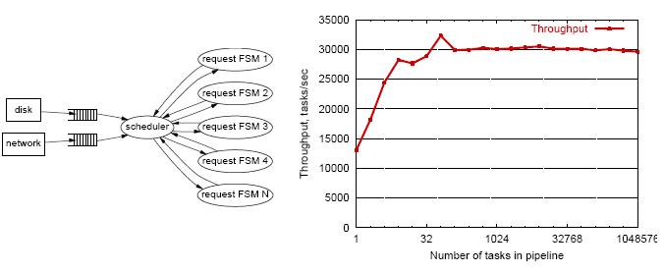
Summary: Event-Driven (Asynchronous) Programming
Advantages
Single address space for ease of sharing
No synchronization/thread overhead
Many examples: Click router, Flash web server, TP Monitors, NOX controller, Google Chrome (libevent), Dropbox (libevent), …

Slide 48
Problems of Event-Driven Server
Obscure control flow for programmers and tools
Difficult to engineer, modularize, and tune
Difficult for performance/failure isolation between FSMs

Slide 49
Summary: Architecture
Architectures
Multi threads
Asynchronous
Hybrid
Assigned reading: SEDA
Netty design

Slide 50

Summary: The High-Performance Network Servers Journey
Avoid blocking (so that we can reach bottleneck throughput)
Introduce threads
Limit unlimited thread overhead
Thread pool, async io
Coordinating data access
synchronization (lock, synchronized)
Coordinating behavior: avoid busy-wait
wait/notify; select FSM, Future/Listener
Extensibility/robustness
language support/design for interfaces

Slide 51
Beyond Class: Design Patterns
We have seen Java as an example
C++ and C# can be quite similar. For C++ and general design patterns:
http://www.cs.wustl.edu/~schmidt/PDF/OOCP-tutorial4.pdf
http://www.stal.de/Downloads/ADC2004/pra03.pdf

Slide 52
Recap: Best Server Design Limited Only by Resource Bottleneck
CPU
DISK
Before
NET
CPU
DISK
After
NET

Slide 53
Some Questions
When is CPU the bottleneck for scalability?
So that we need to add helper threads
How do we know that we are reaching the limit of scalability of a single machine?
These questions drive network server architecture design
Some basic performance analysis techniques are good to have

Slide 54
Outline
Admin and recap
High performance servers
Thread design
Asynchronous design
Operational analysis

Slide 55
Operational Analysis
Relationships that do not require any assumptions about the distribution of service times or inter-arrival times
Hence focus on measurements
Identified originally by Buzen (1976) and later extended by Denning and Buzen (1978).
We touch only some techniques/results
In particular, bottleneck analysis
More details see linked reading

Slide 56
Under the Hood (An example FSM)
exit
(throughput λ until some
center saturates)
start (arrival rate λ)
CPU
I/O request
File I/O
network
Memory cache

Slide 57
Operational Analysis: Resource Demand of a Request
CPU
V_{CPU} visits for S_{CPU} units of resource time per visit
Network
V_{Net} visits for S_{Net} units of resource time per visit
Disk
V_{Disk} visits for S_{Disk} units of resource time per visit
Memory
V_{Mem} visits for S_{Mem} units of resource time per visit

Slide 58
Operational Quantities
T: observation interval Ai: # arrivals to device i
Bi: busy time of device i Ci: # completions at device i
i = 0 denotes system

Slide 59
Utilization Law
The law is independent of any assumption on arrival/service process
Example: Suppose NIC processes 125 pkts/sec, and each pkt takes 2 ms. What is utilization of the network NIC?

Slide 60
Deriving Relationship Between R, U, and S for one Device
Assume flow balanced (arrival=throughput), Little’s Law:
Assume PASTA (Poisson arrival--memory-less arrival--sees time average), a new request sees Q ahead of it, and FIFO
According to utilization law, U = XS

Slide 61
Forced Flow Law
Assume each request visits device i Vi times

Slide 62
Bottleneck Device
Define Di = Vi Si as the total demand of a request on device i
The device with the highest Di has the highest utilization, and thus is called the bottleneck

Slide 63
Bottleneck vs System Throughput

Slide 64
Example 1
A request may need
10 ms CPU execution time
1 Mbytes network bw
1 Mbytes file access where
50% hit in memory cache
Suppose network bw is 100 Mbps, disk I/O rate is 1 ms per 8 Kbytes (assuming the program reads 8 KB each time)
Where is the bottleneck?

Slide 65
Example 1 (cont.)
CPU:
D_{CPU}=
Network:
D_{Net} =
Disk I/O:
Ddisk =
10 ms ( e.q. 100 requests/s)
1 Mbytes / 100 Mbps = 80 ms (e.q., 12.5 requests/s)
0.5 * 1 ms * 1M/8K = 62.5 ms (e.q. = 16 requests/s)

Slide 66
Example 2
A request may need
150 ms CPU execution time (e.g., dynamic content)
1 Mbytes network bw
1 Mbytes file access where
50% hit in memory cache
Suppose network bw is 100 Mbps, disk I/O rate is 1 ms per 8 Kbytes (assuming the program reads 8 KB each time)
Bottleneck: CPU -> use multiple threads to use more CPUs, if available, to avoid CPU as bottleneck

Slide 67
Interactive Response Time Law
System setup
Closed system with N users
Each user sends in a request, after response, think time, and then sends next request
Notation
Z = user think-time, R = Response time
The total cycle time of a user request is R+Z
In duration T, #requests generated by each user:
T/(R+Z) requests

Slide 68
Interactive Response Time Law
If N users and flow balanced:

Slide 69
Bottleneck Analysis
Here D is the sum of Di

Slide 70
Proof
We know
Using interactive response time law:

Slide 71
Summary: Operational Laws
Utilization law: U = XS
Forced flow law: Xi = Vi X
Bottleneck device: largest Di = Vi Si
Little’s Law: Qi = Xi Ri
Bottleneck bound of interactive response (for the given closed model):

Slide 72

In Practice: Common Bottlenecks
No more file descriptors
Sockets stuck in TIME_WAIT
High memory use (swapping)
CPU overload
Interrupt (IRQ) overload
[Aaron Bannert]

Slide 73
YouTube Design Alg.
http://video.google.com/videoplay?docid=-6304964351441328559#
while (true) { identify_and_fix_bottlenecks(); drink(); sleep(); notice_new_bottleneck(); }

Slide 74
Summary: High-Perf. Network Server
Avoid blocking (so that we can reach bottleneck throughput)
Introduce threads
Limit unlimited thread overhead
Thread pool, async io
Shared variables
Synchronization (lock, synchronized)
Avoid busy-wait
Wait/notify; FSM; asynchronous channel/Future/Handler
Extensibility/robustness
Language support/Design for interfaces
System modeling and measurements
Queueing analysis, operational analysis

Slide 75
Outline
Admin and recap
Single network server
Multiple network servers
Why multiple network servers

Slide 76
Why Multiple Servers?
Scalability
Scaling beyond single server throughput
There is a fundamental limit on what a single server can
process (CPU/bw/disk throughput)
store (disk/memory)
Scaling beyond single geo location latency
There is a limit on the speed of light
Network detour and delay further increase the delay
Notes:
Facebook 12 M HTTP/sec
http://www.datadoghq.com/2013/07/the-best-of-velocity-and-devopsdays-2013-part-ii/

Slide 77
Why Multiple Servers?
Redundancy and fault tolerance
Administration/Maintenance (e.g., incremental upgrade)
Redundancy (e.g., to handle failures)

Slide 78
Why Multiple Servers?
System/software architecture
Resources may be naturally distributed at different machines (e.g., run a single copy of a database server due to single license; access to resource from third party)
Security (e.g., front end, business logic, and database)
Today we focus mostly on the first benefit, for homogeneous (replica) servers

Slide 79
Discussion: Key Technical Challenges in Using Multiple Servers

Slide 80
Outline
Recap
Single network server
Multiple network servers
Why multiple servers
Multiple servers basic mechanism: request routing

Slide 81
Request Routing: Overview
Site A
Site B
?
- Global request routing: select a server site for each request
- Local request routing: select a specific server at the chosen site
Internet
Client

Slide 82
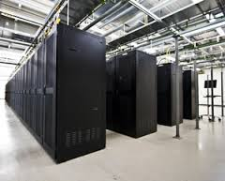
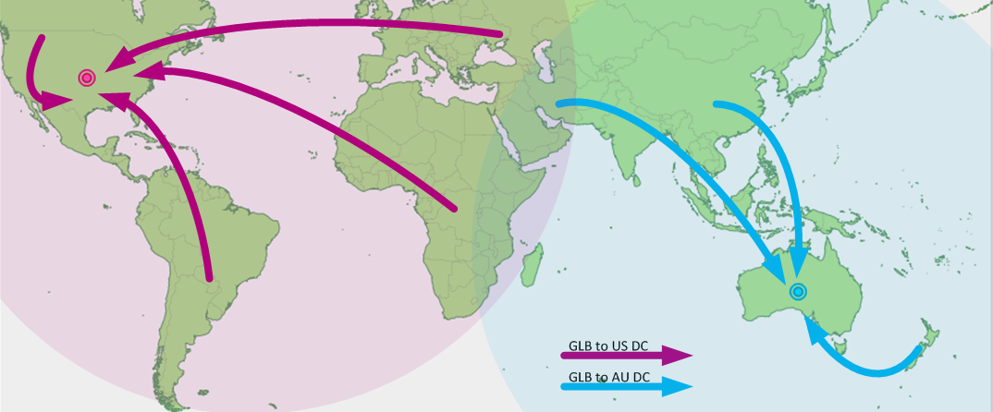
Request Routing: Overview
https://splash.riverbed.com/docs/DOC-1705

Slide 83
Request Routing: Basic Architecture
Site A
Site B
Major components
Server state monitoring
Load (incl. failed or not); what requests it can serve
Network path properties estimation
E.g., bw, delay, loss, network cost between clients and servers
Server assignment alg.
Request direction mechanism
?
Internet
Client
Notes:
What are challenges of each component?

Slide 84
Request Routing: Basic Architecture
server
state
net state: path property between servers/clients
server
selection algorithm
notify client
about selection (direction mech.)
requests

Slide 85
Network Path Properties
Why is the problem difficult?
Scalability: if do measurements, complete measurements grow with N * M, where
N is # of clients
M is # of servers
Complexity/feasibility in computing path metrics
M
N

Slide 86
Network Path Properties: Improve Scalability
Aggregation:
merge a set of IP addresses (reduce N and M)
E.g., when computing path properties, aggregates all clients sharing the same local DNS server
Sampling and prediction
Instead of measuring N*M entries, we measure a subset and predict the unmeasured paths
We will cover it later in the course
M servers
N’~100K local DNS servers
N~all Internet clients

Slide 87
Server Assignment
Why is the problem difficult?
What are potential problems of just sending each new client to the lightest load server?

Slide 88
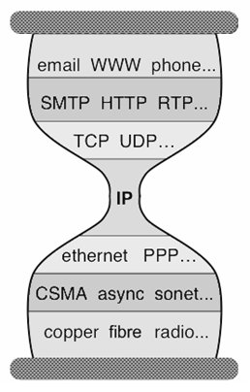
Client Direction Mechanisms
Key difficulty
May need to handle a large of clients
Basic types of mechanisms
Application layer, e.g.,
App/user is given a list of candidate server names
HTTP redirector
DNS: name resolution gives a list of server addresses
IP layer: Same IP address represents multiple physical servers
IP anycast: Same IP address shared by multiple servers and announced at different parts of the Internet. Network directs different clients to different servers
Smart-switch indirection: a server IP address may be a virtual IP address for a cluster of physical servers

Slide 89
Direction Mechanisms are Often Combined
App
DNS name1
DNS name2
IP1
IP2
IPn
Cluster1 in US East
Cluster2
in US West
Cluster2
in Europe
Load
balancer
Load
balancer
proxy
servers

Slide 90
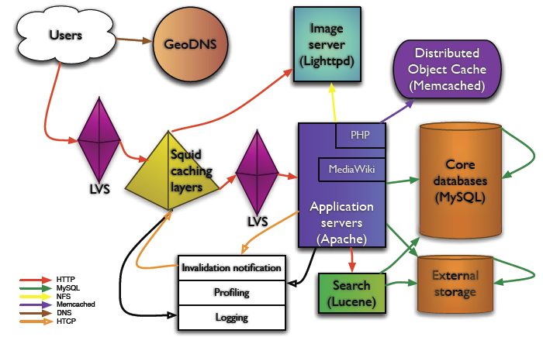
Example: Wikipedia Architecture
http://wikitech.wikimedia.org/images/8/81/Bergsma_-_Wikimedia_architecture_-_2007.pdf

Slide 91
Outline
Recap
Single network server
Multiple network servers
Why multiple servers
Request routing mechanisms
Overview
Application-layer

Slide 92
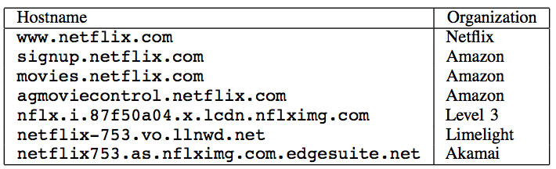
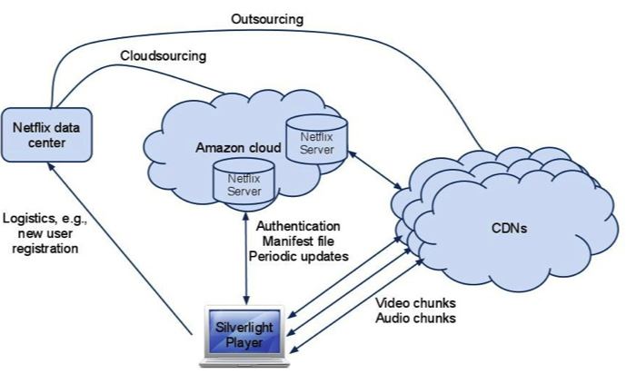
Example: Netflix

Slide 93
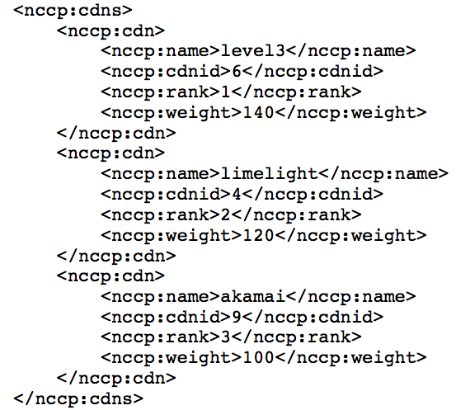
Example: Netflix Manifest File
Client player authenticates and then downloads manifest file from servers at Amazon Cloud

Slide 94
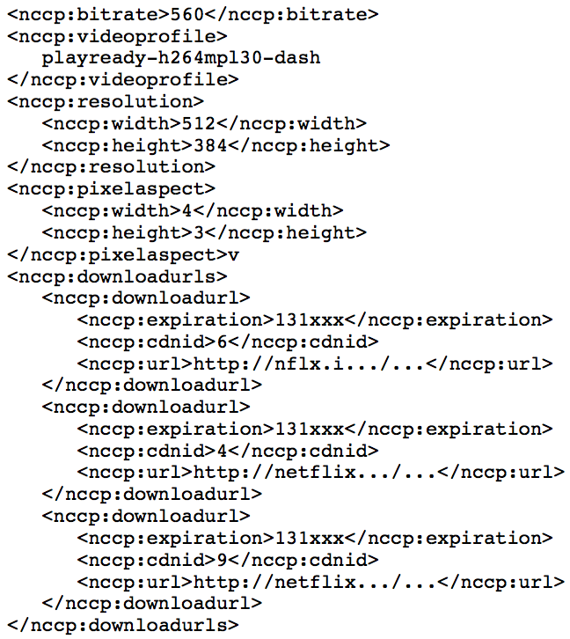
Example: Netflix Manifest File

Slide 95
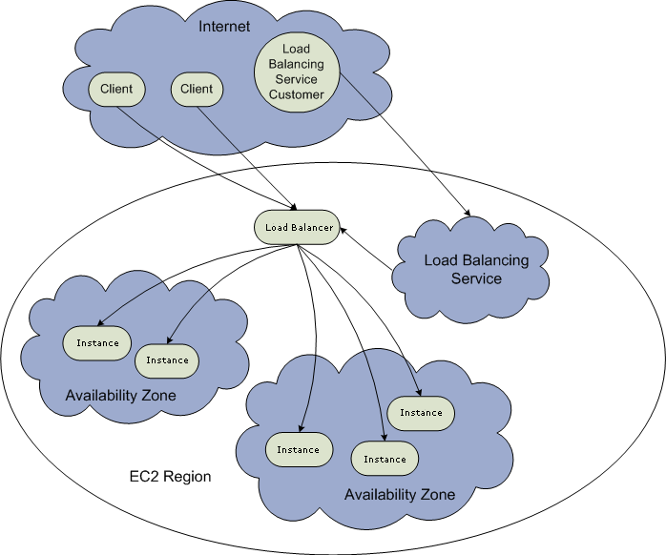
Example: Amazon Elastic Cloud 2 (EC2) Elastic Load Balancing
Use the create-load-balancer command to create an Elastic Load Balancer.
Use the register-instances -with-load-balancer command to register the Amazon EC2 instances that you want to load balance with the Elastic Load Balancer.
Elastic Load Balancing automatically checks the health of your load balancing Amazon EC2 instances. You can optionally customize the health checks by using the configure-healthcheck command.
Traffic to the DNS name provided by the Elastic Load Balancer is automatically distributed across healthy Amazon EC2 instances.
http://docs.aws.amazon.com/ElasticLoadBalancing/latest/DeveloperGuide/elastic-load-balancing.html

Slide 96
Details: Create Load Balancer
The operation returns the DNS name of your LoadBalancer. You can then map that to any other domain name (such as www.mywebsite.com) (how?) %aws elb create-load-balancer --load-balancer-name my-load-balancer --listeners "Protocol=HTTP,LoadBalancerPort=80,InstanceProtocol=HTTP,InstancePort=80" --availability-zones us-west-2a us-west-2b Result:
{ "DNSName": "my-load-balancer-123456789.us-west-2.elb.amazonaws.com”}
http://docs.aws.amazon.com/cli/latest/reference/elb/create-load-balancer.html

Slide 97
Details: Configure Health Check
The operation configures how instances are monitored, e.g., %aws elb configure-health-check --load-balancer-name my-load-balancer --health-check Target=HTTP:80/png,Interval=30,UnhealthyThreshold=2,HealthyThreshold=2,Timeout=3
Result:
{
"HealthCheck": {
"HealthyThreshold": 2,
"Interval": 30,
"Target": "HTTP:80/png",
"Timeout": 3,
"UnhealthyThreshold": 2
}
http://docs.aws.amazon.com/cli/latest/reference/elb/configure-health-check.html

Slide 98
Details: Register Instances
The operation registers instances that can receive traffic, %aws elb register-instances-with-load-balancer --load-balancer-name my-load-balancer --instances i-d6f6fae3
Result:
{ "Instances": [ {"InstanceId": "i-d6f6fae3“},
{"InstanceId": "i-207d9717“},
{"InstanceId": "i-afefb49b“}
]
}
http://docs.aws.amazon.com/cli/latest/reference/elb/register-instances-with-load-balancer.html

Slide 99
Outline
Recap
Single network server
Multiple network servers
Why multiple servers
Request routing mechanisms
Overview
Application-layer
DNS

Slide 100


Basic DNS Indirection and Rotation
%dig cnn.com
157.166.226.25
router
157.166.226.26
IP address
of cnn.com
157.166.255.18
157.166.226.25
157.166.226.26
IP address
of cnn.com
DNS server for cnn.com
157.166.226.26
157.166.226.25

Slide 101
CDN Using DNS (Akamai Architecture as an Example)
Content publisher (e.g., cnn)
provides base HTML documents
runs origin server(s); but delegates heavy-weight content (e.g., images) to CDN
Akamai runs
(~240,000) edge servers for hosting content
Deployment into 130 countries and 1600 networks
Claims 85% Internet users are within a single "network hop" of an Akamai CDN server.
customized DNS redirection servers to select edge servers based on
closeness to client browser, server load
Source: https://www.akamai.com/us/en/about/facts-figures.jsp

Slide 102
Linking to Akamai
Originally, URL Akamaization of embedded content: e.g.,
<IMG SRC= http://www.provider.com/image.gif > changed to
<IMG SRC = http://a661. g.akamai.net/hash/image.gif>
URL Akamaization is becoming obsolete and supported mostly for legacy reasons
Note that this DNS redirection unit is per customer, not individual files.

Slide 103
Exercise
Check any web page of cnn and find a page with an image
Find the URL
Use %dig +trace to see DNS load direction

Slide 104
Akamai Load-Balancing DNS Name
Akamai
e2466.dscg.akamaiedge.net (why two levels in the name?)

Slide 105
Backup Slides

Slide 106
Another view
Events obscure control flow
For programmers and tools
Web Server
Accept Conn.
Threads | Events
thread_main(int sock) { struct session s; accept_conn(sock, &s); read_request(&s); pin_cache(&s); write_response(&s); unpin(&s); } pin_cache(struct session *s) { pin(&s); if( !in_cache(&s) ) read_file(&s); } | AcceptHandler(event e) { struct session *s = new_session(e); RequestHandler.enqueue(s); } RequestHandler(struct session *s) { …; CacheHandler.enqueue(s); } CacheHandler(struct session *s) { pin(s); if( !in_cache(s) ) ReadFileHandler.enqueue(s); else ResponseHandler.enqueue(s); } . . . ExitHandlerr(struct session *s) { …; unpin(&s); free_session(s); }
Read Request
Pin Cache
Read File
Write Response
Exit
[von Behren]

Slide 107
State Management
Events require manual state management
Hard to know when to free
Use GC or risk bugs
Web Server
Accept Conn.
Threads | Events
thread_main(int sock) { struct session s; accept_conn(sock, &s); if( !read_request(&s) ) return; pin_cache(&s); write_response(&s); unpin(&s); } pin_cache(struct session *s) { pin(&s); if( !in_cache(&s) ) read_file(&s); } | CacheHandler(struct session *s) { pin(s); if( !in_cache(s) ) ReadFileHandler.enqueue(s); else ResponseHandler.enqueue(s); } RequestHandler(struct session *s) { …; if( error ) return; CacheHandler.enqueue(s); } . . . ExitHandlerr(struct session *s) { …; unpin(&s); free_session(s); } AcceptHandler(event e) { struct session *s = new_session(e); RequestHandler.enqueue(s); }
Read Request
Pin Cache
Read File
Write Response
Exit
[von Behren]

