Slide 1
Predicting Telecom Customer Churn
A statistical and machine learning approach
Isma Tahir · MSc Computer Science with AI · Keele University · CSC-40080
CSC-40080 · Isma Tahir
1 / 15
Notes:
Hi, I'm Isma. For this project I looked at customer churn in a telecom company, so which customers are likely to leave and what a retention team could do about it.

Slide 2
The business problem
Context
Decision-maker
The decision
A telecom provider with about 7,000 customers in this sample. Roughly 27% of them have left.
The customer retention manager, who has a limited budget for retention offers.
Which customers to contact before they leave.
Keeping a customer costs less than replacing one, and churn hits recurring revenue directly.
(Reichheld and Sasser, 1990)
CSC-40080 · Isma Tahir
2 / 15
Notes:
Churn just means a customer leaving. It matters because the revenue is recurring and winning a new customer costs far more than keeping an old one. The retention manager has to decide where to spend a limited offer budget.

Slide 3
What a useful answer looks like
Evidence
A model
A fair test
Which customer factors are linked to churn, backed by a statistical test.
A classifier that flags at-risk customers better than guessing.
Judged against a simple benchmark, using recall and precision, not accuracy alone.
CSC-40080 · Isma Tahir
3 / 15
Notes:
Data helps because we already know what happened to past customers. A useful answer has evidence about what is linked to churn, and a model that does better than a simple guess.

Slide 4
The data
IBM Telco Customer Churn dataset from Kaggle: 7,043 customers and 21 columns (7,032 after cleaning)
Target: Churn (yes or no)
Features: contract type, tenure, services used, billing and monthly charges
A fictional telecom provider, so I treat it as a realistic example, as the brief allows
SQL used to aggregate churn rate by contract type
(BlastChar, n.d.)
CSC-40080 · Isma Tahir
4 / 15
Notes:
This is a well-known sample dataset, so I'm treating it as a realistic example. I used SQL to group customers by contract and compare churn rates.

Slide 5
Cleaning and preparation
TotalCharges was stored as text. The 11 blank rows were brand new customers with tenure 0, so I dropped them (0.16%)
customerID removed: it identifies customers but does not predict anything
22 duplicate rows kept, as two customers can share every attribute once the ID is removed. No impossible values in tenure or charges
Churn recoded to 1 and 0, categories one-hot encoded
Numeric columns scaled using the training set only, to avoid data leakage
80/20 stratified split keeps the churn ratio the same in both sets
CSC-40080 · Isma Tahir
5 / 15
Notes:
Each choice has a reason. Dropping the 11 rows loses almost nothing. Scaling on the training set only stops information leaking from the test set.

Slide 6
Feature selection
Started from all 19 predictors once the ID was removed
Exploration charts and the statistical tests showed which factors relate to churn
Kept the features so that the models stay interpretable for a manager
Model coefficients and tree importances then show which features matter most
CSC-40080 · Isma Tahir
6 / 15
Notes:
I did not use a formal selection algorithm. I kept the full set so the odds ratios stay readable, and let the models show which features matter.

Slide 7
Methods and why they fit
Chi-square test
Logistic regression
Decision tree
Tests whether contract type and churn are genuinely linked. Suits two categorical variables.
Predicts a yes or no outcome and gives odds ratios a manager can read.
Gives simple if-then rules and captures non-linear patterns that logistic regression can miss.
A Welch t-test also compares monthly charges for customers who left and who stayed.
(Pedregosa et al., 2011)
CSC-40080 · Isma Tahir
7 / 15
Notes:
I picked each method for a reason. The test shows association, logistic regression explains it, and the tree adds rules and non-linear patterns.

Slide 8
Benchmark and metrics
Benchmark
Metrics
Predict that nobody leaves. It is about 73% accurate but catches no churners.
Recall matters most, as missing a churner costs more than a wasted offer. Precision, F1 and a confusion matrix show the trade-off.
Assumptions: independent customers, enough observations per category for chi-square, and class imbalance handled with balanced class weights.
CSC-40080 · Isma Tahir
8 / 15
Notes:
The benchmark makes the point that accuracy alone is misleading when only a quarter of customers churn.

Slide 9
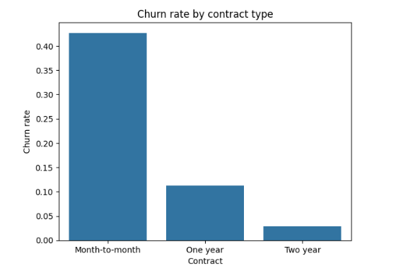
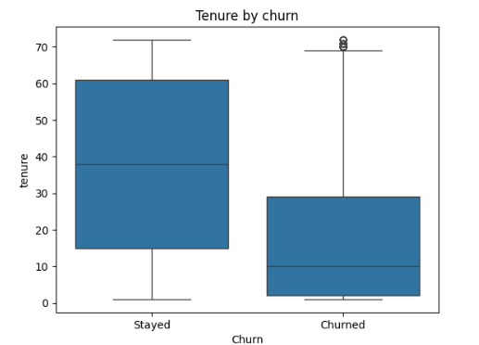
What the data shows
Month-to-month customers churned far more (42.7%) than one-year (11.3%) and two-year (2.8%) customers. Customers who left had much shorter tenure.
CSC-40080 · Isma Tahir
9 / 15
Notes:
Describe the two charts in your own words.

Slide 10
Statistical test results
Test | Result | Meaning
Chi-square: contract vs churn | χ² = 1179.5, df = 2, p < 0.001, Cramér's V = 0.41 | Strong link between contract type and churn, with a large effect size
Welch t-test: monthly charges | t = 18.34, p < 0.001 | Churned customers paid more per month: 74.44 vs 61.31
(Cohen, 1988)
CSC-40080 · Isma Tahir
10 / 15
Notes:
Mention that the chi-square assumption holds (smallest expected count was 391.2) and that the effect size matters as well as the p-value.

Slide 11
Model comparison
Model | Accuracy | Precision (churn) | Recall (churn) | F1 (churn)
Benchmark | 0.73 | 0.00 | 0.00 | 0.00
Logistic regression | 0.73 | 0.49 | 0.79 | 0.61
Decision tree | 0.71 | 0.47 | 0.78 | 0.59
Both models catch about 8 in 10 churners, while the benchmark catches none. Logistic regression is slightly ahead on every measure.
CSC-40080 · Isma Tahir
11 / 15
Notes:
Explain why the benchmark's 73% accuracy is misleading, and what recall and precision mean for the retention team.

Slide 12
What drives churn
Linked to churn
Linked to staying
Fibre optic internet (odds ratio 3.11), electronic check payment (1.51), streaming TV and movies (about 1.45 to 1.47)
Two-year contract (0.23), longer tenure (0.29), one-year contract (0.45)
The decision tree agrees: contract type is its most important feature, followed by fibre optic and tenure. ROC AUC was 0.835 for logistic regression and 0.818 for the tree.
CSC-40080 · Isma Tahir
12 / 15
Notes:
Explain what an odds ratio above or below 1 means.

Slide 13
What this means for the retention manager
Target month-to-month customers first: 42.7% of them churned, against 11.3% and 2.8% on longer contracts
The early months are the riskiest, so reach new customers soon after they sign up
Offer an incentive to move onto a one or two year contract, and look into why fibre optic customers churn more
The model catches about 8 in 10 churners but also flags many who would have stayed (309 false alarms against 297 caught), so an offer has to cost much less than losing a customer
CSC-40080 · Isma Tahir
13 / 15
Notes:
Explain each action in your own words and link it back to the decision on slide 2.

Slide 14
Limitations, evaluation and next steps
Limitations
With more time
A single snapshot in time, no reasons for leaving, class imbalance, fictional US-based data, and association rather than cause.
Cross-validation, a random forest or gradient boosting, tuning the threshold using the real cost of an offer, and testing on newer data.
CSC-40080 · Isma Tahir
14 / 15
Notes:
Be honest about what the analysis can and cannot say.

Slide 15
References
BlastChar (n.d.) Telco Customer Churn [dataset]. Kaggle. Available at: https://www.kaggle.com/datasets/blastchar/telco-customer-churn (Accessed: [add date])
Pedregosa, F. et al. (2011) 'Scikit-learn: machine learning in Python', Journal of Machine Learning Research, 12, pp. 2825–2830.
Reichheld, F.F. and Sasser, W.E. (1990) 'Zero defections: quality comes to services', Harvard Business Review, 68(5), pp. 105–111.
Cohen, J. (1988) Statistical power analysis for the behavioral sciences. 2nd edn. Hillsdale, NJ: Lawrence Erlbaum Associates.
CSC-40080 · Isma Tahir
15 / 15
Notes:
Only keep references you have actually read or used. Check the formatting against Keele's Harvard guide.

Slide 16
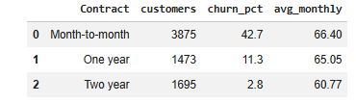
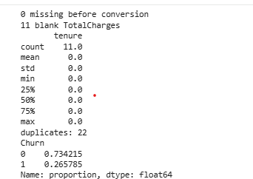
Appendix: data preparation (Cells 2 and 3)
CSC-40080 · Isma Tahir
Appendix
Notes:
Backup screenshots for the SQL and cleaning steps.

Slide 17
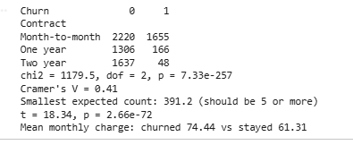
Appendix: statistical tests (Cell 5)
CSC-40080 · Isma Tahir
Appendix
Notes:
Backup screenshot for the statistical tests.

Slide 18
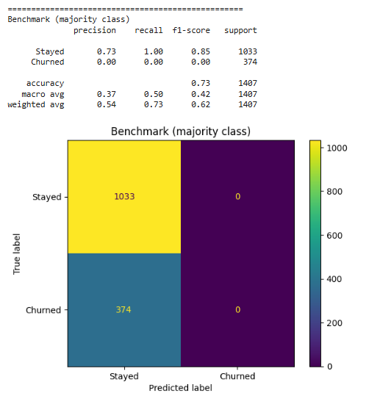
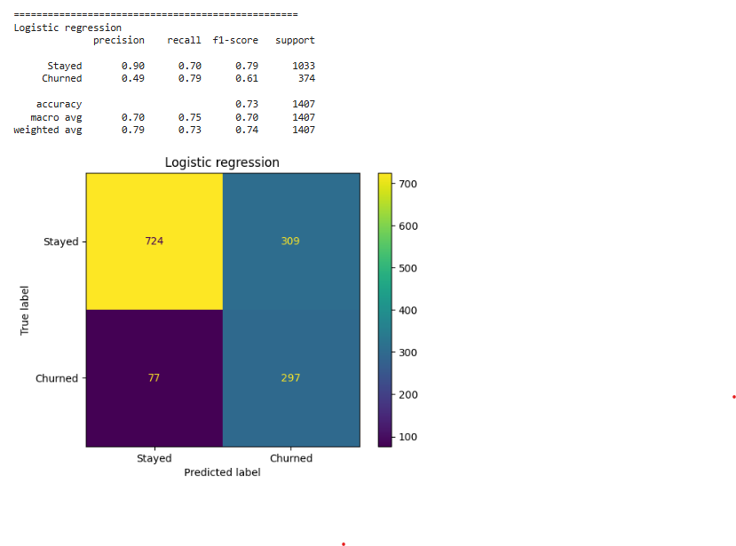
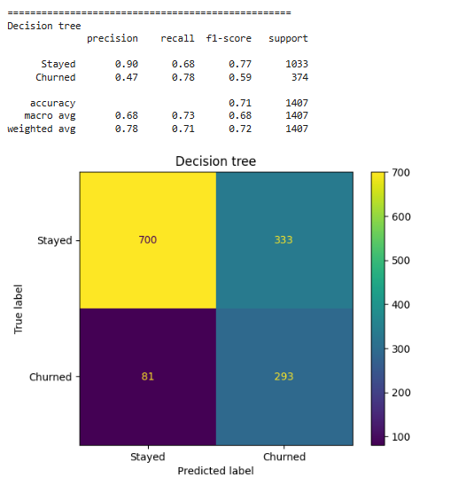
Appendix: model output (Cell 7)
CSC-40080 · Isma Tahir
Appendix
Notes:
Backup screenshots for the three models.

Slide 19
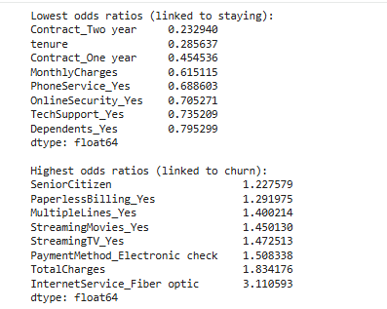
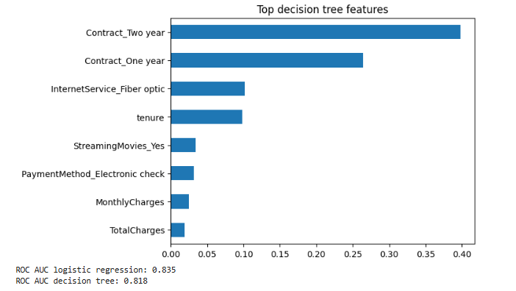
Appendix: what drives churn (Cell 8)
CSC-40080 · Isma Tahir
Appendix
Notes:
Backup screenshots for the odds ratios and tree importances.

