Slide 1
MHA Statistics Workshop
Friday Session – Descriptive Statistics
Amber McIlwain
amcilwain@pacificu.edu

Slide 2
Workshop Agenda
Friday
Saturday
Part I: Introduction
Statistics overview
Part II: Descriptive Statistics
Computing and understanding averages
Understanding variability
Presenting data
Computing correlation coefficients
Introduction to understanding reliability and variability
Part III: “Chance”
Hypothesis testing
Probability
Part IV: Inferential Statistics
Statistically significant
Testing!
Predicting!
More statistical procedures!
Part V: MHA Statistics
For epidemiology
For quality management

Slide 3
In this workshop, you will learn how to…
Collect
Organize
Summarize, and
Interpret data

Slide 4
Introduction
Arthur Benjamin: Teach Statistics before Calculus!
Do you have experience with statistics? Explain, e.g., specific courses, comfort level with the subject.
What do you expect from this workshop?
Reflect on Arthur Benjamin’s TED Talk. What is your response to the question, “why study statistics?”
Frame your response within the context of healthcare administration.

Slide 5
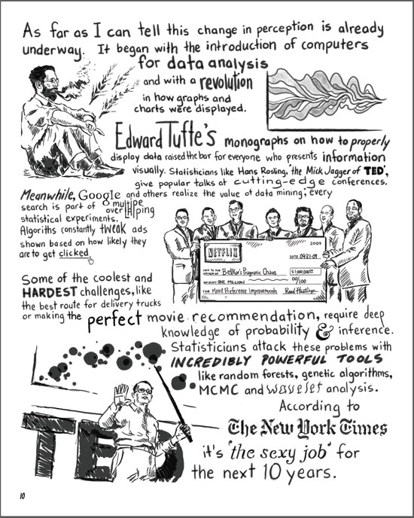
Statistics…
…is a set of tools and techniques used for describing, organizing, and interpreting information or data (Salkind, 2014)
http://www.statisticsblog.com/2012/10/comic-with-stats-discussion/

Slide 6
Statistics
Descriptive Statistics
Inferential Statistics
Used to organize and describe the characteristics of a data set
Used to make inferences from a sample to a population
Descriptive statistics include any treatment of data that does not involve generalizations, predictions, or estimations. Once generalizations, estimations, and predictions are involved, the analysis is inferential.

Slide 7
Computing and Understanding Averages
In this section, you will learn about…
Measures of central tendency
Computing the mean for a set of scores
Computing the median for a set of scores
Computing the mode for a set of scores
Selecting a measure of central tendency

Slide 8
Measures of Central Tendency
The AVERAGE is a single score that best represents a set of scores
Another name for AVERAGE is measure of central tendency
MEASURES OF CENTRAL TENDENCY
MEAN | MEDIAN | MODE

Slide 9

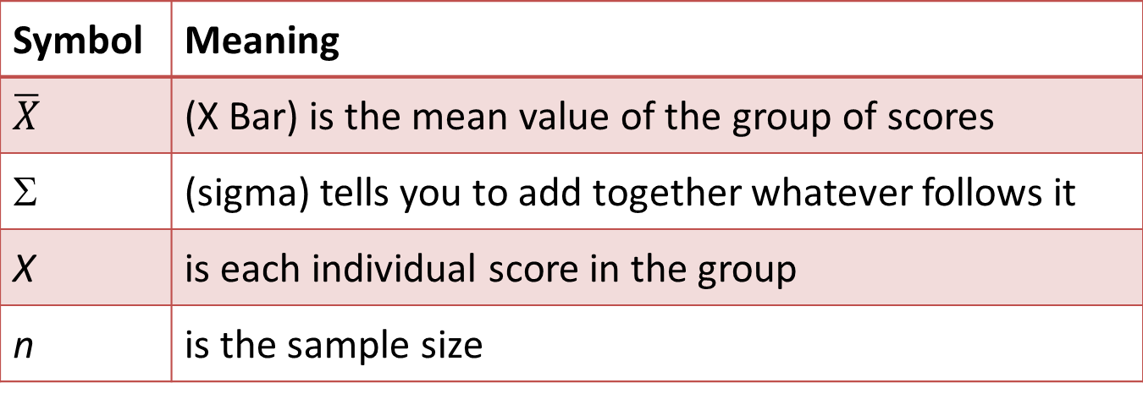
Computing the Mean
mean = sum of all scores/number of scores
$$\overline{X}=\frac{\sum{X}}{n}$$
Symbol | Meaning
$$\overline{X}$$ | (X Bar) is the mean value of the group of scores
Σ | (sigma) tells you to add together whatever follows it
X | is each individual score in the group
n | is the sample size

Slide 10
Computing the Mean
List the entire set of values in one or more columns
Compute the sum or total of all the values
Divide the total or sum by the number of values
Example: Use these data to calculate the average wage rate of the employees.
Sum
Employee | Hours | Wage
1 | 20 | $15.00
2 | 40 | $18.00
3 | 35 | $12.00
4 | 30 | $20.00
5 | 37 | $14.00
6 | 25 | $23.00
$15 + $18 + $12 + $20 + $14 + $23 = $102
$102/6 = $17 average wage rate
Divide by n

Slide 11
Things to remember…
Sample mean is a measure of central tendency that best represents the population mean
n = sample size, N = population size
The mean is the centermost point where all values on one side of the mean are equal in weight to all values on the other side of the mean
Mean is VERY sensitive to extreme scores (outliers) that can “skew” or distort findings

Slide 12
Weighted Mean
List all values for which the mean is being calculated (list them only once)
List the frequency (number of times) that value appears
Multiply the value by the frequency
Sum all Value x Frequency
Divide by the total Frequency (total n size)

Slide 13
Median
Point at which 50% of scores fall below it and 50% fall above it
Steps in finding the median…
List the values, in order, either from highest to lowest or lowest to highest.
Find the middle-most score. That’s the median.
What if there are two middle scores?
What if the two middle scores are the same?

Slide 14
A little about Percentiles…
Percentiles divide data in 100 equal parts
Percentile ranks are used to define percent of cases equal to and below a certain point on a distribution
75th percentile – means that the score received is at or above 75 % of all other scores in the distribution
Median is always at the 50th percentile

Slide 15
Things to remember…
The mean is the middle point of a set of values, while the median is the middle point of a set of cases
Because the median cares about the number of cases, extreme scores (i.e., outliers) do not impact it

Slide 16
Computing the Mode
Mode = most frequently occurring score
The least precise measure of central tendency
When two values occur the same number of times—bimodal distribution
Steps to finding the mode
List all values in the distribution
Tally the number of times each value occurs
The value occurring the most is the mode

Slide 17
When to use what…
Use mode when the data are qualitative, categorical, or nominal (e.g., eye color, political party) and values can only fit into one category (i.e., mutually-exclusive)
Use median when you have extreme scores
Use mean when the data does not include extreme scores (i.e., outliers) and are not qualitative, categorical, or nominal
Measures of Central Tendency for Wage Data

Slide 18
Understanding Variability
In this section, you will learn about…
Why variability is valuable as a descriptive tool
How to compute the range, the standard deviation, and the variance
How the standard deviation and variance are alike, and how they are different

Slide 19
Importance of Variability
Variability reflects how scores differ from one another (specifically the mean)
Measures of variability (aka spread, dispersion)
Range
Standard deviation
Variance
*You typically report the average and the variability together to describe a distribution

Slide 20
Computing the Range
Range is the most general estimate of variability
There are 2 types of range—the more commonly used is the exclusive range
Exclusive range: range = h – l
Inclusive range: range = h – l + 1
Note: h = highest score, l = lowest score

Slide 21
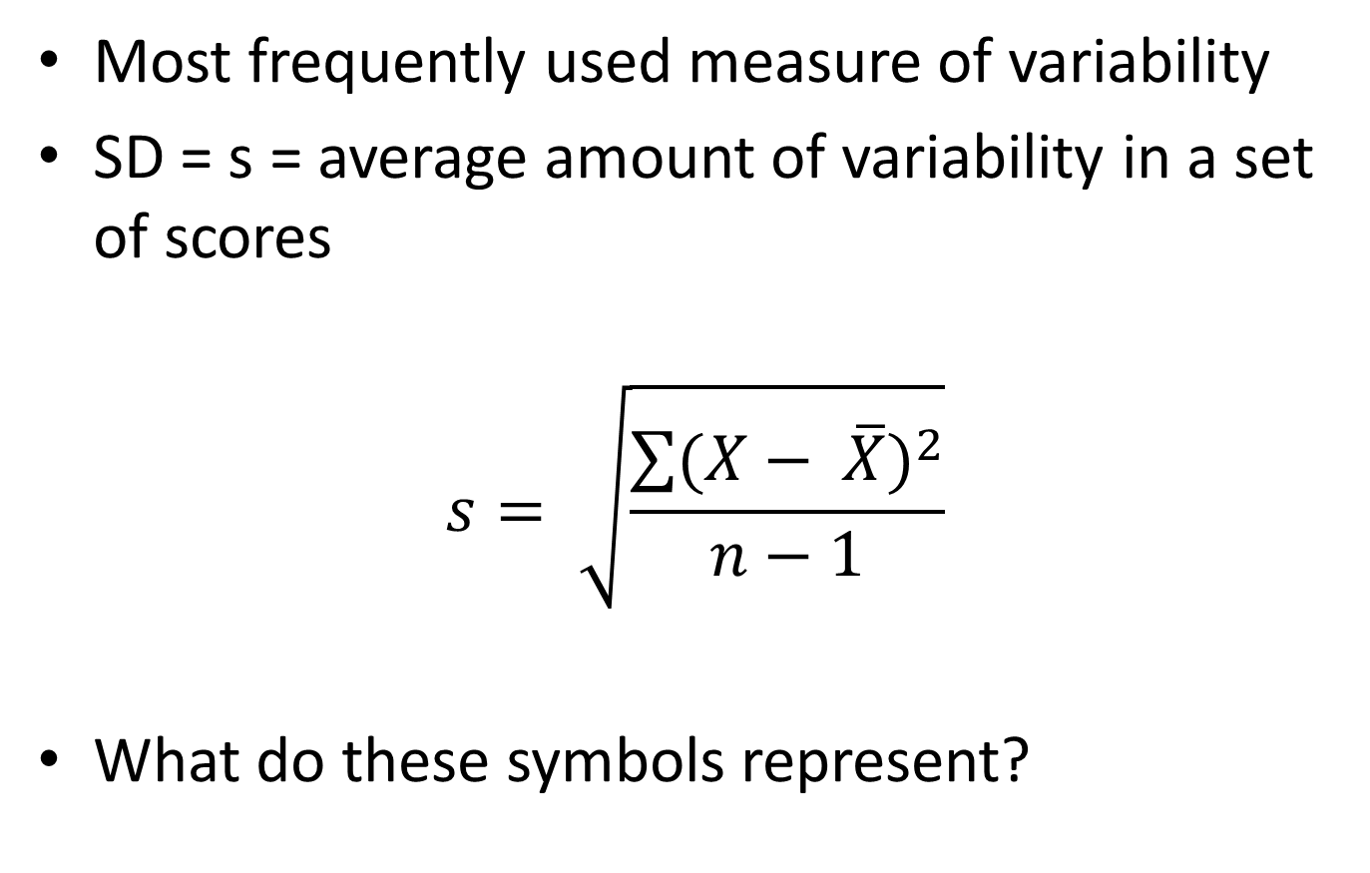
Computing Standard Deviation
Most frequently used measure of variability
SD = s = average amount of variability in a set of scores
$$s= \sqrt{\frac{\sum{{(X− \overline{X})}^{2}}}{n−1}}$$
What do these symbols represent?

Slide 22
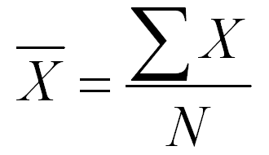
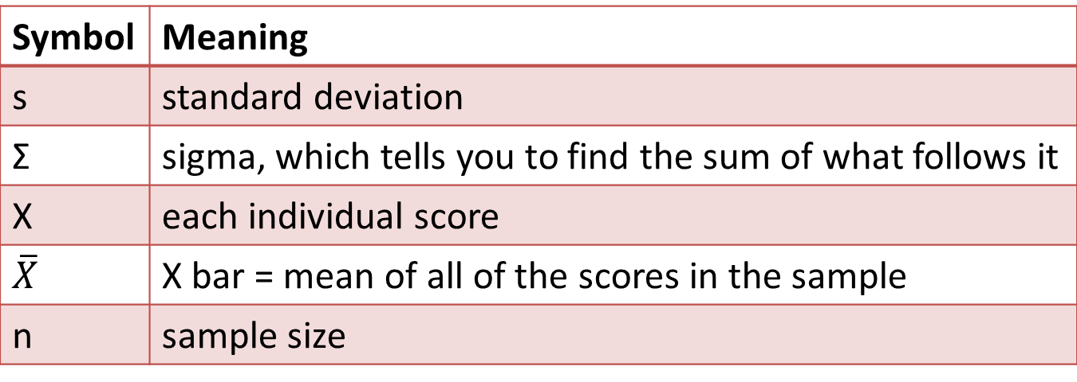
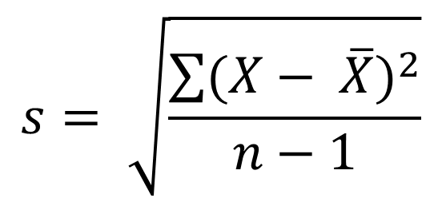
Important Symbols
deviation score
$$s= \sqrt{\frac{\sum{{(X− \overline{X})}^{2}}}{n−1}}$$
Look familiar?
Symbol | Meaning
s | standard deviation
Σ | sigma, which tells you to find the sum of what follows it
X | each individual score
$$\overline{X}$$ | X bar = mean of all of the scores in the sample
n | sample size

Slide 23
Computing Standard Deviation
Calculate the mean
Subtract the mean from each observation, and square the difference
Sum the squared difference
Divide the sum of the squared differences by n–1
Take the square root of the value obtained in step 4 (the result is the standard deviation)

Slide 24
Computing Standard Deviation e.g., incubation periods for hepatitis A: 27, 31, 15, 30, 22 days
Calculate the arithmetic mean.
Mean = (27 + 31 + 15 + 30 +22) / 5 = 125 / 5 = 25.0
Subtract the mean from each observation. Square the difference.
value – mean | difference | difference squared
27 – 25 | +2 | 4
31 – 25 | +6 | 36
15 – 25 | -10 | 100
30 – 25 | +5 | 25
22 – 25 | -3 | 9

Slide 25
Computing Standard Deviation e.g., incubation periods for hepatitis A: 27, 31, 15, 30, 22 days
Sum the squared differences
Sum = 4 + 36 + 100 + 25 + 9 =174
Divide the sum of the squared differences by (n – 1). This is the variance.
Variance = 174 / (5 – 1) = 174 / 4 = 43.5 days squared
Take the square root of the variance. The result is the standard deviation.
Standard deviation = square root of 43.5 = 6.6 days

Slide 26
Things to remember…
Standard deviation is computed as the average distance from the mean
The larger the standard deviation the more spread out the values are
Like the mean, the standard deviation is sensitive to extreme scores
If s = 0, then there is no variability among scores and the scores are essentially identical in value

Slide 27
Analogy—Mean and Standard Deviation
The site for a new school was selected because it provides a central location. An alternative site on the west side of town was considered, but rejected because it would require extensive busing for students living on the east side. The location represents the mean; just as the school is located at the center of town, the mean is located in the center of a distribution of scores. For each student, it is possible to measure the distance between home and the new school. Some students live only a few blocks from the new school and others lives as much as 3 miles away. Let’s say the average distance a student must travel to school was calculated to be 0.8 miles. The average distance from school represents standard deviation, which measures the standard distance from an individual score to the mean.

Slide 28
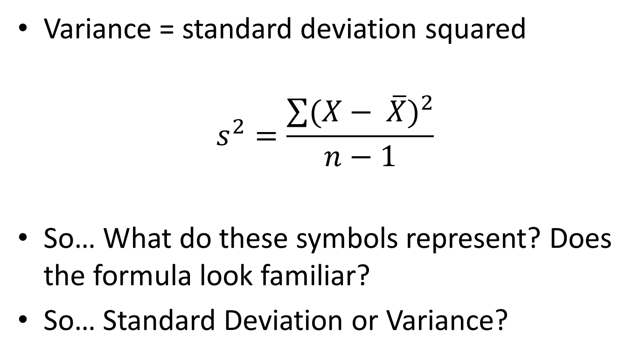
Computing Variance
Variance = standard deviation squared
$$s^{2}=\frac{\sum{{(X− \overline{X})}^{2}}}{n−1}$$
So… What do these symbols represent? Does the formula look familiar?
So… Standard Deviation or Variance?

Slide 29
Presenting Data
In this section, you will learn about…
Why “pictures are worth a thousand words”
Different types of charts and their uses
Using Excel to create figures

Slide 30
Why illustrate data?
Hans Rosling: The best stats you’ve ever seen
Did Rosling’s data displays and commentary hold your interest and/or help you understand the information? Why or why not?
How Governments Can Better Use Data Visualization (examples of poor graphical representations)
Pick 1 to analyze—Describe why the graph is not effective. Discuss ways in which the data might have been presented in a more effective way.

Slide 31
Discussion—about data
Do you have access to data at work?
If so, what kind of data? How do you use it?
What kind of information do you derive when working with this data?

Slide 32
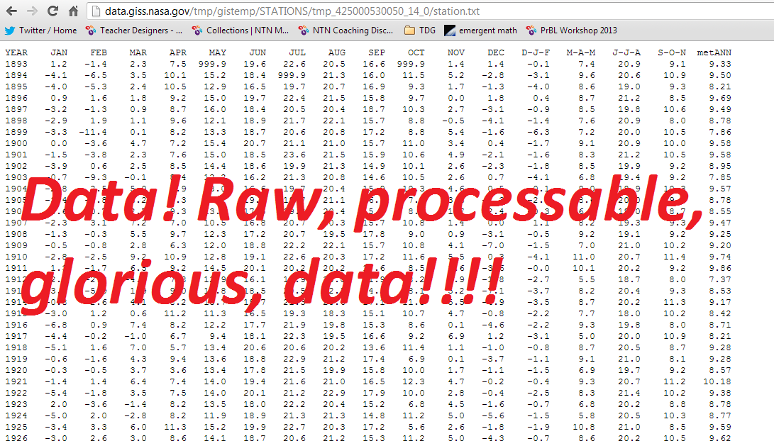
What does raw data tell you? A: nothing!
Source: http://emergentmath.com/2013/03/06/how-does-one-provide-the-complex-data-of-global-warming-to-students/

Slide 33
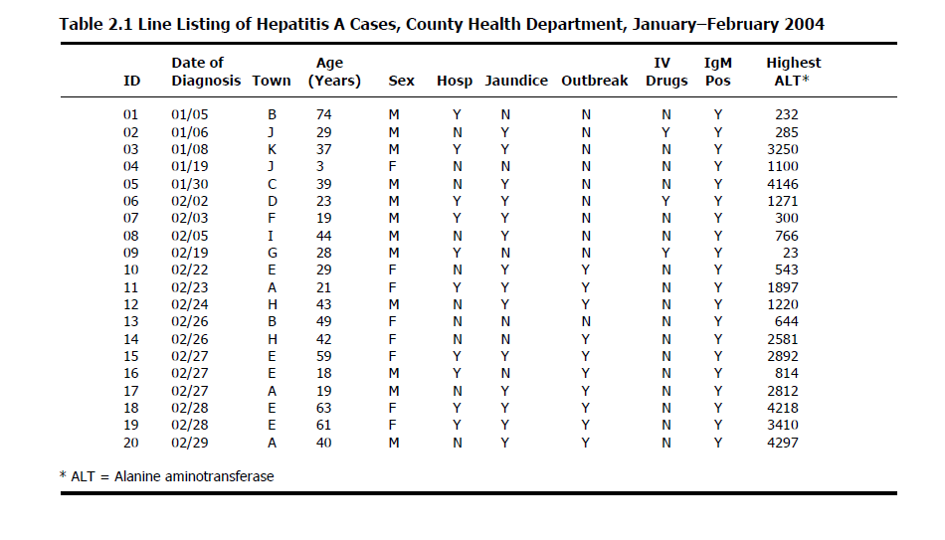
Organizing Data
Column = Variable
Row = Case, Record, Observation
Value (of variable) – qualitative or quantitative; levels of measurement (nominal, ordinal, interval, ratio)
Variables contain info about one characteristic of a case
(variable: measurable characteristic that varies)

Slide 34
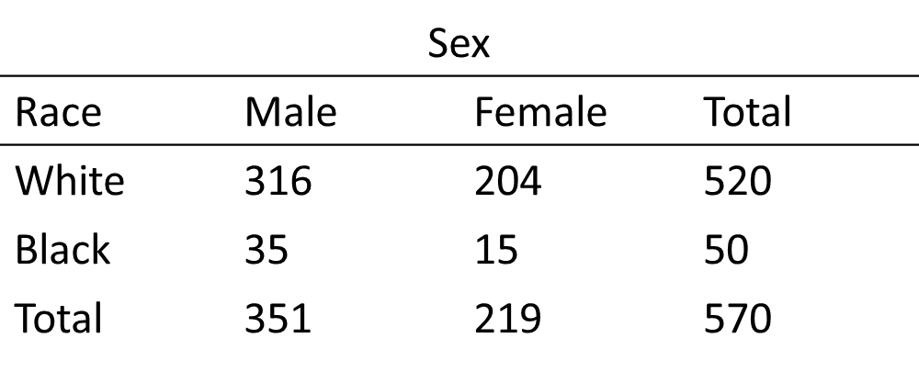
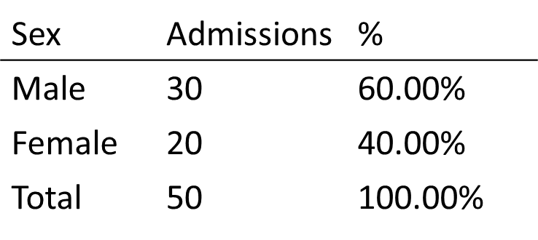
Frequency Distribution
Method of tallying, and representing the number of times a certain score occurs
If necessary, group scores into interval classes/ranges
Frequency distribution tables
The most basic is a frequency distribution with one variable, e.g., hospital admissions, by sex:
Data can be tabulated to show counts by 2 or 3 variables, for instance age and sex
2-variable table that is cross-tabulated is a 2x2 contingency table, e.g., classifying “lung cancer patients” on 2 variables, race and sex:

Slide 35
Frequency Distribution
Male | 12
Female | 8
How many of the cases are male?

Slide 36
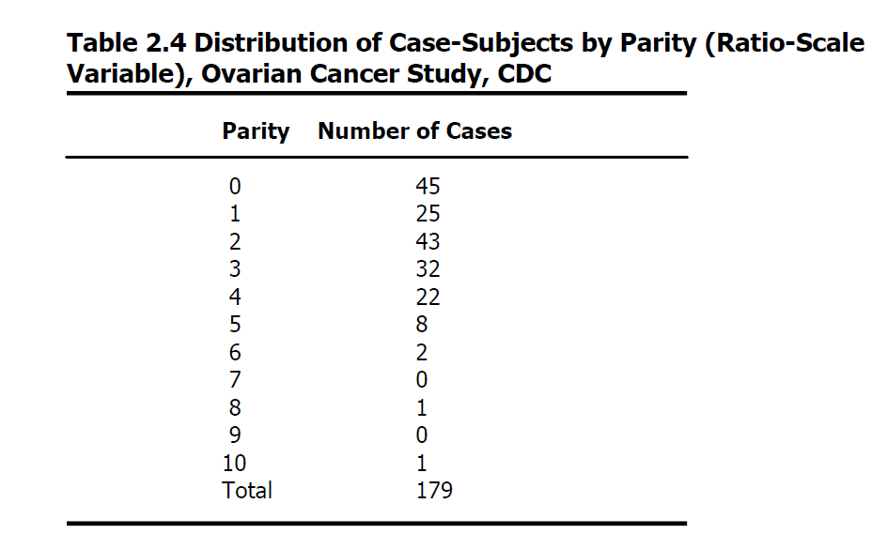
Frequency Distribution
Example: large dataset from study of women with ovarian cancer—let’s look at parity
To construct a frequency table to display this data
List all values that the variable “parity” can take, from lowest value to highest (e.g., 0, 1, 2, 3… )
For each value, record the number of women who had that number of births

Slide 37
Frequency Distribution
At an influenza immunization clinic, residents of a retirement community were asked in how many previous years they had received an influenza vaccine. These are the answers from the first 19 residents:
2, 0, 3, 1, 0, 1, 2, 2, 4, 8, 1, 3, 3, 12, 1, 6, 2, 5, 1
Organize these data into a frequency distribution.
Previous Years | Residents
0-2 | 11
3-5 | 5
6-8 | 2
9-12 | 1
Total | 19
https://youtu.be/jbaXnT5CX18

Slide 38
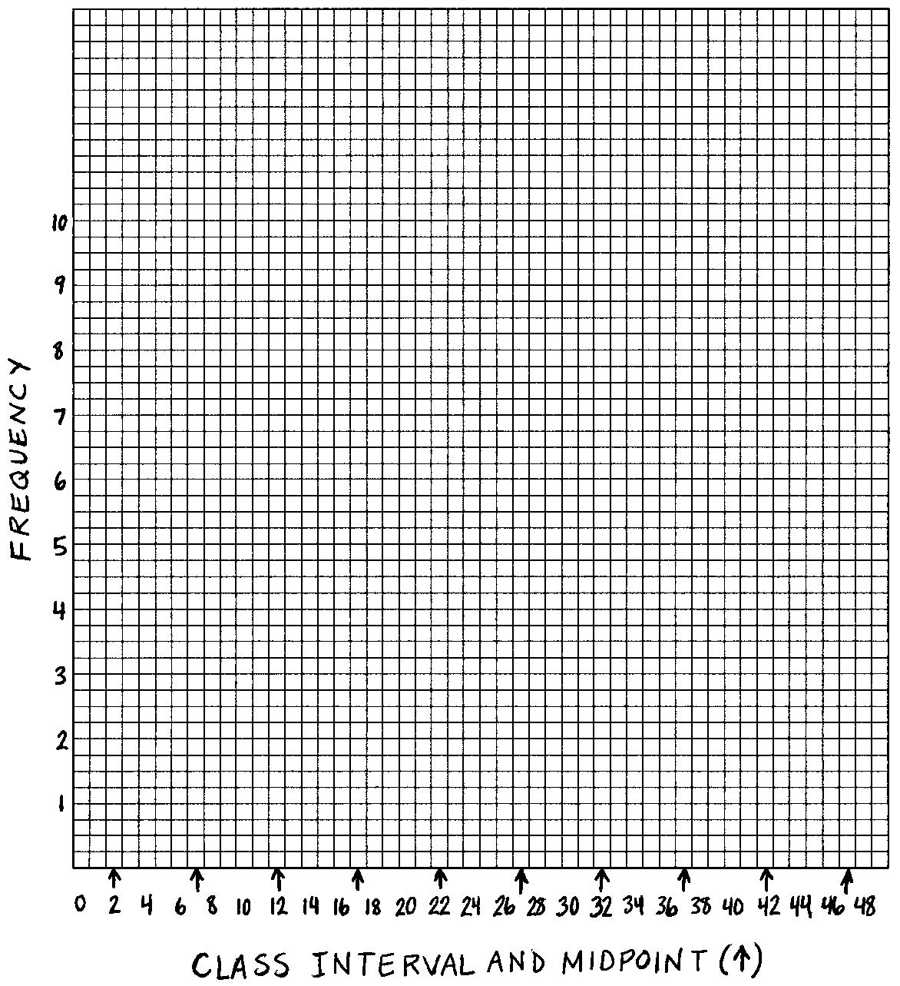
Creating a Histogram
Class intervals along x-axis
Place values at equal distances along the x-axis
Identify the midpoint of each class interval by adding the top and bottom values of the class interval and dividing by 2 (e.g., the midpoint of the class interval 0-4 is the average of 0 and 4, or 4/2 = 2)

Slide 39
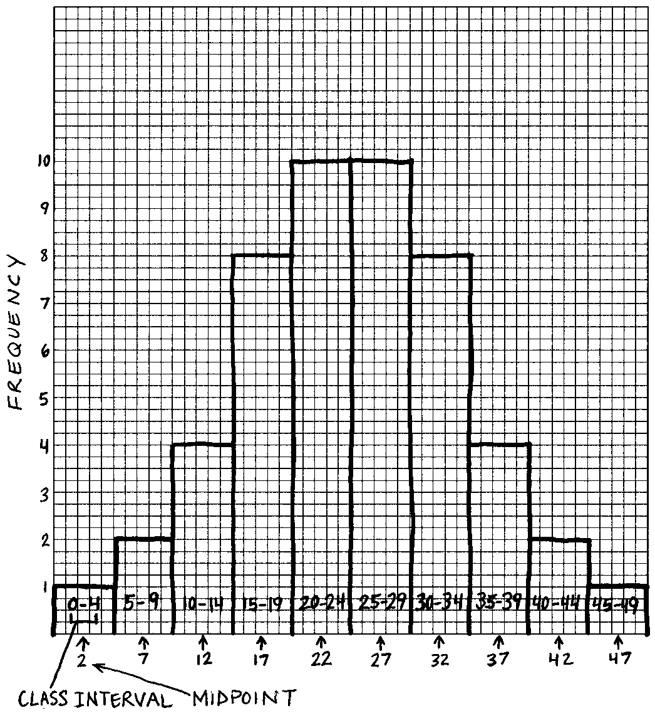
Creating a Histogram
Draw a bar/column around each midpoint that represents the entire class interval to the height representing the frequency of that class
Notice how each class interval is presented by a range of scores along the x-axis

Slide 40
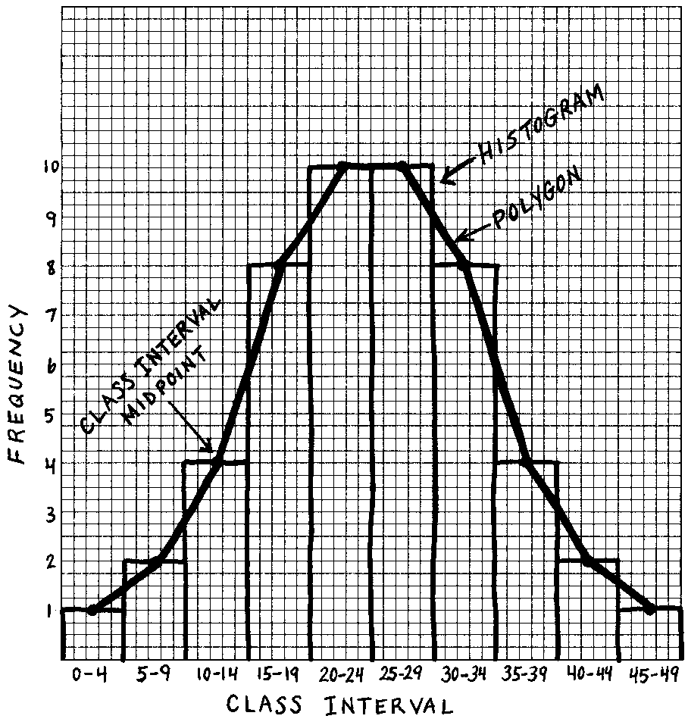
Frequency Polygon
A continuous line that represents the frequencies of scores within a class interval

Slide 41
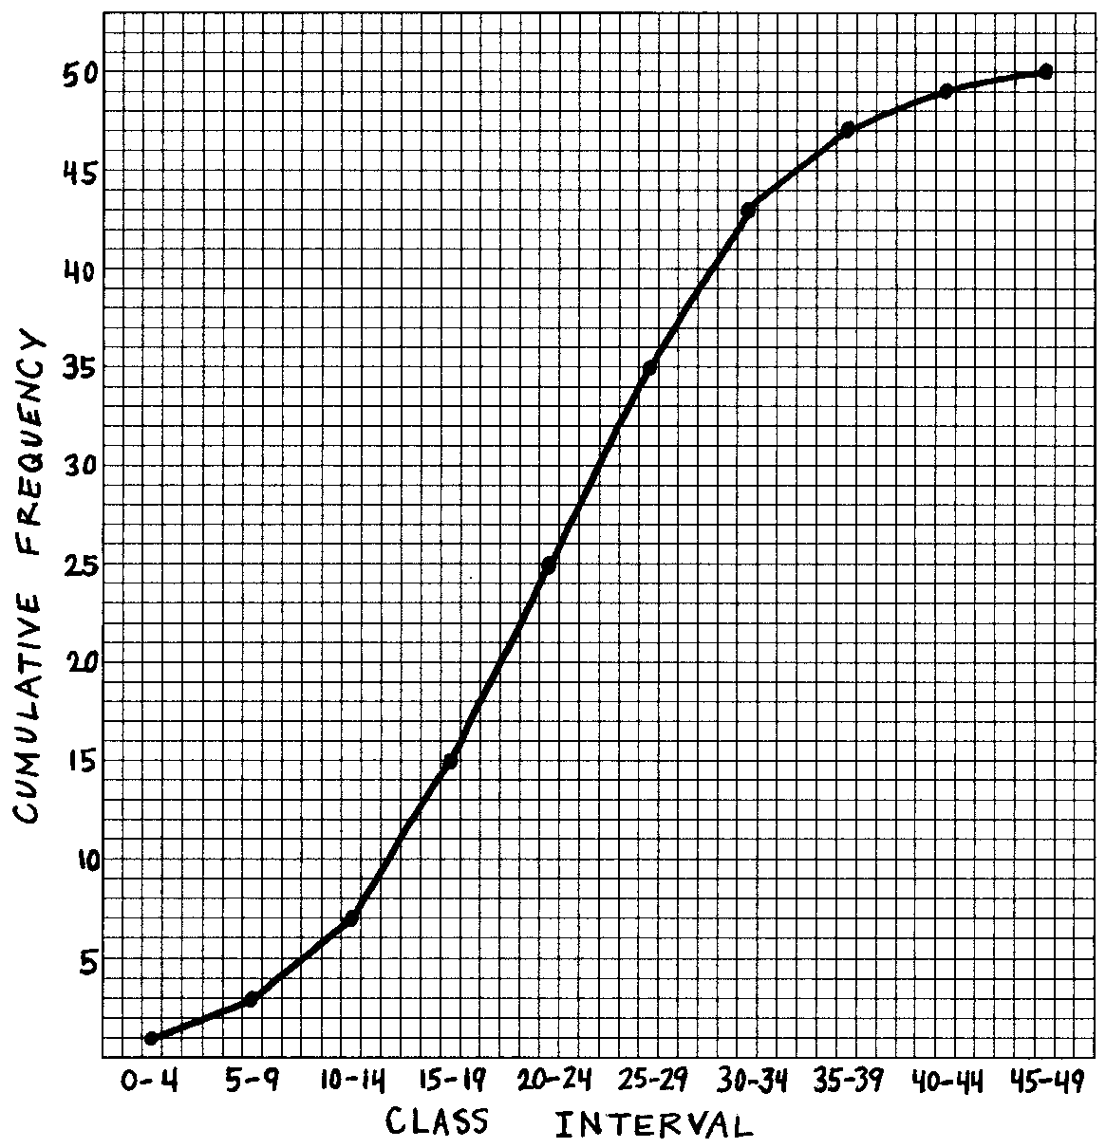
Cumulative Frequency Distribution
Much less common than the histogram, a cumulative frequency distribution can be graphed to illustrate the cumulative frequency of occurrences by class intervals.
Creating one requires a third column (cumulative frequency) to the data table
This type of graph is sometimes called an ogive

Slide 42
Distributions can differ in 4 ways…
Average value
Variability
Skewness
Kurtosis

Slide 43
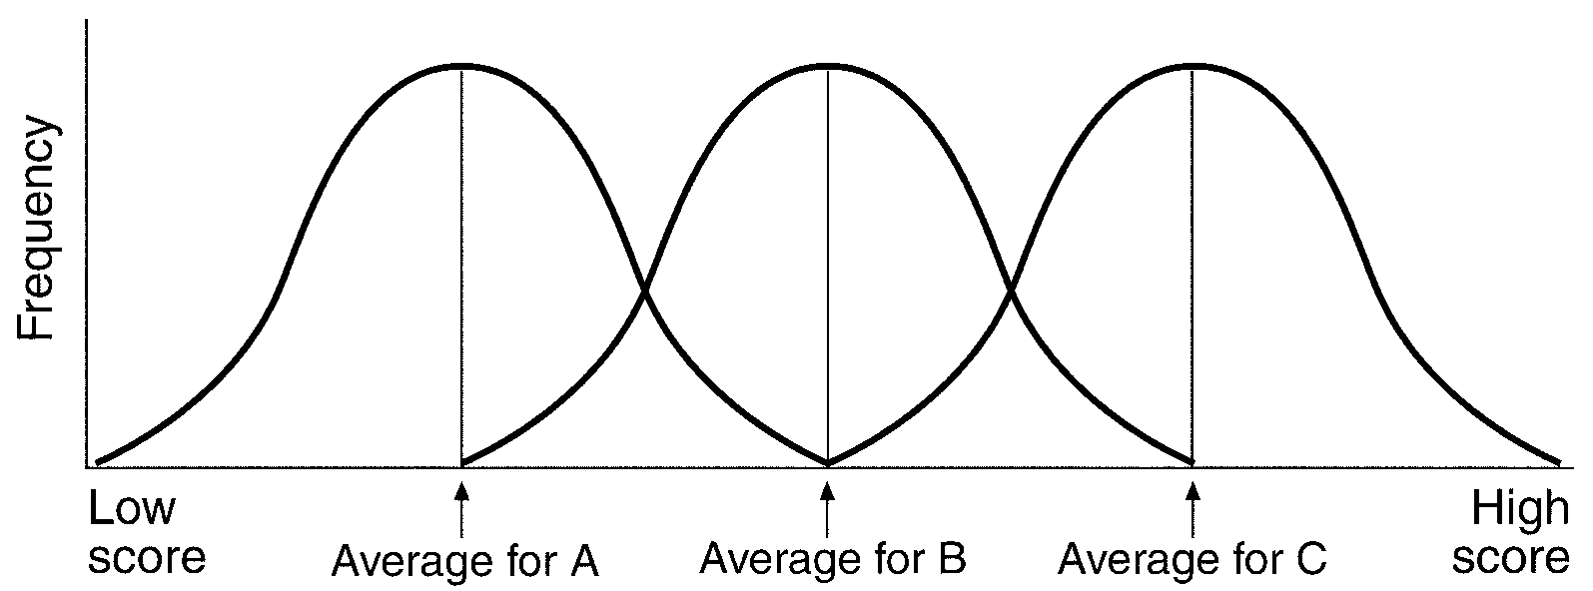
Average Value

Slide 44
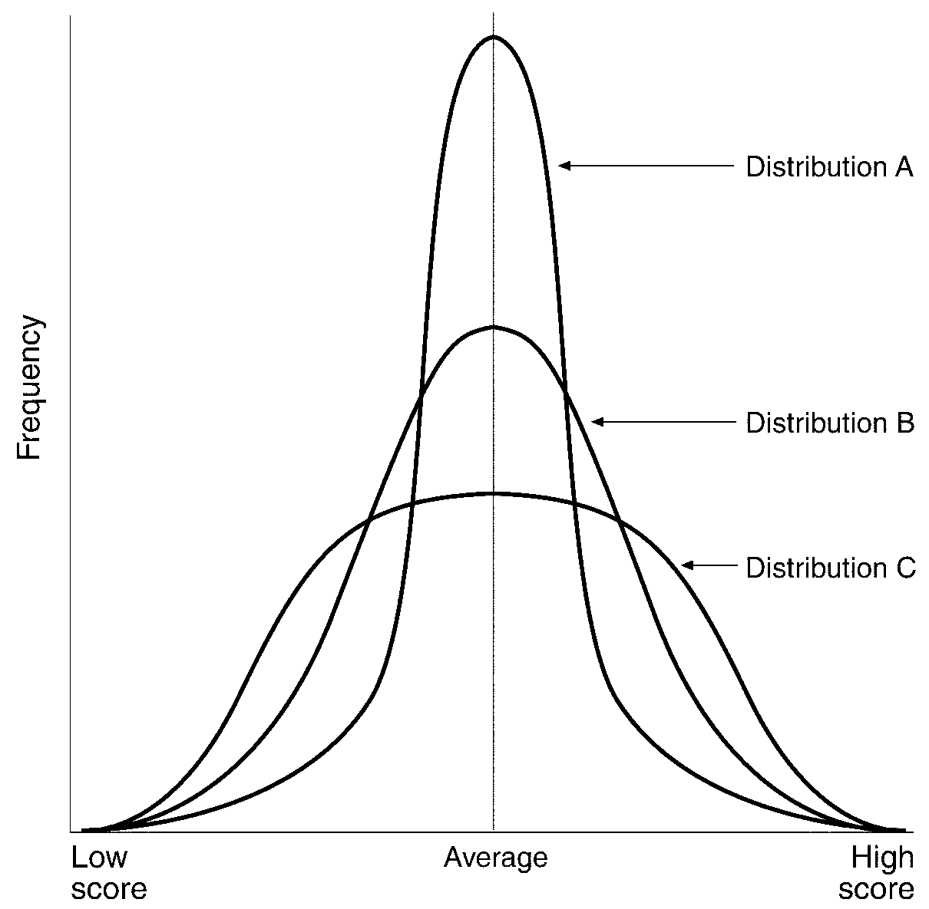
Variability

Slide 45
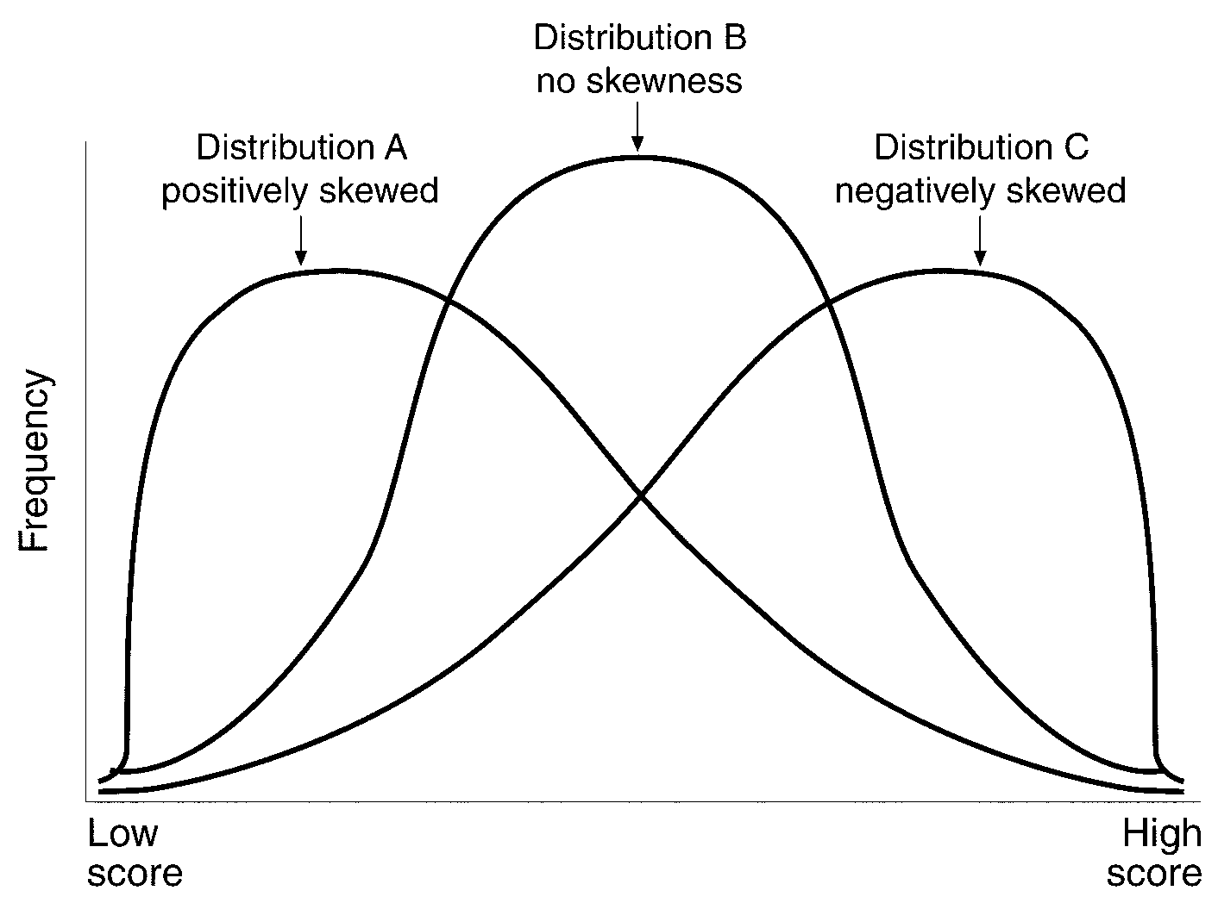
Skewness

Slide 46
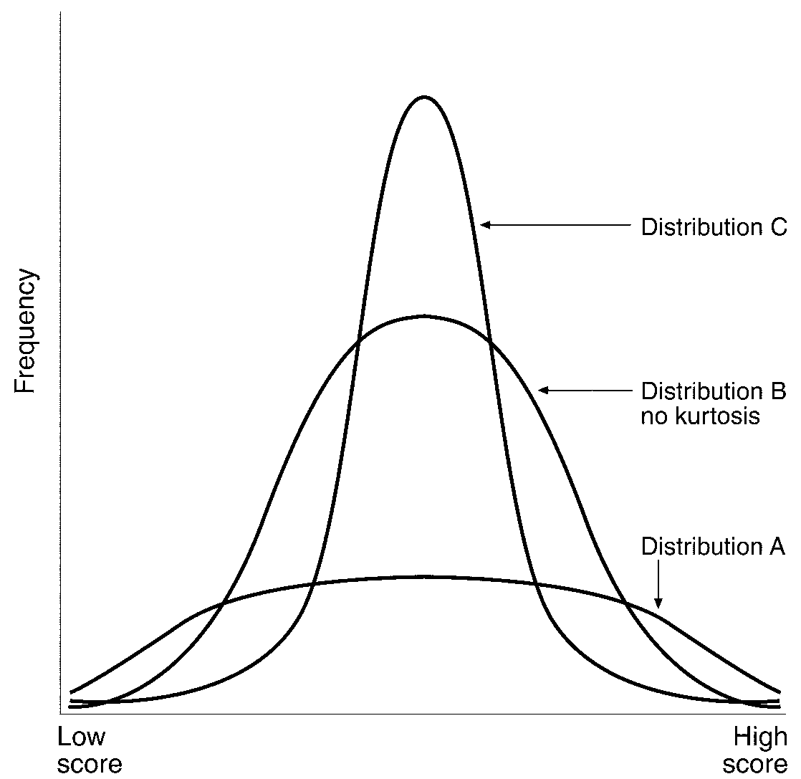
Kurtosis

Slide 47
Presenting Data in Figures
Column and bar graphs
Line graphs
Pie charts
Presenting Health Care Data in Visual Displays

Slide 48
Discussion—data display
Create a quick one-question poll of your fellow classmates.
Display the data in an appropriate chart.
Is a pie chart an appropriate choice? What about a column graph?

Slide 49
Computing Correlation Coefficients
In this section, you will learn about…
What correlations are and how they work
How to compute a simple correlation coefficient
How to interpret the value of the correlation coefficient
What other types of correlations exist

Slide 50
What correlations are about…
r_{XY} = correlation between X and Y
Examines the relationship between variables with values ranging from -1 to +1
How the value of one variable changes in relation to changes in another variable
Bivariate correlation (2 variables)
Pearson product-moment correlation examines the relationship between two continuous variables

Slide 51
Discrete vs. Continuous Variables
Discrete variables have a finite number of distinct and separate categories (integers, i.e., whole numbers, not fractions)
Examples:
Household size
Number of missing teeth
Hospital admissions
Continuous variables can take on an infinite number of values (these can take on factional values, e.g., 98.6)
Examples:
Age
Height
Weight

Slide 52
Types of Correlation Coefficients
Positive Correlation
direct correlation
When one variable increases the other variable also increases
Negative Correlation
indirect correlation
When one variable increases and the other decreases

Slide 53
Things to remember
Correlations…
Range in value from -1 to +1
Absolute value indicates strength
Reflect situation where there are at least two data points
May want to use “indirect” and “direct” instead of “positive” and “negative” to keep from assigning value to the relationship

Slide 54
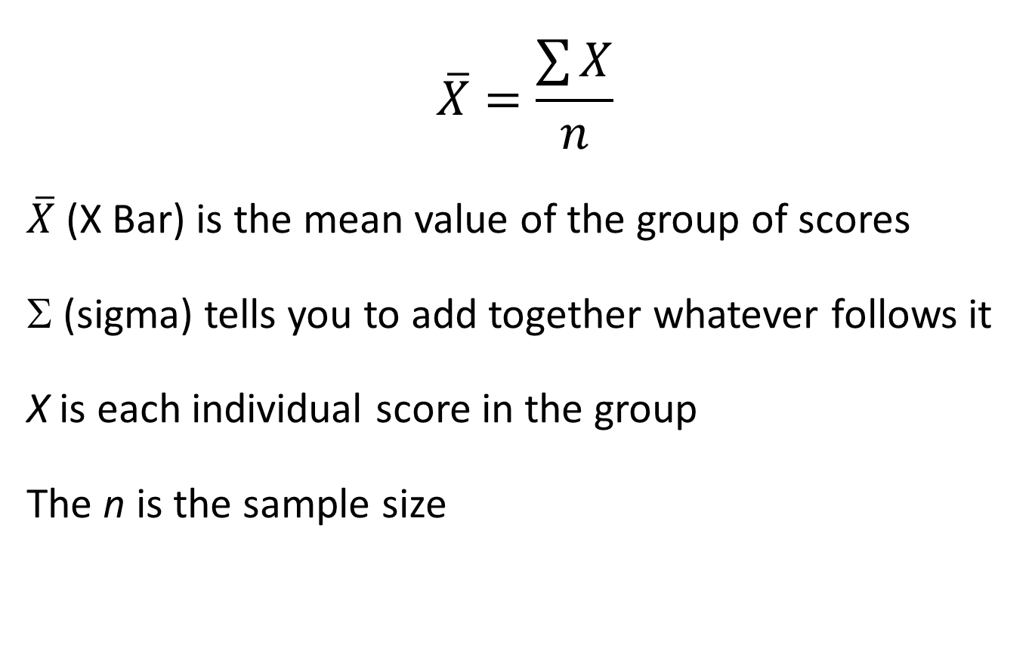
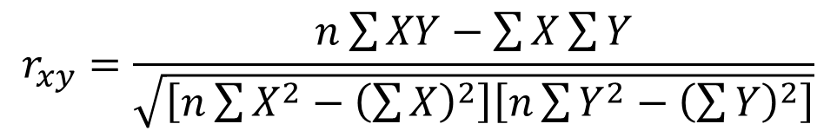
Computing Simple Correlations
Pearson product-moment…
What do these symbols represent?
$$r_{xy}=\frac{n\sum{XY}−\sum{X}\sum{Y}}{\sqrt{\left[n\sum{X^{2}−{\left(\sum{X}\right)}^{2}}\right]\left[n\sum{Y^{2}}−{\left(\sum{Y}\right)}^{2}\right]}}$$
$$r_{xy}=\frac{n\sum{XY}−\sum{X}\sum{Y}}{\sqrt{\left[n\sum{X^{2}−{\left(\sum{X}\right)}^{2}}\right]\left[n\sum{Y^{2}}−{\left(\sum{Y}\right)}^{2}\right]}}$$

Slide 55
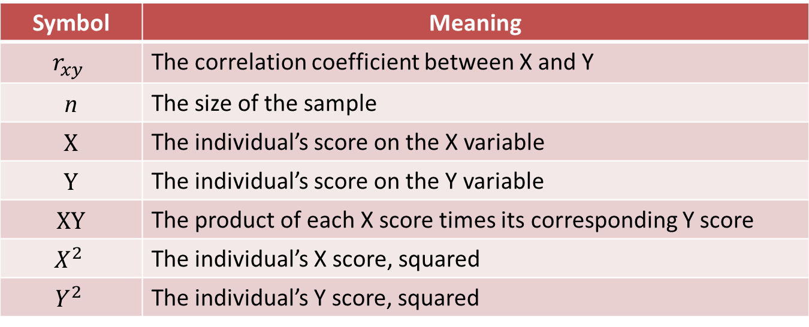
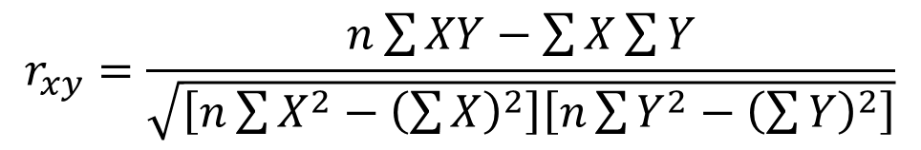
Computing Simple Correlations
$$r_{xy}=\frac{n\sum{XY}−\sum{X}\sum{Y}}{\sqrt{\left[n\sum{X^{2}−{\left(\sum{X}\right)}^{2}}\right]\left[n\sum{Y^{2}}−{\left(\sum{Y}\right)}^{2}\right]}}$$
Symbol | Meaning
$$r_{xy}$$ | The correlation coefficient between X and Y
n | The size of the sample
X | The individual’s score on the X variable
Y | The individual’s score on the Y variable
XY | The product of each X score times its corresponding Y score
$$X^{2}$$ | The individual’s X score, squared
$$Y^{2}$$ | The individual’s Y score, squared

Slide 56
Steps in Computation
List the two values for each participant
Compute the sum of X values, and compute the sum of Y values
Square the X values, and square the Y values
Find the sum of the XY products
Now “plug” these values into the formula
SEE…It’s EASY!! (but VERY time consuming)

Slide 57
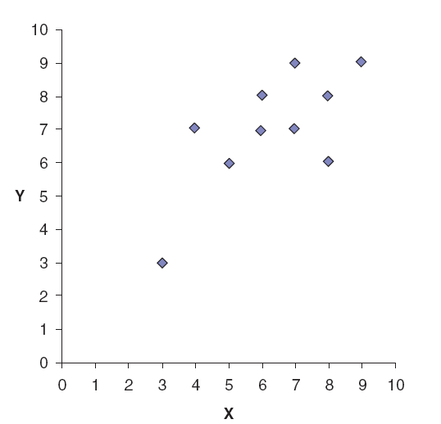
Visual Picture: The Scatterplot

Slide 58
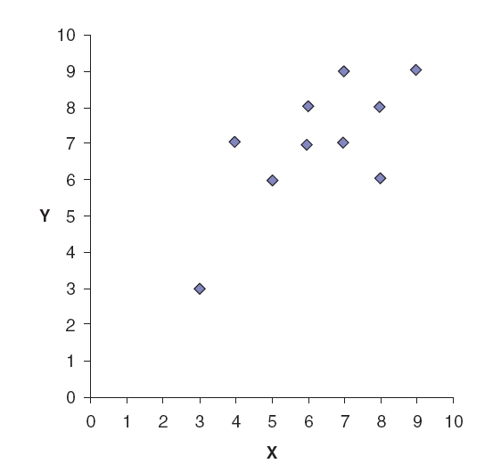
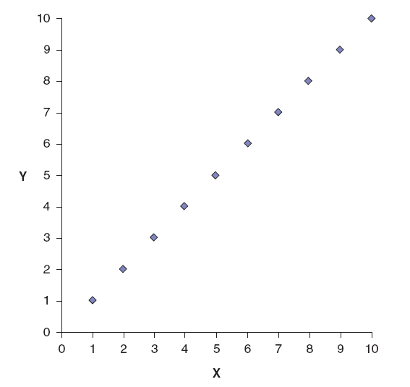
Strong Positive Relationship

Slide 59
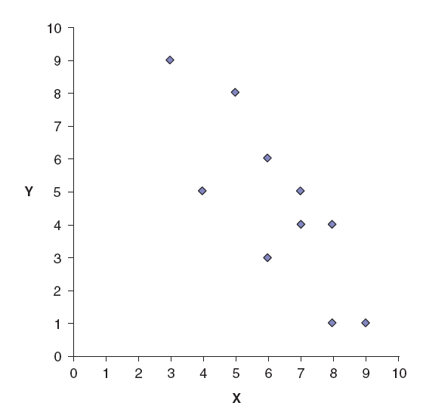
Strong Negative Relationship

Slide 60
Correlation Matrix
 | Income | Education | Attitude | Vote
Income | 1.00 | 0.574 | -0.08 | -0.291
Education |  | 1.00 | -0.149 | -0.199
Attitude |  |  | 1.00 | -0.169
Vote |  |  |  | 1.00

Slide 61
Rule of Thumb
Size of the Correlation | Coefficient General Interpretation
0.8 to 1.0 | Very strong relationship
0.6 to 0.8 | Strong relationship
0.4 to 0.6 | Moderate relationship
0.2 to 0.4 | Weak relationship
0.0 to 0.2 | Weak or no relationship

Slide 62
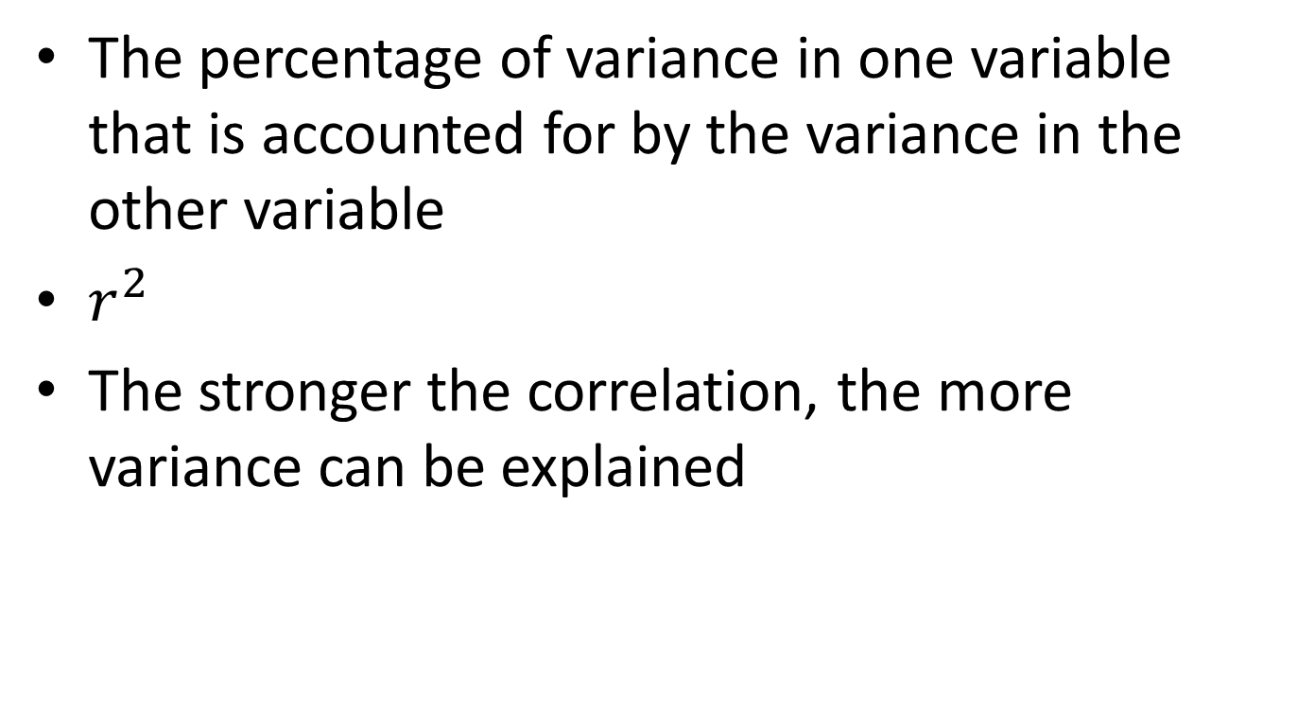
Coefficient of Determination
The percentage of variance in one variable that is accounted for by the variance in the other variable
$r^{2}$
The stronger the correlation, the more variance can be explained

Slide 63

Coefficient of Nondetermination
The amount of unexplained variance
Also known as the Coefficient of Alienation
$1−r^{2}$

Slide 64
Correlation Activity
Generate a list of 30 words.
Calculate the correlation between word length (number of letters) and number of syllables.
Is this a positive or negative relationship?
What does that tell you about the relationship between the length of a word and the number of syllables?
Compare this value to those of your classmates. Why do you think your results are different?
Using the data from your words, create a scatterplot.
Do you see a positive or negative relationship?
What does this tell you about the relationship between the length of a word and the number of syllables?
How tightly packed are the data points along a straight line?
Compare your scatterplot to those of your classmates. How similar or different are they? Do you spot any outliers in your data set?

Slide 65
An Introduction to Understanding Reliability and Validity
In this section, you will learn about…
What reliability and validity are and why they are important
This is a stats workshop! What’s up with this measurement stuff?
The basic measurement scales
How to compute and interpret various types of reliability coefficients
How to compute and interpret various types of validity coefficients

Slide 66
What’s up with this measurement stuff?!!
Validity means that the test, scale, instrument, etc., measures what it is supposed to.
Reliability means that the test, scale, instrument, etc. is consistent in measuring what it was designed to measure.
Dependent variable is what the researcher looks at to see whether any changes has occurred as a function of the treatment that has taken place.
Independent variable is what the researcher manipulates in the experiment (i.e., the treatment).

Slide 67
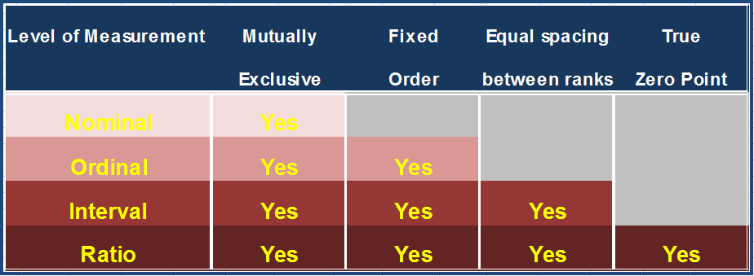
Scales of Measurement
Data falls into 1 of 4 scales of measurement:

Slide 68
Nominal
Characteristics of an outcome that fits one and only one category
Mutually exclusive categories such as city of birth (i.e., a person can only be born in one city).
Categories cannot be ordered meaningfully
Least precise level of measurement

Slide 69
Ordinal
Characteristics being measured are ordered
Rankings such as #1, #2, #3
You know that a higher rank is better, but not by how much

Slide 70
Interval
Test or tool is based on an underlying continuum that allows you to talk about how much higher one score is than another
Intervals along the scale are equal to one another
The 0 on the scale does not mean the absence of the item (e.g., degrees Fahrenheit).

Slide 71
Ratio
Characterized by the presence of absolute zero on the scale
An absence of any of the trait being measured
Examples of a ratio level of measurement includes that of weight and pulse.

Slide 72
Things to remember…
Any outcome can be assigned one of four scales of measurement
Scales of measures have an order
The “higher” up the scale of measurement, the more precise the data
More precise scales contain all of the qualities of the scales below it

Slide 73
Reliability
Reliability is whether a test, or whatever you use as a measurement tool, measures something consistently.

Slide 74
Test Scores
Observed score: what you actually get on a test (e.g., 89 or 65)
True score: the true, 100% accurate reflection of what you really know
Rarely are the observed and true scores the same.

Slide 75
Observed Score = True Score + Error Score
The error score is the difference between the observed score and the true score.
Sources of error include testing situations or conditions that impact the obtained score rather than the qualities of the trait being measured
Example: the temperature of the room if it impacts the test score

Slide 76
Types of Reliability
Test-Retest: Measure of Stability of a Test Over Time
Parallel Forms: Measure of Equivalence of Multiple Forms of a Test
Internal Consistency
Measure of Consistency of the Test Items
Cronbach’s Alpha (coefficient alpha)
Inter-Rater: Measure of Agreement Among Raters

Slide 77
How Big is Big?
When interpreting reliability coefficients, you want two things:
The reliability coefficients to be positive and not to be negative
Reliability coefficients that are as large as possible (between .00 and +1.00)

Slide 78
Establishing Reliability
Standardize instructions
Increase the number of items
Delete unclear items
Make the test not too easy or too hard
Reduce the effects of external distractions

Slide 79
What is the Truth?
A valid test is one that measures what it is supposed to measure
The three most commonly used types of validity are:
content validity
criterion validity
predictive criterion validity
concurrent criterion validity
construct validity

Slide 80
Content Validity
Property of a test such that the test items sample the universe of items for which the test is designed
How to Establish…
Content Expert
Do items represent all possible items?
How well do the number of items reflect what was taught?

Slide 81
Criterion Validity
A type of validity that examines how well a test reflects some criterion that exists in either the present (concurrent) or the future (predictive)
Concurrent Criterion Validity: how well a test outcome is consistent with a criterion that exists in the present
Predictive Criterion Validity: how consistent a test outcome is with a criterion that occurs in the future

Slide 82
Construct Validity
How well a test reflects an underlying idea, such as intelligence or aggression
Most interesting…most difficult source of validity to establish
Want your construct to correlate with related behaviors and not correlate with behaviors that are not related

Slide 83
And if you can’t establish validity… Then what?
If your test does not measure what you want it to, you will probably have to rewrite it
Consult a content expert, examine the criterion you have selected, and look at the theoretical rationale that underlies the test

Slide 84
Validity and Reliability
Really close cousins
A test can be reliable but not valid
A test cannot be valid unless it is reliable because if a test does what it is supposed to, then it has to do it consistently to work

Slide 85
Activity
Describe a test that is not reliable, and another that is not valid.

