Slide 1
MHA Statistics Workshop
Saturday Session – Inferential Statistics
Amber McIlwain
amcilwain@pacificu.edu

Slide 2
Workshop Agenda
Friday
Saturday
Part I: Introduction
Statistics overview
Part II: Descriptive Statistics
Computing and understanding averages
Understanding variability
Presenting data
Computing correlation coefficients
Introduction to understanding reliability and variability
Part III: “Chance”
Hypothesis testing
Probability
Part IV: Inferential Statistics
Statistically significant
Testing!
Predicting!
More statistical procedures!
Part V: MHA Statistics
For epidemiology
For quality management

Slide 3
Hypothesis Testing
In this section, you will learn about…
The difference between a sample and a population
The importance of the null and research hypothesis
The criteria for judging a good hypothesis

Slide 4
What is a hypothesis?
An “educated guess”
Role: to reflect the general problem statement or question that is driving the research
Translates the problem or research question into a form that can be tested.

Slide 5
Samples and Populations
Population: The large group to which you would like to generalize your findings
Sample: The smaller, representative group of the population that is used to do the research
Sampling error: a measure of how well a sample represents the population

Slide 6
The Null Hypothesis
Statements that contain two or more things that are equal (unrelated) to one another
H₀ : μ₁ = μ₂
The starting point and is accepted as true without knowing more information
Benchmark to compare actual outcomes

Slide 7
The Research Hypothesis
Statement that there is a relationship between two variables
There are two types of research hypotheses
Non directional
Directional

Slide 8
Non directional Research Hypotheses
H₁ : X₁ ≠ X₂
Reflects a difference, but the direction is not specified
Tested with a two-tailed test

Slide 9
Directional Research Hypotheses
H₁ : X₁ > X₂ H₁ : X₁ < X₂
Reflects a difference and the direction is specified
Tested with a one-tailed test

Slide 10
Differences Between Null and Research Hypotheses
Null | Research
No relationship between variables | Relationship between variables
Refers to the population | Refers to the sample
Indirectly tested | Directly tested
Written using Greek symbols | Written using Roman symbols
Implied hypothesis | Explicit hypothesis

Slide 11
What Makes a Good Hypothesis?
In sum, good hypotheses should be:
stated in declarative form,
positing a relationship between variables,
reflecting a theory or a body of literature on which they are based,
brief and to the point, and
testable.

Slide 12
Are Your Curves Normal? Probability and Why it Counts
In this section, you will learn about…
Why understanding probability is basic to the understanding of statistics
What the normal, or bell-shaped, curve is and what its characteristics are
How to compute and interpret z scores

Slide 13
Why Probability?
The normal curve
provides us with a basis of understanding the probability associated with any possible outcome
is the basis for determining the degree of confidence that an outcome is “true”
Example: Are changes in student scores due to a particular intervention that took place or by chance alone?

Slide 14
The Normal Curve
A.K.A. the Bell-Shaped Curve
Visual representation of a distribution of scores
Three characteristics…
Mean, median, and mode are equal to one another
Perfectly symmetrical about the mean
Tails are asymptotic (get closer to horizontal axis but never touch it)

Slide 15
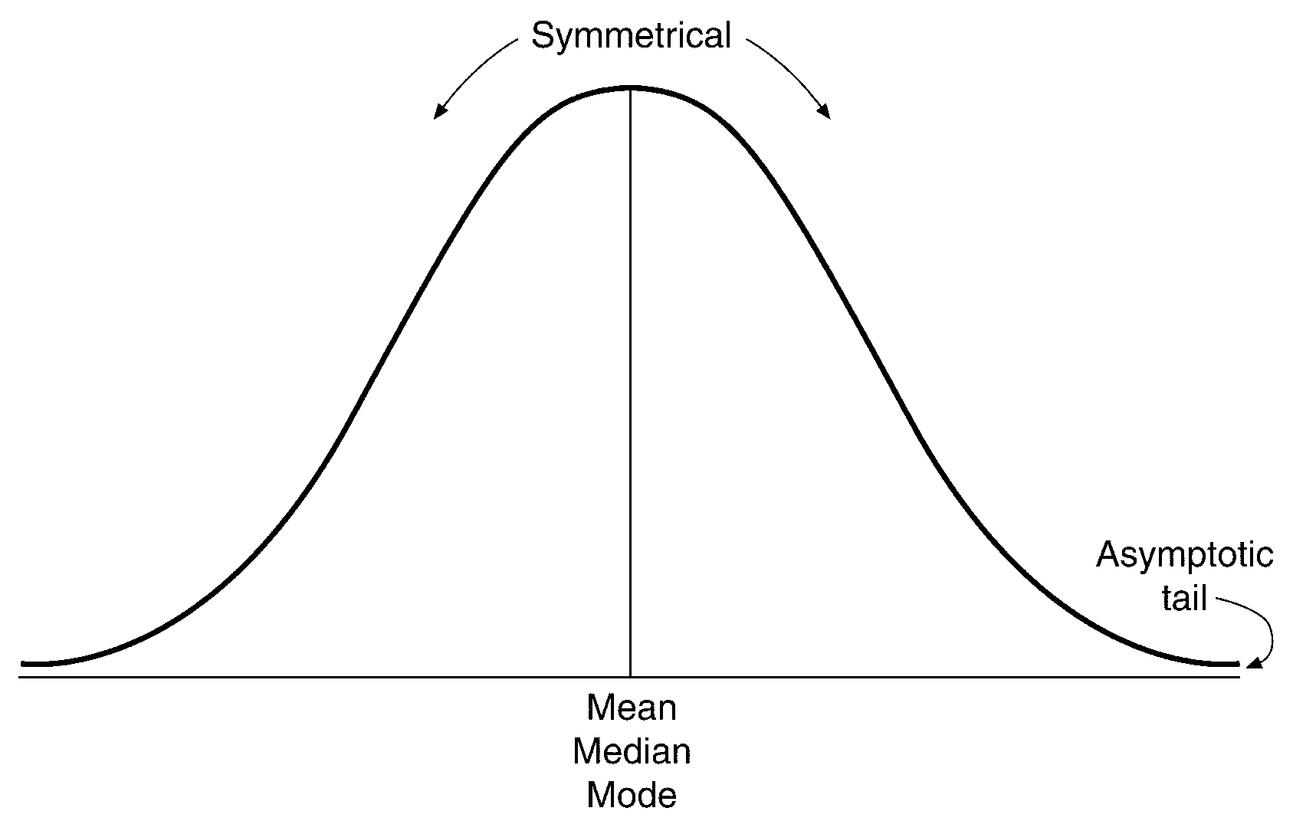
The Normal Curve

Slide 16
Hey, That’s Not Normal!
Sometimes there are sets of scores where the distribution is not normal.
Sets of data larger than 30 often approximate the shape of a normal curve

Slide 17
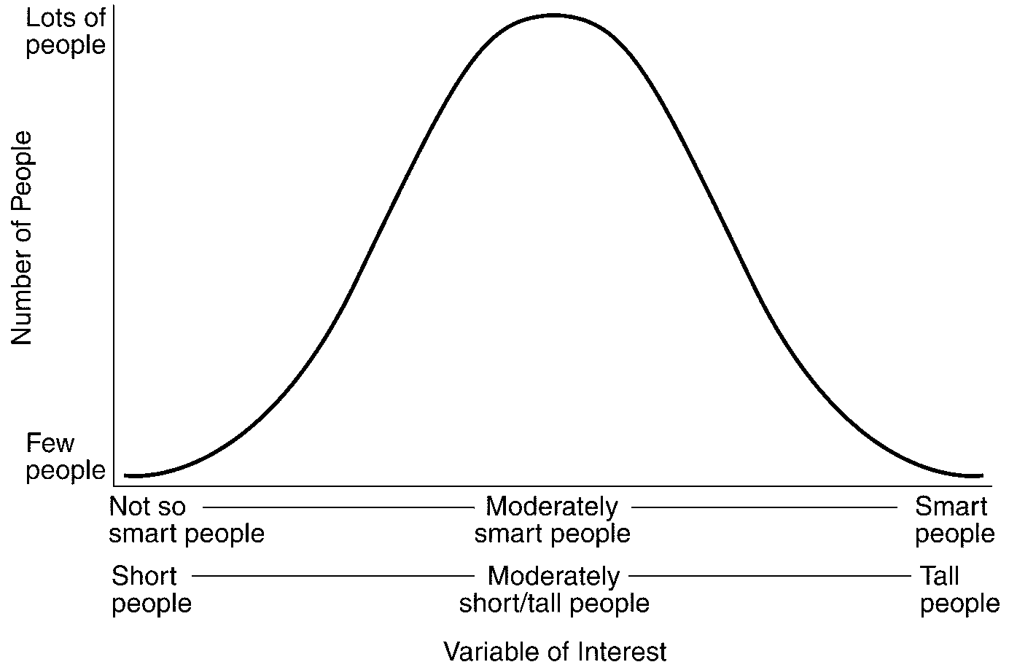
More Normal Curve 101

Slide 18
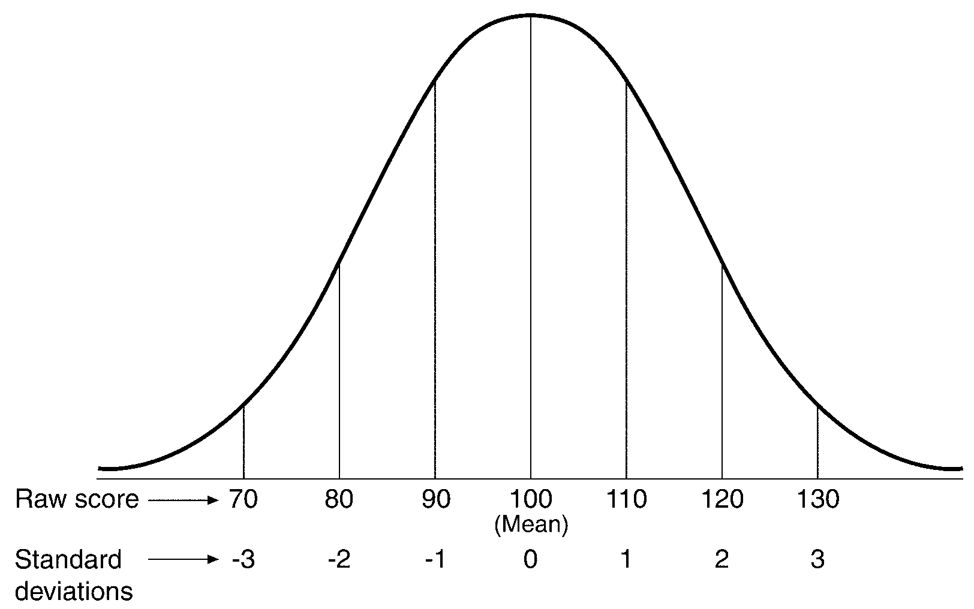
More Normal Curve 101

Slide 19
More Normal Curve 101
For all normal distributions…
almost 100% of scores will fit between -3 and +3 standard deviations from the mean
Because of this, distributions can be compared
Between different points on the X-axis, a certain percentage of cases will occur

Slide 20
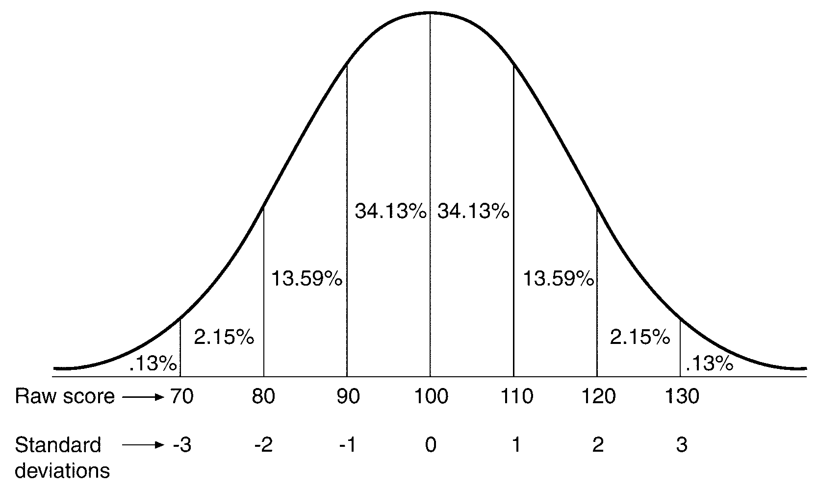
What’s Under the Curve?

Slide 21
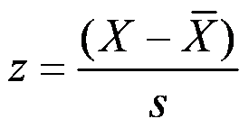
The z Score
A standard score that is the result of dividing the amount that a raw score differs from the mean of the distribution by the standard deviation.

Slide 22
The z Score
Scores below the mean are negative (left of the mean) and those above are positive (right of the mean)
A z score is the number of standard deviations the raw score is from the mean
z scores across different distributions are comparable

Slide 23
What z Scores Represent
The areas of the curve that are covered by different z scores also represent the probability of a certain score occurring.
So try this one…
In a distribution with a mean of 50 and a standard deviation of 10, what is the probability that one score will be 70 or above?

Slide 24
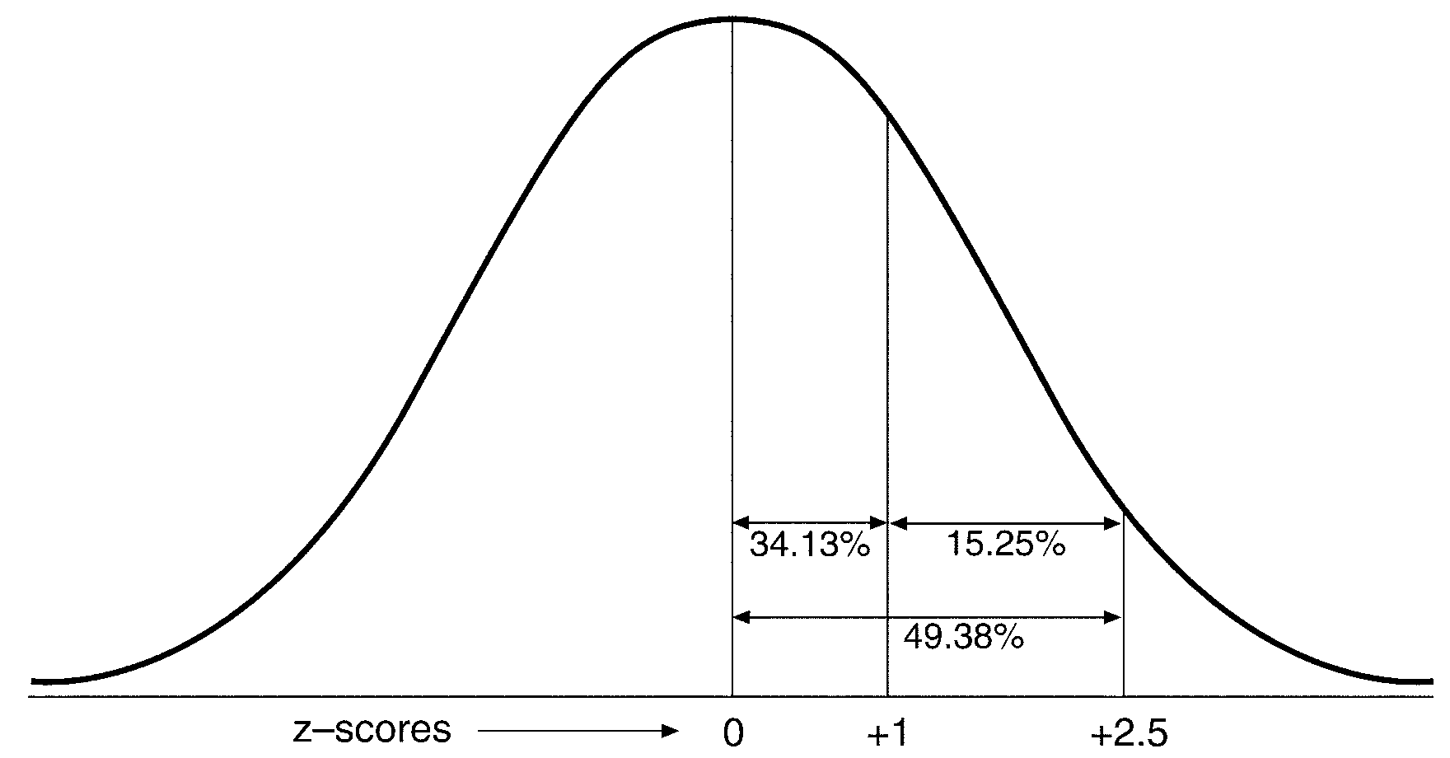
The Difference between z scores

Slide 25
What z Scores Really Represent
Knowing the probability that a z score will occur can help you determine how extreme a z score you can expect before determining that a factor other than chance produced the outcome

Slide 26
Hypothesis Testing and z Scores
Any event can have a probability associated with it
Probability values help determine how “unlikely” the event might be
The key --- less than 5% chance of occurring and you have a significant result

Slide 27
Significantly Significant: What it Means
In this section, you will learn about…
What the concept of significance is and why it is important
The importance of and difference between Type I and Type II errors
How inferential statistics works
How to select the appropriate statistical test for your purposes

Slide 28
The Concept of Significance
Any difference between groups that is due to a systematic influence rather than chance
Must assume that all other factors that might contribute to differences are controlled

Slide 29
If Only We Were Perfect…
Significance level: The risk associated with not being 100% positive that what occurred in the experiment is a result of what you did or what is being tested
The goal is to eliminate competing reasons for differences as much as possible.
Statistical Significance: The degree of risk you are willing to take that you will reject a null hypothesis when it is actually true.

Slide 30
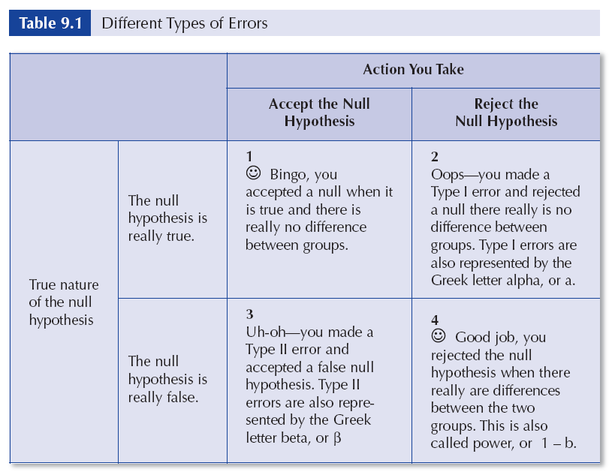
The World’s Most Important Table

Slide 31
Type I Errors (Level of Significance)
The probability of rejecting a null hypothesis when it is true
Conventional levels are set between .01 and .05
Usually represented in a report as
p < .05

Slide 32
Power
How well a statistical test can detect and reject a null hypothesis when it is false.

Slide 33
Significance Versus Meaningfulness
A study can be statistically significant but not very meaningful
Statistical significance can only be interpreted for the context in which it occurred
Statistical significance should not be the only goal of scientific research
Significance is influenced by sample size…we’ll talk more about this later.

Slide 34
How Inference Works
Step 1: Select representative samples
Step 2: Collect the relevant data
Step 3: Reach a conclusion as to whether or not the difference between the scores is the result of chance
Step 4: Reach a conclusion that applies to the whole population, based on the finding within the samples

Slide 35
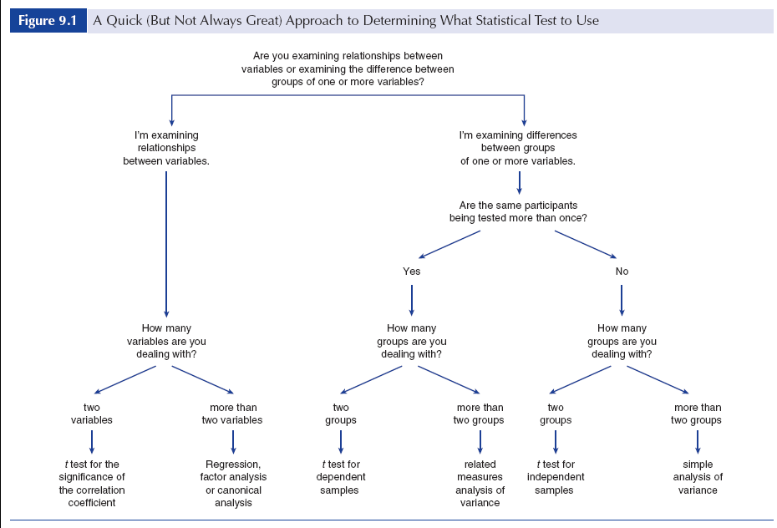
Deciding What Test to Use

Slide 36
How a Test of Significance Works
State the null hypothesis
Set the level of risk associated with the null hypothesis
Select the appropriate test statistic
Compute the test statistic value
Determine the value needed for rejection of the null hypothesis
Compare the obtained value to the critical value
If the obtained value is more extreme than the critical value, the null hypothesis cannot be accepted
If the obtained value does not exceed the critical value, the null hypothesis is the most attractive explanation

Slide 37
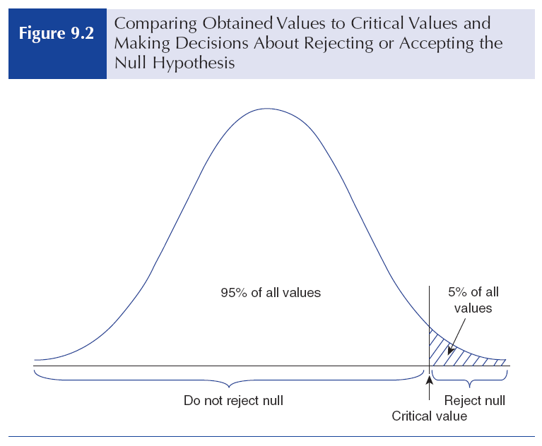
The Picture Worth a Thousand Words

Slide 38
Be Even More Confident
Confidence interval: The best estimate of the range of a population value given the sample value.
95% Confidence= Score + 1.96 (standard deviation)
99% Confidence= Score + 2.56 (standard deviation)

Slide 39
The One Sample z Test
In this section, you will learn about…
When the z-test for one sample is appropriate to use
How to compute the observed z value
Interpreting the z value and understanding what it means

Slide 40
One-Sample Z-Test
If we examine the differences between a sample and a population…
…and there is only one group being tested…
…then the appropriate test statistic is a one-sample Z-test.

Slide 41
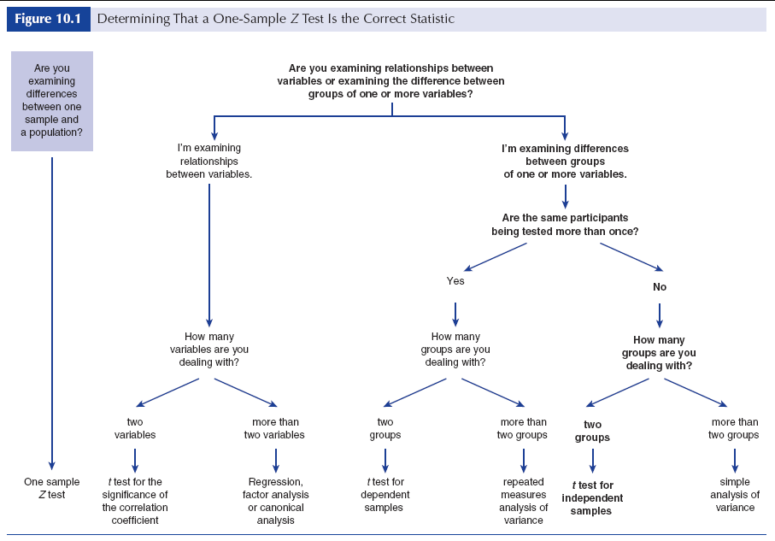
The One Sample z Test

Slide 42
Computing the Test Statistic
State the null and research hypotheses
Set the level of risk associated with the null hypothesis
Select the appropriate test statistic
Compute the test statistic value (called the obtained value)
Determine the value needed for rejection of the null hypothesis using the appropriate table of critical values for the particular statistic
Compare the obtained value and the critical value
Make your decision

Slide 43
So How Do I Interpret…
z = 2.20, p < .05
z represents the test statistic used
2.20 is the obtained value (from the formula)
p < .05

Slide 44
Tests Between the Means of Different Groups
In this section, you will learn about…
When the t-test for independent means is appropriate to use
How to compute the observed t value
Interpreting the t value and understanding what it means

Slide 45
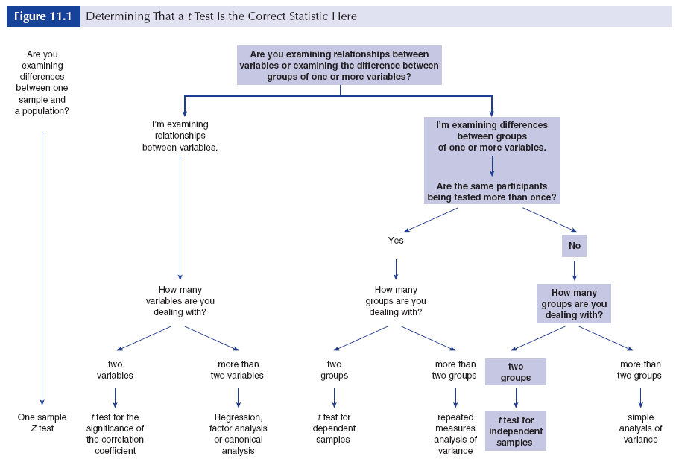
t Test for Independent Samples

Slide 46
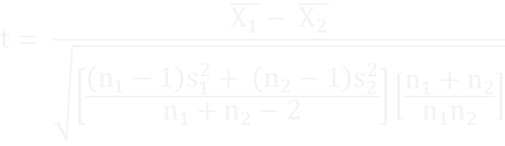
Computing the Test Statistic
Numerator is the difference between the means
Denominator is the amount of variation within and between each of the two groups

Slide 47
Steps to Computing t Statistic
State the null and research hypotheses.
Set the level of risk associated with the null hypothesis.
Select the appropriate test statistic.
Compute the test statistic value.
Determine the critical value.
Compare the obtained value to the critical value.
Make decision.

Slide 48
Degrees of Freedom
The degrees of freedom approximate the sample size
Degrees of freedom can vary based on the test statistic selected
For t-test for independent means:
df= n₁ – 1 + n₂ – 2

Slide 49
So How Do I Interpret…
t ₍₅₈₎ = -.14, p > .05
t represents the test statistic used
58 is the number of degrees of freedom
-.14 is the obtained value (from the formula)

Slide 50
Special Effects…
Effect size is a measure of how different two groups are from one another
Standardized difference between two group means

Slide 51

Computing Effect Size
Small = 0.0 - .20
Medium = .20 - .50
Large = .50 and above

Slide 52
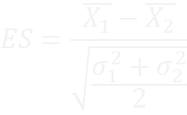
Another Formula for Effect Size

Slide 53
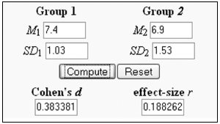
Effect Size Calculator
http://www.uccs.edu/~lbecker/
Notes:
http://www.uccs.edu/~faculty/lbecker/, hosts an online effect size calculator.

Slide 54
Tests Between the Means of Related Groups
In this section, you will learn about…
When the t-test for dependent means is appropriate to use
How to compute the observed t value
Interpreting the t value and understanding what it means

Slide 55
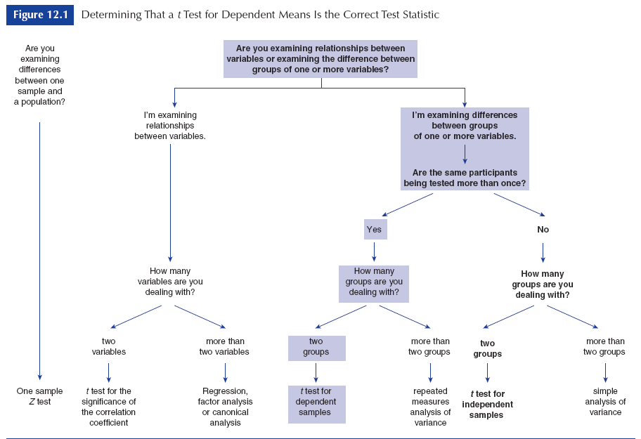
The Path to Wisdom and Knowledge

Slide 56
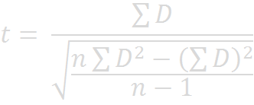
Computing the Test Statistic

Slide 57
Computing the Test Statistic
State the null and research hypotheses.
Set the level of risk associated with the null hypothesis.
Select the appropriate test statistic.
Compute the test statistic value.
Determine the critical value(s).
Compare the obtained and critical values.
Make a decision.

Slide 58
Degrees of Freedom
The degrees of freedom approximates the sample size
Degrees of freedom can vary based on the test statistic selected
For t-test for dependent means:
df= n – 1 (where n equals the number of pairs of observations)

Slide 59
So How Do I Interpret…
t ₍₂₄₎ = 2.45, p > .05
t represents the test statistic used
24 is the number of degrees of freedom
2.45 is the obtained value (from the formula)
p > .05 indicates the probability

Slide 60
Statistics for Community Health and Managerial Epidemiology

Slide 61
“Battling Bad Science”
What is the main idea or underlying value of this talk?
What is the speaker’s purpose or perspective?
Why is this topic important?
How do the ideas presented in the talk relate to evidence-based management?

Slide 62
What is EB Management?
Evidence-based management (in healthcare): “the systematic application of the best available evidence to the evaluation of managerial strategies for improving the performance of health services organizations” (EBM, p. 56)
How is this different?
“…the notion that whenever possible, health services managers should incorporate into their decision making evidence from well-conducted management research” (p. 56)
AND OTHER RESEACH—e.g. epi—THAT CAN INFORM DECISION MAKING

Slide 63
Types of Management questions
Core business transactions
How can the health system’s information on patient eligibility for benefits be made more accurate?
Operational management
How can nurse absenteeism be reduced?
Does hand washing among healthcare workers reduce hospital-acquired infections?
Will decreasing the patient-nurse ratio improve patient outcomes?
Strategic management
Does the implementation of an EMR improve the quality of patient care?
Health services planning
Should a healthcare organization reallocate resources during flu season?

Slide 64
The Research Process
EB Management
Epidemiology Research (Analytic Studies)
Formulate the research question
Acquire research evidence
Assess the quality of the evidence
Present the evidence
Apply the evidence to the decision
Evaluate the results
Design
Conduct
Analysis
Interpretation

Slide 65
Methods for Developing Actionable Evidence for Health Services Research
Framing the question behind the decision
Finding sources of information
Evaluating the evidence
Assessing the accuracy of information
Assessing the applicability of information
Assessing the actionability of information
Determining if the information is adequate

Slide 66
Study Designs
Meta-analysis
Randomized Controlled Trial
Quasi-Experimental Study
Prospective Cohort Study
Retrospective Cohort Study
Case Control Study
Patient Survey
Uncontrolled Observational Study
Qualitative Study

Slide 67
Epidemiology
Descriptive epidemiology
Clinical epidemiology
MANAGERIAL EPIDEMIOLOGY
Using epidemiological tools in health management to…
Design/manage health care for populations
Manage resources to maintain/promote population health
Using epidemiological concepts/tools to inform health management decisions (EB decision making)

Slide 68
Tool: Epi Info
What is Epi Info™?
“Physicians, nurses, epidemiologists, and other public health workers lacking a background in information technology often have a need for simple tools that allow the rapid creation of data collection instruments and data analysis, visualization, and reporting using epidemiologic methods. Epi Info™, a suite of lightweight software tools, delivers core ad-hoc epidemiologic functionality without the complexity or expense of large, enterprise applications.”
How is Epi Info™ Used?
“Epi Info™ is used worldwide for the rapid assessment of disease outbreaks; for the development of small to mid-sized disease surveillance systems; as ad hoc components integrated with other large scale or enterprise-wide public health information systems; and in the continuous education of public health professionals learning the science of epidemiology, tools, and techniques.”

Slide 69
Learning Objectives (adapted from Moser et al., 2008)
After this section, you will be able to:
Identify key sources of data for managerial epidemiologic purposes—see Aschengrau & Seage (2014), Chapter 4
Apply the basic terminology and definitions of epidemiology
Calculate basic epidemiology measures
Draw appropriate inferences from epidemiologic data
Evaluate the strengths and limitations of epidemiologic reports
Moser, M., Ramiah, K., & Ibrahim, M. (2008). Epidemiology core competencies for Master of Public Health students. Public Health Reports, 123(Suppl 1), 59-66.

Slide 70
Commonly Used Frequency Measures
Frequency distribution
Calculations to describe and compare measures of disease occurrence:
Rates, proportions, ratios
Measures of disease frequency
Incidence, prevalence
Effect measures (measures of association)
Relative risk, odds ratio

Slide 71
Quantifying Disease Frequency
3 factors to consider when measuring disease frequency
Number of people affected by the disease
Size of the source population
Length of time the population is followed
Failure to consider all 3 will result in an incomplete picture of the impact of the disease on the population.

Slide 72
Frequency (measures of disease occurrence)
Frequency measures compare one part of the frequency distribution to another part of the distribution, or to the entire distribution
Common frequency measures:
Ratios
Proportions
Rates
Basic formula:
(numerator/denominator) x 10^{n}
or x/y x 10^{n}

Slide 73
Ratio
The relative magnitude of two quantities or a comparison of any two values
To calculate:
number or rate of events, items, persons, etc. in one group / number or rate of events, items, persons, etc. in another group

Slide 74
Calculation of a Ratio: Discharges for July 2014
Define x and y
X = number of female discharges
Y = number of male discharges
Identify x and y
X = 457
Y = 395
Set up the ratio x/y
457/395
Reduce the fraction so that either x or y equals 1
1.16/1
There were 1.16 female discharges for every male discharge

Slide 75
Proportion
The comparison of a part to the whole (a type of ratio that includes the numerator in the denominator)
To calculate:
(number of persons or events with a particular characteristic / total number of persons or events, of which the numerator is a subset) x 10^{n}
or x/(x+y) x 10^{n}
Note: 10 is usually 100 (or n=2), thus proportion is often expressed as a percentage

Slide 76
Calculation of a Proportion: Discharges for July 2014
Define x and y
X = number of female discharges
Y = number of male discharges
Identify x and y
X = 457
Y = 395
Set up the proportion x/(x+y)
457/(457+395) = 457/852
Reduce the fraction so that either x or y equals 1
0.54/1
The proportion of discharges that were female is 0.54 (or 54% of all discharges)

Slide 77
Rate
A measure of the frequency with which an event occurs in a defined population over a specified period of time (i.e., how fast something is happening)
To calculate:
(number of cases or events occurring during a given time period x 10^{n}) / number of cases or population at risk during same time period
or
(total number of times something did happen x 10^{n}) / total number of times something could happen

Slide 78
Calculation of C-Section Rate for July 2015
In July, 23 C-sections were performed; in this time period, 149 women delivered; what is the C-section rate?
Define variable of interest (numerator) and population or number of cases at risk (denominator)
Numerator: total number of C-sections performed in July
Denominator: total number of women who delivered in July
(including C-sections)
Identify the numerator and denominator
Numerator: 23
Denominator: 149
Set up the rate
23/149
Divide the numerator by the denominator and multiple by 100
(23/149) x 100 = 15.4%
The C-section rate for the month of July is 15.4%

Slide 79
Measures of Disease Frequency
Incidence
measure of change from non-disease to disease (numerator) in a population-at-risk (denominator) over a specific period of time
Number of new cases of disease that develop in a defined population during a defined period of time
Prevalence
measure of the number of events, e.g., instances of a disease, in a population at a specific time
Number of existing cases of disease in a defined population during a defined period of time

Slide 80
Characteristic | Incidence | Prevalence
What is measured | Rapidity of disease occurrence; proportion of population developing new cases of disease | Proportion of population with disease
Units | Cases/person-time or cases/ population-at-risk | Cases/total population (whether newly diagnosed cases or cases developing some time in the past)
Time of disease diagnosis | Newly diagnosed | Surviving cases, whether diagnoses recently or at any time in the past
Denominator | Number of person-years (or person-months) free of the disease of interest; number of persons free of disease at baseline | Number of persons present in the population of interest

Slide 81
Examples
The prevalence of type II diabetes in Washington County residents in 2009 was 13%.
The prevalence of obesity in preschool children increased from 12% to 15% in 2010 for Washington County.
The incidence rate of tuberculosis in Multnomah County was 4.9 cases per 100,000 residents in the year 2010 versus the state or Oregon rate of 2.3 cases per 100,000 residents in the same year.

Slide 82
Types of rates
Crude rates
Presented for an entire population
Adjusted rates
Statistically constructed rates that account for differences between populations
Category-specific rates
Presented for a category of the population (e.g., age, sex)

Slide 83
Standardization of rates
Rates confuse and mislead
Crude death rates:
Miami, FL = 250/1000,000/year
Anchorage, AK = 125/100,000/year
Are folks in Miami less healthy?
Or are they older?
Standardization
Most common is by age
Why standardize?
To compare population groups
“levels the playing field”
Two methods—direct and indirect

Slide 84
Concept Evaluation
If we wanted to obtain a measure of the incidence of breast cancer among women in Oregon during 1997, what breast cancer cases would we count in the numerator?
All cases of breast cancer among women in Oregon in 1997
Only newly diagnosed cases of breast cancer among women in Oregon in 1997
Correct answer is b: because incidence measures a change from non-disease to disease, only newly diagnosed cases of breast cancer should be counted in the numerator. Surviving women with breast cancer diagnosed prior to 1997 are not part of the change from non-disease to disease in the year 1997.

Slide 85
Concept Evaluation
Assuming that we begin to measure incidence on January 1, 1997, which Oregon women would be counted for the denominator of the incidence measure?
All women in Oregon in 1997.
Only women in Oregon without breast cancer on January 1, 1997.
Correct answer is: b. All women in Oregon who, on January 1, 1997, do not have breast cancer. More specifically, all women who do not have a diagnosis of breast cancer. Some women may have undiagnosed breast cancer on that date, but they would not be counted in the numerator because they cannot be identified as a case. Therefore, they would be at risk for breast cancer and thus be included in the denominator.

Slide 86
Concept Evaluation
To measure the prevalence of breast cancer among women in Oregon for the year 1997, what breast cancer cases would we count in the numerator?
All breast cancer cases reported to the Oregon Cancer Registry in 1997
All breast cancer cases ever reported to the Oregon Cancer Registry
All surviving breast cancer cases ever reported to the Oregon Cancer Registry
Correct answer is: c. Only surviving cases of breast cancer are included, since prevalence is a measure of the number of cases of disease present in the population at a point in time (commonly referred to as point prevalence) or during a period of time (commonly referred to as period prevalence).

Slide 87
Measures of Association
Quantifies relationship between exposure and disease among two groups (comparison!)
Types of measures:
Risk ratio (relative risk)
Odds ratio

Slide 88
2x2 Table
 | Outcome | Outcome | Total
Exposure | Yes | No
Yes | a | b | a + b
No | c | d | c + d
Total | a + c | b + d | N

Slide 89
Risk
Probability that an event will occur
e.g., that a person will die within one year
Risk in Exposed = a/(a+b)
Risk in unexposed, “Baseline risk” = c/(c+d)
 | Outcome | Outcome | Total
Exposure | Yes | No
Yes | a | b | a + b
No | c | d | c + d
Total | a + c | b + d | N

Slide 90
Odds
The ratio of the probability of occurrence of an event to that of non-occurrence
e.g., odds of smokers developing a chronic cough
Odds in Exposed = a/b
Odds in unexposed, “Baseline odds” = c/d
 | Outcome | Outcome | Total
Exposure | Yes | No
Yes | a | b | a + b
No | c | d | c + d
Total | a + c | b + d | N

Slide 91

Would you swim here?

Slide 92
Develop a Question: PICO
Population: children under 5 years of age
Intervention (exposure): Swimming in the Ishim River
Comparator (control): Not swimming in the Ishim river
Outcome: Otitis Media
Question: What is the risk that a child
under 5 will develop an ear infection
after swimming in the Ishim river?

Slide 93
Odds Ratio
 | Outcome | Outcome | Total
Exposure | Yes | No
Yes | a | b | a + b
No | c | d | c + d
Total | a + c | b + d | N
Odds ratio = (a/b)(c/d)=ad/bc

Slide 94

Odds Ratio
 | Ear Infection | Ear Infection | Total
Swimming in Ishim | Yes | No
Yes | 40 | 60 | 100
No | 5 | 95 | 100
Total | 45 | 155 | 200
Odds of getting infection for swimmers: 40/60 = 0.67
Odds of getting infection for non-swimmers: 5/95 = 0.052

Slide 95

Relative Risk
 | Outcome | Outcome | Total
Exposure | Yes | No
Yes | a | b | a + b
No | c | d | c + d
Total | a + c | b + d | N

Slide 96

Relative Risk
 | Ear Infection | Ear Infection | Total
Swimming in Ishim | Yes | No
Yes | 40 | 60 | 100
No | 5 | 95 | 100
Total | 45 | 155 | 200
Risk of getting infection for swimmers: 40/100 = 0.4
Risk of getting infection for non-swimmers: 5/100 = 0.05

Slide 97
OR versus RR Key Messages
Odds and Odds Ratios are difficult to conceptualize but statisticians prefer them in some situations because of their mathematical properties
Odds Ratios always exaggerate the relative risk, but when baseline risk is low (e.g. <10%), the OR approximates the relative risk
Relative Risk is a more intuitive measure and is becoming more common in medical literature

Slide 98
Resources
Excel 2013 Tutorial (CGFLearnFree.org)
Excel Formulas Tutorial (CGFLearnFree.org)
Principles of Epidemiology in Public Health Practice Third Edition
link to pdf of self-study course (all 500+ pages!)

