Slide 1
GYMPRO
A center for exercise and fitness

Slide 2
Authors
ISMAIL ATOLAGBE
ADEBISI ADEGOKE

Slide 3
Overview of the Application:
Goals and purposes: To help users manage their gym workouts, track progress, and achieve fitness goals.
Problems it will solve: It will make it easier for users to plan and track their gym activities, stay motivated, and make progress towards their fitness goals.
Target users: Gym-goers, fitness enthusiasts, personal trainers.

Slide 4
Possible Operations
Register/Login: Allow users to create an account or log in to access the app.
View Gym Information: Display information about the gym, such as location, opening hours, facilities, and contact details.
Track Workouts: Enable users to track their workouts, including exercises, sets, reps, and weights lifted.
Create Workout Plans: Allow users to create and customize workout plans based on their fitness goals and preferences.
View Class Schedule: Display a schedule of gym classes and allow users to sign up for classes.

Slide 5
Track Progress: Provide tools for users to track their fitness progress, such as weight, body measurements, and photos.
Nutrition Tracking: Offer features for users to track their daily nutrition intake and set dietary goals.
Social Features: Include social features such as a community forum or social media integration to connect users with each other and share fitness tips and experiences.
Personalized Recommendations: Provide personalized workout and nutrition recommendations based on user's goals, preferences, and progress.
Settings: Allow users to customize their app settings, such as notifications, units of measurement, and privacy settings.

Slide 6
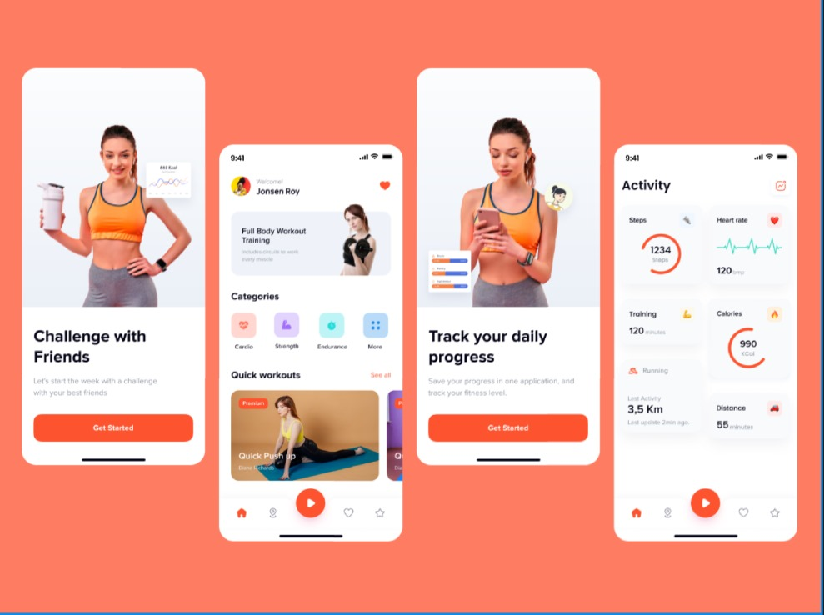

Slide 7
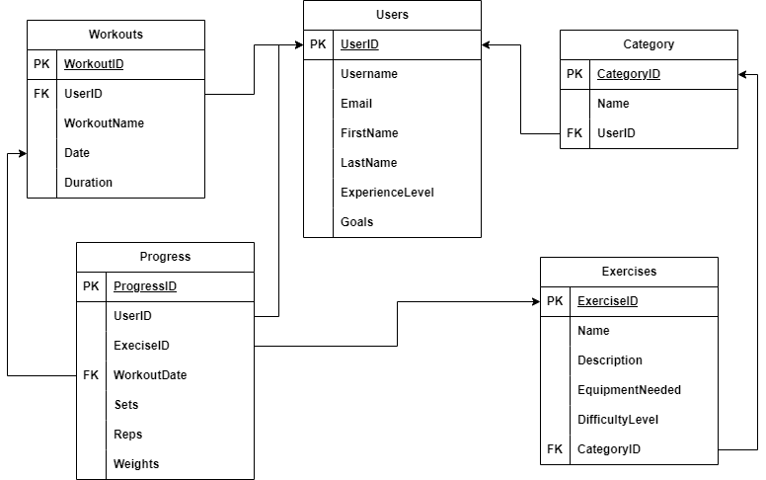
SCHEMA

Slide 8
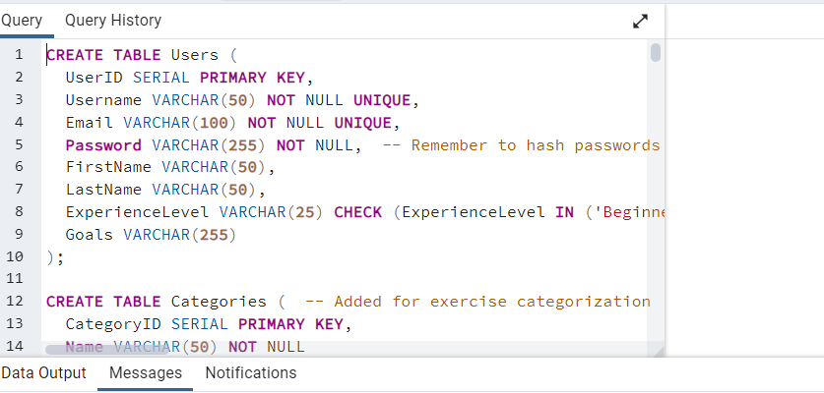
SQL Queries (Tables creation)

Slide 9
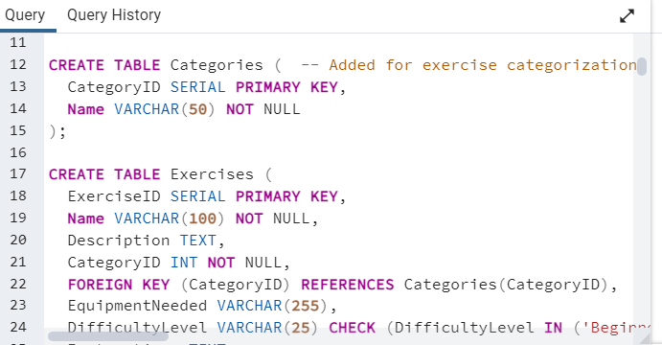
More Table Queries

Slide 10
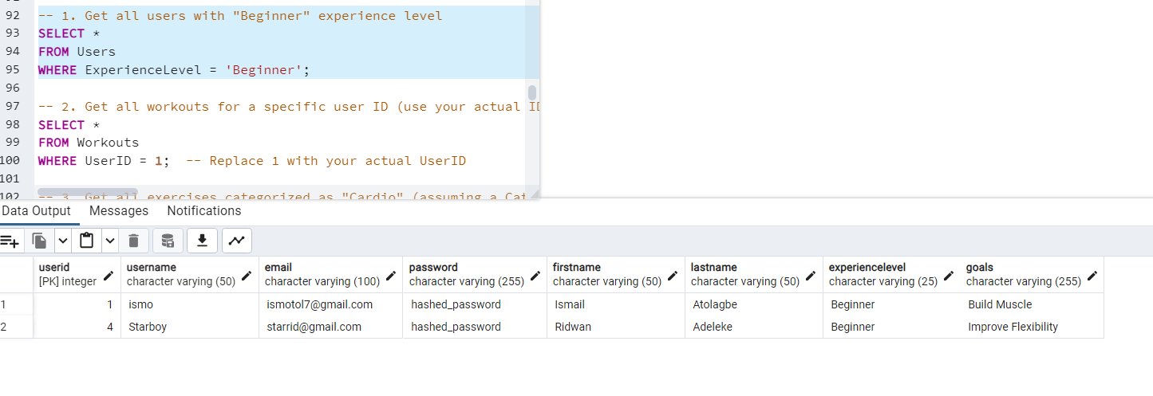
Using “WHERE” Query on SQL

Slide 11
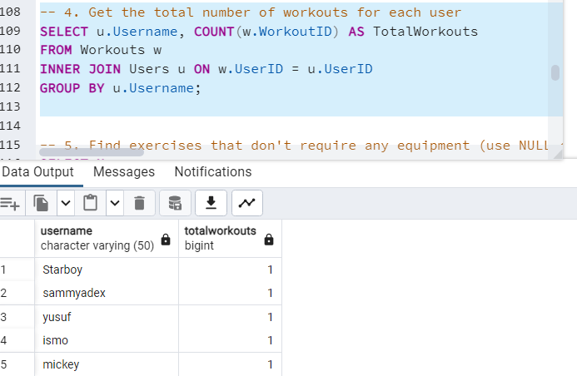
Using “GROUP BY” Query

Slide 12
THANK YOU FOR LISTENING

