Slide 1

A.I. for Nuclear Physics
Extrapolating Nuclear Masses using Bayesian GPR
Rahul Jain
March 4, 2020

Slide 2

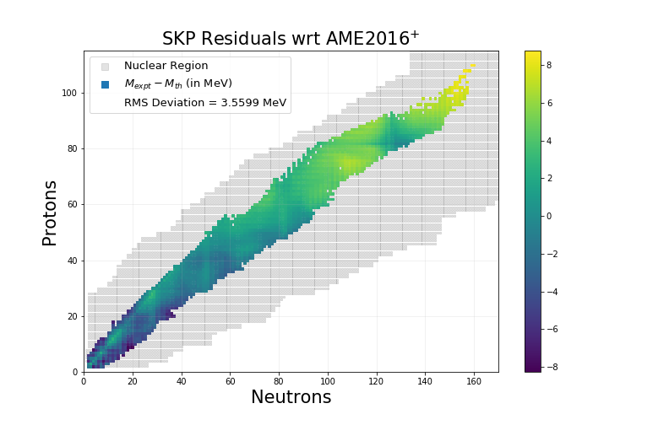
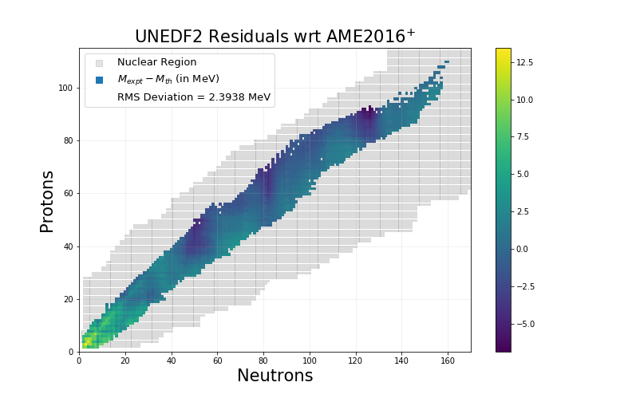
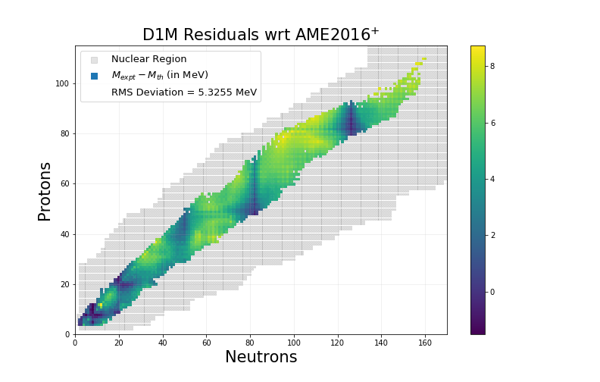
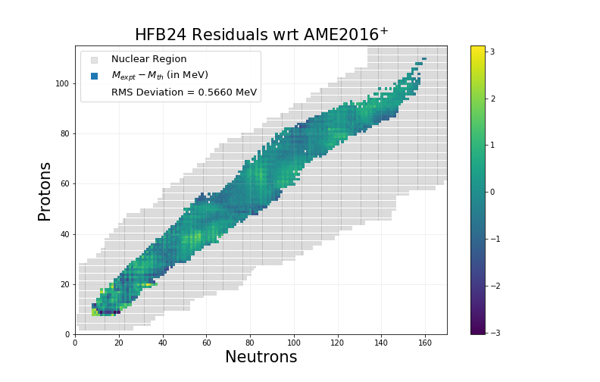
Motivation
Different theoretical mass models have very different uncertainties.
These uncertainties are not very well propagated to the region of interest.
Region of interest

Slide 3
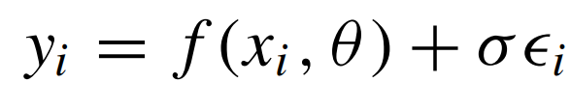

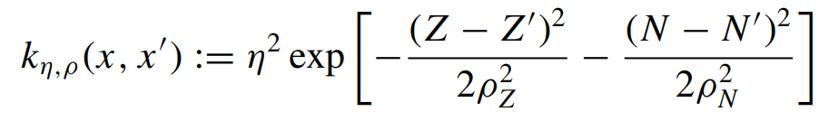
Technical Details: Model
Bayesian Gaussian Process Regression:
- Realistic Uncertainty Quantification in extrapolated regions.
- Stable performance due to less parameters.
- Inbuilt Stochasticity.
- Can directly handle experimental error bars.
- Length scale as the measure of feature importance.
Validation Metrics:
- RMS Deviation from Experimental Values.
- Empirical Coverage Probabilities.

Slide 4
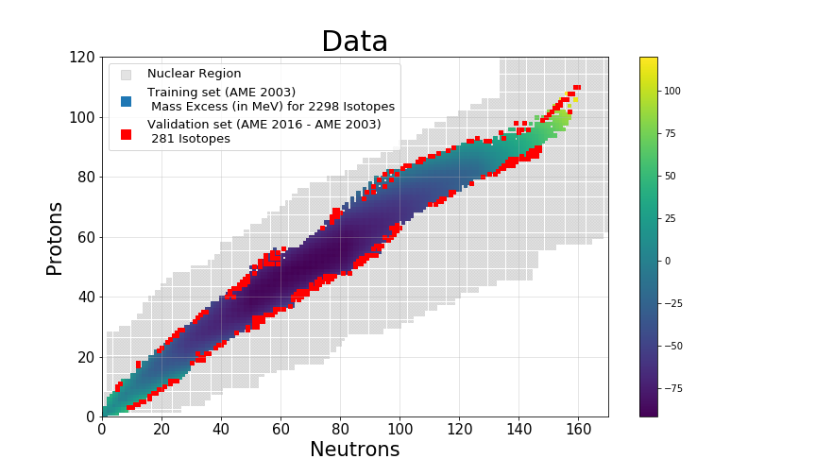
Technical Details: Data
Experimental Masses: Atomic Mass Evaluation Tables, 2003 and 2016.
Theoretical Masses: Mass Explorer, Erik Olsen et al., FRIB Theory Alliance.
Region of interest

Slide 5
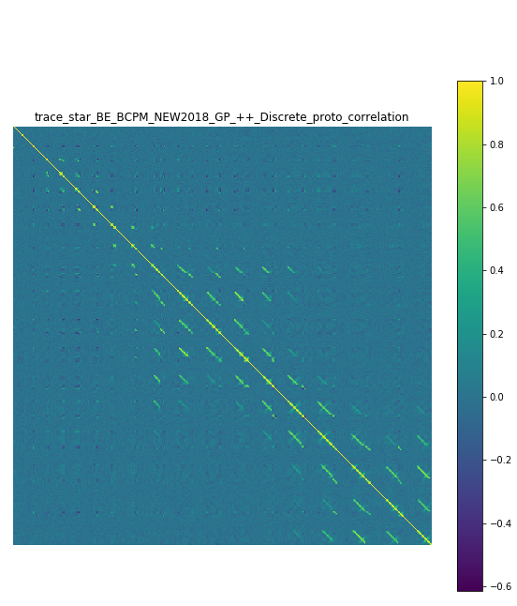
Summary and Outlook
Lots of correlations from preliminary results.
Currently tuning hyperparameters.
Collaborating with Department of Statistics and Probability at MSU.
Computationally intensive: Sparse GP?
General framework!

