Slide 1
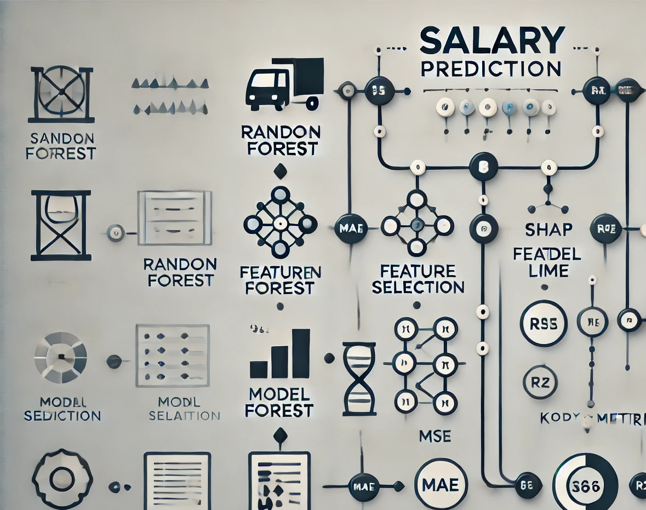

PROJECT OF AI FOR CYBERSECURITY
Giacomo Maldarella
University of Pisa
AI4Cybersec 931II
27-01-2025

Slide 2
Table of Content
Goal and specifics
Data Acquisition
Data Exploration
Preprocessing
Processing
Result Summary
Acknowledgments
Goal and specifics
Data Acquisition
Data Exploration
Preprocessing
Processing
Result Summary
Acknowledgments

Slide 3
Goal and specifics
Goal: Develop a machine learning model to predict salaries in the cybersecurity industry based on various features, enhancing accuracy and identifying key factors influencing salary variations.
Specifications:
Data Exploration Visualize numerical and categorical features Analyze relationships between features and salary Explore trends over time and regional disparities
Data Preprocessing Data cleaning: remove duplicates, handle missing values Encoding: OneHotEncoder and OrdinalEncoder Scaling: Standard scaling for numerical features Outlier detection: Apply log transformation to target
Model Development and Validation Models used: Linear Regression Random Forest XGBoost
Feature selection using: Recursive Feature Elimination (RFE) Understanding Low Model Performance by Job Title
Explainable Artificial Intelligence SHAP (SHapley Additive Explanations) LIME (Local Interpretable Model-agnostic Explanations)
Hyperparameter tuning with RandomSearchCV
Key Metric Goals:
Evaluate models using K-Fold Cross Validation
Focus on improving:
Mean Absolute Error (MAE)
Root Mean Squared Error (RMSE)
R-Squared (R²)

Slide 4
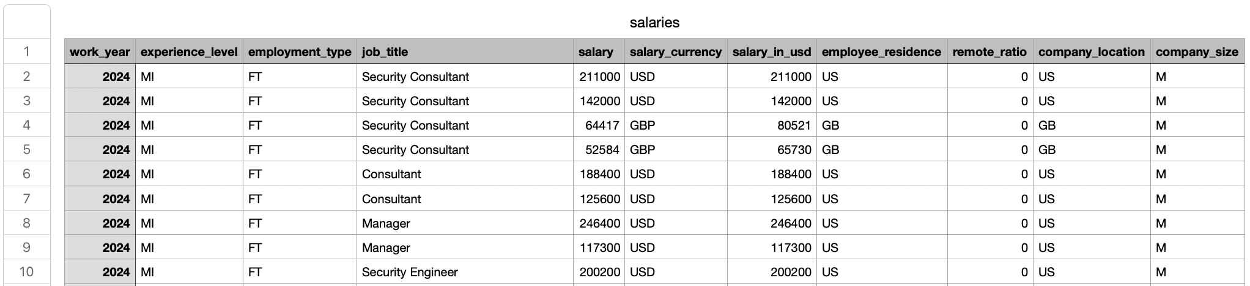
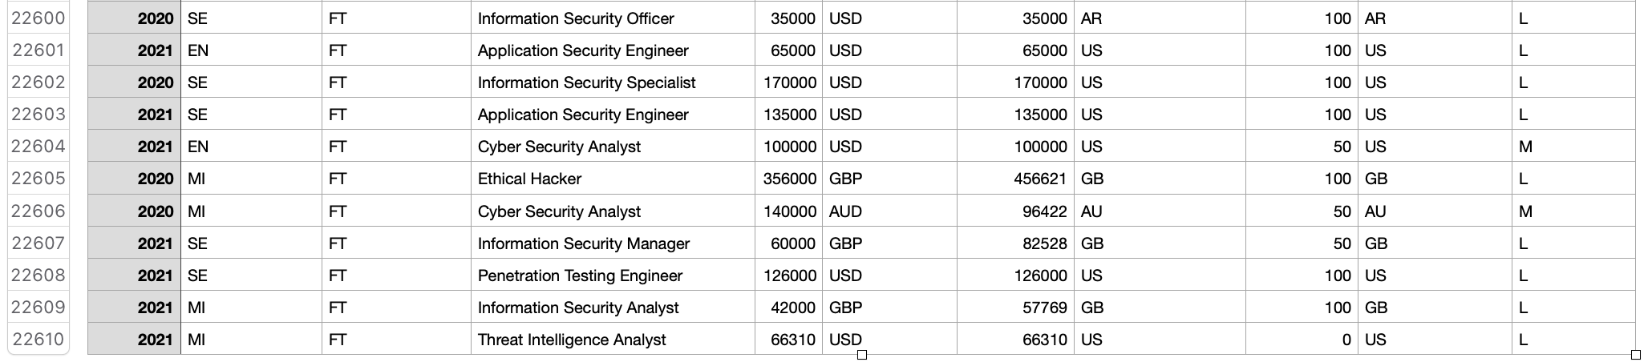
Data Acquisition
Dataset
Reason for Choosing This Dataset:
The dataset provides insights into the evolving landscape of cybersecurity roles, highlighting salary disparities based on experience, location, and job titles.
Dataset Description:
The dataset contains over 20,000 records from various countries, with a strong prevalence of data from the United States.
It spans from 2020 to 2024, making it highly recent and relevant to current industry trends.
The data includes both continuous and categorical variables.
…
Platform: Kaggle

Slide 5
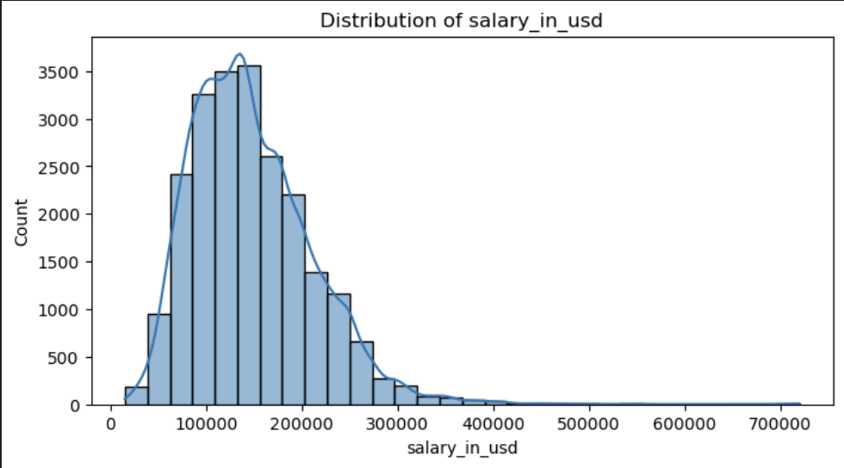
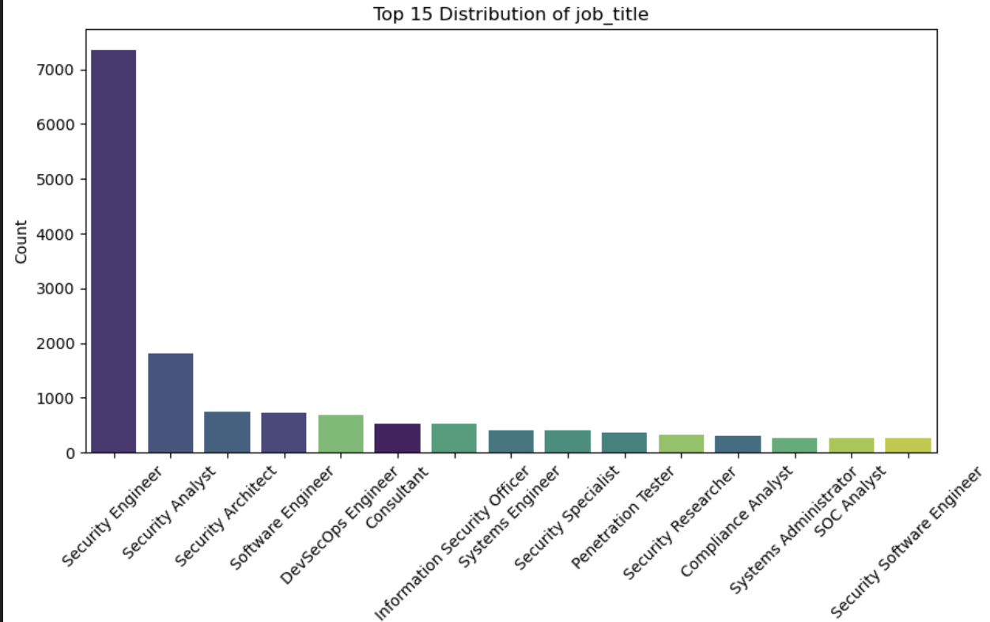
Data Exploration
Objective: Understand the dataset through visual and statistical analysis to identify patterns, correlations, and key insights that may influence salary predictions.
1. Visualizing Numerical Features
2. Visualizing Categorical Features
3. Relationship Between Categorical Features and Salary
4. Relationship Between Numerical Features and Salary
5. Salary Trends Over Time

Slide 6
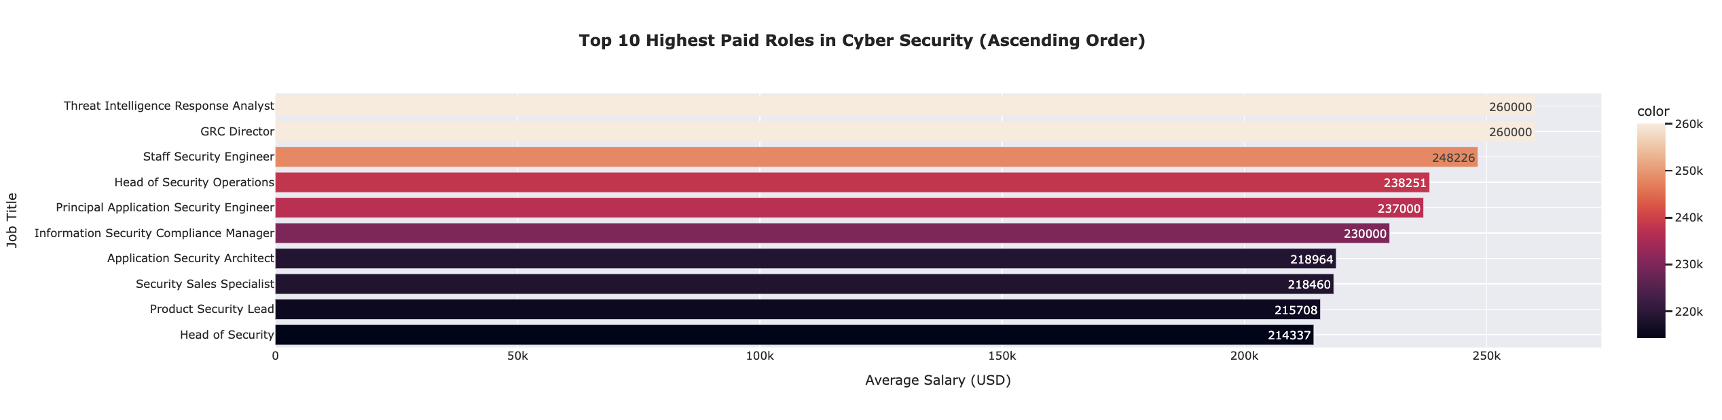
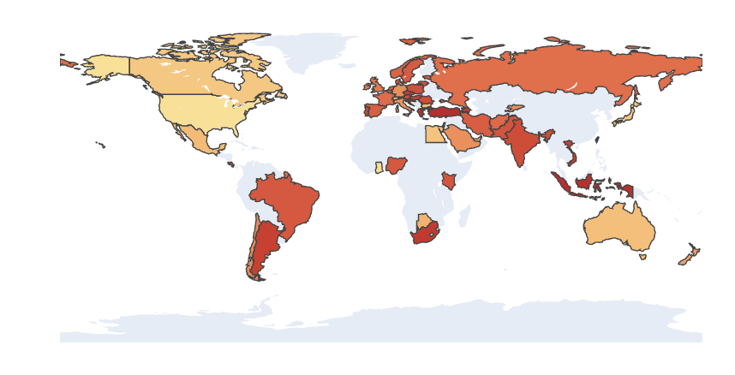
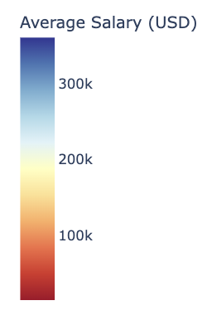
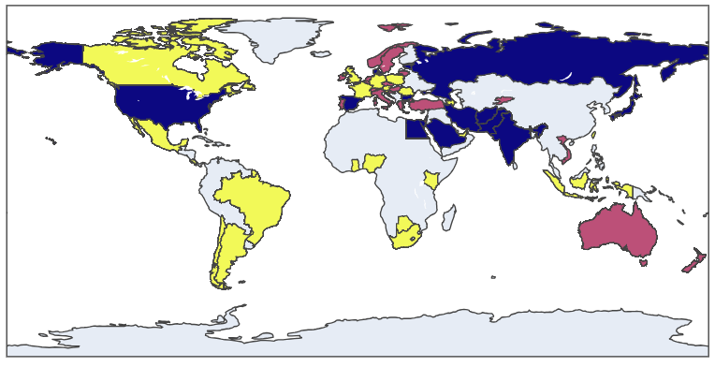
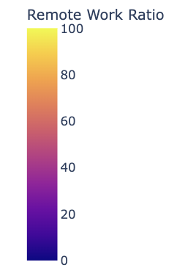
Data Exploration
6. Average Salary for Different Cybersecurity Roles
7. Regional Salary Disparity
8. Remote work and salary

Slide 7

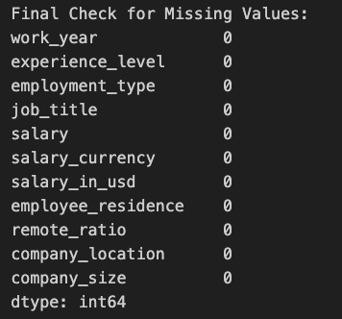
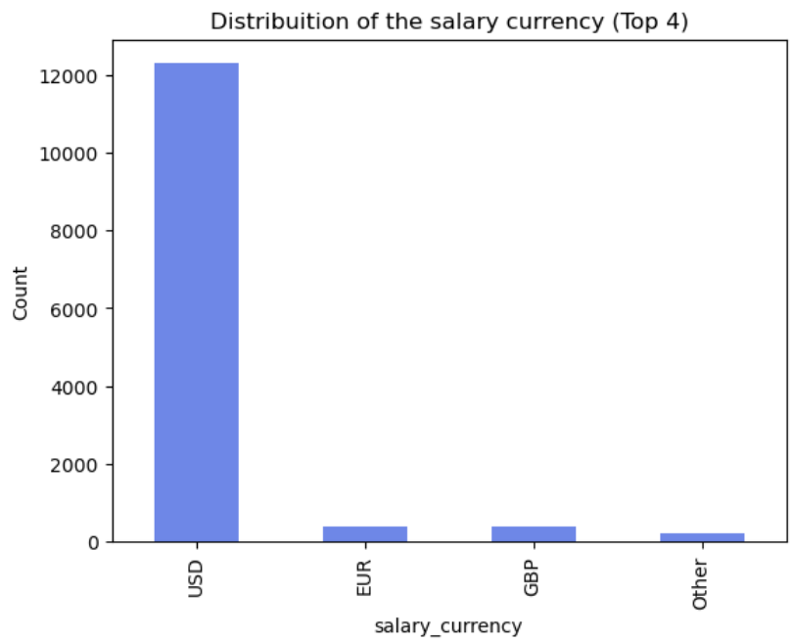
Data Preprocessing – Data Cleaning
Objective: Ensure data quality by addressing duplicates, missing values, and high-cardinality features to improve model performance.
Duplicates Removal
Handling Missing Values:
Identified and removed duplicate records to ensure unique observations.
Missing values were imputed or dropped depending on their relevance to the analysis.
Reducing High Cardinality in Categorical Features:
For categorical columns with numerous unique values (e.g., employee_residence), only the top 4 most frequent categories were retained.
All remaining categories were grouped under "Other" to simplify the dataset and prevent overfitting.

Slide 8
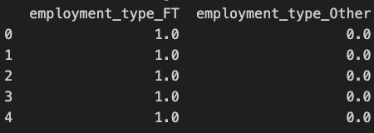
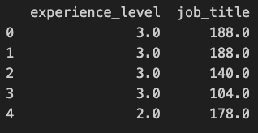
Data Preprocessing - Encoding
Objective: Convert categorical features into a numerical format suitable for machine learning models.
OneHotEncoder – Applied to features with a small number of unique values.
Each unique category is represented as a binary column (0 or 1).
Prevents losing valuable information from low-cardinality features without introducing bias.
OrdinalEncoder – Used for features with a logical order.
This method assigns an integer to each category, preserving its rank or significance.
helps manage high-cardinality features by avoiding an explosion of dimensions, keeping the dataset compact and manageable.

Slide 9
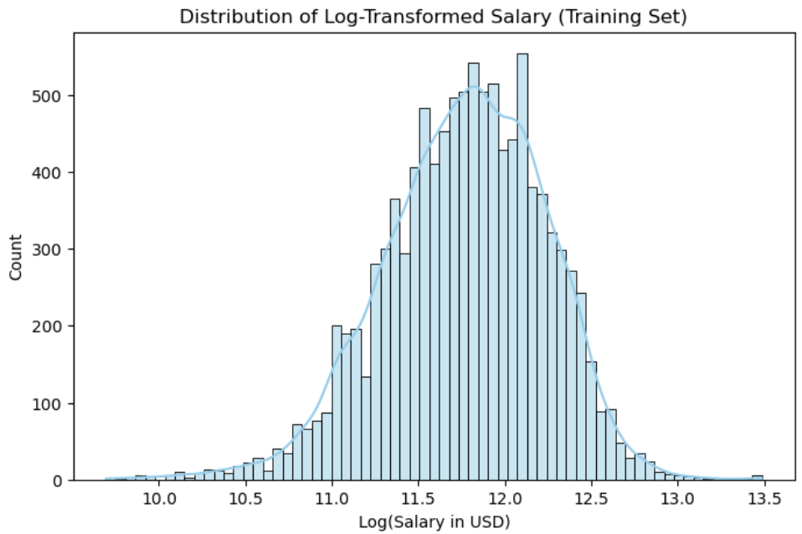
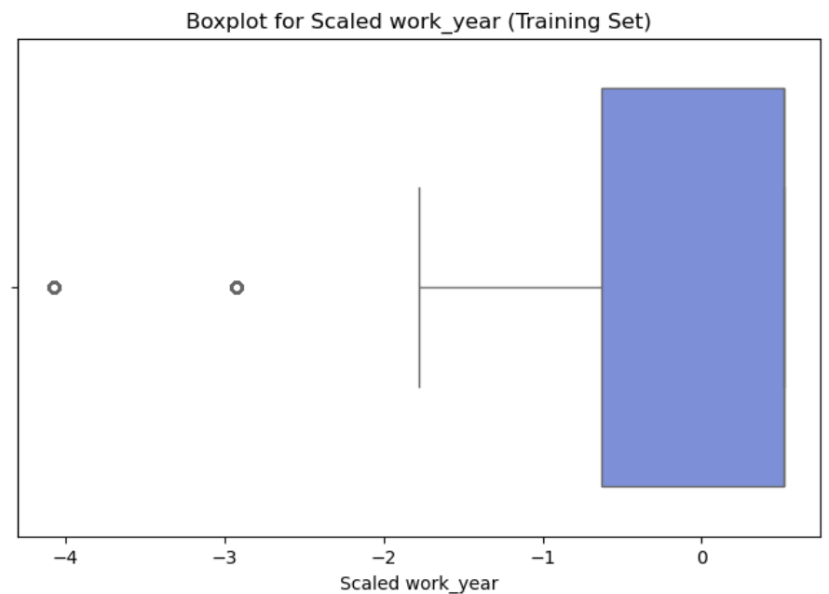
Data Preprocessing – Outlier detection and scaling
Objective: Normalize the data to ensure models are not biased by extreme values and to bring numerical features to the same scale.
Outlier Detection (Log Transformation):
A log transformation was applied only to the target variable (salary_in_usd).
This helps reduce the skewness caused by extreme salary values, stabilizing model predictions.
Scaling Numerical Features:
StandardScaler was applied to work_year and remote_ratio.
These features have different ranges, and scaling ensures the model treats them equally during training.

Slide 10
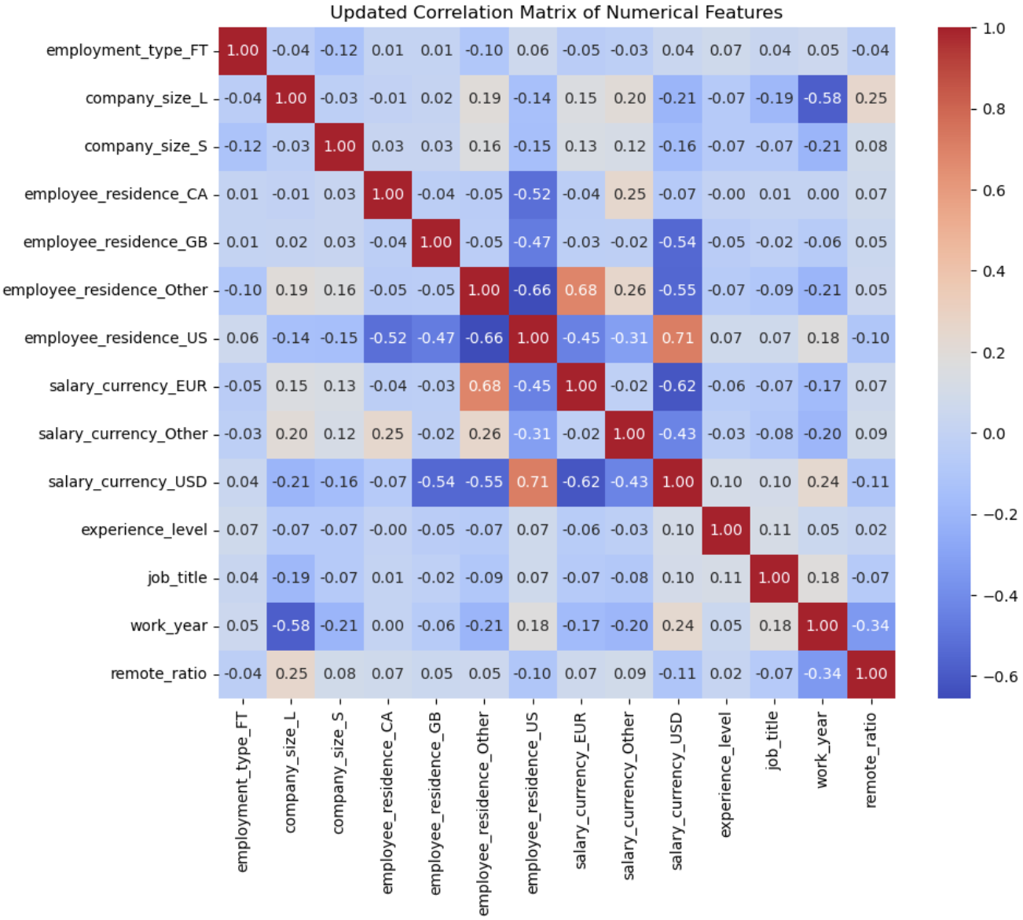
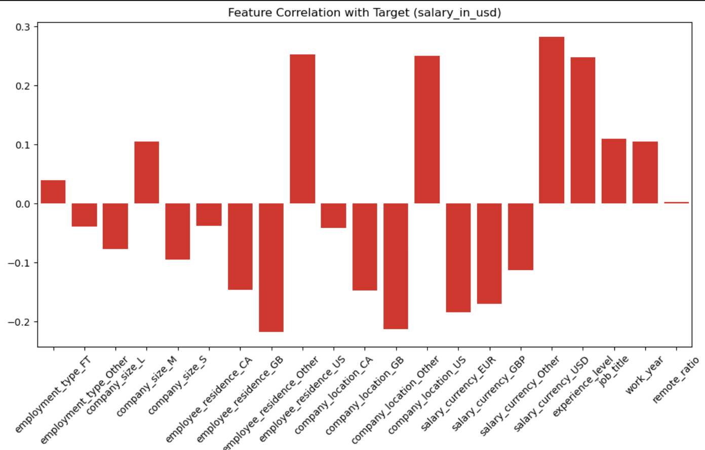
Data Preprocessing – Pearson Correlation
Correlation Matrix for Numerical Features:
A heatmap was generated to visualize correlations between numerical features.
This helps identify relationships between independent variables.
Correlation with Target (salary_in_usd):
A bar plot shows how each feature correlates with the target.
Positive correlations indicate features that increase with salary, while negative values suggest the opposite.
Threshold for High Correlation:
Pairs of features with a correlation higher than 0.85 were flagged.
Results:
Features such as salary_currency_USD and employee_residence_US show the strongest positive correlation with salary_in_usd.
No features had extreme correlations above the threshold, indicating no immediate need to drop significant columns.
This analysis ensures model stability and avoids overfitting by reducing redundant data.

Slide 11
Data Processing
Overall processing
Linear Regression
Random Forest
Split dataset in ≤ 300K and >300K
Recursive Feature Elimination
RandomSearch CV
XGBoost
RandomSearch CV
Understanding Low Model Performance by Job Title
Split dataset in ≤ 300K and >300K
XAI

Slide 12
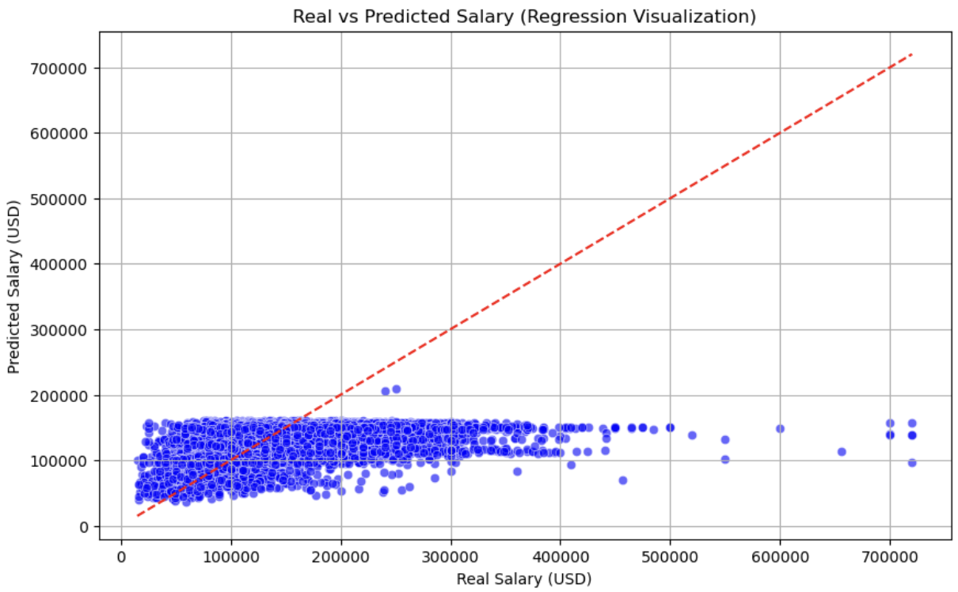
Data Processing – Linear Regression
Results Interpretation:
Visual Analysis (Scatter Plot):
The red dashed line represents the ideal prediction (y = x).
Most predictions cluster below the line, indicating the model tends to underestimate higher salaries.
There are a few extreme outliers (salaries > 300k) poorly predicted by the model.
Performance Metrics (Bottom Panel):
MAE: 44,758 USD (average error in salary prediction).
RMSE: 61,631 USD (penalizes larger errors).
R²: 0.11 (the model explains only 11% of variance, indicating low performance).

Slide 13
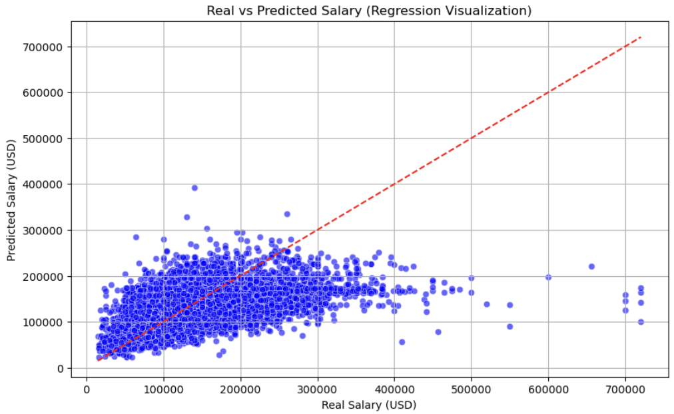
Data Processing – Random Forest
General Trend:
The model captures some degree of salary variation, but not with high precision.
Deviations and Outliers:
For salaries above approximately $300,000, predictions tend to flatten, suggesting underestimation of high salaries.
Outliers are present, particularly at higher salary ranges, where the model struggles to make accurate predictions.
Evaluation Metrics:
Mean Absolute Error (MAE): $43,018
Root Mean Squared Error (RMSE): $57,973
R² (R-Squared): 0.21 – Indicates that only 21% of the variance in salaries is explained by the model. This is relatively low, showing room for improvement.

Slide 14
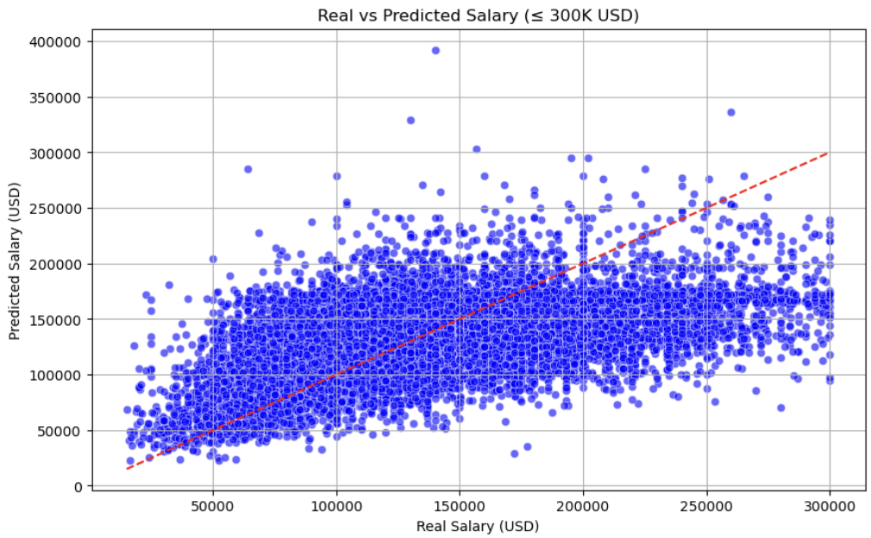
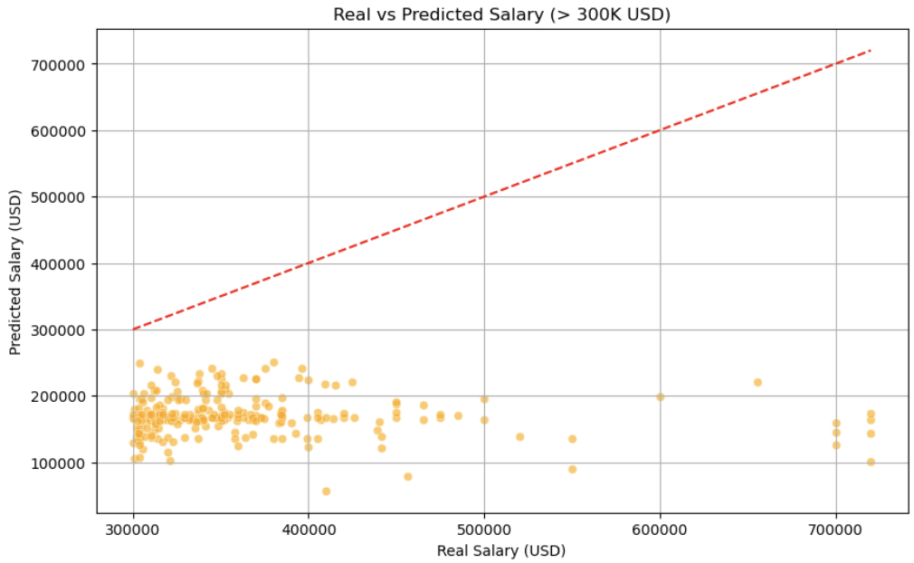
Data Processing – Random Forest split value
Results:
Salaries ≤ $300K:
Model shows reasonable predictive capability with an R² of 0.22.
Errors are distributed relatively consistently, but some underestimation is observed at higher salary levels.
Salaries > $300K:
Model struggles significantly for high salaries, with an R² of -6.04.
This suggests the need for more training data or different modeling approaches for extreme salaries.

Slide 15
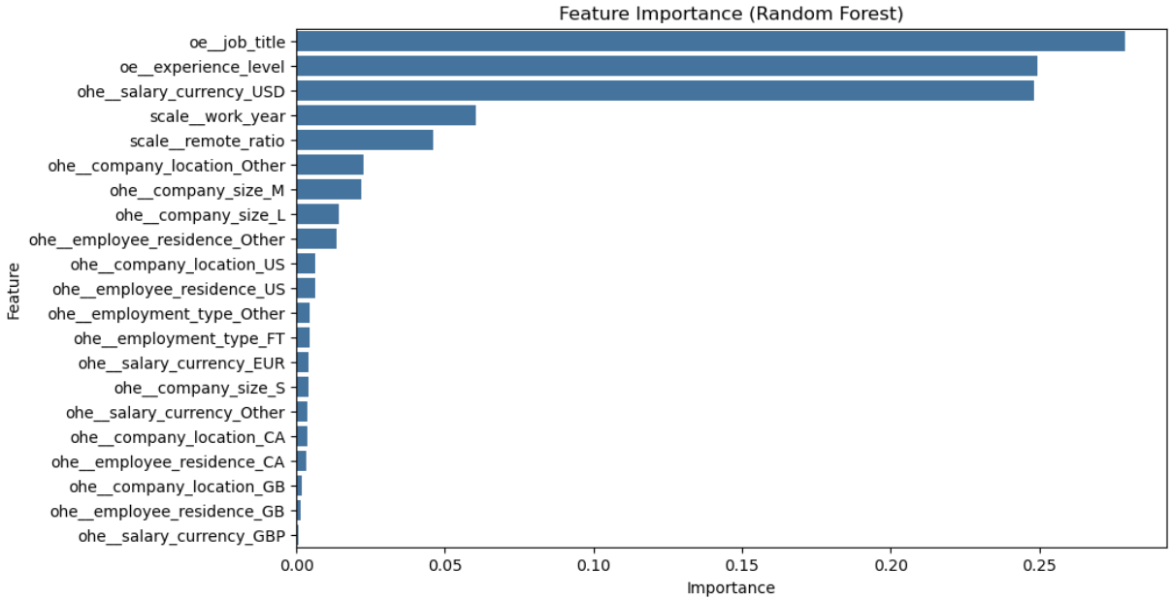
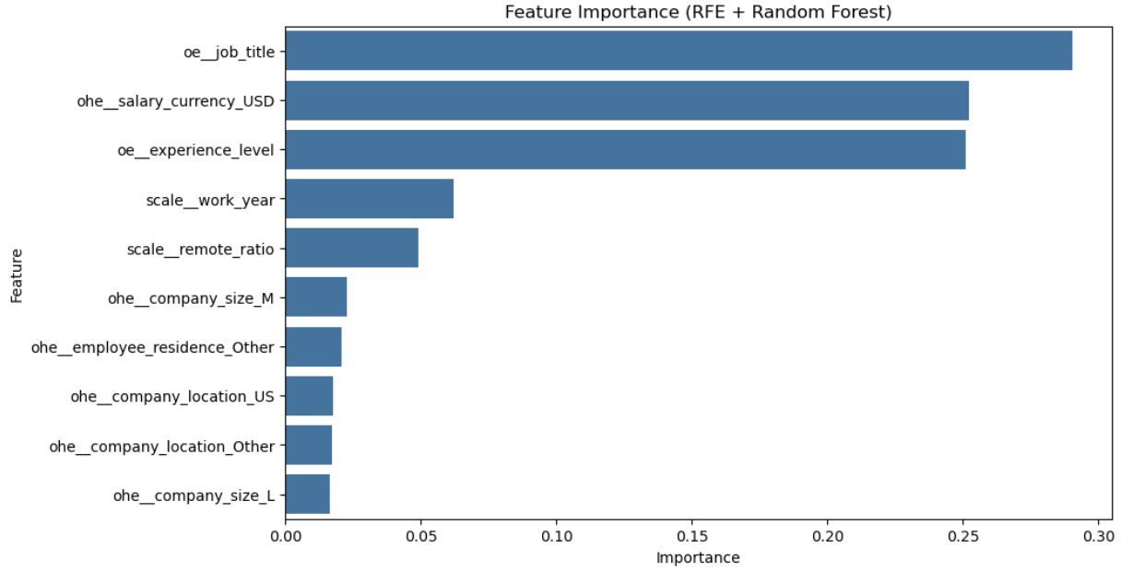
Data Processing – Feature Selection
1. Random Forest Feature Importance
How it Works:
Random Forest provides a built-in feature importance mechanism by calculating how much each feature decreases the impurity (Gini or variance).
Results:
The most important features were:
oe__job_title - ohe__salary_currency_USD- oe__experience_level
Other factors, such as company size and location, had lower importance.
2. Permutation Importance
3. Recursive Feature Elimination (RFE)
How it Works:
RFE recursively removes the least important features by training the model iteratively. It continues until the desired number of features is selected.
Results:
The top 10 features selected through RFE align with the results of Feature Importance and Permutation Importance.
This method reinforced the significance of job title, salary currency, and experience level.

Slide 16
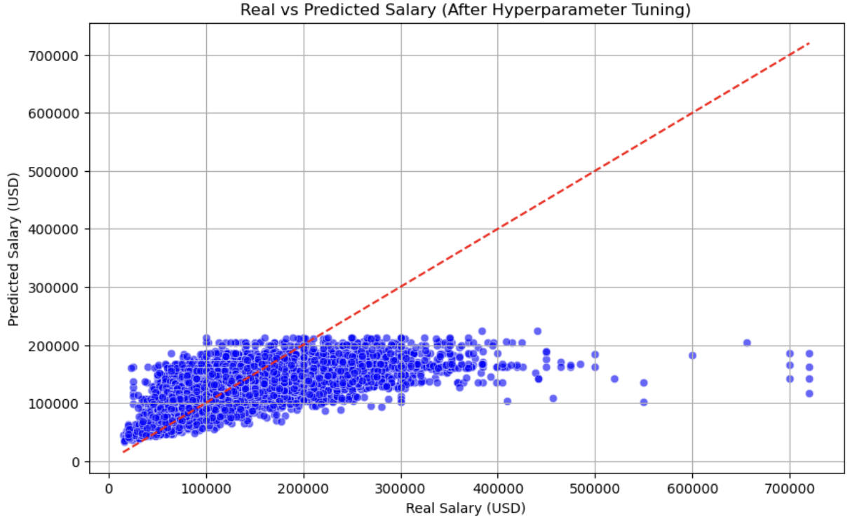
Data Processing – RandomSearch CV
Hyperparameters Explained:
n_estimators – Number of trees in the forest.
Values tested: [100, 200, 300, 400]
Best Value: 300
max_depth – Maximum depth of the individual decision trees. (Prevent overfitting)
Values tested: [10, 20, 30, 50, None]
Best Value: 30
min_samples_split – Minimum number of samples required to split an internal node.
Values tested: [2, 5, 10]
Best Value: 2 (aggressive splits to prevent underfitting)
min_samples_leaf – Minimum number of samples required to be in a leaf node.
Values tested: [1, 2, 4]
Best Value: 2
max_features – Number of features to consider for the best split.
Values tested: [sqrt, log2]
Best Value: sqrt (uses the square root of the total features, balancing performance and speed)
Results After Tuning:
MAE: 39,064 USD
RMSE: 54,749 USD
R²: 0.2996

Slide 17
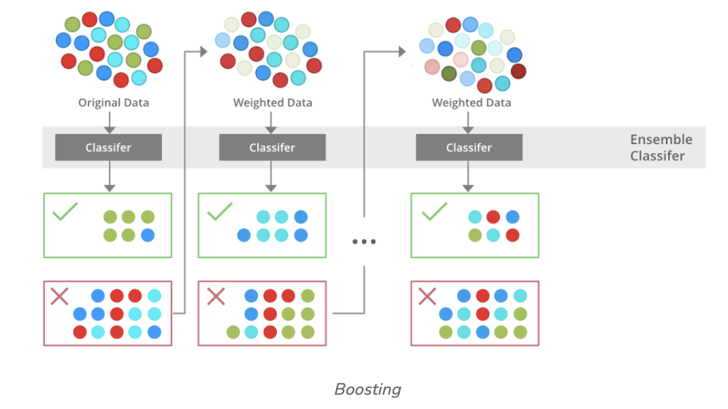
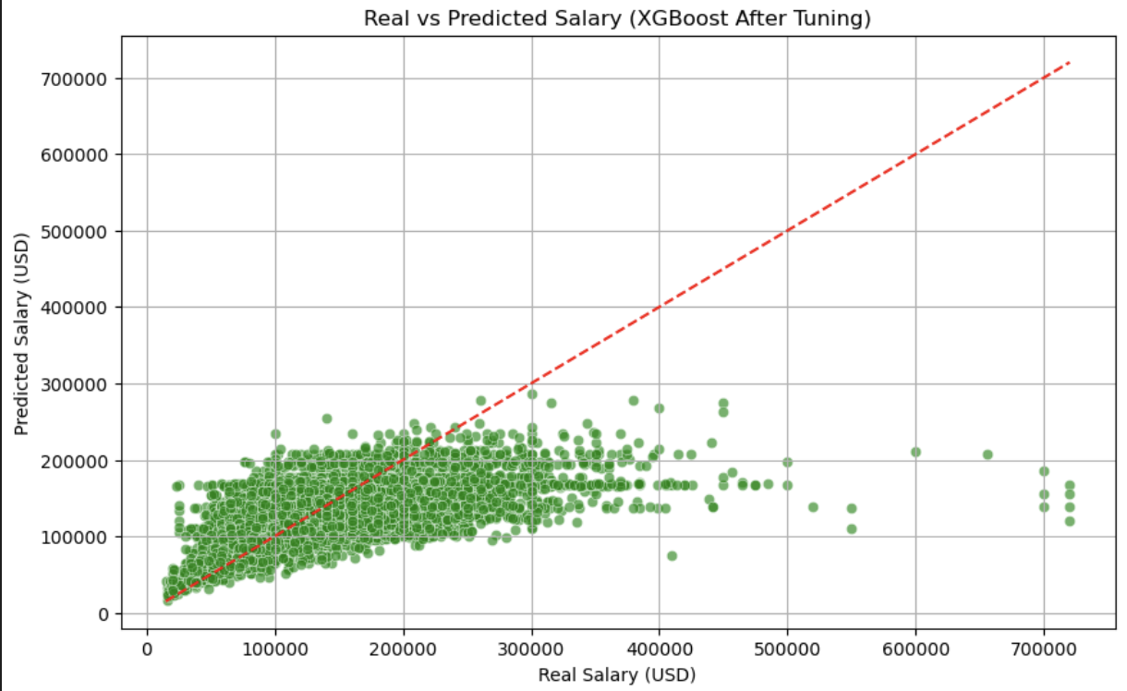
Data Processing – XGBoost RandomSearch CV
[1] Reference
First Classifier: Trained on the original data. Misclassified samples are assigned higher weights.
Second Classifier: Focuses on correcting the errors from the first classifier. Misclassified points continue to receive more weight.
Iterative Process: This continues until a strong ensemble classifier is created by aggregating all weak learners.
Final Model: The ensemble classifier makes the final decision, combining the outputs of all classifiers.
Results After Tuning:
MAE: 39,551 USD
RMSE: 54,630 USD
R²: 0.3026

Slide 18
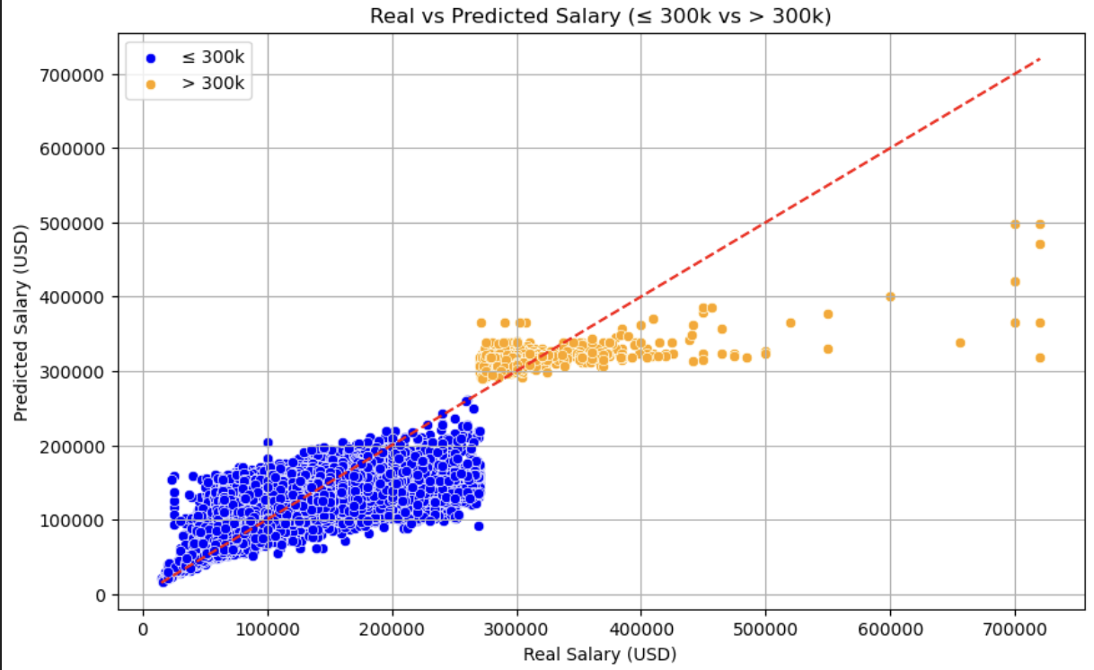
Data Processing – XGBoost split value
The model was divided into two segments:
Salary ≤ 300k:
XGBRegressor without hyperparameter tuning.
Faster training and evaluation.
Salary > 300k:
XGBRegressor with hyperparameter tuning using RandomizedSearchCV.
Aimed at addressing the higher variance in this segment.
Lower Salary Range (≤ 300k):
MAE: 34,043 USD
RMSE: 43,651 USD
R²: 0.35
The model performs better for this segment, achieving higher R² and lower errors.
Higher Salary Range (> 300k):
MAE: 34,931 USD
RMSE: 54,747 USD
R²: 0.41
Predictions for higher salaries show slightly higher errors and lower R², indicating challenges in modeling high-variance data.

Slide 19
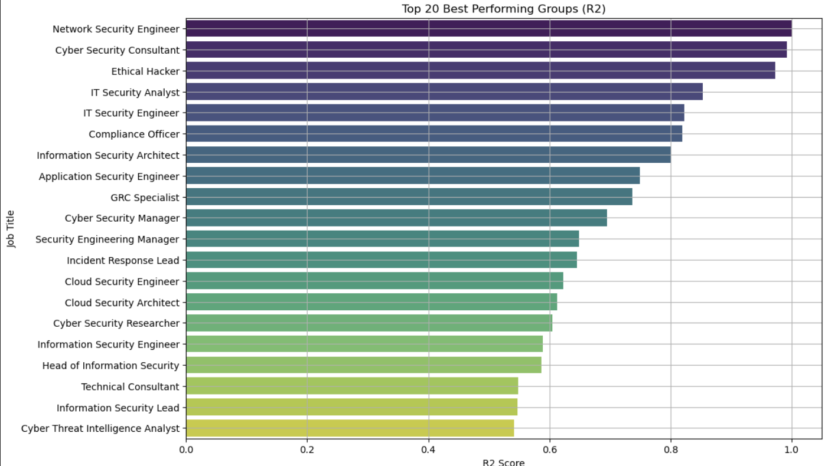
Understanding Low Model Performance by Job Title
Motivation
To explain why these results were low and what caused the poor performance.
I identified that the variable job_title was the most significant feature in predicting salaries. Based on this finding, I decided to split the dataset into groups by job_title to analyze whether individual job titles had distinct characteristics that could explain the variability in model performance.
Result Job Titles with High R²:
Groups like "Network Security Engineer" and "Cyber Security Consultant" exhibited distinct and consistent patterns in features and salaries, The data for these groups showed less variability and better alignment with the features.

Slide 20
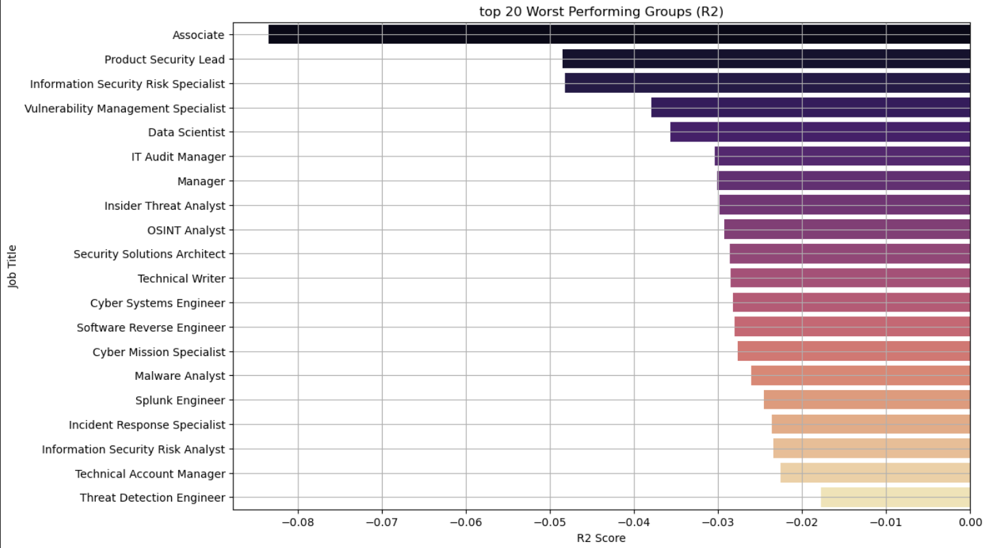
Understanding Low Model Performance by Job Title
I observed that certain job titles had negative R² scores, indicating that the model performed worse than a simple baseline mean prediction for those groups.
Job Titles with Negative R²:
Titles such as "Associate" and "Product Security Lead" showed particularly poor performance. These groups often had:
High salary variability, making predictions more challenging.
Uneven or uninformative feature distributions, limiting the model's ability to learn meaningful patterns.
For some titles, the small number of observations amplified the effect of outliers.

Slide 21
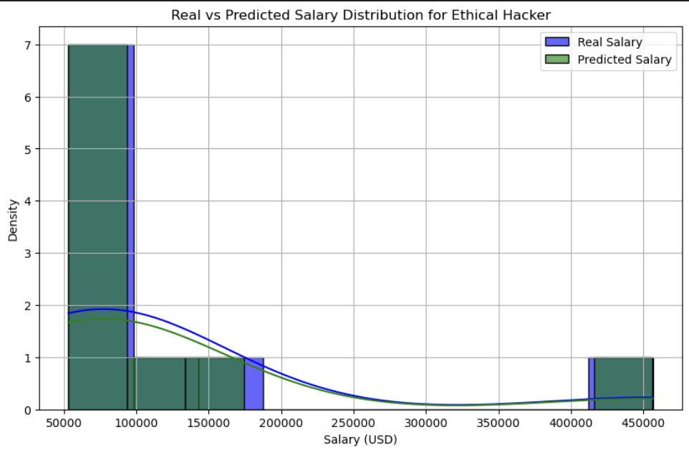
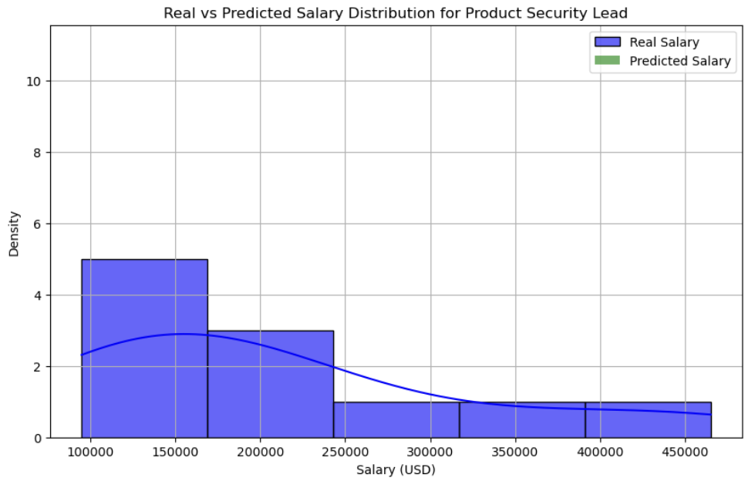
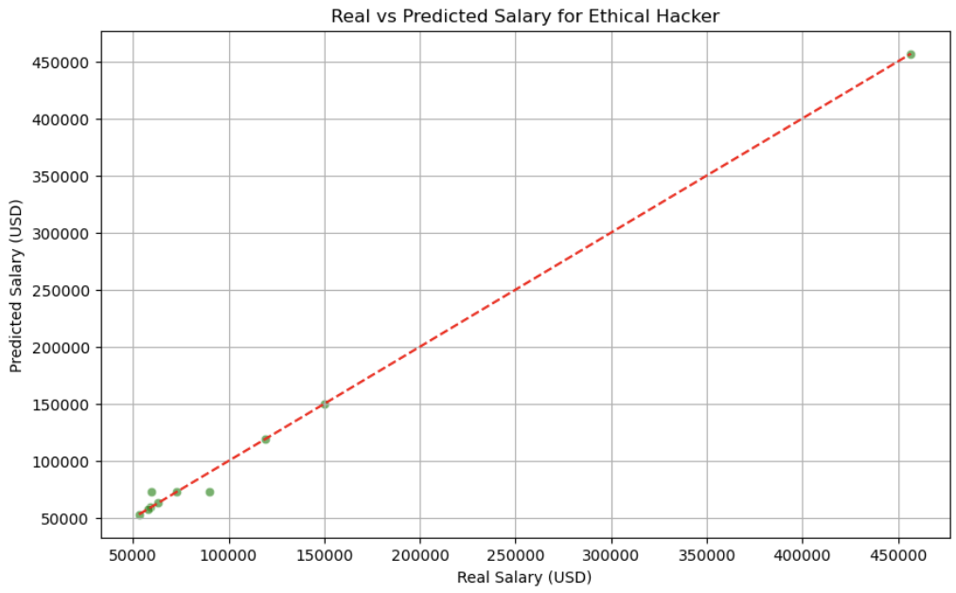
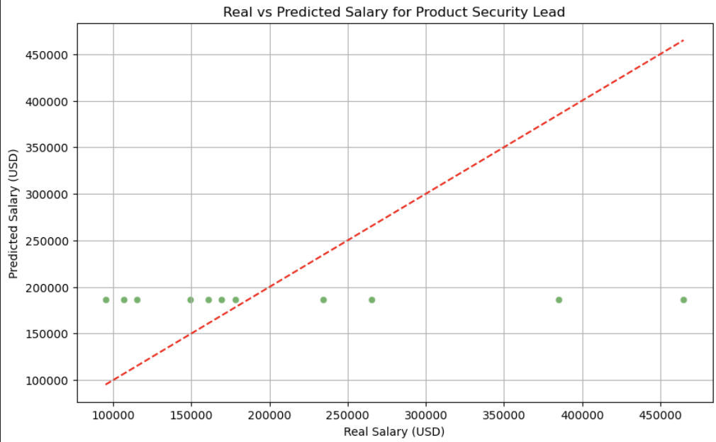
Understanding Low Model Performance by Job Title

Slide 22
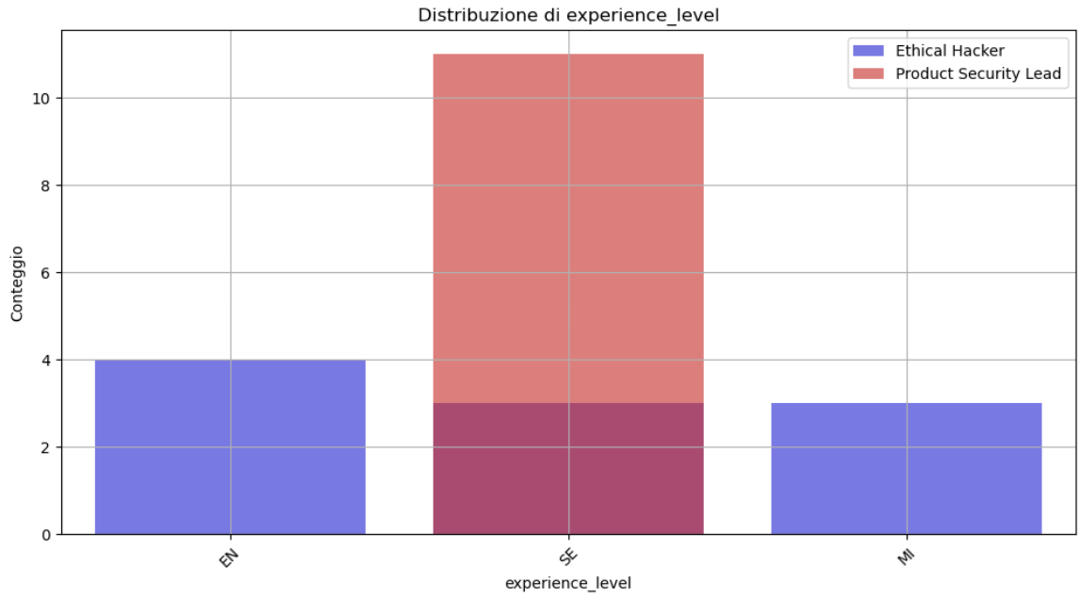
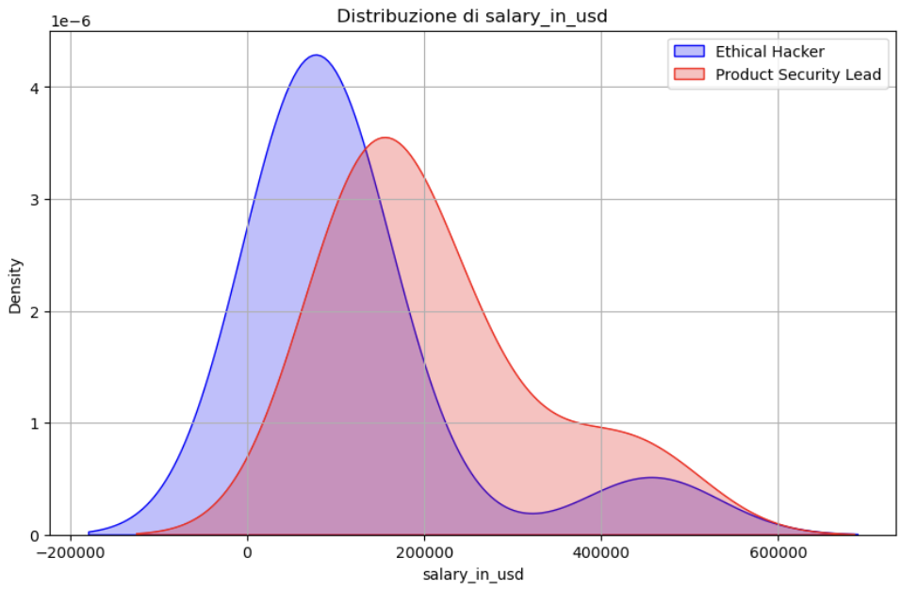
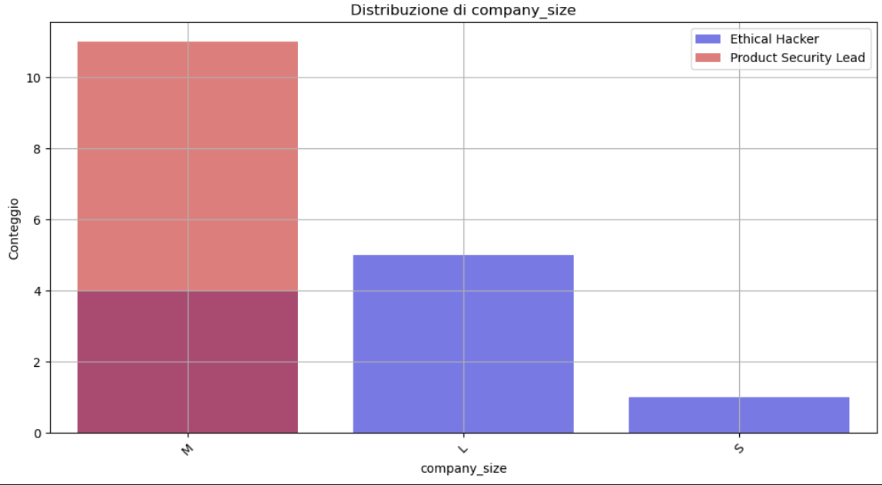
Why these results?
To understand why the model performs well for some job titles and poorly for others, I selected two contrasting examples:
Ethical Hacker (R² high): This group represents a job title where the model performs well.
Product Security Lead (R² low): This group represents a job title where the model struggles to predict accurately.

Slide 23
Why these results?
Key Observations
Group Size:
Both groups have small sample sizes: 10 observations for Ethical Hacker and 11 for Product Security Lead.
Small datasets are inherently more sensitive to noise and outliers, which impacts model performance.
Salary Distribution:
Ethical Hacker: Salaries are concentrated within a narrower range (~50k to ~150k USD), creating a predictable pattern for the model.
Product Security Lead: Salaries are spread over a much wider range (up to 600k USD), introducing variability that the model struggles to explain.
Feature Distribution:
Experience Level:
Ethical Hacker: Balanced distribution across levels (EN, SE, MI).
Product Security Lead: Highly skewed toward senior-level positions (SE), reducing feature variability.
Company Size:
Ethical Hacker: Observations are distributed across small, medium, and large companies.
Product Security Lead: Dominated by medium-sized companies, limiting the information available for predictions.
Features with Zero Variance:
For Product Security Lead, certain features such as:
work_year: All observations have the same value, resulting in zero variance.
remote_ratio: Similarly, this feature has no variability within the group.
Features with zero variance do not contribute to the model and reduce its ability to capture meaningful relationships, further lowering predictive performance.

Slide 24
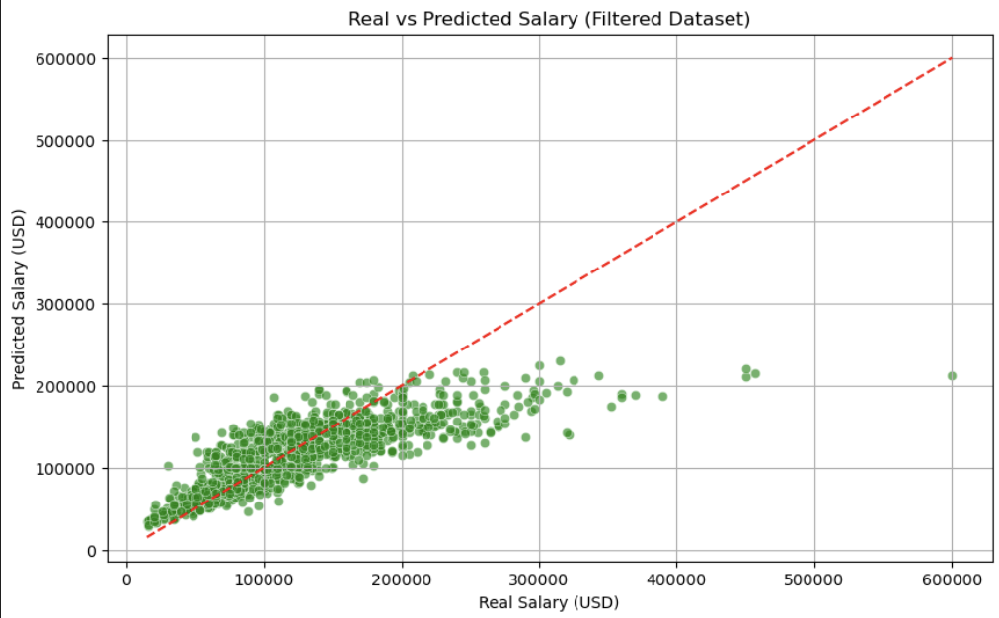
Understanding Low Model Performance by Job Title
Identification of Low-Performing Roles:
Job titles with an R² below 0.5 were identified and excluded from the dataset.
This step removed groups with significant variability or poor feature distributions that negatively impacted the model.
Filtered Dataset:
This filtering ensures the model focuses on data where it is likely to perform better.
Re-Training the Model:
The filtered dataset was used to re-train the model with RandomizedSearchCV for hyperparameter optimization.
A 5-fold cross-validation was applied to ensure robustness in the evaluation.
Evaluation on the Filtered Dataset:
A scatter plot of real vs. predicted salaries illustrates the model's improved performance.
Key Insights
The filtered dataset size (1,214 observations) limits the model's ability to generalize, especially for the high-salary group, which comprises fewer data points.
But,

Slide 25
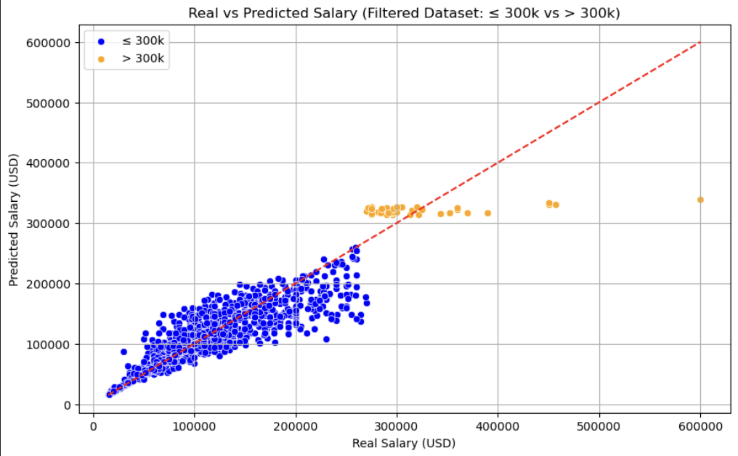
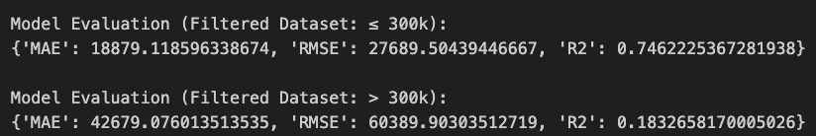

Understanding Low Model Performance by Job Title
WARNING

Slide 26
Understanding Low Model Performance by Job Title
WARNING
After conducting extensive analyses and experiments with the dataset, it has become clear that the dataset is not fully suitable for achieving consistently reliable and accurate results.

Slide 27
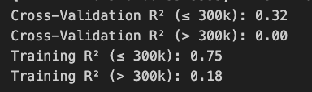
Understanding Low Model Performance by Job Title
WARNING
Cross-Validation vs Training R² for ≤ 300k:
Cross-Validation R²: 0.32
Training R²: 0.75
The large gap between these values suggests overfitting:
The model performs significantly better on the training data but fails to generalize to unseen data during cross-validation.
This indicates the model has learned patterns specific to the training set (potentially noise) but cannot apply these patterns to new data.
Cross-Validation vs Training R² for > 300k:
Cross-Validation R²: 0.00
Training R²: 0.18
In this range, the model struggles to learn meaningful patterns even on the training data, leading to poor generalization:
The low R² values reflect the limited predictive power of the model for this segment of the dataset.
This is likely due to the small sample size or high variability in salaries above 300k.
After conducting extensive analyses and experiments with the dataset, it has become clear that the dataset is not fully suitable for achieving consistently reliable and accurate results.

Slide 28
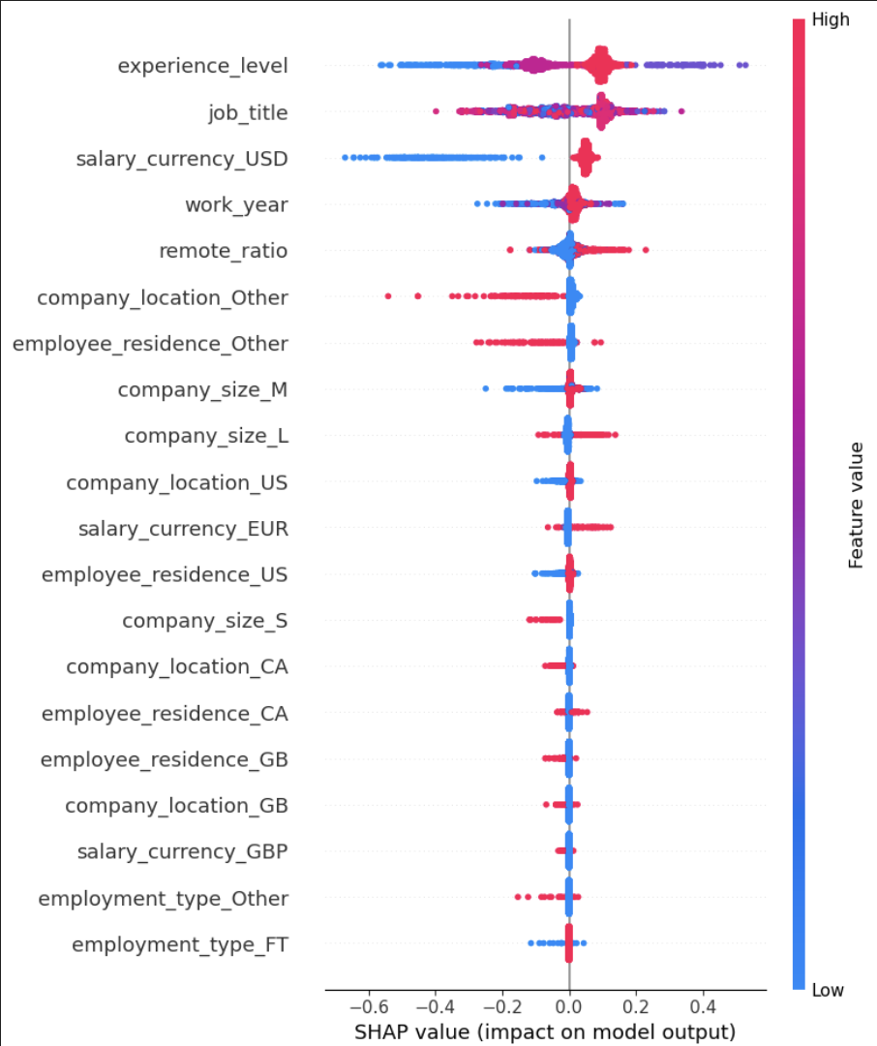
Data Processing – XAI
SHAP:
Experience Level, Job Title, and Currency (USD) are the most influential features and explainable of the model.
Higher remote ratio negatively impacts predictions.

Slide 29
Result Summary
 | MAE | RMSE | R²
Linear Regression | 44,758 | 61,631 | 0.11
Random Forest | 43,018 | 57,973 | 0.21
RFE | 43,050 | 57.005 | 0.21
RF with RandomSearch CV | 39,064 | 54,749 | 0.29
XGBoost with RandomSearch CV | 39,551 | 54,630 | 0.3026
XGBoost | split | MAE | RMSE | R²
without | ≤300K | 34,043 | 43,651 | 0.35
with | >300K | 34,931 | 54,747 | 0.41

Slide 30
Result Summary – T-test
Approach:
Conducted 5-fold cross-validation for each model.
Collected R² scores for each fold as the performance metric.
Applied paired t-test to compare the mean R² scores between models.
Comparison | P-value | Significant
Linear Regression vs Random Forest | 0.0001 | Yes
Linear Regression vs XGBoost | 0.0002 | Yes
Random Forest vs XGBoost | 0.0024 | Yes
Conclusion:
XGBoost is the top-performing model, with statistically significant improvements over both Random Forest and Linear Regression.
Random Forest also significantly outperforms Linear Regression, making it a strong alternative to XGBoost.

Slide 31
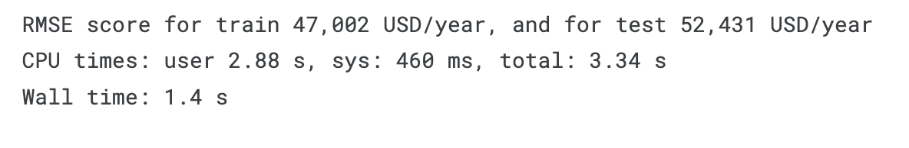
Model Performance Comparison with Baseline and Next step
[2] Reference
Conclusion:
While the RMSE values may seem high, they are reasonable given the nature of the dataset and the task's complexity.
The model is more effective than the baseline, demonstrating a better generalization to unseen data.
Future improvements could involve:
Collecting additional features or external datasets.
Implementing advanced feature engineering or domain-specific knowledge to improve model explainability.

Slide 32

Thank you for the attention!
Reference: [1]: https://www.geeksforgeeks.org/xgboost/
[2]: https://www.kaggle.com/code/dima806/information-security-salary-autoviz-catboost-shap

