Slide 1
Week 1 Progress
Sample-Efficient Active Level-Set Estimation, with an Application to Melt-Pool Regime Boundaries
Goal: show the first working active-learning loop, first visually on make_moons and then numerically on thresholded Branin.
The goal was not to develop the final acquisition method yet, but to get the sequential active-learning loop running on synthetic benchmarks and to verify that we can visualize and measure boundary recovery.
2
3
6 → 50
33.7% → 6.1%
synthetic benchmarks
make_moons + Branin
seeds checked
for stability
labelled evaluations
per run
mean Branin test error
Week 1 progress • Sample-Efficient Active Level-Set Estimation • 1
Notes:
Opening: This is the progress overview Ioan asked for. The message is simple: the Week 1 plumbing loop is running, the plots are collected in one place, and the Branin benchmark gives a numerical error curve against an exact boundary.

Slide 2
What Week 1 is testing
A tiny version of the thesis: choose labels sequentially and see if the boundary estimate improves.
Key objects
Why synthetic first?
μ(x): GP latent mean; sign decides predicted label
2D data can be plotted and debugged visually
μ(x)=0: believed boundary between −1 and +1
Branin has an exact known threshold boundary
σ(x): model uncertainty from the GP
The same loop later transfers to laser data
Start with
6 labels
Fit GP regressor
stand-in
Score pool
Reveal label
Refit + repeat
initial labelled set
predict μ and σ
choose smallest |μ(x)|
mimic expensive oracle
until budget 50
The loop starts with six labelled points, fits a GP regressor as a simple stand-in, scores the unlabelled pool using the smallest absolute latent mean, reveals one label, and then refits. The believed boundary is the contour where the GP latent mean is zero.
Week 1 success criterion: the loop completes, the boundary estimate becomes more localized, and Branin test error falls against the exact boundary.
Week 1 progress • Sample-Efficient Active Level-Set Estimation • 2
Notes:
Explain the loop slowly: start with six labels, fit the simple GP regressor, score the unlabelled pool, reveal exactly one new label, then refit. Emphasize that this is the Week 1 stand-in, not the final GP classifier or final acquisition function.

Slide 3
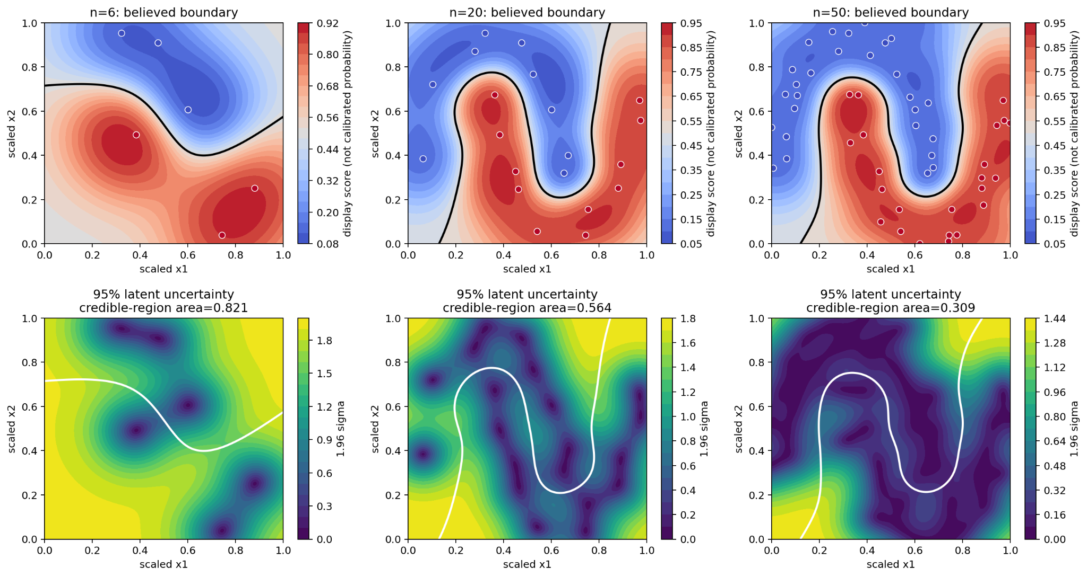
Visual sanity check: make_moons
Does the active-learning loop visibly contract uncertainty around a believed boundary?
What to read from the plot
Top row: GP display score, not calibrated probability, and believed boundary μ=0
Bottom row: 95% latent uncertainty region
Credible-region area
0.821 → 0.564 → 0.309
The credible-region area decreases from 0.821 to 0.309 for seed 0, so visually the uncertain region around the believed boundary contracts.
This tells me the loop behaves sensibly before moving to a measurable benchmark.
Interpretation: this is a visual sanity check. The credible region shrinks, but correctness is measured on Branin.
Week 1 progress • Sample-Efficient Active Level-Set Estimation • 3
Notes:
Use this slide as the visual sanity check. make_moons is not the final metric; it tells us whether the sequential loop produces sensible boundary contraction that we can inspect by eye.

Slide 4
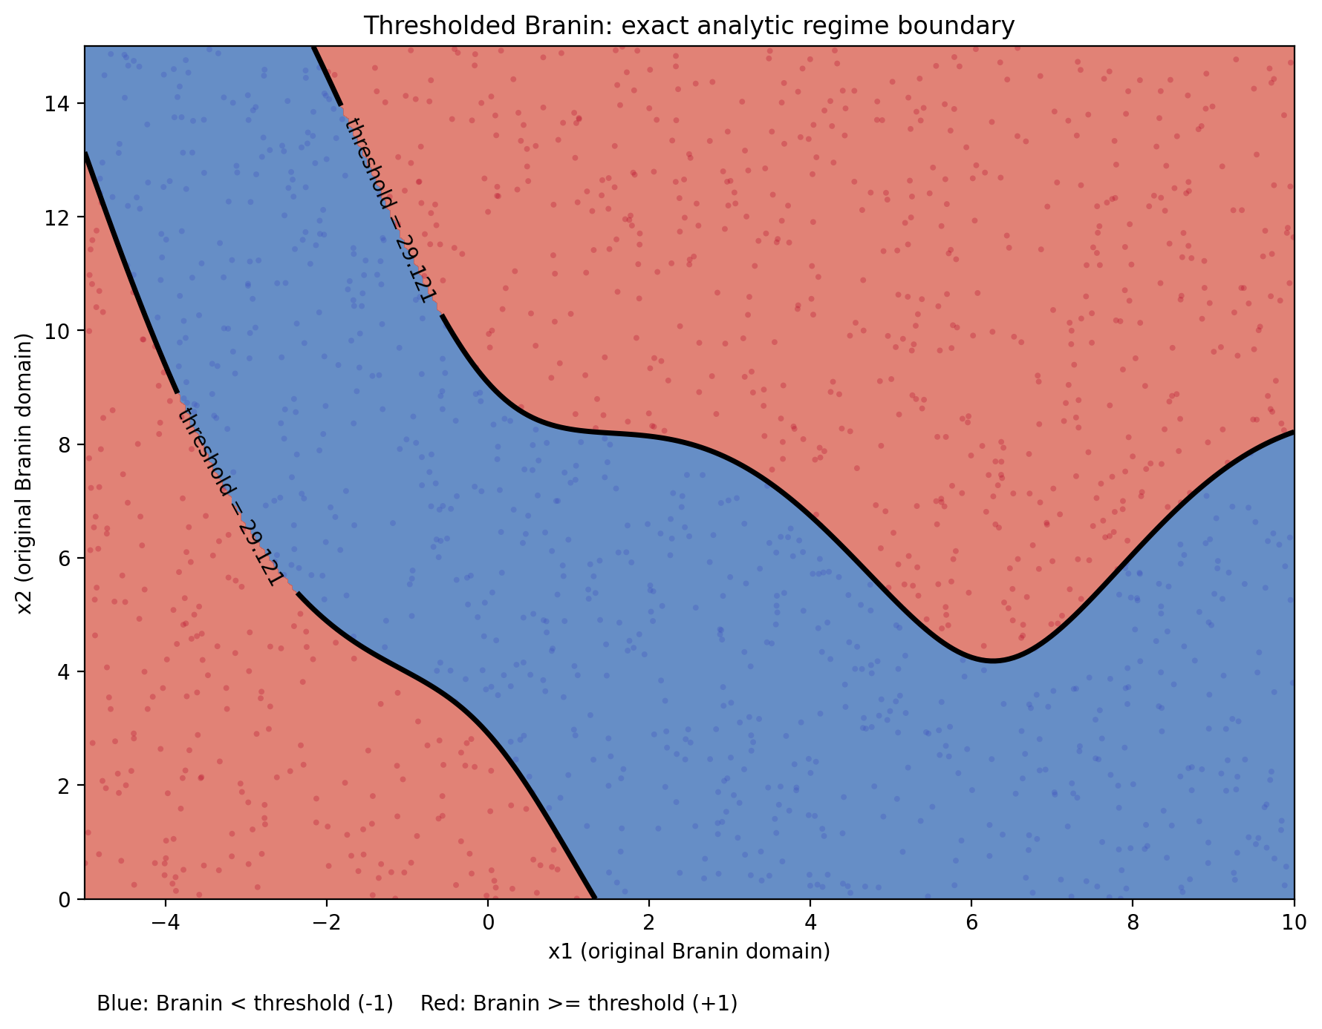
Measured benchmark: thresholded Branin
Unlike make_moons, Branin gives an exact analytic boundary, so we can compute a numerical error.
How the benchmark is built
Evaluate Branin on x₁∈[−5,10], x₂∈[0,15]
Threshold τ = 45th percentile over 20,000 reproducible random points
Label +1 if Branin(x) ≥ τ, otherwise −1
Pool: 1,500 candidate points; Test: 4,000 independent points. The pool is used for candidate selection, while the test set is only used for evaluation.
Branin is useful because the exact threshold boundary is known. I thresholded the Branin function at the 45th percentile, which gave τ = 29.121. The black curve is the exact analytic boundary used for evaluation.
τ = 29.121
45th
recorded threshold
percentile threshold
Week 1 progress • Sample-Efficient Active Level-Set Estimation • 4
Notes:
This is the numerical benchmark. Because Branin is known, the analytic boundary can be computed directly. That is why we can evaluate exact misclassification error on a held-out test set.

Slide 5
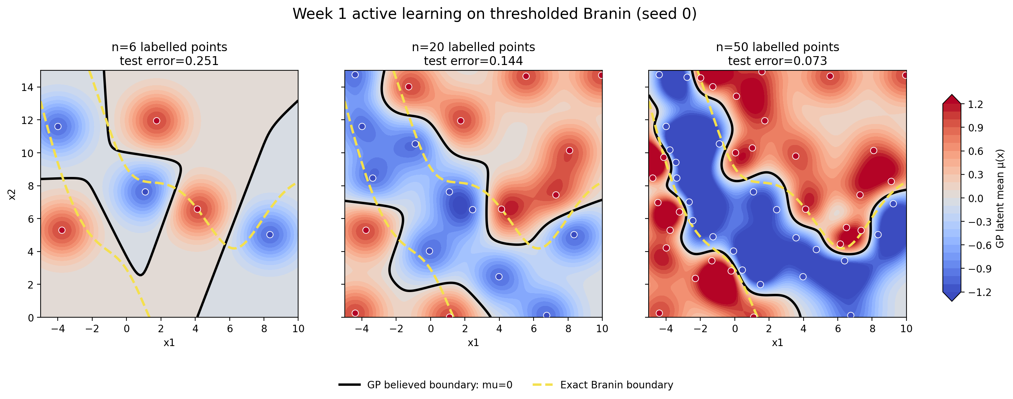
Branin active learning snapshots
The GP boundary becomes more informative as labels are revealed; the exact boundary is shown for reference.
The black line is the GP believed boundary, and the yellow dashed line is the exact Branin boundary. As the labelled budget increases from 6 to 20 to 50, the model’s boundary estimate becomes more informative and the test error for seed 0 drops from 0.251 to 0.073.
Seed 0: test error drops 0.251 → 0.144 → 0.073
• Black = GP believed boundary μ=0 • Yellow dashed = exact Branin boundary
Week 1 progress • Sample-Efficient Active Level-Set Estimation • 5
Notes:
Point out that the GP boundary is still imperfect locally. The success signal is not visual perfection; it is that the error drops and the model starts finding the relevant boundary geometry with only 50 labels.

Slide 6
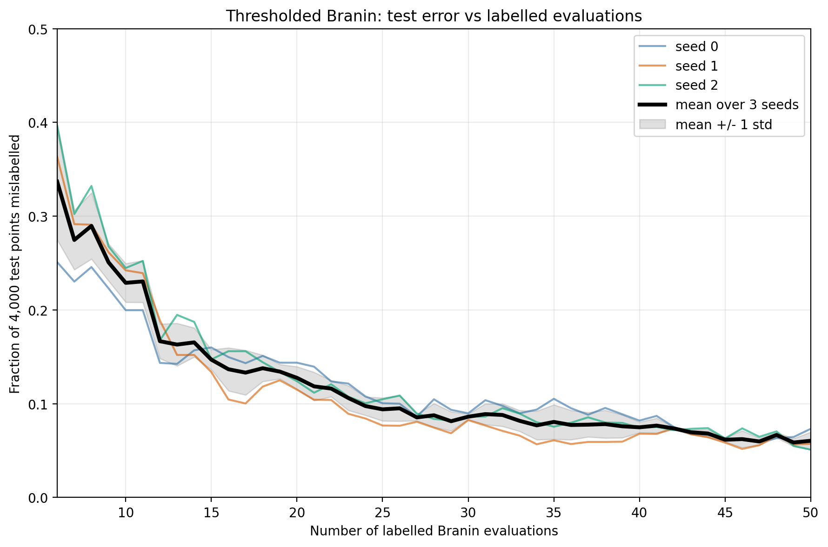
Numeric result: Branin test error falls across seeds
Error is the fraction of 4,000 independent test points mislabelled against the exact thresholded-Branin labels.
Per-seed improvement
Seed
Initial
Final
0
25.10%
7.32%
1
36.35%
5.73%
2
39.60%
5.10%
33.68%
6.05%
mean initial error at n=6
mean final error at n=50
This is the main numeric result. For each budget, I predicted labels on 4,000 independent test points and measured the fraction that disagreed with the exact Branin-threshold labels. Across three seeds, the mean error decreases from 33.68% to 6.05%.
Caveat: the curve need not fall at every single query; GP refitting can move the boundary globally. The important signal is the strong downward trend across all seeds.
Week 1 progress • Sample-Efficient Active Level-Set Estimation • 6
Notes:
This is the main numeric result. Each point on the curve is the fraction of 4,000 independent test points classified incorrectly. The mean error falls from about 33.7 percent to about 6.1 percent.

Slide 7
Week 1 status and next step
The plumbing loop is now working; Week 2 can compare acquisition rules under a fixed loop.
✓
make_moons visual loop completed
Week 2 plan
✓
Branin thresholded benchmark generated
Keep data, GP model, pool, test set and budget fixed
✓
GP regressor stand-in fitted on {-1,+1} labels
Change only the selection rule
✓
Sequential reveal → fit → score → query → refit loop runs
Compare: Random, smallest |μ|, Straddle (1.96σ - |μ|)
✓
Branin error measured against exact boundary
Plot error-vs-evaluations with mean and spread bands
✓
3-seed stability check completed
Note
Current GP regressor is a Week 1 stand-in. It exposes μ and σ clearly, but it is not the final GP classifier planned for the thesis.
Week 1 confirms that the pipeline is working. The natural next step is to keep this loop fixed and compare different acquisition rules: random, smallest |μ|, and straddle 1.96σ−∣μ∣.
Week 1 progress • Sample-Efficient Active Level-Set Estimation • 7
Notes:
Close with the transition to Week 2: keep the loop fixed and compare selection rules. The deck is now useful as an ongoing progress log, matching Ioan's request for an overview with graphics.

