Slide 1
Week 2 — Active Level-Set Estimation
Week 2 Progress
Sample-Efficient Active Level-Set Estimation, with an Application to Melt-Pool Regime Boundaries
Goal: compare acquisition rules fairly on the fixed thresholded-Branin loop.
The loop, data, GP regressor stand-in, initial labels, test set and budget are held fixed. Only the next-point selection rule changes.
5
5
6 → 50
35.2%
6.0%
acquisition rules
seeds
labelled evaluations
mean initial error
best mean final error
randomized straddle
Main message: boundary-aware rules finish clearly below random; randomized straddle is best in this run, with straddle very close.
Week 2 progress • Sample-Efficient Active Level-Set Estimation • 1
1
Notes:
Opening: This is the Week 2 progress overview. The central message is that the acquisition comparison is now running under a fair fixed-loop design. I kept the Week 1 Branin setup fixed and changed only the acquisition rule. The result is that boundary-aware rules clearly outperform random, while randomized straddle is the best method in this run but should not be overclaimed as a final conclusion.

Slide 2
What Week 2 is testing
A fair acquisition-rule comparison: same active-learning problem, different next-point rules.
Fairness principle
For each seed, all methods use the same Branin threshold, pool, test set, GP regressor, budget, and initial labelled points. Therefore, differences in error curves should come from the acquisition rule.
Shared Branin
Shared pool
Shared test set
Shared start
Shared GP
Change only
τ = 29.121
1,500 points
4,000 points
same 6 labels
GPR stand-in
acquisition rule
RECORDED SETUP
Seeds: 0–4 • Initial labels: 6 • Total budget: 50 • Threshold percentile: 45% • Model: GaussianProcessRegressor on {-1,+1} labels
Fairness checks are true for all five seeds.
Week 2 progress • Sample-Efficient Active Level-Set Estimation • 2
2
Notes:
This slide explains why the comparison is fair. The point is not just that the methods are different; the important part is that everything except the acquisition rule is fixed. Within each seed, the methods start from the same six labelled points and evaluate on the same 4,000 test points. This makes the result much easier to interpret.

Slide 3
Five acquisition rules
All rules score or choose among the same unlabelled Branin pool.
Random
Smallest |μ|
Uniform random unlabelled point
argmin |μ(x)|
Floor baseline: no boundary information.
Chooses the point closest to the current GP boundary.
Straddle
Randomized straddle
max 1.96σ(x) − |μ(x)|
max √β σ(x) − |μ(x)|
Balances boundary closeness and GP uncertainty.
Same idea as straddle, but the uncertainty weight changes each step.
Expected feasibility
E[max((1.96σ)² − Y², 0)]
Contour-focused expected-improvement-style heuristic.
Important: μ and σ are latent outputs of the GP-regression stand-in; they are not calibrated class probabilities.
Week 2 progress • Sample-Efficient Active Level-Set Estimation • 3
3
Notes:
Here I define the five rules in plain language. The first three match Ioan’s Week 2 brief: random, smallest absolute mean, and straddle. I also included two useful extensions: randomized straddle and expected feasibility. I should emphasize that these are still heuristic rules under the GP-regression stand-in, not the final GP classifier or final thesis method.

Slide 4
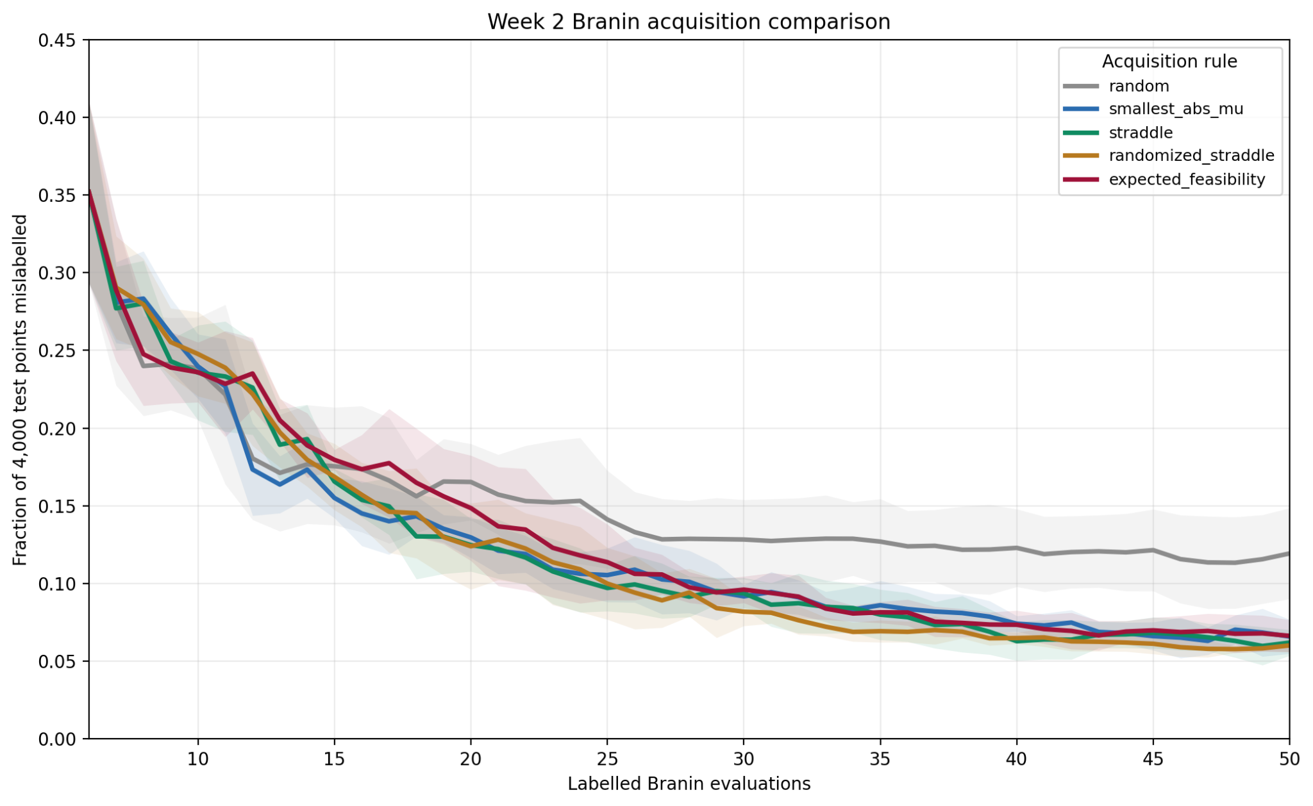
Mean error curves across five seeds
Error is the fraction of 4,000 independent Branin test points mislabelled. Lower is better.
What the curves show
•
All methods start from the same mean error: 35.19%.
•
Random improves, but plateaus higher than the boundary-aware rules.
•
Smallest |μ|, straddle, randomized straddle and expected feasibility all end around 6–7%.
•
Individual curves are not required to be monotone because the GP is refit globally after each new label.
Main signal: boundary-aware acquisition is useful.
Week 2 progress • Sample-Efficient Active Level-Set Estimation • 4
4
Notes:
This is the main curve figure. The y-axis is misclassification error on 4,000 independent Branin test points. The important message is not that every curve decreases at every single step. The important message is the separation between random and the boundary-aware methods. Random remains clearly higher, while the boundary-aware methods finish close to six or seven percent.

Slide 5
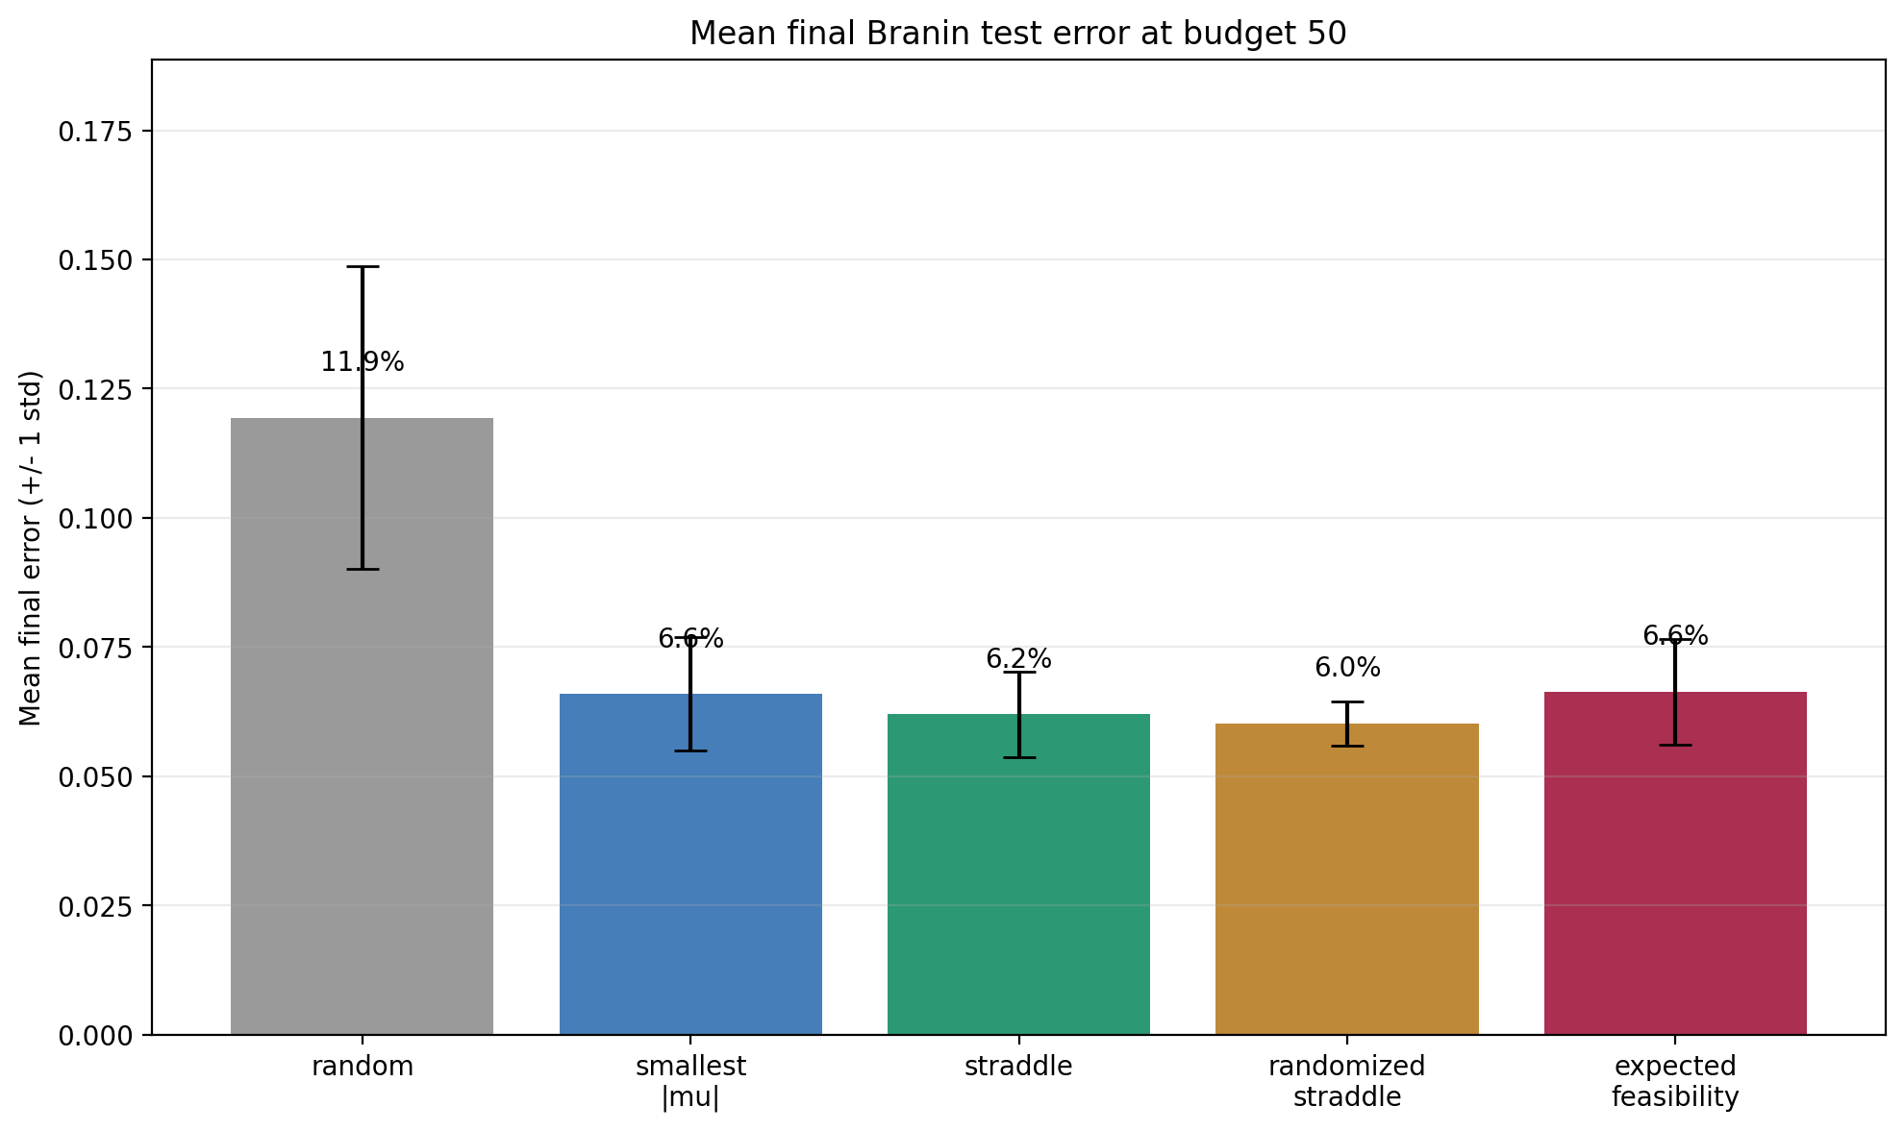
Final ranking at budget 50
Randomized straddle is best by mean final error in this run, but straddle is very close.
Mean final error
1
randomized straddle
6.02%
2
straddle
6.20%
3
smallest |μ|
6.59%
4
expected feasibility
6.64%
5
random
11.94%
Safe wording
Best in this run, not a final method ranking yet.
Week 2 progress • Sample-Efficient Active Level-Set Estimation • 5
5
Notes:
This slide gives the final ranking at budget 50. Randomized straddle has the lowest mean final error at 6.02 percent, followed very closely by straddle at 6.20 percent. I should not overclaim this difference because it is small and the experiment still uses only five seeds on one synthetic benchmark. The stronger conclusion is that all boundary-aware rules perform much better than random.

Slide 6
Sample efficiency proxy: reaching 8% test error
This is a lightweight tolerance check, not a geometric contour-distance metric.
First budget where the mean curve reaches ≤ 8% error
randomized straddle
n=32
straddle
n=35
expected feasibility
n=37
smallest |μ|
n=39
random
did not reach
labelled evaluations
30
35
40
Interpretation: randomized straddle reaches the 8% proxy at n=32, compared with n=39 for smallest |μ|; random does not reach it on the mean curve.
Week 2 progress • Sample-Efficient Active Level-Set Estimation • 6
6
Notes:
This slide translates the curves into a simple sample-efficiency proxy. The chosen tolerance is eight percent misclassification error on the test set. Randomized straddle reaches this threshold at n equals 32 on the mean curve, while smallest absolute mean reaches it at n equals 39 and random does not reach it. I should emphasize that this is only a test-error proxy, not a geometric boundary-distance measure.

Slide 7
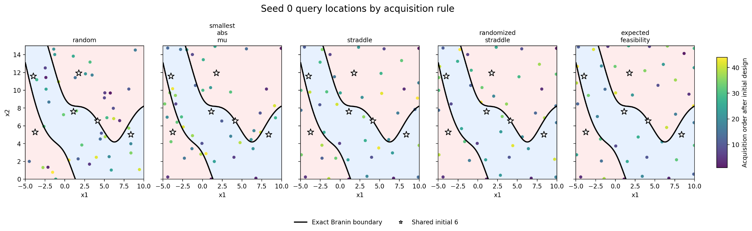
Query behavior on seed 0
Where did each method spend its labelled evaluations by budget 50?
•
The black curve is the exact Branin boundary; stars are the shared initial six points.
•
Random has no boundary mechanism; the other rules use μ and/or σ to choose more informative candidates.
•
This is qualitative evidence only; the quantitative comparison is still the test-error curve.
Week 2 progress • Sample-Efficient Active Level-Set Estimation • 7
7
Notes:
This slide is a qualitative check. The black curve is the exact thresholded-Branin boundary, and the stars are the shared initial points. Random samples without using the GP boundary or uncertainty. The other methods use the latent mean and uncertainty to choose points that should be more informative for the boundary. I should not make a strong claim from this plot alone; it supports the quantitative results.

Slide 8
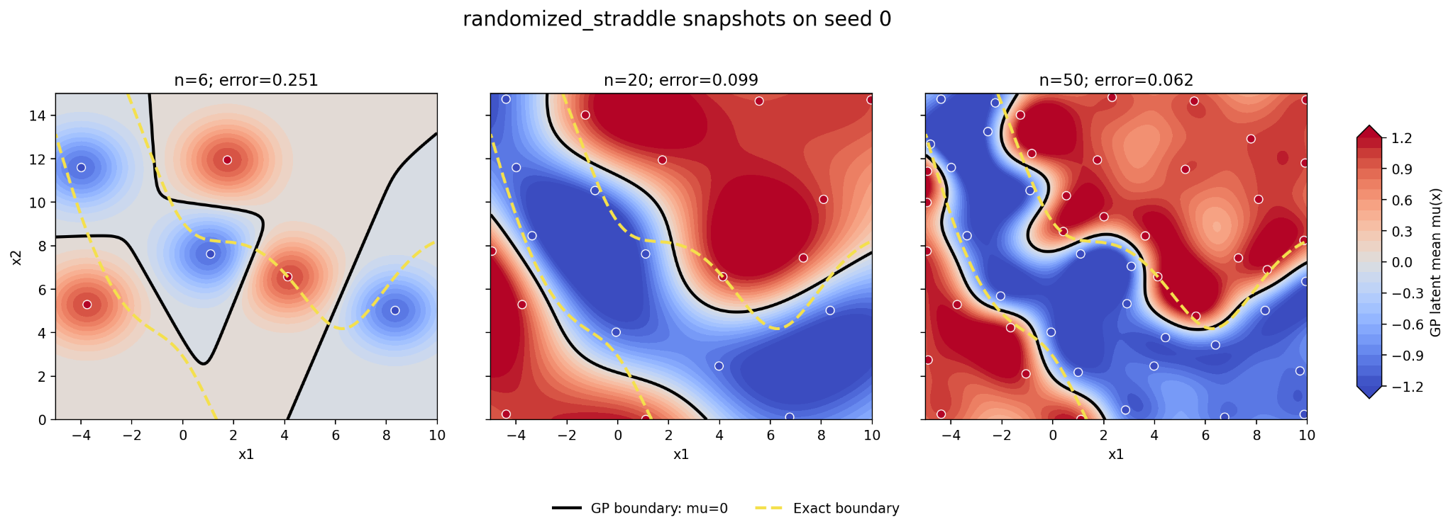
Best-method snapshots: randomized straddle
For seed 0, the GP boundary becomes more informative as labels are acquired.
Seed 0: test error drops from 25.1% at n=6 to 9.9% at n=20 and 6.02% at n=50. Black = GP boundary μ=0; yellow dashed = exact boundary.
Week 2 progress • Sample-Efficient Active Level-Set Estimation • 8
8
Notes:
This is the best-method snapshot slide. For seed zero, randomized straddle reduces the test error from 25.1 percent to 9.9 percent and then to 6.2 percent. The black contour is the GP boundary mu equals zero, and the yellow dashed contour is the exact Branin threshold boundary. The boundary is not perfect, but it becomes much more informative with only 50 labels.

Slide 9
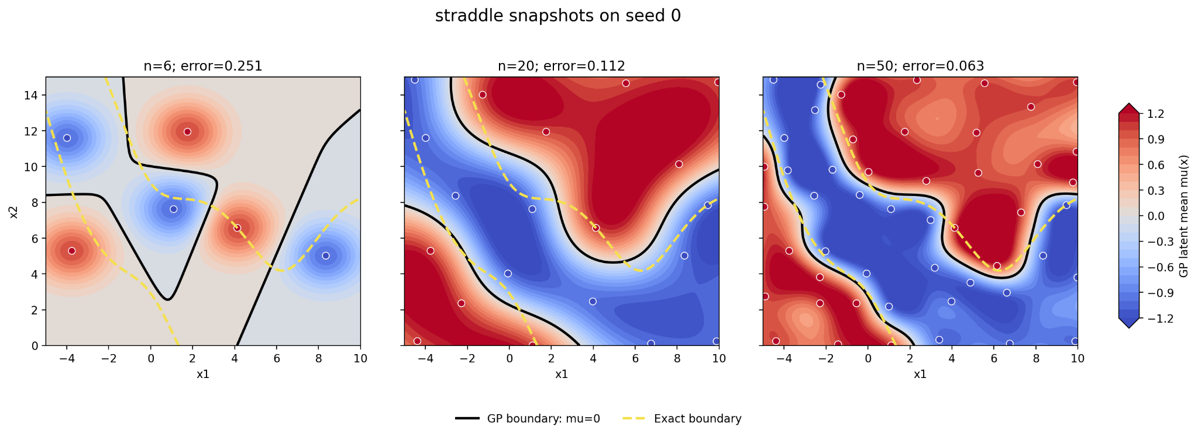
Close competitor: straddle
Straddle is almost tied with randomized straddle, so the ranking should be treated cautiously.
Straddle reaches 6.20% mean final error versus 6.02% for randomized straddle. The safe conclusion is not a final ranking, but that boundary- and uncertainty-aware rules outperform random.
Week 2 progress • Sample-Efficient Active Level-Set Estimation • 9
9
Notes:
This slide is included to avoid overclaiming randomized straddle. Straddle is extremely close in final error. Therefore, my conclusion should be that boundary-aware and uncertainty-aware rules are useful, not that randomized straddle is definitively the best acquisition function. More seeds, benchmarks, or a geometric metric are needed for stronger ranking claims.

Slide 10
Week 2 status and discussion points
The acquisition comparison is complete as a first Branin benchmark; next we should decide how to strengthen it.
Completed
✓
Fixed-loop Branin comparison implemented
✓
Five acquisition rules evaluated
✓
Five-seed mean and spread generated
✓
Fairness checks true for all seeds
✓
Error curves, final ranking and query plots saved
✓
Slide notes and CSV summaries available
Week 2 progress • Sample-Efficient Active Level-Set Estimation • 10
10
Notes:
Closing: Week 2 is complete as a first fair comparison. I would ask Ioan whether he considers this enough for Week 2 and what he wants next. My suggested next step is to strengthen the synthetic benchmark, either with a geometric boundary-distance metric or a controlled boundary-width sweep, before moving toward higher-dimensional or real laser data.

