Slide 1
Week 3-7 - Active Level-Set Progress
Ioan meeting update
Sample-Efficient Active Level-Set Estimation, with an Application to Melt-Pool Regime Boundaries
Goal: summarize what we tested after the Week 3 acquisition-plan promise.
We moved from one named 4D benchmark into boundary metrics, new acquisition rules, GP-classifier surrogates, and Hartmann4 validation.
3
5
12->80
20+
q20/q30
benchmarks
primary seeds
4D budget
method variants
main boundary metrics
not just global
Main message: we tried several acquisition families, and the strongest lesson is about robustness across benchmarks, not one winner on one plot.
Week 3-7 update - Sample-Efficient Active Level-Set Estimation - 1
1
Notes:
Say: In Week 3 I said I would compare multiple acquisition functions. The work grew from that promise into a full benchmark campaign.
Emphasize: we did not only run Ackley4; we added metrics, new rules, classifier surrogates, and Hartmann4.

Slide 2
What changed after Week 3
The work became a structured benchmark campaign, not just a few acquisition-rule trials.
Fairness principle
Within each benchmark and seed, methods reuse the same threshold, pool, test set, initial labels, model family, and budget where the comparison is acquisition-only.
Week 3
Week 4
Week 5
Week 6
Week 7
Change only
Ackley4 named benchmark
Boundary metrics
New GPR acquisitions
GP classifier surrogate
SUR/IVR + Hartmann4
method or surrogate
RECORDED SETUP
Branin uses 6->50 labels; Ackley4 and Hartmann4 use 12->80 labels. Primary runs use five seeds unless marked diagnostic.
Fairness checks passed in the reported benchmark runs.
Week 3-7 update - Sample-Efficient Active Level-Set Estimation - 2
2
Notes:
Say: The important thing is that each comparison is fair inside its benchmark. Same pool, same test set, same initial labels, same budget.
Then pivot: once the surrogate changes, I will call that out explicitly, because it is no longer acquisition-only.

Slide 3
The scope expanded beyond Ackley4
Week 3-7 Coverage
Same thesis question, broader stress tests: can we learn threshold boundaries sample-efficiently?
Goal: test whether boundary-aware acquisitions remain useful across metrics, surrogates, and named benchmarks.
The work now covers 2D Branin, thresholded 4D Ackley, and thresholded 4D Hartmann, with global and near-boundary error tracked together.
3
2
global
q20/q30
Hartmann4
benchmarks
surrogate families
classification error
near-boundary error
new Week 7 test
added deliberately
Main message: Ackley stayed hard, Hartmann changed the story, and Branin often rewards methods that do not transfer cleanly.
Week 3-7 update - Sample-Efficient Active Level-Set Estimation - 3
3
Notes:
Say: The benchmark set now has Branin for interpretable 2D behavior, Ackley4 as the hard named 4D case, and Hartmann4 as a second 4D check.
Point out: q20 and q30 are the metrics I trust most for boundary performance.

Slide 4
Week 3: first named 4D acquisition comparison
Ackley4 kept the active level-set setting while moving closer to the target 4D process-parameter space.
Random
Smallest abs(mu)
No boundary information
closest predicted boundary
Floor baseline for all later work.
Queries near the GP decision boundary.
Straddle
Randomized straddle
1.96 sigma - abs(mu)
random uncertainty weight
Balances boundary proximity and uncertainty.
Adds step-wise randomness to straddle.
Expected feasibility
contour-focused EI heuristic
A classic level-set style baseline.
Important: Week 3 still uses a GP-regression stand-in; mu and sigma are latent, not calibrated class probabilities.
Week 3-7 update - Sample-Efficient Active Level-Set Estimation - 4
4
Notes:
Say: Week 3 was the clean extension of Week 2: same original acquisition family, but now on thresholded 4D Ackley.
Keep caveat visible: the GP regressor is still a warm-up surrogate here.

Slide 5
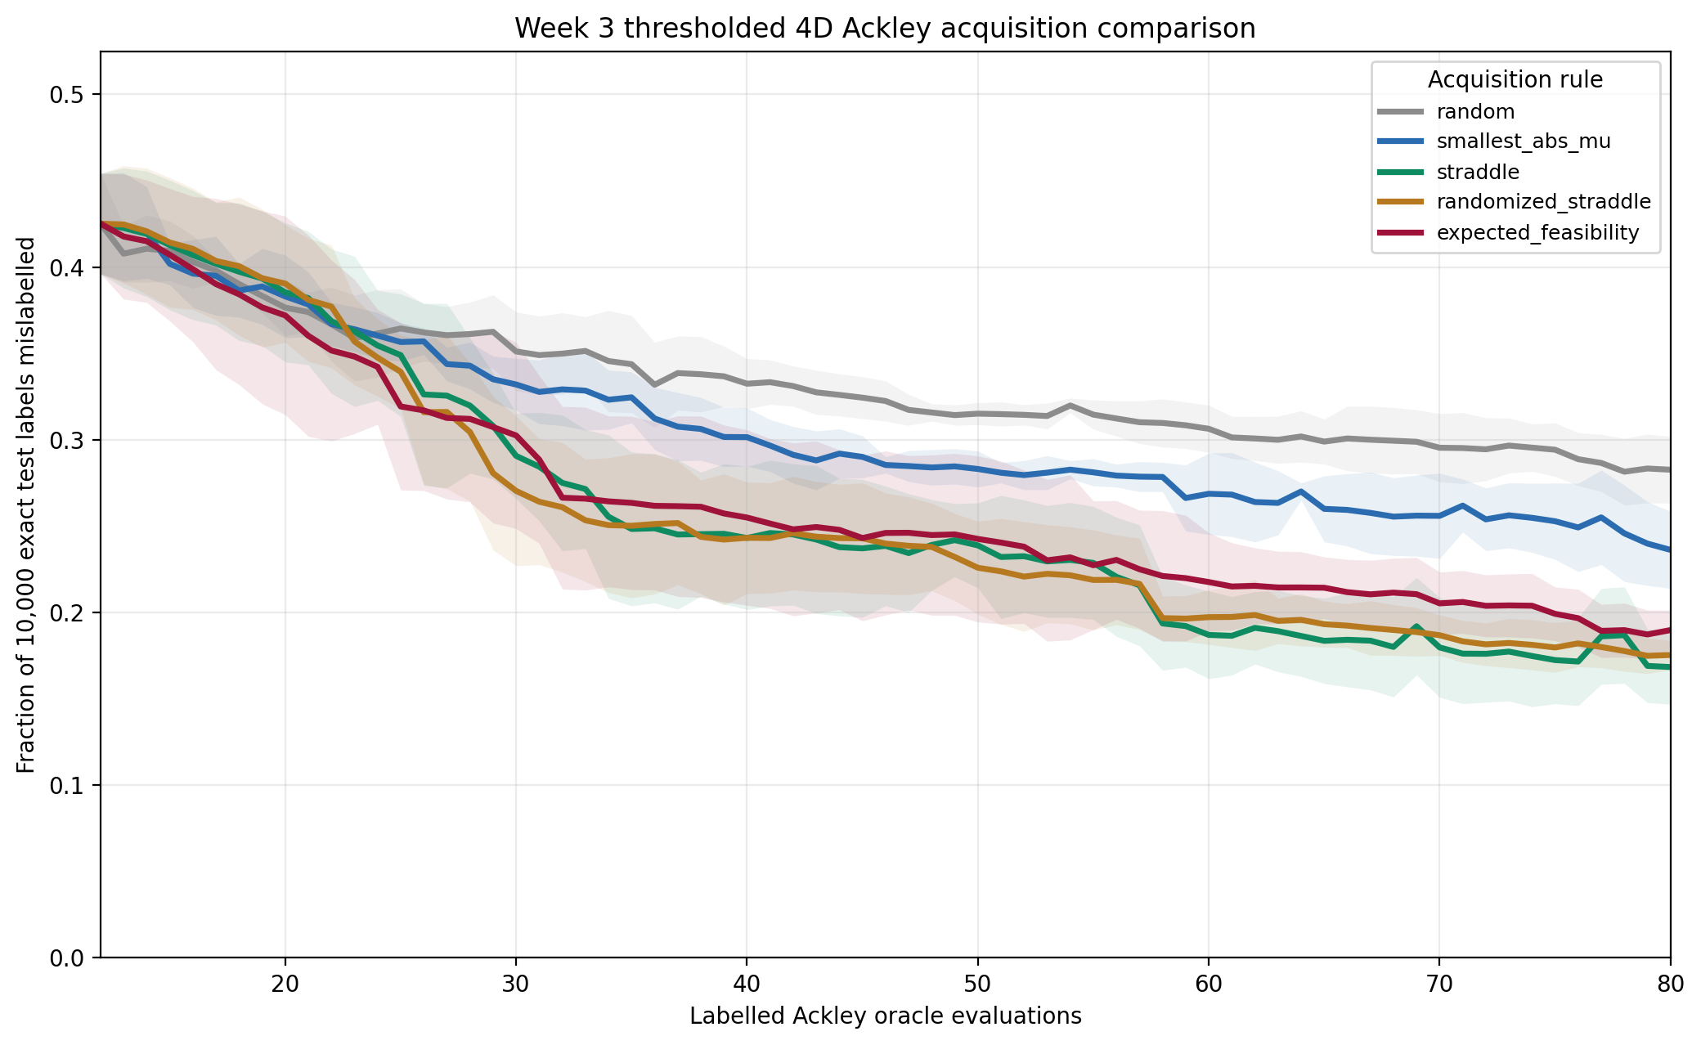
Week 3 result: straddle wins globally on Ackley4
At budget 80, boundary-aware rules clearly beat random; strict tolerances remain difficult.
What the curves show
-
All methods start from the same five-seed initial design.
-
Straddle and randomized straddle reach 20% mean error around n=58.
-
Expected feasibility catches up later; random remains high.
-
No mean curve reaches 16% error by n=80, so Ackley4 stays challenging.
Main signal: boundary-aware acquisition transfers from Branin to named 4D Ackley, but not perfectly.
Week 3-7 update - Sample-Efficient Active Level-Set Estimation - 5
5
Notes:
Say: The simple boundary-aware methods do transfer to Ackley4. Straddle is the global winner, randomized straddle is close.
Mention: the 16 percent tolerance not being reached is important; Ackley4 is genuinely harder than Branin.

Slide 6
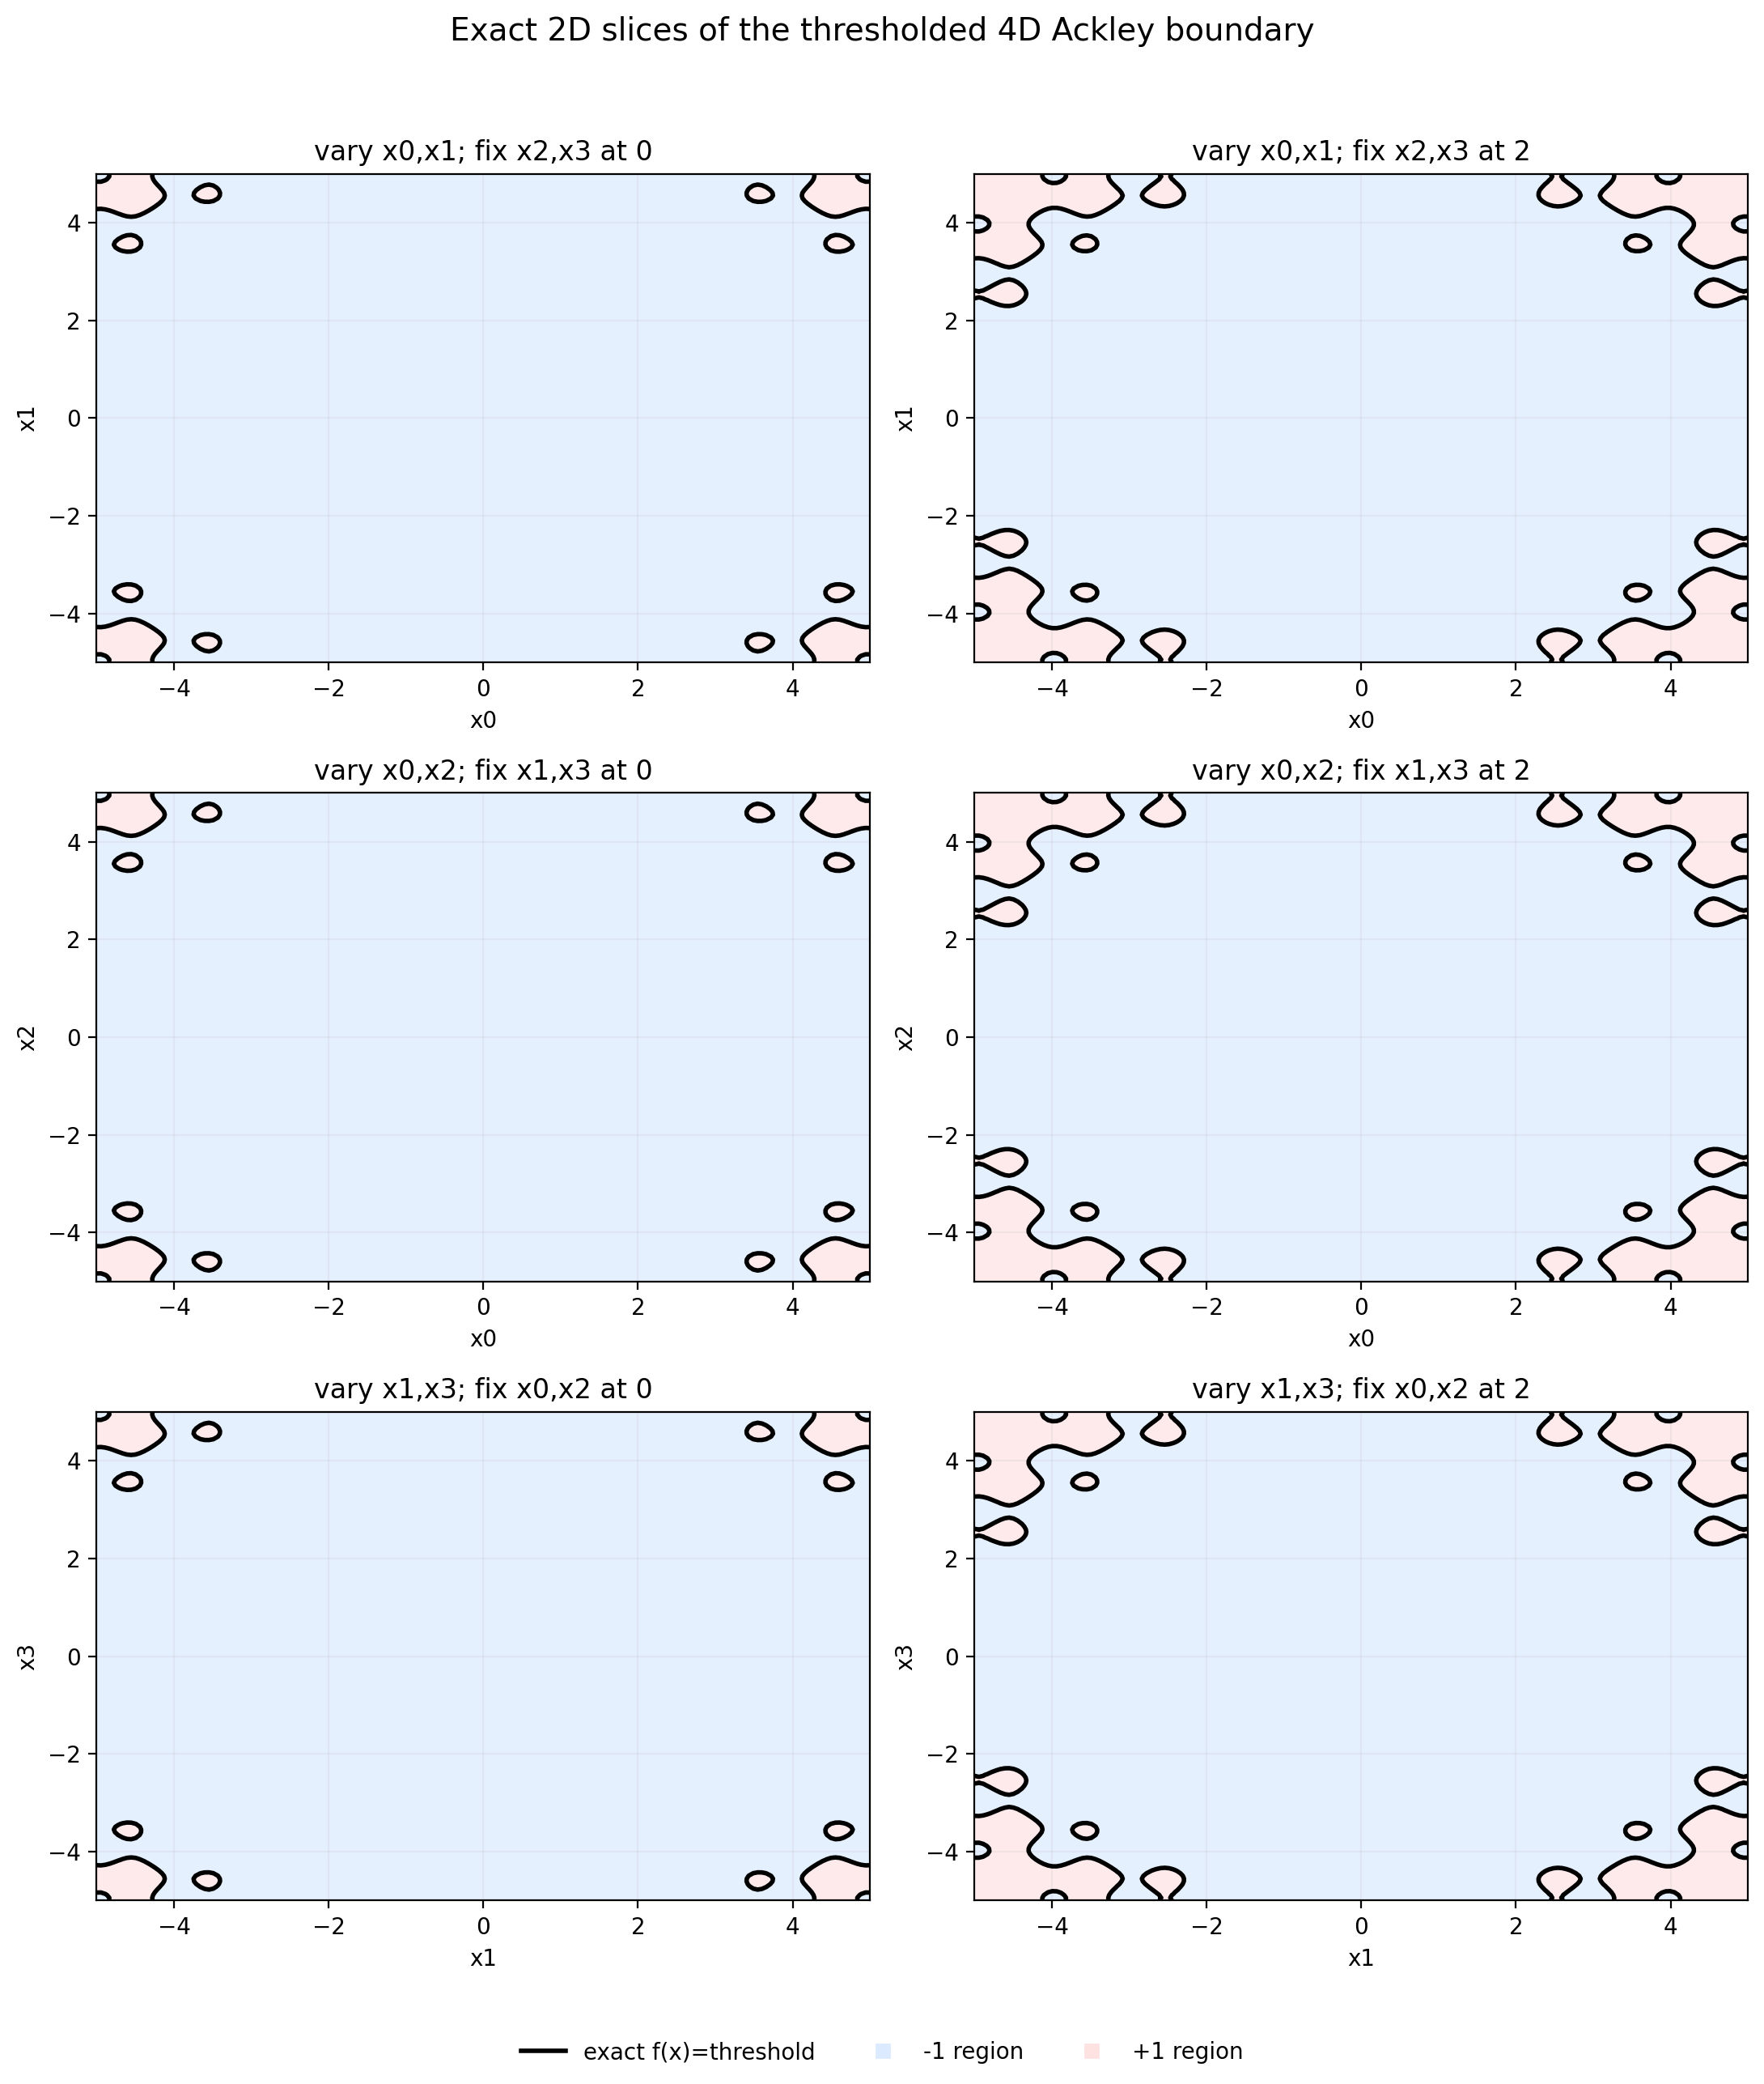
Ackley4 diagnostics explain why one plot is not enough
2D slices and projections are only diagnostic views of a 4D boundary.
-
The exact boundary is visible only on fixed 2D slices.
-
Projected query locations can hide behavior in the other dimensions.
-
This motivated Week 4: evaluate boundary-region error directly, not only global error.
Week 3-7 update - Sample-Efficient Active Level-Set Estimation - 6
6
Notes:
Say: Because this is 4D, the figures are partial views. They are useful for sanity checking, not definitive evidence.
Bridge: this is exactly why I added Week 4 boundary-specific metrics.

Slide 7
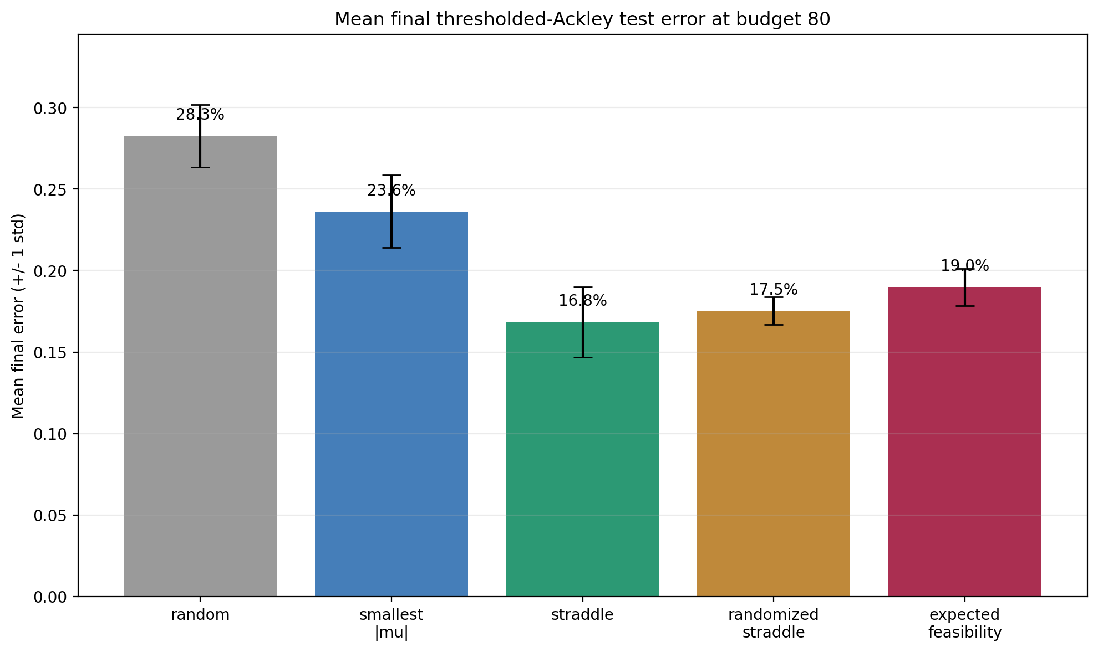
Week 3 final ranking at budget 80
Straddle is best by mean final global error; randomized straddle is very close.
Mean final error
1
straddle
16.84%
2
randomized straddle
17.54%
3
expected feasibility
18.98%
4
smallest abs(mu)
23.62%
5
random
28.27%
Safe wording
Best on this named 4D global-error benchmark, not a final thesis method ranking.
Week 3-7 update - Sample-Efficient Active Level-Set Estimation - 7
7
Notes:
Say: By global error, straddle is best. But the ranking is close among the boundary-aware methods, so I should not oversell one run.
Mention: random being much worse shows acquisition matters.

Slide 8
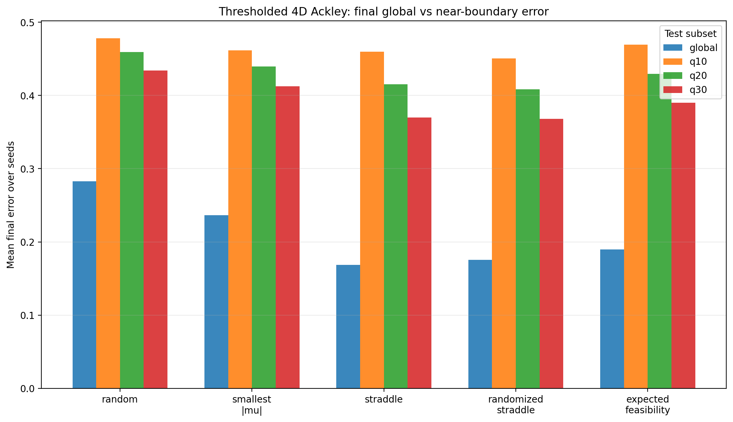
Week 4: boundary metrics change the ranking
Global error is useful, but level-set estimation needs near-boundary evaluation.
What the boundary metrics show
-
Branin and Ackley both disagree with the global ranking on at least one boundary metric.
-
On Ackley4, straddle wins global error; randomized straddle wins q10/q20/q30.
-
Smallest abs(mu) queries closest to the boundary but is not the best predictor.
-
q20/q30 are more stable than q10 and become the main boundary metrics.
Main signal: close-to-boundary sampling is useful but insufficient without uncertainty and coverage.
Week 3-7 update - Sample-Efficient Active Level-Set Estimation - 8
8
Notes:
Say: Week 4 is one of the most important additions. It showed that global error and boundary error can disagree.
Use the key line: sampling close to the boundary is not enough; the point also has to be informative.

Slide 9
Week 5: we derived and tested new acquisition ideas
The new rules were built to repair concrete weaknesses seen in Week 4.
Diversified straddle
Boundary-gated diversity
straddle + input diversity
diversity only inside straddle gate
Test whether coverage prevents repeated local sampling.
Avoid letting diversity pull queries away from the boundary.
Lookahead BUR
Gated geometric BC
fantasy labels reduce boundary uncertainty
curvature + uncertainty + repulsion
Choose points expected to shrink aggregate straddle uncertainty.
Test whether predicted boundary geometry identifies hard regions.
Reference baselines
original Week 3 rules kept
Every new idea was compared against the simple strong baselines.
Important: these are heuristic GPR acquisitions, so the question is empirical robustness, not elegance.
Week 3-7 update - Sample-Efficient Active Level-Set Estimation - 9
9
Notes:
Say: Week 5 was where we started deriving our own variants instead of only comparing existing rules.
Frame it positively: even negative results were useful because they told us which intuitions did not survive Ackley.

Slide 10
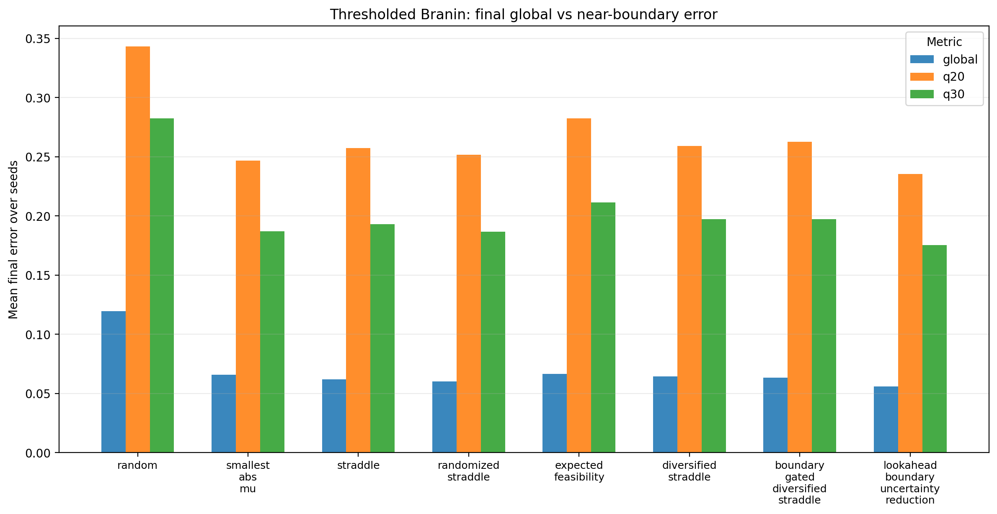
Week 5.2: lookahead helps Branin but fails Ackley4
Expected boundary-uncertainty reduction is promising, but not robust under the GPR surrogate.
Lookahead vs baselines
1
Branin global
5.59%
2
Branin q20
23.55%
3
Branin q30
17.53%
4
Ackley global
22.90%
5
Ackley q20/q30
44.42 / 40.80%
Safe wording
A thesis-relevant idea, but not a default method after the Ackley stress test.
Week 3-7 update - Sample-Efficient Active Level-Set Estimation - 10
10
Notes:
Say: Lookahead boundary-uncertainty reduction is the strongest positive new idea on Branin, but it breaks on Ackley.
Conclusion: keep it as a thesis-relevant idea, but not as the default method.

Slide 11
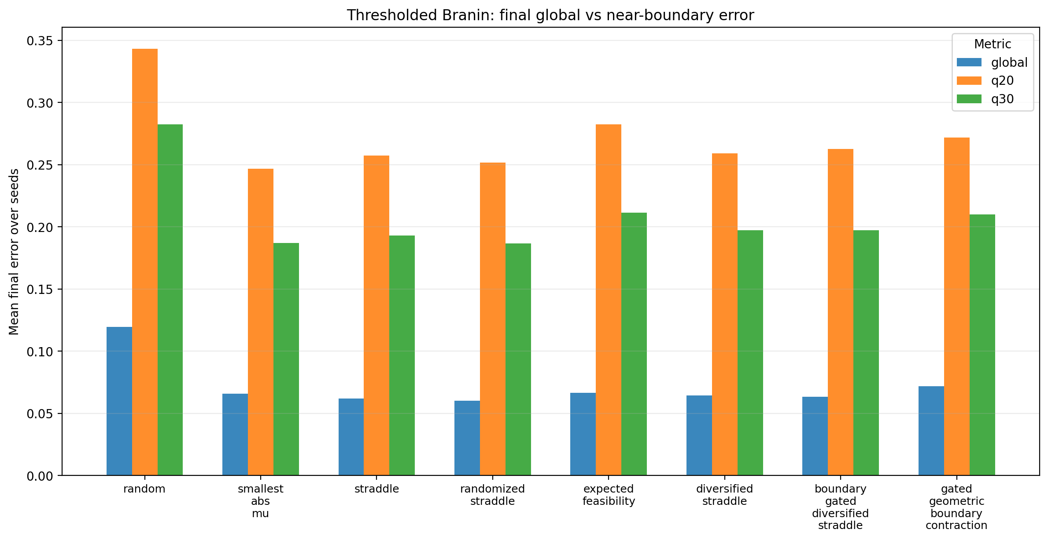
Week 5.3: geometry reduces uncertainty, not error
Gated geometric boundary contraction did not beat the strong baselines on Branin or Ackley4.
GBC compared with baselines
1
Branin global
7.17%
2
Branin q20/q30
27.18 / 21.00%
3
Ackley global
20.04%
4
Ackley q20/q30
42.20 / 38.47%
5
Uncertainty
often lower
Safe wording
Lower latent uncertainty can mean confident wrongness, so it cannot define success alone.
Week 3-7 update - Sample-Efficient Active Level-Set Estimation - 11
11
Notes:
Say: The geometry idea reduced latent uncertainty, but prediction error got worse. This is a very useful warning.
Use the phrase: a method can become confidently wrong.

Slide 12
Interim lesson after Weeks 3-5
The new acquisition ideas were useful because they clarified what does not generalize.
Learned so far
✓
Ackley4 is a defensible named 4D bridge benchmark.
✓
Boundary metrics are necessary; global error alone is misleading.
✓
Simple baselines remain hard to beat, especially randomized straddle.
✓
Lookahead is interesting on Branin but not reliable on Ackley4.
✓
Uncertainty-region contraction is a diagnostic, not a correctness metric.
✓
This motivates testing the surrogate model itself, not only acquisitions.
Week 3-7 update - Sample-Efficient Active Level-Set Estimation - 12
12
Notes:
Say: After Week 5, the lesson was not that new acquisitions are useless. The lesson was that we need robustness and better surrogate behavior.
Bridge to Week 6: that motivated testing a real GP classifier.

Slide 13
Week 6: switch from GP regressor to GP classifier
We stopped reusing latent mu/sigma rules and used classifier-native probability scores.
Fixed GPC
predict_proba
RBF kernel, optimizer=None
p(+1) used directly
Runtime-stable first classifier benchmark.
No fake GP-regressor uncertainty.
Margin
Entropy
abs(p - 0.5)
monotone-equivalent to margin
Binary boundary uncertainty baseline.
Useful sanity check, often same behavior.
Uncertainty repulsion
uncertain + away from labels
Best fixed-kernel classifier rule in Week 6.
Important: classifier rows and regressor rows change the surrogate family, so comparisons are not acquisition-only.
Week 3-7 update - Sample-Efficient Active Level-Set Estimation - 13
13
Notes:
Say: Week 6 replaces the GP-regression stand-in with a classifier and uses predict_proba-based acquisitions.
Emphasize: I did not fake mu/sigma-style uncertainty for the classifier.

Slide 14
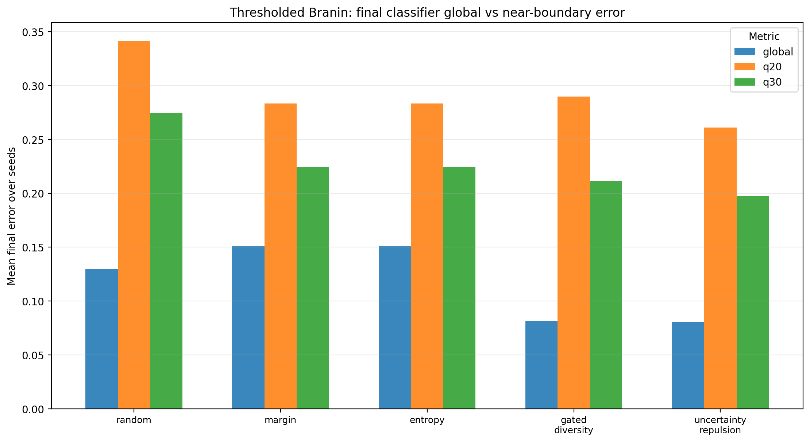
Week 6 fixed GPC: cleaner probabilities, not better results
Classifier uncertainty repulsion was the best fixed-GPC method on both benchmarks.
Best fixed-GPC result
1
Branin global
8.04%
2
Branin q20/q30
26.10 / 19.78%
3
Ackley global
17.59%
4
Ackley q20/q30
41.75 / 37.97%
5
Regressor refs
still better
Safe wording
Surrogate choice alone did not solve boundary learning under the fixed kernel.
Week 3-7 update - Sample-Efficient Active Level-Set Estimation - 14
14
Notes:
Say: The fixed classifier gave cleaner probability semantics, but it did not beat the best regressor references.
Caveat: this is not acquisition-only because the surrogate changed.

Slide 15
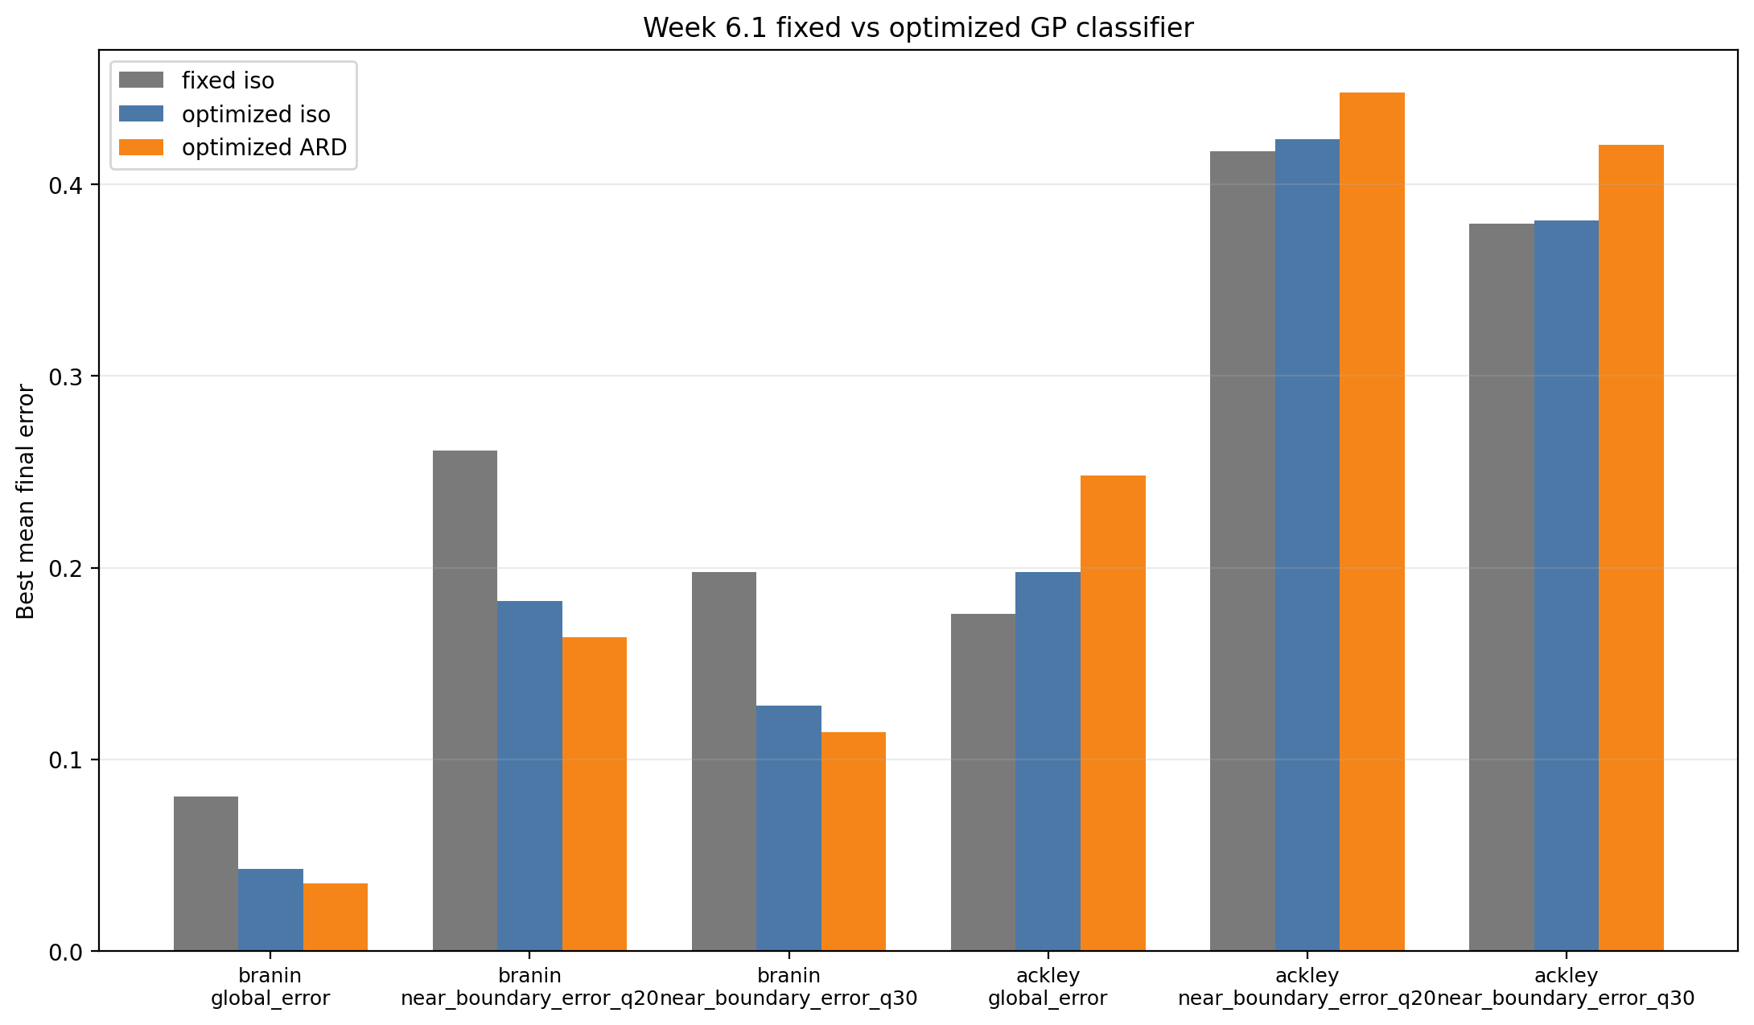
Week 6.1: optimized GPC helps Branin, not Ackley4
Kernel learning changed the classifier story, but the improvement did not transfer to the hard 4D benchmark.
Best classifier variant
1
Branin ARD global
3.52%
2
Branin ARD q20
16.38%
3
Branin ARD q30
11.43%
4
Ackley best global
17.59% fixed
5
Ackley q20/q30
41.75 / 37.97% fixed
Safe wording
Kernel optimization is important, but ARD is not automatically a 4D solution.
Week 3-7 update - Sample-Efficient Active Level-Set Estimation - 15
15
Notes:
Say: Optimizing the classifier kernel changes the Branin result dramatically, especially ARD plus gated diversity.
Then be careful: Ackley4 still prefers the fixed classifier baseline; ARD is not a magic 4D fix.

Slide 16
Week 7: boundary-weighted IVR and SUR
We tested literature-inspired uncertainty-reduction objectives and added Hartmann4.
Hartmann4
GPR boundary-weighted IVR
standard 4D benchmark
weighted variance reduction
A second named 4D stress test beyond Ackley.
Cheap targeted-IMSE style diagnostic.
GPR Bernoulli SUR
GPC Bernoulli SUR
fantasy label refit
classifier fantasy refit
More faithful but more expensive uncertainty reduction.
Expensive; first run limited to seed-0 diagnostics.
Question
does lower integrated uncertainty mean better boundary error?
The answer is benchmark-dependent.
Important: SUR/IVR connects the work to active level-set literature, but runtime and robustness decide whether it is usable.
Week 3-7 update - Sample-Efficient Active Level-Set Estimation - 16
16
Notes:
Say: Week 7 brings in the uncertainty-reduction literature: IVR and SUR ideas targeted to the boundary.
Mention: Hartmann4 was added specifically to avoid overfitting conclusions to Ackley.

Slide 17
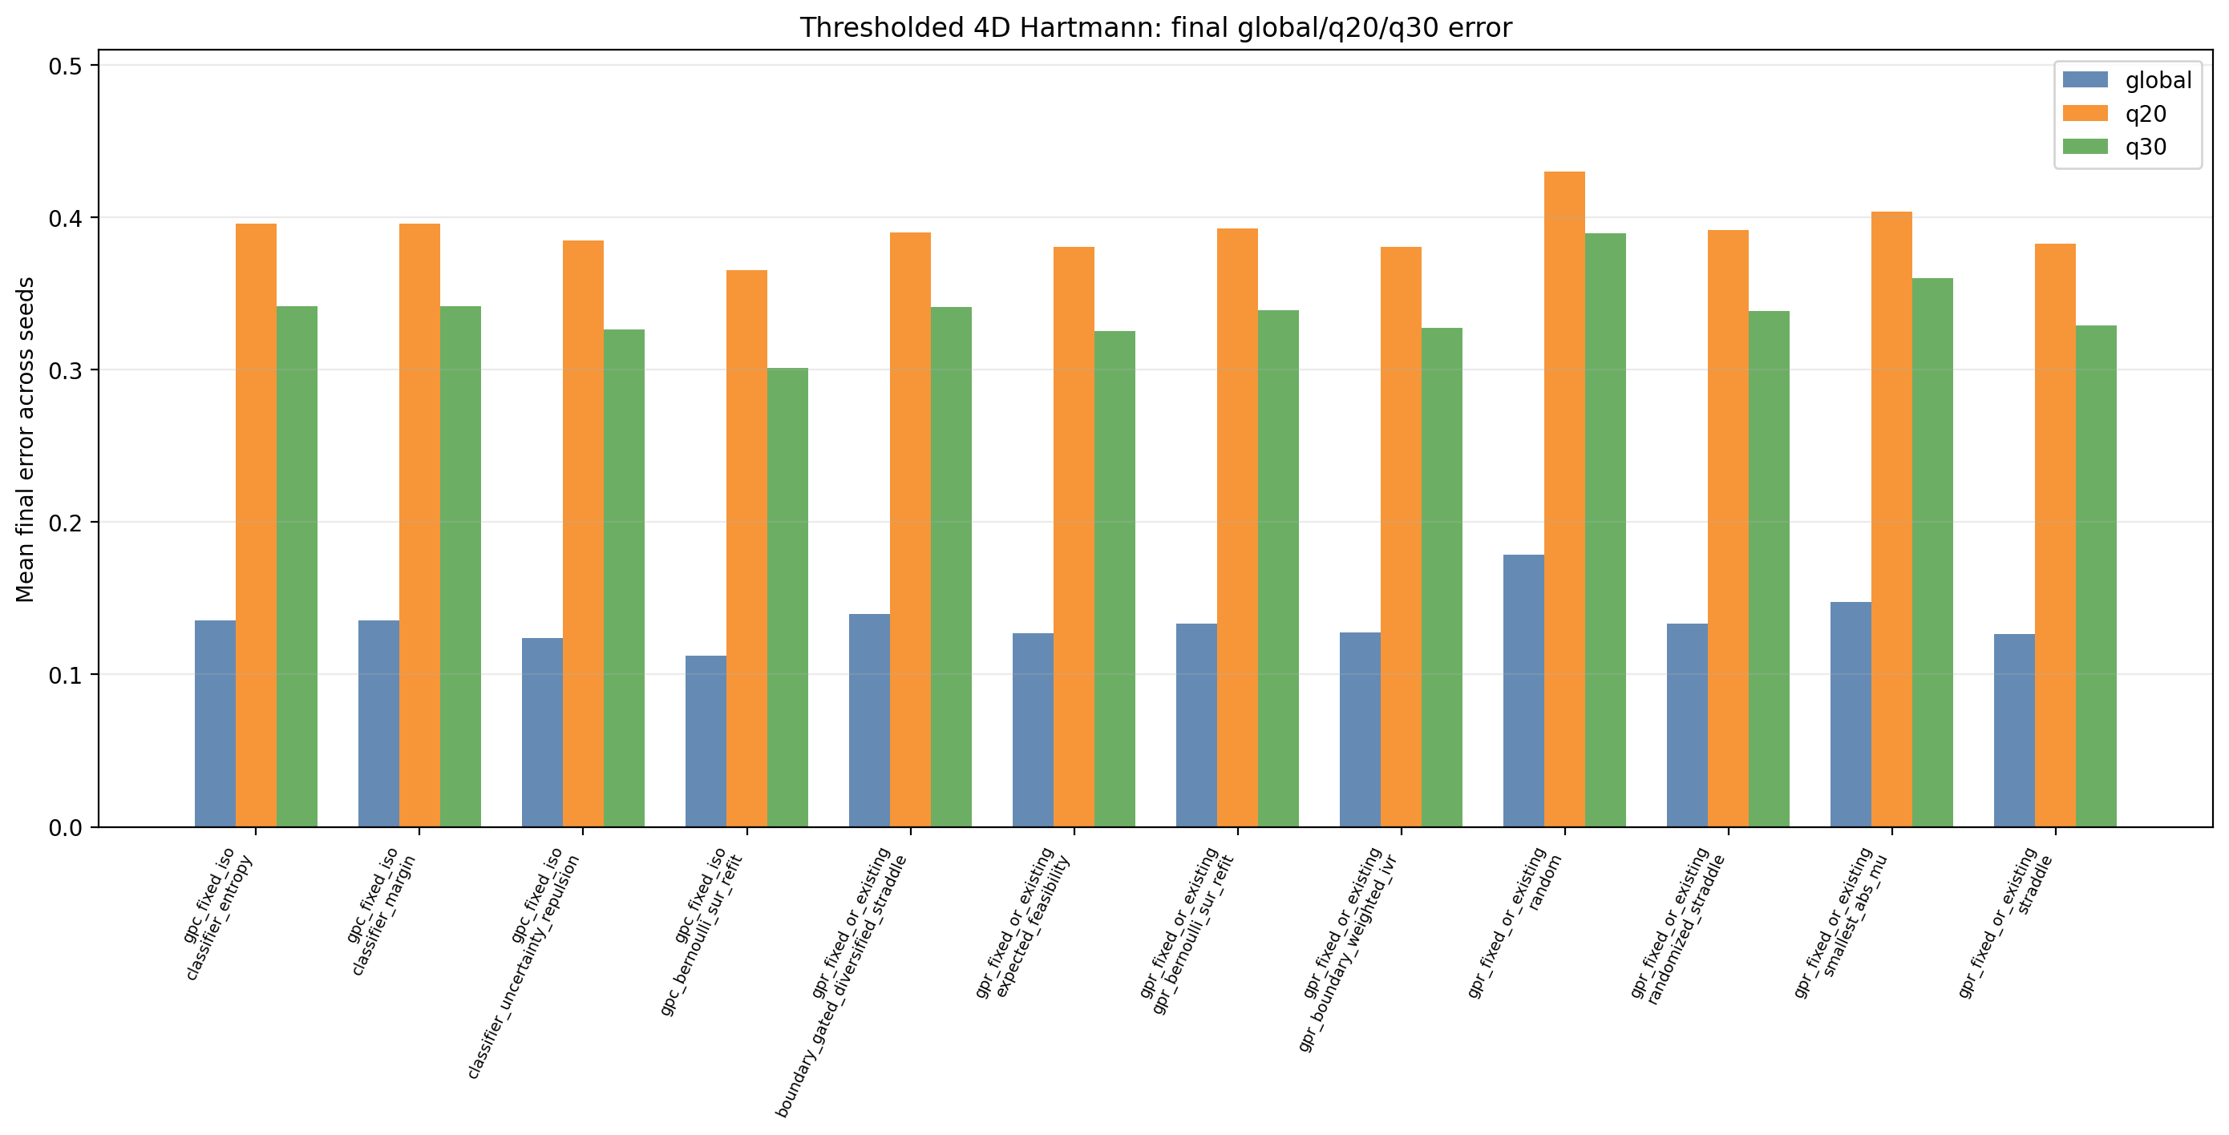
Week 7: Hartmann4 changes the picture
New GPR uncertainty-reduction methods did not replace simple baselines, but Hartmann4 gave a useful signal.
Comparable five-seed winners
1
Branin
mixed baselines
2
Ackley4
straddle family
3
Hartmann global
GPC rep.
4
Hartmann q20/q30
EF
5
IVR on Hartmann
helps, not best
Safe wording
Hartmann suggests the Ackley failure is not universal, but simple baselines still matter.
Week 3-7 update - Sample-Efficient Active Level-Set Estimation - 17
17
Notes:
Say: On five-seed comparable results, simple baselines still win many metrics. Hartmann4 is the interesting exception where IVR is useful but not best.
Point out: the seed-0 classifier SUR result was promising but needed validation.

Slide 18
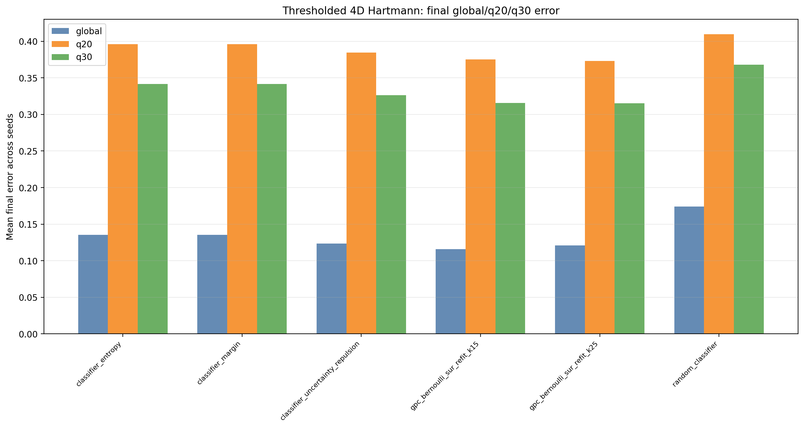
Week 7.1: classifier SUR validates only on Hartmann4
The Week 7 seed-0 GPC-SUR signal generalized on Hartmann4, not on Branin or optional Ackley.
Fixed-GPC SUR validation
1
Branin best
repulsion 7.32 / 25.60 / 18.97%
2
Hartmann global
SUR k15 11.60%
3
Hartmann q20
SUR k25 37.30%
4
Hartmann q30
SUR k25 31.55%
5
Optional Ackley
SUR did not help
Safe wording
Use GPC-SUR as a focused diagnostic, not as the default expensive acquisition loop.
Week 3-7 update - Sample-Efficient Active Level-Set Estimation - 18
18
Notes:
Say: Week 7.1 tested whether the classifier SUR signal survives across seeds. It does on Hartmann4, not on Branin or optional Ackley.
Conclusion: SUR is a focused diagnostic, not the default loop for real data.

Slide 19
What we have tried so far
Experiment Inventory
The work after Week 3 is now a broad acquisition and surrogate benchmark suite.
Goal: preserve a compact comparison set for Ioan while showing that we explored the design space seriously.
Coverage includes original acquisition rules, diversity and gating, lookahead, geometry, fixed and optimized GPC, IVR/SUR, and Hartmann4 validation.
3
2
5+
q20/q30
5
benchmarks
surrogate families
experiment blocks
primary boundary metrics
primary seeds
plus diagnostics
Main message: the project is no longer a single Ackley run; it is a benchmarked search over what actually survives transfer.
Week 3-7 update - Sample-Efficient Active Level-Set Estimation - 19
19
Notes:
Say: This slide is the evidence that we did the comprehensive work promised after Week 3.
It also helps Ioan see that the next step should be narrowing, not endlessly adding variants.

Slide 20
What this teaches us
The defensible conclusion is not one magic acquisition function; it is a disciplined comparison strategy.
Discussion points for Ioan
✓
Keep straddle, randomized straddle, expected feasibility, and classifier repulsion as core baselines.
✓
Use q20/q30 near-boundary error as primary evidence beside global error.
✓
Do not treat lower uncertainty-region or Bernoulli uncertainty as success by itself.
✓
Keep optimized GPC as important on Branin, but do not claim it solves Ackley4.
✓
Keep GPC-SUR as a Hartmann-like diagnostic, not a default runtime-heavy method.
✓
Next decision: stop adding variants and move toward calibration plus melt-pool data interface.
Week 3-7 update - Sample-Efficient Active Level-Set Estimation - 20
20
Notes:
Say: My suggested direction is to keep a compact comparison set, use q20/q30 as primary evidence, and move toward surrogate calibration and the melt-pool data interface.
Ask Ioan: Which methods should become the final baseline set before real-data work?

