Slide 1
Week 3 Coverage
The study expanded beyond a single Ackley4 run
Same thesis question, broader stress tests: can we learn threshold boundaries sample-efficiently?
Goal: test whether boundary-aware acquisitions remain useful across metrics, surrogates, and named benchmarks.
The work now covers 2D Branin, thresholded 4D Ackley, and thresholded 4D Hartmann, with global and near-boundary error tracked together.
3
2
global
q20/q30
Hartmann4
benchmarks
surrogate families
classification error
near-boundary error
second 4D check
added deliberately
Main message: Ackley stayed hard, Hartmann changed the story, and Branin often rewards methods that do not transfer cleanly.
Week 3 extended update - Sample-Efficient Active Level-Set Estimation - 3
3
Notes:
This slide is meant to reframe Week 3 as more than a single 4D Ackley experiment. The original thesis question stayed the same: we want to identify a threshold boundary with as few evaluations as possible. What changed is the breadth of the stress test. I now compare methods across Branin, Ackley4, and Hartmann4; across GP regression and GP classifier surrogates; and across both global classification error and boundary-focused q20/q30 error. The main point is that performance is benchmark-dependent. Branin is useful and interpretable, Ackley4 is a hard 4D stress test, and Hartmann4 gives a second 4D check so that we do not overfit the story to Ackley alone.

Slide 2
Ackley4 was the first named 4D acquisition comparison
Ackley4 kept the active level-set setting while moving closer to the target 4D process-parameter space.
Random
Smallest abs(mu)
No boundary information
closest predicted boundary
Floor baseline for all later work.
Queries near the GP decision boundary.
Straddle
Randomized straddle
1.96 sigma - abs(mu)
random uncertainty weight
Balances boundary proximity and uncertainty.
Adds step-wise randomness to straddle.
Expected feasibility
contour-focused EI heuristic
A classic level-set style baseline.
GPR = Gaussian Process Regressor: mu and sigma are latent boundary-surface quantities, not calibrated class probabilities.
Week 3 extended update - Sample-Efficient Active Level-Set Estimation - 4
4
Notes:
Ackley4 was the first named 4D acquisition comparison
Here I moved from the 2D Branin benchmark to a named 4D benchmark. This is closer to the final melt-pool setting because the target problem also lives in a multi-dimensional process-parameter space. The methods are intentionally simple baselines first: random gives a lower reference; smallest abs(mu) samples near the current predicted zero-contour; straddle balances closeness to the boundary with model uncertainty; randomized straddle adds stochasticity to avoid a too-deterministic path; and expected feasibility is a contour-focused level-set heuristic. In the GP-regression setup, mu and sigma are not calibrated class probabilities; they are latent boundary-surface quantities used to estimate the zero level set.

Slide 3
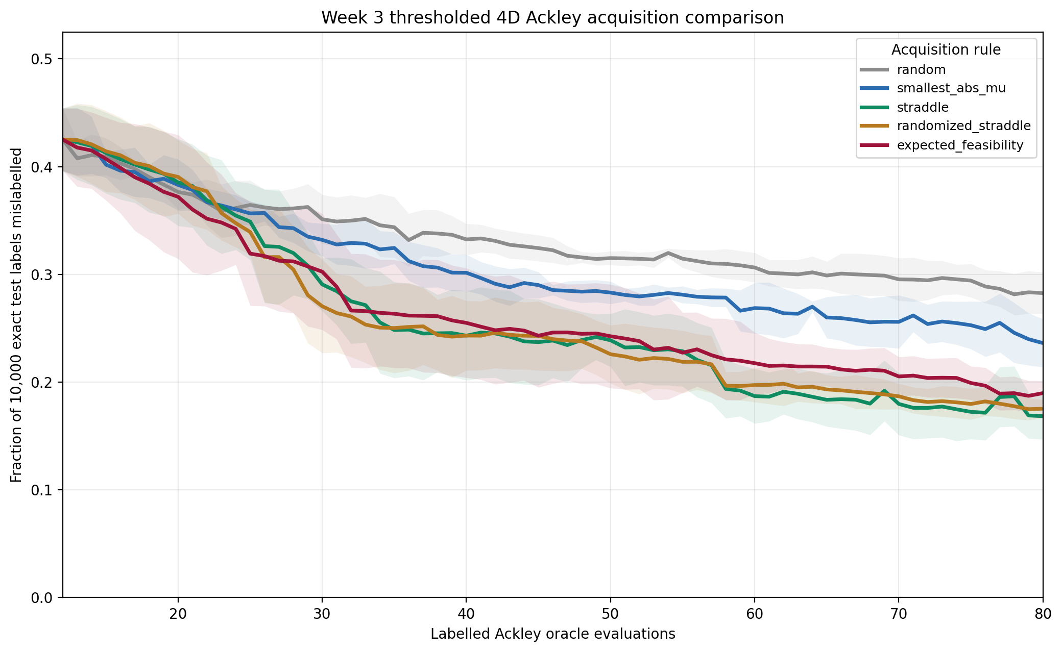
Ackley4 result: straddle wins globally
At budget 80, boundary-aware rules clearly beat random; strict tolerances remain difficult.
What the curves show
-
All methods start from the same five-seed initial design.
-
Straddle and randomized straddle reach 20% mean error around n=58.
-
Expected feasibility catches up later; random remains high.
-
No mean curve reaches 16% error by n=80, so Ackley4 stays challenging.
Main signal: boundary-aware acquisition transfers from Branin to named 4D Ackley, but not perfectly.
Week 3 extended update - Sample-Efficient Active Level-Set Estimation - 5
5
Notes:
Ackley4 result: straddle wins globally
The main message from this plot is that acquisition choice matters in 4D. Boundary-aware methods clearly outperform random, so the active level-set idea transfers beyond the simple 2D benchmark. However, Ackley4 remains difficult: even the best methods do not reach very low global error within the budget. Straddle performs best by mean global error, while randomized straddle stays close. This means the standard boundary-aware uncertainty heuristics are useful, but the harder geometry of Ackley makes the problem much less forgiving than Branin.

Slide 4
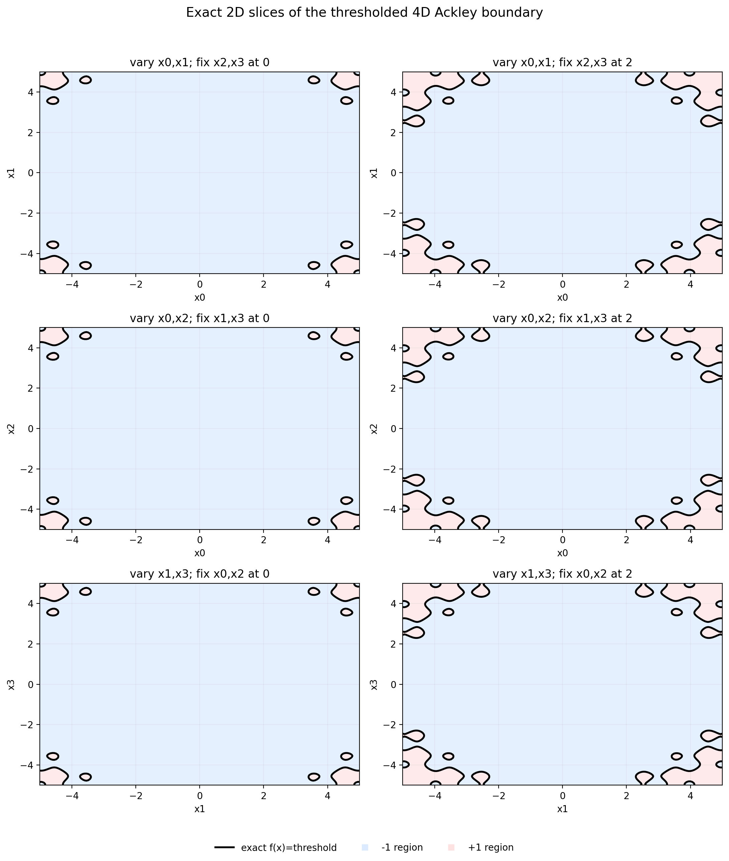
Ackley4 diagnostics explain why one plot is not enough
2D slices and projections are only diagnostic views of a 4D boundary.
-
The exact boundary is visible only on fixed 2D slices.
-
Projected query locations can hide behavior in the other dimensions.
-
This motivated the boundary-metric block: evaluate boundary-region error directly, not only global error.
Week 3 extended update - Sample-Efficient Active Level-Set Estimation - 6
6
Notes:
Ackley4 diagnostics explain why one plot is not enough
These plots are diagnostic, not a complete view of the 4D boundary. A 2D slice can show the true boundary only after fixing the other two coordinates, and a 2D projection can hide what happens in the remaining dimensions. So a visually reasonable slice does not guarantee that the method has learned the full 4D boundary well. This motivated the next evaluation step: instead of relying only on plots or global test error, I added direct near-boundary metrics that evaluate performance in the region that actually matters for level-set estimation.

Slide 5
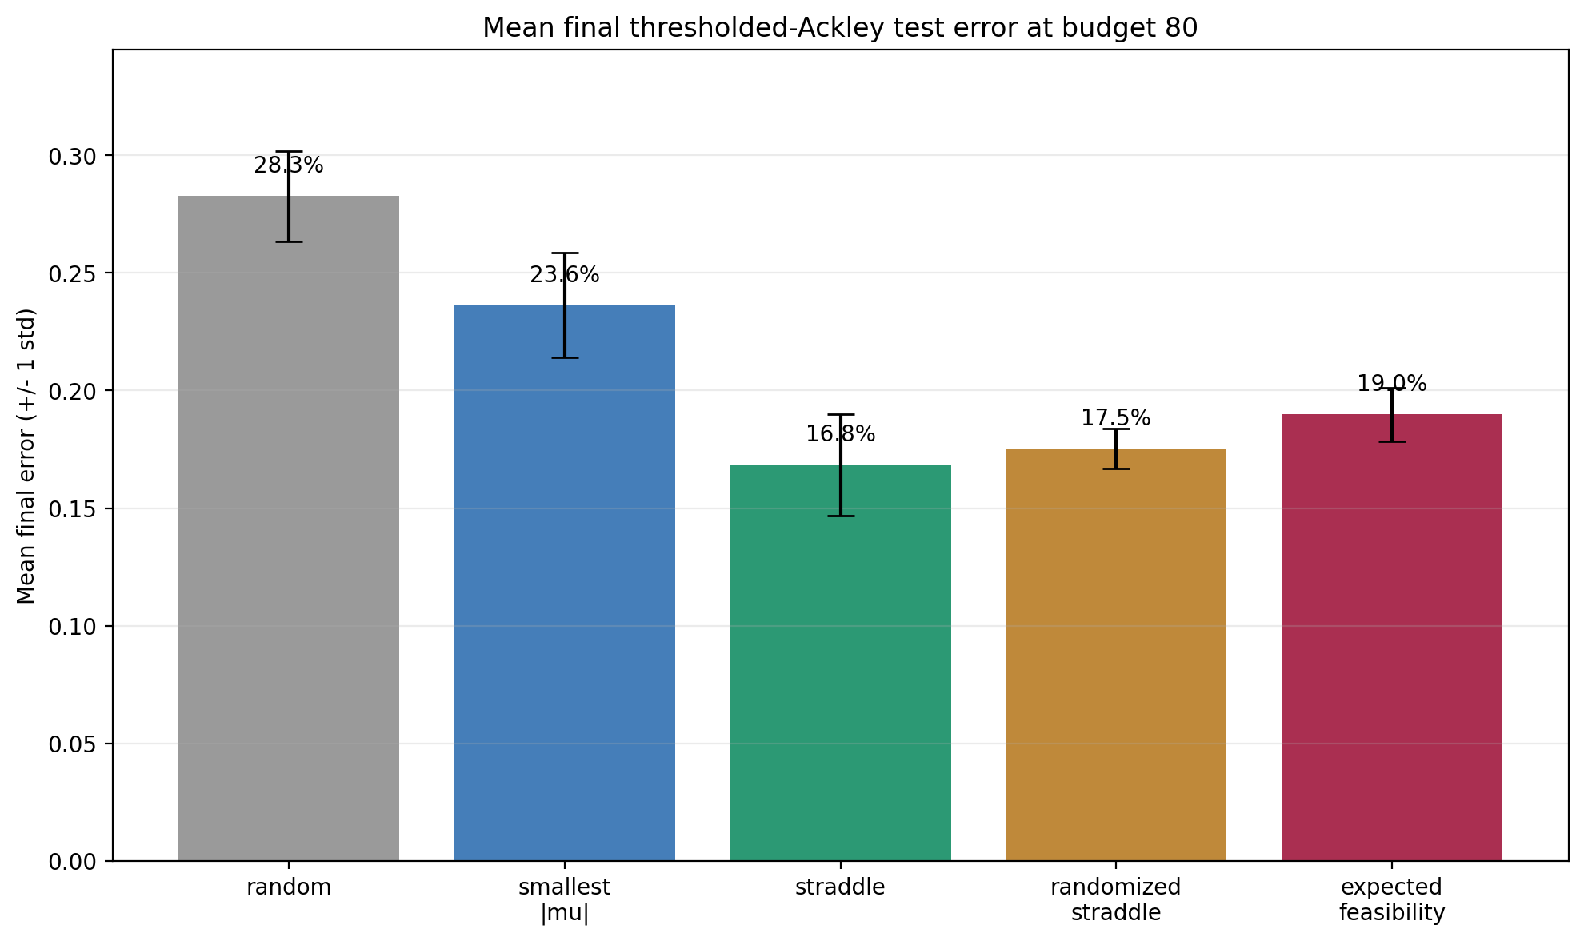
Ackley4 final ranking at budget 80
Straddle is best by mean final global error; randomized straddle is very close.
Mean final error
straddle
16.84%
randomized straddle
17.54%
expected feasibility
18.98%
smallest abs(mu)
23.62%
random
28.27%
Safe wording
Best on this named 4D global-error benchmark, not a final thesis method ranking.
Week 3 extended update - Sample-Efficient Active Level-Set Estimation - 7
7
Notes:
At the final budget, straddle has the best mean global error, with randomized straddle very close behind. Expected feasibility is still much better than random, but does not win globally on Ackley4. Smallest abs(mu) performs worse, which is important because it shows that simply querying closest to the current predicted boundary is not enough. The safe interpretation is: straddle is best on this specific named 4D global-error benchmark, but this is not a universal ranking of all acquisition functions.

Slide 6
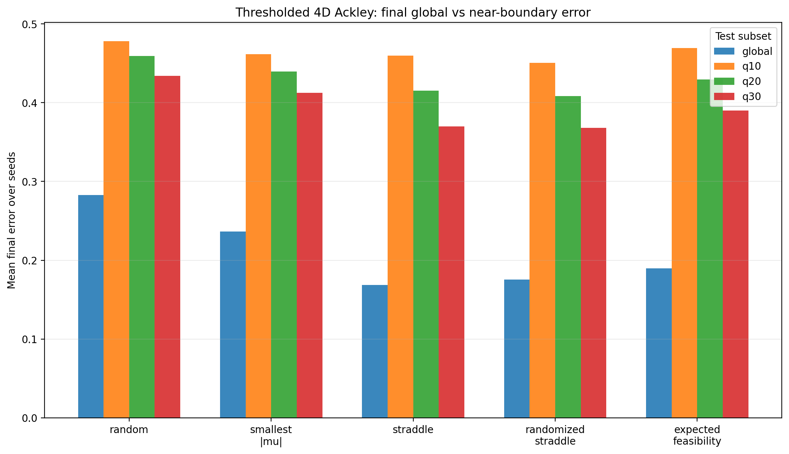
Boundary metrics change the ranking
Global error is useful, but level-set estimation needs near-boundary evaluation.
What the boundary metrics show
-
Branin and Ackley both disagree with the global ranking on at least one boundary metric.
-
On Ackley4, straddle wins global error; randomized straddle wins q10/q20/q30.
-
Smallest abs(mu) queries closest to the boundary but is not the best predictor.
-
q20/q30 are more stable than q10 and become the main boundary metrics.
Main signal: close-to-boundary sampling is useful but insufficient without uncertainty and coverage.
Week 3 extended update - Sample-Efficient Active Level-Set Estimation - 8
8
Notes:
This is the key evaluation shift. Global error is useful, but it can be misleading for boundary estimation because many test points are far away from the threshold boundary and are therefore easy to classify. The q20 and q30 metrics focus on the closest 20% and 30% of test points to the true boundary, so they better reflect boundary quality. On Ackley4, straddle wins global error, but randomized straddle is stronger on q10/q20/q30. Also, smallest abs(mu) queries close to the boundary but does not produce the best boundary predictions. So boundary proximity, uncertainty, and coverage all matter together.

Slide 7
New acquisition variants tested specific hypotheses
The new rules were built to repair concrete weaknesses seen in the boundary metrics.
Diversified straddle
Boundary-gated diversity
score = straddle + distance bonus
diversify only inside boundary gate
Test whether coverage prevents repeated local sampling.
Avoid letting diversity pull queries away from the boundary.
Lookahead BUR
Gated geometric BC
fantasy labels reduce boundary uncertainty
curvature + uncertainty + repulsion
Choose points expected to shrink aggregate straddle uncertainty.
Test whether predicted boundary geometry identifies hard regions.
Reference baselines
straddle family kept
Every new idea was compared against the simple strong baselines.
GPR = Gaussian Process Regressor. These are heuristic GPR acquisitions, so the question is empirical robustness, not elegance.
Week 3 extended update - Sample-Efficient Active Level-Set Estimation - 9
9
Notes:
After seeing the metric disagreement, I tested new acquisition variants as targeted hypotheses. Diversified straddle asked whether spatial coverage can prevent repeated local sampling. Boundary-gated diversity tried to fix a weakness of naive diversity by applying diversity only among boundary-relevant candidates. Lookahead BUR asked whether the next point should be chosen by its expected reduction in aggregate boundary uncertainty after fantasy labels. Gated geometric boundary contraction tested whether curvature and geometry of the predicted boundary can identify difficult regions. The important design choice is that all of these were compared against the strong simple baselines, not only against random.

Slide 8
Lookahead helps Branin but fails Ackley4
Expected boundary-uncertainty reduction is promising, but not robust under the GPR surrogate.
Lookahead vs baselines
Branin global
5.59%
Branin q20
23.55%
Branin q30
17.53%
Ackley global
22.90%
Ackley q20/q30
44.42 / 40.80%
Safe wording
A thesis-relevant idea, but not a default method after the Ackley stress test.
Week 3 extended update - Sample-Efficient Active Level-Set Estimation - 10
10
Notes:
Lookahead boundary-uncertainty reduction is conceptually attractive because it tries to choose the point that will reduce future boundary uncertainty, not only the point that is uncertain now. It worked well on Branin, improving global and near-boundary error. But on Ackley4 it failed to transfer and was worse than the strong straddle-family baselines. The lesson is that a more sophisticated objective is not automatically better. Under the current GP-regression surrogate, reducing an aggregate latent uncertainty measure does not always align with reducing near-boundary classification error in a harder 4D landscape.

Slide 9
Geometry can reduce uncertainty without reducing error
Gated geometric boundary contraction did not beat the strong baselines on Branin or Ackley4.
GBC compared with baselines
Branin global
7.17%
Branin q20/q30
27.18 / 21.00%
Ackley global
20.04%
Ackley q20/q30
42.20 / 38.47%
Uncertainty
often lower
Safe wording
Lower latent uncertainty can mean confident wrongness, so it cannot define success alone.
Week 3 extended update - Sample-Efficient Active Level-Set Estimation - 11
11
Notes:
The geometric boundary-contraction idea tested whether posterior-mean geometry, curvature, uncertainty, and repulsion could guide sampling toward difficult boundary regions. The result was negative but useful: it often reduced the model’s latent uncertainty region, but did not improve error enough on Branin or Ackley4. This is an important warning for the thesis. A method can make the surrogate more confident without making it more correct. Therefore uncertainty-region fraction is a diagnostic, not a final success metric.

Slide 10
Acquisition variants taught a conservative lesson
The new acquisition ideas were useful because they clarified what does not generalize.
Learned so far
✓
Ackley4 is a defensible named 4D bridge benchmark.
✓
Boundary metrics are necessary; global error alone is misleading.
✓
Simple baselines remain hard to beat, especially randomized straddle.
✓
Lookahead is interesting on Branin but not reliable on Ackley4.
✓
Uncertainty-region contraction is a diagnostic, not a correctness metric.
✓
This motivates testing the surrogate model itself, not only acquisitions.
Week 3 extended update - Sample-Efficient Active Level-Set Estimation - 12
12
Notes:
The new methods were useful mainly because they clarified what does not generalize robustly. Ackley4 is a good named 4D bridge benchmark, but it is hard. Boundary-focused metrics are necessary, because global error alone can tell the wrong story. Simple methods such as straddle and randomized straddle remain surprisingly difficult to beat. Lookahead and geometry-based methods are interesting but benchmark-sensitive. This led to the next natural question: maybe the limiting factor is not only the acquisition function, but also the surrogate model.

Slide 11
Switch from GP regressor to GP classifier
We stopped reusing latent mu/sigma rules and used classifier-native probability scores.
GPC
GPR
Gaussian Process Classifier
Gaussian Process Regressor
Models p(y=+1 | x) for binary labels.
Models latent mu/sigma boundary surface.
Margin
Entropy
score = -abs(p - 0.5)
-p log p - (1-p) log(1-p)
Queries near class probability 0.5.
Highest at p=0.5; sanity-check uncertainty rule.
Repulsion
uncertainty + distance from labels
Avoids repeated clustered uncertain samples.
Important: classifier rows and regressor rows change the surrogate family, so comparisons are not acquisition-only.
Week 3 extended update - Sample-Efficient Active Level-Set Estimation - 13
13
Notes:
I tested a GP classifier because the final data is binary labelled. GPC means Gaussian Process Classifier; it models p(y=+1|x). GPR means Gaussian Process Regressor; it gives a latent mu and sigma.
Formula reference: margin uses abs(p-0.5), entropy is -p log p -(1-p)log(1-p), and uncertainty repulsion combines classifier uncertainty with a distance or diversity term so uncertain samples do not cluster. Since the final physical data is binary-labelled, I tested a Gaussian Process Classifier as a more probability-native surrogate. In GPC, the boundary is p(y=+1|x)=0.5 rather than mu(x)=0. The classifier acquisitions use probability scores: margin samples near p=0.5, entropy is also highest near p=0.5, and uncertainty repulsion adds a distance term to avoid repeatedly sampling clustered uncertain points. The important caveat is that GPC rows and GPR rows are not only different acquisitions; they also use different surrogate models, so the comparison tests both acquisition behavior and model choice.

Slide 12
Fixed GPC gives cleaner probabilities, not better results
Classifier uncertainty repulsion was the best fixed-GPC method on both benchmarks.
Best fixed-GPC result
Branin global
8.04%
Branin q20/q30
26.10 / 19.78%
Ackley global
17.59%
Ackley q20/q30
41.75 / 37.97%
Regressor refs
still better
Safe wording
Surrogate choice alone did not solve boundary learning under the fixed kernel.
Week 3 extended update - Sample-Efficient Active Level-Set Estimation - 14
14
Notes:
The fixed-kernel GP classifier gave cleaner probability-native acquisition rules, but it did not beat the strongest GP-regression references. Within the fixed-GPC family, classifier uncertainty repulsion was the best method on Branin and Ackley, because it combines uncertainty near p=0.5 with spatial repulsion. But overall, switching to a classifier did not solve the boundary-learning problem. This supports Ioan’s point: even though the labels are binary, the thesis target is the geometry of the boundary, and GP regression can still be a flexible and useful latent-boundary model.

Slide 13
Optimized GPC helps Branin, not Ackley4
Kernel learning changed the classifier story, but the improvement did not transfer to the hard 4D benchmark.
Best classifier variant
Branin ARD global
3.52%
Branin ARD q20
16.38%
Branin ARD q30
11.43%
Ackley best global
17.59% fixed
Ackley q20/q30
41.75 / 37.97% fixed
Safe wording
Kernel optimization is important, but ARD is not automatically a 4D solution.
Week 3 extended update - Sample-Efficient Active Level-Set Estimation - 15
15
Notes:
This slide shows that kernel optimization matters, but does not solve everything. Optimized GPC, especially with ARD length-scales, strongly improved Branin and even beat earlier regressor references there. But the same improvement did not transfer to Ackley4. On Ackley, the fixed classifier remained better than the optimized variants. So the conclusion is not “GPC is bad” or “GPC is best”; the conclusion is that classifier performance is sensitive to benchmark geometry and hyperparameter behavior. ARD can help on smooth low-dimensional structure, but it is not automatically a robust 4D solution.

Slide 14
Boundary-weighted IVR and SUR connect to the literature
We tested literature-inspired uncertainty-reduction objectives and added Hartmann4.
Hartmann4
IVR
standard 4D benchmark
Integrated Variance Reduction
A second named 4D stress test beyond Ackley.
Reduce posterior variance over boundary-relevant points.
SUR
GPC-SUR
Stepwise Uncertainty Reduction
classifier fantasy refit
Use fantasy labels to reduce expected future uncertainty.
Uses predict_proba and Bernoulli uncertainty p(1-p).
Question
does lower integrated uncertainty mean better boundary error?
The answer is benchmark-dependent.
Important: SUR/IVR connects the work to active level-set literature, but runtime and robustness decide whether it is usable.
Week 3 extended update - Sample-Efficient Active Level-Set Estimation - 16
16
Notes:
This slide connects the empirical work to literature-inspired active learning objectives. IVR means Integrated Variance Reduction: instead of scoring only one candidate locally, it asks how much querying that candidate would reduce posterior variance over a boundary-relevant reference set. SUR means Stepwise Uncertainty Reduction: it uses fantasy outcomes for a candidate and estimates the expected reduction in future uncertainty. GPC-SUR does the same idea in the classifier setting, using p(y=+1|x) and Bernoulli uncertainty p(1-p). The key question is whether reducing integrated uncertainty also reduces q20/q30 boundary error. The answer is: sometimes, but not robustly across all benchmarks.

Slide 15
Hartmann4 changes the picture
New GPR uncertainty-reduction methods did not replace simple baselines, but Hartmann4 gave a useful signal.
Comparable five-seed winners
Branin
mixed baselines
Ackley4
straddle family
Hartmann global
GPC rep.
Hartmann q20/q30
EF
IVR on Hartmann
helps, not best
Safe wording
Hartmann suggests the Ackley failure is not universal, but simple baselines still matter.
Week 3 extended update - Sample-Efficient Active Level-Set Estimation - 17
17
Notes:
Hartmann4 was added because Ackley4 might be too specific or too harsh. The Hartmann results changed the story in a useful way: integrated uncertainty-reduction methods looked more helpful there than on Ackley. However, they still did not fully replace the simple baselines. Expected feasibility remained very strong on Hartmann q20/q30, and IVR helped but was not the overall best. The correct interpretation is that Ackley failure is not universal, but benchmark dependence is real. This strengthens the thesis because it shows that acquisition behavior depends on the geometry of the underlying boundary.

Slide 16
Classifier SUR validates only on Hartmann4
The seed-0 GPC-SUR signal generalized on Hartmann4, not on Branin or optional Ackley.
Fixed-GPC SUR validation
Branin best
repulsion 7.32 / 25.60 / 18.97%
Hartmann global
SUR k15 11.60%
Hartmann q20
SUR k25 37.30%
Hartmann q30
SUR k25 31.55%
Optional Ackley
SUR did not help
Safe wording
Use GPC-SUR as a focused diagnostic, not as the default expensive acquisition loop.
Week 3 extended update - Sample-Efficient Active Level-Set Estimation - 18
18
Notes:
The GPC-SUR validation tested whether the promising seed-0 signal was real or just noise. The result was mixed. On Hartmann4, GPC-SUR k15/k25 generalized and improved the relevant metrics. On Branin, the seed-0 signal did not generalize; on optional Ackley, SUR did not help. Also, GPC-SUR is expensive because it requires fantasy classifier refits for shortlisted candidates. So the safe conclusion is that GPC-SUR is a serious diagnostic and a good literature connection, especially for Hartmann-like behavior, but it is not robust enough to become the default acquisition loop.

Slide 17
What was tried inside the Week 3 package
Experiment Inventory
The expanded Week 3 package is now a broad acquisition and surrogate benchmark suite.
Coverage includes original acquisition rules, diversity and gating, lookahead, geometry, fixed and optimized GPC, IVR/SUR, and Hartmann4 validation.
3
2
5+
q20/q30
5
benchmarks
surrogate families
experiment blocks
primary boundary metrics
primary seeds
plus diagnostics
Main message: the project is no longer a single Ackley run; it is a benchmarked search over what actually survives transfer.
Week 3 extended update - Sample-Efficient Active Level-Set Estimation - 19
19
Notes:
This slide summarizes the actual contribution of the expanded Week 3 package. It is no longer just one Ackley experiment; it is a controlled benchmark suite over acquisition functions, surrogate choices, and boundary-focused metrics. I tested standard pointwise rules, diversity and gating, lookahead uncertainty reduction, geometry/curvature ideas, fixed and optimized GP classifiers, IVR/SUR objectives, and Hartmann4 validation. The contribution is not finding one magic acquisition function that wins everywhere. The contribution is identifying which acquisition ideas survive transfer, which ones fail, and which methods are reliable enough to take into the real melt-pool data phase.

Slide 18
What we learned and what should continue
The main lesson from this benchmark phase is that active boundary estimation is not the same as ordinary label prediction. Global classification error is useful, but it can hide poor boundary quality because most test points are far from the threshold. Therefore q20 and q30 near-boundary error should remain primary evaluation metrics. Across the experiments, simple GP-regression baselines were surprisingly robust: straddle, randomized straddle, and expected feasibility are the methods I would keep as the core real-data starting point, with random as the baseline and smallest abs(mu) as a useful exploitation reference.
The more complex methods were still valuable, but mostly as diagnostics. Diversity showed that coverage helps only when it remains boundary-aware. Lookahead and SUR showed that reducing integrated uncertainty is theoretically attractive, but not always aligned with near-boundary accuracy. Geometry and curvature-based scoring showed that the surrogate can become confidently wrong. GP classifiers are important because the real labels are binary, but fixed GPC did not dominate GP regression, and optimized GPC improved Branin without transferring to Ackley. GPC-SUR worked best on Hartmann4, but was too benchmark-dependent and expensive to become the default method.
For the real melt-pool data phase, the safest plan is to start conservatively: use GP regression with straddle, randomized straddle, and expected feasibility; evaluate with boundary-focused metrics whenever possible; keep classifier uncertainty repulsion as a diagnostic classifier baseline; and only run GPC-SUR or other SUR-style methods if runtime allows or if the real data appears smooth enough to justify it. The thesis story is therefore not “one new acquisition beats everything,” but rather “a systematic empirical study showing which acquisition objectives align or fail to align with boundary-focused level-set estimation.”

