Slide 1
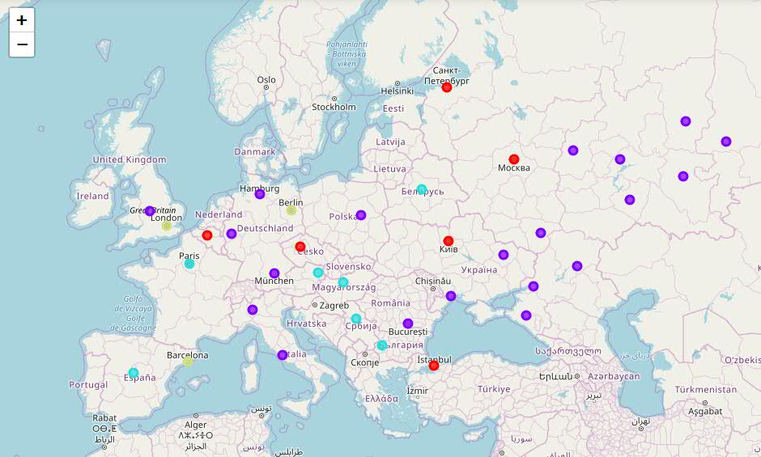
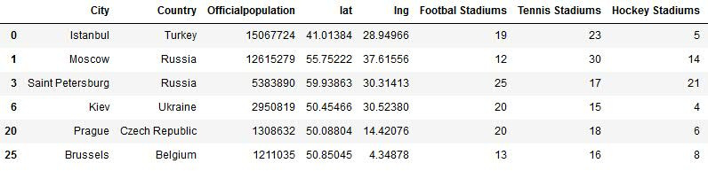
Classify largest European cities according to their ability to host multisport event
A simple Data science project aiming to demonstrate the possibilities
and power of the combination of Python, Python Data science (and other) packages, unsupervised machine learning and the Foursquare API. Though this case study is not the best match for Foursquare as such, it still can be used to demonstrate what can be achieved using the tools named.
The following was done to achieve the results shown on the attached map and table:
Info about European cities with largest population was retrieved from Wikipedia a processed using the pandas package
Numbers of Football, Hockey and Tennis Stadium were retrieved for each city.
K-means clustering was used to group cities with similar parameters.
Groups showing with the optimal ratio between the Stadiums was selected as the best candidate.

