Slide 1
Presentation title
Date 2016
Supporting content
  Firstname Lastname
  Job title
    surname@isoc.org

Slide 2
Sub-section divider title
Supporting content outlining
the following section.

Slide 3
Sub-section divider title
Supporting content outlining
the following section.

Slide 4
Sub-section divider title
Supporting content outlining
the following section.

Slide 5
“The Internet Society is operating on a world
stage to help all of the stakeholders of the Internet
to understand what the implications of the
technology are, what policies are beneficial,
and what right and freedoms need to be preserved
in the use of this system.”
  Vint Cerf

Slide 6
“The Internet Society is operating on a world
stage to help all of the stakeholders of the Internet
to understand what the implications of the
technology are, what policies are beneficial,
and what right and freedoms need to be preserved
in the use of this system.”
  Vint Cerf

Slide 7

“Large statement or small quote.”

Slide 8
Internet Exchange Points (IXPs).
A well recognised, vital part of the Internet ecosystem
and essential for facilitating a robust domestic ICT sector.
Primary role of an IXP
    Keep local Internet traffic within local infrastructure
    and to reduce costs associated with traffic exchange
    between networks.
      Secondary bullet style
        Tertiary bullet style
    Improve the quality of Internet services and drive demand
    in by reducing delay and improving end-user experience.

Slide 9
Measuring the benefits of an IXP.
Benefit | Before KIXPs | After KIXPs | Summary
Latency | 200–600 ms | 2-10 ms | Significant increase in performance.
Local traffic exchange | Negligible | 1 Gbits/s | Estimated total saving of $1,440,000 per year on international transit.
Content | All content was accessed through international links, almost all content hosted abroad. | Google network present locally. Rehoming of content hosted abroad. | Increased revenues up to $ 6 millions per 100 Mbit/s of new mobile data traffic.
E-government | KRA collected taxes manually | Revenues collected online. | Significant reliance on KIXP to clear customs and raise revenues.
Domain names | .com was predominant domain, registered overseas. | ke is the predominant domain, registered and based locally. | KENIC uses KIXP to help increase service delivery for .ke
Regional routes | All regional traffic tromboned internationally | An increasing amount of regional traffic exchanged at KIXP. | KIXP more attractive to content providers and backbones able to access regional servers.

Slide 10
The rise of relatively data-heavy applications is one reason for the growth in mobile Internet per connection.
Global mobile Internet connections
In millions

Slide 11
The role of IXPs.
Primary role
    Keep local Internet traffic within local infrastructure and reduce costs associated with traffic exchange between networks.
    Improve the quality of Internet services and drive demand by reducing delay and improving end-user experience.
    Create a convenient hub for attracting key Internet infrastructures within countries.
    Act as a catalyst for overall Internet development including commercial, governmental and academic stakeholders.
Collective responsibility
  Reaping the benefits of ICT is dependent on reducing Internet connectivity and bandwidth costs, improving infrastructure, and improving quality of service to all Internet users.
  The responsibility now rests on ISPs, governments, businesses, and consumers. Collectively we must press for faster roll out of the ICT infrastructure and services that are foundational to our dreams of building a Caribbean

Slide 12
Formula for IXP development.
Caption 10/12pt
  Caption body copy
Technical
infrastructure.
The Internet works on three types of IXP infrastructure.
Technical infrastructure.
    Needs not to be expensive, to be effective
Governance infrastructure.
    Typically not-for-profit, neutral and
    transparent member-driven model.
Human infrastructure.
    Local skills and capacity building are
    key drivers of success and sustainability.
Governance
infrastructure.
Human
infrastructure.

Slide 13

Upcoming events.
Caption 10/12pt
  Caption body copy
    African Peering and
    Interconnection forum (AfPIF).
    Gathers more than 100 technical
    and policy experts from around the world.
    Fosters the African Internet community
    and content.
    Promotes African Internet Exchange
    Points (IXPs) and interconnection.

Slide 14
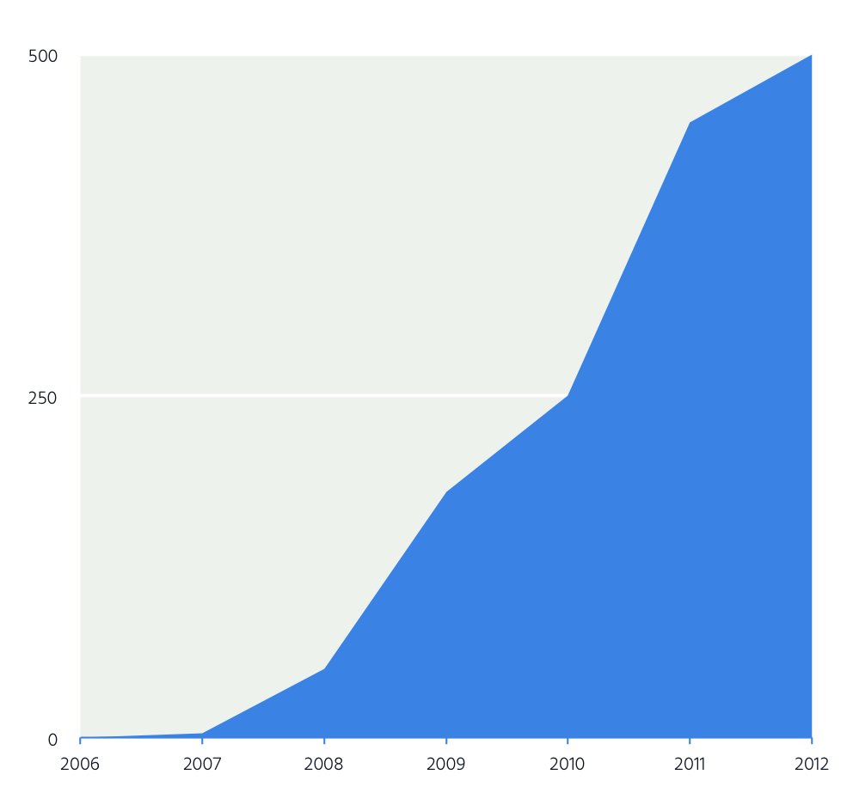
The Internet is open for fun.
Figure 3.12
  Daily tweets on Twitter
    (in millions)
  Twitter is growing with over 500 million tweets now sent every day.
  The use of social media is vast, with 6,282 tweets,
  786 Instagram photo uploads, and 1,109 Tumblr posts every second on one recent day, 20 December 2013.
  Twitter’s use has grown dramatically since its March 2006 launch, with over 500 million tweets now sent every day by over 230 million active users. The service is truly global, operating in 35 languages, with 77% of accounts originating from outside of its home market.

Slide 15
We’re working towards creating an enabling environment for the Internet.
Promotion of private
sector investment and
providing regulatory certainty
Competition, non–discriminatory tariff frameworks and open access particularly at the levels of international bandwidth, IP transit, interconnection, and backhaul.
Local-loop unbundling,
as well as infrastructure
sharing, to ensure competitive service offerings to end-users.
Internet Exchange Points
can be a catalyst of a
robust domestic Internet environment and market.

Slide 16
Building a better Internet.
Technology
  Protocol standards,
  global interoperability.
Economy
  Permissionless and
  innovation driving
  new business models.
Political
  Openness is possible
  across many different
  policy regimes.
Society
  The Internet as a social
  medium for users.

Slide 17
Firstname Lastname
  Job title
    surname@isoc.org

Slide 18
  There are many ways to support
  the Internet. Find out today how
  you can make an impact.

Slide 19
Presentation title
Date 2016
Supporting content
  Firstname Lastname
  Job title
    surname@isoc.org

Slide 20
Sub-section divider title
Supporting content outlining
the following section.

Slide 21
Sub-section divider title
Supporting content outlining
the following section.

Slide 22
Sub-section divider title
Supporting content outlining
the following section.

Slide 23
“The Internet Society is operating on a world
stage to help all of the stakeholders of the Internet
to understand what the implications of the
technology are, what policies are beneficial,
and what right and freedoms need to be preserved
in the use of this system.”
  Supporting content

Slide 24
“The Internet Society is operating on a world
stage to help all of the stakeholders of the Internet
to understand what the implications of the
technology are, what policies are beneficial,
and what right and freedoms need to be preserved
in the use of this system.”
  Supporting content

Slide 25
“Large statement or small quote.”

Slide 26
Internet Exchange Points (IXPs).
A well recognised, vital part of the Internet ecosystem
and essential for facilitating a robust domestic ICT sector.
Primary role of an IXP
    Keep local Internet traffic within local infrastructure
    and to reduce costs associated with traffic exchange
    between networks.
      Secondary bullet style
        Tertiary bullet style
    Improve the quality of Internet services and drive demand
    in by reducing delay and improving end-user experience.

Slide 27
Measuring the benefits of an IXP.
Benefit | Before KIXPs | After KIXPs | Summary
Latency | 200–600 ms | 2-10 ms | Significant increase in performance.
Local traffic exchange | Negligible | 1 Gbits/s | Estimated total saving of $1,440,000 per year on international transit.
Content | All content was accessed through international links, almost all content hosted abroad. | Google network present locally. Rehoming of content hosted abroad. | Increased revenues up to $ 6 millions per 100 Mbit/s of new mobile data traffic.
E-government | KRA collected taxes manually | Revenues collected online. | Significant reliance on KIXP to clear customs and raise revenues.
Domain names | .com was predominant domain, registered overseas. | ke is the predominant domain, registered and based locally. | KENIC uses KIXP to help increase service delivery for .ke
Regional routes | All regional traffic tromboned internationally | An increasing amount of regional traffic exchanged at KIXP. | KIXP more attractive to content providers and backbones able to access regional servers.

Slide 28
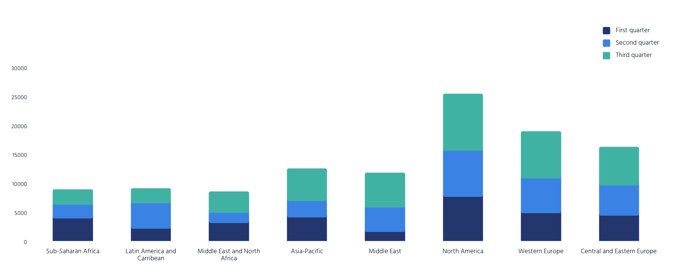
The rise of relatively data-heavy applications is one reason for the growth in mobile Internet per connection.
Global mobile Internet connections
In millions

Slide 29
The role of IXPs.
Collective responsibility
  Reaping the benefits of ICT is dependent on reducing Internet connectivity and bandwidth costs, improving infrastructure, and improving quality of service to all Internet users.
  The responsibility now rests on ISPs, governments, businesses, and consumers. Collectively we must press for faster roll out of the ICT infrastructure and services that are foundational to our dreams of building a Caribbean
Primary role
    Keep local Internet traffic within local infrastructure and reduce costs associated with traffic exchange between networks.
    Improve the quality of Internet services and drive demand by reducing delay and improving end-user experience.
    Create a convenient hub for attracting key Internet
    infrastructures within countries.
    Act as a catalyst for overall Internet development including commercial, governmental and academic stakeholders.

Slide 30
Formula for IXP development.
Caption 10/12pt
  Caption body copy
Technical
infrastructure.
The Internet works on three types of IXP infrastructure.
Technical infrastructure.
    Needs not to be expensive, to be effective
Governance infrastructure.
    Typically not-for-profit, neutral and
    transparent member-driven model.
Human infrastructure.
    Local skills and capacity building are
    key drivers of success and sustainability.
Governance
infrastructure.
Human
infrastructure.

Slide 31
Upcoming events.
Caption 10/12pt
  Caption body copy
    African Peering and
    Interconnection forum (AfPIF).
    Gathers more than 100 technical
    and policy experts from around the world.
    Fosters the African Internet community
    and content.
    Promotes African Internet Exchange
    Points (IXPs) and interconnection.

Slide 32
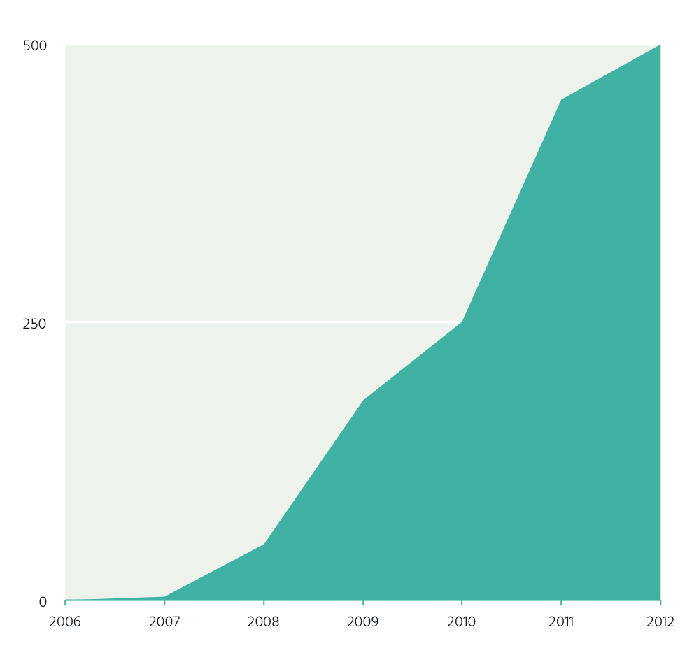
The Internet is open for fun.
Figure 3.12
  Daily tweets on Twitter
    (in millions)
  Twitter is growing with over 500 million tweets now sent every day.
  The use of social media is vast, with 6,282 tweets,
  786 Instagram photo uploads, and 1,109 Tumblr posts every second on one recent day, 20 December 2013.
  Twitter’s use has grown dramatically since its March 2006 launch, with over 500 million tweets now sent every day by over 230 million active users. The service is truly global, operating in 35 languages, with 77% of accounts originating from outside of its home market.

Slide 33
We’re working towards creating an enabling environment for the Internet.
Promotion of private
sector investment and
providing regulatory certainty
Competition, non–discriminatory tariff frameworks and open access particularly at the levels of international bandwidth, IP transit, interconnection, and backhaul.
Local-loop unbundling,
as well as infrastructure
sharing, to ensure competitive service offerings to end-users.
Internet Exchange Points
can be a catalyst of a
robust domestic Internet environment and market.

Slide 34
Building a better Internet.
Technology
  Protocol standards,
  global interoperability.
Economy
  Permissionless and
  innovation driving
  new business models.
Political
  Openness is possible
  across many different
  policy regimes.
Society
  The Internet as a social
  medium for users.

Slide 35
Firstname Lastname
  Job Title
    surname@isoc.org

Slide 36
  There are many ways to support
  the Internet. Find out today how
  you can make an impact.

