Slide 1

GUIDELINES
BRAND
BOOK
DIRECTIONS
WEISO
Notes:
Replace the centre image with your strongest brand photo. Replace [ YOUR BRAND NAME ] with your brand name and add your logo over the image if you have one.

Slide 2
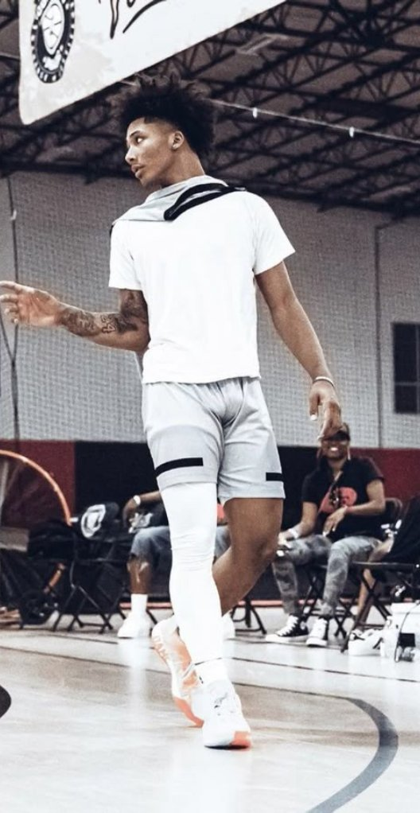
TABLE OF
Contents
01
ABOUT THE BRAND
Who you are, why you exist, what you stand for
02
BRAND VOICE & MESSAGING
How you sound and the exact words you reuse
03
LOGO & IDENTITY
Every mark, where it goes, and what breaks it
04
TYPOGRAPHY
The two fonts that carry the whole brand
05
COLOR PALETTE
The colours, their roles, and their rules
06
ICONOGRAPHY & GRAPHIC ELEMENTS
The small pieces that repeat everywhere
07
MOODBOARD & AESTHETIC
The visual world your brand lives in
08
CREATIVE DIRECTION
The brief every photographer and editor receives
CONTENTS
01

Slide 3
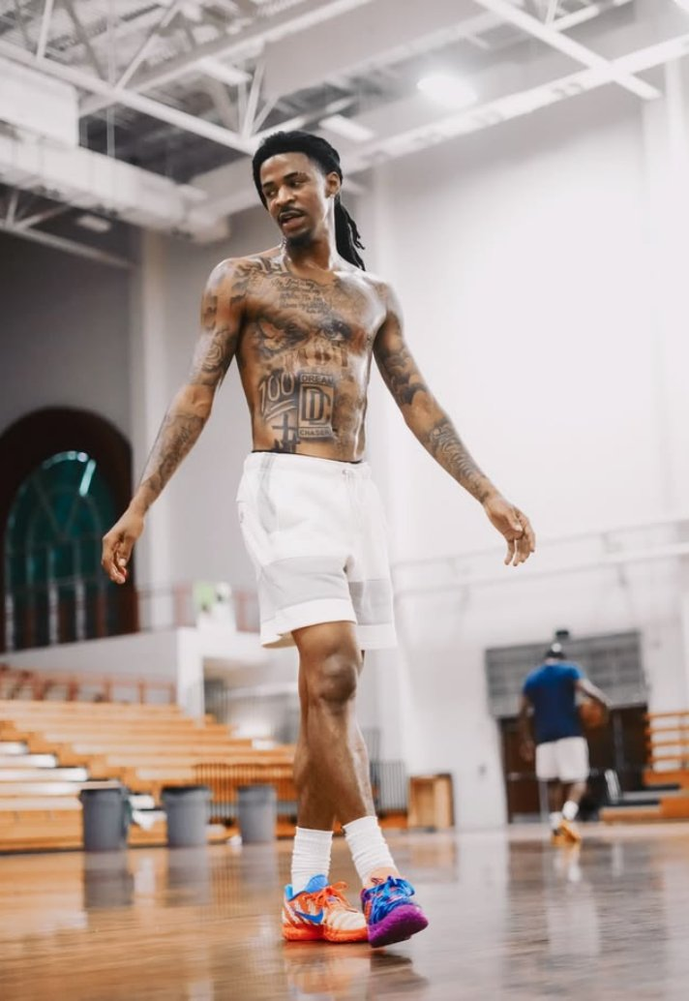
01
About
the brand
Where Weiso comes from: early mornings, late nights, and a nickname earned in the iso.

Slide 4
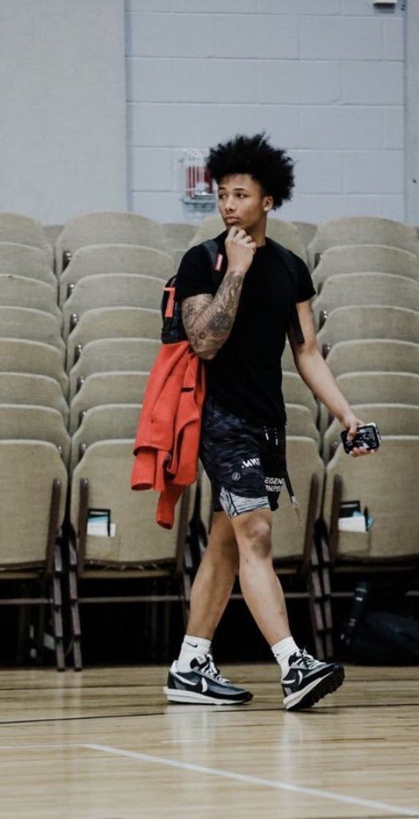
01 — ABOUT THE BRAND
Who we are
BRAND STATEMENT — 2 SENTENCES
WHAT WE KNOW THAT COMPETITORS DON'T
Weiso makes clean, tough basketball clothing for the hooper everyone on the court watches. Made to play in, made to be noticed, for players who work in silence and let their game do the talking.
Our customer cares what others think about them.
On the court and online, they want to look tough and get noticed for what they wear.
So they look up to the tough hoopers: the ones who play pickup and 1v1s, grind every day and put in the hard work.
That’s why Weiso puts its gear on those hoopers. When others see what they wear, they want it too, because every young hooper wants to be the WE: the one everyone watches.
WHY THIS BRAND EXISTS
Weiso was started by Fredrik, a hooper who trained early mornings and late nights, working in silence while nobody knew. It paid off: in games he became unguardable, and the court gave him a nickname: Iso. Few brands made tough, clean shorts for players like that, so he built one.
WE + ISO. WE is the hooper everyone on the court watches: hard-working, tough, humble, focused. ISO is the 1v1, and the nickname that started it all.
01 — ABOUT THE BRAND
02

Slide 5
01 — ABOUT THE BRAND
Vision, mission, values
VISION — THE WORLD YOU'RE BUILDING
VALUES — 4 TO 6, EACH WITH A SENTENCE
Every court in the world has a WE: the hooper everyone watches, studies and wants to match up against, wearing Weiso. Weiso becomes the name young players connect with the 1v1 and the silent work behind it.
1. Work in silence. We show the grind, not the hype. Nobody needs to know about the hours until they show in the game.
2. Tough by design. If a piece can’t survive a real pickup run, it doesn’t drop.
3. Clean over loud. If a graphic makes a piece louder but not better, it’s out.
4. Be the WE. Hard-working, tough, humble, focused: the hooper everyone watches. Everything we make and post is for them.
MISSION — WHAT YOU DO EVERY DAY
We design clean, tough basketball clothing made to play in and made to be noticed. We put it on the hoopers people watch and film their pickup runs, 1v1s and workouts, so young players everywhere see the work behind the game, and put in their own.
01 — ABOUT THE BRAND
03

Slide 6
01 — ABOUT THE BRAND
Brand personality
PERSONALITY IN 4 WORDS
TRAIT 01
Tough · Humble · Nonchalant · Hard-working
Meeting Weiso should feel like the quiet hooper at pickup who doesn’t say much, then cooks everyone.
Tough
Heavy block lettering, black and white, real courts, never studios. The brand looks like it can take a hit.
TRAIT 02
Humble
THE FEELINGS A CUSTOMER MOVES THROUGH
The hoopers and the product do the talking. No bragging captions, no fake hype, no “best brand ever”.
From first look to loyalty:
1. Noticed
2. Curious
3. Respect
4. Confident
5. Becoming the WE
TRAIT 03
Nonchalant
Cool, calm, never trying too hard. Short captions, no over-explaining, no begging for likes.
TRAIT 04
Hard-working
We show the reps: early mornings, late nights, sweat, losing and coming back. The grind is the content.
01 — ABOUT THE BRAND
04

Slide 7
01 — ABOUT THE BRAND
Target audience
Basketball players worldwide. Mostly 10–18, plus a growing group of 18–30s.
SEGMENT
PRIMARY MOTIVATION
PRIMARY FEAR
LOYALTY DRIVER
WHERE YOU REACH THEM
Young hoopers
Ages 10–14
Be like the hoopers everyone watches online
Looking basic or getting overlooked
Seeing their favourite hoopers wear Weiso; getting noticed themselves
TikTok, Instagram, teammates and friends
Teen hoopers
Ages 15–18
Become the WE: the one everyone on the court watches
Looking soft or basic in front of others
Tough hoopers they respect wearing it; gear that holds up in real runs
TikTok, Instagram Reels, pickup and workout content
Grown hoopers
Ages 18–30
Clean, tough gear for pickup runs and league games
Gear that looks cheap or made for kids
Quality, clean design, new drops like compression and hoodies
Instagram, Meta ads, local courts and leagues
01 — ABOUT THE BRAND
05

Slide 8
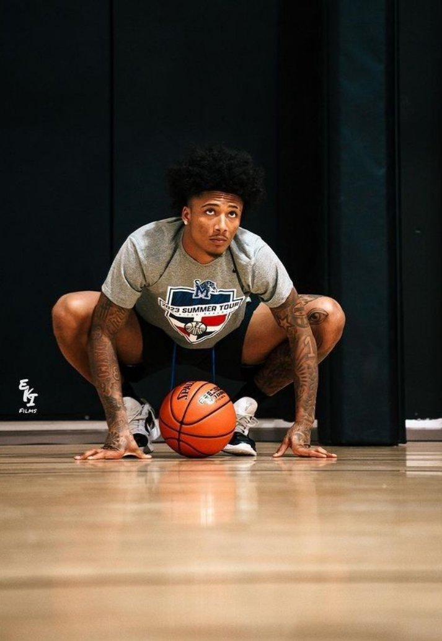
02
Brand voice
& messaging
How the WE talks: quiet, confident, and never louder than the work.

Slide 9
02 — BRAND VOICE
How we sound
OUR VOICE IN ONE SENTENCE
WE NEVER SOUND LIKE
We talk like a hooper who’s been in the gym since 6am while nobody knew: short, calm, confident. We don’t shout and we don’t beg. We let the work and the hoopers do the talking.
If it sounds like an ad, rewrite it.
— Corporate: “Elevate your game with our premium performance apparel.”
— Begging: “Please like and share!!”, “Link in bio 🙏🙏”
— Fake hype: “Best shorts in the world”, “Almost sold out!” when it isn’t
— Trying too hard: forced slang, walls of emojis
— Trash talk about other brands or players
WE ALWAYS SOUND LIKE
— Confident, never cocky
— Short, never lazy
— Tough, never mean
— Real hooper talk, never cringe slang
— About the work, never about the hype
02 — BRAND VOICE
06

Slide 10
02 — BRAND VOICE
Messaging framework
Write it once here, then copy it everywhere. Nobody on your team should ever be inventing this copy again.
ELEMENT
YOUR COPY
WHERE TO USE IT
BRAND DESCRIPTOR
Basketball clothing built for the 1v1.
Website header, packaging, anywhere the name appears.
PRIMARY SLOGAN
The work shows in the iso.
Campaigns, closing frame of every ad, all brand moments.
CORE MESSAGE
Nobody sees the early mornings, the late nights, the hours you put in alone. But it all shows in the iso. Weiso makes clean, tough basketball clothing for the hooper who puts in that work: the one everyone on the court ends up watching.
Homepage hero, Our Story page, press and pitch materials.
BRAND STATEMENT
Weiso makes clean, tough basketball clothing for the hooper everyone on the court watches. Made to play in, made to be noticed, for players who work in silence and let their game do the talking.
Social bios, email footers, About page header.
02 — BRAND VOICE
07

Slide 11
02 — BRAND VOICE
Messaging framework
Continued.
ELEMENT
YOUR COPY
WHERE TO USE IT
MISSION STATEMENT
We design clean, tough basketball clothing made to play in and made to be noticed. We put it on the hoopers people watch and film their pickup runs, 1v1s and workouts, so young players everywhere see the work behind the game, and put in their own.
Team alignment, investor materials, hiring.
USP LINE
Started by a hooper who earned the nickname Iso. A brand built around the 1v1, worn by the hoopers everyone watches.
Competitive positioning, press, partnership pitches.
COMMUNITY LINE
Put in the work. Post it. Tag @weiso.eu. Be the WE.
Community page, social bio, UGC campaigns.
PACKAGING INSERT
Nobody saw the hours. Now they’ll see the iso. Go be the WE. Post your first run in Weiso and tag @weiso.eu.
Inside every package, with every order.
02 — BRAND VOICE
08

Slide 12
02 — BRAND VOICE
Signature phrases
The recurring language of the brand. Everything your team is allowed to reach for without asking.
PRODUCT & PROOF WORDS
EMOTIONAL & IDENTITY LINES
WORDS WE NEVER USE
Only claims we can prove.
— Built for the court
— Made to play in
— Clean design, no noise
— Worn by real hoopers
— Holds up in real pickup runs
Short enough for a story frame, a video end card or the last line of an email.
— The work shows in the iso.
— Nobody saw the hours.
— Work in silence.
— Be the WE.
— Built in silence. Shown in the iso.
— Put in the hours. Take the iso.
If it would look embarrassing in a screenshot, don’t post it.
— “Premium”, “elevate”, “luxury”
— “Best in the world”
— Fake urgency: “almost sold out!”
— Forced slang: “drip”, “swag” overload
— Begging for likes or follows
— Other brands’ names or slogans
02 — BRAND VOICE
09

Slide 13
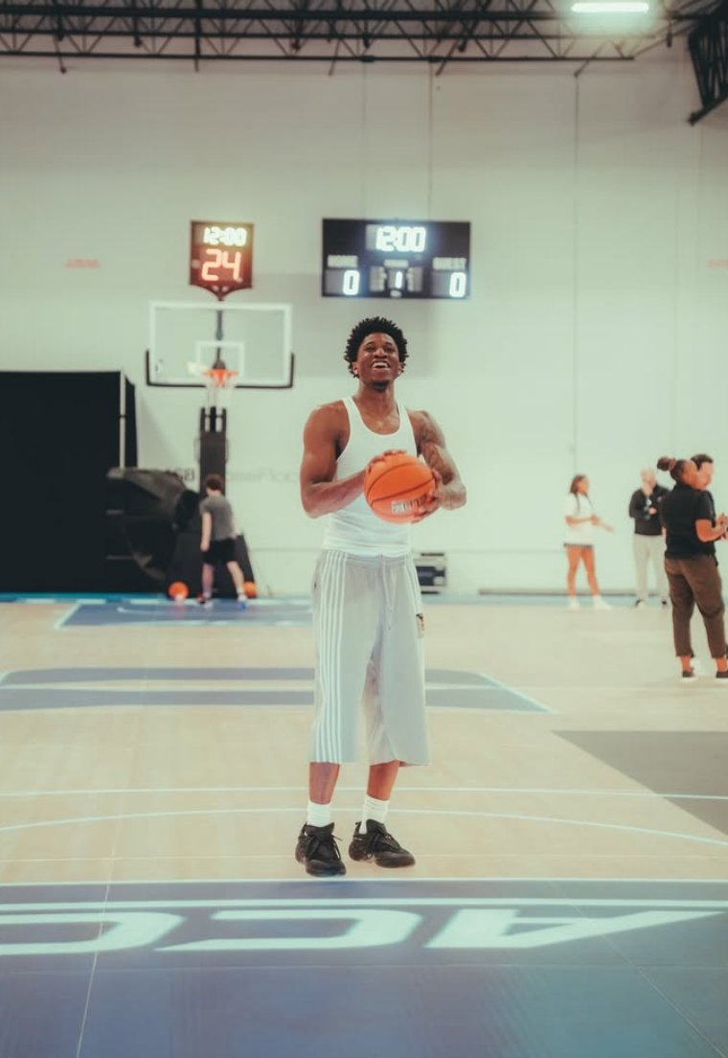
03
Logo &
identity
The WI icon: WE and ISO locked into one mark, and the rules that keep it strong.

Slide 14

03 — LOGO & IDENTITY
Logo concept
THE THINKING BEHIND THE MARK
The WI icon is the main logo.
It locks a W and an I into one shape: the W for WE, the I for ISO, standing straight up through the middle like a hooper alone in the iso.
The WEISO wordmark (heavy, blocky jersey lettering) is only used with it or alone when the name must be read.
HOW PEOPLE SHOULD PERCEIVE IT
Tough · Clean · Athletic · Confident
It should feel like a crest on a jersey: serious, strong and made for the court.
03 — LOGO & IDENTITY
10

Slide 15



03 — LOGO & IDENTITY
The logo suite
PRIMARY LOGO
SECONDARY · FULL LOGO
WORDMARK
The WI icon. The main Weiso logo: product, profile picture, website header, tags, stickers. The default choice.
Icon above the name. When people need to read the name: packaging, documents, email header, press.
The name alone. Wide or small spaces: the waistband or leg of shorts, mobile header, ad lower-thirds.
Min. size: 32 px digital / 1 cm print
Min. size: 120 px digital / 3 cm print
Min. size: 100 px wide / 2.5 cm print
Official files: the WI icon as white and black transparent PNGs. The full logo and wordmark support it. A badge can be added later.
03 — LOGO & IDENTITY
11

Slide 16

03 — LOGO & IDENTITY
Clear space & file formats
CLEAR SPACE RULE
X = the width of the I in the middle of the icon.
Keep at least X of empty space on every side of the logo. No text, edges, other logos or seams inside that space. The same X applies to the full logo and the wordmark.
FILE FORMATS & WHEN TO USE EACH
White on black: the main version. Social, website, dark products.
Black on white: light backgrounds, packaging, documents.
White or black on transparent PNG: on top of photos, video and products.
SVG / EPS: vector files for print, embroidery and resizing. Ask the designer.
PNG / JPG: PNG for digital, JPG for documents.
03 — LOGO & IDENTITY
12

Slide 17






03 — LOGO & IDENTITY
Never do this
If you’re unsure, use the white WI icon on a plain black background.
Don't stretch or squash
Don’t recolour it: black or white only
Don't rotate or tilt
Don't add effects or shadows
Don't place on a busy background
Don't rebuild it in another font
03 — LOGO & IDENTITY
13

Slide 18
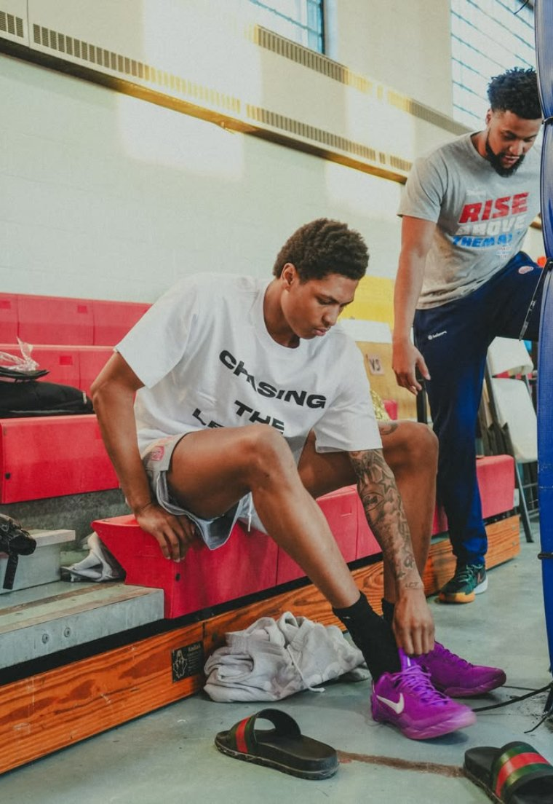
04
Typography
Two fonts. Tall and tough for the headline, clean for everything else. Nothing extra.

Slide 19
04 — TYPOGRAPHY
The type system
HEADER FONT
BODY FONT
Antonio
Inter
ABCDEFGHIJKLMNOPQRSTUVWXYZ
abcdefghijklmnopqrstuvwxyz
1234567890 ! @ # $ % & * ( )
ABCDEFGHIJKLMNOPQRSTUVWXYZ
abcdefghijklmnopqrstuvwxyz
1234567890 ! @ # $ % & * ( )
CHARACTER · WHERE IT'S USED
CHARACTER · WHERE IT'S USED
Tall, condensed, bold, strong, athletic. Headlines, product names, sale banners, video text and anything in capitals. Weights: Bold and SemiBold. Never smaller than 18 pt / 24 px.
Clean, modern and easy to read on a phone. Body text, product descriptions, captions, website menus, buttons and prices. Weights: Regular, Medium and SemiBold. Both fonts are free on Google Fonts.
04 — TYPOGRAPHY
14

Slide 20
04 — TYPOGRAPHY
Hierarchy & rules
HIERARCHY
NEVER DO THIS
H1 · Hero
48 pt · Antonio
Never use the header font for running body copy — it stops being readable past two lines.
H2 · Section
32 pt · Antonio
Never use the body font for hero headlines — the brand will look generic immediately.
H3 · Subhead
20 pt · Antonio
Never introduce a third font. Two is the whole system.
Body
11 pt · Inter
Never set Antonio below 18 pt / 24 px. It gets too thin and cramped to read.
Caption / label
9 pt · Inter
Never stretch, compress or distort either font. If the layout doesn't work, change the layout.
Button / UI
11 pt · Inter
Never set text in grey on black. Anything people must read is black or white.
04 — TYPOGRAPHY
15

Slide 21
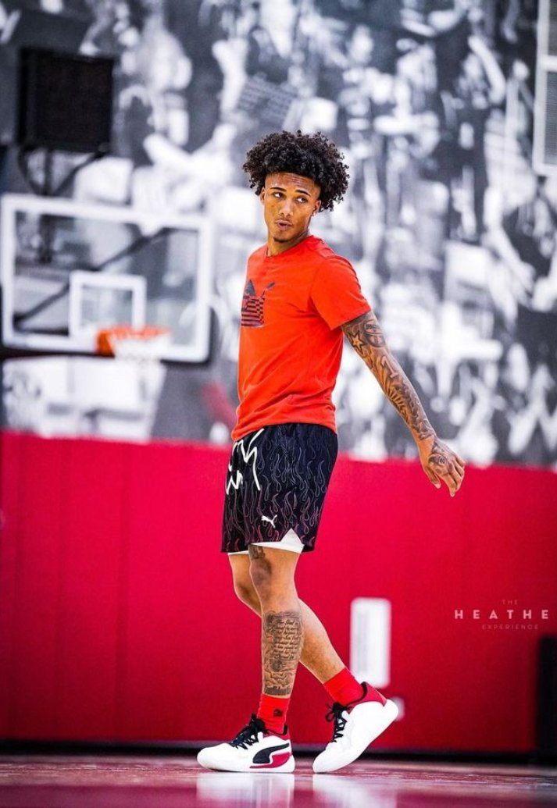
05
Color
palette
Black and white, like an empty gym before sunrise. The products bring the colour.

Slide 22
05 — COLOR PALETTE
The palette
The brand is black and white. Products can be any colour; the brand around them stays black and white.
#000000
#FFFFFF
#8C8C8C
#1A1A1A
#F2F2F0
SIGNATURE · WEISO BLACK
SUPPORTING · WHITE
SECONDARY · CONCRETE
ANCHOR · ASPHALT
SURFACE · CHALK
Logo, backgrounds, packaging. The main brand colour.
Logo on black, text on dark backgrounds, clean space.
Captions, small details, dividers. Never the logo or headlines.
Dark website and social backgrounds. Softer than pure black.
Light backgrounds, packaging inserts, documents.
05 — COLOR PALETTE
16

Slide 23
05 — COLOR PALETTE
What each colour does
COLOUR PSYCHOLOGY — ONE PARAGRAPH PER COLOUR
USAGE RATIO
Black and white is the most honest choice: nothing to hide behind, like an iso.
Black: tough, serious, strong. The colour of early mornings and late nights in an empty gym. It makes the product look hard.
White: clean and sharp. It gives black room to breathe and makes the logo pop.
Concrete: the court and the concrete. Quiet, for details only.
Asphalt: outdoor courts. A softer black for big screen areas.
Chalk: chalk lines and clean paper. A softer white for printed pieces.
60 / 30 / 10
Black 60% · White 30% · Greys 10%. Black leads: backgrounds, packaging, logo. White is for the logo, text and space. Greys only for small details.
COLOUR RULES & COMBINATIONS
White logo on black, Asphalt or photos. Black logo on white or Chalk. Never grey on black or grey on grey for anything people must read. Products can come in any colour. Everything around them (logo, text, ad frames, packaging, website) stays black and white, so the colours of the product pop.
05 — COLOR PALETTE
17

Slide 24
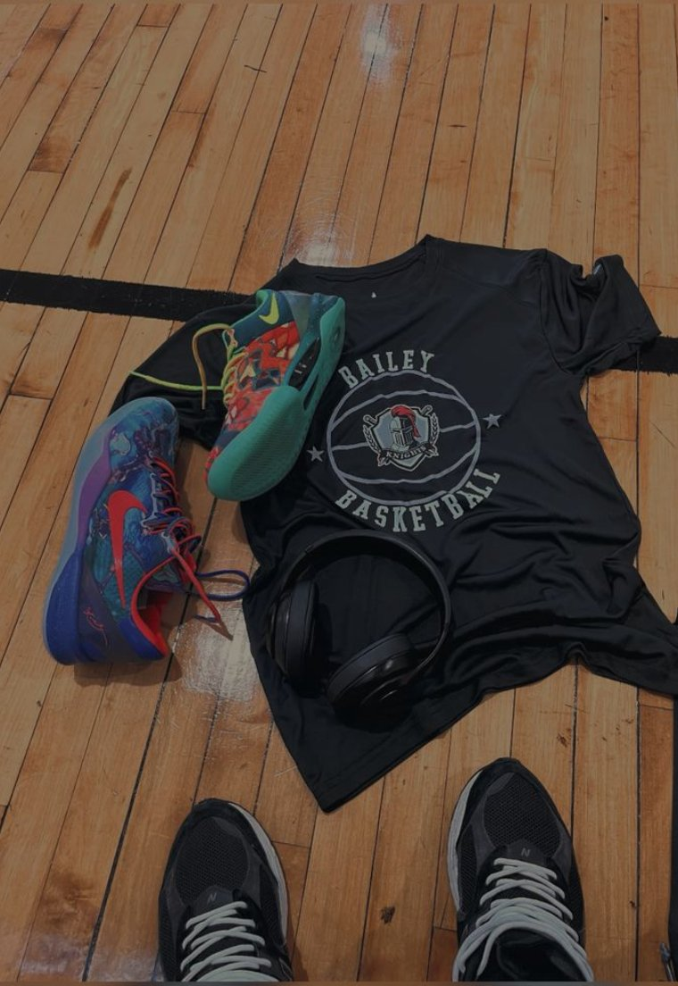
06
Iconography
& elements
The small pieces, kept as quiet and clean as the brand.

Slide 25




06 — ICONOGRAPHY & GRAPHIC ELEMENTS
Icons & graphic elements
Four simple icons for the shop, product pages and packaging. Drafts: the designer redraws them in the final Weiso style.
ICON & ELEMENT RULES
Outline, not filled.
Thick lines that match the weight of the WEISO letters. Square corners, no rounded bubbles. Black on white or white on black only. Sizes: 24 px on the website, 48 px in ads, 1 cm in print.
Graphic elements.
The WI icon as a small stamp: tags, stickers, back of the neck. Simple court lines as a background detail. Nothing else.
Shipping
Returns
Fabric
Size guide
06 — ICONOGRAPHY
18

Slide 26
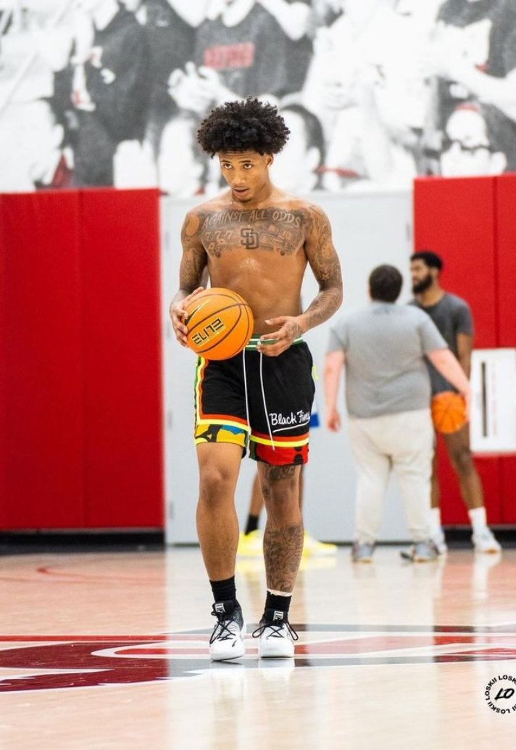
07
Moodboard
& aesthetic
Empty gyms, hardwood, sweat: the world where the unseen hours happen.

Slide 27
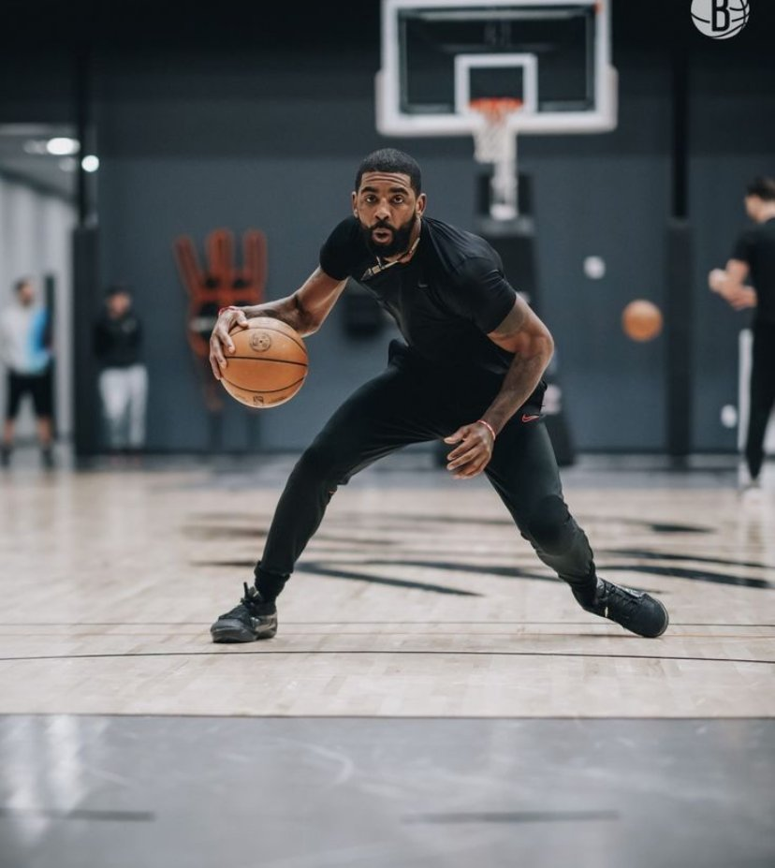
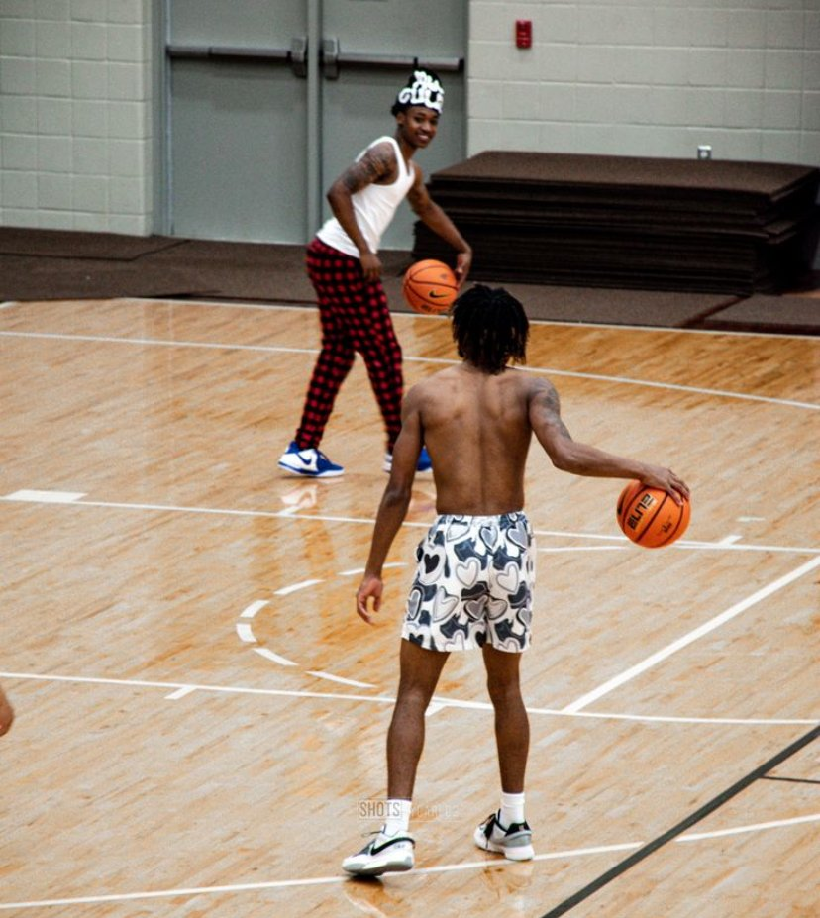
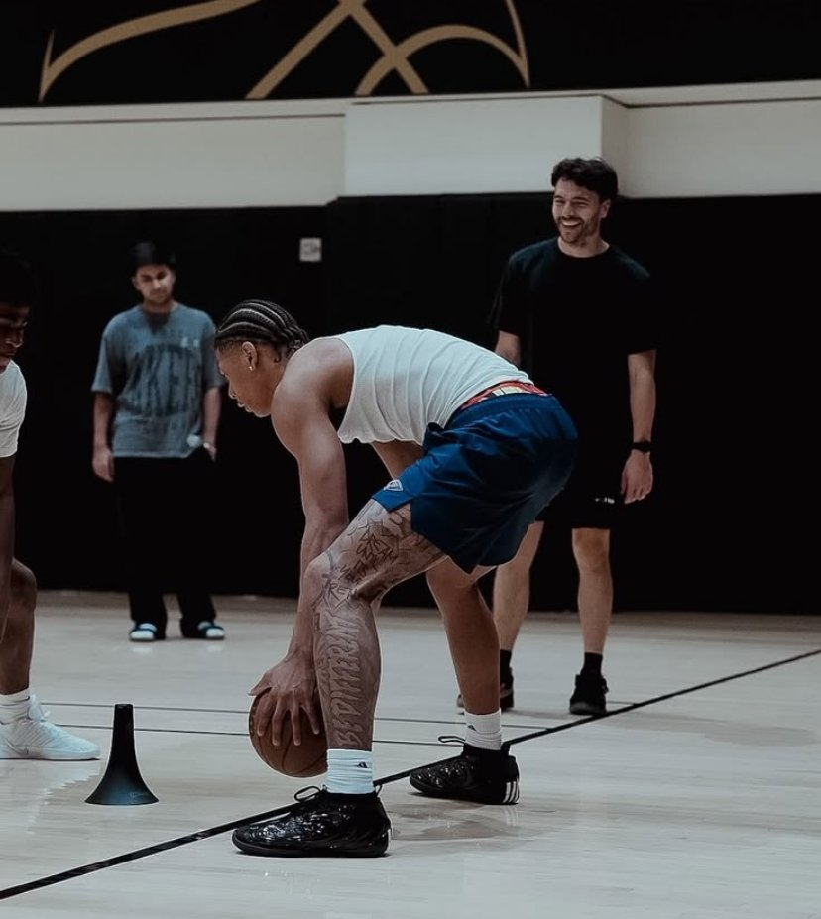
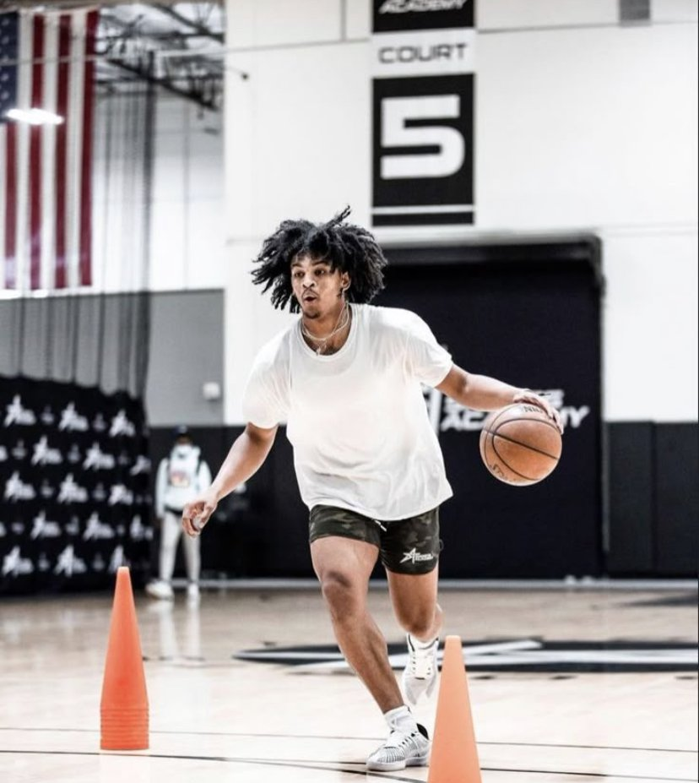
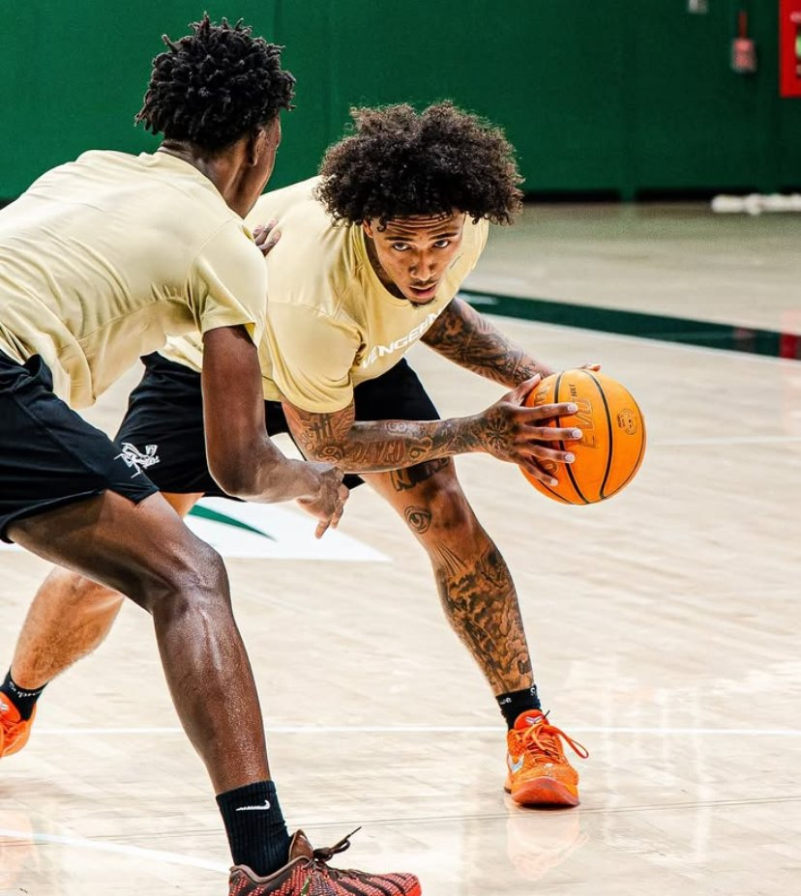
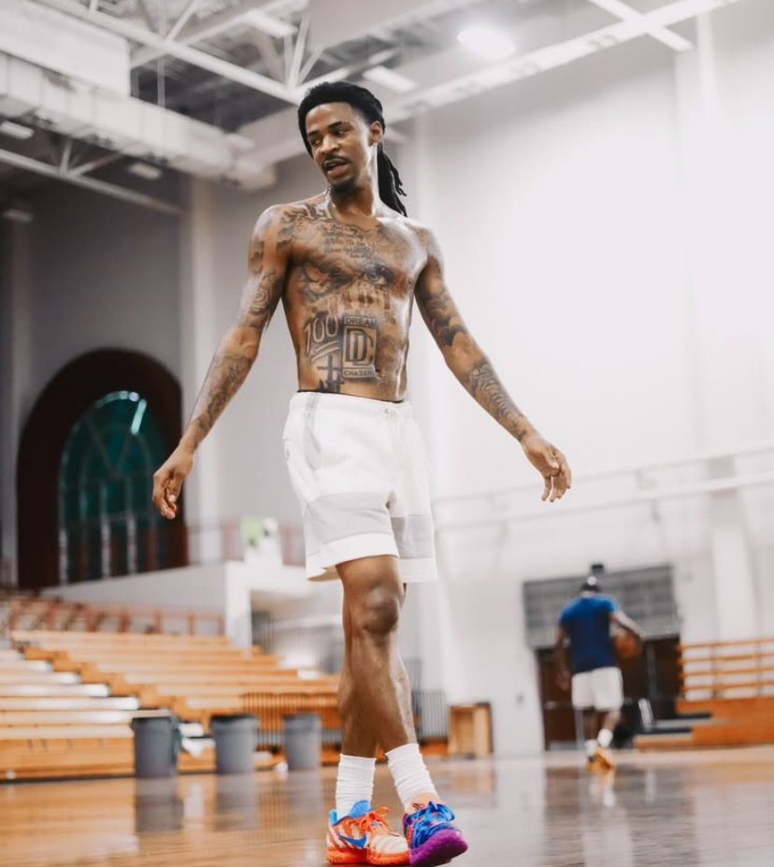
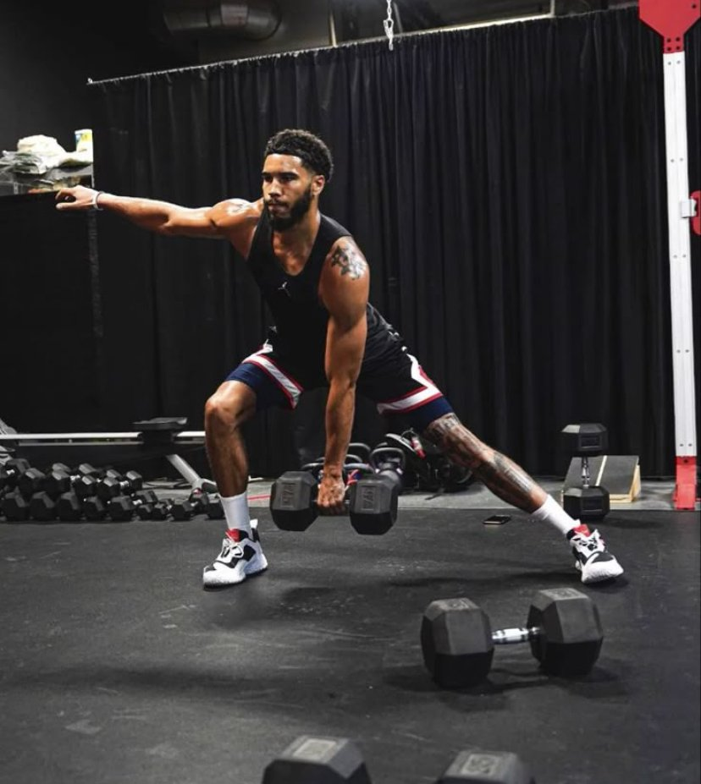
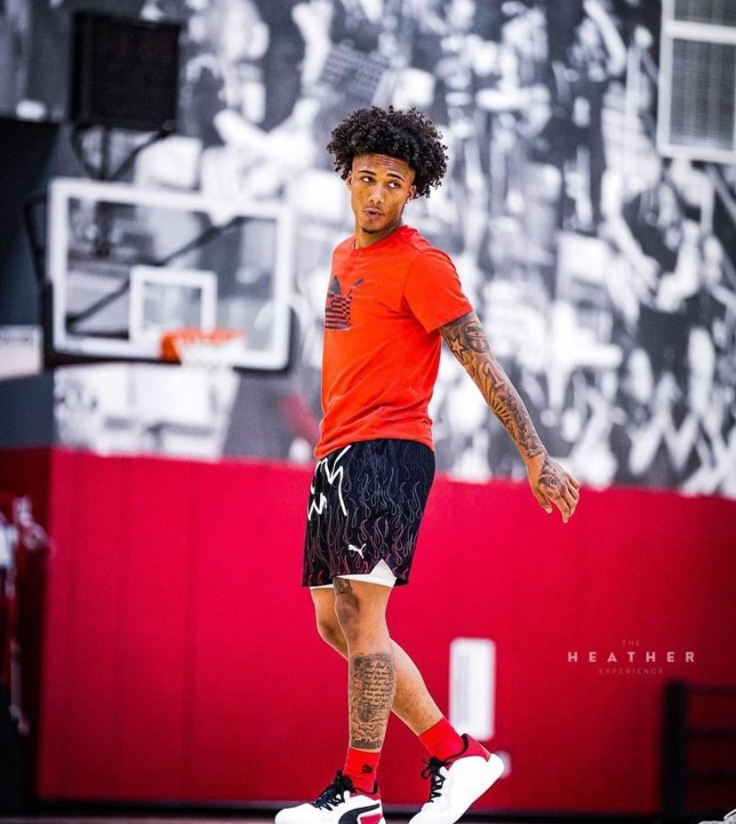
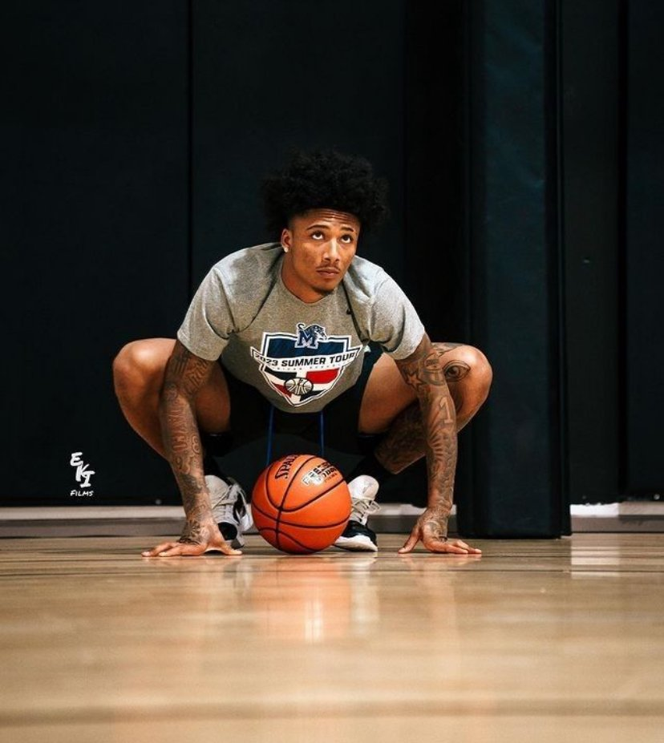
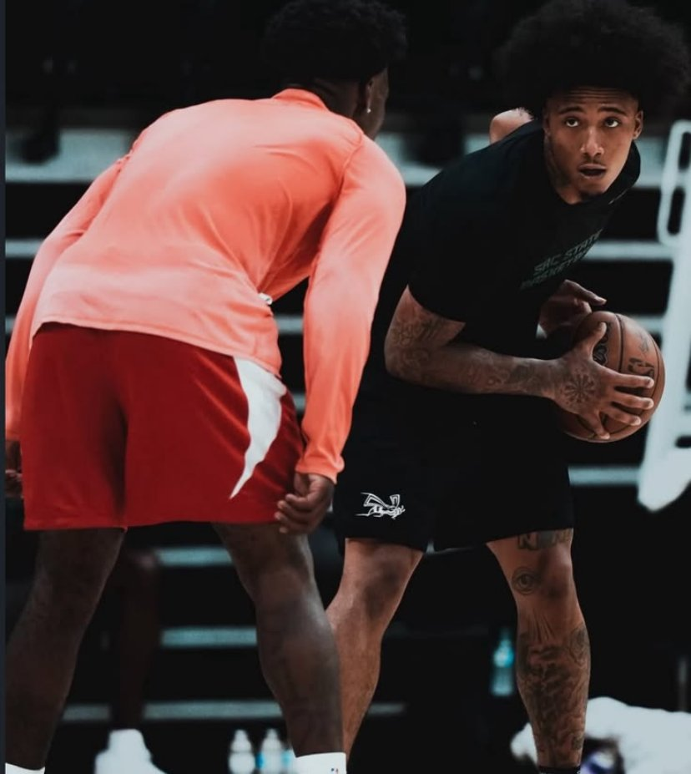
vibe
GRIND
07 — MOODBOARD
19

Slide 28
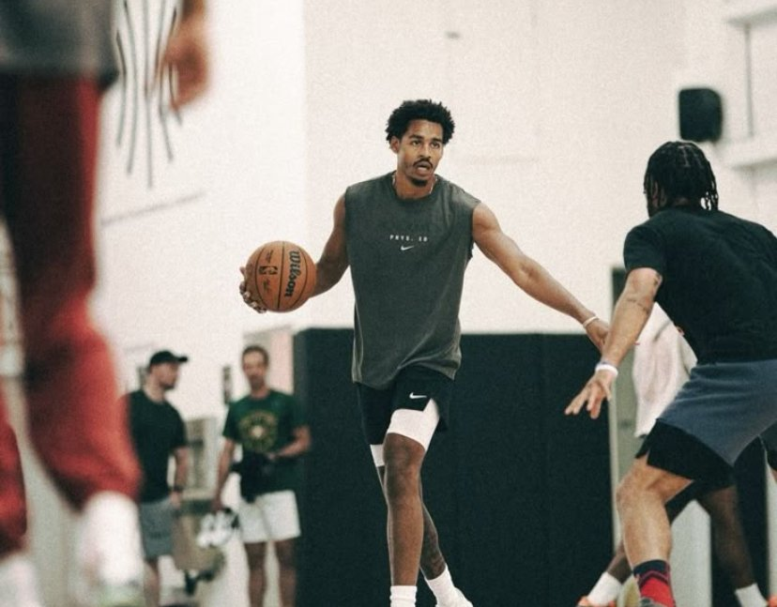
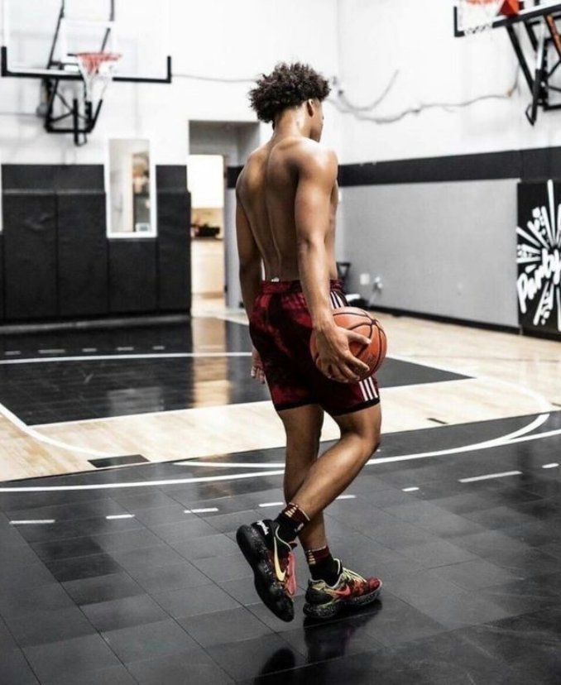
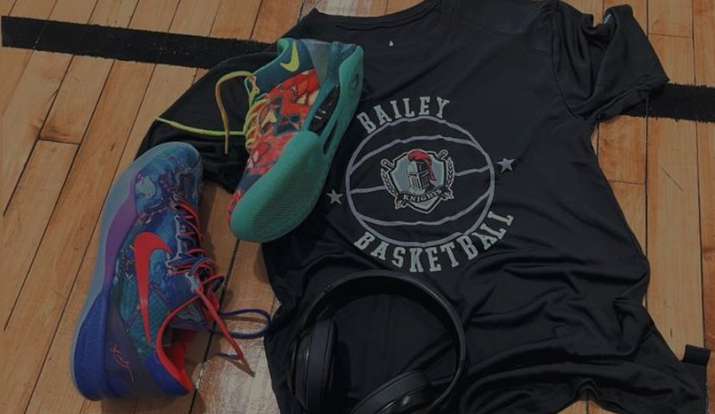
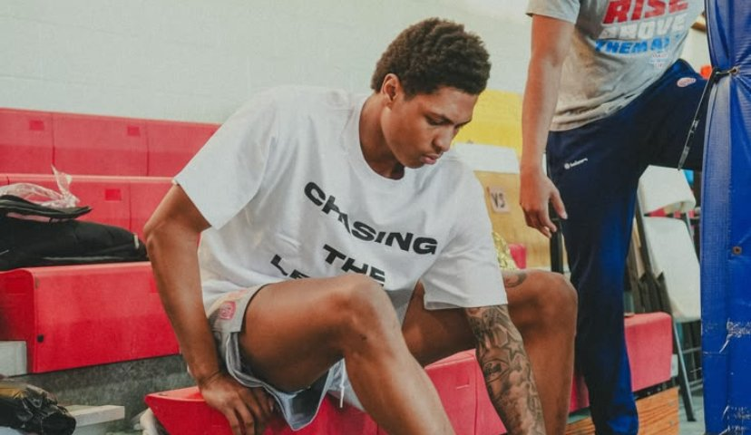
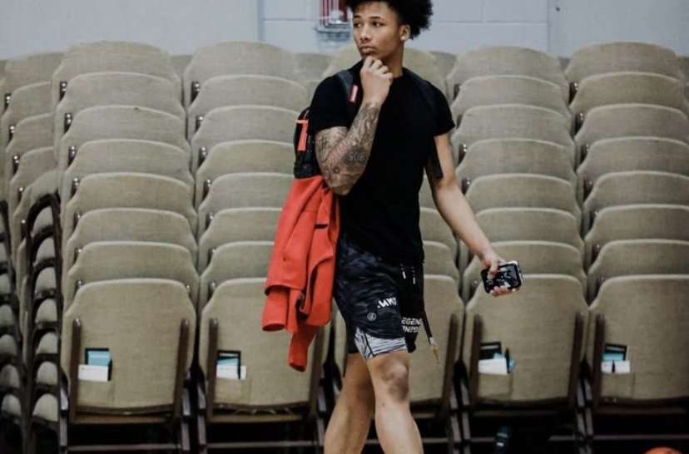
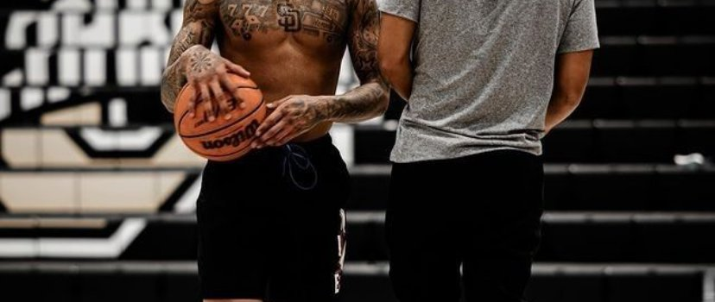
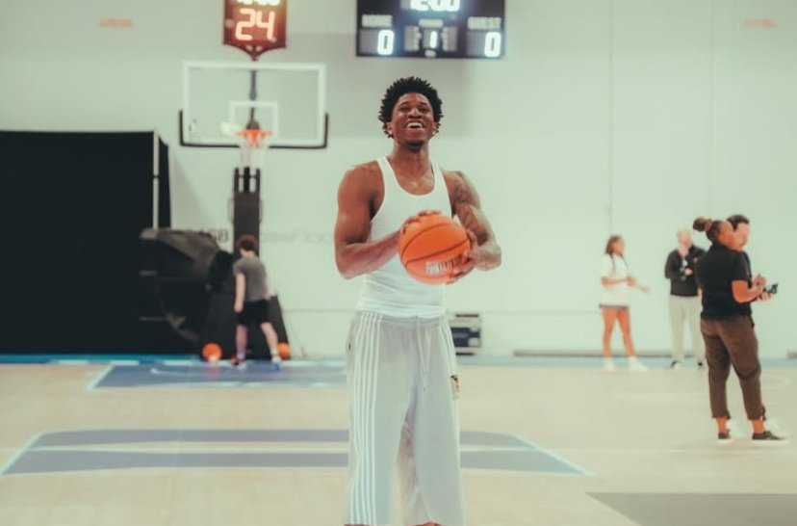
the world
Reference photos only, not ours to post. Gyms, hardwood, cones, stacked chairs: where the unseen hours happen.
MOOD WORDS
— Grind
— Hardwood
— Focus
— Sweat
— Silence
— Real
— Hard light
— Pickup
— Iso
— Confident
07 — MOODBOARD
20

Slide 29
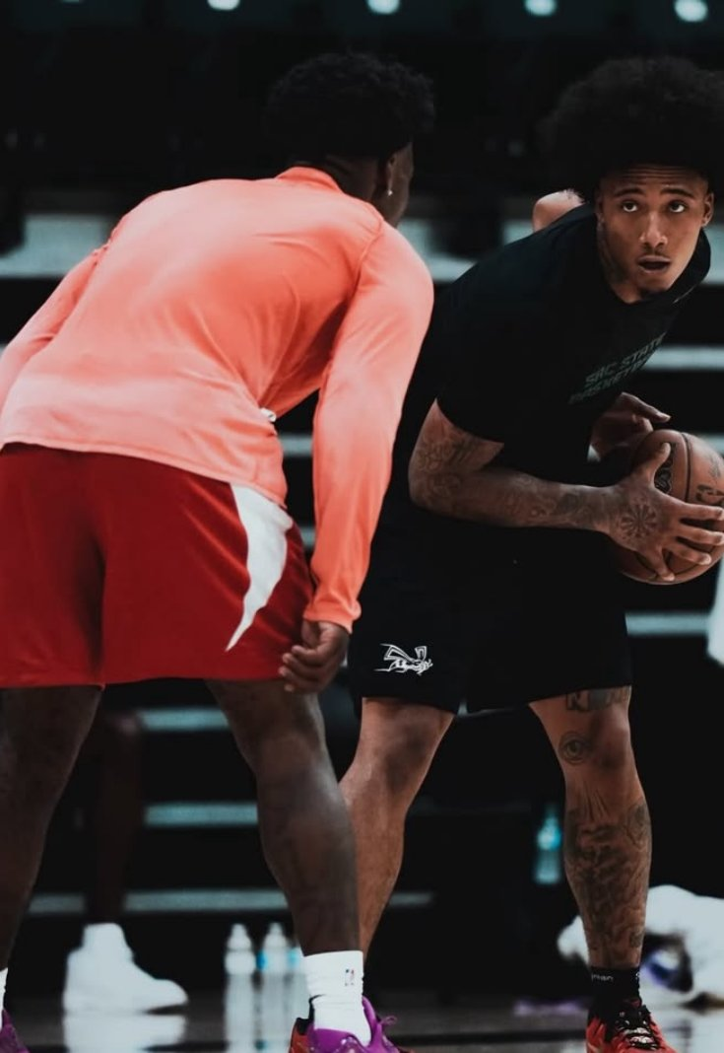
08
Creative
direction
The brief for every shoot: film the WE, show the work nobody sees.

Slide 30
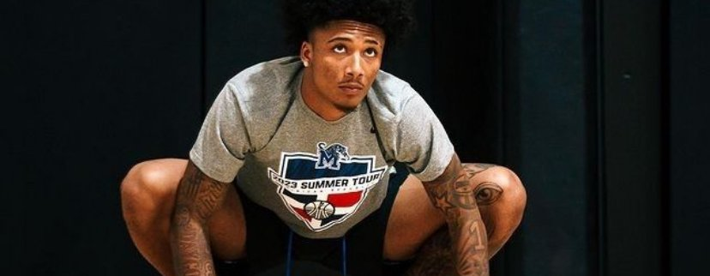
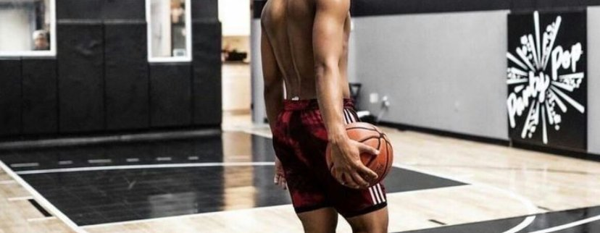
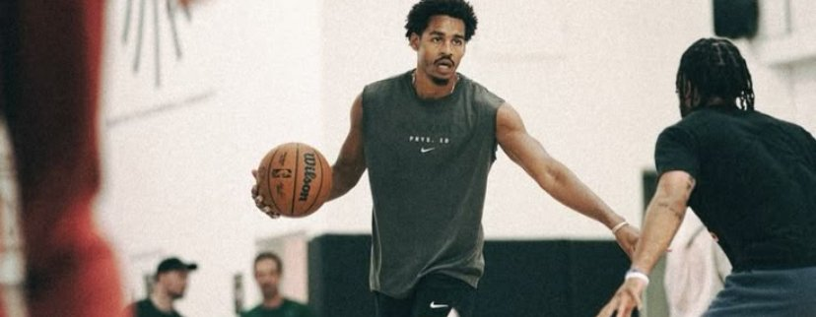
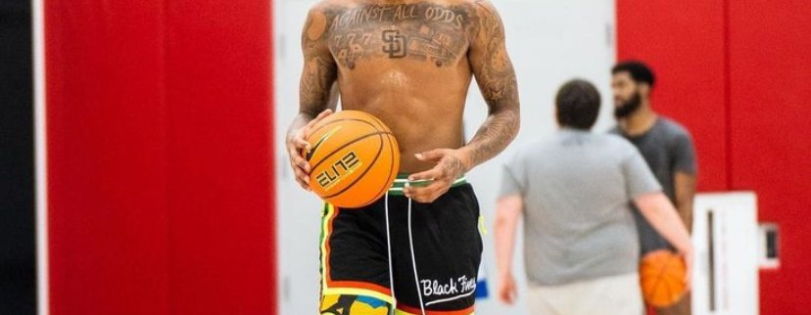
08 — CREATIVE DIRECTION
Photography direction
THE ONE-SENTENCE BRIEF
Film the WE doing the work nobody sees: a documentary of the grind, never a catalogue in a studio.
PRINCIPLE 01 — LIGHT
PRINCIPLE 02 — ENVIRONMENT
PRINCIPLE 03 — THE SUBJECT
PRINCIPLE 04 — THE PRODUCT
Early mornings and late nights: court lights, deep shadows. Day: hard sun, strong contrast. Think: an empty gym at 6am, a lit outdoor court at 10pm.
Outdoor courts, indoor gyms, streets. Real surfaces: asphalt, chain-link fences, worn wood floors. Banned: studios, plain backdrops, bedrooms.
Mostly real: pickup games, 1v1s, workouts, sweat. Some posed shots of hoopers: calm, confident, rarely smiling, not always looking at the camera.
Worn, never laid flat in ads. The shorts move with the player. Every shoot needs at least one shot where the logo and product colour are easy to see.
08 — CREATIVE DIRECTION
21

Slide 31
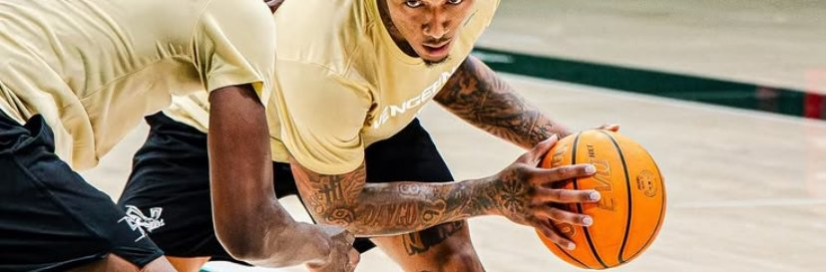

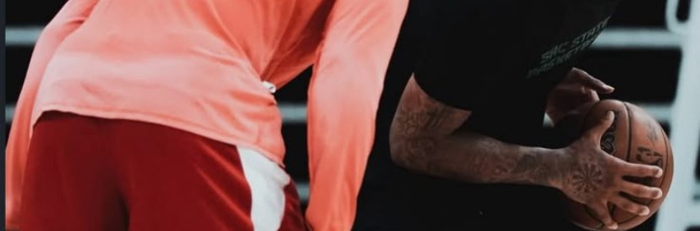
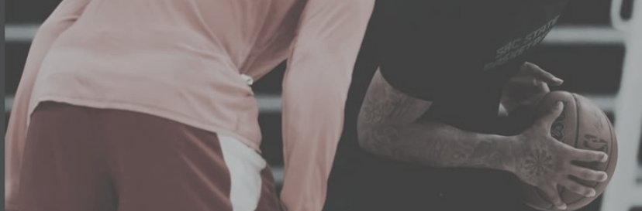

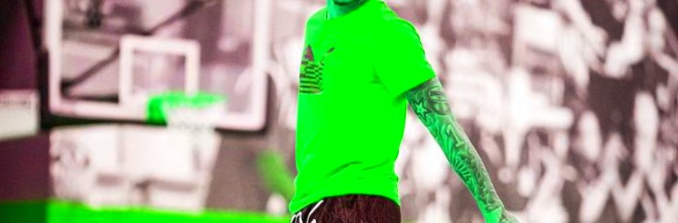
08 — CREATIVE DIRECTION
Grading, do's & don'ts
COLOUR GRADING — APPLY TO EVERY IMAGE BEFORE PUBLISHING
ALWAYS
NEVER
High contrast, deep blacks, slightly cool shadows. Keep product colours true: never shift the colour of the shorts. Light grain on night shots is fine. Black-and-white edits are allowed for mood shots, never for product shots.
Real game moment, player mid-move
Blurry, missed moment
AI-GENERATED CONTENT POLICY
No AI-generated people, courts or products in anything we post or advertise. The hoopers are real and the work is real; that’s the brand. AI is only for help behind the scenes: removing backgrounds, cleaning noise, drafting captions.
Night court, hard light, deep shadows
Flat, grey, washed-out edit
Product clear, in true colour
Filter that changes the product colour
08 — CREATIVE DIRECTION
22

Slide 32
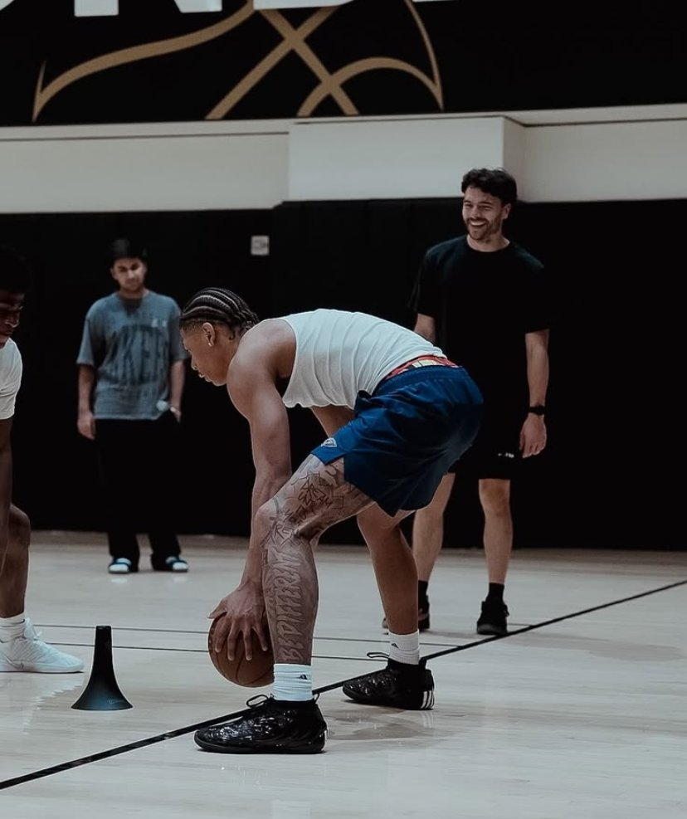
08 — CREATIVE DIRECTION
Ads & content rules
STATIC AD RULES
VIDEO & UGC RULES
Keep 10% free space at the edges for app buttons.
MUST:
— White-on-black logo, bottom corner or end frame
— One short line of copy, in Antonio
— A real hooper in Weiso, product clearly visible
NEVER:
— More than 2 lines of text on the image
— Discount bursts, stickers or extra colours
— Stock photos or AI-generated people
Hook in the first 1–2 seconds: a move, a crossover, a bucket. Captions in Inter, white, lower third. Hard hip-hop or drill beats. Pace follows the play. Last frame: logo + “The work shows in the iso.”
Creators can change:
the moves, the court, the music, their own words.
Creators can’t change:
the logo, the slogan, the fonts, or add other brands.
08 — CREATIVE DIRECTION
23

Slide 33

The work shows in the iso.
WEISO · BRAND GUIDELINES
shopweiso.com · @weiso.eu · @weisobrand

