Slide 1


THE ML JOURNEY
Sohan Shetty
Machine Learning (MGMT 59000-146)

Slide 2
AGENDA
Problem Statement
Workflow
Exploratory Data Analysis
Preprocessing
Model Evaluation & Model Selection
Insights & Recommendations

Slide 3
PROBLEM STATEMENT
Sales Forecasting of Walmart M5 Dataset
1913 Days
Multiple Numerical and Categorical Variables
California State
Household Items
Sales Data
Calendar Data

Slide 4





WORKFLOW
Dataset
EDA
Preprocessing
Predictive Modeling
Insights

Slide 5
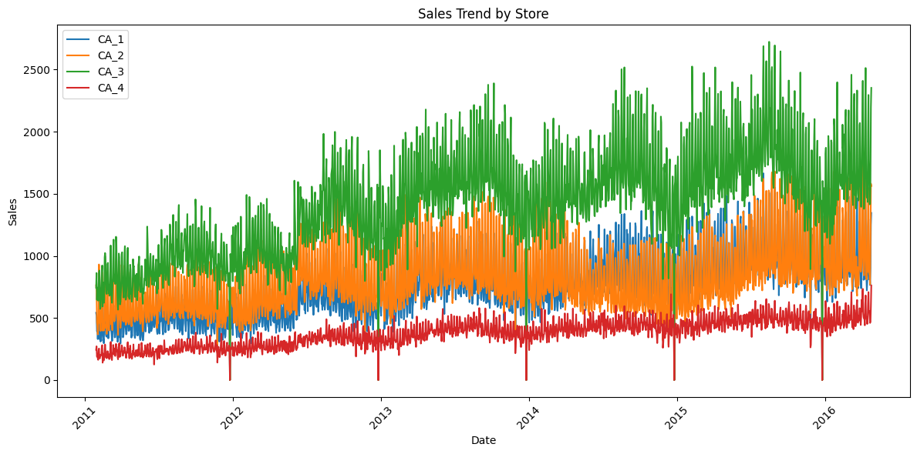
EDA

Slide 6
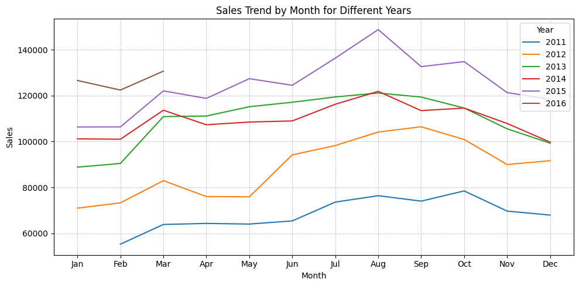
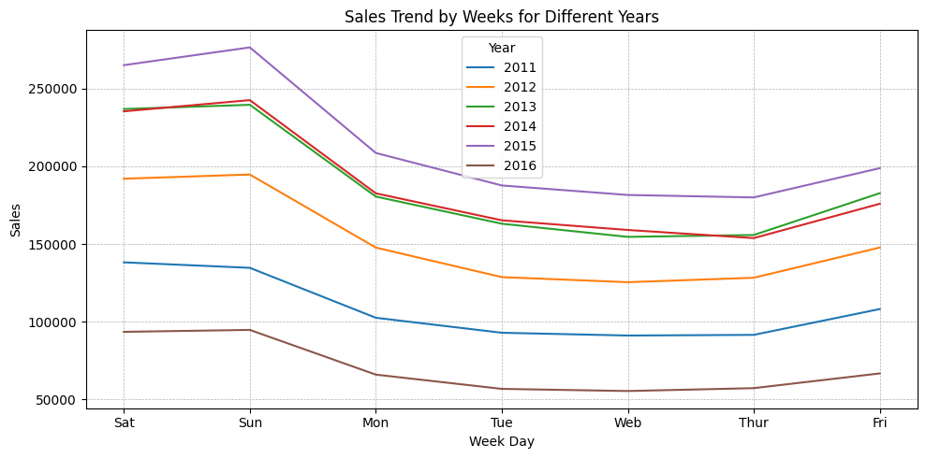
EDA

Slide 7
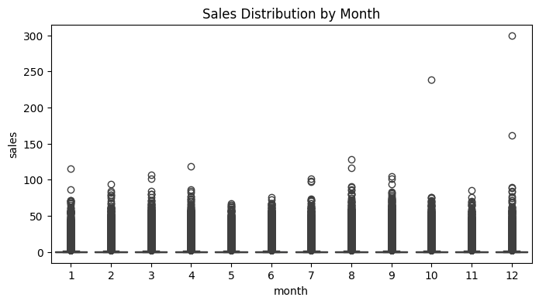
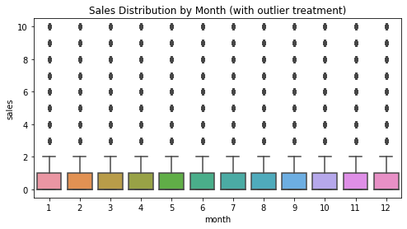
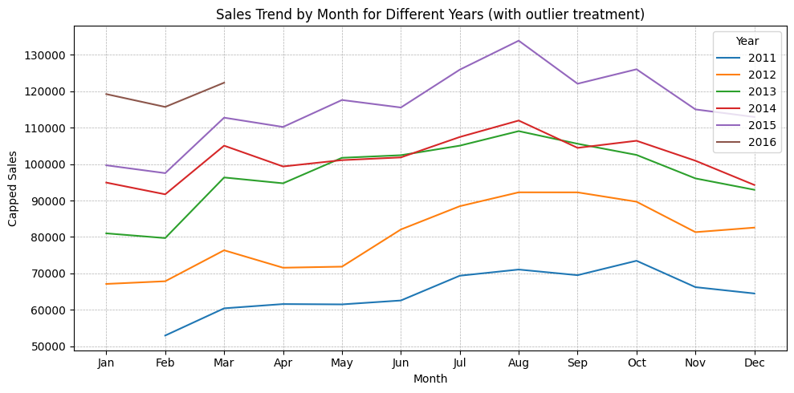
Preprocessing

Slide 8
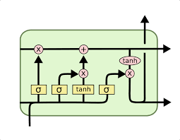
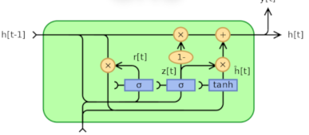
DL
RMSE | 1.27
R square | 0.45
Processing
LSTM
RMSE | 1.35
R square | 0.31
RMSE | 1.08
R square | 0.55
GRU

Slide 9



DL ML
RMSE | 1.33
R square | 0.44
Processing
Processing

Slide 10




DL ML
RMSE | 1.27
R square | 0.45
Processing
LSTM
RMSE | 1.35
R square | 0.31
RMSE | 1.08
R square | 0.55
GRU

Slide 11

DATA INSIGHTS & RECOMMENDATIONS
DATA INSIGHTS
DATA INSIGHTS

Slide 12
DATA INSIGHTS & RECOMMENDATIONS
Recommendations / Lessons Learned
Do not be overambitious
All that glitters is not gold
Start your data journey sooner
Seek feedback

Slide 13
THANK YOU

