Slide 1

Note: The data and information in this document is reflective of a hypothetical situation and client. This document is to be used for KPMG Virtual Internship purposes only.
Sprocket Central Pty Ltd
Data analytics approach
[Data Analytics Team] - [Yadvendar Singh]

Slide 2
Note: The data and information in this document is reflective of a hypothetical situation and client. This document is to be used for KPMG Virtual Internship purposes only.
Agenda
Introduction
Data Exploration
Model Development
Interpretation

Slide 3
Note: The data and information in this document is reflective of a hypothetical situation and client. This document is to be used for KPMG Virtual Internship purposes only.
Introduction
1000 New Customers to Target from the Datasets
Problem Outline:
Sprocket Central Pty Ltd is our valuable client and their marketing team is looking to boost their business.
The team need recommendation of 1000 new customers that should be targeted to drive the most value for the organization.
Proposed Solution:
The Project has been divided into 3 phases as follows – Data Exploration, Model Development and Interpretation to build the recommendation.
Our Data Analysis will compose of:
Job industry, wealth segmentation by age.
Product purchases by age, and gender etc.
Loyal customers classification.
RFM analysis and customer classification.
Forecasting of Revenue.

Slide 4
Note: The data and information in this document is reflective of a hypothetical situation and client. This document is to be used for KPMG Virtual Internship purposes only.
Data Exploration
Data Quality Assessment
Data Quality Dimensions
Assessment was made on the following mentioned dimension and has been sent to you via an email.
Correct Values | Accuracy
Data Fields with Values | Completeness
Values up to Date | Currency
Values Free from Contradiction | Consistency
Data Items with Value Meta-data | Relevancy
Records that are Duplicated | Uniqueness
Allowable Values | Validity

Slide 5
Note: The data and information in this document is reflective of a hypothetical situation and client. This document is to be used for KPMG Virtual Internship purposes only.
Data Exploration
Data Quality Assessment Summary:
Dimensions | Transactions | Customer Demographics | Customer Address
Accuracy |  | 1. default
Completeness | 1. online_order 2. brand 3. product_line 4. product_class 5. product_size 6. product_first_sold_date | 1. last_name 2. DOB 3. Completeness 4. Completeness 5. default 6. tenure
Currency |  | 1. default
Consistency |  | 1. DOB 2. default | 1. states
Relevancy |  | 1. default
Uniqueness |  | 1. default
Validity | 1. product_first_sold_date | 1. gender_dimension 2. default

Slide 6
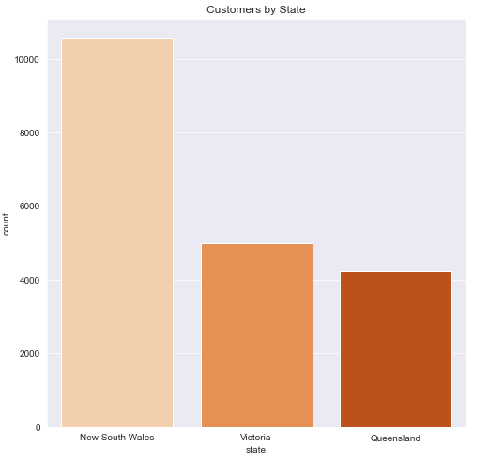
Note: The data and information in this document is reflective of a hypothetical situation and client. This document is to be used for KPMG Virtual Internship purposes only.
Data Exploration
Customer By State
New South Wales has highest number of customers, followed by Victoria and Queensland.
X axis -> state
Y axis -> Count/Number of Customers

Slide 7
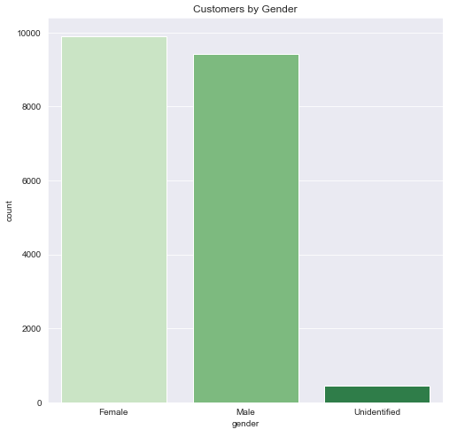
Note: The data and information in this document is reflective of a hypothetical situation and client. This document is to be used for KPMG Virtual Internship purposes only.
Data Exploration
Customer By Gender
Females have topped our customers by gender chart, followed by Males.
Unidentified gender are those people who didn’t identify themselves as either “Male”
or “Female”.
X axis -> gender
Y axis -> Count/Number of Customers

Slide 8
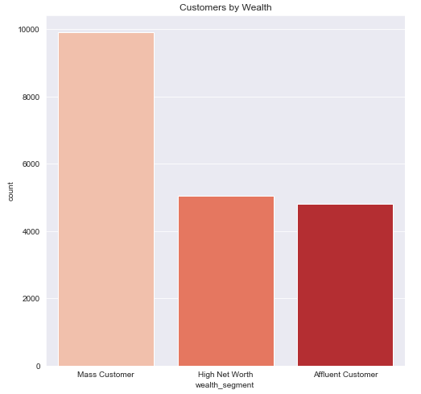
Note: The data and information in this document is reflective of a hypothetical situation and client. This document is to be used for KPMG Virtual Internship purposes only.
Data Exploration
Customer By Wealth Segment
There are almost 2x more Mass Customers than Affluent Customers.
Ratio of High Net Worth and Affluent Customers is ~1.
X axis -> Wealth Segment
Y axis -> Count/Number of Customers

Slide 9
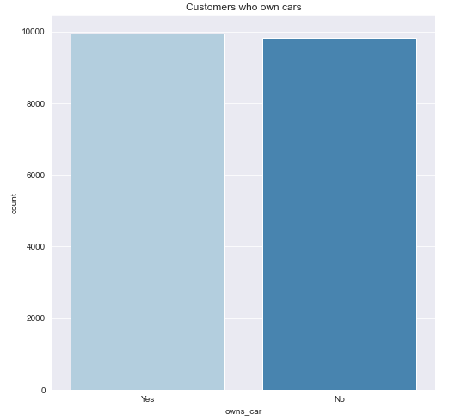
Note: The data and information in this document is reflective of a hypothetical situation and client. This document is to be used for KPMG Virtual Internship purposes only.
Data Exploration
Customers who OWN Cars
There is no significant difference between the customers who owns the car to those who doesn’t.
This signifies that our Bicycle sales is independent of car variable.
X axis -> Owns Cars -> Category (Yes or No)
Y axis -> Count/Number of Customers

Slide 10
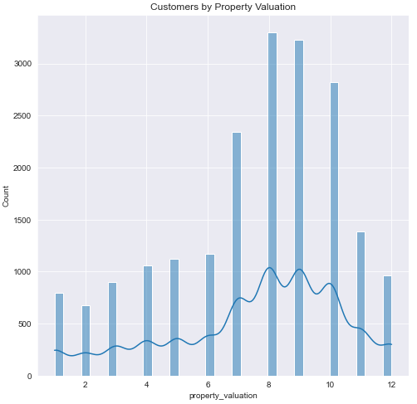
Note: The data and information in this document is reflective of a hypothetical situation and client. This document is to be used for KPMG Virtual Internship purposes only.
Data Exploration
Customers by Property Valuation
The highest number of customers are those whose property has been evaluated between (8,10).
The distribution of customers between (1,6) and (11,12) is same
X axis -> Property_valuation -> Rank [1, 2, 3, 4, 5, 6, 7, 8, 9, 10, 11, 12]
Y axis -> Count/Number of Customers

Slide 11
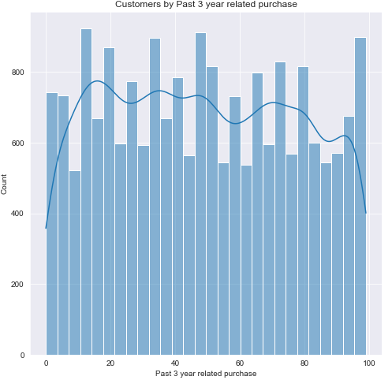
Note: The data and information in this document is reflective of a hypothetical situation and client. This document is to be used for KPMG Virtual Internship purposes only.
Data Exploration
Customers by Past 3-year related purchase
We have customers who made 0 purchase to the customers who made around 100 purchase.
Majority of our customers have bought more than 20 bicycles.
X axis -> Past 3-year bike related purchase
Y axis -> Count/Number of Customers

Slide 12
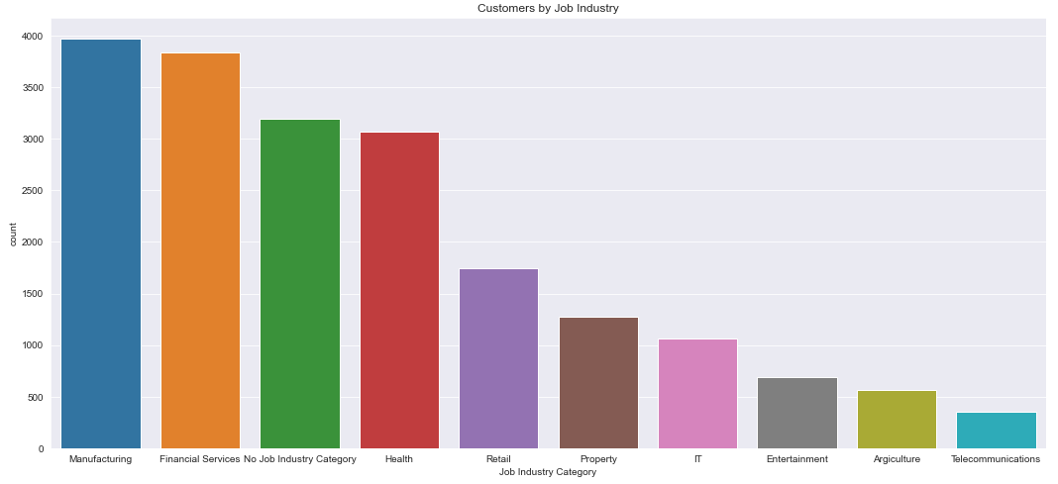
Note: The data and information in this document is reflective of a hypothetical situation and client. This document is to be used for KPMG Virtual Internship purposes only.
Data Exploration
Customers by Job Industry
Financial and Manufacturing services marks up highest customers.
Customers in Entertainment, Agriculture, and Telecommunication are the lowest.
Moderate number of customers come from retail and property sectors.
X axis -> Job Industry Category
Y axis -> Count/Number of Customers

Slide 13
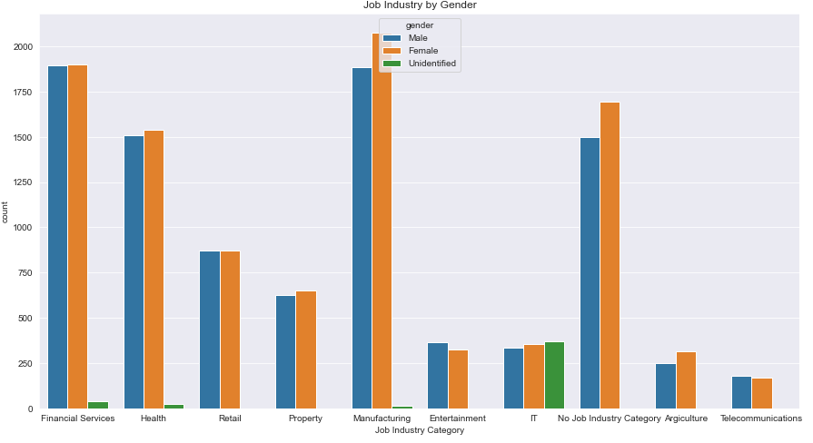
Note: The data and information in this document is reflective of a hypothetical situation and client. This document is to be used for KPMG Virtual Internship purposes only.
Data Exploration
Customers by Job Industry and Gender
There are a greater number of Females in almost all Industries.
There are slightly more Males in Entertainment and Telecommunication Category Only.
X axis -> Job Industry Category
Y axis -> Count/Number of Customers

Slide 14
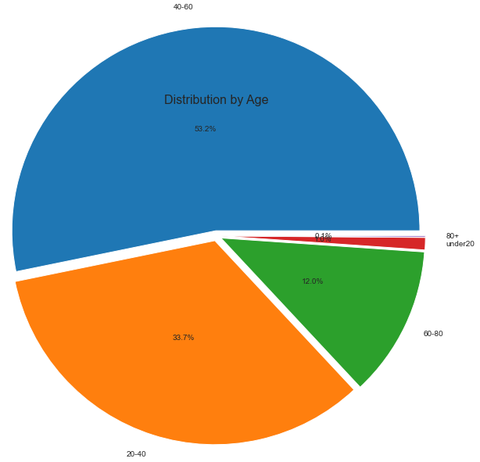
Note: The data and information in this document is reflective of a hypothetical situation and client. This document is to be used for KPMG Virtual Internship purposes only.
Data Exploration
Customers Distribution by Age
Highest number of customers are from age-group [40-60], (Mid Age Group).
0.1% customers are above 80 years of age.
1.0% customers are from under20 age group.
More than 1/4th of the customers are in the age range [20-40].
12.0% customers are in the age range (60-80)

Slide 15
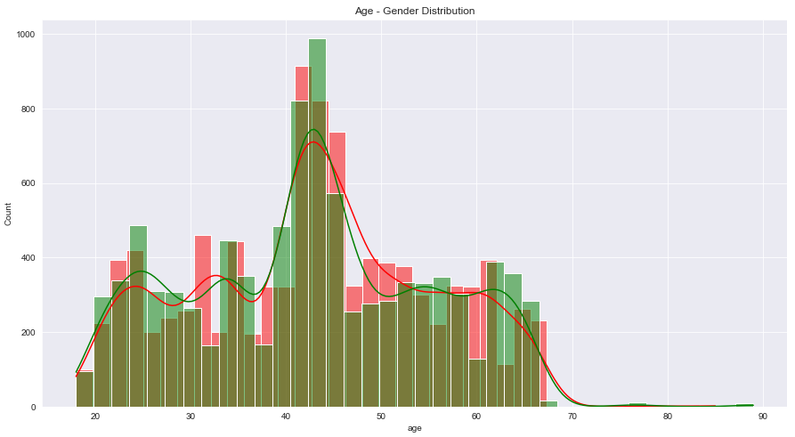
Note: The data and information in this document is reflective of a hypothetical situation and client. This document is to be used for KPMG Virtual Internship purposes only.
Data Exploration
Customers Distribution by Age and Gender
Overall, More Females makes up Bike related Transactions.
There is not much variation in the Male Female Customers.
Male
Female
X axis -> Age
Y axis -> Count/Number of Customers

Slide 16
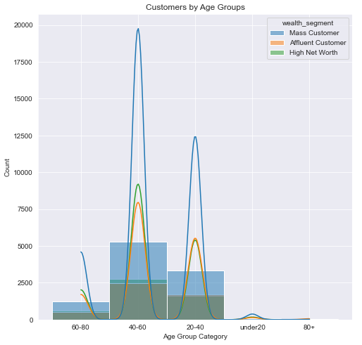
Note: The data and information in this document is reflective of a hypothetical situation and client. This document is to be used for KPMG Virtual Internship purposes only.
Data Exploration
Age Group Distribution by Wealth Segment
The count of Mass Customers is nearly equal to the sum of both Affluent Customers and High Net Worth Customers.
Mass Customer >High Net Worth > Affluent Customer
X axis -> Age Group Category
Y axis -> Count/Number of Customers

Slide 17
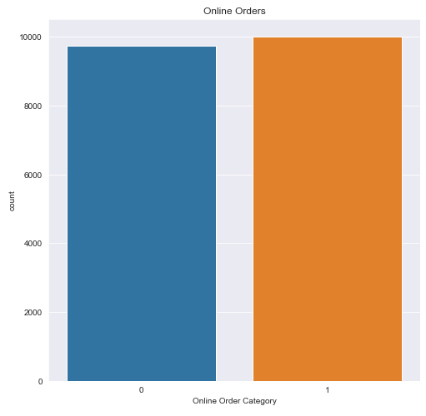
Note: The data and information in this document is reflective of a hypothetical situation and client. This document is to be used for KPMG Virtual Internship purposes only.
Data Exploration
Order Segmentation
Offline and Online order shows the similar trend.
X axis -> Online Order Category
Y axis -> Count/Number of Customers

Slide 18
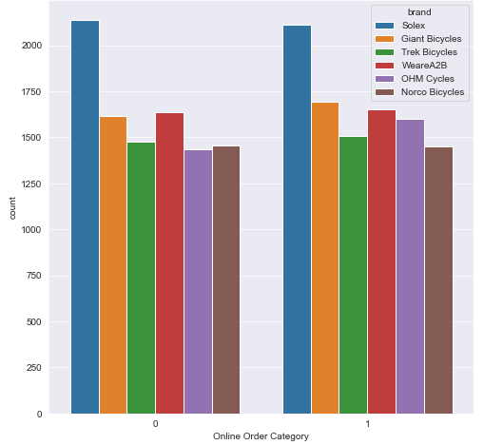
Note: The data and information in this document is reflective of a hypothetical situation and client. This document is to be used for KPMG Virtual Internship purposes only.
Data Exploration
Order Segmentation by Brand
Offline and Online order for all brands shows similar kind of trend.
There is not much variation in online and offline orders.
X axis -> Online Order Category
Y axis -> Count/Number of Customers

Slide 19
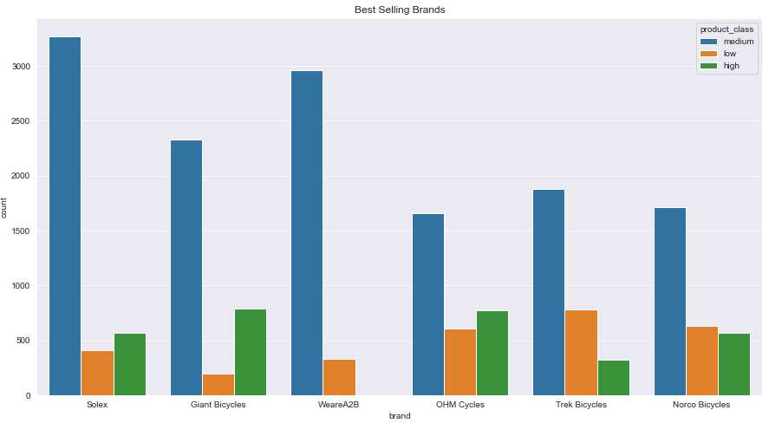
Note: The data and information in this document is reflective of a hypothetical situation and client. This document is to be used for KPMG Virtual Internship purposes only.
Data Exploration
Best Selling Brands by Product Class
Best Selling Products are from Solex , followed by WeareA2B.
Trek Bicycles and Norco Bicycles have some of the lowest sales.
Medium Product Class has high number of sales in each Brands.
WeareA2B have no to less sales related to high product class.
X axis -> Brand
Y axis -> Count/Number of Customers

Slide 20
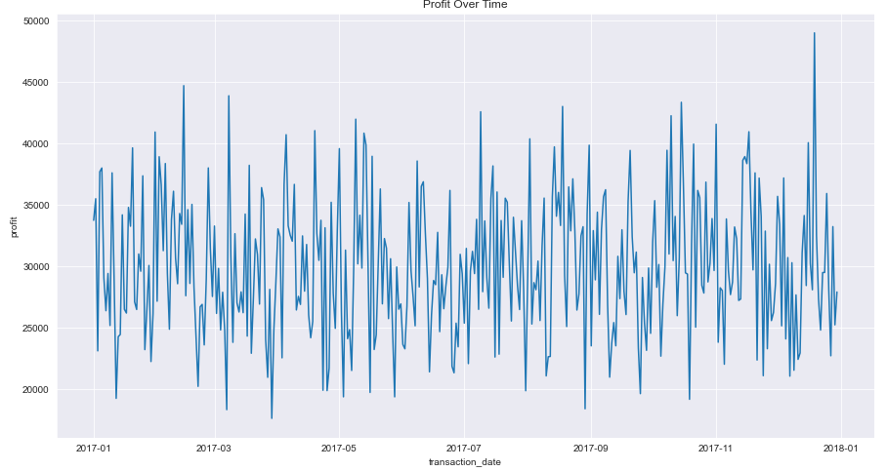
Note: The data and information in this document is reflective of a hypothetical situation and client. This document is to be used for KPMG Virtual Internship purposes only.
Data Exploration
Profit Over Time
Profit is constant over the entire year.
There is a Big Spike in Profit in the
month of December.
X axis -> Transaction Date
Y axis -> Profit

Slide 21
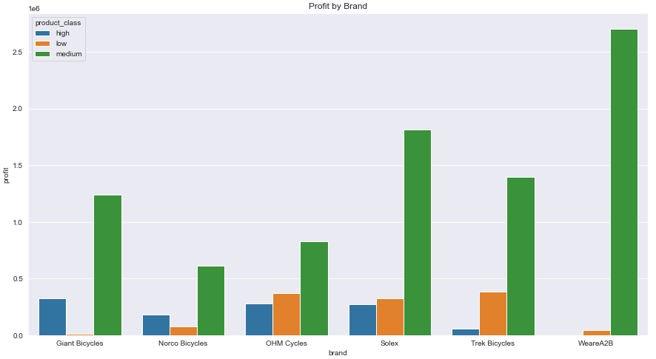
Note: The data and information in this document is reflective of a hypothetical situation and client. This document is to be used for KPMG Virtual Internship purposes only.
Data Exploration
Profit By Brand and Product Class
Highest Profit grossed (>2.5 million) is from WeareA2B brand and product class Medium.
This can be attributed to the fact that best sold bicycles are from Medium product class.
Medium product class has made more than 0.5 million for every brand.
X axis -> brand
Y axis -> Profit in Millions

Slide 22
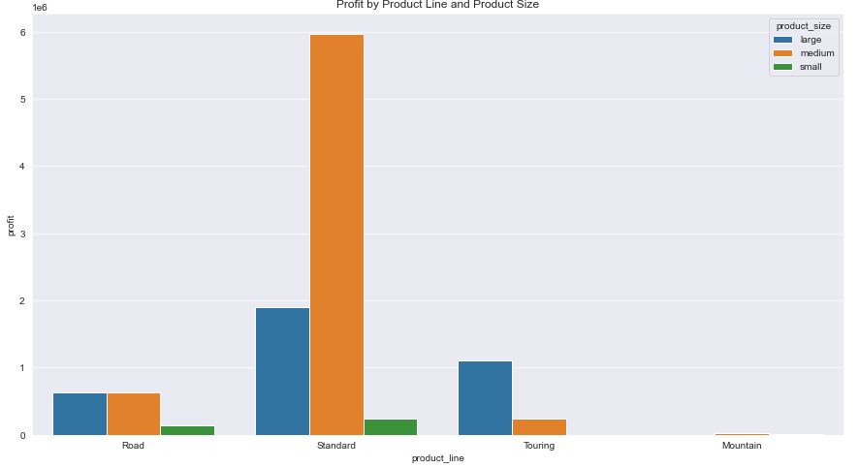
Note: The data and information in this document is reflective of a hypothetical situation and client. This document is to be used for KPMG Virtual Internship purposes only.
Data Exploration
Profit By Product Line and Product Size
Highest Profit comes from Standard product line with Medium Product Size.
This can also be attributed to a greater number of sales towards standard product line.
X axis -> Product Line
Y axis -> Profit in Millions

Slide 23
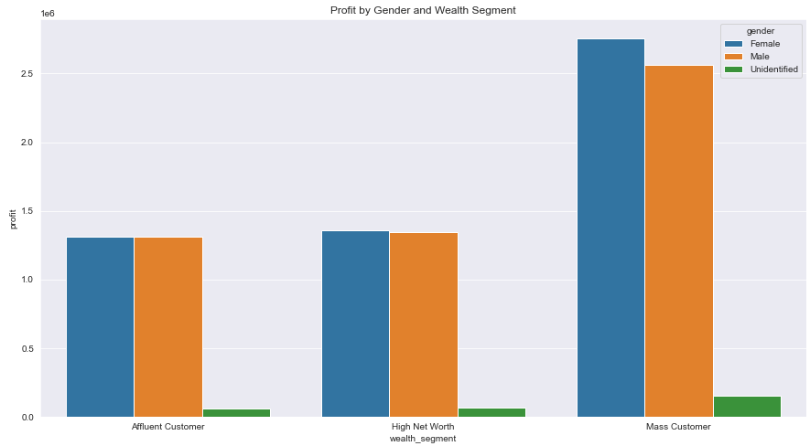
Note: The data and information in this document is reflective of a hypothetical situation and client. This document is to be used for KPMG Virtual Internship purposes only.
Data Exploration
Profit By Gender and Wealth Segment
Mass Customers generated more revenue than both Affluent and High Net Worth Customers.
Female made more purchase in each category.
X axis -> Wealth Segments
Y axis -> Profit in Millions

Slide 24
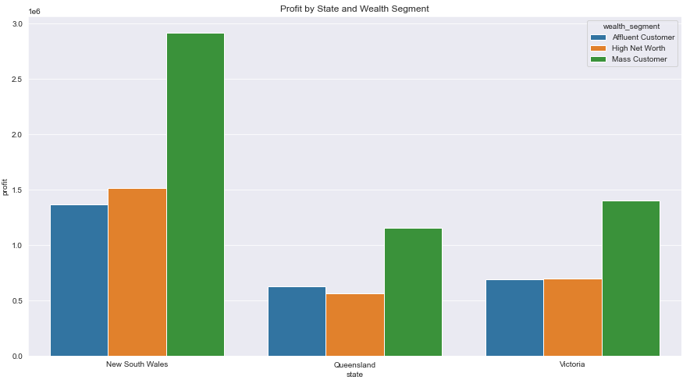
Note: The data and information in this document is reflective of a hypothetical situation and client. This document is to be used for KPMG Virtual Internship purposes only.
Data Exploration
Profit By State and Wealth Segment
New South Wales has highest number of customers in all three wealth segments.
Only in Queensland we have low High Net Worth customers as compared to other states.
X axis -> Wealth Segments
Y axis -> Profit in Millions

Slide 25
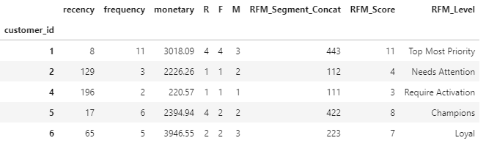
Note: The data and information in this document is reflective of a hypothetical situation and client. This document is to be used for KPMG Virtual Internship purposes only.
Model Development
Customer Classification based on RFM Analysis.
RFM stands for Recency, Frequency, and Monetary value, each corresponding to some key customer trait. Frequency and Monetary value affects a customer’s lifetime value, and recency affects retention, a measure of engagement.

Slide 26
Note: The data and information in this document is reflective of a hypothetical situation and client. This document is to be used for KPMG Virtual Internship purposes only.
Model Development
Customer Description based on RFM Value
Rank | Description | RFM Score | RFM Level
1 | Customers who used to visit and purchase quite often but haven’t visited quite recently. We can bring them back with some sort of promotion strategies | 9 | Top Most Priority
2 | Customers who bought recently, with highest total purchase. So, we can create strategies to give them priority | (8,9] | Champions
3 | Customers who visited more often than “Potential” customers but are not so good with their purchase. So, we can give more promotion on our product for them. | (7,8] | Loyal
4 | Customers who doesn’t visit often but are good with their purchase if compared to “Loyal” customers. So, we can reach the potential customers give more promotion, recommended product in our retail, and give them membership. | (6,7] | Potential
5 | Promising because we hope they would be our loyal customers. So, we can reach them with information about membership program and benefits. They visit more often than “Needs Attention” customers. | (5,6] | Promising
6 | Customers whose visit history and purchase are very low as compared to other customers. They require direct approach from our team. Maybe we can start with sending product catalog, daily product or most recent purchase from another customer. | (4,5] | Needs Attention
7 | This segment is very hard to reach as they might be the customers who visited our chain, or online store but never comeback. | Less than 4 | Require Activation

Slide 27
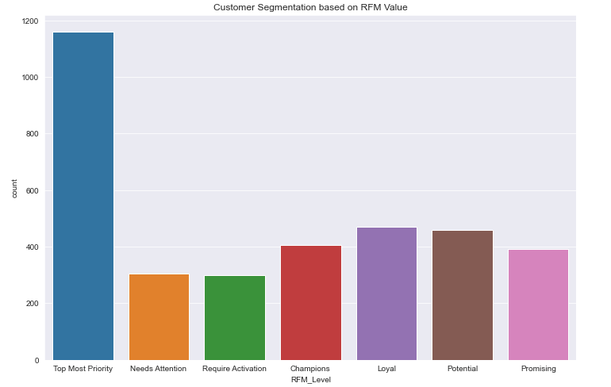
Note: The data and information in this document is reflective of a hypothetical situation and client. This document is to be used for KPMG Virtual Internship purposes only.
Model Development
Customer Classification based on RFM Analysis.
Customers belonging to Top Most Priority Category are highest.
There are almost similar number of customers belonging to Loyal and Potential type.
Require Activation and Needs Attention have the lowest number of customers.
We need to convert all these low revenue generating customer types to our Top Most Priority by the approach mentioned above.
X axis -> RFM Level
Y axis -> Count of Customers.

Slide 28
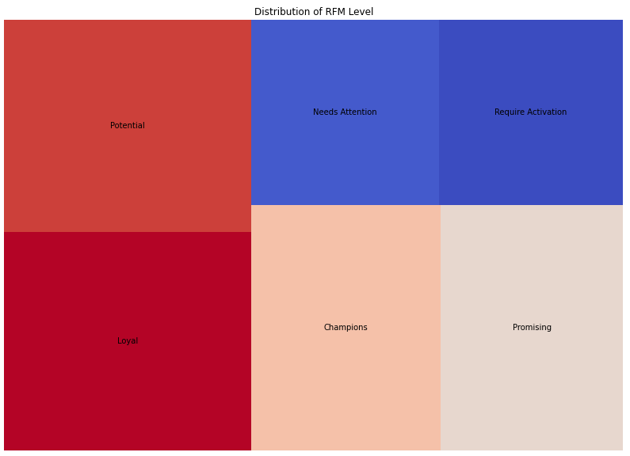
Note: The data and information in this document is reflective of a hypothetical situation and client. This document is to be used for KPMG Virtual Internship purposes only.
Model Development
Customer Classification based on RFM Analysis.
Squarify plot gives us a clear picture of how our customers are segmented based on RFM Level.

Slide 29
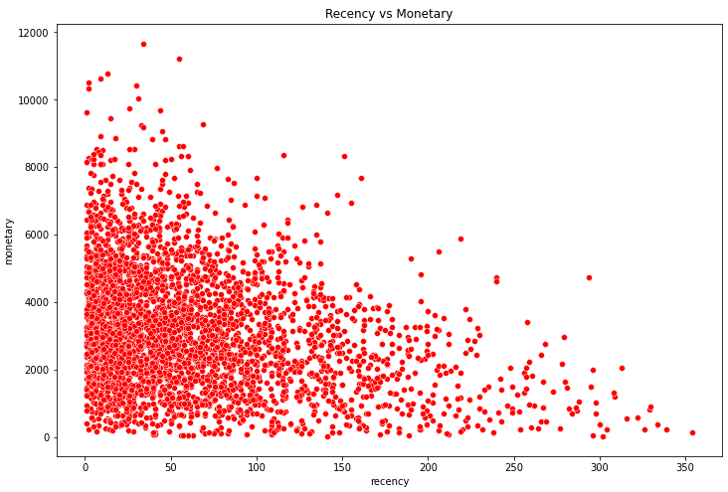
Note: The data and information in this document is reflective of a hypothetical situation and client. This document is to be used for KPMG Virtual Internship purposes only.
Model Development
Recency Vs Monetary
Customers who purchased more recently have generated more revenue than the customers who visited earlier.
Customers who have made purchase between 2 to 5 months have generated a moderate revenue.
Those with purchase history more than 7 months old generated low revenue.
X axis -> Recency
Y axis -> Monetary

Slide 30
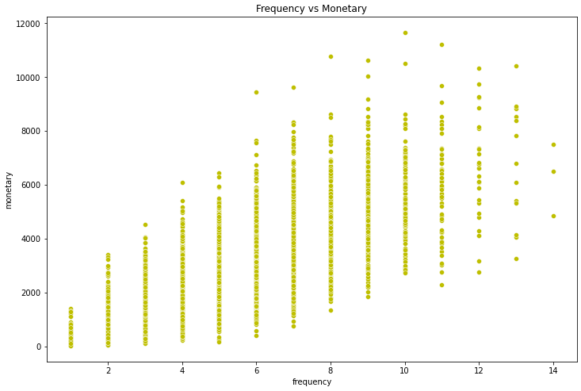
Note: The data and information in this document is reflective of a hypothetical situation and client. This document is to be used for KPMG Virtual Internship purposes only.
Model Development
Frequency Vs Monetary
Frequency and Monetary are directly proportional to each other.
As Frequency increases revenue also increases.
Customers with frequent transactions made highest revenue.
X axis -> Frequency
Y axis -> Monetary

Slide 31
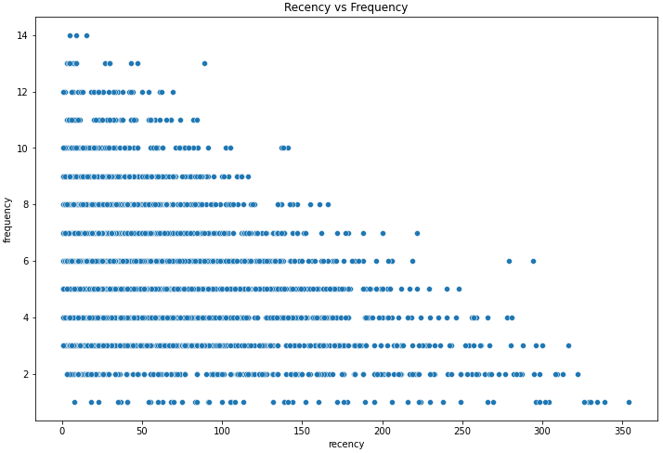
Note: The data and information in this document is reflective of a hypothetical situation and client. This document is to be used for KPMG Virtual Internship purposes only.
Model Development
Recency Vs Frequency
As recency increases frequency decreases. i.e., Customers who purchased more than 250 days ago are not visiting website frequently.
Customers who have visited more recently have higher chance of visiting more frequently and make purchase.
X axis -> Recency
Y axis -> Frequency

Slide 32
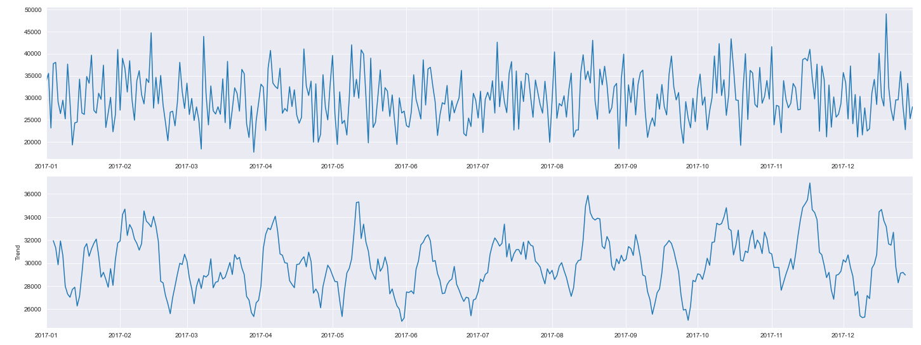
Note: The data and information in this document is reflective of a hypothetical situation and client. This document is to be used for KPMG Virtual Internship purposes only.
Model Development
Time Series Analysis (Additive Model)
This model gives us variation and Trend in a Time series related data.
Sales were high in mid of every month.
March, June and July recoded some of the lowest sales.
November marked highest sale of all months.

Slide 33
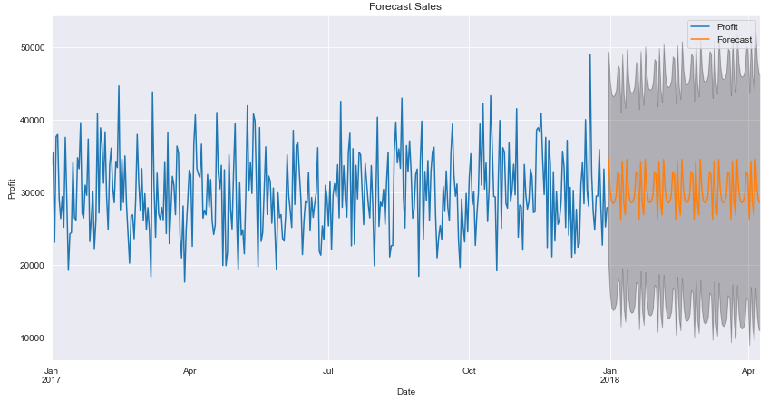
Note: The data and information in this document is reflective of a hypothetical situation and client. This document is to be used for KPMG Virtual Internship purposes only.
Model Development
Profit Forecasting (ARIMA Model)
This model helps us in predicting future profit based on past sales record.
The model predicts stable profit based on previous sales record.
Confidence interval of our prediction for revenue lies between 10,000 to 50,000 $.
X axis -> Date
Y axis -> Forecasted Profit

Slide 34
Note: The data and information in this document is reflective of a hypothetical situation and client. This document is to be used for KPMG Virtual Internship purposes only.
Interpretation
Top 1000 Customers to Target
Rank | RFM Level | Total Customers | Selection of Customers
1 | Top Most Priority | 1161 | 1161
2 | Champions | 407 | 407
3 | Loyal | 470 | 470
4 | Potential | 458 | 458
5 | Promising | 391 | 391
6 | Needs Attention | 304 | 0
7 | Require Activation | 298 | 0
The customers marked in the red box are the customers that should be targeted in the new customer list.
Top thousand customers can be filtered using the conditions discussed above.
These 1000 customers will have low recency, high frequency and high monetary.
These customers will generate highest amount of the profit.

Slide 35
Note: The data and information in this document is reflective of a hypothetical situation and client. This document is to be used for KPMG Virtual Internship purposes only.
Interpretation
Future Profit Prediction
By following and targeting our customers based on above mentioned approach we can maximize our profit.
The above-mentioned approach ensures that our profit remains in high confidence interval limit.
X axis -> Date
Y axis -> Forecasted Profit

Slide 36
Note: The data and information in this document is reflective of a hypothetical situation and client. This document is to be used for KPMG Virtual Internship purposes only.
Appendix

Slide 37
Note: The data and information in this document is reflective of a hypothetical situation and client. This document is to be used for KPMG Virtual Internship purposes only.
Appendix
References
Squarify (https://github.com/laserson/squarify )
ARIMA Model (https://machinelearningmastery.com/arima-for-time-series-forecasting-with-python/ )
All the Analysis is done in Python (https://www.python.org/ )

