Slide 1
Information Visualization Visualization Sketch
G21-A
94904 – Matyáš Skalický 95110 – Lenka Obermajerová 95201 – Ingeborg Sætersdal Sollid

Slide 2
Overview
01

Slide 3
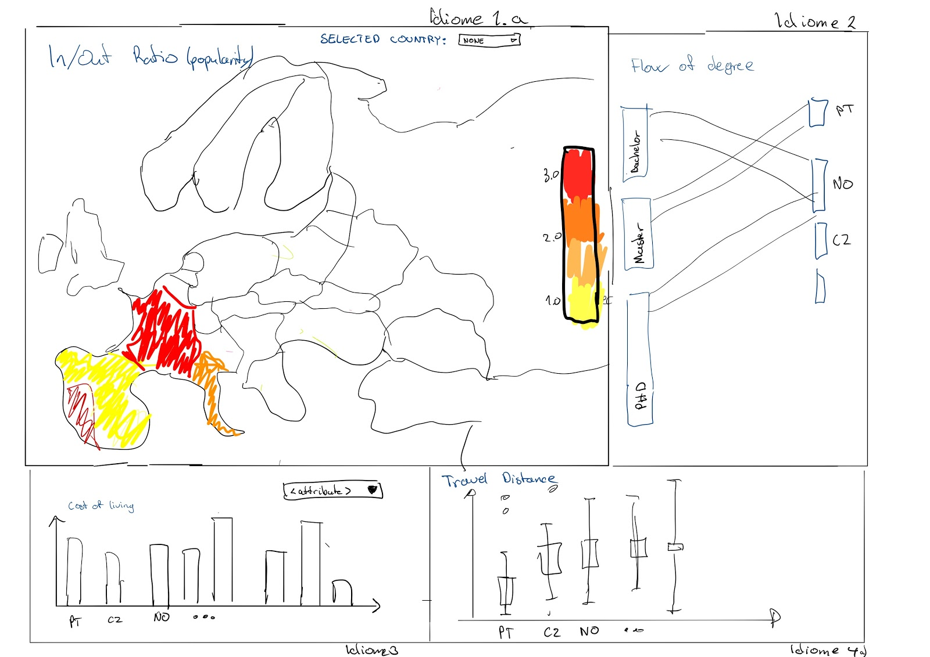
Overview
Notes:
1

Slide 4
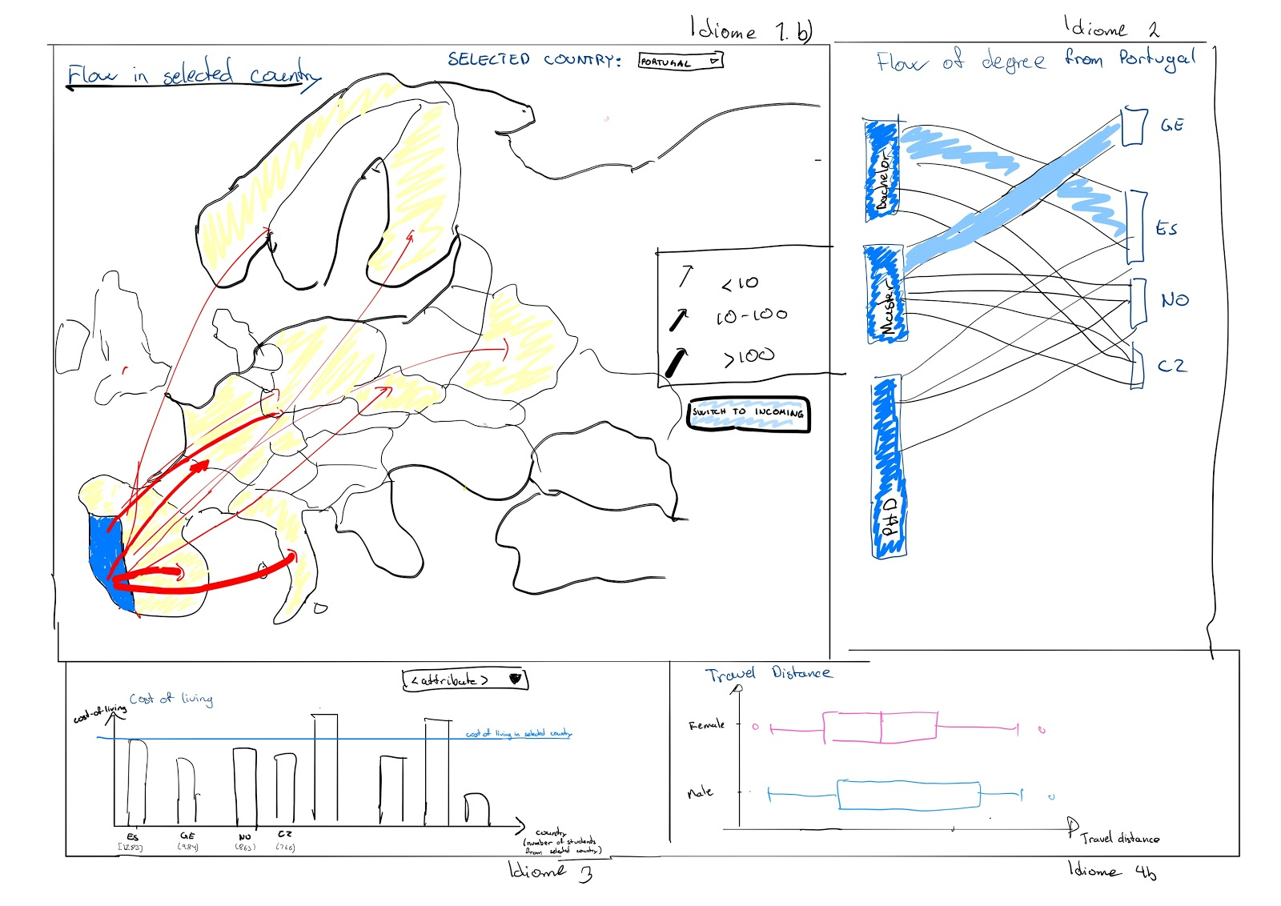
Notes:
1

Slide 5
Visual encoding
02

Slide 6
Visual Encoding
Item: Country
Type: nominal
Visual Encoding: Map, labels
Notes:
1

Slide 7
Visual Encoding
Item: Incoming/Outcoming ratio
Type: Continues
Visual Encoding: Choropleth map. The color tells the ratio value
Notes:
1

Slide 8
Visual Encoding
Item: SendingCountry and ReceivingCountry
Type: nominal
Visual Encoding: Flowmap. Arrows show from/to
Notes:
1

Slide 9
Visual Encoding
Item: StudentIncomingCount, StudentOutgoingCount
Type: continues
Visual Encoding: Flowmap. Thickness of arrows shows number of students
Notes:
2

Slide 10
Visual Encoding
Item: StudentsBachelorIncomingCount, StudentMasterIncomingCount, StudentPhDIncomingCount.
Type: ratio
Visual Encoding: Parallel sets / Sankey Diagram
Notes:
2

Slide 11
Visual Encoding
Item: Cost of living index, rent index, beer prices
Type: Continues
Visual Encoding: Barchart. The height shows the attribute value.
Notes:
2

Slide 12
Visual Encoding
Item: travelDistance (aggregated from CoordinatesSending, CoordinatesReceiving)
Type: continues
Visual Encoding: Boxplot
Notes:
2

Slide 13
Visual Encoding
Item: Gender
Type: continues
Visual Encoding: Boxplot
Notes:
2

Slide 14
Answering the Questions
03

Slide 15
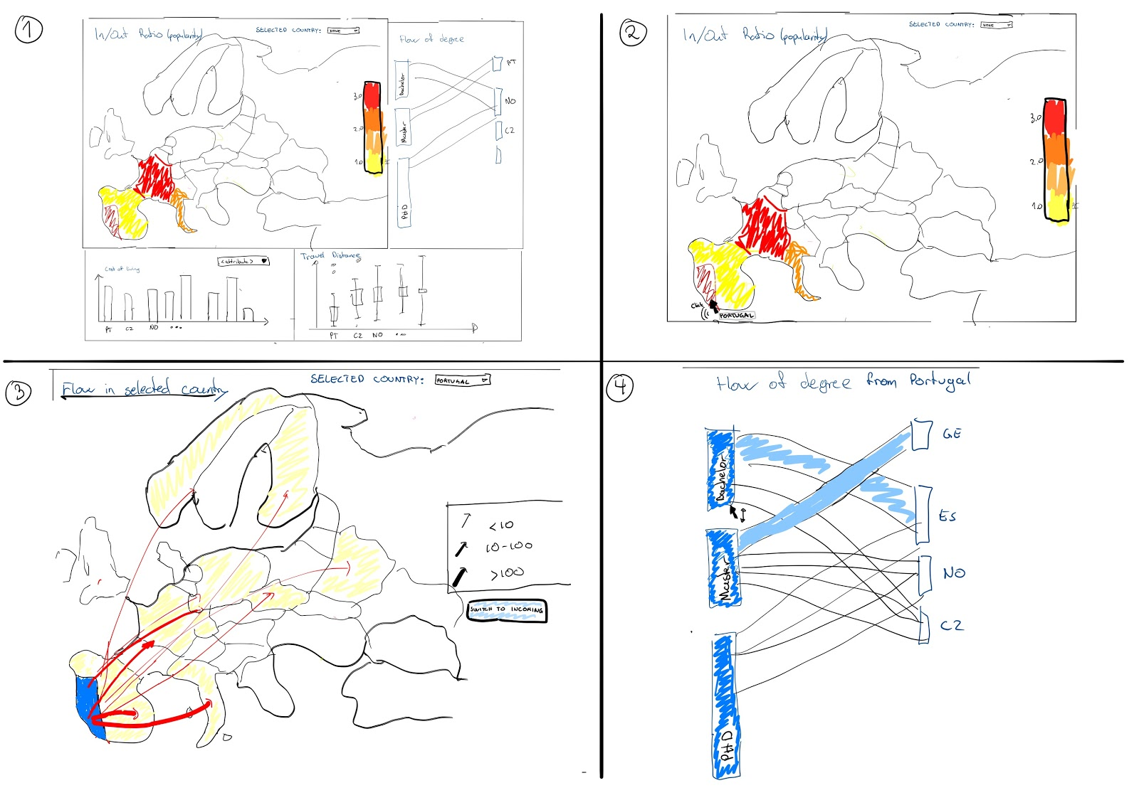
Question 1
Which countries do Portuguese bachelor students choose as an Erasmus destination in comparison to masters and PhDs?
Storyboard:
Notes:
3

Slide 16
Question 2
Is it popular for danish students to go to countries with same or lower cost of living?
Notes:
3

Slide 17
Question 3
Where do the Erasmus students from Portugal like to go on Erasmus?
Notes:
3

Slide 18
Question 4
Do Czech females travel smaller distance to their target country than the Czech males?
Notes:
3

