Slide 1
Information Visualization Project Proposal and Dataset
G21
94904 – Matyáš Skalický
95110 – Lenka Obermajerová
95201 – Ingeborg Sætersdal Sollid

Slide 2
DOMAIN
01

Slide 3
Domain
High level description
reasons why students pick their ERASMUS destination
help to future ERASMUS students to decide which country is the best for them
useful for schools and countries which participate in the ERASMUS program

Slide 4
DATASET
02

Slide 5
Dataset
Dataset description
Which dataset?
How will you obtain the data?

Slide 6
Example QUESTIONS
03

Slide 7
Questions
1) Which countries are popular for being an Erasmus destination? Is there any difference between bachelor and master degrees?
2) What is the flow of students doing Erasmus between countries?
3) Does distance from the home country to the Erasmus country matter?

Slide 8
4) How does difference in cost of living in home and Erasmus country effect the final selection?
5) Do students prefer countries with a language from the same language family as the language from their home country?
6) Does gender effects the choice?

Slide 9
Data Sample
04

Slide 10
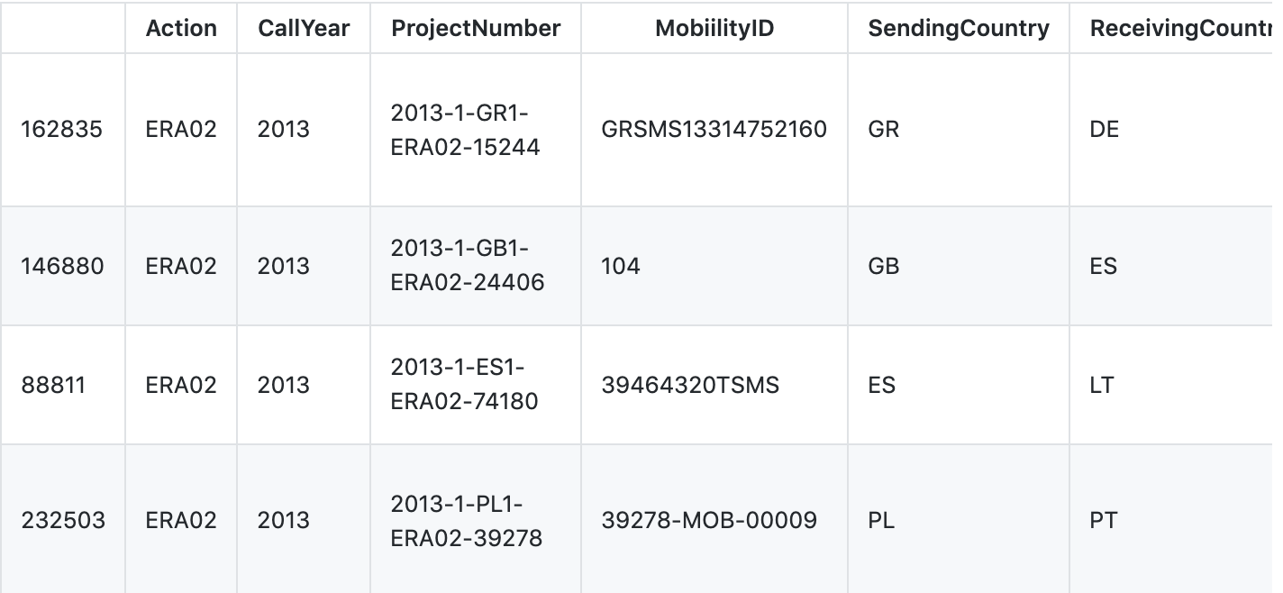
Data Sample
(from Student_Mobility_2013-14.xlsx)

