Slide 1

PHASE THREE - HEIGHTENED ALERT PRECAUTIONARY MEASURES FOR RELIGIOUS ACTIVITIES

Slide 2
Religious Activity | Safe Management Measures (SMMs)
Congregational and Worship Services | From 14 June Up to 50 persons, without pre-event testing, Up to 250 persons, in zones holding no more than 50 persons each, with pre-event testing for all worshippers
Live performance elements during congregational and other worship services | From 14 June Up to 30 persons allowed Unmasking for singing, playing of wind/brass instruments and speaking is not allowed Use of face shields in lieu of masks is not permitted | From 21 June Up to 30 persons allowed 10 allowed to unmask, of which 2 can be unmasked for singing or playing of wind/brass instruments | From Mid-July (date to be announced later) Up to 30 persons allowed 10 allowed to unmask, of which 5 can be unmasked for singing or playing of wind/brass instruments
Other Religious Activities (e.g. religious rites, classes) | From 14 June Religious rites allowed subject to prevailing group size of 5 persons All other religious activities (e.g. religious classes) are not allowed. | From 21 June Religious rites and all other religious activities (e.g. religious classes) are allowed not exceeding 50 persons per activity and subject to a total premise cap of 150
Marriage Solemnisations | From 14 June Up to 50 attendees without pre-event testing , Up to 250 attendees, with pre-event testing for all attendees
Wakes, Funerals and Post-Funeral Rites | From 14 June Up to 20 persons at any one time
Recording and Broadcasting Services | Up to 15 persons allowed. Out of which 10 persons can un-mask, with no more than 2 un-masked for singing and/or playing of wind/brass instruments ROs must notify CPRO in advance | From 21 June Up to 30 persons allowed. Out of which 10 persons can un-mask, with no more than 2 un-masked for singing and/or playing of wind/brass instruments ROs no need to notify CPRO in advance | From Mid-July (date to be announced later) Up to 30 persons allowed. Out of which 10 persons can un-mask, with no more than 5 un-masked for singing and/or playing of wind/brass instruments ROs no need to notify CPRO in advance

Slide 3
REQUIREMENTS FOR PRE-EVENT TESTING (PET)
Pre-event testing | Details
What type of test is acceptable? | MOH-approved COVID-19 test (either an Antigen Rapid Test (ART) or Polymerase Chain Reaction (PCR) test) administered by an approved test provider. # Self Test Kit results are not acceptable.
How much does it cost? | ART : Avg $50 PCR : Ranges from $150 - $250. # no funding provided for tests
Where can I book the test? | List of approved PCR and ART test providers are at https://www.moh.gov.sg/licensing-and-regulation/regulations-guidelines-and-circulars/details/list-of-covid-19-swab-providers.
Are there exemptions to taking PET? | Individuals vaccinated in Singapore Individuals with an exemption notice # Valid documentation must be shown
How long is my test result valid for? | The test results are only valid for 24 hours from the time an individual registers at the testing premises to take the test. The RO must ensure that the result of the test is valid until the end of the worshipper’s participation in the worship service.

Slide 4
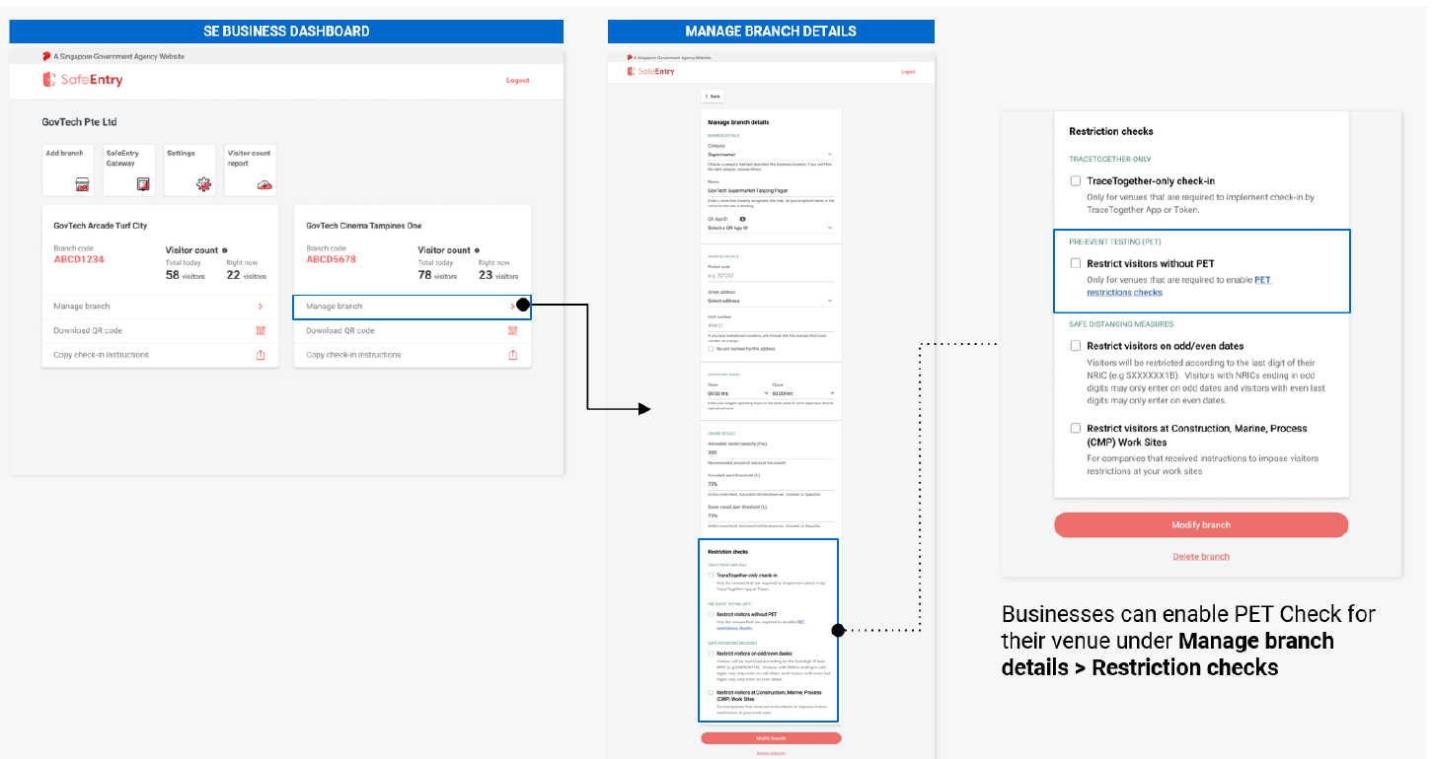
Turning on the PET status check function in SafeEntry (Business) application

Slide 5
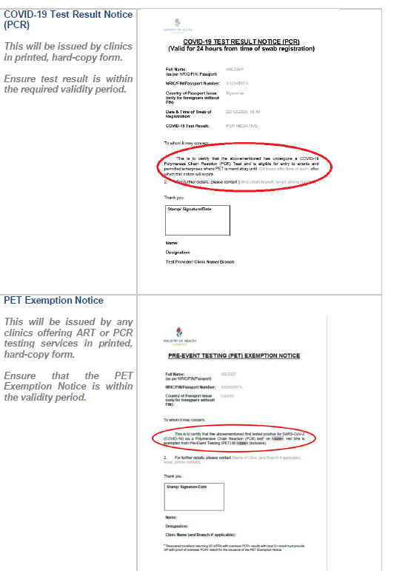
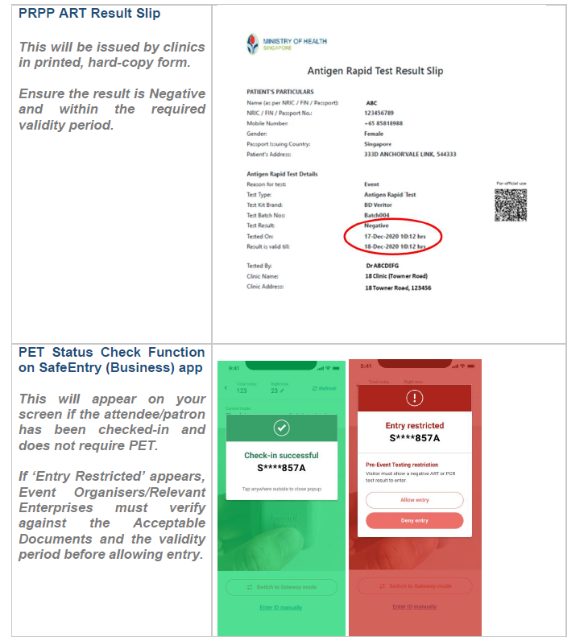
Examples of acceptable documents
For further details on PET requirements, refer to: https://www.moh.gov.sg/covid-19/pet.

