Slide 1


Slide 2
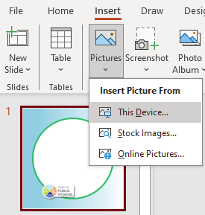
Steps to add YOPH frame to your profile image
1. Using slide 1 as a template, add your profile image by clicking on the menu bar “Insert Picture from This Device”. (Note: the selected image should have a wider background than the template)

Slide 3

Steps to add YOPH frame to your profile image
2. Select the image of your choice from your computer and click “Insert” or “Open”
3. Adjust the size of the image to fit within the frame.

Slide 4

Steps to add YOPH frame to your profile image
4. Once the image is in your desired position, right click on your picture & click on “Send to Back”. Your picture should now be fully within the frame.

Slide 5
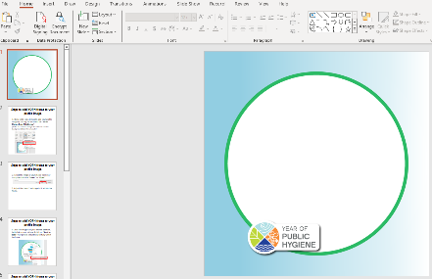
Steps to add YOPH frame to your profile image
5. To download a copy of the new profile pic, scroll up to Slide 1 using the slide thumbnail pane, situated on the left margin of the PowerPoint window. Click on Slide 1 in the slide thumbnail pane.
Click this

Slide 6
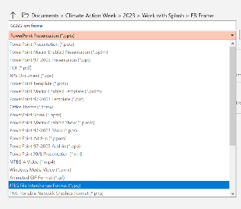

Steps to add YOPH frame to your profile image
6. Click on “File”, “Save As” and ensure that the file format to “JPEG File Interchange Format (*.jpg)”

Slide 7
Steps to add YOPH frame to your profile image
7. Click on “Save”.

Slide 8
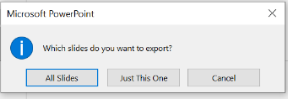
Steps to add YOPH frame to your profile image
8. When a dialog box appears, choose “Just This One” to save a Jpeg version of your image to your selected folder.
9. The photo should be saved in your selected folder now. It is ready for upload to your socials.

