Slide 1

WASSENAAR ARRANGEMENT
MEETING WITH SINGAPORE INDUSTRY
Singapore, 12 July 2017
Introduction to the Wassenaar Arrangement
Ambassador Philip Griffiths
Head of Secretariat
www.wassenaar.org

Slide 2
WASSENAAR ARRANGEMENT
PURPOSES
To contribute to regional and international security and stability by promoting:
Transparency
Greater responsibility in transfers of conventional arms and sensitive dual-use goods & technologies, thus preventing:
destabilising accumulations
acquisition by terrorists

Slide 3
WASSENAAR ARRANGEMENT BASIC COMMITMENTS
WA Participating States undertake to:
Apply fully effective export controls at the national level based on the collectively agreed WA Munitions and Dual-Use Control Lists
Report to WA partners on a regular basis on transfers of conventional arms and sensitive dual-use items and all dual-use transfer denials

Slide 4
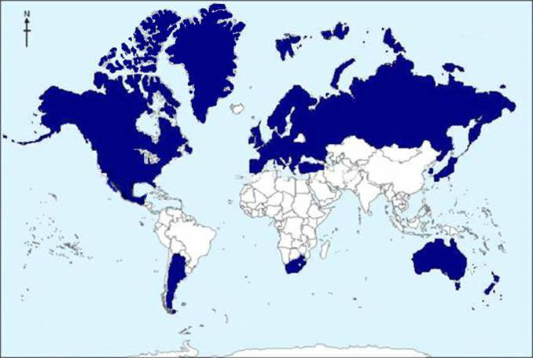
WASSENAAR ARRANGEMENT CURRENTLY 41 PARTICIPATING STATES

Slide 5
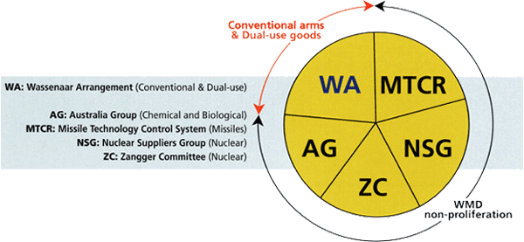
WHERE DOES THE
WASSENAAR ARRANGEMENT FIT?
Conventional arms
& related goods & technologies
WA: Wassenaar Arrangement (Conventional)
AG: Australia Group (Chemical & Biological)
MTCR: Missile Technology Control Regime (Missiles)
NSG: Nuclear Suppliers Group (Nuclear)
ZC: Zangger Committee (Nuclear)
WMD and their means of delivery

Slide 6
WASSENAAR ARRANGEMENT
WA Collective Work
WA Munitions and Dual-Use Export Control Lists
General and Specific Information Exchange
Best Practices, Elements and Procedures
National Implementation

Slide 7
WASSENAAR ARRANGEMENT CONTROL LISTS
Munitions List (approx. 300 entries in 22 categories):
including ammunition, parts and components, production equipment, technology, software
Dual-Use List (over 1,000 entries in 9 categories):
Sensitive List (170 entries)
Very Sensitive List (80 entries)
* * * * * * * *
Non-listed dual-use exports are also controlled in certain circumstances (“catch-all”)

Slide 8
WASSENAAR ARRANGEMENT TRANSPARENCY MEASURES
General Information Exchange:
Regional Views
Discussion of transfer risks and concerns, e.g.
- Suspicious acquisition/brokering activities
- Projects and programmes of concern
- Diversion activities

Slide 9
WASSENAAR ARRANGEMENT TRANSPARENCY MEASURES
Specific Information Exchange:
Semi-annual reporting of certain transfers and denials to non-WA members
8 categories of arms transfers
Sensitive dual-use transfers
All dual-use denials
WAIS – secure electronic communications network

Slide 10
WASSENAAR ARRANGEMENT BEST PRACTICES, ELEMENTS AND PROCEDURES
Some 25 best practices, elements and procedures
Non-binding guidance for national export control policy and practice
A thematically-based Compendium issued
Regular review and updating
Available on the WA website

Slide 11
WASSENAAR ARRANGEMENT OUTREACH
Collective briefings
Bilateral dialogue/visits
International conferences, including industry/ academia
Other export control regimes and relevant organisations
Individual WA Participating States active in their national and/or regional capacities

Slide 12
WASSENAAR ARRANGEMENT & ARMS TRADE TREATY (ATT)
Wide-spread international acceptance of need for regulation of international transfers of conventional arms
Goals of ATT align with those of WA
WA members ready to share experience & expertise with other countries
WA Secretariat monitoring opportunities for WA to contribute to international cooperation

Slide 13
WASSENAAR ARRANGEMENT OTHER WORK IN 2016
Fifth internal Assessment of overall functioning:
Conclusions adopted by 2016 WA Plenary
20th Anniversary of the WA’s inception (1996), including:
Practical Workshop, 27-28 June 2016, Vienna
Commemorative Event, 6 December 2016, Vienna
Upgrading of WA outreach tools (see website)

Slide 14
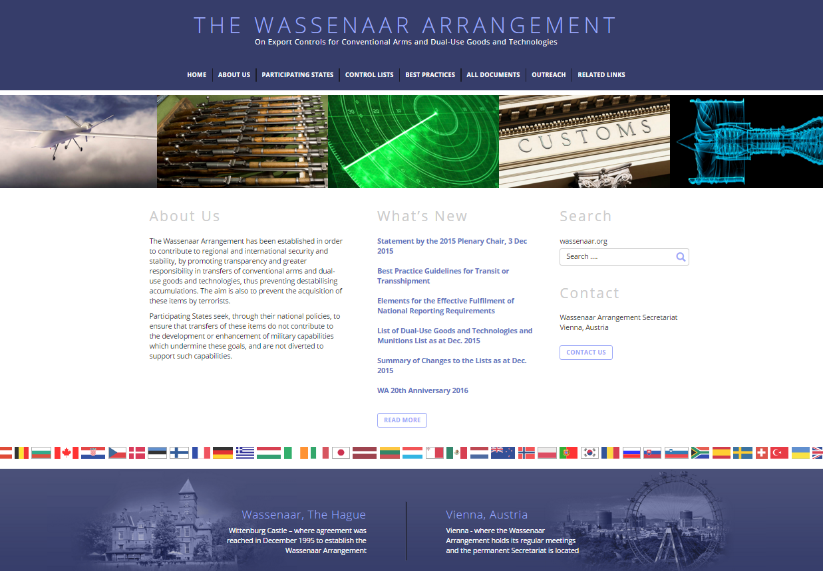
www.wassenaar.org

Slide 15

Tel: +43 1 96003 secretariat@wassenaar.org
www.wassenaar.org

