Slide 1

WASSENAAR ARRANGEMENT
MEETING WITH SINGAPORE OFFICIALS
Singapore, 11 July 2017
WA Best Practices & Resources
Ambassador Philip Griffiths
Head of Secretariat
www.wassenaar.org

Slide 2
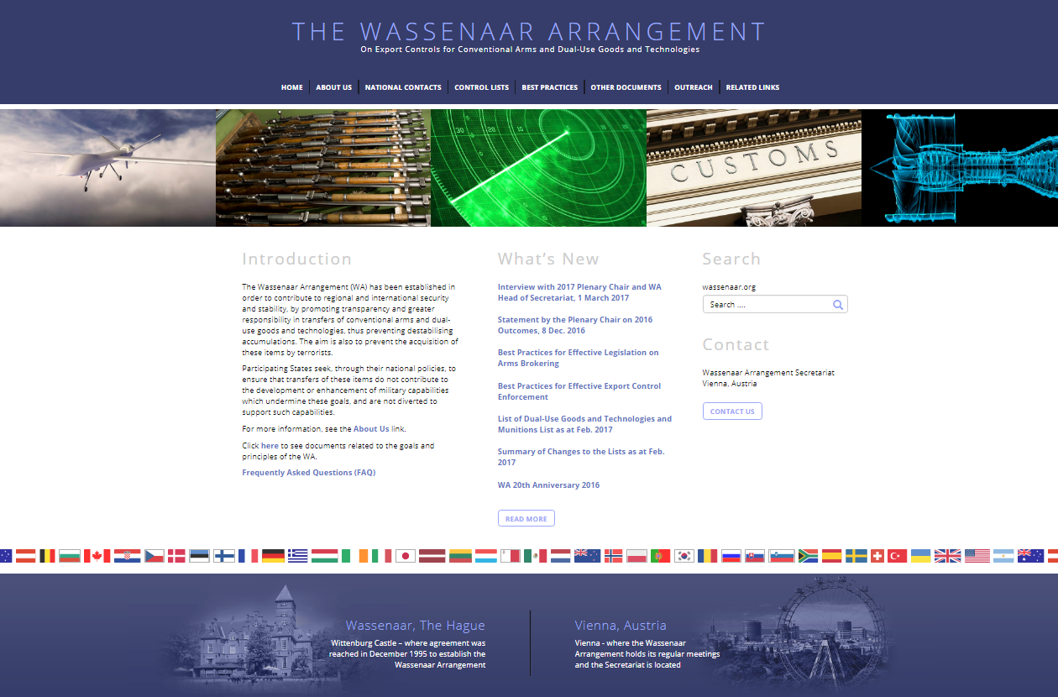

Slide 3
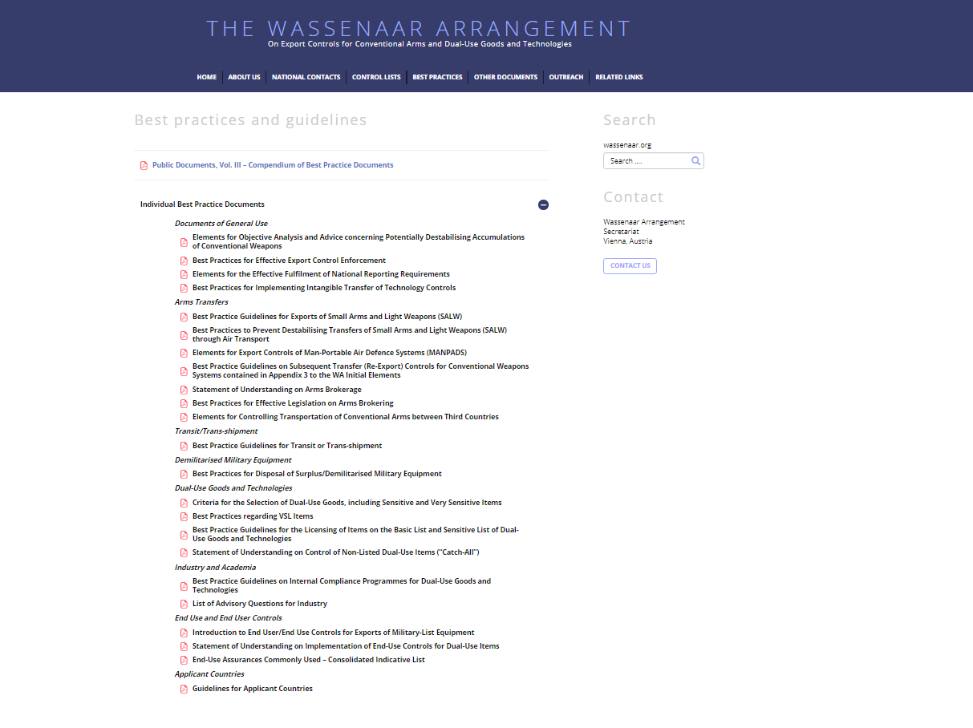

Slide 4
WA BEST PRACTICES GUIDELINES
Examples:
Introduction to End User/End Use Controls for Exports of Military-List Equipment (2014)
Subsequent Transfer (Re-export) Controls for Conventional Weapons Systems (2011)
Internal Compliance Programmes for Dual-Use Goods and Technologies (2011)
Implementing Intangible Transfers of Technology Controls (2006)
Statement of Understanding on Control of Non-Listed Dual-Use Items (2003)
List of Advisory Questions for Industry (2003)
Best Practice Guidelines for Exports of Small Arms and Light Weapons (SALW) (2002, amended 2007)
Elements for Export Controls of Man-Portable Air Defence Systems (MANPADS) (2000, amended 2003 and 2007)

Slide 5
LATEST WA BEST PRACTICES GUIDELINES
2016
Best Practices for Effective Legislation on Arms Brokering (updated)
Best Practices for Effective Enforcement (updated)
2015
Best Practice Guidelines for Transit or Trans-shipment

Slide 6
WA BEST PRACTICES GUIDELINES Introduction to End User/End Use Controls for Exports of Military-List Equipment
Factors to consider in designing an end use/end user control component for a national export control system
To ensure that exported equipment is not diverted
Different forms – e.g. Govt-Govt agreements; commercial contracts enforceable under national law
Anti-circumvention measures – to ensure integrity of the assurance

Slide 7
WA BEST PRACTICES GUIDELINES Subsequent Transfer (Re-export) Controls for Conventional Weapons Systems
Government-to-Government agreements,
end-user assurances and export licences
Re-exports should require prior authorisation, and an undertaking that they will not be used for other than declared purposes, and will not be transferred to an unauthorised internal end-user
Also applicable to weapons produced under licence

Slide 8
WA BEST PRACTICES GUIDELINES Internal Compliance Programmes (ICPs) for Dual-Use Goods and Technologies
Industry/academia play an integral role in achieving effective export controls
Governments to undertake targeted outreach and provide encouragement/incentives
ICPs help exporters to comply with national export controls
ICPs can be a pre-condition for obtaining a general licence (where available)
Detailed Annex of elements for inclusion in ICPs

Slide 9
WA BEST PRACTICES GUIDELINES Intangible Transfers of Technology (ITT) Controls
“Technology” defined in the WA Munitions and Dual-Use Lists:
“Specific information necessary for the ‘development’, ‘production’ or ‘use’ of a product
May take the form of:
Technical data (blueprints, plans, diagrams, etc)
Technical assistance (training, consulting services, etc)
Intangible transmission – oral and electronic
Measures: design national laws and regulations with clear definitions; promote awareness and “self-regulation” by industry, academia, individuals; post-export monitoring; regular compliance checks; training; sanctions

Slide 10
WA BEST PRACTICES GUIDELINES List of Advisory Questions for Industry
Non-exhaustive list intended to guide companies in any export situation
Intended to raise awareness of potentially suspicious transactions and when contact with national licensing authorities might be advisable
Do you know your customer?
Is there anything unusual about the order?

Slide 11
WA BEST PRACTICES GUIDELINES BEST PRACTICE GUIDELINES FOR TRANSIT OR TRANS-SHIPMENT
Tools may include:
Establish and apply a transparent legal/regulatory system, including the authority to stop, inspect, seize and dispose of a shipment
Extend authority to special Customs areas
Require authorisations for transit or trans-shipment of listed items, as well as unlisted items where reliable information exists
Utilise an intelligence-led, risk-based approach
Conduct focused outreach; provide training
Deploy appropriate screening technologies
Exchange information with WA partners

Slide 12
ELEMENTS FOR OBJECTIVE ANALYSIS AND ADVICE CONCERNING POTENTIALLY DESTABILISING ACCUMULATIONS OF CONVENTIONAL WEAPONS
Examples of factors to consider:
Impact on regional security balance
Foreign and military policy and non-proliferation commitments of recipient country
Possible weapons use in human rights violations
Influence on civil armed conflicts
Export controls and secure weapons storage in recipient country

Slide 14
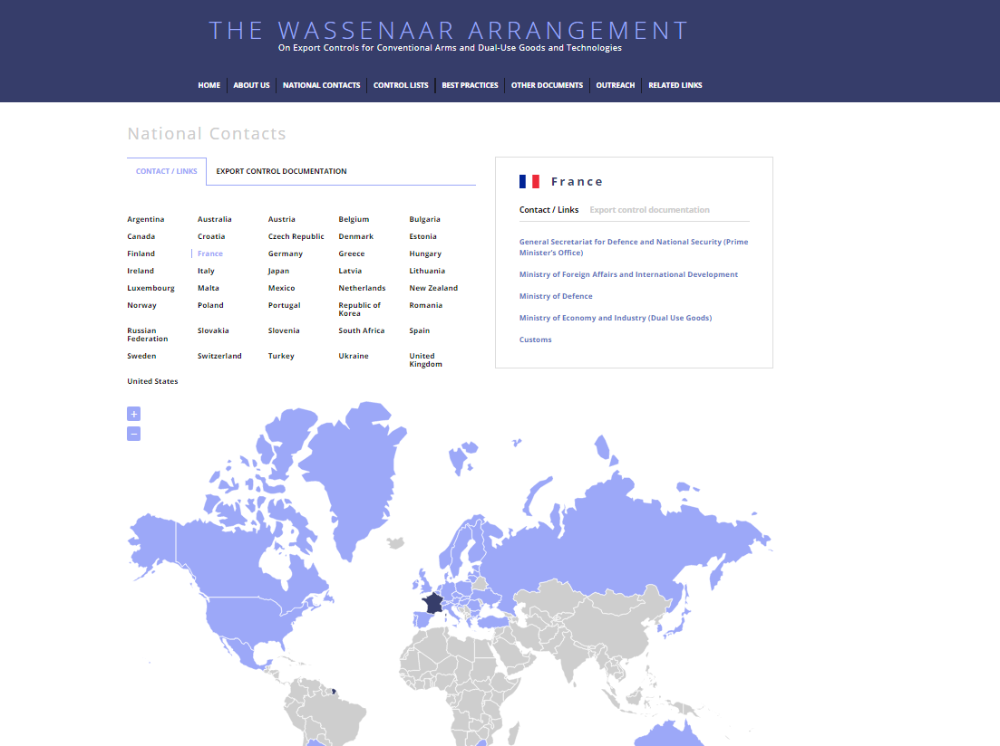

Slide 15
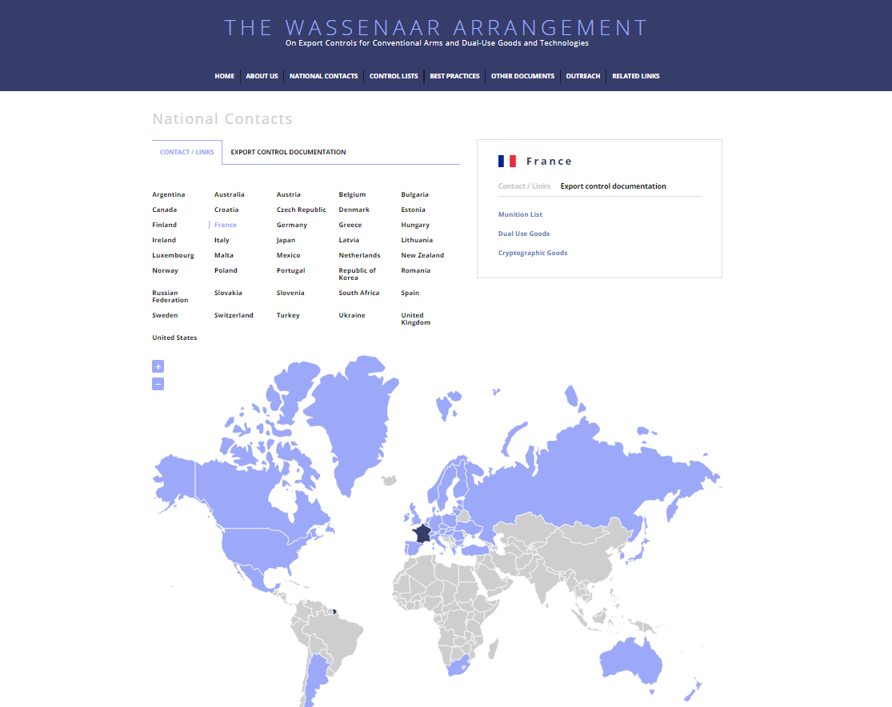

Slide 16

Tel: +43 1 96003 secretariat@wassenaar.org
www.wassenaar.org

