Slide 1
EEGR 471
SECTION 3
ASIC & Board Bring-Up
Idris Somoye

Slide 2
Chip BringUp
A smooth chip bring-up is important for meeting project schedule demands.
Provides a stable target platform for the ensuing validation and software development efforts that are required for the launch of a new SoC
Inspect chip die and design "bring-up" board based on design

Slide 3
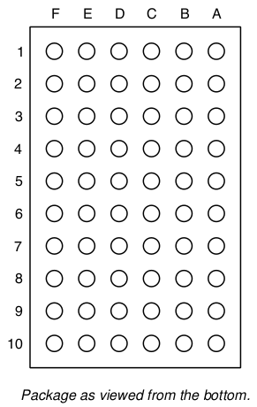
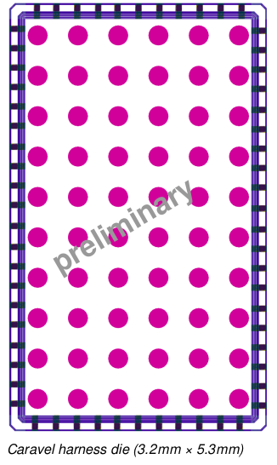
Chip Die Package

Slide 4
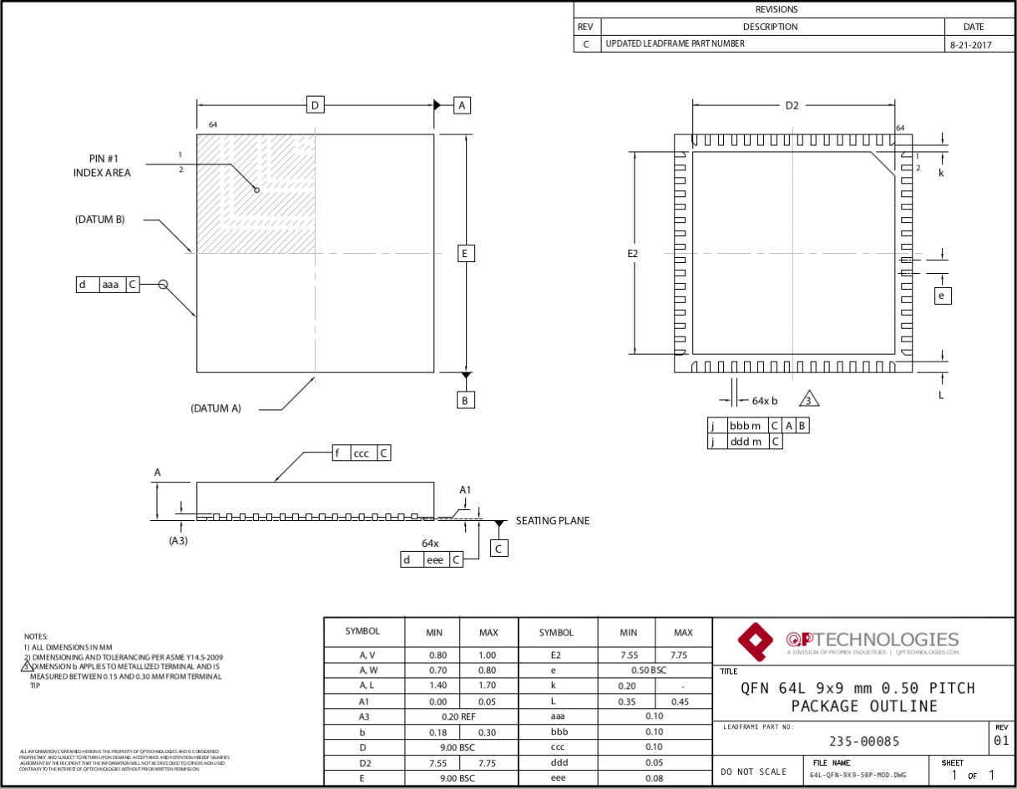

Slide 5
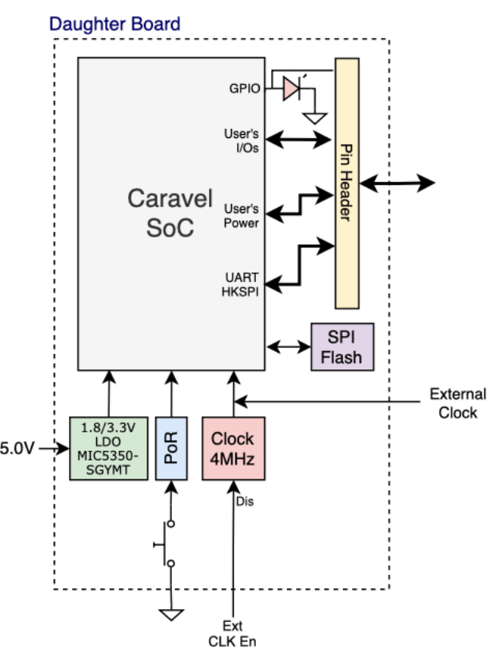
Daughter board Contains Caravel and the necessary components to bring it up and running
Power the Management SoC
Clock and reset the management SoC

Slide 6
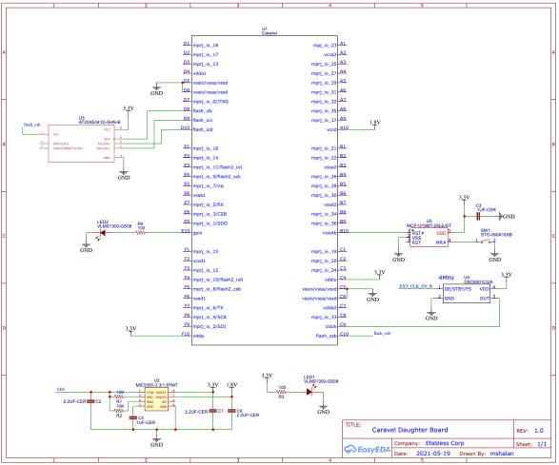

Slide 7
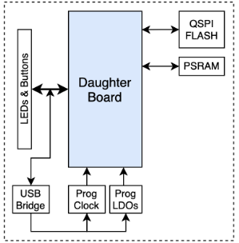
Carrier (Project) Board
Programmable clock source (for testing)
Programmable Power Supply (for testing)
USB bridge for
Controlling the programmable clock source
Controlling the programmable power supply
UART/SPI/I2C interfacing
QSPI Flash (SoC Program Memory)
PSRAM (SoC External RAM)
LEDs and Push buttons

Slide 8
Board BringUp
Bringing up prototype circuit boards is a tipping point in the product development cycle.
Board bring-up must verify the functionality of the hardware so that application software can be loaded and debugged.
Without a known-good-board, diagnosing software bugs would be futile.

Slide 9
Bring up Steps
Visual Inspection
Impedance measurement on power rails
Plugging in
Measure power
Measure Oscillations
Run Design
Check Signal quality
Human-Machine Interface

Slide 10
Visual inspection
Have a quick reference during validation.
Confirm that all the components are correctly fitted.
Confirm that all the pin 1 are placed correctly.
Confirm that there are no visible short circuits between pads.
Confirm that all pads soldered with good quality?
Confirm that the components with defined polarity are placed correctly.

Slide 11
Impedance measurement
Go through all the power rails and measure the impedance between ground and a power rail.
Confirm that there are no short circuits.
Some power rails may have very low impedance starting from 100s of ohms.
Refer to power tree to check is current consumption is higher.

Slide 12
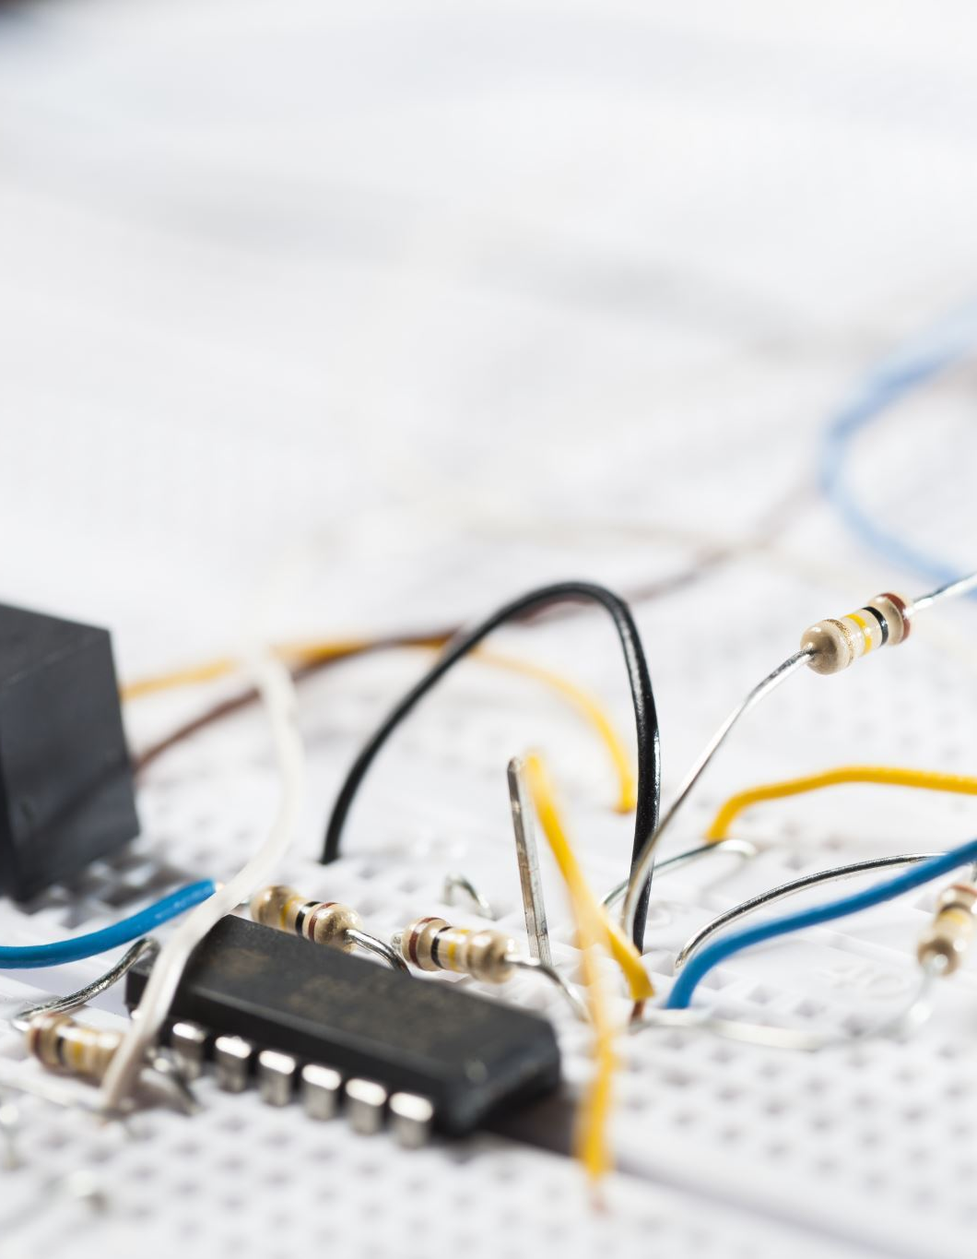
Plugging in
Check voltage output from your power supply. (Before connecting the board)
Set power supply current limit properly. (Before connecting the board)
Have connected the board with correct polarity.
Cover the board for first-time power up(in case something blows up) and switch on the power
Monitor the maximum current, note if the current is changing or is stable. (e.g. if it is increasing continuously, something may be wrong)
Check component temperature with a contactless thermometer. Do not touch the circuit it may damage some component due to ESD.

Slide 13
Measure the power
Check all the power rails and cross verify with schematic/power tree voltage value. Note down the effect of tolerance it might be helpful in finding bug later.
Measure the noise/AC component on each power rail, find if more decoupling is required.

Slide 14
Measure oscillations
Check all the crystals & oscillators.
Frequency
Skew
quality
If some of the crystals are not starting, then the board may never boot up.

Slide 15

Run Design
If everything is working ok, load a basic firmware and start checking peripherals one by one. in this step calibration of ADC and DAC’s can be performed, improve firmware reliability.
After basic check upload full fledged firmware and start checking more inter-related functions.
Based on the need for hardware design the test cases and test setup to minimize the human interference, e.g. try to collect data automatically etc.
Update the firmware with every bug found and re-run the complete set of tests. (look for whack-a-mole effect)

Slide 16
Check the signal quality
Using a good oscilloscope:
ensure all signals are clean in any case where EMC is a requirement.
Look for shape distortion and jitter specifically.
If so, reach to its cause and eliminate it.

Slide 17

Advanced Human-Machine Interface
If everything is ok, you will see console/App getting connected to the board and based on firmware may get a controlling function.
I.E : blinky function
If not you may have to start from the beginning, or look in the schematic, or firmware if something is missed out.
It is suggested to start with the basic interface and identify issues before adding all sophistication to it.

Slide 18
Debug
Even though there are only a few signals that directly impact a target connection to a debugger, it is critical that they are correct.
An improper tie-off or floating signal can result in a target that can’t be properly identified by debug tools or even debugged.

