Slide 1
Testbench Layers
Segment Outcome:
  Students will learn the basic hierarchy of layered logic testbenches.

Slide 2
Simulation Stages and Layers
Layers are blocks of related code that perform similar.
make your task easier by dividing the code into smaller pieces that can be developed separately.

Slide 3
Signal and command layers
Signal layer that contains the design under test and the signals that connect it to the testbench
Driver: drives DUT’s inputs with single commands such as bus read or write.
Monitor: driven by the DUT’s output, takes signal transitions and groups them together into commands.
SystemVerilog for Verification

Slide 4
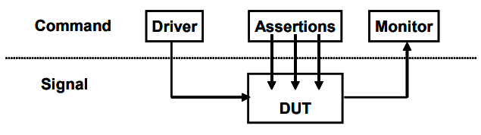
Signal and command layers
SystemVerilog for Verification

Slide 5
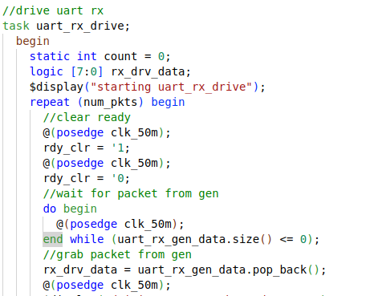
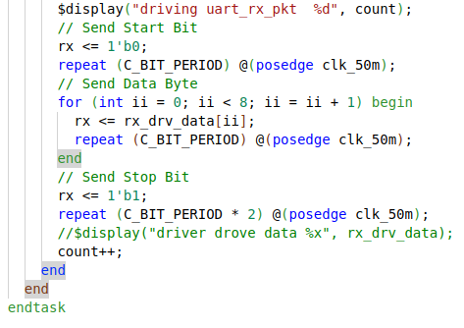
Driver: UART

Slide 6
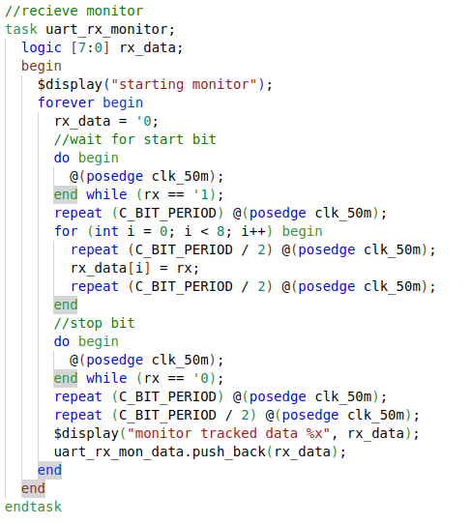
Monitor: UART

Slide 7
The functional layer
Functional layer feeds the command layer
Agent: receives higher-level and breaks them into individual commands.
Scoreboard: receives commands from agent and predicts the results of the transaction.
Checker: compares commands from monitor with those in the scoreboard.
SystemVerilog for Verification

Slide 8
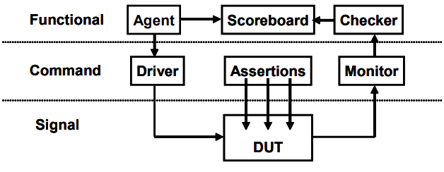
The functional layer
SystemVerilog for Verification

Slide 9
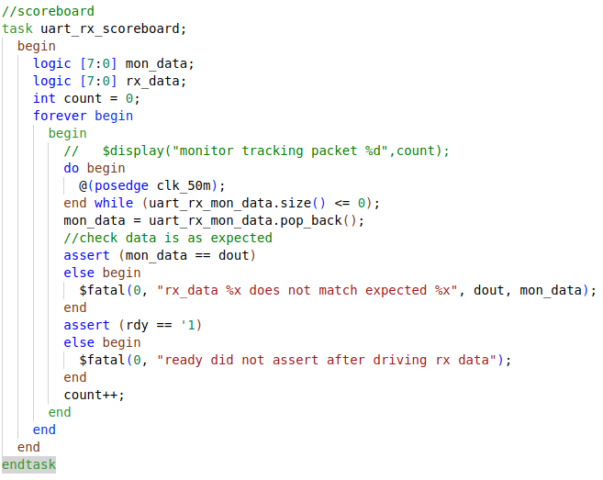
Scoreboard

Slide 10
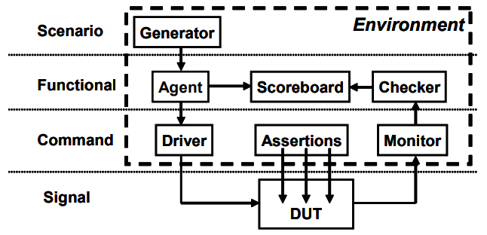
Scenario Layer
Generator in the scenario layer drives the functional layer
orchestrates all these steps with constrained-random values for parameters such as track size and memory location.
Example: MP3 player that can do many thing concurrently
  plays music from storage
  downloads new music from a host
  respond to input from the user
    such as volume and track controls.
Each of these operations is a scenario.
SystemVerilog for Verification

Slide 11
Test Layer and functional coverage
Test:
  top level of the testbench
  contains the constraints to create the stimulus.
  Think of a conductor who does not play any musical instrument, but instead guides the efforts of others.
Functional coverage:
  measures the progress of all tests in fulfilling the requirements in the verification plan.
  changes through the project as the various criteria complete.
  Because it is constantly being modified, it is not part of the environment
SystemVerilog for Verification

Slide 12
Functional Coverage
Need to measure what has been verified in order to check off items in your verification plan
monitor stimulus going into device, its reaction and response
  determine what functionality has been exercised
SystemVerilog for Verification

Slide 13
Functional Coverage Roll Up
Combine data from one or more simulations into a report.
Feedback from functional coverage to stimulus
  change the test to find new approaches to reach uncovered areas of the design
  Example: change the constraint weights based on types of transactions that have been previously generated
SystemVerilog for Verification

Slide 14
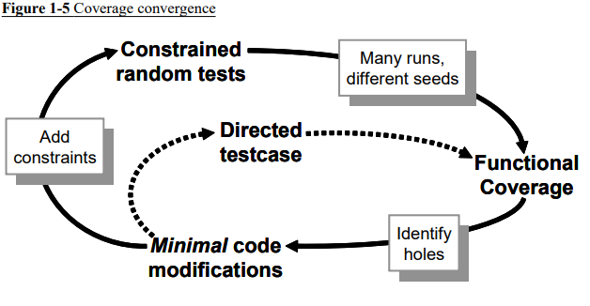
Coverage convergence
SystemVerilog for Verification

Slide 15
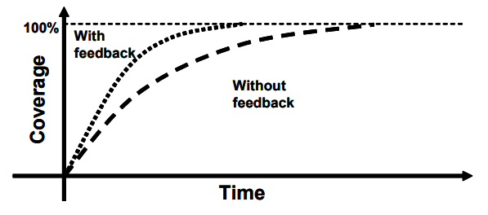
Test progress with and without feedback
SystemVerilog for Verification

Slide 16
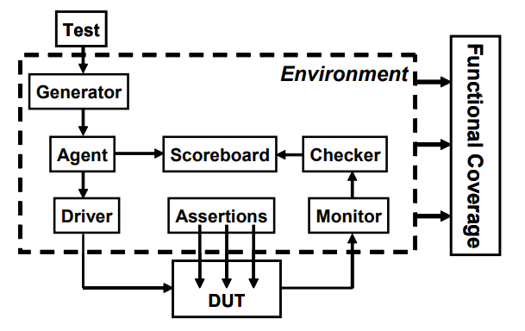
Full Picture
SystemVerilog for Verification

Slide 17
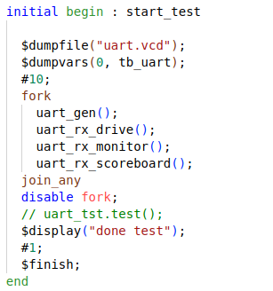
Test: UART

Slide 18
FORK
Fork???
  Multi-thread/ Concurrent Operation
  Hardware operates Concurrently, so test must too.
Fork-join: finish when all threads finish
fork-join_any: finish when any thread finish
Fork-join_none: finish immediately run threads in the background.
Each is useful in different situation

Slide 19
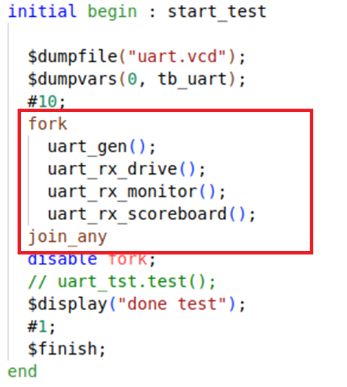
Fork Example
All happening at the same time..
  At least from the simulations point of view

Slide 20
Simulation Phases
coordinate the testbench so all the code for a project works together.
Build
  Generate Configuration
  Build Environment
  Reset the DUT
  Configure the DUT based on generated configuration
Run
  Start environment
  Run the test
Wrap-up
  wait for the final transactions to drain out of the DUT
  Report.
SystemVerilog for Verification

