Slide 1
FAULTS
Segment Outcomes
Students will be introduced to fault types and causes
Students will be introduced fault logic reduction and logic minimization.

Slide 2
Faults
Fault
A representation of a defect
Used in computer programs for analyzing defects in electronic components
Defect
A flaw in the actual hardware

Slide 3
Fault
Error
Caused by a defect
Happens when a defect in hardware causes a line or a gate output to have a wrong value.
Failure
occurs when a defect causes a misbehavior in the functionality of a system that cannot be reversed or recovered.

Slide 4
Fault Abstraction
Effects of defects in a circuit may be seen at different levels of abstraction
i.e., Physical defect of a short between an nMOS transistor gate and its source may be seen at the switch, gate, RT, or system-level

Slide 5
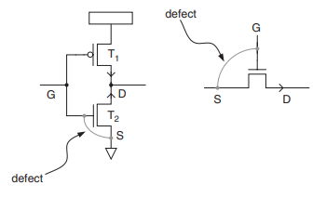
Gate Fault
Mask misalignment in layout may cause a short between gate of a transistor and its source
defect translates to T2 switch transistor always staying open.

Slide 6
Gate Fault
Same defect translates to switch level fault of switch output being open when it is supposed to be 0.

Slide 7
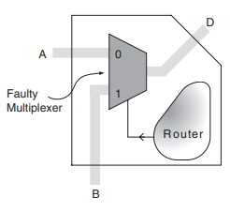
Functional Faults
Fault that affects functionality of a system
Example:
Faulty inverter in a multiplexer circuit causes the overall functionality of the multiplexer to be faulty

Slide 8
Functional Faults
Functional fault of a component at a certain level of abstraction ignores lower-level details of the component
Only considers the input–output behavior of the component

Slide 9
Structural Faults
Complexity of analysis for extracting a faulty model for a component can be simplified by analyzing its sub-components.
(e.g., inverter, AND, and OR gates) and their interconnections (e.g., line i in Fig. 3.5)

Slide 10
Structural Faults
Consider only interconnection faults
lump faults on the two ends of an interconnection and of interconnect itself into faults belonging only to the interconnection.

Slide 11
Structural Faults
Assume that components forming a hardware module are fault free.
Assume only the interconnection of the components may be faulty

Slide 12
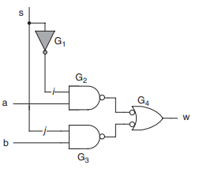
Structural Fault
I.E Inverter fault becomes fault on line i

Slide 13
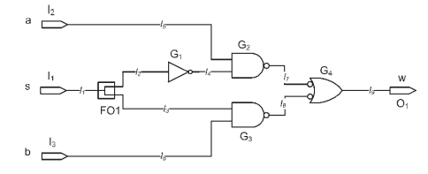
Recognizing Faults
Label possible points of failure
Write w as a function of a,b,s
W_good = (a and (not s)) or (b and s)

Slide 14
Recognizing Faults
Now assume a failure at I4, stuck at 1
W_fault = a or (b and s)
Since W_good != W_fault
I4 can be recognized

Slide 15
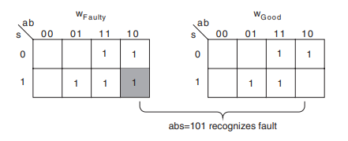
Boolean Difference : Karnaugh maps
Create two k-maps
One the good function
the other the faulty function
Input combination where the k-map entries are different represent valid test vectors.
i.e recognize the faulty circuit from the good one

Slide 16
Example
stuck-open fault on L3
l3 and l2 are branches of a fanout whose stem is l1
l3 stuck open causes the G3 gate to retain its charge forever
G3 acts like an inverter

Slide 17
Stuck-at-x faults
Stuck-open
Stuck-at-0
models' defects on a line or its interconnecting gates such that the line value appears as though it is always 0
Stuck-at-1
models' defects on a line or its interconnecting gates such that the line value appears as though it is always 1

Slide 18
Bridging Faults
Defects on neighboring gates and lines may cause a bridging effect on two lines.
AND bridging
two bridged lines appear as if they are forming an AND functions which feeds all destinations of the bridged lines
OR bridging
Depending on the logic behind and after a bridging fault, the fault may be modeled by an OR function instead of an AND function.

Slide 19
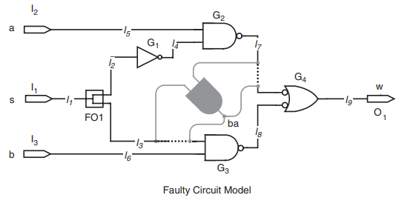
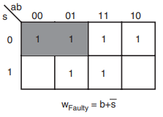
AND-bridging Faults
Fault between I7 and I3.
.
Tests that detect this faults???

Slide 20
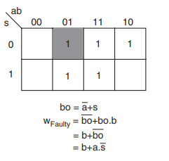
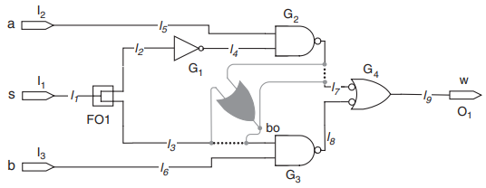
OR-bridging Faults
Fault between I4 and I7.
.
Tests that detect this faults???

