Slide 1
Frameworks Segment
Students will be introduced to Non-synthesizable SystemVerilog and its benefits.

Slide 2
Non-synthesizable SystemVerilog
The vision of SystemVerilog was to first expand on the abstract capabilities of synthesizable code.
significantly add all the features known to be necessary for verification.
A strict superset of the previous Verilog standards.
SystemVerilog for Verification

Slide 3
Non-synthesizable SystemVerilog
The benefits of having a single language and a single coherent run-time environment cannot be expressed enough.
Including the design, testbench, and assertion constructs in a single language is that the testbench has easy access to all parts of the environment without requiring specialized APIs.
SystemVerilog for Verification

Slide 4
Data Types
Logic
  4 state single bit type
Fixed-Size Arrays
  i.e: my_array[5]
Queue
  i.e: my_queue[$]
  Provides sorting, size.
Typedef
  Create new types
SystemVerilog for Verification

Slide 5
Structs
Structs
  allows you more control in how data is laid out in memory by using packed structures.
  A packed structure is stored as a contiguous set of bits with no unused space.
  i.e:
    typedef struct packed logic[7:0] {r,g,b) pixel_t;
SystemVerilog for Verification

Slide 6
Enums
Enums
  strong variable type that is limited to a set of specified names
  instruction opcodes or state machine values.
    i.e:
      typedef enum {ERROR=0, FIRST=1, Second = 2} my_enum_e;
SystemVerilog for Verification

Slide 7

Data Types
Linked Lists
  Yes, they exist in SystemVerilog.
  NO, do not use them.
SystemVerilog for Verification

Slide 8
Tasks, Functions, and Void Functions
task can consume time while a function cannot.
A function cannot have a delay
  #100, a blocking statement such as @(posedge clock) or wait(ready), or call a task
SystemVerilog for Verification

Slide 9
Tasks, Functions, and Void Functions
Why functions????
  Can be synthesized “sometimes”
  Can call at the beginning/ or very end of a test.
SystemVerilog for Verification

Slide 10
Time-unit
use timeunit and timeprecision or ‘timescale to unambiguously specify a time value plus units
  i.e : 0.1ns or 20ps.
  timeunit 1ns; then #1 = wait 1 nano second
SystemVerilog for Verification

Slide 11
Constrained-Random Stimulus
Simulator generates the stimulus.
  But not totally random values.
Use the verification language to describe the format of the stimulus
  “address is 32-bits, opcode is X, Y, or Z, length < 32 bytes”
  Allow the simulator to pick values that meet the constraints.
SystemVerilog for Verification

Slide 12
Constrained-Random Stimulus - 2
Coverage may overlap other tests or may explore new areas that you did not anticipate.
If these new areas find a bug, you are in luck! If the new area is not legal, you need to write more constraints to keep away
SystemVerilog for Verification

Slide 13
What Should You Randomize?
First thing that you might think of is the data fields.
  Easy peazy: just call $random, or c/python alternative
Problem?
  gives a very low payback in terms of bugs found.
  primary types of bugs found with random data are data path errors
    perhaps with bit-level mistakes.
  Need to find bugs in the control logic.
SystemVerilog for Verification

Slide 14
What Should You Randomize?
Need to think broadly about all design input, such as:
  Device configuration
  Environment configuration
  Input data
  Protocol exceptions
  Delays
  Errors and violations
SystemVerilog for Verification

Slide 15
Device and Environment configuration
Should randomize the entire environment configuration
  including the length of the simulation
  number of devices, and how they are configured.
need to create constraints to make sure the configuration is legal.
Consider other environment parameters include test length, error injection rates, delay modes, etc.
SystemVerilog for Verification

Slide 16

Input Data
Think of implementing a transaction such as a bus write and filling the data fields with random values
  Should be easy if you have carefully prepared your transaction classes.
need to anticipate any layered protocols and error injection, plus scoreboarding and functional coverage.
SystemVerilog for Verification

Slide 17
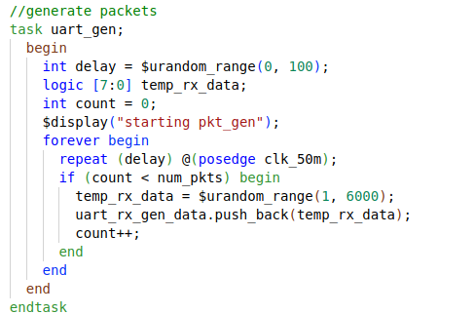
Generate: Uart

Slide 18

Protocol exceptions
If something can go wrong in the real hardware, you should try to simulate it.
Look at all the errors that can occur.
  What happens if a bus transaction does not complete?
  Invalid operation is encountered?
  Does the design specification state that two signals are mutually exclusive?
    Drive them both and make sure the device continues to operate.
Be provocative!
SystemVerilog for Verification

Slide 19
Delays and synchronization
How fast should your testbench send in stimulus?
Use constrained random delays to help catch protocol bugs.
test that uses the shortest delays won’t create all possible stimulus.
subtle bugs are often revealed when intermittent delays are introduced.
SystemVerilog for Verification

Slide 20
Delays and Synchronization
When possible, coordinate various drivers so they can communicate at different relative timing.
What if the inputs arrive at the fastest possible rate, but the output is being throttled back to a slower rate?
What if stimulus arrives at multiple inputs concurrently?
What if it is staggered with different delays?

Slide 21
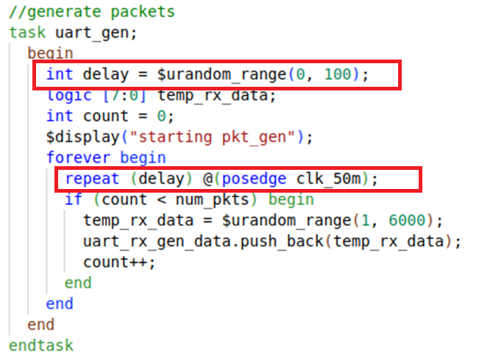
Gen Delays

Slide 22
Parallel random testing
How should you run the tests?
random test consists of the testbench code plus a random seed.
If you run the same test 50 times, each with a unique seed, you will get 50 different sets of stimuli.
SystemVerilog for Verification

Slide 23
Parallel random testing
Running with multiple seeds broadens the coverage of your test and leverages your work.
Need to choose unique seed
  Time of day? What if you have multiple servers kicking off jobs that start at the same time?
  Modern simulators have pretty good seed generation
SystemVerilog for Verification

Slide 24
Cocotb
Open source coroutine-based cosimulation testbench environment for verifying VHDL and SystemVerilog RTL using Python.
cocotb is all about verification productivity.
It allows developers to focus on the verification task itself, and stop fighting with language limitations.
Cocotb.org

Slide 25
Cocotb: Creating a Test
typical cocotb testbench requires no additional HDL code.
The DUT is instantiated as the toplevel in the simulator without any HDL wrapper code.
access all internals of your design, i.e signals, ports, parameters, etc. through an object that is passed to each test, usually called dut.
Things to note:
  Use the @cocotb.test() decorator to mark the test function to be run.
  Use .value = value to assign a value to a signal.
  Use .value to get a signal’s current value.
Cocotb.org

Slide 26
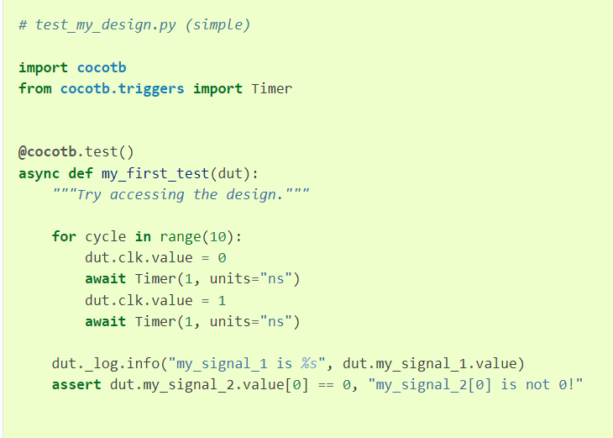
Cocotb: simple testbench
drive 10 periods of a square wave clock onto a port clk of the toplevel.
After,
  the clock stops
  the value of my_signal_1 is printed
  value of index 0 of my_signal_2 is checked to be 0.
Cocotb.org

Slide 27
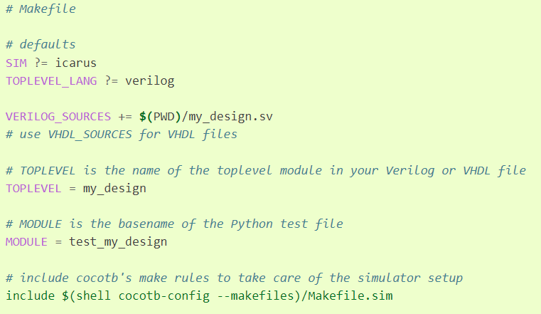
Cocotb: Makefile
In order to run a test, you need to create a Makefile that contains info about your project.
SIM
  default simulator
TOPLEVEL_LANG
  language of your top module
TOPLEVEL
  Name of Top module
MODULE
  basename of python test file
Cocotb.org

