Slide 1
EEGR 417
Section 2: POST-SYNTHESIS

Slide 2
Section Outline
Review
Fault Basics
Fault Modeling, Detection and Mitigation
Test Vectors
ATPG
Scan Chain Overview & Insertion/ DFT
JTAG

Slide 3
Section Outcome
Introduce concepts and tools necessary for proper validation
Layout process of performing effective post-synthesis validation
Present techniques for generating high coverage test patterns.
Present methods for Testing full Systems on Chips and Boards.

Slide 4
Design and Test
Producing a digital system begins with a designer specifying a high-level design language
Ends with manufacturing and shipping parts to the customer.
This process involves many simulations, synthesis, and test phases.

Slide 5
Register transfer level (RTL) Design Process
Designer writes design specification in an RTL language such as Verilog.
Using standard HDL (Hardware Description Language) descriptions and testbenches in the same HDL
Description will be simulated and tested for design errors.

Slide 6
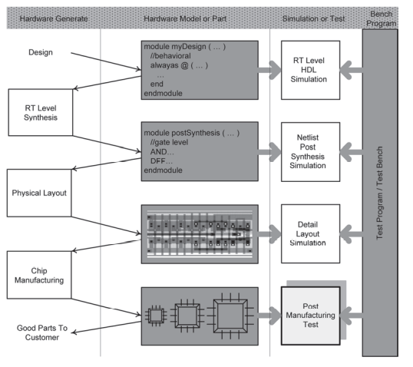
IC Design Process

Slide 7
RTL Simulation
Primarily functional that is extracted from the original specification of the circuit being designed
Detailed timing checks and physical flaws are not addressed at this level of simulation.

Slide 8
RTL Simulation
Can inject design errors to predict the behavior of the design under unanticipated circumstance.
After a satisfactory simulation, and when the designer is reasonably sure the design meets the design specifications, move on to RT level synthesis

Slide 9
RT Level Synthesis
Takes the behavioral description of a design (myDesign) as input, and produces a netlist of the design
Specifies interconnection of low-level basic logic components such as AND and OR gates and D-type flip-flops.

Slide 10
RT Level Synthesis
Netlist must be tested an HDL simulation tool.
referred to as postsynthesis simulation.
Checking for delay issues, races, clock speed, and errors caused by misinterpretation of the RT level design by the synthesis tool

Slide 11
Physical Layout
Verified post-synthesis netlist of the design is used by a layout and placement tool for generating the design’s layout and routing of cells.

Slide 12
Physical Layout
Output of this phase also needs to be tested and verified for correctness.
Simulation here verifies wire lengths, wire widths, and transistor sizes, and detects layout and placement flaws that can be introduced from a netlist to its layout

Slide 13
Chip Manufacturing
Manufactured chips must be individually tested and verified against flaws before they are shipped to the customers

Slide 14
Chip Manufacturing
Testing phase for testing the actual, post-manufacturing, chips is what is referred to as test or testing in digital system design industry.
Testing the circuit under test (CUT) against manufacturing defects
broken wires, shorts, open resistive wires, transistor defects, etc.

Slide 15
Design-Under-Test & Testers
Segment Outcomes
Students will learn the formal definition of DUT.
Students will be introduced to different testers and methods of testing.

Slide 16
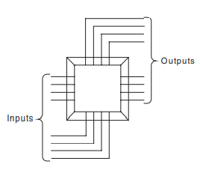
Device Under Test
Can be a system, a board, a packaged chip, a chip, a die on a wafer, a core on a die, or a section of a core
Treat as a Blackbox that can only be controlled and observed from the outside

Slide 17
Device Under Test
Generate test vectors, generate expected outputs vectors, compare output vectors to expected output vectors.

Slide 18
Testers
Device or equipment that applies test vectors to a DUT, collects DUT’s responses, and makes comparisons with the expected data.
Specially made and designed for testing a specific device.
DUT can test itself.
built-in hardware that has been primarily designed for testing the rest of the hardware of the DUT. Built-in Self-test (BIST).

Slide 19
Types of tests
External Testing:
A device is tested by an external device that can be a chip, a board, or a computer or test equipment.
Internal Testing:
The tester for a device is in the same packaging as the device.
Built-in Self-Test (BIST): the tester hardware is integrated with, and on the same chip as the device.

Slide 20
Types of tests
Online Testing.
Testing is done while a device is performing its normal functions.
Offline Testing.
Device being tested must cease its normal operation, and then be tested.
Offline testing can be done by internal or external test hardware

Slide 21
Concurrent Testing
Concurrent Testing (Online).
Normal/Expected used in preforming normal functions are used for testing it.

Slide 22
Concurrent Testing
Concurrent Testing (ATE).
Tester is testing various parts of a chip concurrently.
I.E the analog, memory, and the logic parts tested at the same time.

Slide 23
Testing Speed
At-Speed Testing.
Device being tested at its normal speed of operation, also called AC Testing
DC Testing.
Device is tested at much slower speed than its operation frequency. Allows all events to propagate before outputs are sampled

Slide 24
Types of Tests
In-Circuit Testing.
Device being tested is not removed from its mounting place for testing.

Slide 25
Types of Tests
Guided Probe Testing.
In a process of probing backwards from outputs towards inputs.
Testing is done to find the source of an error that has appeared on the circuit’s outputs.

Slide 26
Types of Tests
Diagnostic.
When testing is done to find the cause of failure

Slide 27
Work smart, not hard?
Combinational circuit with 64 inputs, 64 outputs, and 12 ns internal delay.
Tester running at 1 GHz clock frequency, and it takes four clock cycles (4 ns) to fetch a new test vector and apply it to the circuit.

Slide 28
Work smart, not hard?
At this tester frequency, it takes four clock cycles to lookup the output and compare it with the expected result
How long to test?
Test time : 2^(64) * (12 + 4 + 4)* 10^(-9)s ~ 11,698 years
Why not work smart and hard!

Slide 29
Test Methods
Use algorithms and methods to reduce number of test vectors, select vectors more wisely than just trying every combination
Simplify faults that can occur.
Use a reduced number of faults.
Find mechanisms for evaluating test vectors.
Find parts of circuit that are harder to test.
Generate tests that target hard to test areas.
Evaluate test vectors and keep more efficient ones.
Compact test vectors.

