Slide 1
Test Vectors (ATPG)
Segment Outcomes
Students will gain an introductory understanding of design test pattern generation, including terminology and design techniques, trade offs, and applications
Students will learn to use utilize industry tools to generate high coverage test patterns.

Slide 2
ATPG
Test vectors are generated for post manufacturing test of a digital system
Complexity of digital systems means, automatic methods are used for generation of test pattern.
WHAT NOW:
automatic test pattern generation (ATPG)

Slide 3
ATPG
WHAT NOW:
automatic test pattern generation (ATPG)

Slide 4
What is a Test?
Fault activation
Fault effect
X
1
0
0
1
0
1
X
X
Combinational circuit
1/0
1/0
Primary inputs
(PI)
Primary outputs
(PO)
Path sensitization
Stuck-at-0 fault
3

Slide 5
ATPG
WHY:
Test vectors are generated for post manufacturing test of a digital system
Complexity of digital systems means, automatic methods are used for generation of test pattern.
Complete functional test is impractical.
Designer generated functional patterns typically provide only 70-75% SA coverage.
ATPG supplements to get coverage to >98%.

Slide 6
ATPG (Purpose)
Generate test patterns.
Find redundant circuit logic.
Prove one implementation matches another (Equivalency).

Slide 7
Test Vector
Test Vector:
An input vector that creates different outputs for faulty and good circuits.
Test generation is finding such input vectors.

Slide 8
Controllability and Observability
Controllability
a measure of difficulty of setting a circuit line to a certain value
Primary circuit inputs are the most controllable.
Observability
A measure of difficulty of observing the value change of a line on a primary output.
Primary circuit outputs are the most observable.

Slide 9
ATGP Steps
Fault Activation:
Establishes a signal value at the fault model site that is opposite of the value produced by the fault model.
Fault Propagation:
Moves the resulting signal value, or fault effect, forward by sensitizing a path from the fault site to a primary output.

Slide 10
Test Generation Process
Test generation techniques that try to simplify exhaustive solutions
Fault-oriented Test Generation
Fault Independent Test Generation
Random Test Generation
Deterministic

Slide 11
Test Generation Process
Fault-oriented Test Generation
Focus on a fault in a circuit, search for a test that can detect the fault is fault-oriented test generation
Fault Independent Test Generation
tests are generated independent of faults
test can be generated and then evaluated for faults it can detected
Random Test Generation
Fault simulation and repeat until desired fault coverage is achieved.

Slide 12
Test Generation Process
Algorithmic/Deterministic
Specific fault in the circuit is targeted, and a test vector is generated to detect that fault.
Search the input vector space for a test:
Initialize all signals to unknown (X) state – complete vector space is the playing field
Activate the given fault and sensitize a path to a PO – narrow down to one or more tests

Slide 13
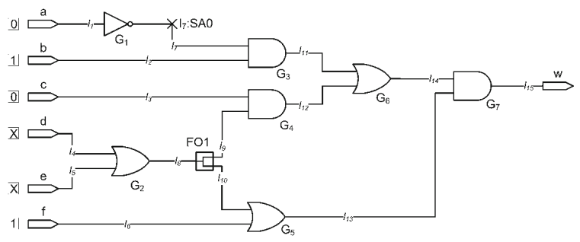
Basic TG Procedure
Test Generation for l7 : SA0???

Slide 14
Basic TG Procedure
Try to force a 1 on the line to make fault present
Achieved by a 1 on the inverter output, 0 on a primary input
The starting 32 value of X on a changes to 0

Slide 15
Basic TG Procedure
Next, we try to propagate the fault effect to the circuit primary output.
use the 1/0 notation for good/faulty line values, which means l 7 is 1/0.
Effect of fault on line l7 can only get closer to the circuit’s primary output if it passes through G3 which requires l 2 to become 1.
The good/faulty value on l 11 becomes 1/0.
To have a 1 on l 2 , input b must become 1

Slide 16
Basic TG Procedure
Set all Inputs to X.
Propagate value through all circuit line to primary outputs

Slide 17
D-Algorithm (Roth et al., 1967, D-alg II)
Use D-algebra
Activate fault
Place a D or D at fault site
Do justification, forward implication and consistency check for all signals
Repeatedly propagate D-chain toward POs through a gate
Do justification, forward implication and consistency check for all signals
Backtrack if
A conflict occurs, or
D-frontier becomes a null set
Stop when
D or D at a PO, i.e., test found, or
If search exhausted without a test, then no test possible
Copyright 2001, Agrawal & Bushnell
15

Slide 18
Definitions
Justification: Changing inputs of a gate if the present input values do not justify the output value.
Forward implication: Determination of the gate output value, which is X, according to the input values.
Consistency check: Verifying that the gate output is justifiable from the values of inputs, which may have changed since the output was determined.
D-frontier: Set of gates whose inputs have a D or D, and the output is X.

Slide 19
D-Calculus and D-Algorithm
Primitive D-cubes of failure (PDF): These model faults including:
SA0 (represented by D)
SA1 (represented by D)
Bridging faults (short circuits)
Arbitrary change in logic gate function (e.g., from AND to OR)
For the AND gate, the PDF for output SA0 is 1 1 D
Here the good machine generates a 1 when both inputs are 1, while the bad machine generates a 0.
The PDFs for the AND gate output SA1 are 0 X D and X 0 D.
Note the PDF are distinct from the propagation D-cubes.
The former models a failure at the gate.
The latter models the conditions for fault effect propagation.

Slide 20
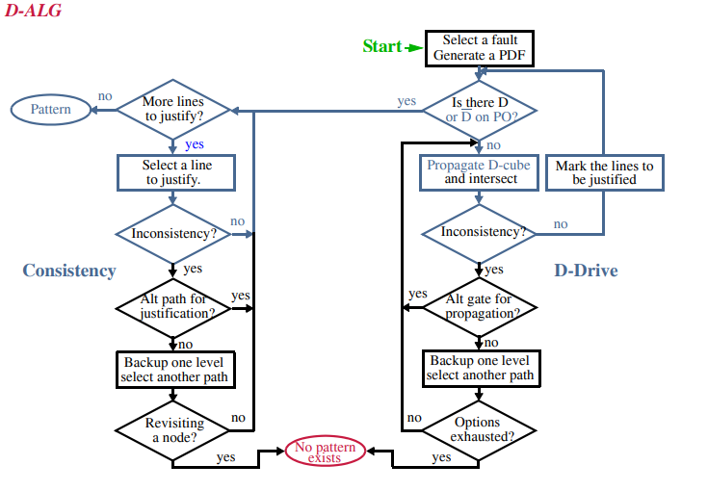

Slide 21
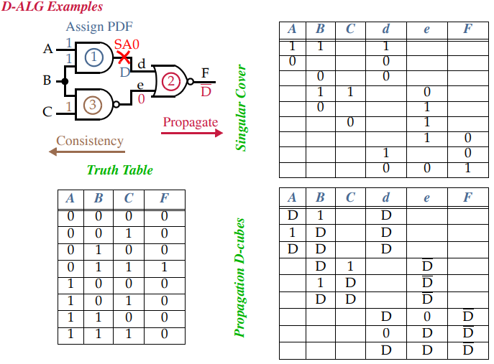

Slide 22
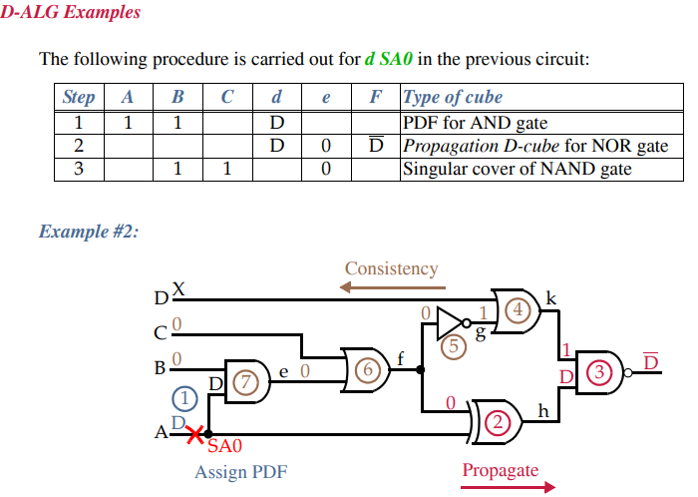

Slide 23
DALG - ISSUES
D-ALG has a search space comprising of all the internal nodes of the circuit along with the PIs.
Makes it very slow
The D-ALG is proven to be ineffective in generation of test vectors for circuits that involve the XOR gates with re-convergent fan-outs.
These kind of circuits are commonly found in applications requiring Error Correction and Translation (ECAT).
WHAT THEN??

Slide 24
Signal values on all lines (PIs and internal lines) are manipulated using 5-valued algebra.
Worst-case combinations of signals that may be tried is 5^{#lines}
For XOR circuit, 5¹² = 244,140,625.
Podem: A reduced-complexity ATPG algorithm
Recognizes that internal signals depend on PIs.
Only PIs are independent variables and should be manipulated.
Because faults are internal, a PI can assume only 3 values (0, 1, X).
Worst-case combinations = 3^{#PI}; for XOR circuit, 3² = 8.

Slide 25
PODEM
New concepts introduced:
Expand binary decision tree only around primary inputs
Use X-PATH-CHECK to test whether D-frontier still there
Objectives -- bring ATPG closer to propagating D (D) to PO
Backtracing

Slide 26
Podem: Path oriented decision making
Step 1: Define an objective (fault activation, D-drive, or line justification)
Step 2: Backtrace from site of objective to PIs (use testability measure guidance) to determine a value for a PI
Step 3: Simulate logic with new PI value
If objective not accomplished but is possible, then continue backtrace to another PI (step 2)
If objective accomplished and test not found, then define new objective (step 1)
If objective becomes impossible, try alternative backtrace (step 2)
Use X-PATH-CHECK to test whether D-frontier still there – a path of X’s from a D-frontier to a PO must exist.

Slide 27
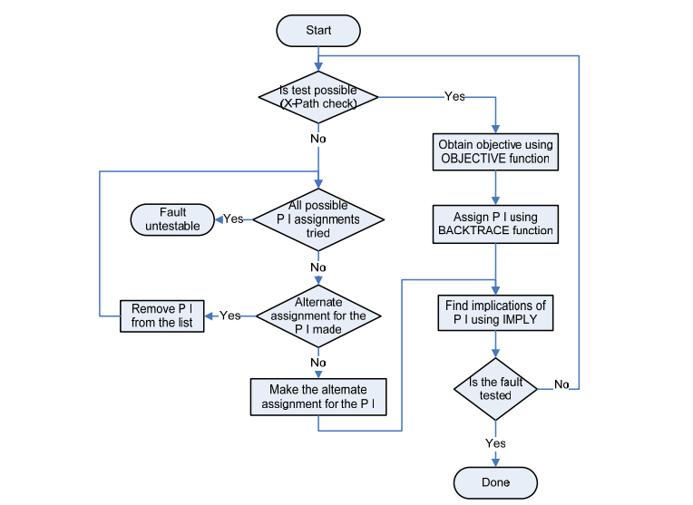
PODEM

Slide 28
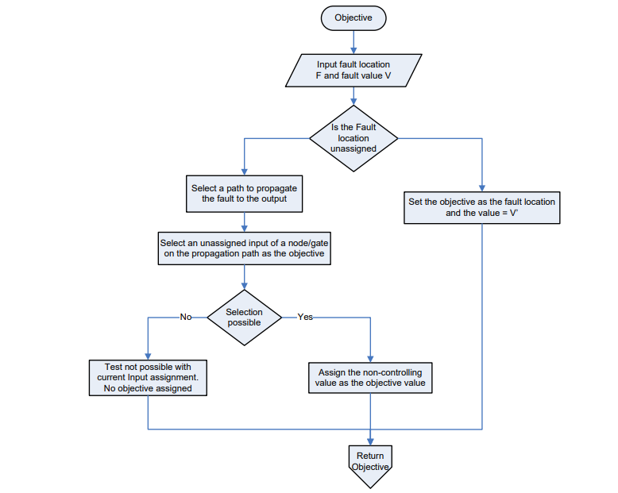
Objective

Slide 29
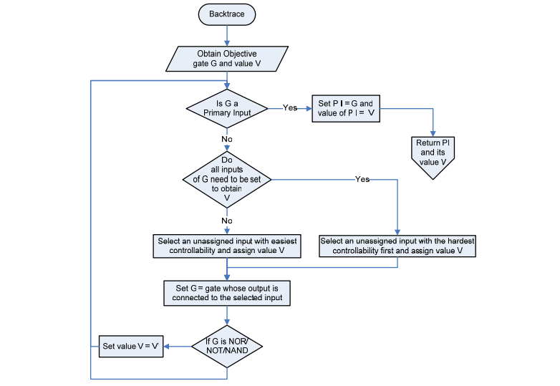
Backtrace

Slide 30
XOR Example Again
Compute SCOAP testability measures: (CC0,CC1)CO
6
(4,2)3
5
(1,1)6
7
(3,2)5
(5,5)0
7
(1,1)6
5
6
(4,2)3
Copyright 2001, Agrawal & Bushnell
VLSI Test: Lecture 9alt
26

Slide 31
Podem: Objective and Backtrace
2&3. Backtrace to a PI
and simulate
1. Objective 1: set fault site to 1
6
(4,2)3
5
1
(1,1)6
7
(3,2)5
sa0
0
D
(5,5)0
7
1
(1,1)6
5
6
X-path check fails
→ Back up:
Erase effects of steps 2&3
Try alternative backtrace
(4,2)3
Copyright 2001, Agrawal & Bushnell
VLSI Test: Lecture 9alt
26

Slide 32
Podem: Back up
4&5. Alt. backtrace to a PI
and simulate
1. Objective 1: set fault site to 1
6
(4,2)3
5
(1,1)6
7
(3,2)5
sa0
D
(5,5)0
0
1
(1,1)6
7
5
X-path
1
X-path check: OK
Objective 1 achieved
6
(4,2)3
Copyright 2001, Agrawal & Bushnell
VLSI Test: Lecture 9alt
26

Slide 33
Podem: D-Drive
5. Backtrace to a PI
and simulate
4. Objective 2: D-drive, set line to 1
6
(4,2)3
1
D
5
(1,1)6
7
(3,2)5
sa0
1
D
(5,5)0
7
0
1
D
(1,1)6
5
1
D at PO
→Test found
6
(4,2)3
Copyright 2001, Agrawal & Bushnell
VLSI Test: Lecture 9alt
26

Slide 34
DFT & SCAN
Segment Outcomes
Students will be introduced to design techniques that make the task of testing feasible.
Students will be discussing about the most common DFT technique for logic test, called Scan.

Slide 35
Scan
Internal modification of the design’s circuitry to increase its test-ability.
Makes the process of pattern generation easier for detection of the faults we discussed earlier.
Difficult to control the flop’s value through primary inputs and observe the captured response in primary outputs.

Slide 36
Scan Insertion
Goal of ‘Scan Insertion’ is to make a difficult-to-test sequential circuit behave (during testing process) like an easier-to-test combinational circuit.
Achieving this goal involves two steps
Converting Regular Flop to Scan Flop
Stitching the Scan Flops to form Scan Chains

Slide 37
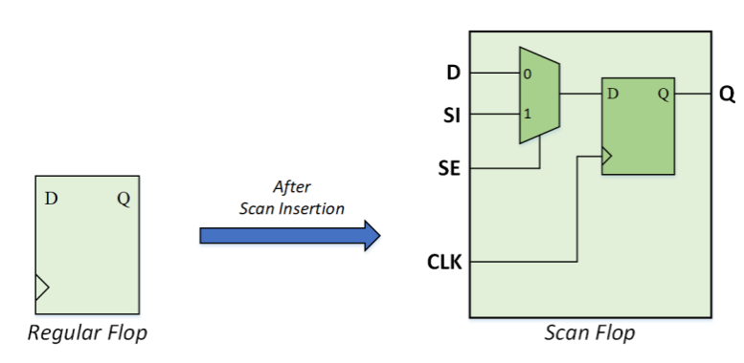
Scan Conversion
All the flops in the design are converted into scan flops, except –
The ones that are excluded by user. These are called non-scan flops.
The ones that have DFT DRC violation(s).

Slide 38
Scan Flops Stitching
Scan flops are stitched to form scan chain(s).
The number of scan chains depends upon various user inputs:
Length of scan chain
Clock domain mixing
Power domain mixing
Voltage domain mixing

Slide 39
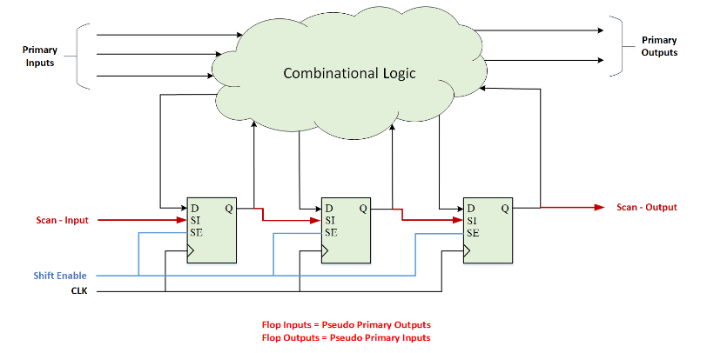
Scan Flops Stitching

Slide 40
Initialization
To set any flop value to x… 1/0.
Set the SE = 1, such that SI to Q path is activated.
Shift in the required values serially through a top level primary input called Scan-Input.
Can use same clock as design or a special “SCAN CLK”

Slide 41
Capture
Capture the values from combinational circuit by making SE = 0
Observe the captured response we make the SE = 1
Serially shift out the captured data through a primary output called Scan-Output

Slide 42
PCB Testing
Needs:
locate critical errors that maintain unit function and quality
Confirm electrical Functionality
Conditioning? Low endurance parts?
Test components individually.
Bed-of-Nails.
in-circuit testing by bed-of-nails probing technique for isolating components is no longer an easy solution.

Slide 43
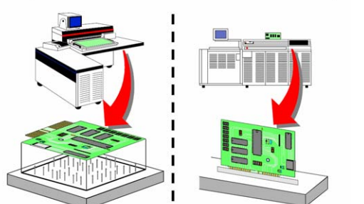
Bed-of-Nails

Slide 44
Bed-of-Nails
Design is placed directly on a test platform with many pins.
Pins make electrical connections with the inputs/outputs of the design.
The Good?
Individual pins of design can be tested meaning individual components can be tested
Faults of the test are located directly on the specific components
device pins, network points
fault location is accurate
can greatly improve production efficiency and reduce maintenance costs.
The Bad?
Does not scale well….
Time consuming

Slide 45
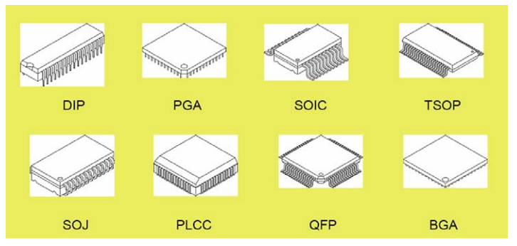
PCB Packaging

Slide 46
Modern IC testing?
Continuous miniaturization of IC’s
In-circuit testing by bed-of-nails probing technique for isolating components is no longer an easy solution
Testing complex components and multicore chips is not possible by off-chip test methods
Need to access various components and/or cores.
Need to be able to isolate them from each other
without a significant increase in the cost of test
JTAG

Slide 47
JTAG
Joint test action group (1985)....
Group of designers, manufactures, and test engineers established a set of specifications for testing board by shifting in serial test data.
IEEE std.1149.1
Also known as boundary scan.
Boundary scan standard eliminates the need for probing a component’s pins with a physical probe.
Improves controllability and observability within a PCB or a chip

Slide 48
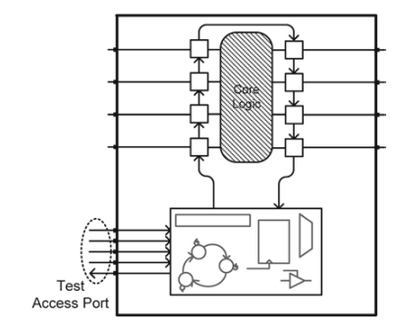
JTAG
Uses a chain of scan flip-flops to shift test data into the inputs of a core logic being tested
Uses the same mechanism to move test response out

Slide 49
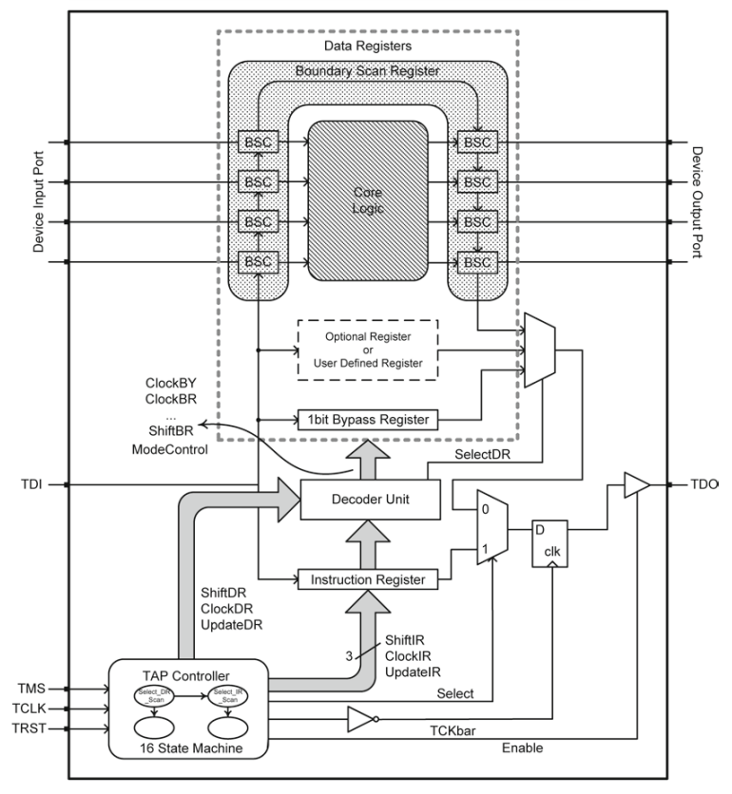
Boundary Scan Architecture
Test Access Port (TAP):
Controllers
Registers
Decoders

Slide 50
Instruction Register
instructions define the operation of the standard in test mode.
An instruction register of at least 2 bits holds the instructions
mandatory part of this standard
instructions are shifted in serially
Two main States
Shift/Capture
Update

Slide 51
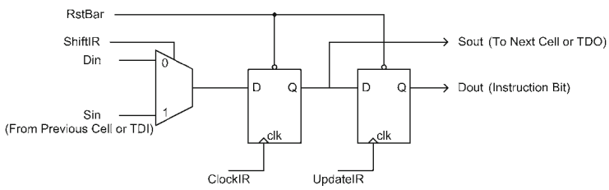
Instruction Register
Shift flip-flop takes serial instruction bits from its Sin, Parallel inputs from DIN.

Slide 52
Instruction Register
When ShiftIR is 1, serial instruction bits from the previous cell’s Sout or TDI are shifted into this flip-flop.

Slide 53
Instruction Register
After completion of capture, rising edge of UpdateIR causes data available on the outputs of the first flip-flops to be loaded into the instruction register

Slide 54
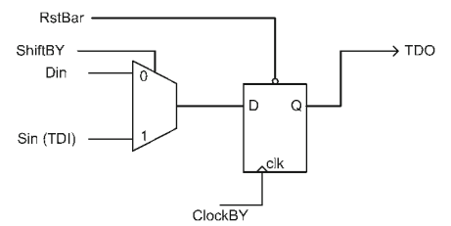
Data Registers
Instruction loaded in the instruction register causes one of the data registers to go between TDI and TDO serial input and serial output.
Any register that can logically be placed in the TDI, TDO serial path is referred to as a data register.

Slide 55
Data Registers
Bypass register
Used to bypass a core from scan chain so that serially shifted data can reach the target core quicker
Device identification register
32-bit register, contains identification code for the core logic that it is a part of
Boundary scan register
Placed on the boundary of the core logic that is being tested.
The register cells go between external pins (interconnects) and ports of the core logic.
User-defined registers
Custom user-defined registers
Must logically be placed between TDI and TDO ports for shift path consistency

Slide 56
TAP Controller
All boundary scan operations are controlled by a simple controller that has sixteen states.
See Section 8.2.3
Controller uses TCLK for the clock, TMS for its input, and, if used, TRST for resetting it.
Two starting states, seven data register control states, and seven instruction register control states.

Slide 57
Decoder
Combinational circuit:
Takes the existing instruction in the instruction register and signals from the TAP controller as inputs
Issues signals to the appropriate data register.

Slide 58
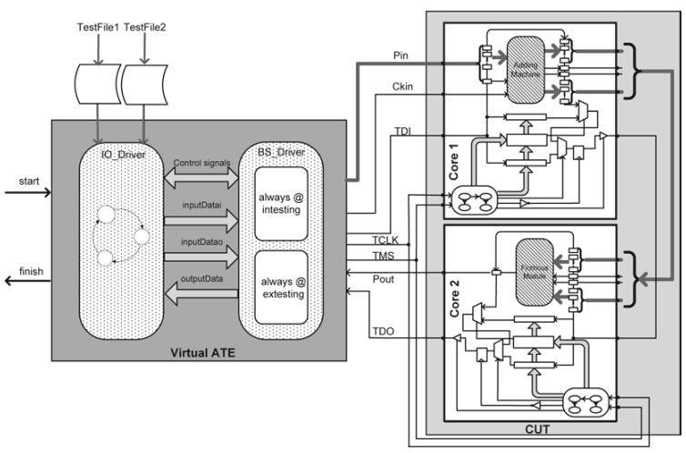
JTAG TEST SUITE

Slide 59
Testing Process
Step 1: Resetting.
TAP controller starts in Test_Logic_Reset state
TMS will be kept high for five consecutive clock pulses.
Step 2: First Data Set.
Before the actual Intest instruction is performed
scan chain must be initialized with the first test vector.
Step 3: Loading Intest and Bypass.
After first test vector is in the boundary scan register.
Intest and Bypass instructions loaded in cores 1 and 2, for performing Intest on core 1 for the rest of input test vectors.
TMS, core 1 is put into Shift_IR state.

Slide 60
Testing Process
Step 4: Let Core Respond to Test.
Now that test data are available at the ports of core 1.
Let core to react to the test data and generate its corresponding response.
Run_Test_Idle State
Step 5: Capture Response.
After the DUT has been given enough time to prepare its test response.
go from Run_Test_Idle state to Capture_DR and then Issue Ready.
Step 6: Next Data Shift-In and Previous Response Shift-Out.
shift out the captured response

Slide 61
Testing Process
Step 7: Response Ready & Check for Last Test.
go to Update_DR state
issues lastData if data that were shifted in were the last test data.
Step 8: Let Core Respond to Last Test.
This step is similar to Step 4, and after it is completed, it goes to Step 9
Step 9: Last Response Shift-Out.
Shift out response.
Step 10: Last Response and Reset.
go to the Test_Logic_ Reset state
announce completion of Intest.

Slide 62
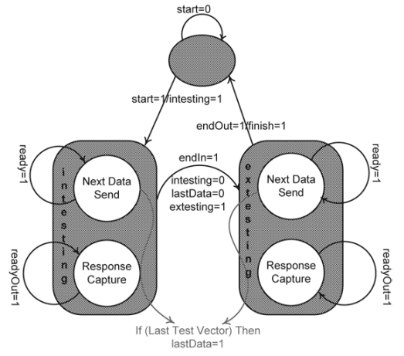
IO State Machine

Slide 63
BIST

Slide 65
D-Algorithm (Roth et al., 1967, D-alg II)
Use D-algebra
Activate fault
Place a D or D at fault site
Do justification, forward implication and consistency check for all signals
Repeatedly propagate D-chain toward POs through a gate
Do justification, forward implication and consistency check for all signals
Backtrack if
A conflict occurs, or
D-frontier becomes a null set
Stop when
D or D at a PO, i.e., test found, or
If search exhausted without a test, then no test possible
Copyright 2001, Agrawal & Bushnell
62

Slide 66
Sequential ATPG
Almost all practical digital systems are sequential circuits.
Their testing is more complex than that of combinational circuits, due to two reasons:
Internal memory states.
State not known at the beginning of test.
The test must initialize the circuit to a known state.
Long test sequences

Slide 67
Test Sequences
A test for a fault in a sequential circuit essentially consists of three parts:
Initialization of the internal memory.
Combinational test to activate the fault and bring its effect to the boundary of the combinational logic.
IIf the fault is in the memory elements, observation of the faulty state in one of the primary outputs.
Thus, the test for a fault may be a sequence of several vectors that must be applied in the specified order.

