Slide 1
Logic Simulation
Segment Outcomes
  Students will be introduced to logic simulation concepts
  Students will understand the basic algorithms behind HDL simulators.
  Students will understand the difference between cycle based and event-based logic simulators.

Slide 2
Logic Simulation
Need a way to check that RTL (Register transfer level) Hardware description is doing what we expect it to do.
Simulate how logic designed will behave when given certain stimulus.
Simulation environment is usually controlled by a top level testbench that instantiates the design as a DUT.
Often with a waveform to view data flow into and through design.
Cycle-Based and Event-Based

Slide 3
Circuit Modeling
Electronic system level
  SW + HW
  Cycle accurate modeling
  C/C++, SystemVerilog, Python
Register-Transfer Level (RTL)
  Define bit and timing accurate architecture
  VHDL and Verilog. Python? C/C++?
Logic/cell/ gate
  Interconnected Boolean operation gates
  Work well for logic design, verification, testing.

Slide 4
Level of Circuit Modeling
Switch
  Interconnects of “Perfect” transistor switch
  Most simulation is at this level
Timing
  Use transistors with device models.
    i.e switch on/off time
  Post Place & Route verification
Circuit
  Lowest level, truest accuracy available in simulation
  Get timing by solving interdependent equations of branch/loop current and node voltage

Slide 5
Logic State for Simulation
Two state (0,1) for combinational and sequential circuits that are properly initialized.
  Note: this is the behavior in hardware… no “x” in HW.
Four states (0,1,X,Z) for uninitialized sequential circuits.
  Z for high impedance, used when you aren't driving the output of a signal, so that some other process can drive it.
  X(Unknown State) for cases when logic value cannot be calculated.
    Such as, uninitialized FF, memory, bus, etc.

Slide 6
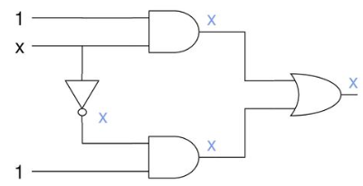
Logic propagation of X
What happens when we treat “x” as a signal
Problem?
  We start to lose information
  Output should be 1 but due to x’s we get x.
AND | 0 | 1 | X
0 | 0 | 0 | 0
1 | 0 | 1 | x
X | 0 | X | X
OR | 0 | 1 | X
0 | 0 | 1 | X
1 | 1 | 1 | 1
X | X | 1 | X

Slide 7
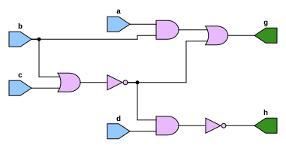

Slide 8
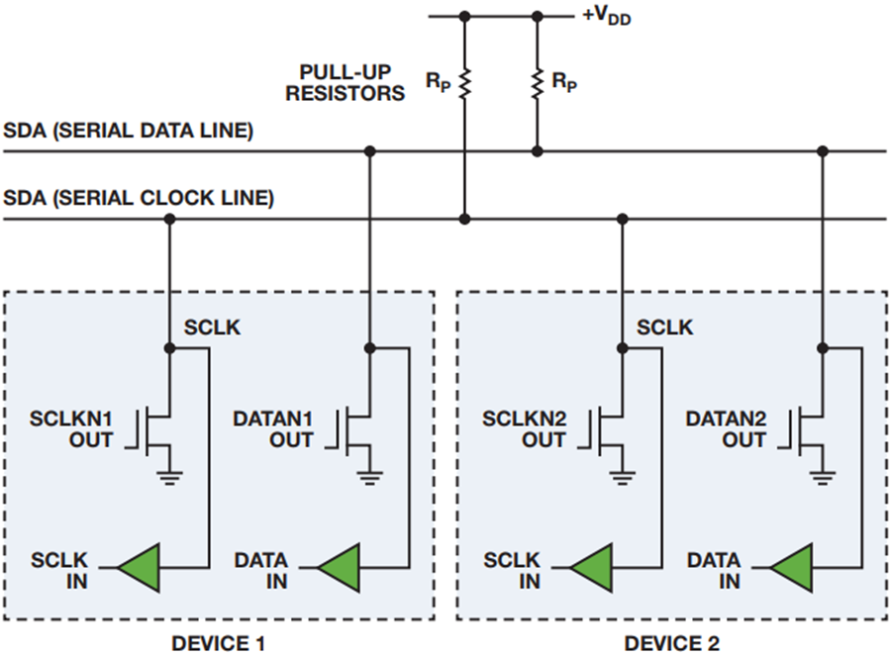
High Impedance
Floating state: node with no path to vdd or gnd.
Logic state of Z can be determined dynamically
  Single floating node
    Keeps value driven before becoming floating
  A set of floating node get connected
  A floating node connected to Vdd/Gnd becomes 1/0.
  Multiple sources driving a floating node, the value depends on strength of the driving logic.

Slide 9
Modeling Levels and Signals
Level | Circuit Description | Signal | Timing Resolution | Application
ESL | SystemC | 0,1 | Transaction | System
Behavior | HDL | 0,1 | Cycle | Architecture
Logic | Gate-level HDL | 0,1,X,Z | Zero, unit, multiple cell delays | Logic design and test
Switch | Transistor, RC interconnects | 0,1,X | Zero, possible gross-grain timing | Full-custom logic verification
Timing | SPICE | Analog | Fine-grain time | Timing verification
Circuit | SPICE | Analog | Continous time | Timing/analog verification

Slide 10
Simulators
Open Source
  Verilator – C/C++
  Icarus Verilog - Verilog
  GHDL – VHDL
Commercial
  QuestaSim
  Xcellium
*not a simulator, more a framework that works on most simulator

Slide 11
Simulation: Cycle based
Computes steady state response of a circuit at each clock cycle.
It does not simulate detailed circuit timing, but instead computes the steady state response of a circuit at each clock cycle.
User observes circuit signals once per clock cycle. Cycle based simulators work only with synchronous designs.

Slide 12
Simulation: Cycle based
Available simulators that are cycle based include:
  Verilator
  VCS
  NCSIM

Slide 13
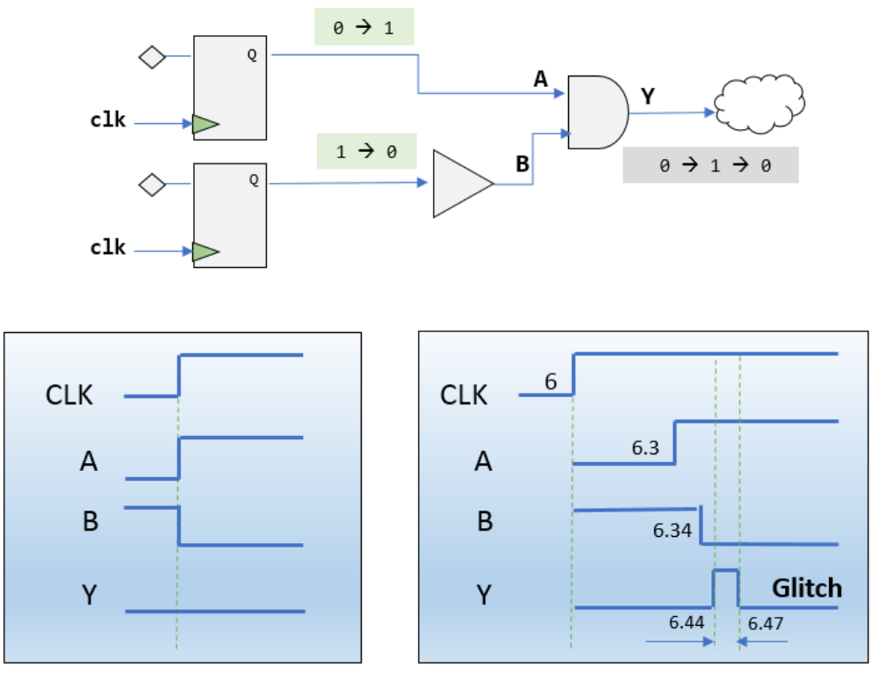
Simulation: Cycle based
Lack of detailed circuit timing means the user cannot see the glitch behavior of signals between clock cycles.
Notes:
https://i0.wp.com/semiengineering.com/wp-content/uploads/2019/07/Synopsys_which-glitch-is-which-fig1.png?ssl=1
<number>

Slide 14
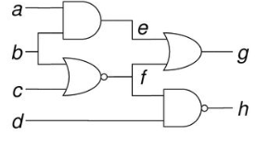
Cycle-based
Circuit is simulated by executing compiled code of the circuit.
Levelization
  To ensure that a signal is evaluated after all its sources are evaluated
Levelization Process
  Assign all Primary Inputs to 0
  Level of gate G is Lg = 1 + max(L1,L2,..)
    Where Li’s are G’s input gates
Level 0: a, b, c, d
Level 1: e, f
Level 2: g, h

Slide 15
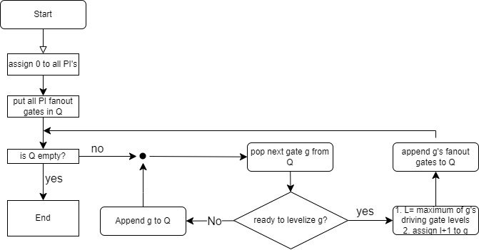
Levelization algorithm flow

Slide 16
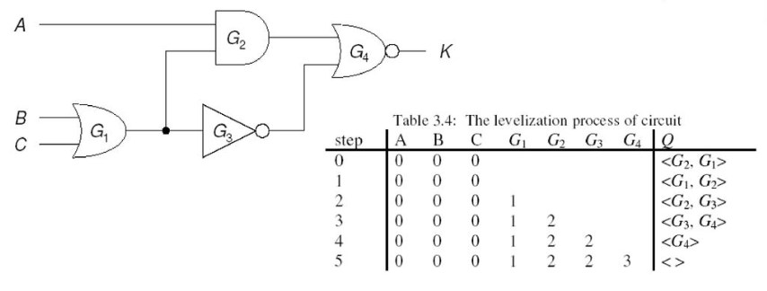
Example of Levelization
Order produced by flow

Slide 17
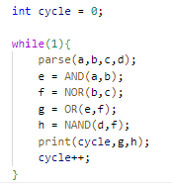
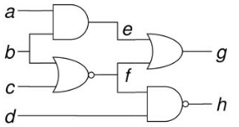
Cycle-based simulation
Effective for 2-state (0,1) simulation
  Very fast
  Can be compiled directly into machine language
Mostly useful for functional verification, when timing is not analyzed
  Will miss glitches.. i.e signals changing in between clock edges.

Slide 18
Verilator
  Verilator is a tool that compiles Verilog and SystemVerilog sources to highly optimized (and optionally multithreaded) cycle-accurate C++ or SystemC code.
  The converted modules can be instantiated and used in a C++ or a SystemC testbench, for verification and/or modelling purposes.

Slide 19
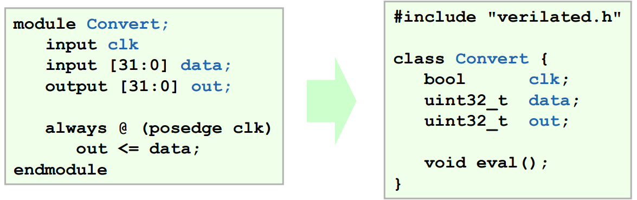
Verilator HDL to C Conversion
The top wrapper looks like the top Verilog module.
Inputs and outputs map directly to bool, uint32_t, uint64_t, or array of uint32_t’s:
Notes:
Verilator Internals, July 2005
<number>

Slide 20
Downsides of Cycle-based simulation
Zero-delay model
  Perfect switch assumption
  Timing problems. i.e glitches, race conditions are ignored
Simulation time
  Every circuit is evaluated at every cycle even though typically only 1-10% of signals change at any time.

Slide 21
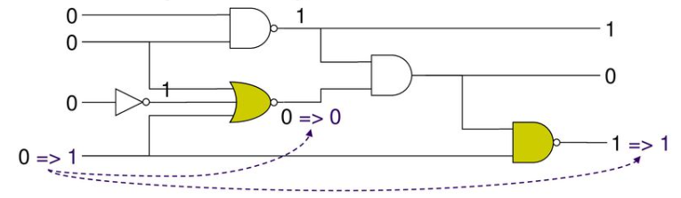
Event-Based simulation
Event is defined as a change in value of a signal, input or internal.
Event based simulator evaluates a gate (element) only if one or more events occur at its inputs
  Minimizes the amount of computation done
  Follows path of signal flow

Slide 22
Simulation: Event Based
Intermediary and output signals update whenever there’s a change in an input signal.
Allows for simulating designs with possible glitches.

Slide 23
Event-Based simulation
Allows for post-synthesis and timing-based simulation.
Event based simulation very slowed compared to Cycle based since it must simulate much more behavior.

Slide 24
Event-Based simulation
Available Simulators that are Event Based:
  Most commercial simulators are event based
  QuestaSim
  Vivado
  Xcelium
  Icarus Verilog. *Open source*

Slide 25
Basic Principles
Designed to eliminate unnecessary gate simulations without introducing an unacceptable amount of additional testing.
An event is defined to be a change in the value of a net.

Slide 26
Basic Principles: Event Based
Main function of an Event Driven simulator is to detect events, and schedule gate simulations in response to them
Two times when it is necessary to test nets for changes
    when a new input vector is read
    immediately after a gate is simulated.

Slide 27
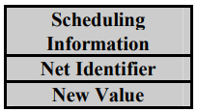
Event-Based Sim Basic Principles Ctd.
Two times when it is necessary to test nets for changes
    when a new input vector is read
    immediately after a gate is simulated.

Slide 28
Input Simulation
When an event is detected, an event structure must be created and stored for future processing.
Event Queue will be used to store any events that have been detected and not yet processed.
Notes:
Algorithm 3-1. Input Vector Processing.
<number>

Slide 29
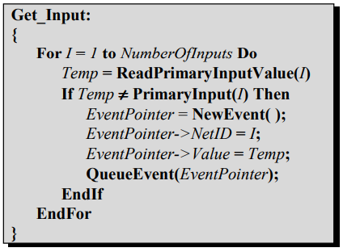
Input Processing Algo.

Slide 30
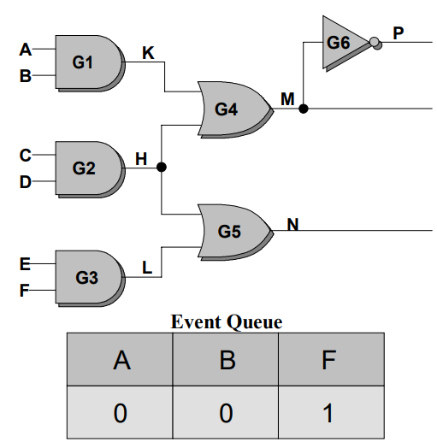
Input Vector Processing
Consider simulating with two consecutive input vectors
  (1,1,0,0,1,0)
  (0,0,0,0,1,1)
Vectors differ in three positions
Events must be created for Net A,B,F.

Slide 31
Event Processing
First part of event processing is to copy net values from the event structures into permanent storage.
second part is to schedule all gates in the fanout of a net for simulation.
  place the identification of the gate into another queue called the Gate Queue.

Slide 32
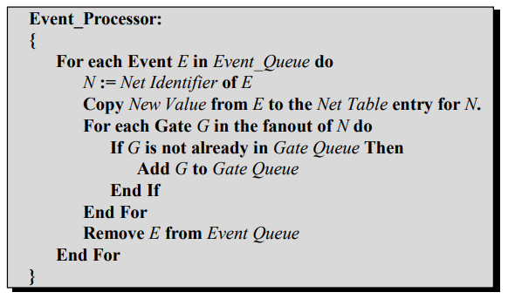
Event Processing Algo.

Slide 33
Gate Processing
After Event Processing, simulate each gate in gate queue
Also, necessary to test the output of each simulated gate for changes and schedule events.

Slide 34
Gate Processing
Gate simulation creates new events and places them in the Event Queue.
Simulation of an input vector consists of a single call to the Input Processing Routine, and several calls to the gate and event processors.

Slide 35
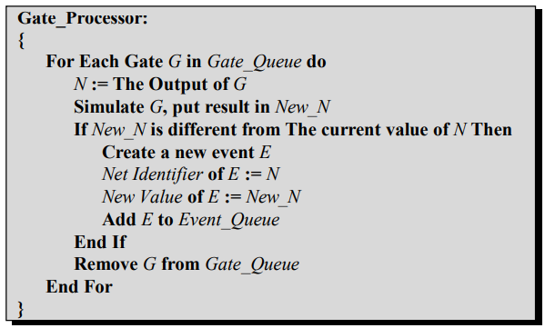
Gate Processing Algo.

Slide 36
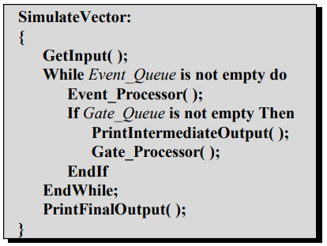
Simulate Vector Alg.

Slide 37
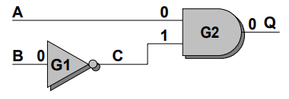
Timing Model
Event based simulation provides a unit-delay model (timescale).
  Unlike Cycle-Based simulation which provides zero-delay model (perfect switch).
Example
  Initial Values: A=0, B=0, Next Values: A=1, B=1
  Cycle-Based Simulation will leave Q at Zero
  What happens in Event-Based??

Slide 38
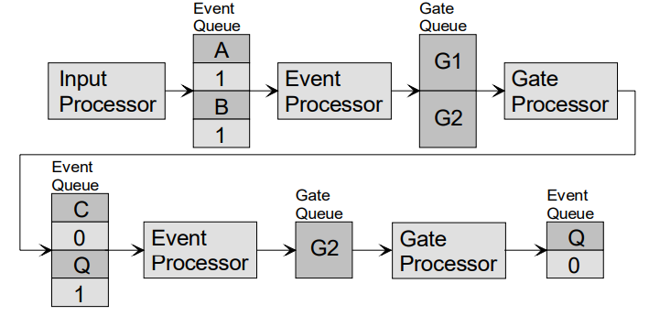
Event-Based Timing Simulation
  Input 0 of G2 will propagate first, Q = 1
  Input 1 of G2 will then become 0, Q = 0;

Slide 39
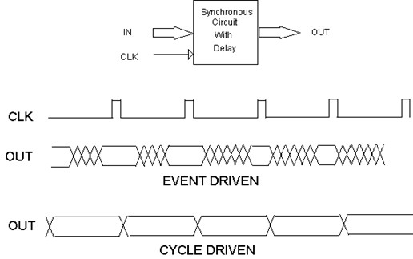
Big Picture: Cycle based vs Event Based

Slide 40
Lab 2
Use pyverilog to parse simple Verilog file
Create two simulators that can accept test vectors in csv format.
  Cycle-based
  Event-based
Should output a vector or value changes.

