Slide 1
Fault Modeling
Segment Outcomes
Students will o understand fault simulation and use this process for improving test and testability of their designs during the design phase.
Students will learn to use fault simulation for test data generation, test set evaluation, circuit testability evaluation, providing information for testers, finding faults in a circuit, diagnostics, and many other applications.

Slide 2
Fault Model
Representation of a defect and is used in computer programs for analyzing defects in electronic components.
The good circuit model (Golden Model), and the Faultable Model are instantiated and a setup for comparing and reporting their responses is proved

Slide 3
Multiple Faults
Any number of faults can happen in a circuit simultaneous in any combination.
Permutations quickly become intractable.

Slide 4
Multiple Faults
Multiple faults may distort the faulty effects of each other and prevent all such faults from being detected.
multiple faults can mask each other, and presence of a certain fault may never be known.

Slide 5
Fault Simulation Assumptions
Circuit netlist with provisions to become faulty
Good circuit netlist or behavioral description
A file containing test data
A file containing fault list

Slide 6
Fault Simulator Outputs
Report files
Flags and messages

Slide 7
Sequential Circuit Fault Simulation
Different from combinational fault simulation.
Internal states of the circuit and its clocking and resetting requirements.

Slide 8
Sequential Circuit Fault Simulation
Reset is required with every fault that is injected in the circuit.
Internal flip-flops of the circuit may be holding values from the last fault and last set of inputs.

Slide 9
Sequential Circuit Fault Simulation
Clocking the circuit after the application of a test vector.
Allows faults hidden in the internal states of the circuit to appear on the circuit primary outputs.
Example: fault the effect of which reaches circuit flip-flop input, but not any of the circuit’s primary outputs.
Upon clock input:
this fault gets another chance to come back into the logic of the circuit.
possibly appears on the circuit primary outputs.

Slide 10
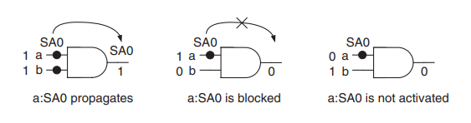
Fault Activation
Fault is activated if the line value reaching the fault is different from its faulty value.

Slide 11
Fault Activation
A “0” on a line with SA1 fault activates it

Slide 12
Fault Activation
A “1” on both inputs activates a SA0 fault.

Slide 13
Fault Coverage
Fault coverage (or test coverage) is the ratio of detected faults over total faults in a circuit.
Fault simulation is used as a stand-alone program to calculate fault coverage to measure how good the test set is.

Slide 14
Fault Coverage Procedure
Start with a given test set and a fault list
Assume a good circuit model and a faultable model are instantiated and being compared
Procedure consists of two nested loops

Slide 15
Fault Coverage Procedure
procedure consists of two nested loops
outer loop considers every fault in the fault list
inner loop applies tests in the test set to the faulty circuit until one detects the fault

Slide 16
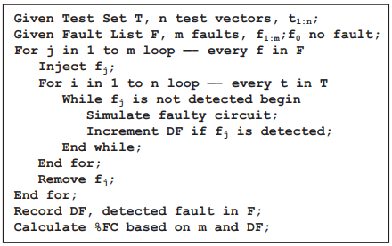
Fault Coverage Procedure

Slide 17
Sequential Circuit Fault Coverage
Different from combination fault coverage.
Application of reset after injection of each fault
application of clock after assigning a test vector to the circuit inputs.

Slide 18
Test Refinement
Test efficiency is the number of faults covered by a test vector.

Slide 19
Test Refinement
Fault simulation can be used to:
identify test vectors that are low in efficiency
Identify test vectors that detect faults already covered by other test vectors.

Slide 20
Test Refinement
Based on efficiency and coverage:
If it is found that there are tests that do not have a significant contribution to the overall fault coverage.
Have no contribution at all, they can be removed from the test set.

Slide 21
Test Refinement
Test set can be refined for the fewest number of tests and the highest coverage.

Slide 22
Random Test Generation
Random test generation can be regarded as a complement or a replacement for costly automatic test pattern generation algorithms.
Randomly generated input vector is examined for detection of faults
Keep or discard test vector based on whether fault is detected.

Slide 23
Fault simulation for random tests
Test t is randomly selected and its efficiency in detecting undetected faults is measured by a fault simulation loop.

Slide 24
Fault simulation for random tests
Remaining undetected faults are injected into the circuit-under-test, and a counter is incremented if the random test vector, t, detects the injected fault f.

Slide 25
Fault simulation for random tests
At the end, the value of this counter is used in deciding on keeping or discarding the test

Slide 26
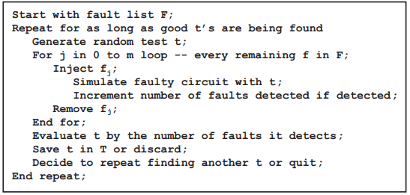
Fault simulation for random tests

Slide 27
Fault-oriented Test Generation
Fault-oriented test generation is a process that a certain circuit fault is selected, and a test is generated for it.
test generation scheme is a complex process and requires many iterations though the circuit for producing a test vector that detects the targeted fault.

Slide 28
Fault-oriented Test Generation
Once the test is found, identify other faults that are detected by the same test vector.
eliminates the need for repeating the test generation process for faults that are already detected.

Slide 29
Fault-oriented Test Generation
Identifying faults detected by a test vector, in addition to the fault that was targeted, is done by fault simulation.
fault-oriented test generation program usually includes fault simulation, as part of its process.

Slide 30
Fault-oriented Test Generation
When test t is generated, it is applied to the circuit input.
Faults that are not detected are injected in the circuit one at a time.

Slide 31
Fault-oriented Test Generation
Faults in a faulty circuit that produce a different output than the good circuit output are marked as detected.
Such faults are removed from the list of faults for which test needs to be made.

Slide 32
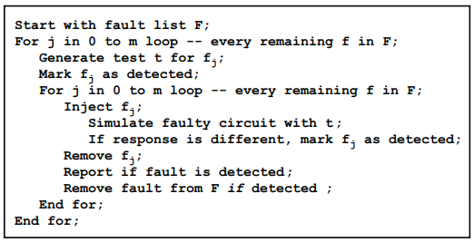
Fault-oriented Test Generation

Slide 33
Fault Dictionary
Fault dictionaries are data bases in which a correspondence is made between circuit faults and test vectors that detect them.
used in hardware testing for fault diagnosis.

Slide 34
Fault Dictionary
In its simplest form:
a fault dictionary for a combinational circuit is a two-dimensional table
its rows designating circuit faults and its columns representing test vectors.
READ CHAPTER 4.2.3.1

Slide 35
Fault Simulation Techniques
Segment Outcomes
Students will learn several fault simulation techniques for performance improvements.
Students will learn techniques to obtain better performances by parallel propagation of test vectors, propagating faults instead of tests, simulating only parts of the circuit, taking advantage of behavioral codes, and other optimization techniques.

Slide 36
Serial Fault Simulation
Simplest fault simulation method
Faulty model simulated for all test vectors and results are compared for the detection of the injected fault.

Slide 37
Serial Fault Simulation
In serial fault simulation
a fault is injected
test vectors are applied
when the fault is detected, or tests are exhausted
a new fault is injected.

Slide 38
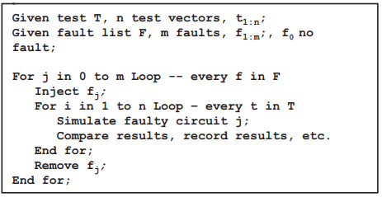
Serial Fault Simulation
With this new fault, the circuit is reset, and the new faulty circuit is simulated, and the same procedure is repeated.

Slide 39
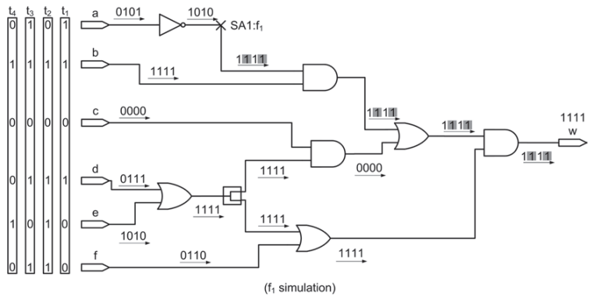
Serial simulation

