Slide 1
DFT & SCAN
Segment Outcomes
Students will be introduced to design techniques that make the task of testing feasible.
Students will be discussing about the most common DFT technique for logic test, called Scan.

Slide 2
Scan
Internal modification of the design’s circuitry to increase its test-ability.
Makes the process of pattern generation easier for detection of the faults we discussed earlier.
Difficult to control the flop’s value through primary inputs and observe the captured response in primary outputs.

Slide 3
Scan Insertion
Goal of ‘Scan Insertion’ is to make a difficult-to-test sequential circuit behave (during testing process) like an easier-to-test combinational circuit.
Achieving this goal involves two steps
Converting Regular Flop to Scan Flop
Stitching the Scan Flops to form Scan Chains

Slide 4
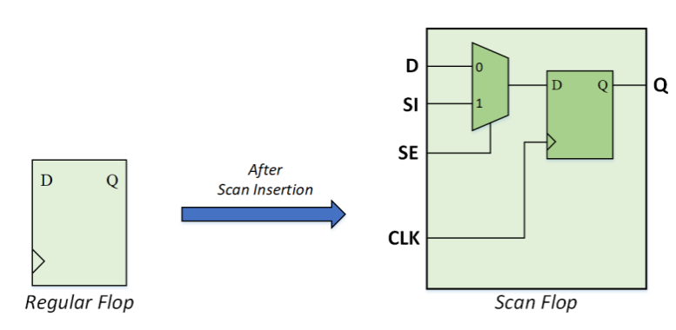
Scan Conversion
All the flops in the design are converted into scan flops, except –
The ones that are excluded by user. These are called non-scan flops.
The ones that have DFT DRC violation(s).

Slide 5
Scan Flops Stitching
Scan flops are stitched to form scan chain(s).
The number of scan chains depends upon various user inputs:
Length of scan chain
Clock domain mixing
Power domain mixing
Voltage domain mixing

Slide 6
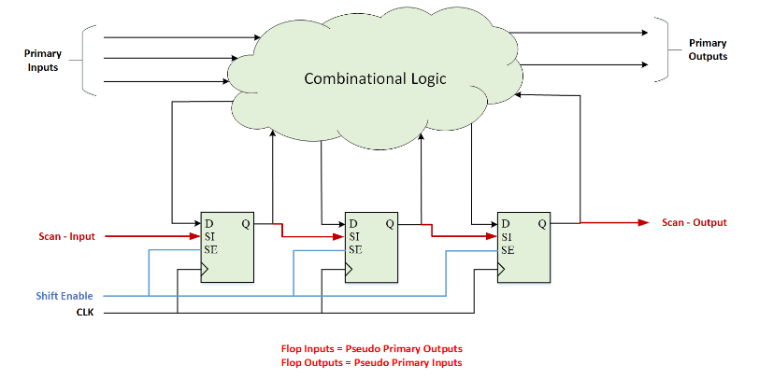
Scan Flops Stitching

Slide 7
Initialization
To set any flop value to x… 1/0.
Set the SE = 1, such that SI to Q path is activated.
Shift in the required values serially through a top level primary input called Scan-Input.
Can use same clock as design or a special “SCAN CLK”

Slide 8
Capture
Capture the values from combinational circuit by making SE = 0
Observe the captured response we make the SE = 1
Serially shift out the captured data through a primary output called Scan-Output

Slide 9
PCB Testing
Needs:
locate critical errors that maintain unit function and quality
Confirm electrical Functionality
Conditioning? Low endurance parts?
Test components individually.
Bed-of-Nails.
in-circuit testing by bed-of-nails probing technique for isolating components is no longer an easy solution.

Slide 10
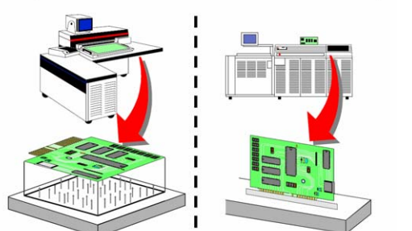
Bed-of-Nails

Slide 11
Bed-of-Nails
Design is placed directly on a test platform with many pins.
Pins make electrical connections with the inputs/outputs of the design.
The Good?
Individual pins of design can be tested meaning individual components can be tested
Faults of the test are located directly on the specific components
device pins, network points
fault location is accurate
can greatly improve production efficiency and reduce maintenance costs.
The Bad?
Does not scale well….
Time consuming

Slide 12
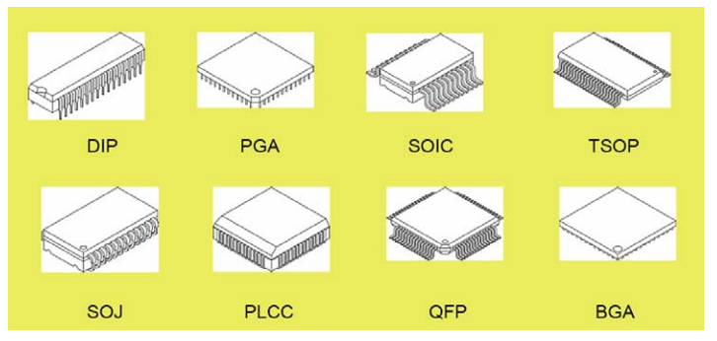
PCB Packaging

Slide 13
Modern IC testing?
Continuous miniaturization of IC’s
In-circuit testing by bed-of-nails probing technique for isolating components is no longer an easy solution
Testing complex components and multicore chips is not possible by off-chip test methods
Need to access various components and/or cores.
Need to be able to isolate them from each other
without a significant increase in the cost of test
JTAG

Slide 14
JTAG
Joint test action group (1985)....
Group of designers, manufactures, and test engineers established a set of specifications for testing board by shifting in serial test data.
IEEE std.1149.1
Also known as boundary scan.
Boundary scan standard eliminates the need for probing a component’s pins with a physical probe.
Improves controllability and observability within a PCB or a chip

Slide 15
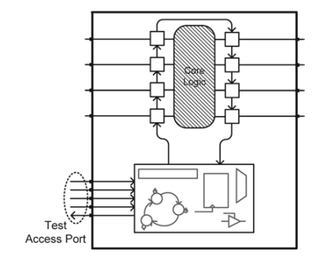
JTAG
Uses a chain of scan flip-flops to shift test data into the inputs of a core logic being tested
Uses the same mechanism to move test response out

Slide 16
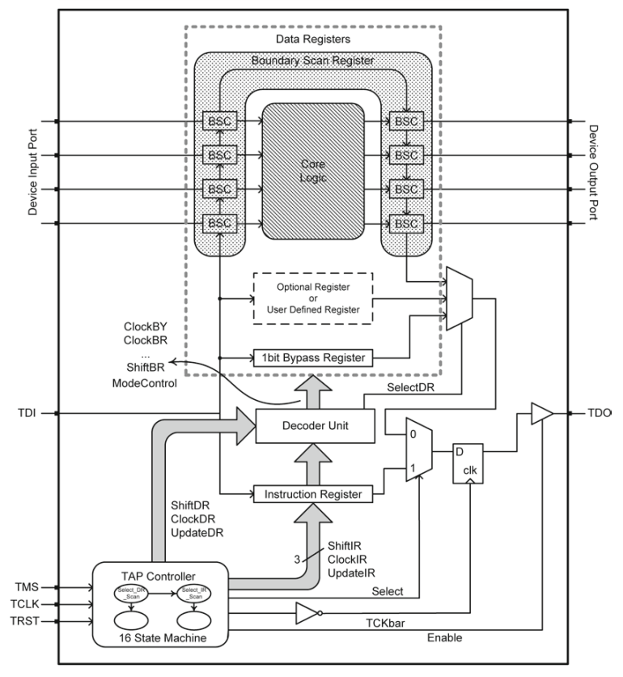
Boundary Scan Architecture
Test Access Port (TAP):
Controllers
Registers
Decoders

Slide 17
Instruction Register
instructions define the operation of the standard in test mode.
An instruction register of at least 2 bits holds the instructions
mandatory part of this standard
instructions are shifted in serially
Two main States
Shift/Capture
Update

Slide 18
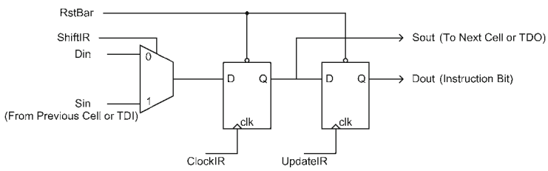
Instruction Register
Shift flip-flop takes serial instruction bits from its Sin, Parallel inputs from DIN.

Slide 19
Instruction Register
When ShiftIR is 1, serial instruction bits from the previous cell’s Sout or TDI are shifted into this flip-flop.

Slide 20
Instruction Register
After completion of capture, rising edge of UpdateIR causes data available on the outputs of the first flip-flops to be loaded into the instruction register

Slide 21
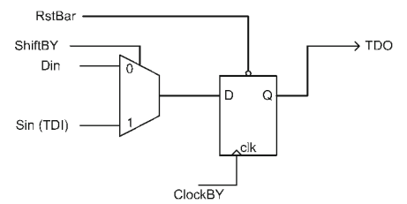
Data Registers
Instruction loaded in the instruction register causes one of the data registers to go between TDI and TDO serial input and serial output.
Any register that can logically be placed in the TDI, TDO serial path is referred to as a data register.

Slide 22
Data Registers
Bypass register
Used to bypass a core from scan chain so that serially shifted data can reach the target core quicker
Device identification register
32-bit register, contains identification code for the core logic that it is a part of
Boundary scan register
Placed on the boundary of the core logic that is being tested.
The register cells go between external pins (interconnects) and ports of the core logic.
User-defined registers
Custom user-defined registers
Must logically be placed between TDI and TDO ports for shift path consistency

Slide 23
TAP Controller
All boundary scan operations are controlled by a simple controller that has sixteen states.
See Section 8.2.3
Controller uses TCLK for the clock, TMS for its input, and, if used, TRST for resetting it.
Two starting states, seven data register control states, and seven instruction register control states.

Slide 24
Decoder
Combinational circuit:
Takes the existing instruction in the instruction register and signals from the TAP controller as inputs
Issues signals to the appropriate data register.

Slide 25
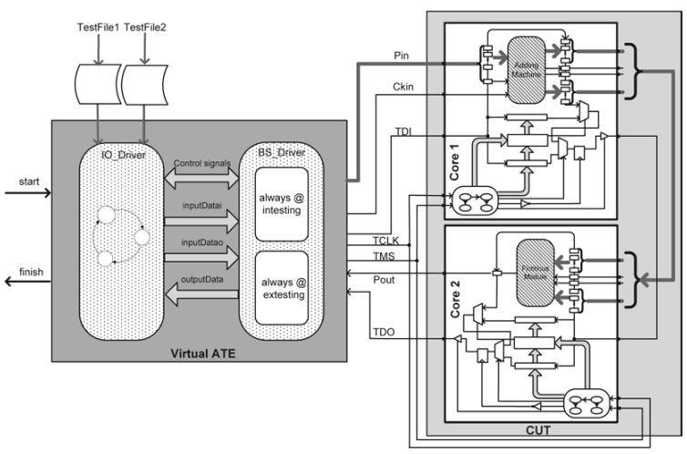
JTAG TEST SUITE

Slide 26
Testing Process
Step 1: Resetting.
TAP controller starts in Test_Logic_Reset state
TMS will be kept high for five consecutive clock pulses.
Step 2: First Data Set.
Before the actual Intest instruction is performed
scan chain must be initialized with the first test vector.
Step 3: Loading Intest and Bypass.
After first test vector is in the boundary scan register.
Intest and Bypass instructions loaded in cores 1 and 2, for performing Intest on core 1 for the rest of input test vectors.
TMS, core 1 is put into Shift_IR state.

Slide 27
Testing Process
Step 4: Let Core Respond to Test.
Now that test data are available at the ports of core 1.
Let core to react to the test data and generate its corresponding response.
Run_Test_Idle State
Step 5: Capture Response.
After the DUT has been given enough time to prepare its test response.
go from Run_Test_Idle state to Capture_DR and then Issue Ready.
Step 6: Next Data Shift-In and Previous Response Shift-Out.
shift out the captured response

Slide 28
Testing Process
Step 7: Response Ready & Check for Last Test.
go to Update_DR state
issues lastData if data that were shifted in were the last test data.
Step 8: Let Core Respond to Last Test.
This step is similar to Step 4, and after it is completed, it goes to Step 9
Step 9: Last Response Shift-Out.
Shift out response.
Step 10: Last Response and Reset.
go to the Test_Logic_ Reset state
announce completion of Intest.

Slide 29
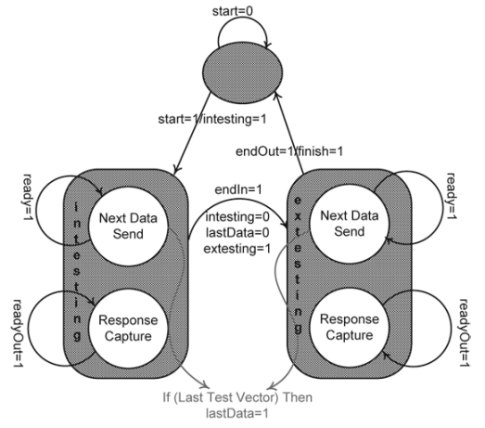
IO State Machine

Slide 30
BIST

Slide 32
D-Algorithm (Roth et al., 1967, D-alg II)
Use D-algebra
Activate fault
Place a D or D at fault site
Do justification, forward implication and consistency check for all signals
Repeatedly propagate D-chain toward POs through a gate
Do justification, forward implication and consistency check for all signals
Backtrack if
A conflict occurs, or
D-frontier becomes a null set
Stop when
D or D at a PO, i.e., test found, or
If search exhausted without a test, then no test possible
Copyright 2001, Agrawal & Bushnell
29

Slide 33
Sequential ATPG
Almost all practical digital systems are sequential circuits.
Their testing is more complex than that of combinational circuits, due to two reasons:
Internal memory states.
State not known at the beginning of test.
The test must initialize the circuit to a known state.
Long test sequences

Slide 34
Test Sequences
A test for a fault in a sequential circuit essentially consists of three parts:
Initialization of the internal memory.
Combinational test to activate the fault and bring its effect to the boundary of the combinational logic.
IIf the fault is in the memory elements, observation of the faulty state in one of the primary outputs.
Thus, the test for a fault may be a sequence of several vectors that must be applied in the specified order.

