Slide 1
EEGR 471
Section 1: Simulation

Slide 2
Section Outline
Introduction
Logic Specifications
Test plans
Simulation
  Cycle vs Event based
Testbench
  Directed vs Layered
Methodology
Formal Verification

Slide 3
Section Outcome
Introduce concepts and tools necessary for proper verification
Layout process of performing effective functional verification
Present techniques for applying effective stimulus and monitors design responses as a result.
Explain benefits of bus functional models and how to implement them.

Slide 4
Prior Knowledge
This section is focused on verification of described/simulatable hardware design…. So VHDL or Verilog
  Students are expected to have basic knowledge of one of these description languages.
We will be reviewing and verifying digital designs, so basic knowledge of logic design.
We will be going over SystemVerilog which in simulation is mostly class based.
  So… some understanding of Object-Oriented Programming is expected.

Slide 5
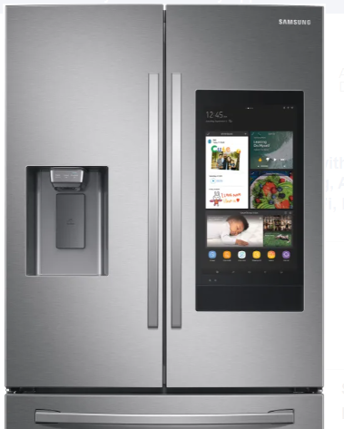
BACKGROUND
ICs are an integral part of daily life in 2023.
Included in everything:
  Phones
  TV’s
  Laptops
  Watches
  Earphones
  and yes, even Fridges.

Slide 6
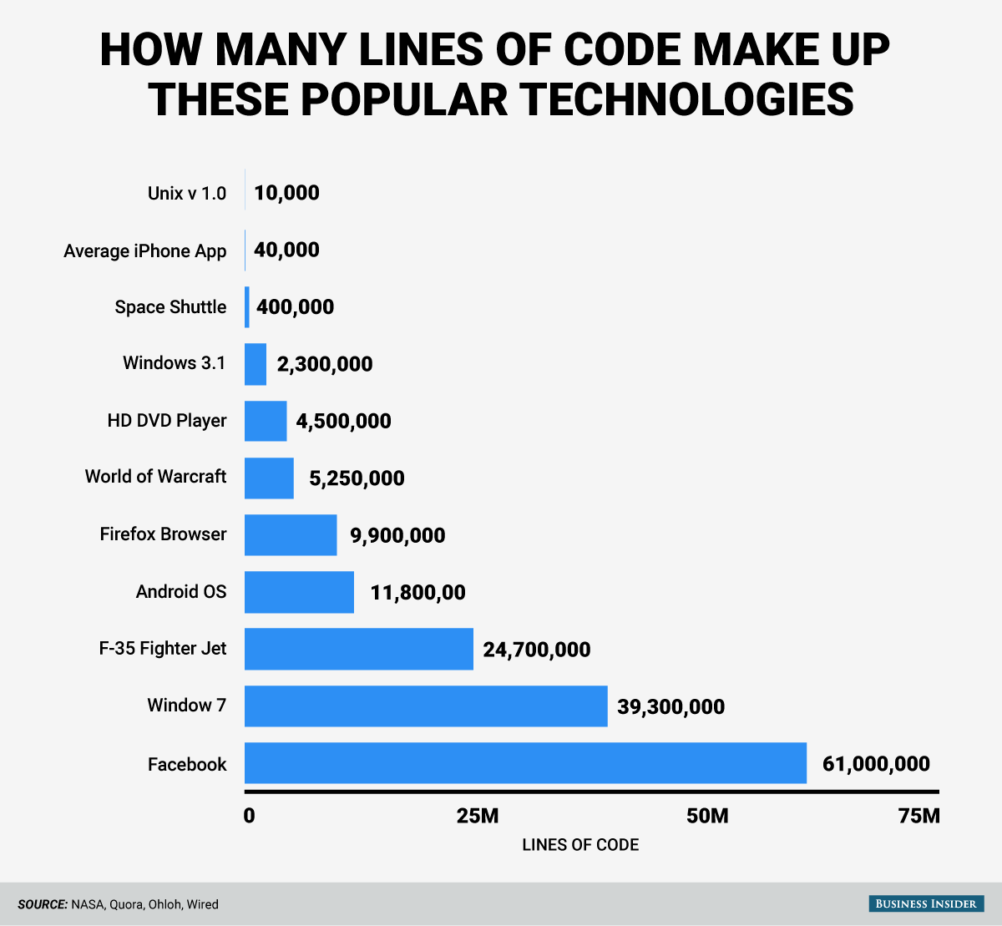
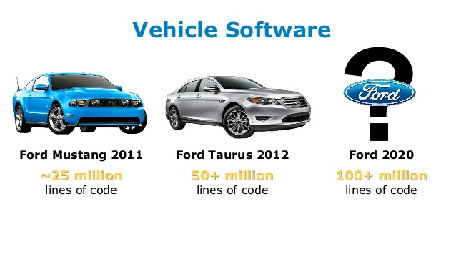
HW/SW Systems
Complexity in Lines of Code
Notes:
Adapted from : https://ati.ttu.ee/~jaan/verification/1_introduction%20english.ppt

Slide 7
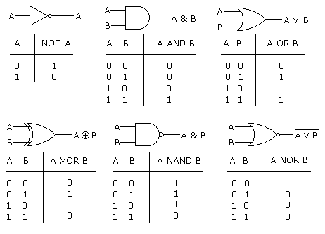
Building blocks: Logic Gates
At the heart of IC’s are logic gates.. Combined into complex systems

Slide 8
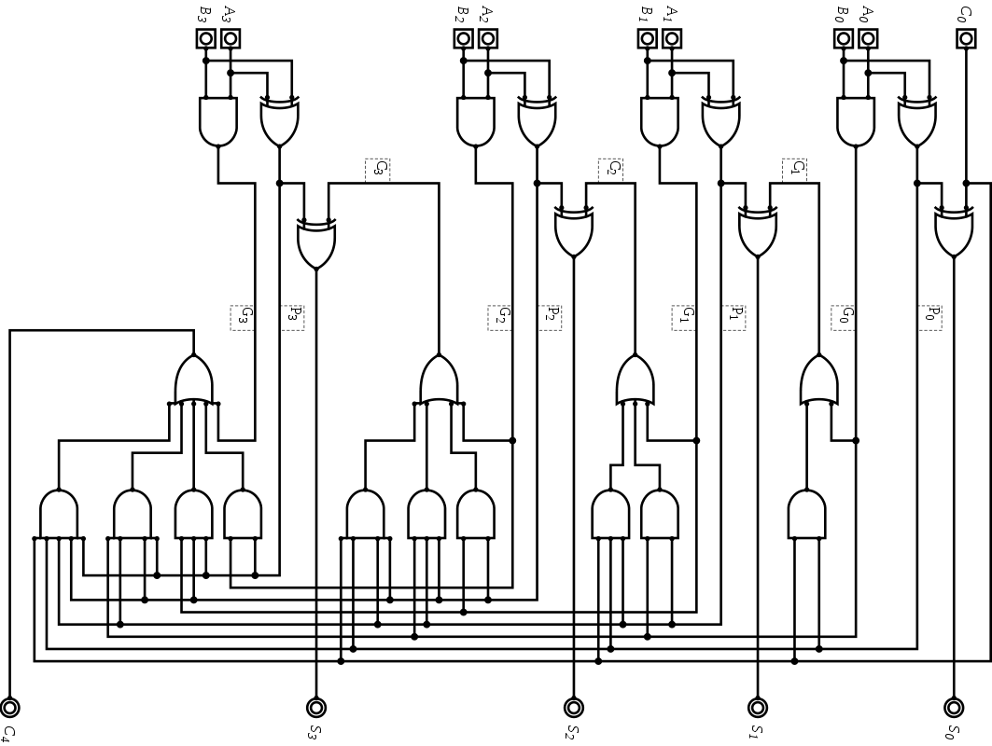
Sea of Gates

Slide 9
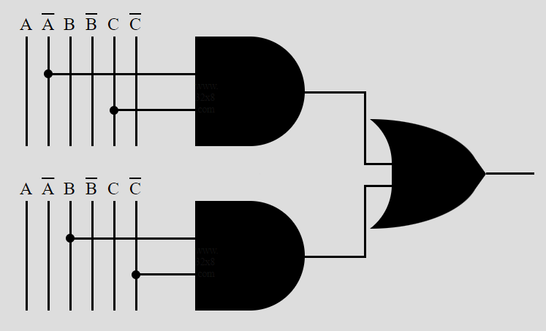
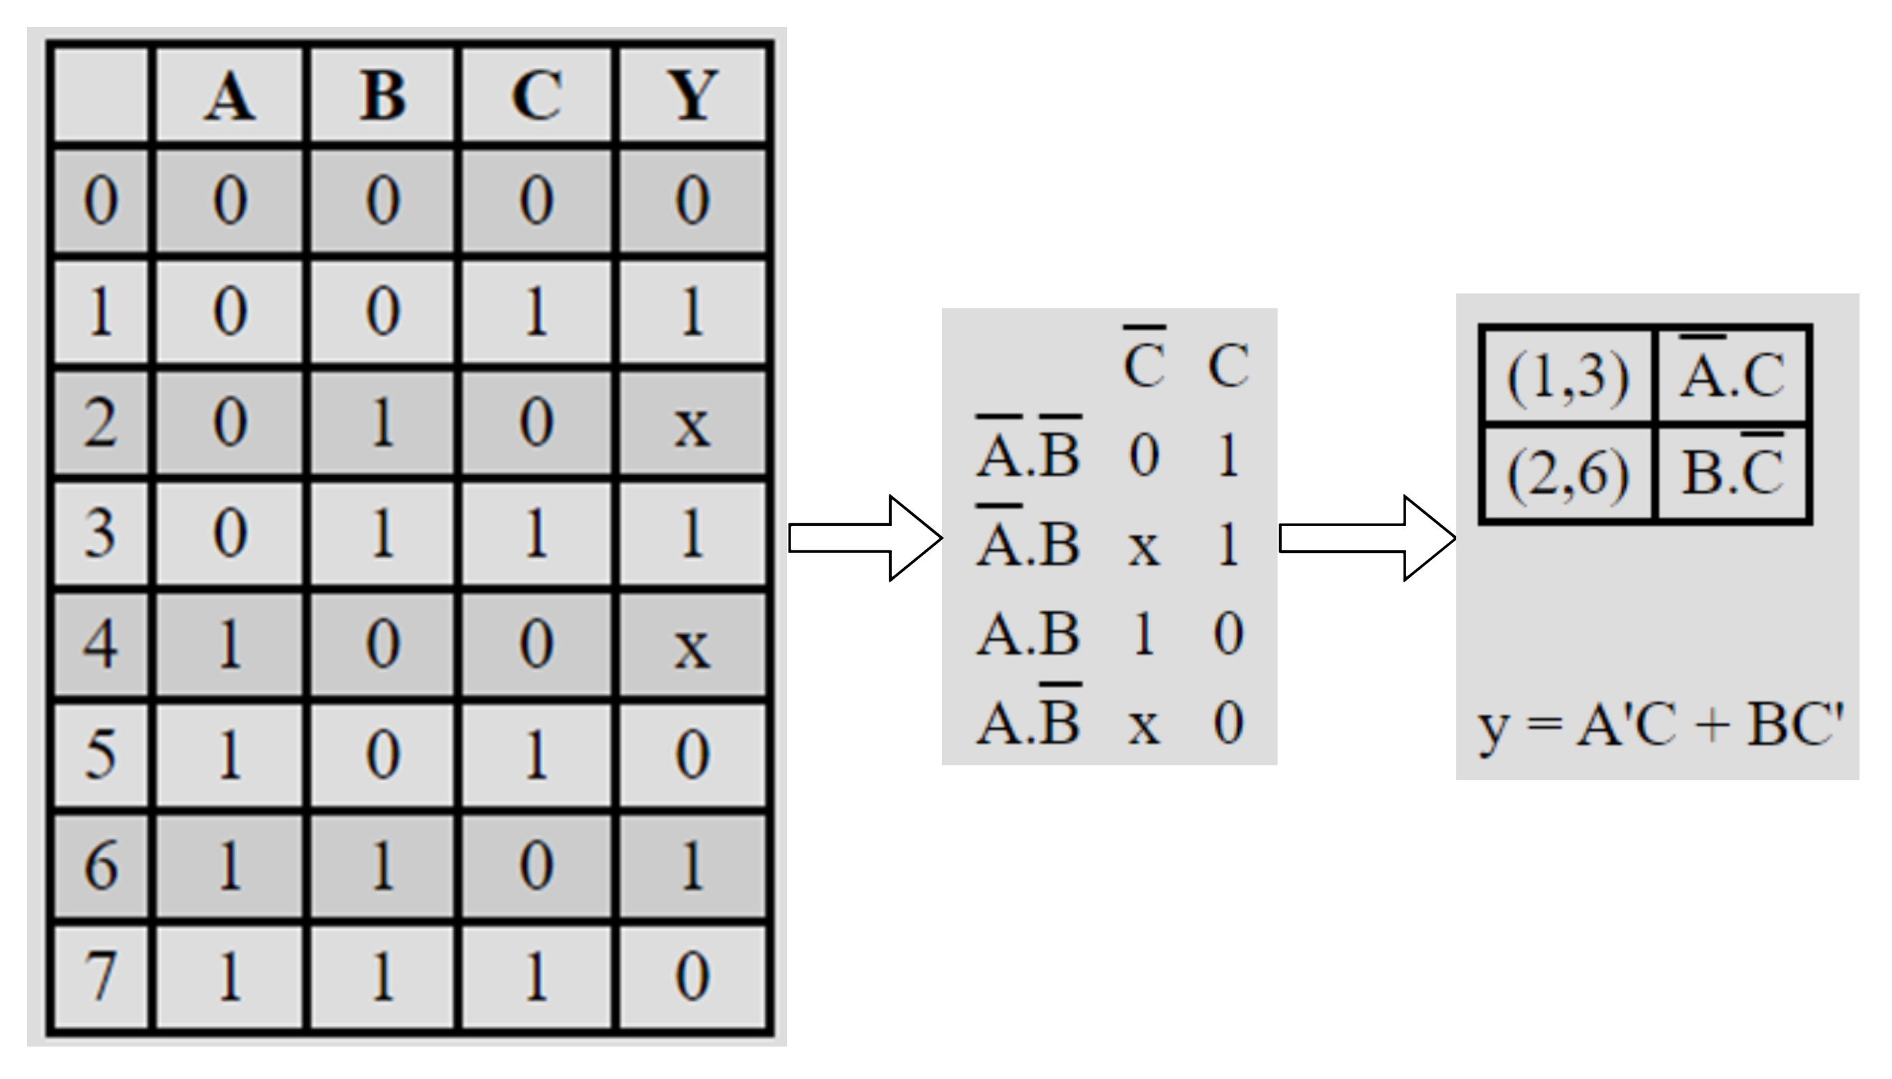
Logic Design: Early Days
Write out logic by hand
  Truth Tables, K-maps, State tables.

Slide 10
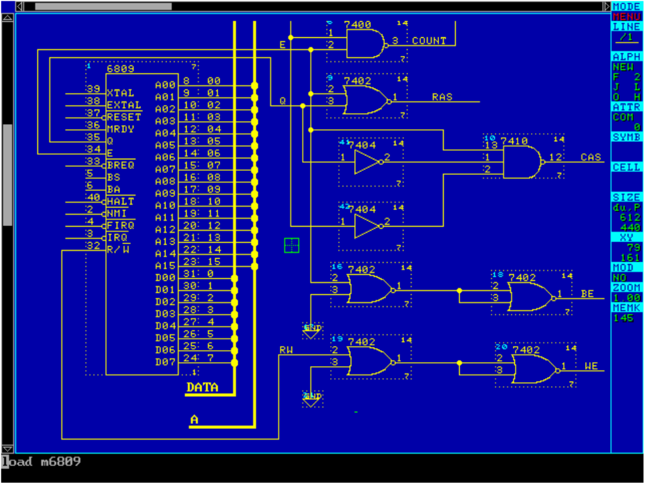
Logic Design: Middle Ages
Schematic Entry
  Draw design gate by gate.
  then map to available resources.
Notes:
Cs.cornell.edu/courses/cs3410/2019sp/riscv/interpreter/

Slide 11
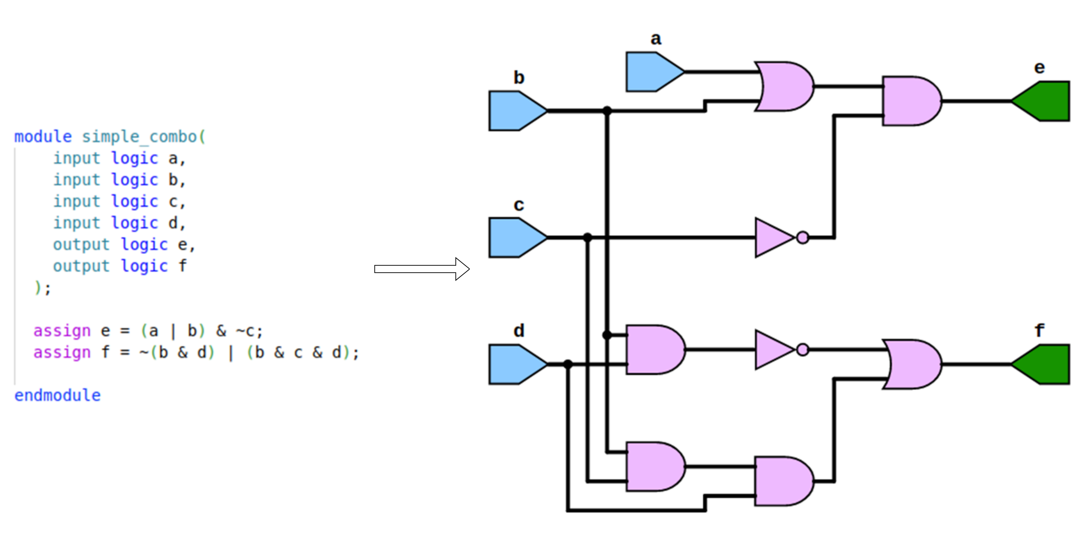
Logic Design: HDL and Synthesis

Slide 12
Design automation
System
design
Logic
design
Physical
design
productivity gap
  58% versus 21% annually
40
60
70
< 1979
Simulation
Schematic
entry
Placement &
routing
30
50
2
~ 1983
Tehnology’s
capabilities
Hierarchy,
generators
transistors
on the die
30
40
2
1986
Logic synthesis
30
2
1988-92
Designer’s productivity
High-level synthesis /
System-level synthesis
10
2
1992-95
time
Specialized
high-level synthesis
today
Person months /
20 000 logic gates
3
2
~1996-...
Notes:
Adapted from: https://ati.ttu.ee/~jaan/verification/1_introduction%20english.ppt

Slide 13
Digital IC FLOW
Specification
Requirements Negotiation | Verification
RTL Logic Design | Verification
Synthesis | Verification
Implementation & (Place & Route) | Verification
Bitstream or Layout (GDSII) | Validation | Emulation
Specification
Requirements Negotiation
RTL Logic Design
Synthesis
Bitstream or Layout (GDSII)
Specification Review
Test Plan
RTL Simulation
Formal Verification
Post- Synthesis Verification
Equivalence checking
Validation
Emulation
Implementation & (Place & Route)
Post-implementation Verification

Slide 14
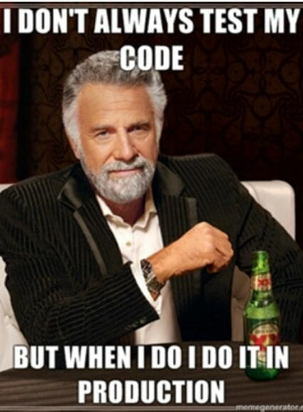
Verification Engineers
Some figures:
2-4 verification engineers per designer
Verification takes 70-85 % of total cost of chip design
Why has verification become that important?
Notes:
Adapted from https://ati.ttu.ee/~jaan/verification/1_introduction%20english.ppt

Slide 15
Why Verification matters
$250+ million investment just to get started.
Bugs found pre-fab cost project lines of Code; bugs found after tapeout cost millions.
Re-spin (design correction and re-fabrication) is long and costly
  Around $25 million per re-spin.
Best chance of minimizing bugs ???
  Proper Verification

Slide 16
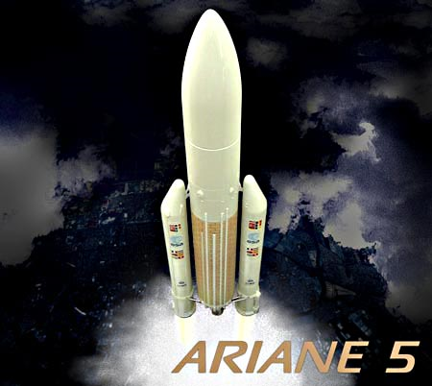
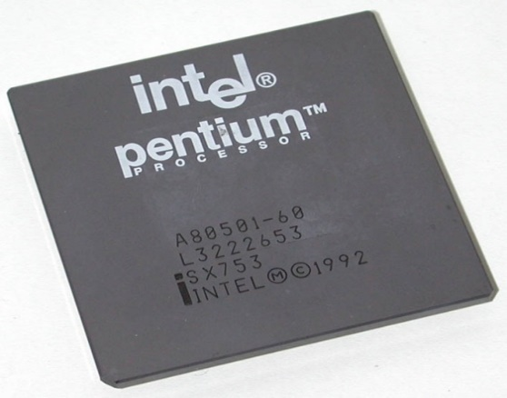
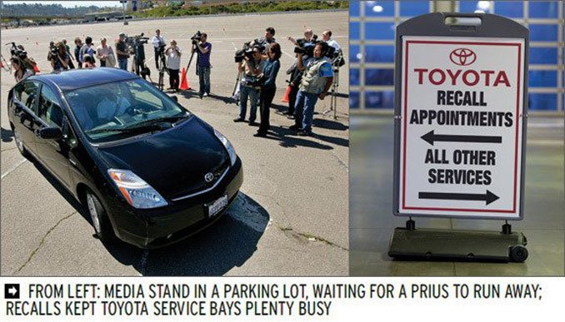
When things go wrong...
1985-1987 - Therac-25 medical accelerator. At least 5 patients die.
1993 - Intel Pentium floating point divide. Costs te company $475 million.
June 4, 1996 - Ariane 5 Flight 501. Rocket disintegrates 40 seconds after launch.
February 2010 - Toyota Prius failure. Toyota loses its market share.
Notes:
Adapted from: https://ati.ttu.ee/~jaan/verification/1_introduction%20english.ppt

Slide 17
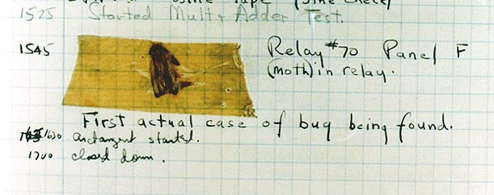
The first bug found
Harvard Mark II system, 1945
Notes:
Adapted from: https://ati.ttu.ee/~jaan/verification/1_introduction%20english.ppt

Slide 18
Types of verification
Mixed-signal
Digital
Analog, RF, etc.
Functional, timing, layout, electrical
Notes:
Adapted from: https://ati.ttu.ee/~jaan/verification/1_introduction%20english.ppt

Slide 19
Digital Logic verification
Functional
Formal
Post-Synthesis
NOTE: In this class, we are going to tie everything to a specification
Notes:
Adapted from: https://ati.ttu.ee/~jaan/verification/1_introduction%20english.ppt

Slide 20
Functional Verification
Process of demonstrating that a design works as specified.
  I.E design functions as it is expected to by whoever asked for it to be created.

Slide 21
Formal Verification
Process of converting the behavior described in the specification requirements into mathematical functions known as formal model.
Then checking that the design satisfies properties also derived from the specification.

Slide 22
Post-Synthesis Verification
Process of demonstrating that the design, once converted from HDL into low level gates and implemented in the physical world still behaves as described in the specification.

Slide 23
Verification flow

Slide 24
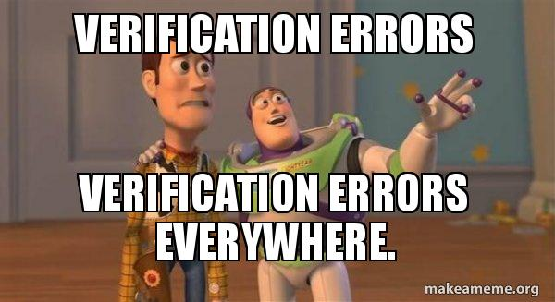

Slide 25
Lab 1
Get ubuntu VM running/ School server instance??
Installs
  vs code
    TerosHDL extension
  verilator
  Iverilog
  Yosys
  pyverilog

