Slide 1
Testbench Segment
Outcomes
  Students will learn the basic concepts of a testbench
  Students will learn how and utilize directed testbenches.
  Students will learn and utilize layered testbenches and how they compare to directed testbenches.

Slide 2
Testbench
An overall environment that instantiates or contains the design under test (DUT) with the abilities to apply inputs the design and monitor outputs.

Slide 3
Basic Testbench Functionality
The purpose of a testbench is to determine the correctness of the design under test (DUT).
This is accomplished by the following steps.
  Generate stimulus
  Apply stimulus to the DUT
  Capture the response
  Check for correctness
  Measure progress against the overall verification goals

Slide 4
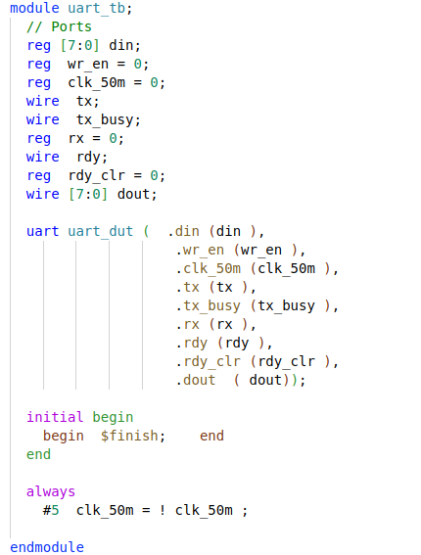
Testbench Basics
Template
  Dummy template that declares inputs to and outputs from Design under test (DUT).
  Then instantiates the DUT.

Slide 5
Testbench Components
If the real device connects to AMBA, USB, PCI, and SPI buses
  must build equivalent components in your testbench that can generate stimulus and check the response.
high-level transactors that obey the protocol, but execute more quickly
SystemVerilog for Verification

Slide 6
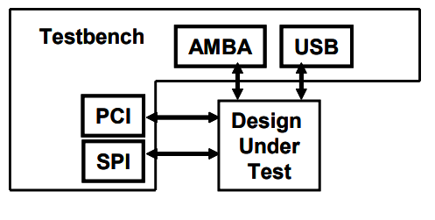
Testbench components
SystemVerilog for Verification

Slide 7
Directed Testing
Manually write stimulus vectors that exercise features in the DUT.
Simulate the DUT with these vectors
Manually review the resulting log files and waveforms to make sure the design does what you expect.
Once the test works correctly, you check off the test in the verification plan and move to the next
SystemVerilog for Verification

Slide 8
Directed Testing Pros?
Incremental approach makes steady progress
produces almost immediate results
  since little infrastructure is needed when you are guiding the creation of every stimulus vector.
Given enough time and staffing, directed testing is sufficient to verify many designs.
“I bought five watches the other day. I have a lot of time on my hands….”
SystemVerilog for Verification

Slide 9
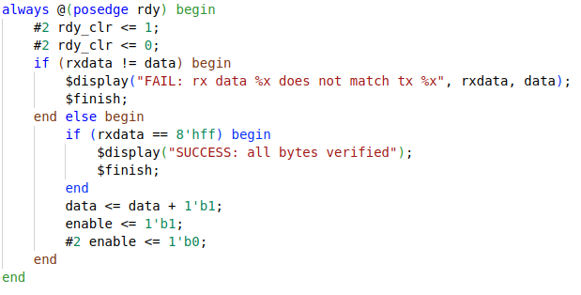
Directed TB: Uart

Slide 10
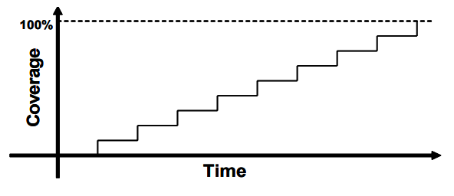
Directed test progress
SystemVerilog for Verification

Slide 11
Directed Testing Cons?
What if you do not have the time or resources to carry out the directed testing approach?
Might always make forward progress but… the slope remains the same.
Test time scales with design complexity
  When design becomes more complex, will take twice as long to verify
  Or twice as many people verifying… Project managers will love that ☺.
SystemVerilog for Verification

Slide 12
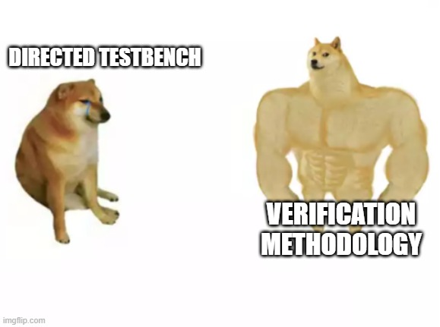
What then?
You need a methodology that finds bugs faster in order to reach the goal of 100% coverage.
You need Methodology
SystemVerilog for Verification

Slide 13
Methodology Basics
Constrained-random stimulus
Functional coverage
Layered testbench using transactors
Common testbench for all tests
Test-specific code kept separate from testbench
SystemVerilog for Verification

Slide 14
Methodology Basics
What goes into that testbench block?
It is made of many bus functional models (BFM), that you can think of as testbench components — to the DUT they look like real components, but are part of the testbench, not RTL.
SystemVerilog for Verification

Slide 15
Methodology: Testbench Components
Generate
  Creates stimulus likely to “stress” design
  Ideally trigger as many parts of the design as possible
Driver
  Drives the generated stimulus to the design
Monitor
  Monitor the design input-output ports to capture design activity
Scoreboard
  Checks output from the design with expected behavior

Slide 16
Layered Testbench
key concept for any modern verification methodology is the layered testbench.
may seem to make the testbench more complex but it helps to make your task easier
  dividing the code into smaller pieces that can be developed separately.
SystemVerilog for Verification

Slide 17
Layered Testbench
Don’t try to write a single routine that can randomly generate all types of stimulus
  both legal and illegal
  Inject errors with a multi-layer protocol.
routine quickly becomes complex and unmaintainable
SystemVerilog for Verification

Slide 18
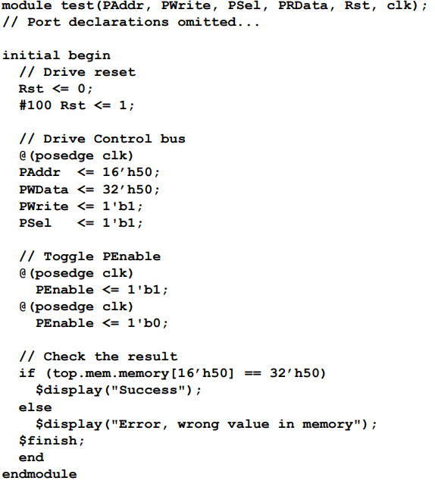
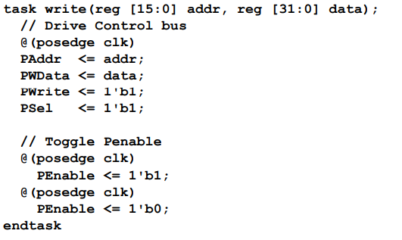
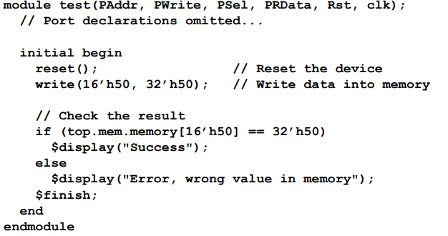
Flat v.s Layered
SystemVerilog for Verification

Slide 19
Frameworks Segment
Students will be introduced to Non-synthesizable SystemVerilog and its benefits.
Students will be introduced to cocotb and how it compares to SystemVerilog.

Slide 20
cocotb
Open source coroutine-based cosimulation testbench environment for verifying VHDL and SystemVerilog RTL using Python.
cocotb is all about verification productivity.
It allows developers to focus on the verification task itself, and stop fighting with language limitations.
Cocotb.org

Slide 21
Cocotb: Creating a Test
typical cocotb testbench requires no additional HDL code.
The DUT is instantiated as the toplevel in the simulator without any HDL wrapper code.
access all internals of your design, i.e signals, ports, parameters, etc. through an object that is passed to each test, usually called dut.
Things to note:
  Use the @cocotb.test() decorator to mark the test function to be run.
  Use .value = value to assign a value to a signal.
  Use .value to get a signal’s current value.
Cocotb.org

Slide 22
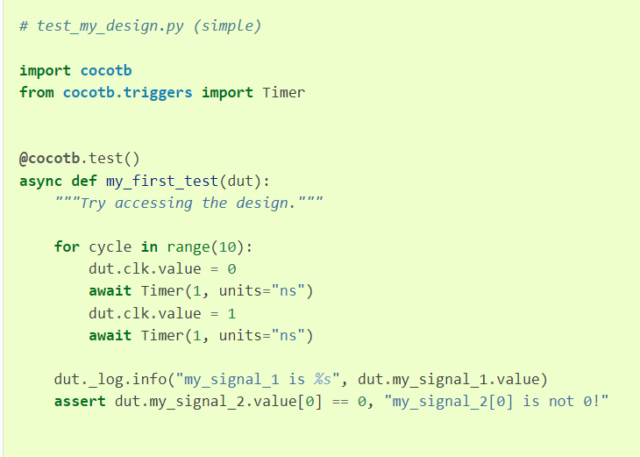
Cocotb: simple testbench
drive 10 periods of a square wave clock onto a port clk of the toplevel.
After,
  the clock stops
  the value of my_signal_1 is printed
  value of index 0 of my_signal_2 is checked to be 0.
Cocotb.org

Slide 23
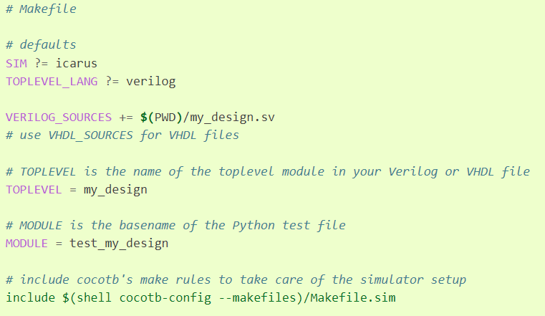
Cocotb: Makefile
In order to run a test, you need to create a Makefile that contains info about your project.
SIM
  default simulator
TOPLEVEL_LANG
  language of your top module
TOPLEVEL
  Name of Top module
MODULE
  basename of python test file
Cocotb.org

Slide 24
Non-synthesizable SystemVerilog
The vision of SystemVerilog was to first expand on the abstract capabilities of synthesizable code.
significantly add all the features known to be necessary for verification.
A strict superset of the previous Verilog standards.
SystemVerilog for Verification

Slide 25
Non-synthesizable SystemVerilog
The benefits of having a single language and a single coherent run-time environment cannot be expressed enough.
Including the design, testbench, and assertion constructs in a single language is that the testbench has easy access to all parts of the environment without requiring specialized APIs.
SystemVerilog for Verification

Slide 26
Data Types
Logic
  4 state single bit type
Fixed-Size Arrays
  i.e: my_array[5]
Queue
  i.e: my_queue[$]
  Provides sorting, size.
Typedef
  Create new types
SystemVerilog for Verification

Slide 27
Structs
Structs
  allows you more control in how data is laid out in memory by using packed structures.
  A packed structure is stored as a contiguous set of bits with no unused space.
  i.e:
    typedef struct packed logic[7:0] {r,g,b) pixel_t;
SystemVerilog for Verification

Slide 28
Enums
Enums
  strong variable type that is limited to a set of specified names
  instruction opcodes or state machine values.
    i.e:
      typedef enum {ERROR=0, FIRST=1, Second = 2} my_enum_e;
SystemVerilog for Verification

Slide 29

Data Types
Linked Lists
  Yes, they exist in SystemVerilog.
  NO, do not use them.
SystemVerilog for Verification

Slide 30
Tasks, Functions, and Void Functions
task can consume time while a function cannot.
A function cannot have a delay
  #100, a blocking statement such as @(posedge clock) or wait(ready), or call a task
SystemVerilog for Verification

Slide 31
Tasks, Functions, and Void Functions
Why functions????
  Can be synthesized “sometimes”
  Can call at the beginning/ or very end of a test.
SystemVerilog for Verification

Slide 32
Time-unit
use timeunit and timeprecision or ‘timescale to unambiguously specify a time value plus units
  i.e : 0.1ns or 20ps.
  timeunit 1ns; then #1 = wait 1 nano second
SystemVerilog for Verification

Slide 33
Constrained-Random Stimulus
Simulator generates the stimulus.
  But not totally random values.
Use the verification language to describe the format of the stimulus
  “address is 32-bits, opcode is X, Y, or Z, length < 32 bytes”
  Allow the simulator to pick values that meet the constraints.
SystemVerilog for Verification

Slide 34
Constrained-Random Stimulus - 2
Coverage may overlap other tests or may explore new areas that you did not anticipate.
If these new areas find a bug, you are in luck! If the new area is not legal, you need to write more constraints to keep away
SystemVerilog for Verification

Slide 35
What Should You Randomize?
First thing that you might think of is the data fields.
  Easy peazy: just call $random, or c/python alternative
Problem?
  gives a very low payback in terms of bugs found.
  primary types of bugs found with random data are data path errors
    perhaps with bit-level mistakes.
  Need to find bugs in the control logic.
SystemVerilog for Verification

Slide 36
What Should You Randomize?
Need to think broadly about all design input, such as:
  Device configuration
  Environment configuration
  Input data
  Protocol exceptions
  Delays
  Errors and violations
SystemVerilog for Verification

Slide 37
Device and Environment configuration
Should randomize the entire environment configuration
  including the length of the simulation
  number of devices, and how they are configured.
need to create constraints to make sure the configuration is legal.
Consider other environment parameters include test length, error injection rates, delay modes, etc.
SystemVerilog for Verification

Slide 38
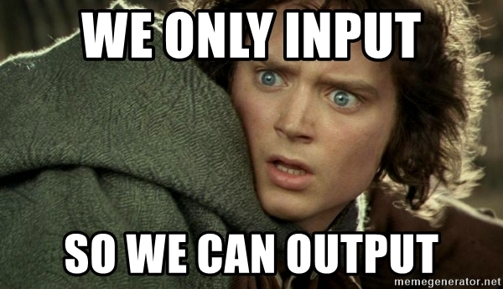
Input Data
Think of implementing a transaction such as a bus write and filling the data fields with random values
  Should be easy if you have carefully prepared your transaction classes.
need to anticipate any layered protocols and error injection, plus scoreboarding and functional coverage.
SystemVerilog for Verification

Slide 39
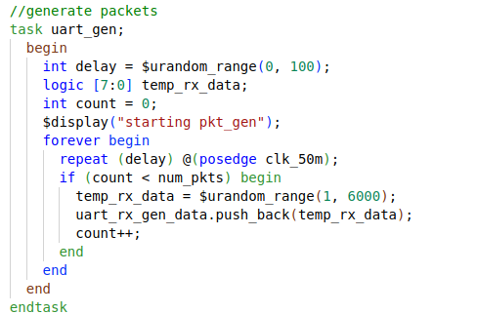
Generate: Uart

Slide 40

Protocol exceptions
If something can go wrong in the real hardware, you should try to simulate it.
Look at all the errors that can occur.
  What happens if a bus transaction does not complete?
  Invalid operation is encountered?
  Does the design specification state that two signals are mutually exclusive?
    Drive them both and make sure the device continues to operate.
Be provocative!
SystemVerilog for Verification

Slide 41
Delays and synchronization
How fast should your testbench send in stimulus?
Use constrained random delays to help catch protocol bugs.
test that uses the shortest delays won’t create all possible stimulus.
subtle bugs are often revealed when intermittent delays are introduced.
SystemVerilog for Verification

Slide 42
Delays and Synchronization
When possible, coordinate various drivers so they can communicate at different relative timing.
What if the inputs arrive at the fastest possible rate, but the output is being throttled back to a slower rate?
What if stimulus arrives at multiple inputs concurrently?
What if it is staggered with different delays?

Slide 43
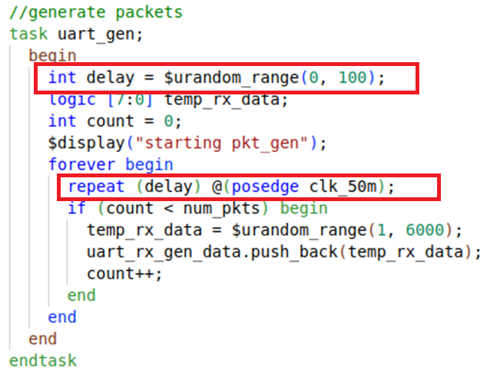
Gen Delays

Slide 44
Parallel random testing
How should you run the tests?
random test consists of the testbench code plus a random seed.
If you run the same test 50 times, each with a unique seed, you will get 50 different sets of stimuli.
SystemVerilog for Verification

Slide 45
Parallel random testing
Running with multiple seeds broadens the coverage of your test and leverages your work.
Need to choose unique seed
  Time of day? What if you have multiple servers kicking off jobs that start at the same time?
  Modern simulators have pretty good seed generation
SystemVerilog for Verification

Slide 46
Signal and command layers
Signal layer that contains the design under test and the signals that connect it to the testbench
Driver: drives DUT’s inputs with single commands such as bus read or write.
Monitor: driven by the DUT’s output, takes signal transitions and groups them together into commands.
SystemVerilog for Verification

Slide 47
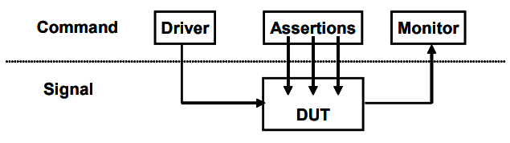
Signal and command layers
SystemVerilog for Verification

Slide 48
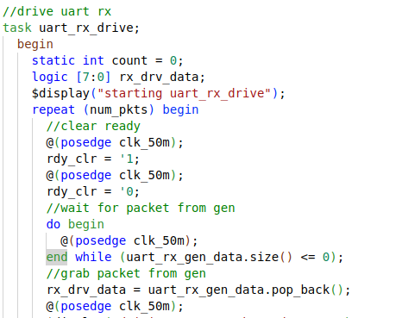
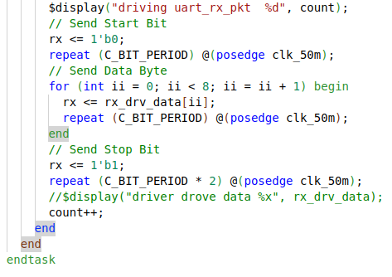
Driver: UART

Slide 49
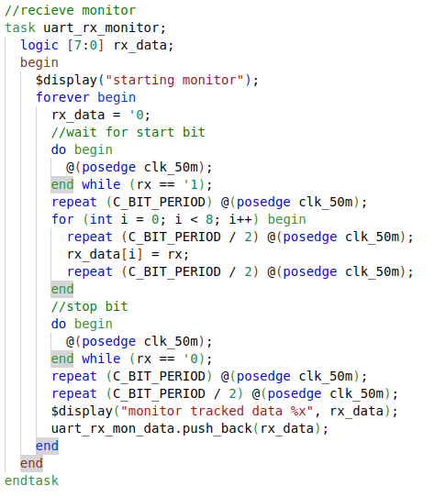
Monitor: UART

Slide 50
The functional layer
Functional layer feeds the command layer
Agent: receives higher-level and breaks them into individual commands.
Scoreboard: receives commands from agent and predicts the results of the transaction.
Checker: compares commands from monitor with those in the scoreboard.
SystemVerilog for Verification

Slide 51
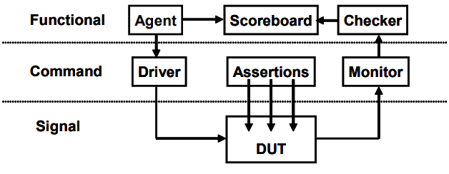
The functional layer
SystemVerilog for Verification

Slide 52
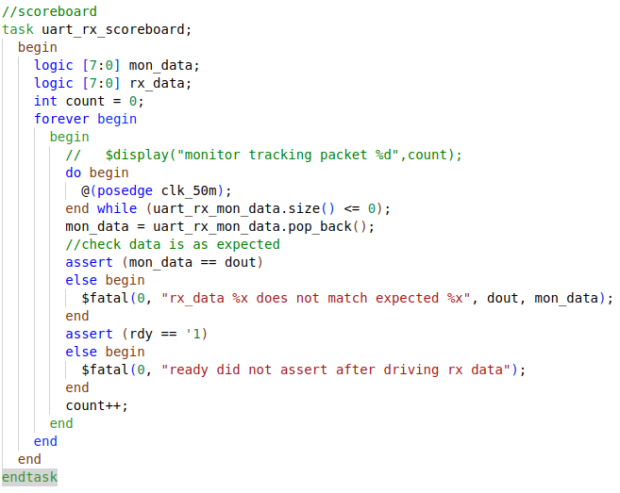
Scoreboard

Slide 53
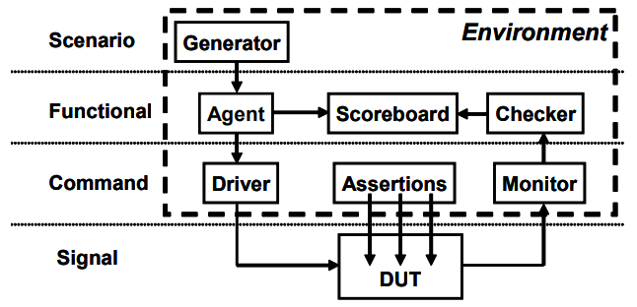
Scenario Layer
Generator in the scenario layer drives the functional layer
orchestrates all these steps with constrained-random values for parameters such as track size and memory location.
Example: MP3 player that can do many thing concurrently
  plays music from storage
  downloads new music from a host
  respond to input from the user
    such as volume and track controls.
Each of these operations is a scenario.
SystemVerilog for Verification

Slide 54
Test Layer and functional coverage
Test:
  top level of the testbench
  contains the constraints to create the stimulus.
  Think of a conductor who does not play any musical instrument, but instead guides the efforts of others.
Functional coverage:
  measures the progress of all tests in fulfilling the requirements in the verification plan.
  changes through the project as the various criteria complete.
  Because it is constantly being modified, it is not part of the environment
SystemVerilog for Verification

Slide 55
Functional Coverage
Need to measure what has been verified in order to check off items in your verification plan
monitor stimulus going into device, its reaction and response
  determine what functionality has been exercised
SystemVerilog for Verification

Slide 56
Functional Coverage Roll Up
Combine data from one or more simulations into a report.
Feedback from functional coverage to stimulus
  change the test to find new approaches to reach uncovered areas of the design
  Example: change the constraint weights based on types of transactions that have been previously generated
SystemVerilog for Verification

Slide 57
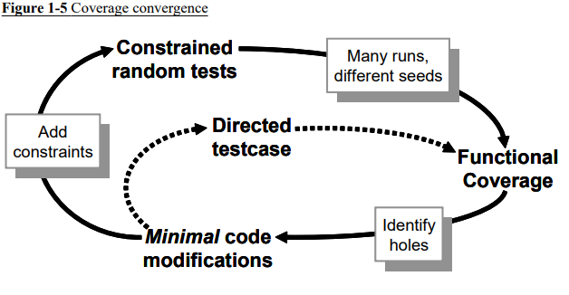
Coverage convergence
SystemVerilog for Verification

Slide 58
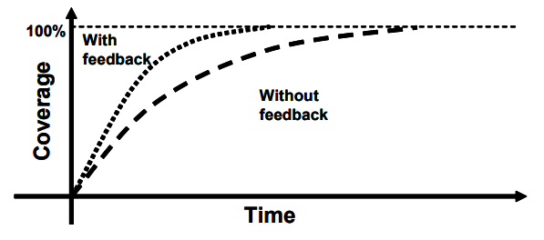
Test progress with and without feedback
SystemVerilog for Verification

Slide 59
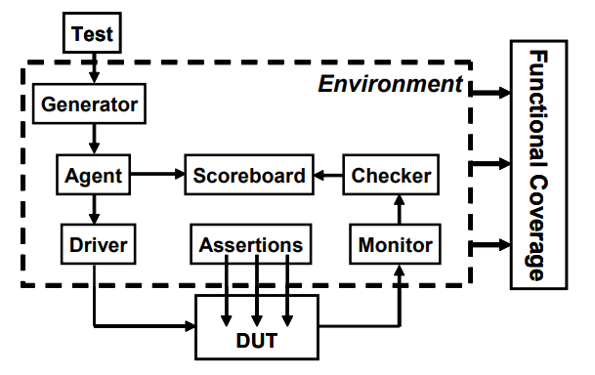
Full Picture
SystemVerilog for Verification

Slide 60
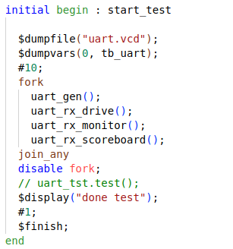
Test: UART

Slide 61
FORK
Fork???
  Multi-thread/ Concurrent Operation
  Hardware operates Concurrently, so test must too.
Fork-join: finish when all threads finish
fork-join_any: finish when any thread finish
Fork-join_none: finish immediately run threads in the background.
Each is useful in different situation

Slide 62
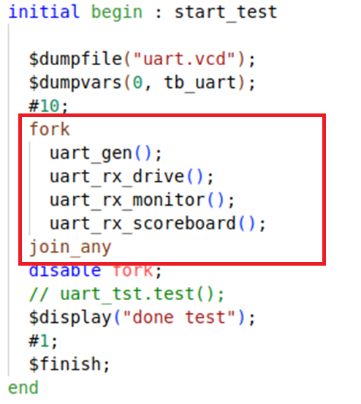
Fork Example
All happening at the same time..
  At least from the simulations point of view

Slide 63
Simulation Phases
coordinate the testbench so all the code for a project works together.
Build
  Generate Configuration
  Build Environment
  Reset the DUT
  Configure the DUT based on generated configuration
Run
  Start environment
  Run the test
Wrap-up
  wait for the final transactions to drain out of the DUT
  Report.
SystemVerilog for Verification

Slide 64
Object Oriented Programming
Goal of a testbench is to apply stimulus to a design and then check the result to see if it is correct.
data that flows in and out of design is grouped together into transactions.
easiest way to organize the testbench is around the transactions, and the operations that you perform.
In OOP, the transaction is the object that is focus of your testbench.
SystemVerilog for Verification

Slide 65

Class
Basic building block containing routines and variables.
In Verilog, you need to instantiate a module to use it.
Encapsulates the data together with the routines that manipulate it.
Handle
  a pointer to an object.
  An OOP handle is like the address of the object
  stored in a pointer that can only refer to one type.
SystemVerilog for Verification

Slide 66
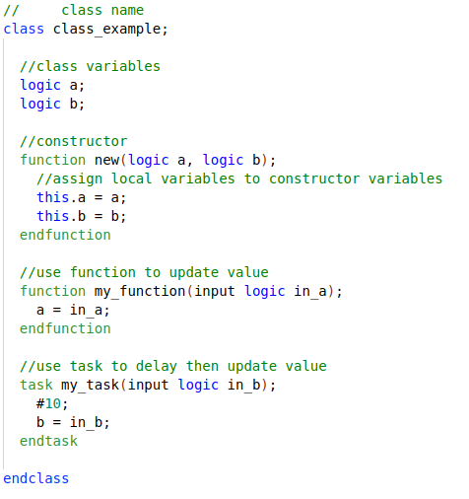
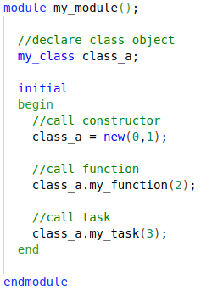
Create Object
SystemVerilog for Verification

Slide 67
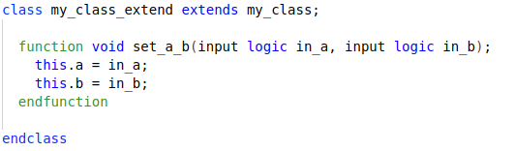
Inheritance
Main “power” of OOP
  take an existing class, i.e such as a transaction
  selectively change parts of its behavior by replacing routines
  but without having to change the surrounding infrastructure.
SystemVerilog for Verification

Slide 68
Interface
Encapsulate related Signals into a block
Same interface can be re-used in other projects
Easier to connect DUT to other verification components I.E classes.
Note:
  Interface is essentially a module.. Anything you can do in a module you can do in an interface……
    Except it can’t be top module.
Classes must instantiate “Virtual” Interfaces.

Slide 69
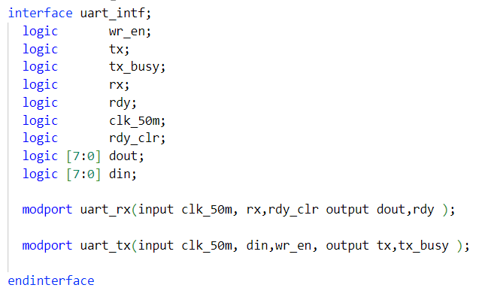
Uart Interface

Slide 70
Virtual Interface
A virtual interface is a variable that represents an interface instance.
Why Virtual Interface
  SystemVerilog interface is static in nature, whereas classes are dynamic in nature.
    Remember an interface IS a module
  Not allowed to declare the interface within classes but can refer to or point to the interface.
Virtual interface is a variable of an interface type
  used in classes to provide access to the interface signals.

Slide 71
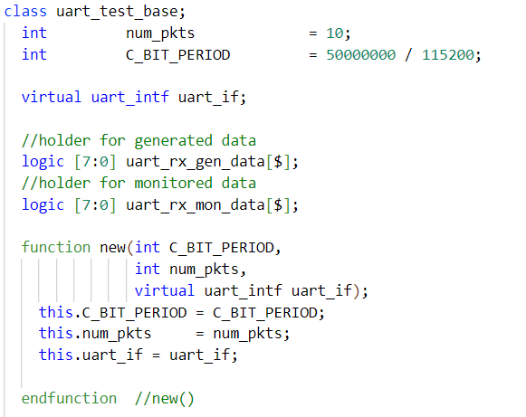
Uart Class

Slide 72
Callbacks
“hook” to inject new code without modifying the original classes.
Your driver may want to:
  Inject errors, Drop the transaction, Delay the transaction, Synchronize transaction with others, Put the transaction in the scoreboard, Gather functional coverage data.
SystemVerilog for Verification

Slide 73
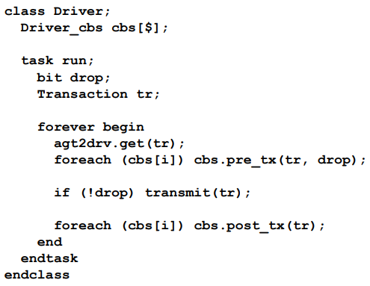
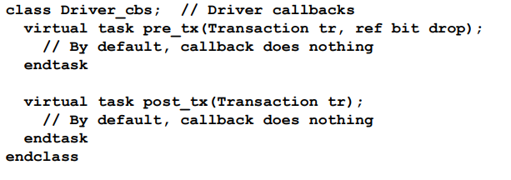
Driver Callbacks
SystemVerilog for Verification

Slide 74
Coverage Type
Coverage is a generic term for measuring progress to complete design verification.
coverage tools gather information during a simulation and then post-process it to produce a coverage report.
can use this report to look for coverage holes and then modify existing tests or create new ones to fill the holes.
iterative process continues until you are satisfied with the coverage level.
SystemVerilog for Verification

Slide 75
Code Coverage
Code coverage measures how thoroughly your tests exercised the “implementation” of the design specification, and not the verification plan.
Types of code coverage:
  line coverage : measuring how many lines of code have been executed which
  path coverage: paths through the code and expressions have been executed
  toggle coverage: which single-bit variables have had the values 0 or 1
  FSM coverage: which states and transitions in a state machine have been visited
Untested design code could conceal a hardware bug or may be just redundant code.
SystemVerilog for Verification

Slide 76
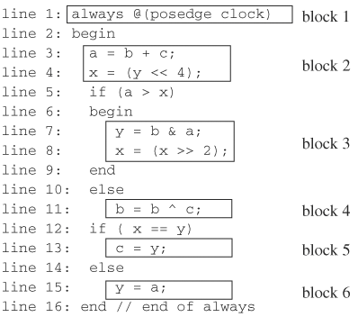
Code coverage: block coverage

Slide 77

100% Code Coverage???
Job done?? Not exactly
What about actual functionality?
SystemVerilog for Verification

Slide 78
Functional coverage
Verification plan lists how that functionality is to be stimulated, verified, and measured.
Gather measurements on what functions were covered by test?
  All opcodes? all operating modes? All baud-rates?
Functional coverage is tied to the design intent and is sometimes called “specification coverage,”
what happens if a block of code is missing from the design?
  Code coverage cannot catch this mistake, but functional coverage can.
SystemVerilog for Verification

Slide 79
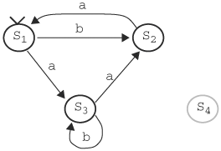
coverage: state coverage
Sequence b,a,b,a,b,a,b,a,... gives 66.67% of state coverage, as S1 and S2 traversed (2 out of 3).
S4 is illegal state, thus max state coverage is 75%!

Slide 80
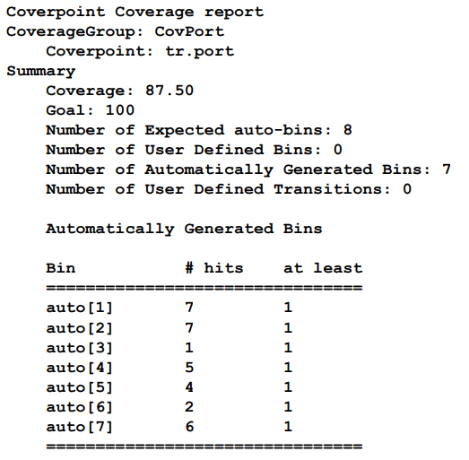
Coverage Report
SystemVerilog for Verification

Slide 81
Let’s Synthesize!
Coverage is at an acceptable level?
  Sign off on RTL
Design is synthesized unto low level primitives. Now what?

Slide 82
Synthesis Mismatch
Mismatches between RTL and Synthesized Netlist can occur
Remember HDL stands for Hardware “Description” Language.
Synthesis tool can misinterpret what was described.

Slide 83
Practices that lead to Mismatches
Incomplete sensitivity list
  Netlist will trigger on any change regardless of sensitivity list
Complete sensitivity list with mis-ordered assignments
  Assignments in blocks execute sequentially in RTL sim.
  Synthesis will order assignment correctly based on dependencies.
Functions:
  no synthesis tool warnings when function code simulates latch behavior
Improper initialization
Timing Delays
  Placing delays on the left side of always block assignments does not accurately model either RTL or behavioral models.

Slide 84
How do we verify Equivalence?
Verify Netlist through simulation
  Use same verification code on netlist.
Most vendors provide simulation libraries for their primitives.
  Can be difficult to work with
  Google “glbl.v error” later.
Can instantiate both RTL and Netlist in design.
  Verify that given the same inputs they produce same outputs.
Problem?
  Many synthesis tools will reorder signals to meet timing.

Slide 85
Equivalence checking
It is necessary to match the variable names of the designs under comparison!
We implement canonical forms ...
... or look for an input vector that would distinguish the output responses of two designs. SAT methods. Similar to test pattern generation.

Slide 86
Equivalence checking
Comparison of pre- and post-scan schematics
Comparison of RTL versus transistor layout
Verification of minor changes in the design

Slide 87
Logic Equivalence check
tool validates the design by injecting random vectors
Conformal from Cadence and Formality from Synopsys
Process:
  Specification of blackbox
  Reading libraries and designs
  Specification of design constraints
  Specification of modeling directives
  Switch to LEC mode
    Mapping process
    Compare process

Slide 88
LEC: Specification of blackbox
Non-essential/Negligible design parts broken down into blocks
  i.e analog blocks, memories, and digital blocks.
  blocks are treated as blackbox when running LEC.
  IPs can be included as blackbox.
makes sure only the I/O ports are read and not the entire design.
cut the runtime by a huge amount and will be of great assistance when we are running LEC on large designs

Slide 89
LEC: Read RTL and Libraries
Read Verilog and VHDL file
Read in standard simuilation libraries
built-in Hardware Descriptive Language (HDL) rule check searches for lint errors and warnings.

Slide 90
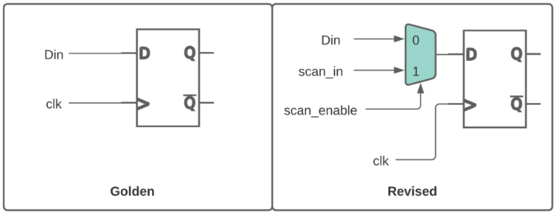
LEC Specification of design constraints
DFT insertion can create multiple functional modes for design
adding constraints to the design to ensure it is in common functional mode
I.E: Tie scan_enable to zero

Slide 91
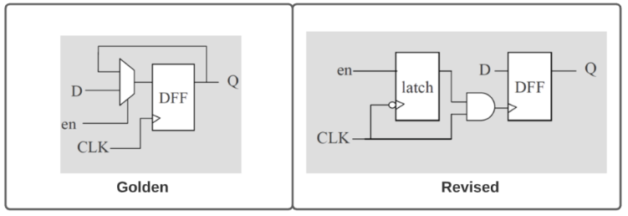
LEC Specification of modeling directives
Synthesis can output different netlist optimizations
  Power optimized, Area optimized, Effort optimized
Clock gating logic in golden design would be converted to latch-based clock gating.
Need to add modeling directives to match both designs.

Slide 92
LEC Mapping process
maps key points such as
  primary inputs (PI), primary outputs (PO), DFFs, D-latches, blackboxes, Z-gates, and cut gates
First will use name-based mapping
Followed by function-based mapping
Name-based mapping takes less runtime than function-based mapping
  tools tries to map key points with name-based mapping before switching to function based mapping.

Slide 93
LEC Compare process
Comparison done only on mapped key points.
  important that all key points should be mapped
Will try to prove equivalency by passing all combinations of inputs to the logic cone and checks the output behavior.
After running, key points will be categorized as equivalent, inverted equivalent, non-equivalent, and abort points.
If all the compare points come out as equivalent, then we can confidently assert that the golden and revised design are matching.

Slide 94
Formal Verification
Problem with test benches?
  Only examines a known good branch
  Cannot check for every out of bounds conditions
  Demonstrate design works
    Through a normal working path – or a limited number of extraneous paths
  Never rigorous enough to check everything
  Not uniform in rigor
I.E
  For a FIFO
    Only read when you know it’s not empty
An Introduction to Formal Methods

Slide 95
Simulation-based vs formal

Slide 96
Model-checking
The goal is to find an input assignment violating the assumed property.
If such an assignment (counter-example!) exists then we can simulate it to obtain signal waveforms for debugging.
If there exists no counter-example then we have proven that the implementation matches the property.

Slide 97
Model-checking
Problems:
How do you extract only this portion of the design that is related to the property to be checked. Currently done manually...
Selection of the properties to be checked is tricky...
Bugs may occur in the implementation, in properties or in configuration (i.e. environment).
Roughly 70 % of total effort for setting up the configuration.

Slide 98
Model-checking
Theorem provers
Not very automated but...
handle larger designs, require less memory.
Use higher order logic.
  Thus, can check more complex properties.

Slide 99
Formal verification Flow

Slide 100
Basic Premise
Two separate and distinct fashions
  First method calculates the answer
  Second method proved it was right
Example: Division
  89, 321/499 = 179
  Does it? Let’s check: 179 * 499 = 89, 321 — Yes!
Formal is similar
  Design is the first method
  Formal properties are the second
An Introduction to Formal Methods

Slide 101
Basics
Assert
  An assert ( X ) statement indicates that X must be true, or the design will fail to prove
Assume
  An assume ( X ) statement will limit the state space that the formal verification engine examines.
An Introduction to Formal Methods

Slide 102
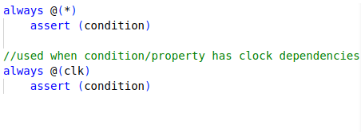
Assert/assume forms
An Introduction to Formal Methods

Slide 103
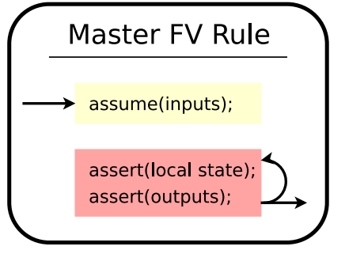
General Rule
An Introduction to Formal Methods

Slide 104
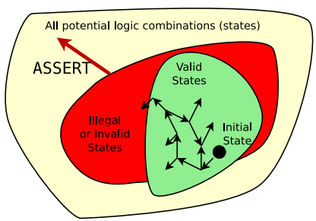
Assert
Assertions define the illegal state space.
Additional assertions will increase the size of the illegal state space.
An Introduction to Formal Methods

Slide 105
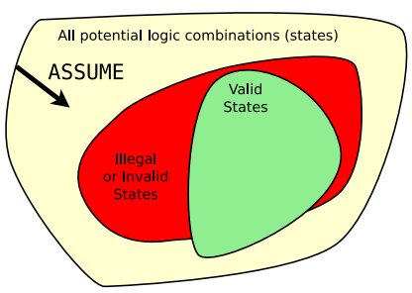
Assume
Assumptions limit the universe of all possibilities
Additional assumptions will decrease the size of the total state space
  Caution: careful not to make assumptions that are impossible
  I.E., assume a 4-bit signal is greater than 30
An Introduction to Formal Methods

Slide 106
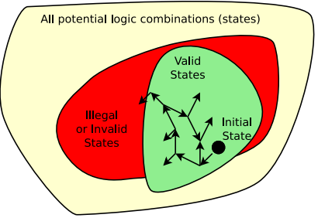
Bounded Model Checking
For bounded model checking:
  Start at the initial state
  Examine all possible states for N clocks
  Try to find a way to make an assert (); fail
  If it’s not possible in N clocks, then pass
An Introduction to Formal Methods

Slide 107
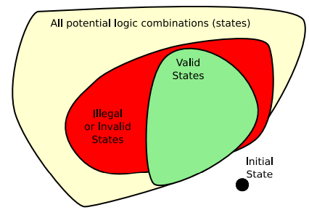
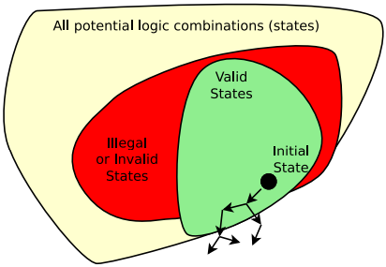
No Solution
Problem: initial assume(!initial_state); Model fails, no line number given.
Problem: assume(!reachable_state); Model fails, no line number given.
An Introduction to Formal Methods

Slide 108
Assertions vs Assumptions
Suggestion,
  Any SystemVerilog properties that constraints the input state-space of our DUT are assumptions.
  Properties that checks the validity of output signals are assertions.

Slide 109
BMC UART
Consider relationship between inputs and outputs
For this DUT we need to cover forward progress, rdy handshaking, tx_busy propagation.
Uart Protocol??
  Testbench/BFM will confirm protocol
  Caveat, should be robust enough to find errors in protocol/ protocol violations.

Slide 110


BMC Example
Extra points to suggests some more properties for UART

Slide 111


Slide 112
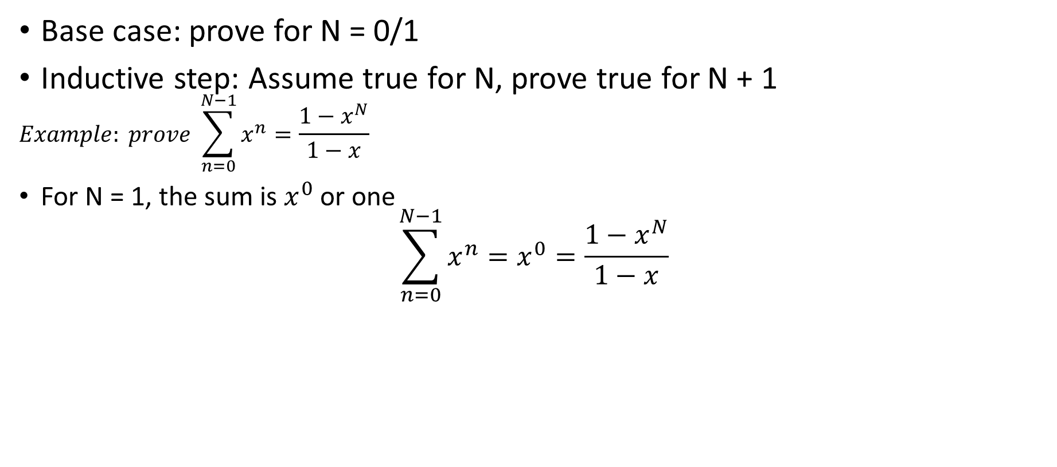
BACKGROUND: K- Induction
Base case: prove for N = 0/1
Inductive step: Assume true for N, prove true for N + 1
$$Example: prove \sum_{n=0}^{N−1}{x^{n}}=\frac{1−x^{N}}{1−x}$$
For N = 1, the sum is $x^{0}$ or one
$$\sum_{n=0}^{N−1}{x^{n}}=x^{0}=\frac{1−x^{N}}{1−x}$$
So, this is true (for x != 1).
For the inductive step, we’ll
  Assume true for N, then prove for N + 1
An Introduction to Formal Methods

Slide 113
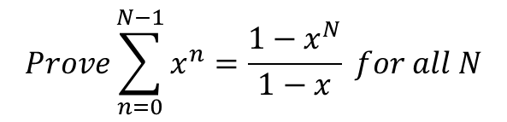

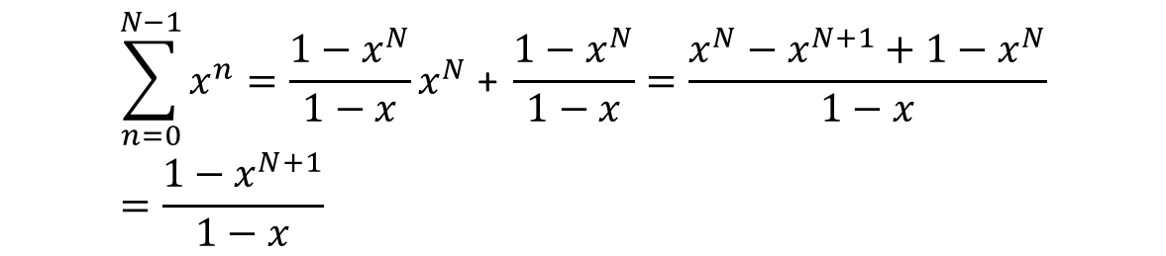
BACKGROUND: Proof
$$Prove\sum_{n=0}^{N−1}{x^{n}}=\frac{1−x^{N}}{1−x} for all N$$
Assume true for N, prove for N + 1
$$Prove\sum_{n=0}^{N−1}{x^{n}}=x^{N}+\sum_{n=0}^{N−1}{x^{n}}=x^{N}+ \frac{1−x^{N}}{1−x}$$
Prove for N + 1
$$\sum_{n=0}^{N−1}{x^{n}}=\frac{1−x^{N}}{1−x}x^{N}\text{ + }\frac{1−x^{N}}{1−x}=\frac{x^{N}−x^{N+1}+1−x^{N}}{1−x}=\frac{1−x^{N+1}}{1−x}$$
This proves the inductive case.
Hence this is true for all N (where N > 0 and x != 1 )
An Introduction to Formal Methods

