Slide 1
Testbench Layers
Segment Outcome:
  Students will learn the basic hierarchy of layered logic testbenches.

Slide 2
Simulation Stages and Layers
Layers are blocks of related code that perform similar.
make your task easier by dividing the code into smaller pieces that can be developed separately.

Slide 3
Signal and command layers
Signal layer that contains the design under test and the signals that connect it to the testbench
Driver: drives DUT’s inputs with single commands such as bus read or write.
Monitor: driven by the DUT’s output, takes signal transitions and groups them together into commands.
SystemVerilog for Verification

Slide 4
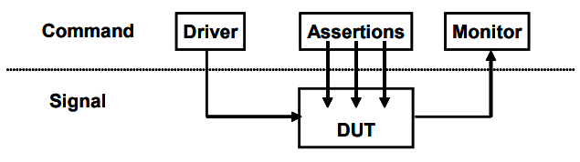
Signal and command layers
SystemVerilog for Verification

Slide 5
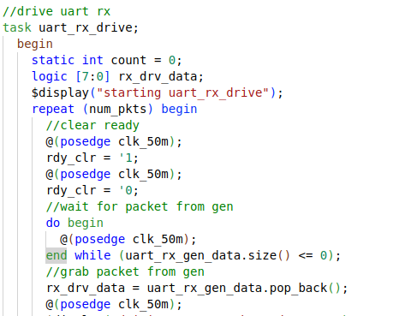
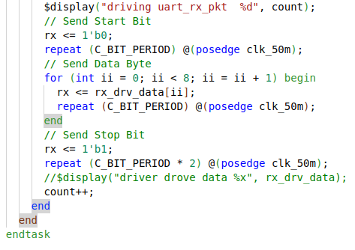
Driver: UART

Slide 6
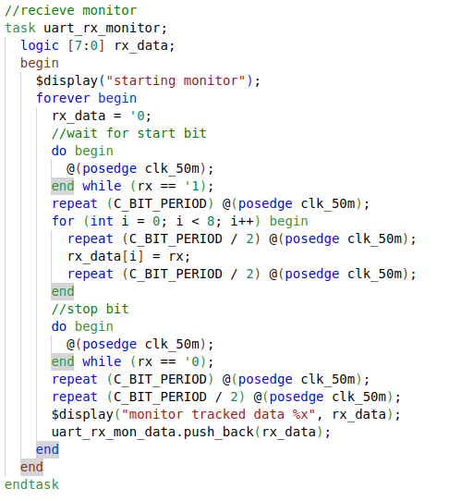
Monitor: UART

Slide 7
The functional layer
Functional layer feeds the command layer
Agent: receives higher-level and breaks them into individual commands.
Scoreboard: receives commands from agent and predicts the results of the transaction.
Checker: compares commands from monitor with those in the scoreboard.
SystemVerilog for Verification

Slide 8
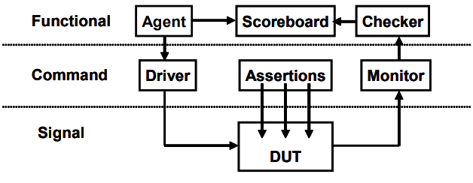
The functional layer
SystemVerilog for Verification

Slide 9
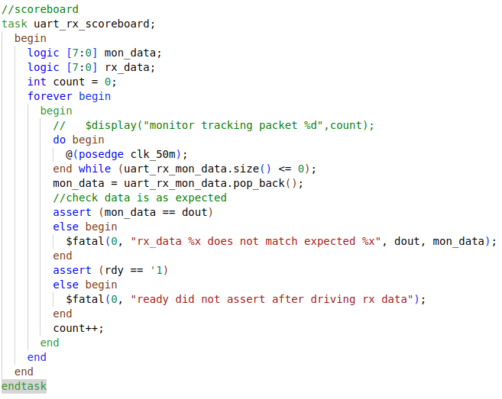
Scoreboard

Slide 10
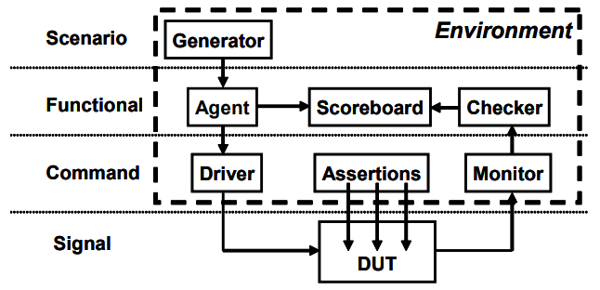
Scenario Layer
Generator in the scenario layer drives the functional layer
orchestrates all these steps with constrained-random values for parameters such as track size and memory location.
Example: MP3 player that can do many thing concurrently
  plays music from storage
  downloads new music from a host
  respond to input from the user
    such as volume and track controls.
Each of these operations is a scenario.
SystemVerilog for Verification

Slide 11
Test Layer and functional coverage
Test:
  top level of the testbench
  contains the constraints to create the stimulus.
  Think of a conductor who does not play any musical instrument, but instead guides the efforts of others.
Functional coverage:
  measures the progress of all tests in fulfilling the requirements in the verification plan.
  changes through the project as the various criteria complete.
  Because it is constantly being modified, it is not part of the environment
SystemVerilog for Verification

Slide 12
Functional Coverage
Need to measure what has been verified in order to check off items in your verification plan
monitor stimulus going into device, its reaction and response
  determine what functionality has been exercised
SystemVerilog for Verification

Slide 13
Functional Coverage Roll Up
Combine data from one or more simulations into a report.
Feedback from functional coverage to stimulus
  change the test to find new approaches to reach uncovered areas of the design
  Example: change the constraint weights based on types of transactions that have been previously generated
SystemVerilog for Verification

Slide 14
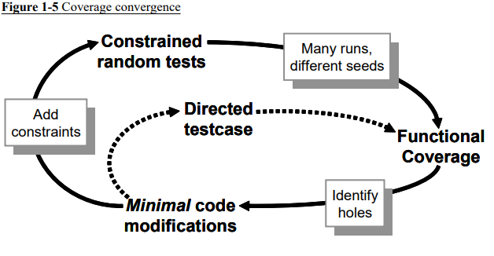
Coverage convergence
SystemVerilog for Verification

Slide 15
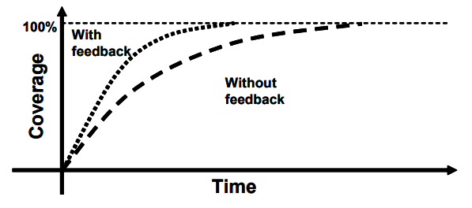
Test progress with and without feedback
SystemVerilog for Verification

Slide 16
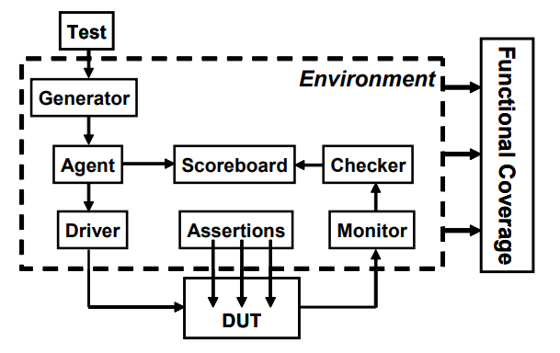
Full Picture
SystemVerilog for Verification

Slide 17
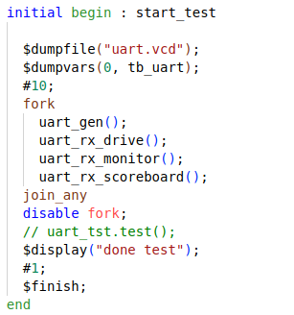
Test: UART

Slide 18
FORK
Fork???
  Multi-thread/ Concurrent Operation
  Hardware operates Concurrently, so test must too.
Fork-join: finish when all threads finish
fork-join_any: finish when any thread finish
Fork-join_none: finish immediately run threads in the background.
Each is useful in different situation

Slide 19
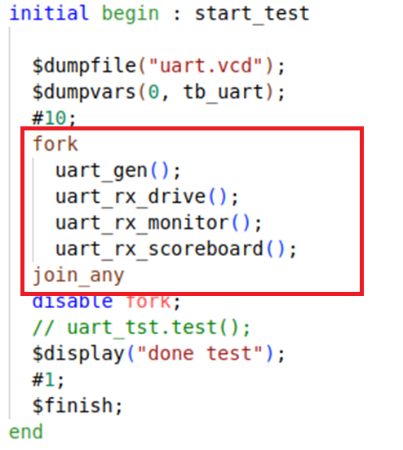
Fork Example
All happening at the same time..
  At least from the simulations point of view

Slide 20
Simulation Phases
coordinate the testbench so all the code for a project works together.
Build
  Generate Configuration
  Build Environment
  Reset the DUT
  Configure the DUT based on generated configuration
Run
  Start environment
  Run the test
Wrap-up
  wait for the final transactions to drain out of the DUT
  Report.
SystemVerilog for Verification

Slide 21
Object Oriented Programming
Goal of a testbench is to apply stimulus to a design and then check the result to see if it is correct.
data that flows in and out of design is grouped together into transactions.
easiest way to organize the testbench is around the transactions, and the operations that you perform.
In OOP, the transaction is the object that is focus of your testbench.
SystemVerilog for Verification

Slide 22

Class
Basic building block containing routines and variables.
In Verilog, you need to instantiate a module to use it.
Encapsulates the data together with the routines that manipulate it.
Handle
  a pointer to an object.
  An OOP handle is like the address of the object
  stored in a pointer that can only refer to one type.
SystemVerilog for Verification

Slide 23
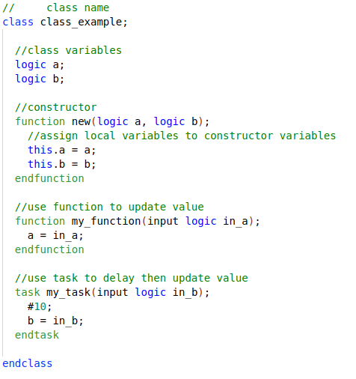
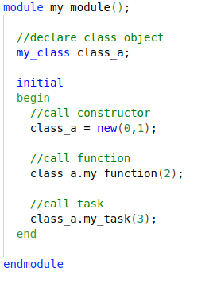
Create Object
SystemVerilog for Verification

Slide 24
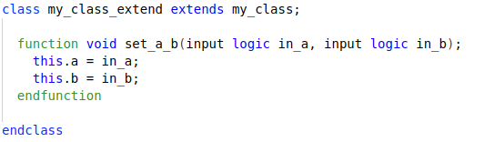
Inheritance
Main “power” of OOP
  take an existing class, i.e such as a transaction
  selectively change parts of its behavior by replacing routines
  but without having to change the surrounding infrastructure.
SystemVerilog for Verification

Slide 25
Interface
Encapsulate related Signals into a block
Same interface can be re-used in other projects
Easier to connect DUT to other verification components I.E classes.
Note:
  Interface is essentially a module.. Anything you can do in a module you can do in an interface……
    Except it can’t be top module.
Classes must instantiate “Virtual” Interfaces.

Slide 26
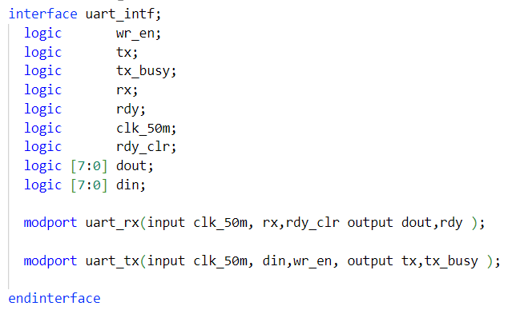
Uart Interface

Slide 27
Virtual Interface
A virtual interface is a variable that represents an interface instance.
Why Virtual Interface
  SystemVerilog interface is static in nature, whereas classes are dynamic in nature.
    Remember an interface IS a module
  Not allowed to declare the interface within classes but can refer to or point to the interface.
Virtual interface is a variable of an interface type
  used in classes to provide access to the interface signals.

Slide 28
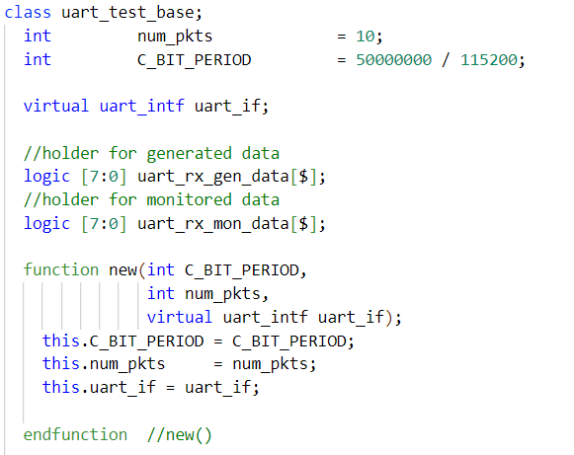
Uart Class

Slide 29
Callbacks
“hook” to inject new code without modifying the original classes.
Your driver may want to:
  Inject errors, Drop the transaction, Delay the transaction, Synchronize transaction with others, Put the transaction in the scoreboard, Gather functional coverage data.
SystemVerilog for Verification

Slide 30
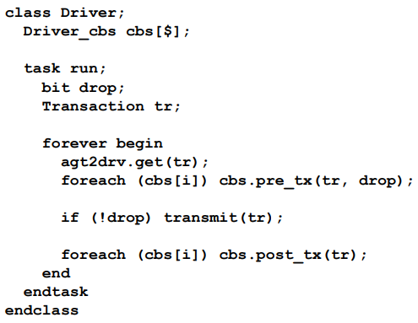
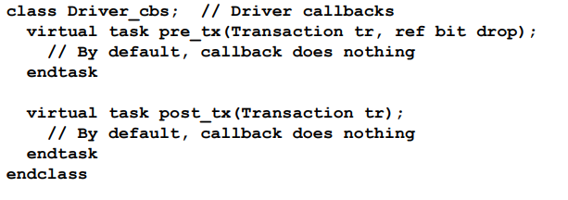
Driver Callbacks
SystemVerilog for Verification

Slide 31
Coverage Type
Coverage is a generic term for measuring progress to complete design verification.
coverage tools gather information during a simulation and then post-process it to produce a coverage report.
can use this report to look for coverage holes and then modify existing tests or create new ones to fill the holes.
iterative process continues until you are satisfied with the coverage level.
SystemVerilog for Verification

Slide 32
Code Coverage
Code coverage measures how thoroughly your tests exercised the “implementation” of the design specification, and not the verification plan.
Types of code coverage:
  line coverage : measuring how many lines of code have been executed which
  path coverage: paths through the code and expressions have been executed
  toggle coverage: which single-bit variables have had the values 0 or 1
  FSM coverage: which states and transitions in a state machine have been visited
Untested design code could conceal a hardware bug or may be just redundant code.
SystemVerilog for Verification

Slide 33
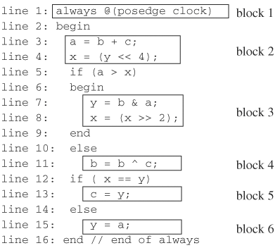
Code coverage: block coverage

Slide 34

100% Code Coverage???
Job done?? Not exactly
What about actual functionality?
SystemVerilog for Verification

Slide 35
Functional coverage
Verification plan lists how that functionality is to be stimulated, verified, and measured.
Gather measurements on what functions were covered by test?
  All opcodes? all operating modes? All baud-rates?
Functional coverage is tied to the design intent and is sometimes called “specification coverage,”
what happens if a block of code is missing from the design?
  Code coverage cannot catch this mistake, but functional coverage can.
SystemVerilog for Verification

Slide 36
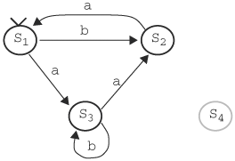
coverage: state coverage
Sequence b,a,b,a,b,a,b,a,... gives 66.67% of state coverage, as S1 and S2 traversed (2 out of 3).
S4 is illegal state, thus max state coverage is 75%!

Slide 37
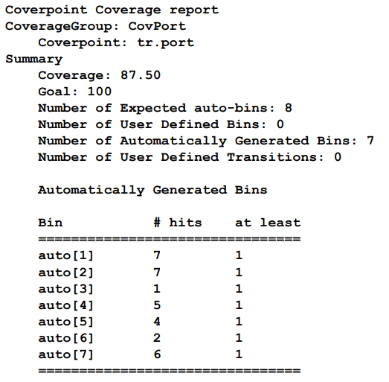
Coverage Report
SystemVerilog for Verification

Slide 38
Let’s Synthesize!
Coverage is at an acceptable level?
  Sign off on RTL
Design is synthesized unto low level primitives. Now what?

Slide 39
Synthesis Mismatch
Mismatches between RTL and Synthesized Netlist can occur
Remember HDL stands for Hardware “Description” Language.
Synthesis tool can misinterpret what was described.

Slide 40
Practices that lead to Mismatches
Incomplete sensitivity list
  Netlist will trigger on any change regardless of sensitivity list
Complete sensitivity list with mis-ordered assignments
  Assignments in blocks execute sequentially in RTL sim.
  Synthesis will order assignment correctly based on dependencies.
Functions:
  no synthesis tool warnings when function code simulates latch behavior
Improper initialization
Timing Delays
  Placing delays on the left side of always block assignments does not accurately model either RTL or behavioral models.

Slide 41
How do we verify Equivalence?
Verify Netlist through simulation
  Use same verification code on netlist.
Most vendors provide simulation libraries for their primitives.
  Can be difficult to work with
  Google “glbl.v error” later.
Can instantiate both RTL and Netlist in design.
  Verify that given the same inputs they produce same outputs.
Problem?
  Many synthesis tools will reorder signals to meet timing.

Slide 42
Equivalence checking
It is necessary to match the variable names of the designs under comparison!
We implement canonical forms ...
... or look for an input vector that would distinguish the output responses of two designs. SAT methods. Similar to test pattern generation.

Slide 43
Equivalence checking
Comparison of pre- and post-scan schematics
Comparison of RTL versus transistor layout
Verification of minor changes in the design

Slide 44
Logic Equivalence check
tool validates the design by injecting random vectors
Conformal from Cadence and Formality from Synopsys
Process:
  Specification of blackbox
  Reading libraries and designs
  Specification of design constraints
  Specification of modeling directives
  Switch to LEC mode
    Mapping process
    Compare process

Slide 45
LEC: Specification of blackbox
Non-essential/Negligible design parts broken down into blocks
  i.e analog blocks, memories, and digital blocks.
  blocks are treated as blackbox when running LEC.
  IPs can be included as blackbox.
makes sure only the I/O ports are read and not the entire design.
cut the runtime by a huge amount and will be of great assistance when we are running LEC on large designs

Slide 46
LEC: Read RTL and Libraries
Read Verilog and VHDL file
Read in standard simuilation libraries
built-in Hardware Descriptive Language (HDL) rule check searches for lint errors and warnings.

Slide 47
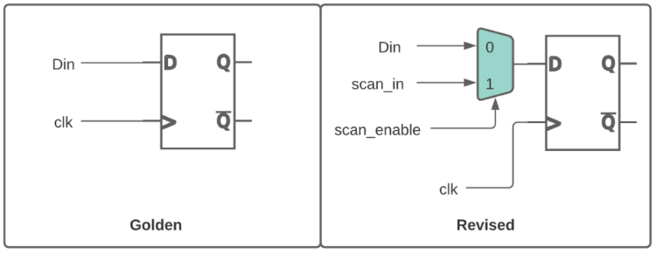
LEC Specification of design constraints
DFT insertion can create multiple functional modes for design
adding constraints to the design to ensure it is in common functional mode
I.E: Tie scan_enable to zero

Slide 48
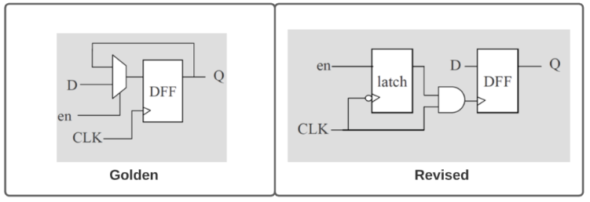
LEC Specification of modeling directives
Synthesis can output different netlist optimizations
  Power optimized, Area optimized, Effort optimized
Clock gating logic in golden design would be converted to latch-based clock gating.
Need to add modeling directives to match both designs.

Slide 49
LEC Mapping process
maps key points such as
  primary inputs (PI), primary outputs (PO), DFFs, D-latches, blackboxes, Z-gates, and cut gates
First will use name-based mapping
Followed by function-based mapping
Name-based mapping takes less runtime than function-based mapping
  tools tries to map key points with name-based mapping before switching to function based mapping.

Slide 50
LEC Compare process
Comparison done only on mapped key points.
  important that all key points should be mapped
Will try to prove equivalency by passing all combinations of inputs to the logic cone and checks the output behavior.
After running, key points will be categorized as equivalent, inverted equivalent, non-equivalent, and abort points.
If all the compare points come out as equivalent, then we can confidently assert that the golden and revised design are matching.

Slide 51
Formal Verification
Problem with test benches?
  Only examines a known good branch
  Cannot check for every out of bounds conditions
  Demonstrate design works
    Through a normal working path – or a limited number of extraneous paths
  Never rigorous enough to check everything
  Not uniform in rigor
I.E
  For a FIFO
    Only read when you know it’s not empty
An Introduction to Formal Methods

Slide 52
Simulation-based vs formal

Slide 53
Model-checking
The goal is to find an input assignment violating the assumed property.
If such an assignment (counter-example!) exists then we can simulate it to obtain signal waveforms for debugging.
If there exists no counter-example then we have proven that the implementation matches the property.

Slide 54
Model-checking
Problems:
How do you extract only this portion of the design that is related to the property to be checked. Currently done manually...
Selection of the properties to be checked is tricky...
Bugs may occur in the implementation, in properties or in configuration (i.e. environment).
Roughly 70 % of total effort for setting up the configuration.

Slide 55
Model-checking
Theorem provers
Not very automated but...
handle larger designs, require less memory.
Use higher order logic.
  Thus, can check more complex properties.

Slide 56
Formal verification Flow

Slide 57
Basic Premise
Two separate and distinct fashions
  First method calculates the answer
  Second method proved it was right
Example: Division
  89, 321/499 = 179
  Does it? Let’s check: 179 * 499 = 89, 321 — Yes!
Formal is similar
  Design is the first method
  Formal properties are the second
An Introduction to Formal Methods

Slide 58
Basics
Assert
  An assert ( X ) statement indicates that X must be true, or the design will fail to prove
Assume
  An assume ( X ) statement will limit the state space that the formal verification engine examines.
An Introduction to Formal Methods

Slide 59
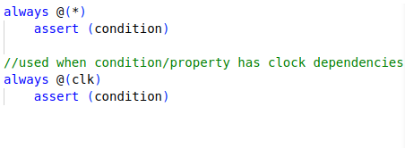
Assert/assume forms
An Introduction to Formal Methods

Slide 60
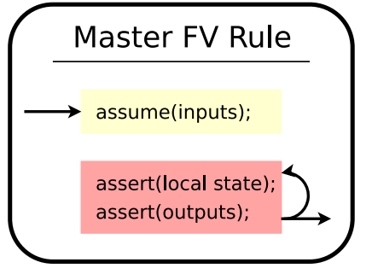
General Rule
An Introduction to Formal Methods

Slide 61
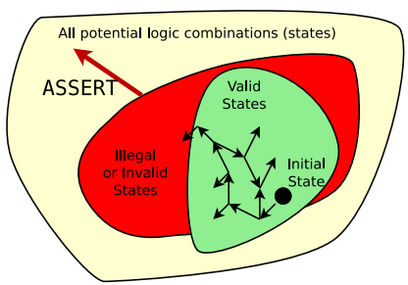
Assert
Assertions define the illegal state space.
Additional assertions will increase the size of the illegal state space.
An Introduction to Formal Methods

Slide 62
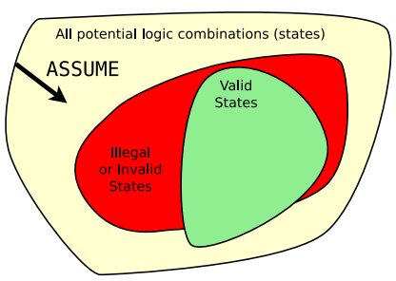
Assume
Assumptions limit the universe of all possibilities
Additional assumptions will decrease the size of the total state space
  Caution: careful not to make assumptions that are impossible
  I.E., assume a 4-bit signal is greater than 30
An Introduction to Formal Methods

Slide 63
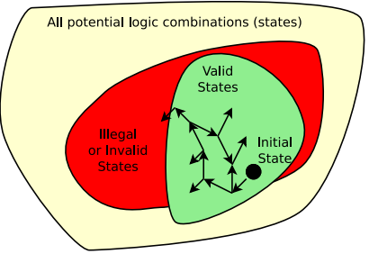
Bounded Model Checking
For bounded model checking:
  Start at the initial state
  Examine all possible states for N clocks
  Try to find a way to make an assert (); fail
  If it’s not possible in N clocks, then pass
An Introduction to Formal Methods

Slide 64
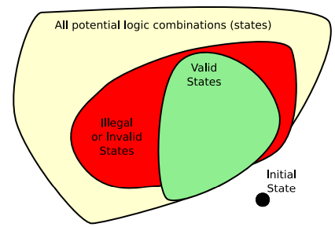
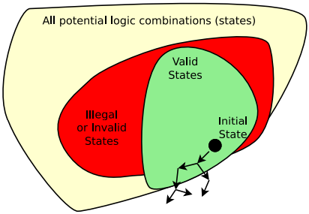
No Solution
Problem: initial assume(!initial_state); Model fails, no line number given.
Problem: assume(!reachable_state); Model fails, no line number given.
An Introduction to Formal Methods

Slide 65
Assertions vs Assumptions
Suggestion,
  Any SystemVerilog properties that constraints the input state-space of our DUT are assumptions.
  Properties that checks the validity of output signals are assertions.

Slide 66
BMC UART
Consider relationship between inputs and outputs
For this DUT we need to cover forward progress, rdy handshaking, tx_busy propagation.
Uart Protocol??
  Testbench/BFM will confirm protocol
  Caveat, should be robust enough to find errors in protocol/ protocol violations.

Slide 67


BMC Example
Extra points to suggests some more properties for UART

Slide 68


Slide 69
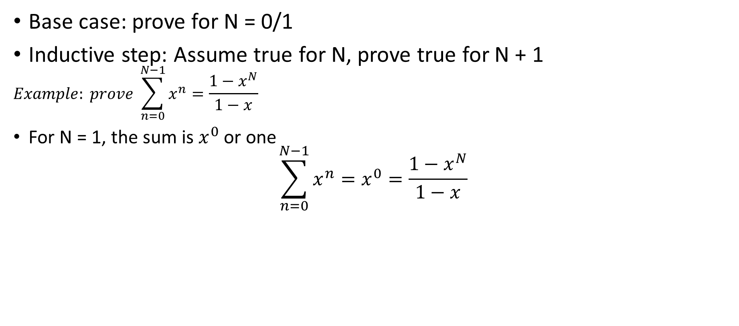
BACKGROUND: K- Induction
Base case: prove for N = 0/1
Inductive step: Assume true for N, prove true for N + 1
$$Example: prove \sum_{n=0}^{N−1}{x^{n}}=\frac{1−x^{N}}{1−x}$$
For N = 1, the sum is $x^{0}$ or one
$$\sum_{n=0}^{N−1}{x^{n}}=x^{0}=\frac{1−x^{N}}{1−x}$$
So, this is true (for x != 1).
For the inductive step, we’ll
  Assume true for N, then prove for N + 1
An Introduction to Formal Methods

Slide 70
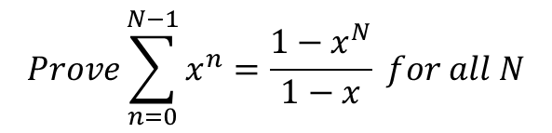

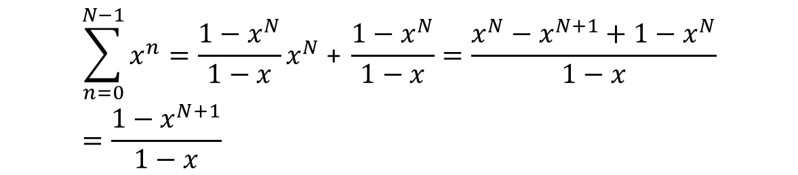
BACKGROUND: Proof
$$Prove\sum_{n=0}^{N−1}{x^{n}}=\frac{1−x^{N}}{1−x} for all N$$
Assume true for N, prove for N + 1
$$Prove\sum_{n=0}^{N−1}{x^{n}}=x^{N}+\sum_{n=0}^{N−1}{x^{n}}=x^{N}+ \frac{1−x^{N}}{1−x}$$
Prove for N + 1
$$\sum_{n=0}^{N−1}{x^{n}}=\frac{1−x^{N}}{1−x}x^{N}\text{ + }\frac{1−x^{N}}{1−x}=\frac{x^{N}−x^{N+1}+1−x^{N}}{1−x}=\frac{1−x^{N+1}}{1−x}$$
This proves the inductive case.
Hence this is true for all N (where N > 0 and x != 1 )
An Introduction to Formal Methods

