Slide 1
Object Oriented Simulation
Segment Outcomes
  Students will be introduced to Object Oriented Programming (OOP) concepts in relation to RTL.
  Students will create complex data types and tie them together with the routines that work with them.
  Students will be able create testbenches and system-level models at a more abstract level by calling routines to perform an action rather than toggling bits.

Slide 2
Object Oriented Programming
Goal of a testbench is to apply stimulus to a design and then check the result to see if it is correct.
data that flows in and out of design is grouped together into transactions.
easiest way to organize the testbench is around the transactions, and the operations that you perform.
In OOP, the transaction is the object that is focus of your testbench.
SystemVerilog for Verification

Slide 3

Class
Basic building block containing routines and variables.
In Verilog, you need to instantiate a module to use it.
Encapsulates the data together with the routines that manipulate it.
Handle
  a pointer to an object.
  An OOP handle is like the address of the object
  stored in a pointer that can only refer to one type.
SystemVerilog for Verification

Slide 4
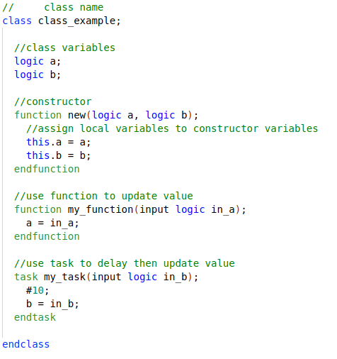
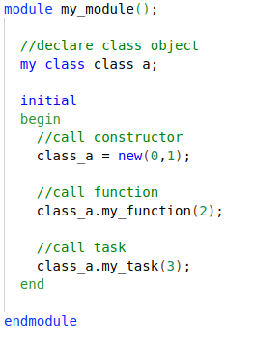
Create Object
SystemVerilog for Verification

Slide 5
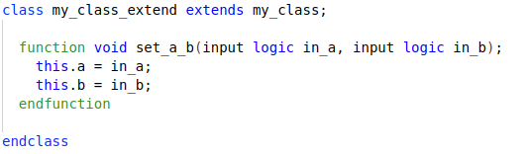
Inheritance
Main “power” of OOP
  take an existing class, i.e such as a transaction
  selectively change parts of its behavior by replacing routines
  but without having to change the surrounding infrastructure.
SystemVerilog for Verification

Slide 6
Interface
Encapsulate related Signals into a block
Same interface can be re-used in other projects
Easier to connect DUT to other verification components I.E classes.
Note:
  Interface is essentially a module.. Anything you can do in a module you can do in an interface……
    Except it can’t be top module.
Classes must instantiate “Virtual” Interfaces.

Slide 7
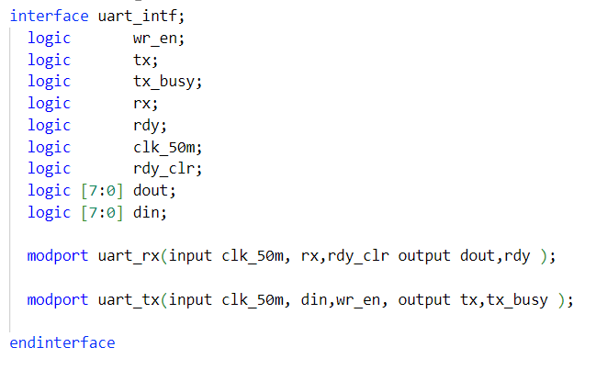
Uart Interface

Slide 8
Virtual Interface
A virtual interface is a variable that represents an interface instance.
Why Virtual Interface
  SystemVerilog interface is static in nature, whereas classes are dynamic in nature.
    Remember an interface IS a module
  Not allowed to declare the interface within classes but can refer to or point to the interface.
Virtual interface is a variable of an interface type
  used in classes to provide access to the interface signals.

Slide 9
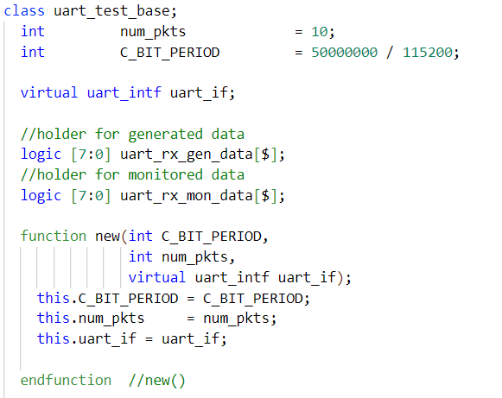
Uart Class

Slide 10
Callbacks
“hook” to inject new code without modifying the original classes.
Your driver may want to:
  Inject errors, Drop the transaction, Delay the transaction, Synchronize transaction with others, Put the transaction in the scoreboard, Gather functional coverage data.
SystemVerilog for Verification

Slide 11
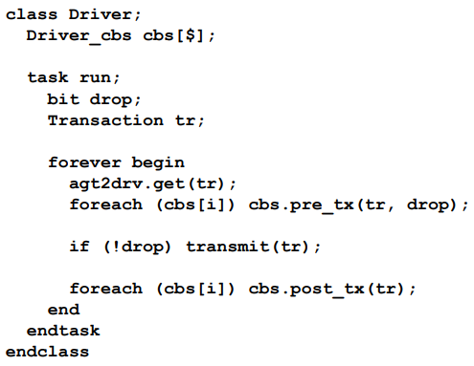
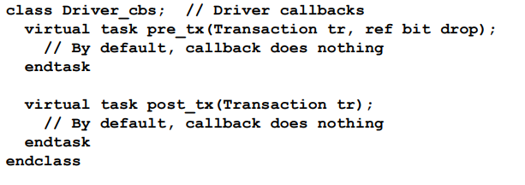
Driver Callbacks
SystemVerilog for Verification

Slide 12
Coverage Type
Coverage is a generic term for measuring progress to complete design verification.
coverage tools gather information during a simulation and then post-process it to produce a coverage report.
can use this report to look for coverage holes and then modify existing tests or create new ones to fill the holes.
iterative process continues until you are satisfied with the coverage level.
SystemVerilog for Verification

Slide 13
Code Coverage
Code coverage measures how thoroughly your tests exercised the “implementation” of the design specification, and not the verification plan.
Types of code coverage:
  line coverage : measuring how many lines of code have been executed which
  path coverage: paths through the code and expressions have been executed
  toggle coverage: which single-bit variables have had the values 0 or 1
  FSM coverage: which states and transitions in a state machine have been visited
Untested design code could conceal a hardware bug or may be just redundant code.
SystemVerilog for Verification

Slide 14
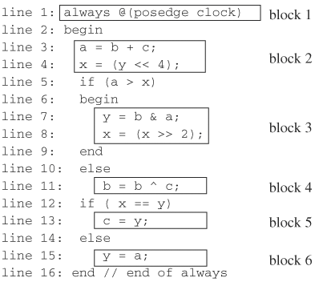
Code coverage: block coverage

Slide 15
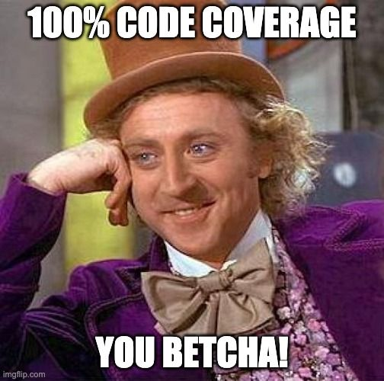
100% Code Coverage???
Job done?? Not exactly
What about actual functionality?
SystemVerilog for Verification

Slide 16
Functional coverage
Verification plan lists how that functionality is to be stimulated, verified, and measured.
Gather measurements on what functions were covered by test?
  All opcodes? all operating modes? All baud-rates?
Functional coverage is tied to the design intent and is sometimes called “specification coverage,”
what happens if a block of code is missing from the design?
  Code coverage cannot catch this mistake, but functional coverage can.
SystemVerilog for Verification

Slide 17
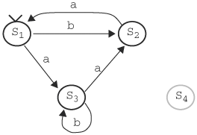
coverage: state coverage
Sequence b,a,b,a,b,a,b,a,... gives 66.67% of state coverage, as S1 and S2 traversed (2 out of 3).
S4 is illegal state, thus max state coverage is 75%!

Slide 18
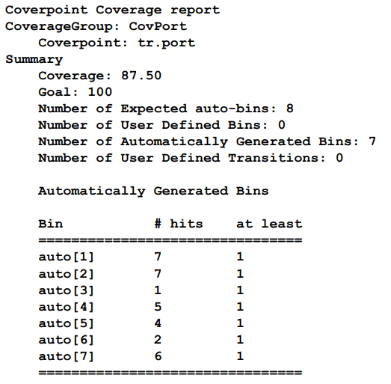
Coverage Report
SystemVerilog for Verification

Slide 19
Let’s Synthesize!
Coverage is at an acceptable level?
  Sign off on RTL
Design is synthesized unto low level primitives. Now what?

