Slide 1
Synthesis Verification
Segment Outcomes
  Students will be introduced common logic synthesis issues.
  Students will understand methods of detecting and mitigating logic synthesis failures.

Slide 2
Synthesis Mismatch
Mismatches between RTL and Synthesized Netlist can occur
Remember HDL stands for Hardware “Description” Language.
Synthesis tool can misinterpret what was described.

Slide 3
Practices that lead to Mismatches
Incomplete sensitivity list
  Netlist will trigger on any change regardless of sensitivity list
Complete sensitivity list with mis-ordered assignments
  Assignments in blocks execute sequentially in RTL sim.
  Synthesis will order assignment correctly based on dependencies.
Functions:
  no synthesis tool warnings when function code simulates latch behavior
Improper initialization
Timing Delays
  Placing delays on the left side of always block assignments does not accurately model either RTL or behavioral models.

Slide 4
How do we verify Equivalence?
Verify Netlist through simulation
  Use same verification code on netlist.
Most vendors provide simulation libraries for their primitives.
  Can be difficult to work with
  Google “glbl.v error” later.
Can instantiate both RTL and Netlist in design.
  Verify that given the same inputs they produce same outputs.
Problem?
  Many synthesis tools will reorder signals to meet timing.

Slide 5
Equivalence checking
It is necessary to match the variable names of the designs under comparison!
We implement canonical forms ...
... or look for an input vector that would distinguish the output responses of two designs. SAT methods. Similar to test pattern generation.

Slide 6
Equivalence checking
Comparison of pre- and post-scan schematics
Comparison of RTL versus transistor layout
Verification of minor changes in the design

Slide 7
Logic Equivalence check
tool validates the design by injecting random vectors
Conformal from Cadence and Formality from Synopsys
Process:
  Specification of blackbox
  Reading libraries and designs
  Specification of design constraints
  Specification of modeling directives
  Switch to LEC mode
    Mapping process
    Compare process

Slide 8
LEC: Specification of blackbox
Non-essential/Negligible design parts broken down into blocks
  i.e analog blocks, memories, and digital blocks.
  blocks are treated as blackbox when running LEC.
  IPs can be included as blackbox.
makes sure only the I/O ports are read and not the entire design.
cut the runtime by a huge amount and will be of great assistance when we are running LEC on large designs

Slide 9
LEC: Read RTL and Libraries
Read Verilog and VHDL file
Read in standard simuilation libraries
built-in Hardware Descriptive Language (HDL) rule check searches for lint errors and warnings.

Slide 10
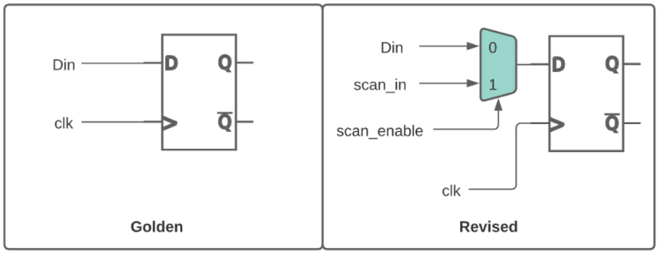
LEC Specification of design constraints
DFT insertion can create multiple functional modes for design
adding constraints to the design to ensure it is in common functional mode
I.E: Tie scan_enable to zero

Slide 11
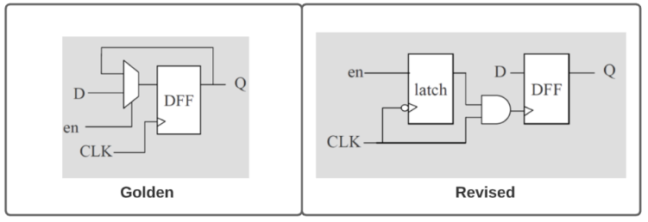
LEC Specification of modeling directives
Synthesis can output different netlist optimizations
  Power optimized, Area optimized, Effort optimized
Clock gating logic in golden design would be converted to latch-based clock gating.
Need to add modeling directives to match both designs.

Slide 12
LEC Mapping process
maps key points such as
  primary inputs (PI), primary outputs (PO), DFFs, D-latches, blackboxes, Z-gates, and cut gates
First will use name-based mapping
Followed by function-based mapping
Name-based mapping takes less runtime than function-based mapping
  tools tries to map key points with name-based mapping before switching to function based mapping.

Slide 13
LEC Compare process
Comparison done only on mapped key points.
  important that all key points should be mapped
Will try to prove equivalency by passing all combinations of inputs to the logic cone and checks the output behavior.
After running, key points will be categorized as equivalent, inverted equivalent, non-equivalent, and abort points.
If all the compare points come out as equivalent, then we can confidently assert that the golden and revised design are matching.

Slide 14
Formal Verification
Problem with test benches?
  Only examines a known good branch
  Cannot check for every out of bounds conditions
  Demonstrate design works
    Through a normal working path – or a limited number of extraneous paths
  Never rigorous enough to check everything
  Not uniform in rigor
I.E
  For a FIFO
    Only read when you know it’s not empty
An Introduction to Formal Methods

Slide 15
Simulation-based vs formal

Slide 16
Model-checking
The goal is to find an input assignment violating the assumed property.
If such an assignment (counter-example!) exists then we can simulate it to obtain signal waveforms for debugging.
If there exists no counter-example then we have proven that the implementation matches the property.

Slide 17
Model-checking
Problems:
How do you extract only this portion of the design that is related to the property to be checked. Currently done manually...
Selection of the properties to be checked is tricky...
Bugs may occur in the implementation, in properties or in configuration (i.e. environment).
Roughly 70 % of total effort for setting up the configuration.

Slide 18
Model-checking
Theorem provers
Not very automated but...
handle larger designs, require less memory.
Use higher order logic.
  Thus, can check more complex properties.

Slide 19
Formal verification Flow

Slide 20
Basic Premise
Two separate and distinct fashions
  First method calculates the answer
  Second method proved it was right
Example: Division
  89, 321/499 = 179
  Does it? Let’s check: 179 * 499 = 89, 321 — Yes!
Formal is similar
  Design is the first method
  Formal properties are the second
An Introduction to Formal Methods

Slide 21
Basics
Assert
  An assert ( X ) statement indicates that X must be true, or the design will fail to prove
Assume
  An assume ( X ) statement will limit the state space that the formal verification engine examines.
An Introduction to Formal Methods

Slide 22
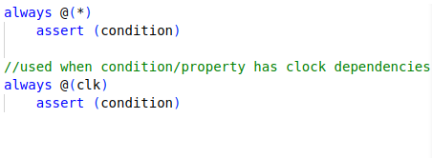
Assert/assume forms
An Introduction to Formal Methods

Slide 23
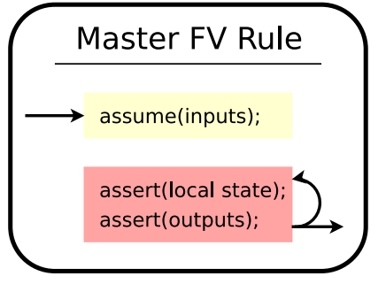
General Rule
An Introduction to Formal Methods

Slide 24
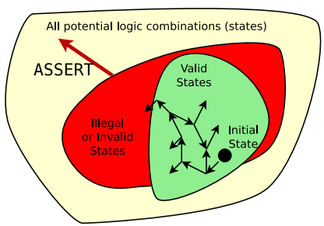
Assert
Assertions define the illegal state space.
Additional assertions will increase the size of the illegal state space.
An Introduction to Formal Methods

Slide 25
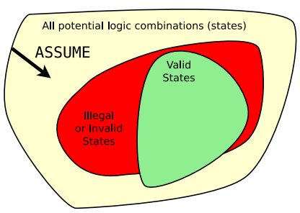
Assume
Assumptions limit the universe of all possibilities
Additional assumptions will decrease the size of the total state space
  Caution: careful not to make assumptions that are impossible
  I.E., assume a 4-bit signal is greater than 30
An Introduction to Formal Methods

Slide 26
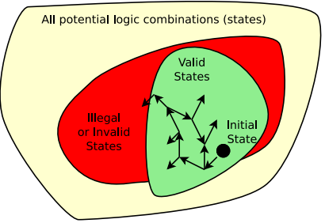
Bounded Model Checking
For bounded model checking:
  Start at the initial state
  Examine all possible states for N clocks
  Try to find a way to make an assert (); fail
  If it’s not possible in N clocks, then pass
An Introduction to Formal Methods

Slide 27
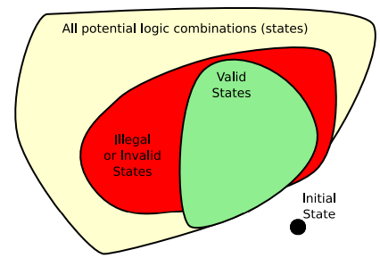
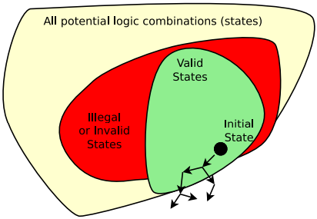
No Solution
Problem: initial assume(!initial_state); Model fails, no line number given.
Problem: assume(!reachable_state); Model fails, no line number given.
An Introduction to Formal Methods

Slide 28
Assertions vs Assumptions
Suggestion,
  Any SystemVerilog properties that constraints the input state-space of our DUT are assumptions.
  Properties that checks the validity of output signals are assertions.

Slide 29
BMC UART
Consider relationship between inputs and outputs
For this DUT we need to cover forward progress, rdy handshaking, tx_busy propagation.
Uart Protocol??
  Testbench/BFM will confirm protocol
  Caveat, should be robust enough to find errors in protocol/ protocol violations.

Slide 30


BMC Example
Extra points to suggests some more properties for UART

Slide 31


Slide 32
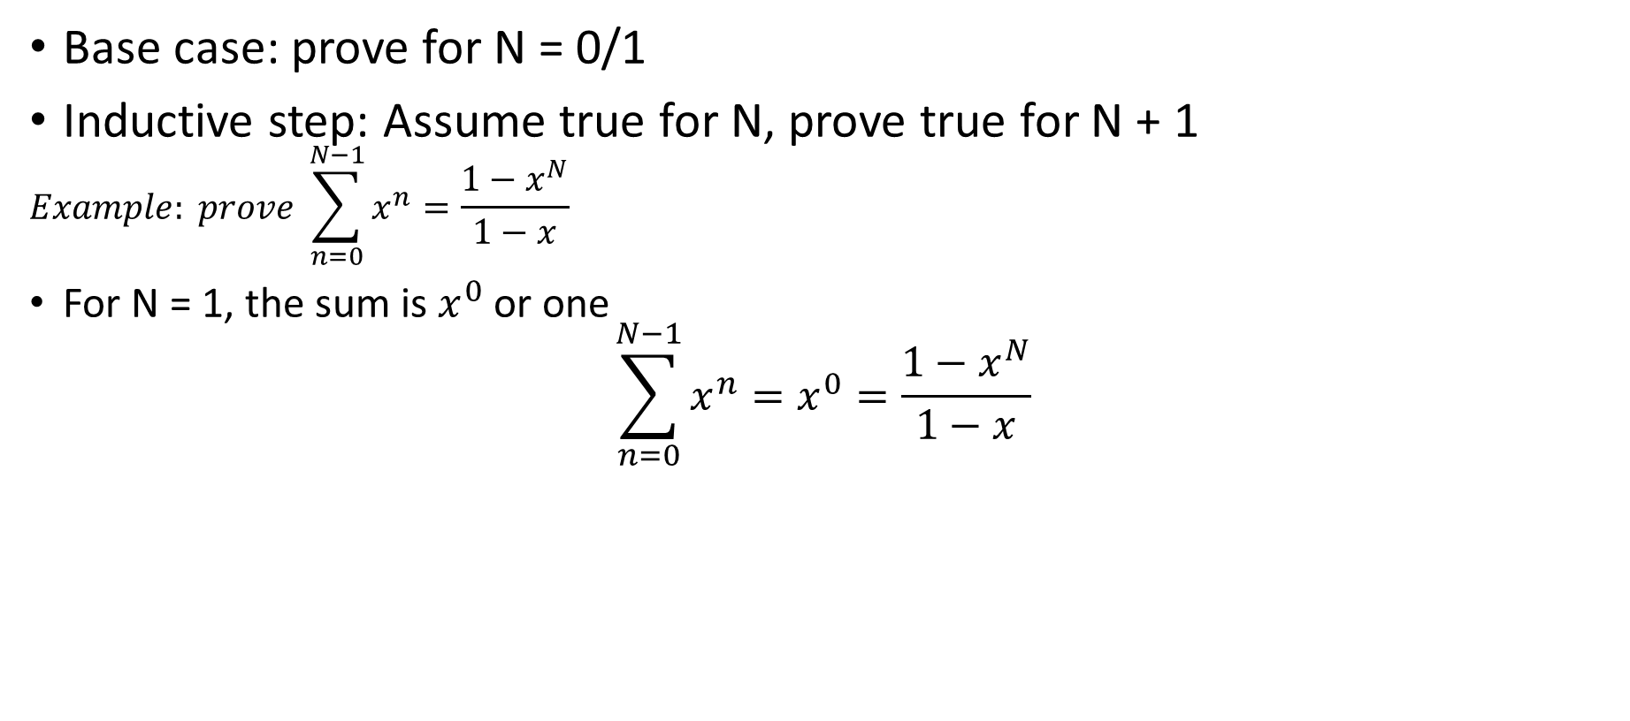
BACKGROUND: K- Induction
Base case: prove for N = 0/1
Inductive step: Assume true for N, prove true for N + 1
$$Example: prove \sum_{n=0}^{N−1}{x^{n}}=\frac{1−x^{N}}{1−x}$$
For N = 1, the sum is $x^{0}$ or one
$$\sum_{n=0}^{N−1}{x^{n}}=x^{0}=\frac{1−x^{N}}{1−x}$$
So, this is true (for x != 1).
For the inductive step, we’ll
  Assume true for N, then prove for N + 1
An Introduction to Formal Methods

Slide 33
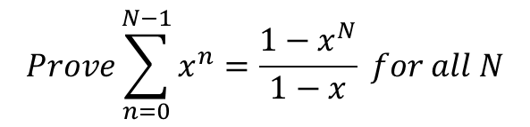

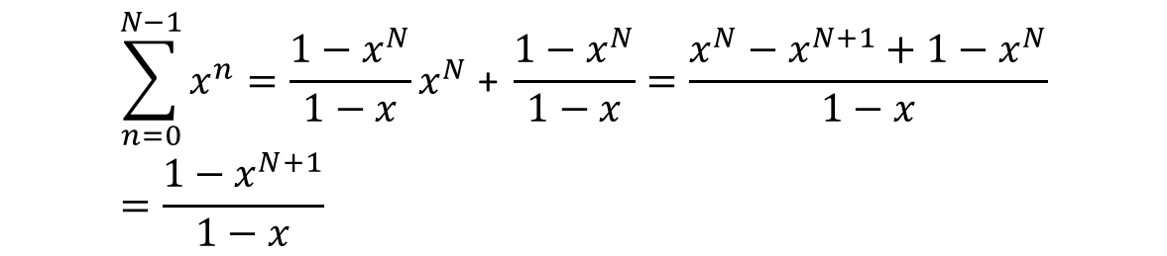
BACKGROUND: Proof
$$Prove\sum_{n=0}^{N−1}{x^{n}}=\frac{1−x^{N}}{1−x} for all N$$
Assume true for N, prove for N + 1
$$Prove\sum_{n=0}^{N−1}{x^{n}}=x^{N}+\sum_{n=0}^{N−1}{x^{n}}=x^{N}+ \frac{1−x^{N}}{1−x}$$
Prove for N + 1
$$\sum_{n=0}^{N−1}{x^{n}}=\frac{1−x^{N}}{1−x}x^{N}\text{ + }\frac{1−x^{N}}{1−x}=\frac{x^{N}−x^{N+1}+1−x^{N}}{1−x}=\frac{1−x^{N+1}}{1−x}$$
This proves the inductive case.
Hence this is true for all N (where N > 0 and x != 1 )
An Introduction to Formal Methods

