Slide 1

Enterprise Software Development

Slide 2
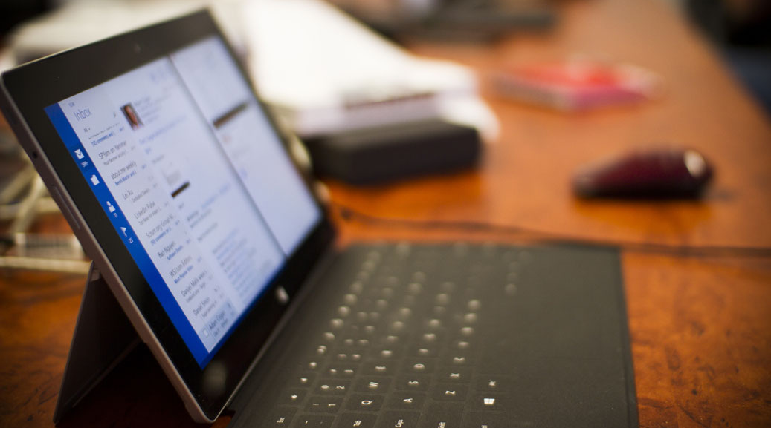
Azure Containers: From Zero to Kubernetes
Full Stack User Group October 2019

Slide 3

Anthony Ison
SSW Senior Software Architect
@isonaj
Full stack software developer
Addicted to buying shares
Has a 17 year old son who is learning to drive
Enjoys making cold brew coffee and flavoured liqueurs

Slide 4

Table of Contents
What are containers?
Running a container
Building a container
Hosting in Kubernetes (AKS)

Slide 5
A brief history
1999 – VMWare introduced virtual machines
2008 – LXC (Containers for Linux)
2013 – Docker brings us container PaaS
2015 – Google develops Kubernetes
2018 – Microsoft Azure Kubernetes Service (AKS)

Slide 6
Virtual Machines and Containers
Application
Application
Application
Libraries
Libraries
Libraries
Kernel
Kernel
Operating System

Slide 7
What are containers?
“A standardised unit of software” – docker.com
Lightweight, standalone, executable package
Shares the host system kernel (no OS per application)
Containers virtualise the OS, instead of the hardware
Isolation – little dependency on environment

Slide 8
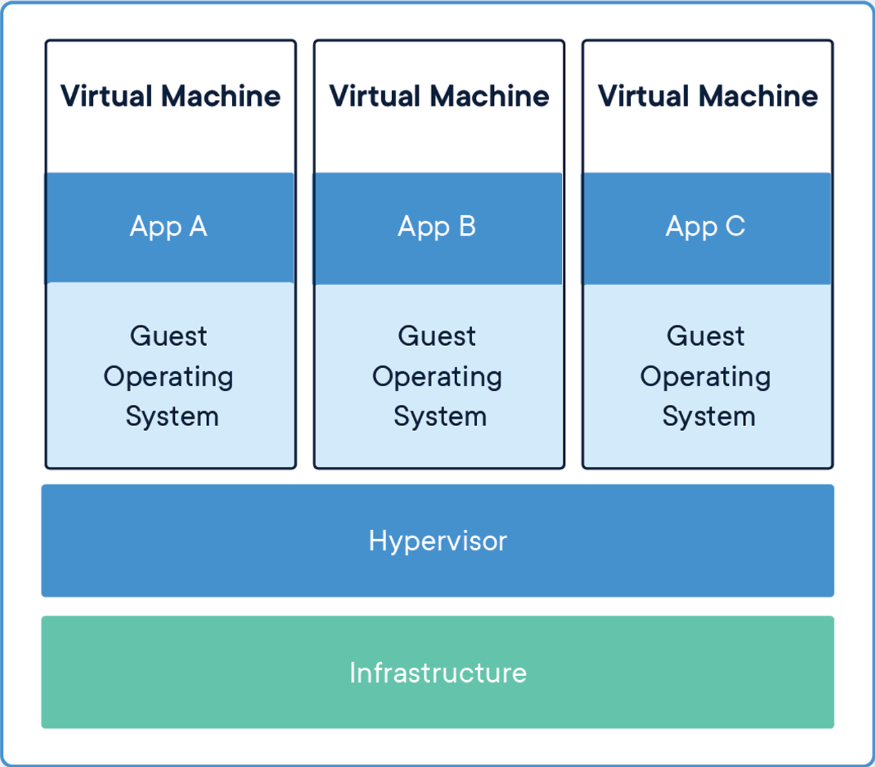
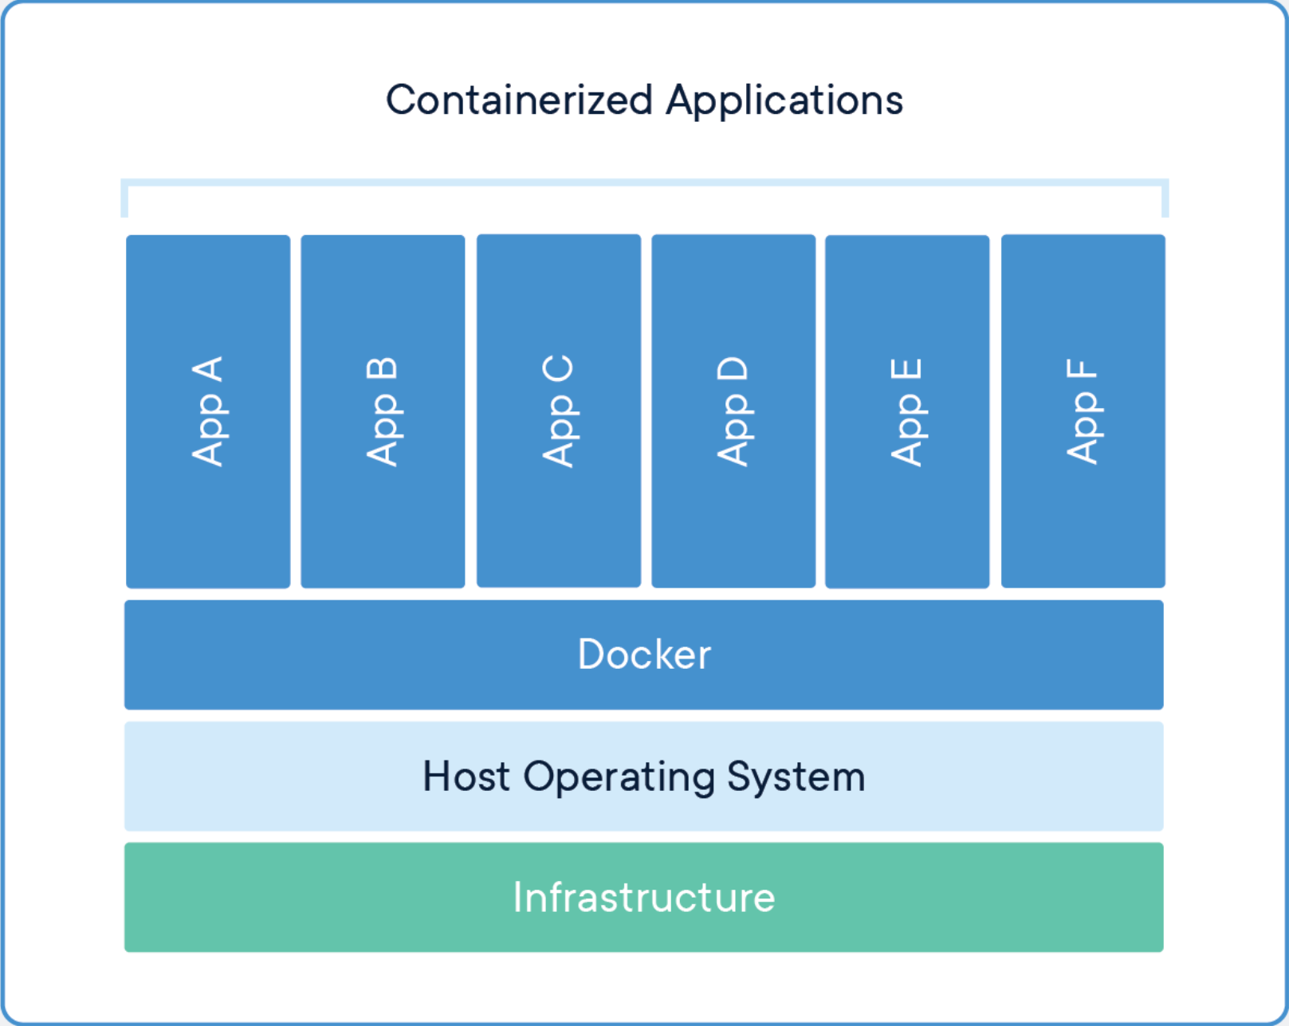
Virtual machines vs containers
from https://www.docker.com/resources/what-container

Slide 9
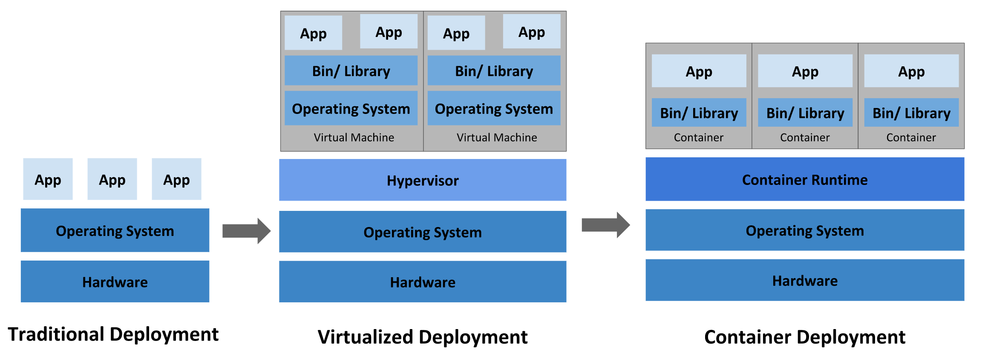
Virtual machines to containers
from https://kubernetes.io/docs/concepts/overview/what-is-kubernetes/

Slide 10
Container registries
Central store of container images (packages)
Docker Hub - first and most popular
Now many syndicated registries
Can be Public or Private

Slide 11
Table of Contents
What are containers?
Running a container
Building a container
Hosting in Kubernetes (AKS)

Slide 12
Running a container
Pull image:
docker pull ubuntu
Run a container:
docker run -it ubuntu

Slide 13
DEMO

Slide 14
What’s in an image name
Sql Server (on Linux)
mcr.microsoft.com/mssql/server:2017-latest-ubuntu
Registry
Account
Name
Tag (version)

Slide 15
Volume mapping
docker run –v C:\tmp:/tmp ubuntu
Host
(Windows)
Container
(Linux)
C:\tmp
/tmp

Slide 16
Port mapping
docker run –p 5000:80 ubuntu
Host
(Windows)
Container
(Linux)
5000
80

Slide 17
Run dotnet tools
docker run -it -v “$(pwd):/src” mcr.microsoft.com/dotnet/core/sdk:2.2-stretch
Host
(Windows)
Container
(Linux)
Current folder
/src

Slide 18
Run SQL Server
docker run -e 'ACCEPT_EULA=Y' -e 'SA_PASSWORD=P@55word!’ –p 5433:1433
–v c:\data:/var/opt/mssql mcr.microsoft.com/mssql/server:2017-latest-ubuntu
Host
(Windows)
Container
(Linux)
5433
1433
C:\data
/var/opt/mssql

Slide 19
DEMO

Slide 20
Table of Contents
What are containers?
Running a container
Building a container
Hosting in Kubernetes (AKS)

Slide 21
Building an image
Build image:
docker build –f TestApp\Dockerfile –t isonaj\testapp .
Push image to registry:
docker push isonaj/testapp

Slide 22
Dockerfile
FROM mcr.microsoft.com/dotnet/core/sdk:2.2-stretch
WORKDIR /app
COPY . .
RUN dotnet publish "TestApp/TestApp.csproj" -c Release -o /app
ENTRYPOINT ["dotnet", "TestApp.dll"]

Slide 23
Layered images
SDK
FROM dotnet/core/sdk
COPY . .
RUN dotnet publish
ENTRYPOINT [“dotnet”]
SOURCE
BINARIES
AUTO START

Slide 24
Layered images (multi-stage)
SDK (LARGE)
RUNTIME (TINY)
COPY . .
BINARIES
RUN dotnet publish
ENTRYPOINT [“dotnet”, “TestApp.dll”]

Slide 25
DEMO

Slide 26
Table of Contents
What are containers?
Running a container
Building a container
Hosting in Kubernetes (AKS)

Slide 27
Hosting containers in Azure
Web apps for containers
Azure Container Instances (ACI)
Azure Kubernetes Service (AKS)

Slide 28
What is Kubernetes?
Cluster of worker nodes (nodepool)
Master node(s) for managing the cluster
Scalable, self healing, highly available platform
Open source

Slide 29
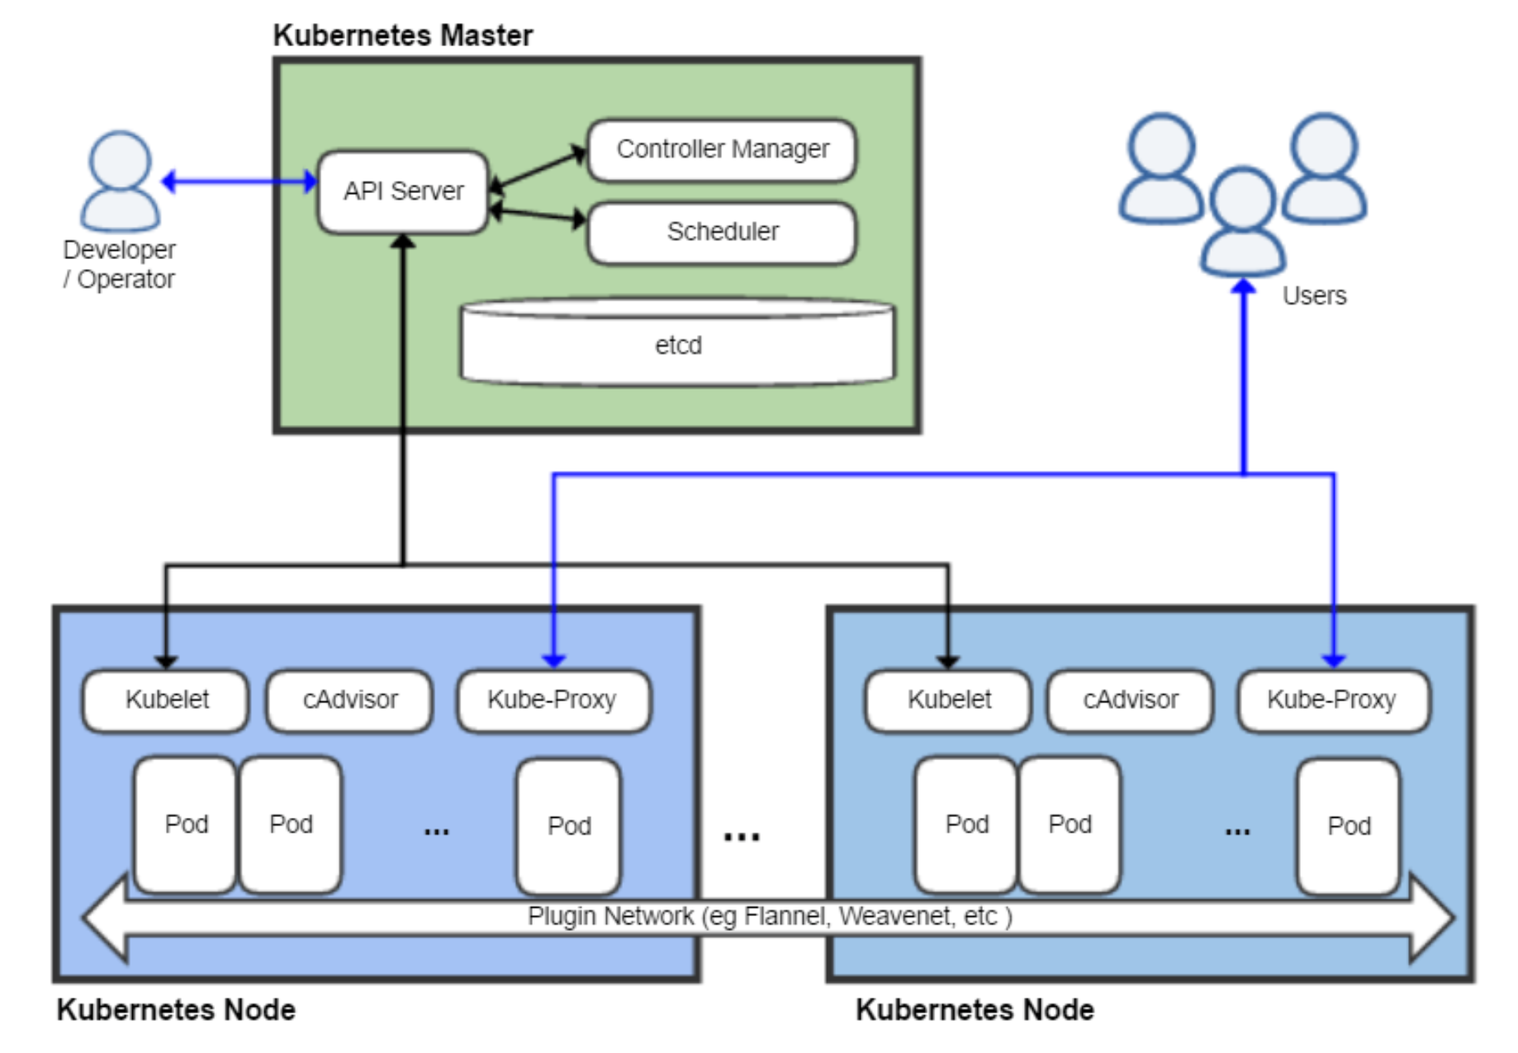
Kubernetes architecture
From https://en.wikipedia.org/wiki/Kubernetes

Slide 30
Why use Kubernetes?
Web apps for containers
PaaS for containers
Pay as you go
Managed security
Simplicity
Azure
Kubernetes
PaaS-like container platform
Massive discounts (up to 72%)
DIY Security
Flexibility
Portable (Azure, AWS, GCP, etc)

Slide 31
Set up with AKS
Create a cluster with:
az aks create –g MyResourceGroup –n MyManagedCluster
Download kubectl:
az aks install-cli
Connect to AKS cluster:
az aks get-credentials –g MyResourceGroup -n MyManagedCluster

Slide 32
Kubernetes components
Container resources
Pod
Volume
ConfigMap
Secret
Pod controllers
Service
Deployment
StatefulSet
Job
DaemonSet

Slide 33
Kubernetes configuration
YAML configuration files
Versioned definitions
Focus on desired state rather than actions

Slide 34
Kubectl
Apply config to cluster:
kubectl apply –f <filename>

Slide 35
DEMO

Slide 36
Learn more
anthonyison.com
hub.docker.com
kubernetes.io
docs.microsoft.com/en-us/azure/aks

Slide 37
Thank you! info@ssw.com.au www.ssw.com.au Sydney | Melbourne | Brisbane

Slide 38

SSW Stock Photos – \\fileserver\DataSSW\Photos\Powerpoint-StockImages

Slide 39
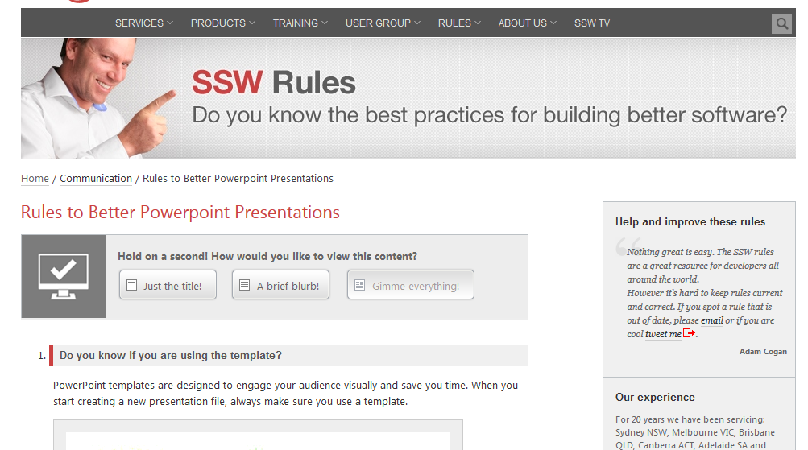
Are you following Rules to Better PPT?

Slide 40


“Coming back to where you started is not the same as never leaving.”
Terry Pratchett, Hat Full of Sky

Slide 41
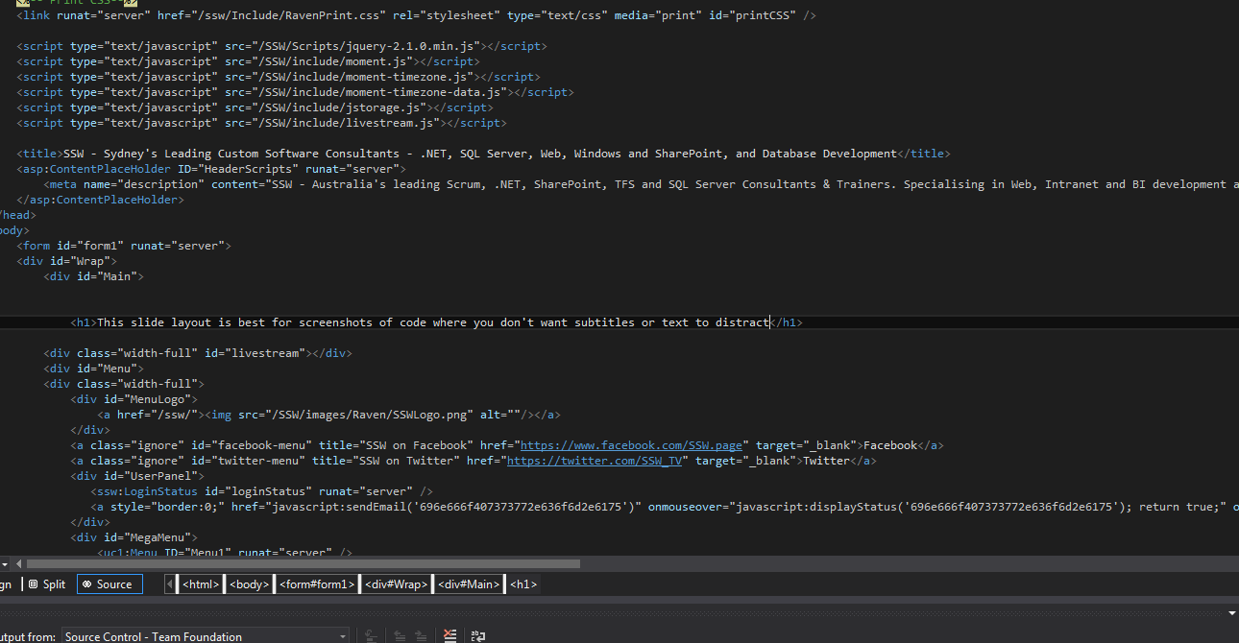

Slide 42
Indenting Text
If you press tab
While selecting the text
You can indent it
Without adding bullet points

Slide 43
The Pros and Cons of Pie
Pie is delicious
I could eat a lot of pie
I love pie
Add your own animation you lazy buggers
Pie is possibly too delicious
Eating too much pie makes you fat
I also like cheesecake

Slide 44
Cake versus Pie
Cake
Sweet
May contain cream
Sometimes contains nuts
Pie
Savoury…. Usually
May contain meat and gravy
Doesn’t usually have nuts

Slide 45
Cake versus Pie versus…
Cake
Sweet
May contain cream
Sometimes contains nuts
Pie
Savoury…. Usually
May contain meat and gravy
Doesn’t usually have nuts
Potato
I love potatoes

Slide 46
This slide has no title, it’s basically made for a huge block of text. You can style this however you want.

Slide 47
This slide has no title, it’s basically made for a huge block of text. You can style this however you want.
With a custom style, the boring slide is now super classy

Slide 48


This is a blank slide
Mainly for drawing shapes or small screenshots
You can do anything you want on this slide

Slide 49
Find me on Slideshare!
http://www.slideshare.net/SSWconsulting

