Slide 1
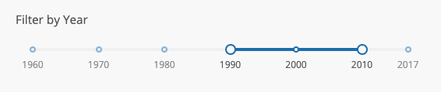
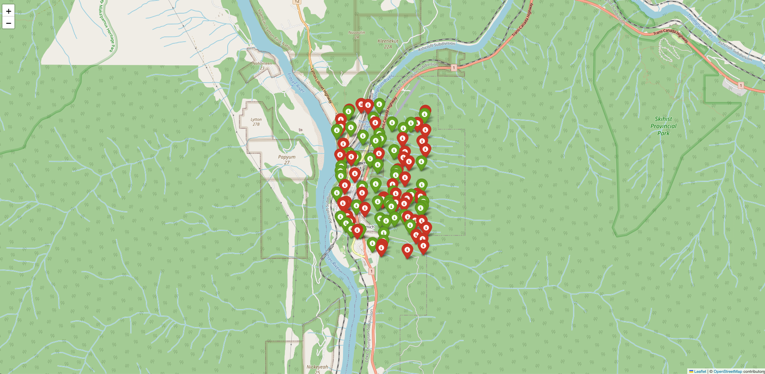
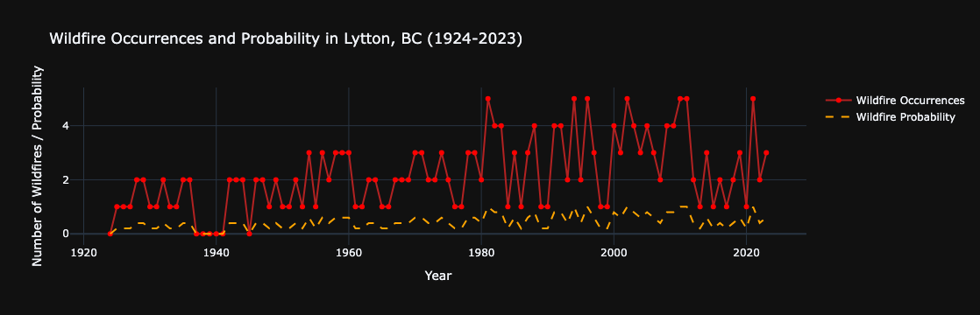
Filter by year or ‘t’ time <option>
Temperature <Probability>
Wind Speed <Probability>
Variable 3 <Probability>
Variable 4 <Probability>
Link to Risk Assessment
Link to Readiness
Link to AI Prompt

Slide 2
Risk Assessment
Critical Infrastructure
Emergency Response
Mitigation Strategies and Recommendations
Population Density and Demographics

Slide 3
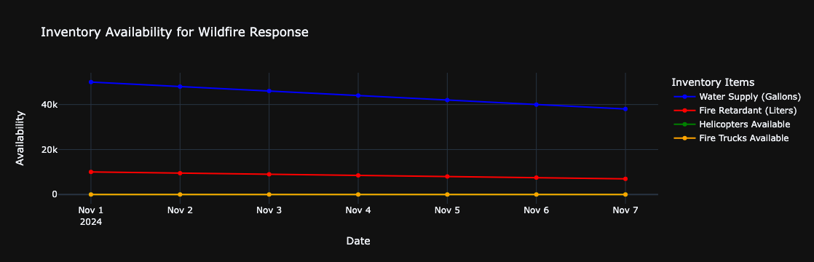
Readiness <Inventory> data

Slide 4
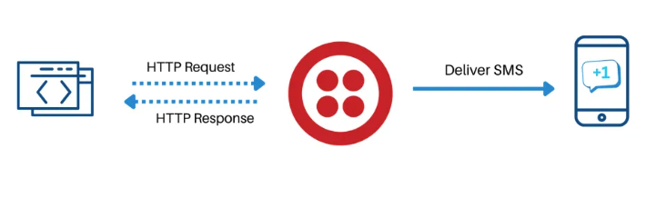


Emergency Response via application and Twilio API

Slide 5
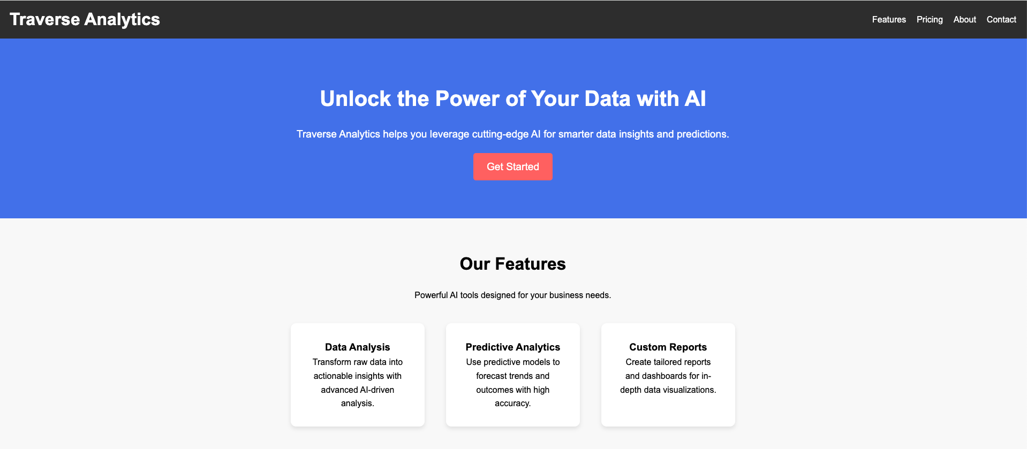
Web application

Slide 6

AI backed Chatbot prompt

