Slide 1

AutoA11y
Accessibility debt, paid down by an agent.
Audit
Fix
Verify
Powered by the Cline SDK · every change a reviewable diff
Team JadiBooty · IIT Kanpur · Cline AI Builders Hackathon
Notes:
Open with the loop, not the backstory. Say: "Existing tools tell you your site is broken. AutoA11y fixes it, then proves the fix worked." Ten seconds, then move on.

Slide 2



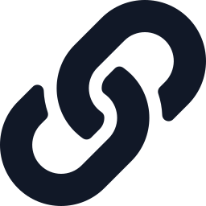
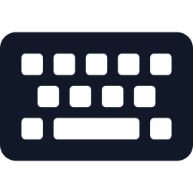

95.9% of the web fails
1 · Problem Statement
India mandates accessibility. Small dev teams lack the labor to deliver it.
Six mechanical error types cause ~96% of all errors
95.9%
Low-contrast text
83.9%
Missing image alt text
53.1%
of the top 1 million home pages fail WCAG 2, averaging 56 errors per page
Unlabeled form inputs
51.0%
Empty links
46.3%
Empty buttons
30.6%
% of home pages affected
Source: WebAIM Million 2026
RPwD Act 2016 + GIGW 3.0 make it mandatory. Small teams have no specialist and no audit budget.
Notes:
Stress that these failures are mechanical; that sets up why an agent can fix them. Say: "Six error types make up about 96% of everything detected. That's a job for automation, not consultants." Figures are from the WebAIM Million 2026 (Feb 2026 crawl): 95.9% of home pages fail, up from 94.8% in 2025, the first rise in six years, with 56.1 errors per page on average. Mention that it got worse this year; that's your urgency hook.

Slide 3
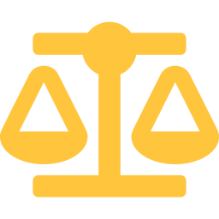

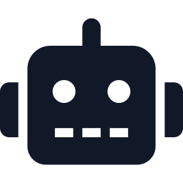
Why now
1 · Problem Statement
Mandates are rising, existing tools only report, and agents can finally repair.
Law demands it
Tools only diagnose
Agents can repair
Nov 2024: SC orders mandatory accessibility rules. Apr 2025: SC holds digital access is part of Article 21.
Lighthouse, WAVE and axe DevTools report problems. None of them repair your code.
The Cline SDK embeds Cline's agent core in any app: read, edit, verify. Repair is finally automatable.
Diagnosis was solved a decade ago. Repair was unsolvable until agents.
Notes:
This is the 'why us, why today' slide. Name both rulings: Rajive Raturi v. Union of India (2024 INSC 858, 8 Nov 2024) held Rule 15(1) of the RPwD Rules ultra vires and directed the Union to frame mandatory accessibility rules. Pragya Prasun & Amar Jain v. Union of India (30 Apr 2025) held that inclusive digital access to e-governance is part of the right to life under Article 21; that petition was about inaccessible government websites and apps. Then land the banner: "Diagnosis was solved a decade ago. Repair was unsolvable until agents."

Slide 4



We sell to the builders
2 · Target Audience
Developers adopt AutoA11y. People with disabilities benefit.
Primary users
Rohit, 26
Freelance developer · Indore
Freelancers, small agencies and IT vendors running government portals
12 client sites in React and plain HTML
A client just asked for GIGW compliance
No accessibility training, no time to learn WCAG
Beneficiaries
2.68 crore Indians with disabilities (Census 2011), plus elderly users
Market wedge
“I need it compliant by Friday.”
Compliance demand from government tenders and contracts
Notes:
Say plainly that end-users with disabilities benefit, but developers are who adopt and pay. Judges respect a team that knows who pays versus who benefits. Note: the Census 2011 figure is widely considered an undercount.

Slide 5


Two modes, one promise
3 · Solution & Features
Turns a multi-week manual audit into a reviewable pull request in minutes.
Scan mode
Fix mode
URL
REPO
Audit any public site
Ranked violation report + Lighthouse score
Zero setup: the free entry point
Cline SDK agent patches the source code
Re-audits until machine-checkable violations hit zero
Every change shown as a reviewable diff
~57%
of accessibility issues are caught by automated testing (Deque, 13,000+ pages). We fix that share completely and flag the rest for human review.
Notes:
Address the automation limit proactively — it answers the toughest judge question before anyone asks: "Automated tools catch roughly half of WCAG issues. We fix that half completely and hand you a checklist for the rest." The ~57% comes from Deque's 2021 study of 13,000+ pages and ~300,000 issues, measured by issue volume. Emphasise: URL mode can only audit — fixing needs repo access.

Slide 6
Four features, all verifiable
3 · Solution & Features
Every feature produces evidence. No claim requires trust.
1
2
3
4
Audit engine
Agentic fix loop
Diff viewer
Score comparison
axe-core in headless Playwright: violations with CSS selectors, plus a Lighthouse score
A Cline SDK agent maps each violation to source, patches, re-audits. Max 5 loops.
Every change line by line, GitHub-style. Nothing hidden.
Before/after Lighthouse score and violation count by category
Notes:
Keep it fast. The point of this slide: every feature produces evidence. Read the four titles, linger half a second on the dark card (the fix loop is the product), then move to architecture.

Slide 7
The loop at the core
4 · Architecture & Cline
A Cline SDK agent and our audit tool iterate until violations pass; results flow to the UI.
Repo
user's code
Sandbox clone
isolated workspace
Baseline audit
Playwright + axe-core
Cline SDK agent
@cline/sdk · file + shell tools
loop until pass, max 5×
Dev review
approve + merge
Diff + score UI
React viewer
Final audit
Lighthouse score
run_audit
custom tool via createTool
STACK
React + Vite + Tailwind
Node 22 + Express
Playwright + axe-core
Lighthouse
@cline/sdk
git + checkpoints
Notes:
Point at the green loop arrows and say: "This is where Cline lives." Flow: the repo is cloned into a sandbox, the baseline audit produces violation JSON with CSS selectors, then a Cline SDK agent (@cline/sdk, the same agent core behind Cline's IDE extension and CLI) fixes the code with its built-in file tools and calls our run_audit custom tool, registered with createTool, until violations pass (max 5 iterations). The final Lighthouse audit and diff go to the UI for developer approval. The SDK requires Node 22+, so the backend runs on Node 22.

Slide 8
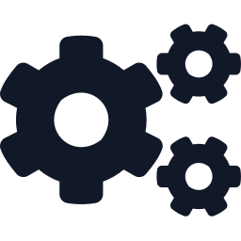

Cline SDK is the engine
4 · Architecture & Cline
The agent calls our audit tool itself and decides when it's done. No hand-written retry loop.
1
Read violation JSON
Built on @cline/sdk
ClineCore: built-in file + shell tools
run_audit via createTool, shipped as a plugin
Hooks stream every step to the UI
Checkpoints for one-click rollback
2
Locate source via CSS selectors
3
Edit JSX / HTML (built-in tools)
Guardrails
4
Call run_audit (our custom tool)
maxIterations = 5
Tool policies: edits only in src/, no deletes
Rules: semantic HTML over ARIA, flag doubts
Human approval before merge
Fails? Loop back. Passes? Stop.
Notes:
Slow down here: this slide scores 'Effective Use of Cline' and the SDK bonus. Key points: (1) We embed the agent with @cline/sdk rather than wrapping an LLM API. (2) run_audit is our own tool, registered with createTool and packaged as a Cline plugin, so the agent verifies its own work and decides when to stop. (3) Guardrails use SDK features: maxIterations caps the loop, tool policies restrict what the agent may do, hooks observe every step for the UI, and checkpoints let us roll back. Say it directly: "Cline closes the loop itself. Our backend doesn't call an LLM repeatedly; the agent reads, edits, verifies and decides." Also mention build-time use: we build AutoA11y itself with Cline during the finale.

Slide 9


Stage 2: what we ship in 8h
5 · MVP Scope (Stage 2)
A working fix loop on a seeded demo site. Everything else is deliberately cut.
In scope
Explicitly out
Fix mode for one plain HTML / React repo
4 violation types: alt text, contrast, labels, empty links/buttons
Audit → Cline SDK fix → re-audit loop, end to end
Diff viewer + before/after score UI
Demo site seeded with 25+ known violations
Scan mode at scale
Hindi alt text
GitHub PR automation
Multiple frameworks
H0–1
Audit endpoint + demo site
H1–3
Cline loop, 1 violation type
H3–5
All 4 types + run_audit tool
H5–6
Diff + score UI
H6–7
Harden + record backup demo
H7–8
Pitch rehearsal
Notes:
The out-of-scope list is your credibility — say "We deliberately cut X, Y and Z" out loud. Hours 1–5 (dark blocks) are the critical path: the Cline loop. The backup recording at hour 6–7 matters because live agent demos fail; judges forgive a failed live run if a recording proves the system works. Check the hackathon rules on whether the seeded demo site can be prepared before the finale; if not, build it in hour 0.

Slide 10
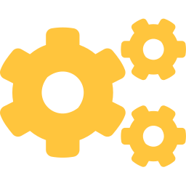
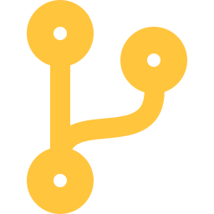
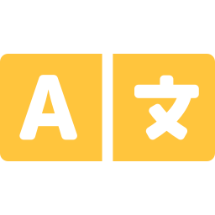

The demo, and what's next
Demo target & roadmap
A sample Indian SMB site, fixed live and verified by the same audit that flagged it.
LIVE DEMO TARGET
ROADMAP
42
91
Ship run_audit as an installable Cline plugin
GitHub Action on every pull request
Hindi and regional-language alt text
Before
After
25 violations → 0 machine-detectable
GIGW compliance report for tenders
Accessibility isn't a knowledge problem anymore. It's a labor problem, and agents do labor.
Notes:
Success metrics to mention if asked: % of violations auto-fixed, score delta, time to fix, and edits needing human revert (target: zero). End on the closing line and stop talking. Don't trail into "so yeah, that's our project."

