Slide 1
Serializing Enums in Type-less Contexts
A Great Talk™ by Sandy Maguire (20396195)

Slide 2
Overview
What is serialization?
How scripts fit in to a game engine
A quick introduction to using Lua and C++ together
Tools to make using Lua easier (SWIG)
Getting custom behavior out of said tools
Hooking it all together

Slide 3
The Question
How can we associate the values of a C++ enums together at runtime?
How can we do it without knowing the C++ type?

Slide 4
Background
Digital Extremes
  AAA developer of games on all modern platforms
  Proprietary editor to do the heavy lifting
  London, Ontario
I was doing AI!

Slide 5
“Time”s
Due to the compile-time related topic of this talk, it is necessary to define a few “time”s:
  Prebuild time: compiling all of the tools used in the build chain
  Build time: compiling the game itself
  SWIG time: the run-time of the tools used in the build chain
  Design time: designing game related content
  Game time: playing the game itself

Slide 6
Serialization
What is serialization?
  A means of loading/saving data, as well as changing it via an interface.
Why is it good?
  It allows us to write save game functions easily, as well as makes for nice hooks into the editor.

Slide 7
Serialization Cont.
Variables are generally serialized via the << operator
We can swap out the stream object to get different results from the same code
  Binary vs text streams
  Saving vs loading streams
Overloads for each type to get the proper behavior

Slide 8
Enum Serialization
Enums are serialized in much the same way, although with some special hacks.

Slide 9
Enum Serialization
C++ enums don't really exist at runtime. They are just numbers
This turns out to be a big problem, so instead we introduce the idea of an EDIT_ENUM

Slide 10
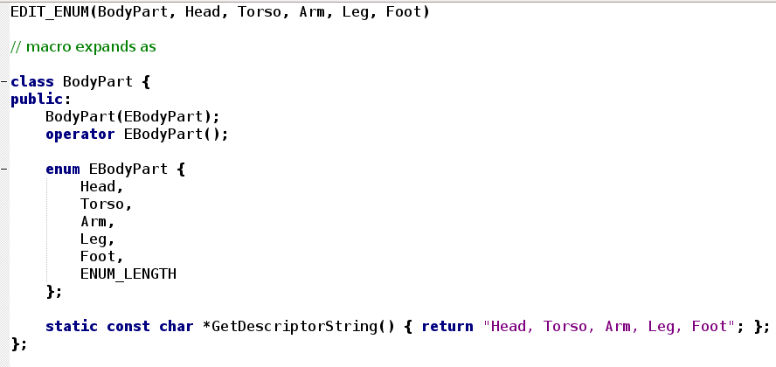
EDIT_ENUM

Slide 11
Descriptor Strings
The Descriptor String is really, really important
  It's the only reason why enum serialization works
If we have it, we have no more worries

Slide 12
Great! So what?
Enum serialization works in all type-safe contexts (ie all of C++)
But there are contexts in which it doesn't work, namely...

Slide 13
Scripts
Evolution has Lua scripts that hook in to the game engine.
  Example: writing teleportation animation stuff, determining how space ships fly, creating boss fights
We can reuse these scripts with arguments that are passed in via the serialization mechanism.

Slide 14
A (Really) Quick Primer on Lua
Easy to hook into C/C++
  We can pass function pointers around and they just work
JIT-ted dynamic language
  It's fast
Support for closures, coroutines, first class functions
  All of the things you want to quickly prototype game functionality

Slide 15
Relevant Lua Bits
It doesn't know what an enum is. It doesn't even really know what a constant is (but we can extend it so it does)
The language is duck typed

Slide 16
Lua Serialization
Scripts are declared with public global variables at the head
  These appear as parameters to be serialized
  Their given values act as defaults for the editor
They also declare global functions.
  These appear as functions to be called.
  Only the referenced parameters appear as arguments

Slide 17
How do we get the type?
If (line.looksLike(“[0-9]+”)) return number;

Slide 18
How do we get the type?
If (line == “String()”) return string;

Slide 19
How do we get the type???
If (line == “????”) return enum;
Let's figure this out.

Slide 20
The Problem (again)
Lua doesn't have a concept of enums. It only knows about constants.
C++ doesn't have a central location for storing enums.
There is too much code to change to solve either of these directly

Slide 21
Constraints
Memory
  We're running on consoles, remember!
Time complexity is not an issue
  The majority of the overhead is done at design-time

Slide 22
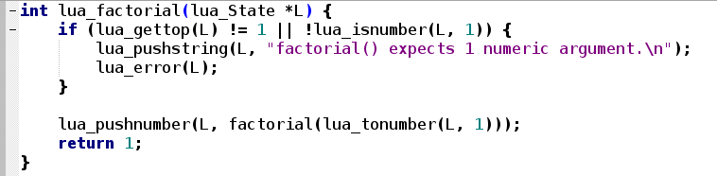
Lua Wrappers
Lua wrappers, although easy to use, are tedious to write

Slide 23
SWIG
The Sandy Principle™: “It's better to do tedious things with computers than by hand”
Enter SWIG
  The “Simplified Wrapper and Interface Generator”
  It does all of the heavy lifting for us

Slide 24
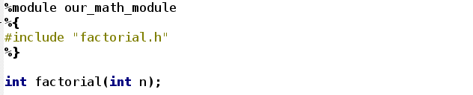
SWIG
SWIG takes (slightly modified) C++ headers like this:

Slide 25
SWIG
And turns them into something like...

Slide 26
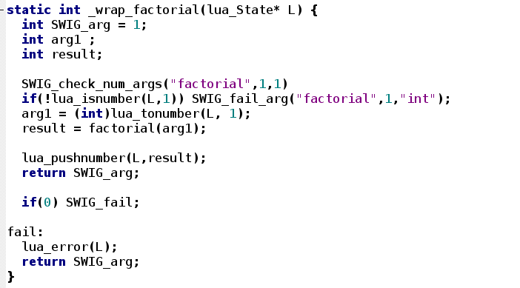
SWIG

Slide 27
A Closer Look at SWIG's Enums
While SWIG supports binding C++ enums, it provides no type safety
There is no way to determine which enums belong together. They are all in the same namespace.
Each value is actually exported as a constant
We need a way to group them together

Slide 28
Good Thinking, SWIG!
SWIG is designed around a template expanding library
  For ease of use of creating new languages
  We can use this to extend the generated code without too much work
Template changes don't require a recompile

Slide 29
Extending SWIG
Changing the templates gives us swig-time space to associate enums together
  But we can't actually associate them yet
To do so, we have to extend SWIG

Slide 30
Extending SWIG
SWIG gives a C++ parser interface not unlike most XML parsers
We simply give each enum a unique identifier when it is declared, and remove the identifier when we go out of scope

Slide 31
Mostly Success!
The generated SWIG files now have enough information to describe enum relationships
How do we do anything with this?
Simply put it all in a Lua table, since we're writing Lua code anyway

Slide 32
Great success
Since we now have a structure at design time which describes our enums, we can get back to the original problem
If we know one enum value, we can find all of the other values associated with it with a simple table lookup

Slide 33
And It All Comes Together
Now we can just hook everything up
The serializer recognizes it might have an enum
  It queries Lua to see if it actually is an enum
  If so, it asks what the other values are
  It creates an EDIT_ENUM, and we serialize this
  Proxy the return value back to our object
Brilliant!

Slide 34
Summary
At build-time, all enums get baked into a Lua table via SWIG
At design time, whenever an enum is requested, we lookup its symbolic name
If it exists, the script asks Lua for the rest of the values of the enum, and constructs a descriptor string
We use this string with the usual serializer to inherit the type-safe serializing method

Slide 35
Conclusion
Don't write glue by hand code if you can help it
Design things like this in advance :)

Slide 36
Thanks!

