Slide 1

Human resources slide 1
Astrosage Dataset Analysis
Project by – Pranay Sanyal
Newton batch – May 2025

Slide 2
PROBLEM STATEMENT
AstroSage, a fast-growing astrology platform, has recently secured a ₹1 crore investment to enhance its customer service infrastructure.
Challenge:
The current call center system is experiencing:
High call volumes with fluctuating response times
Inconsistent customer satisfaction
Rising operational costs
Objective:
To analyze historical call center data and identify actionable strategies for:
Maximizing operational efficiency
Enhancing customer satisfaction
Improving overall profitability

Slide 3
DATA OVERVIEW
1)Unique ID/User ID: Identifies individual users and consultations.
2) Guru Names/Guru Unique ID: Indicates the astrologer or expert providing the consultation.
3) Consultation Type: Differentiates between chat and call consultations.
4) Source of Consultation: Specifies where the consultation originated (e.g., app, website).
5) Creation Date/Time: Captures when the consultation was initiated.
6) Refund Status: Tracks whether a refund was issued for the consultation.
7) Chat and Call Status: Indicates whether a chat or call was completed, failed, or refunded.
8) Duration (Chat/Call): Measures the total time spent in each consultation.
9) Earnings and Payment: Columns like "Astrologer Earning," "Net Amount," and "Amount" show financial details.
10) Rating: Allows users to rate their consultation experience.
This data can be analyzed to assess user behavior, guru performance, consultation outcomes, and financial metrics.

Slide 4
Human resources slide 2
Objectives
The primary goal is to provide a comprehensive and data-driven view to stakeholders.
Analyze data to gain insights and key patterns.
Provide suggestions for user satisfaction and effectiveness in good service.
Provide investment strategies in training program, technology updates and hiring.

Slide 5

Human resources slide 3
DATA INFORMATION
(KPI)
DAILY ACTIVE USERS :
Date vs count of user.
This will show the number of user at specific date.
Operation cost
81%
54%
Unique Users
CHANGE IN CALL VOLUME :
Call volume vs date.
This metric will help us to know the change in average call volume day by day
Retention Rate
37%
Repeated callers
35%
SATISFACTION SCORE :
Average call duration
Rating vs count of users.
This will help to know about the satisfaction of the users.
Out of 28027 total user, 22745 users are repeated users.
119 sec

Slide 6
Human resources slide 4
METHODOLOGY :
ANALYSIS OF DATA :
DASHBOARD:
Whole data is summarized in the form of dashboard.
Data is analyzed for KPI’s and other important metrics.
DATA CLEANING:
KEY INSIGHTS AND PATTERN:
The raw data is cleaned by different excel functions. Missing values are been filled and formatting is done.
Provide suggestions on the basis of insights for customer satisfaction and profitability boost.
Astrosage Dataset Analysis.

Slide 7
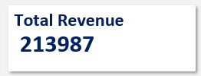
Human resources slide 5
ANALYSIS
KPI –
(Key performance indicator)
There are total 28027 users.
The net revenue of the company is 213987.32 Rs
1) Total users -
2) Net revenue-

Slide 8
ANALYSIS
1)The average daily call volume is 250.
2) On 10/12/23 there was highest call volume i.e 430.
3) On 03/01/2024 there was lowest call volume i.e. 107.
4) December – Highest call volume.
January – Lowest call volume.
5) Call centre receive approx. 250 calls per day but only 56.41% of calls gets complete in total from astrologer side.
Suggestion – There is a need of hiring new skilled agents and freelancers to manage the workload of existing agents.

Slide 9
ANALYSIS
1) Satisfied user (Rating-5,6,7,8) = 27.49 %
2)Unsatisfied user (Rating-0,1,2,3,4) = 72.5%
3) Out of 8541 calls only 3453 calls are getting completed, which is 40.43 %.
4) That means 59.57 % of users are not getting the service despite of booking the call session.
Suggestion – Invest in training programs for the agents, by which they will get training to give better service to the users and manage time properly.
(User distribution on the basis of rating)

Slide 10
ANALYSIS
1) The 78.72% of the total net income for the company comes from Call service only.
2) And the 78.46% of the total income for the astrologer comes from Call service.
3) Total revenue = 213987.32 rs.
4) Correlation between net income and astrologer earning is 0.997,which suggests a very strong positive linear relationship between two variables.
Suggestion - So if the call service is a key revenue driver, investing in training programs would be a strategic move to sustain and enhance that success.

Slide 11
ANALYSIS
Around 8.00 am the traffic of the callers are very high.
Around 01.00 am at night the traffic is very low.
Approx 660 users calls around 8.00 am.
4) There are only 131 agents.
Suggestion-
1) Hire part time or freelancer agents , this reserve agents will balance the workload without increasing permanent cost.
2)Shift optimization- Optimizing more agents shifts to peak periods accordingly. Ensure that more agents are scheduled during high – traffics time.

Slide 12
ANALYSIS
7256 times Guru gets the rating of 0.
2) Satisfied user (Rating-5,6,7,8) = 27.49 %
3) Unsatisfied user (Rating-0,1,2,3,4) = 72.51 %
Suggestion-
Company should run training program which include-
1) Call Handling Techniques
2) Enhancing Skills
3) Cross-Selling:
4) Adaptation to Growth

Slide 13
ANALYSIS
1) Astro Krishaa ( Guru id -287 ) got the highest number of 8 which is 169 times , which is highest satisfaction score earned guru.
2) Astro Yogendra (Guru id- 201 ) got the highest number of 0 i.e. 482 times , which is lowest satisfaction score earned guru.
Suggestion –
Company can implement strategies like-
Professional development and training.
Clear performance metrics.
Recognition and reward.
Upgrade technology and tools.

Slide 14
ANALYSIS
1) 72 % of users use Gurucool website.(Source of consultancy)
2) 28 % of users use App. (Source of consultancy)
3) Highest sales generated by App i.e. 125267.38
Suggestions – Gurucool is only one platform which provide the service of the Chat to the users.
But the average rating of the Gurucool is 2.71, which is the clear indicator of unsatisfied users.
So it is very necessary to improve technology and provide satisfaction to the users

Slide 15
ANALYSIS
29 % of chats get completed between agents and users.
2) 34 % of chat remain incomplete.
3) While 37 % of chat get failed.
4)69.62 % of total users use chat service and gurucool is only website which provide chat service.
Suggestion-
Investing in gurucool technology upgrades will help to improve the overall experience and will help to increase the retention rate of the users. And increase the user satisfaction as it is only 2.71 for chat service.

Slide 16
ANALYSIS
Only 41 % users call get completed.
20 % of user didn’t got any answer.
While 14 % users call get failed.
And 10 % of users call remain incomplete.
Suggestions-
1) Hire part time or freelancer agents , this reserve agents will balance the workload without increasing permanent cost.
2)Shift optimization- Optimizing more agents shifts to peak periods accordingly. Ensure that more agents are scheduled during high – traffics time.

Slide 17

Human resources slide 7
ANALYSIS
0.991
40.43%
27.49%
69.62%
Correlation of net revenue
and astrologer earning
Completed calls
Satisfied users
Chat service
This suggest the positive relation. As the astrologer earning will increase the net revenue will also increase.
Out of 8541 only 3453 calls get completed.
Out of 28027 users only 7704 users gave rating of 6,7,8(satisfactory score).
Out of 28027 users 19514 users use chat service.

Slide 18
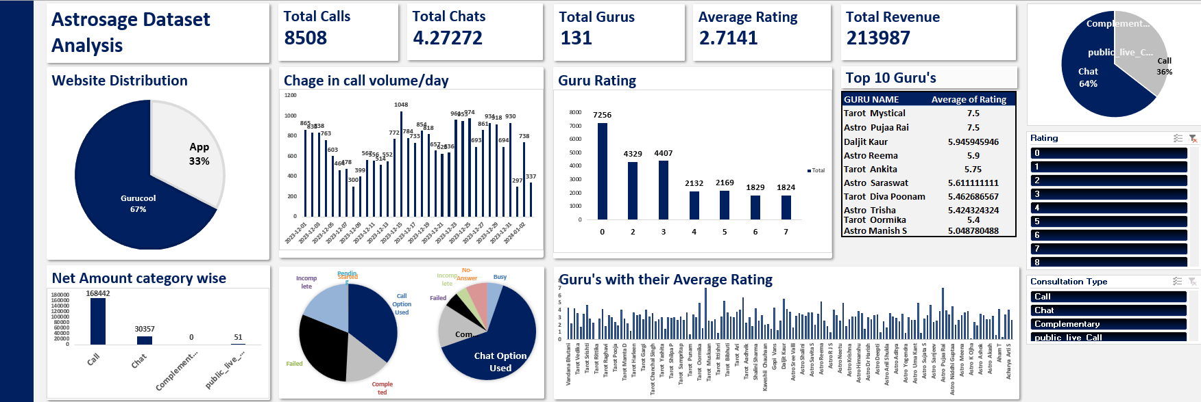
Human resources slide 8
DASHBOARD
.

Slide 19
RECOMMENDATIONS
AFTER ANALYZING ALL THESE INSIGHTS I RECOMMENDE THE COMPANY TO INVEST 1 CRORE IN THREE PHASES-
PHASE 1 – 10 Lakhs for Training Programs.
1) Training about new technologies.
2) Call Handling Techniques:
3) Cross-Selling.
PHASE 2 – 40 Lakhs for Technology Upgrades.
1) As Exotel is the only cloud phone system with which company work, fund should be invested in building another cloud phone system to manage the burden
2) Buy new high-tech equipment.
3) AI chatbots, E-puja feature by video call.
PHASE 3 – 50 lakhs E-commerce business and Mental health category.
Mental Health category- In today time relationship and career uncertainty is at peak. And as in India therapy is very expensive and take it as a taboo. so Astrosage can work as pseudo therapy app for them, which provide sense of certainty. This move can make the company stand separate among the rivals. And bring customers and revenue to the company .
E-commerce - Company can sell the Gem stones and other things related to puja. This will help the company to generate extra revenue and also to attract new customers.
These steps will enhance customer satisfaction, optimize operations, and increase profitability for AstroSage.

Slide 20
Human resources slide 9
CONCLUSION
For the problem statement , I have conducted analysis, created pivots , charts and dashboard to draw conclusion. These finding will help address the problem statements. I thoroughly enjoyed working on this project. It provided a valuable opportunity to apply Excel skill .

Slide 21
Human resources slide 10
Thank You…

