Slide 1


Bank CRM Analysis
Strategies to Reduce Churn & Improve Satisfaction
- PRANAY SANYAL

Slide 2

AGENDA
5. Metrics and their Insights
6. Dashboards
7. Challenges Faced
8. Conclusion
9. Recommendations
Introduction
Aim
Problem Statement
Data Overview

Slide 3

INTRODUCTION
This analysis explores customer churn patterns in a retail bank to identify the key drivers behind customer attrition. By examining demographic, geographic, financial, and behavioral factors, we aim to uncover insights that help the bank:
Understand who is churning and why
Pinpoint high-risk customer segments
Provide data-driven strategies to reduce churn, improve service delivery, and enhance customer satisfaction

Slide 4

PROJECT AIM
To analyze customer demographics, financial profiles, and behavioral patterns in order to identify key drivers of churn and provide data-driven strategies that help the bank:
Reduce customer attrition
Improve service delivery efficiency
Enhance overall customer satisfaction and loyalty

Slide 5

PROBLEM STATEMENT
The bank is experiencing a high rate of customer churn, leading to revenue loss and weakened customer loyalty.
Current customer engagement strategies are not effectively addressing customer needs.
Limited visibility into demographic, financial, and behavioral factors driving churn.
Without actionable insights, the bank risks losing competitive advantage and failing to retain valuable customers.

Slide 6
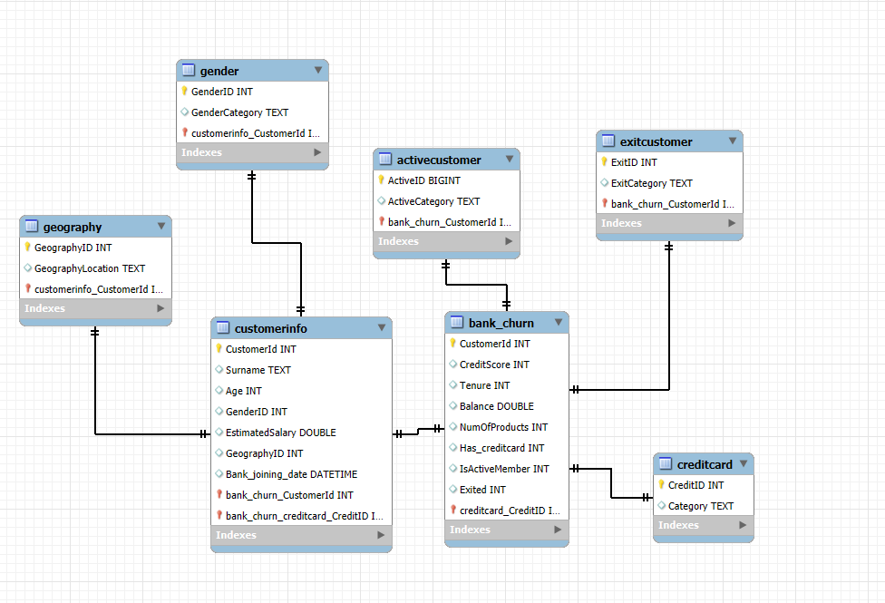
DATA OVERVIEW

Slide 7

LET'S GET INTO
PROBLEM STATEMENT
This Photo by Unknown Author is licensed under CC BY

Slide 8
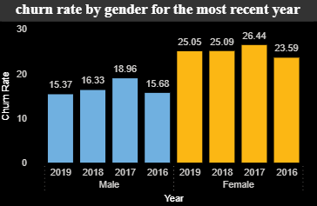
Churn Rate by Gender (2016–2019)
Insights:
Females show consistently higher churn rates (25–26%) compared to males (15–19%).
Male churn is relatively stable, while female churn has remained consistently above 25%, peaking in 2017.
This indicates gender-based behavioral differences in customer loyalty and satisfaction.

Slide 9
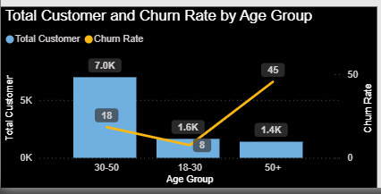
Customer Distribution and Churn by Age Group
Insights:
The 30–50 age group has the highest customer base (7K) but a moderate churn rate of 18%.
Young customers (18–30) have the lowest churn rate (8%), indicating stronger retention in this segment.
Older customers (50+) represent a smaller customer base (1.4K) but show a very high churn rate (45%), signaling disengagement or dissatisfaction among senior customers.

Slide 10
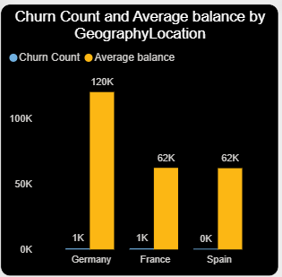
Churn Count and Average Balance by Geography
INSIGHTS:
Germany shows the highest churn count (~1K) and also the highest average balance (120K), meaning high-value customers are leaving.
France and Spain have lower average balances (~62K each), but churn counts are also notable.
The bank risks losing its most profitable segment in Germany, which could heavily impact revenue.

Slide 11
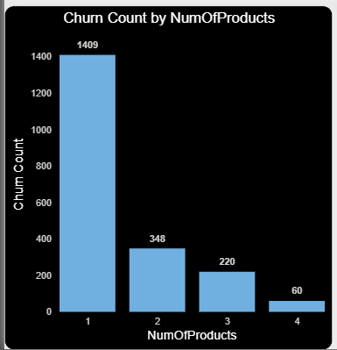
Churn Count by Number of Products
Insights:
Customers with only 1 product show the highest churn count (1,409), indicating weak engagement.
Churn decreases significantly as the number of products increases (e.g., only 60 churn cases with 4 products).
This suggests that multi-product customers are more loyal, while single-product customers are at the highest risk of leaving.

Slide 12
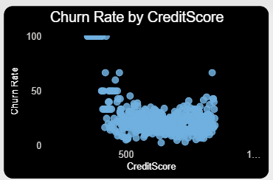
Churn Rate by Credit Score
Insights:
Customers with lower credit scores (<500) show a higher churn tendency, indicating weaker financial stability or dissatisfaction.
As credit score increases (600–800+), the churn rate becomes more stable and relatively lower, suggesting financially stronger customers are more likely to stay.
However, there are still outliers with high churn even at good credit scores, which indicates that churn is influenced by other factors (e.g., product engagement, service quality) beyond just credit score.

Slide 13
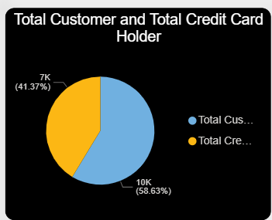
Total Customers vs. Credit Card Holders
Insights:
Out of 17K total customers, only 41% (7K) hold a credit card, while 59% (10K) do not.
This indicates a significant opportunity for cross-selling credit cards to nearly 60% of the customer base.
Credit card holders are generally more engaged and contribute to higher revenue through transaction fees and loyalty benefits.
The lower adoption could signal lack of awareness, stringent eligibility, or low perceived benefits of holding a credit card.

Slide 14
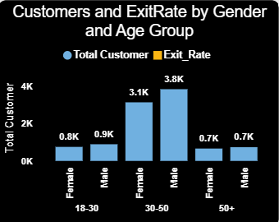
Customer Distribution and Exit Rate by Gender & Age Group
Insights:
The 30–50 age group dominates with the highest number of customers (3.1K females and 3.8K males).
Younger customers (18–30) and older customers (50+) form a much smaller base (~0.7K–0.9K each).
Exit rates appear to be higher in the 30–50 group, despite it being the largest customer base.
This suggests that while mid-age customers are the bank’s core segment, they also represent the highest churn risk.
Gender distribution shows slightly more males (3.8K vs. 3.1K in 30–50 group), but exit behavior seems concerning across both genders in that segment.

Slide 15
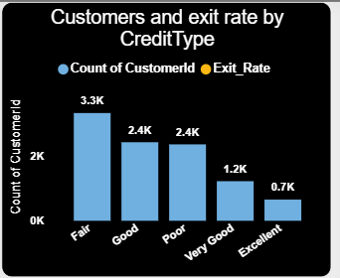
Customer Distribution and Exit Rate by Credit Type
Insights:
The largest customer group falls under Fair credit type (3.3K), followed by Good (2.4K) and Poor (2.4K).
Surprisingly, Very Good (1.2K) and Excellent (0.7K) credit type groups are the smallest segments.
Exit rate trends suggest that even customers with stronger credit profiles (Good, Very Good, Excellent) are not immune to churn, indicating churn is influenced by more than just creditworthiness.
The higher exit rates among Fair and Poor credit type customers may indicate financial stress or dissatisfaction with product offerings.

Slide 16
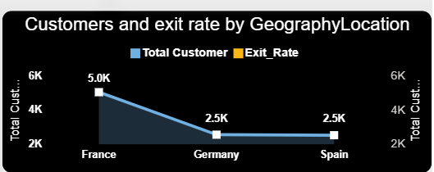
Customer Distribution and Exit Rate by Geography
Insights:
France has the largest customer base (5K), but also contributes significantly to churn, indicating potential dissatisfaction despite scale.
Germany and Spain have a smaller base (2.5K each) but their exit rates are proportionally higher compared to France.
The geographic trend highlights Germany as a key churn hotspot, suggesting location-specific factors (e.g., product preferences, competition, or service quality) might be driving exits.
Spain, while having the same customer count as Germany, shows relatively balanced churn, indicating better retention compared to Germany.

Slide 17
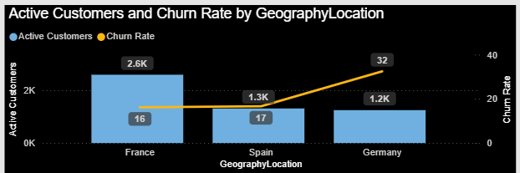
Active Customers and Churn Rate by Geography
Insights:
France has the highest number of active customers (2.6K), with a moderate churn rate (16%) → retention efforts are relatively effective.
Spain shows fewer active customers (1.3K) but a slightly higher churn rate (17%), suggesting retention challenges despite a smaller base.
Germany stands out with the lowest active customers (1.2K) but the highest churn rate (32%), indicating a severe churn issue.
Overall, Germany is the most critical region to address, while France remains the strongest market in terms of customer activity and retention.

Slide 18
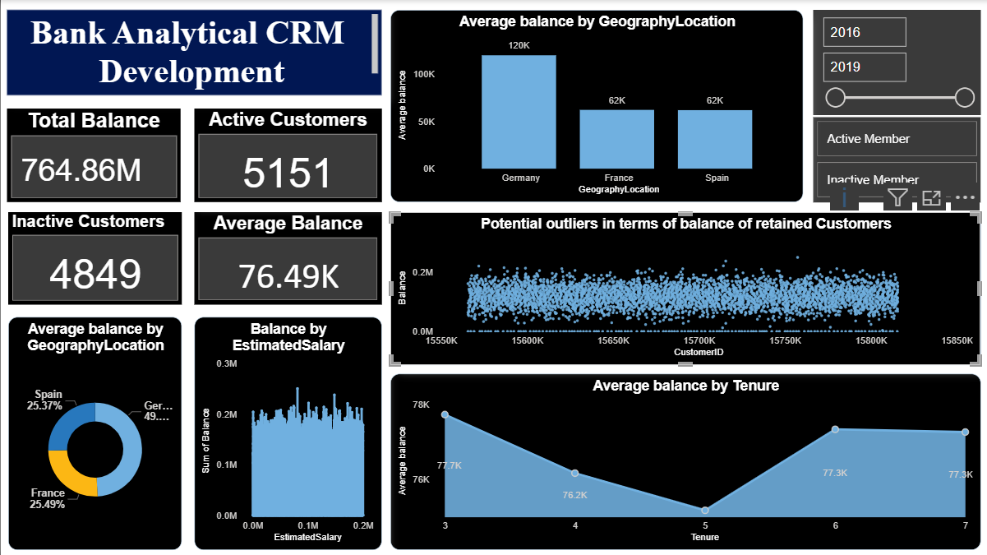
DASHBOARD

Slide 19
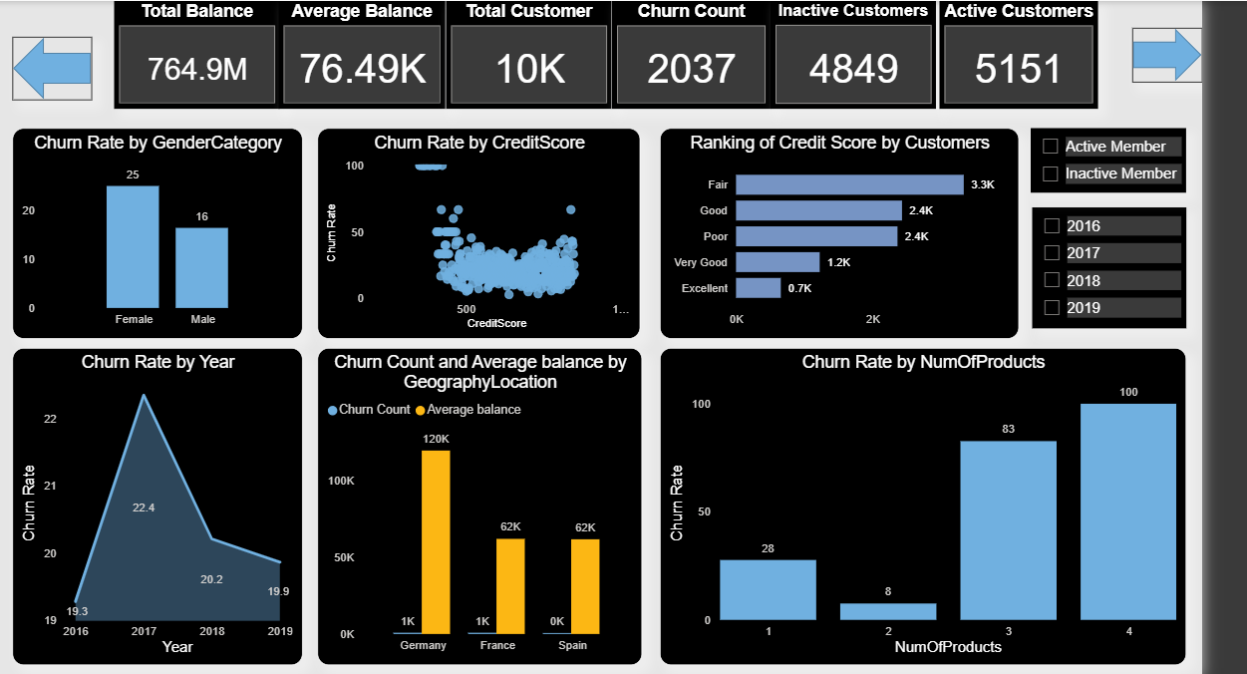

Slide 20
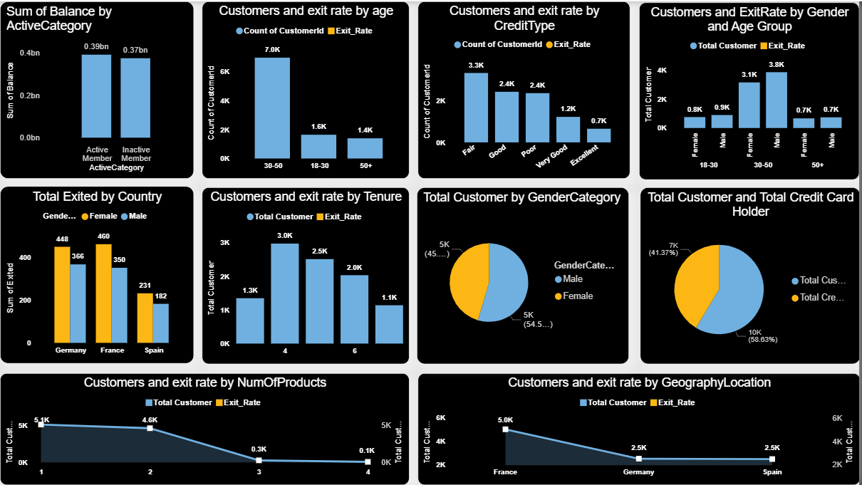

Slide 21
CHALLENGES FACED
Imbalanced Data Distribution
  Churned customers were significantly fewer than active customers, making it challenging to build balanced predictive models.
Data Quality & Missing Values
  Incomplete customer details (e.g., income, spending behavior) restricted deeper insights and required additional preprocessing.
Feature Complexity
  Multiple influencing factors (tenure, credit score, geography, age, etc.) made it difficult to isolate the strongest churn drivers.
Regional Variations
  Customer behavior varied widely by geography (France, Spain, Germany), requiring tailored analysis instead of a one-size-fits-all approach.
Limited Behavioral Data
  Transaction-level or product usage data was not fully available, restricting analysis to demographics and high-level attributes.

Slide 22
CONCLUSION
High-Risk Segments: Churn is highest among females aged 50+ and German customers, requiring targeted retention plans.
Loyal Segments: Young customers (18–30) and those with mid-range credit scores (670–739) show stronger loyalty and lower churn.
Market Insights: France remains the largest and most stable market with high customer volume and lowest churn.
Product Holding: Majority of customers hold only one product, yet contribute significantly to balances, highlighting cross-sell/upsell opportunities.
Credit Card Ownership: Non-credit card holders (~29%) present strong potential for financial product adoption.
Income Factor: Salary is not a strong predictor of churn, balance, or credit score, making other behavioral indicators more reliable.

Slide 23
RECOMMENDATIONS
Target High-Risk Segments
Develop retention programs for females 50+ and German customers, as they show the highest churn.
Boost Engagement through Cross-Sell/Upsell
Launch personalized upselling for single-product holders.
Promote credit card adoption among non-card users (~29%) to increase stickiness.
Strengthen Loyalty Programs
Focus on the 30–50 male segment (large, stable group) with reward-based engagement.
Encourage and incentivize mid-credit score customers (670–739) to maintain their low churn.
Refine Targeting Strategy
Avoid salary-based segmentation since salary shows minimal link to churn, balance, or credit score.
Geographic Strategy
Prioritize France and Spain for growth/expansion, given their high customer bases and lower churn rates.

Slide 24
THANK YOU...

