Slide 1
Title
Subtitle

Slide 2
Title
Text
first item
second item
subitem
third item

Slide 3
Title
first bullet item
second bullet item
subitem
first letter item
second letter item
first subitem
second subitem

Slide 4
Title
Horizontally merged cells
 |  | Vertically merged cells
Vertically merged cells 2
 |  | Horizontally merged cells 2

Slide 5
Custom title
Custom text field
Bold text
Italic text
Underlined text
Strike text
^{Superscript}, _{subscript}
Large, small

Slide 6

Custom title

Slide 7
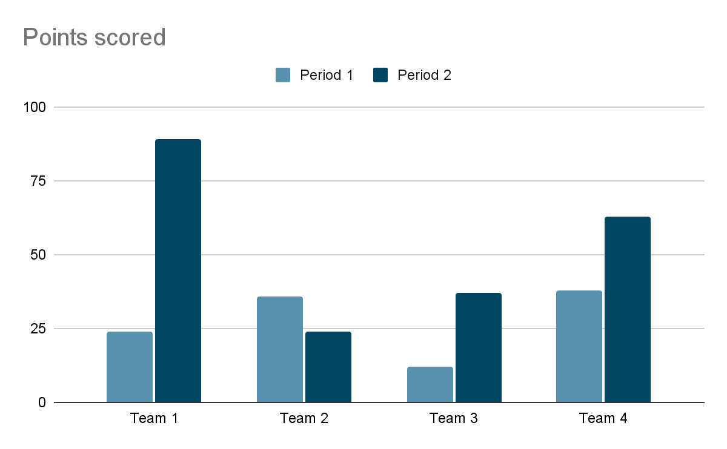

Slide 8

Title
Text text
subtitle

