Slide 1
Status of ISPyB for SAXS at EMBL-HH
Joint MxCuBE – ISPyB meeting

Slide 2
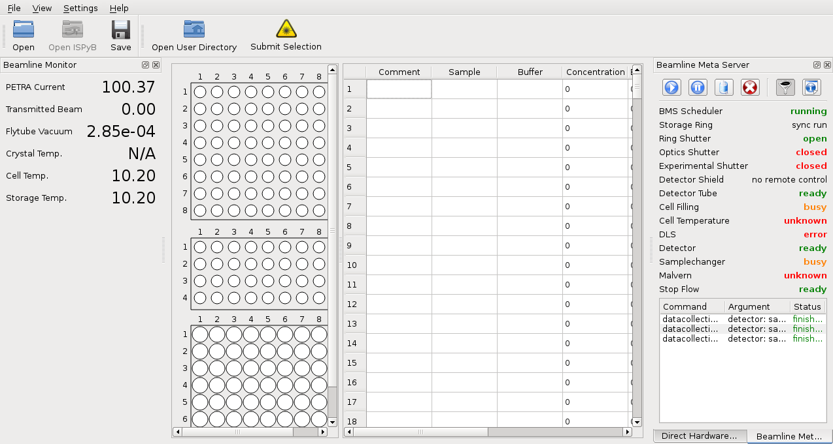
Becquerel: P12 Experiment Control

Slide 3
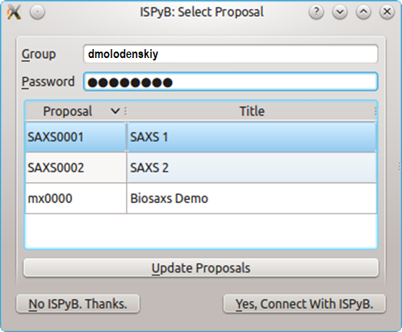
Becquerel: ISPyB login

Slide 4
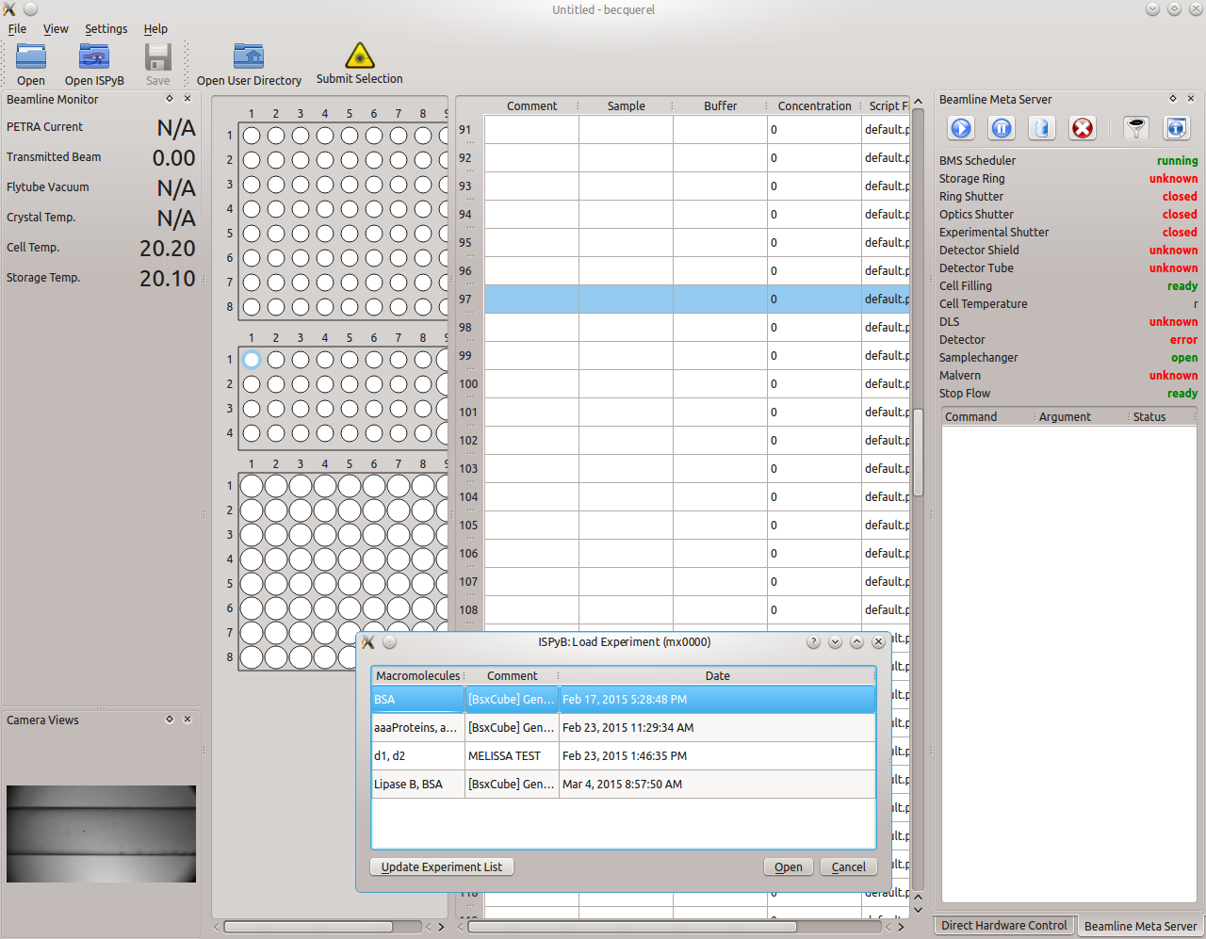
Becquerel: Load Experiment from ISPyB

Slide 5
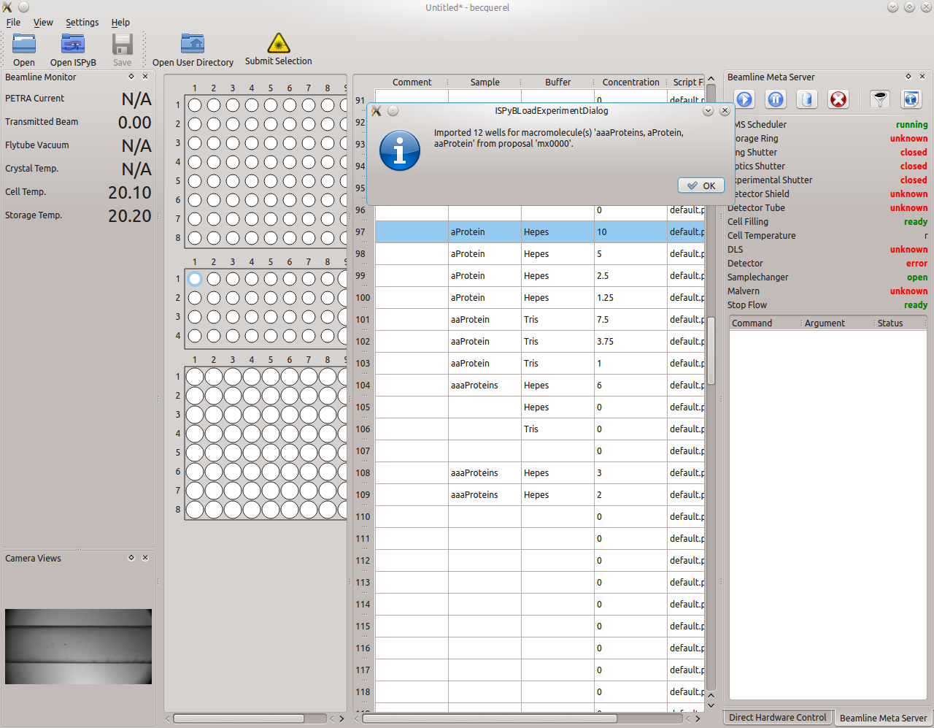
Becquerel: Loaded Experiment from ISPyB

Slide 6
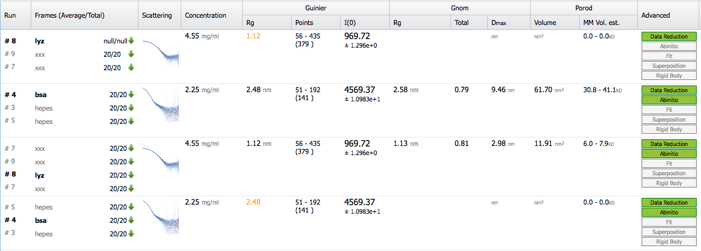
ISPyB results as reported by SASFLOW

Slide 7
Automated SAXS pipeline for
membrane proteins, integrated into ISPyB.
est. August 2018
(under iNext WP5, deliverable 5.5)

Slide 8
ISPyB extensions for membrane proteins:
Layout
Storage of SEC-SAXS runs in the database
Calculation and storage of electron density of a sample
Drop-down list of off-shelf detergents
Calculation of electron densities of hydrophobic and hydrophilic parts of the detergent corona
Modelling by MONSA and MEMPROT (if all the necessary data are available)

Slide 9
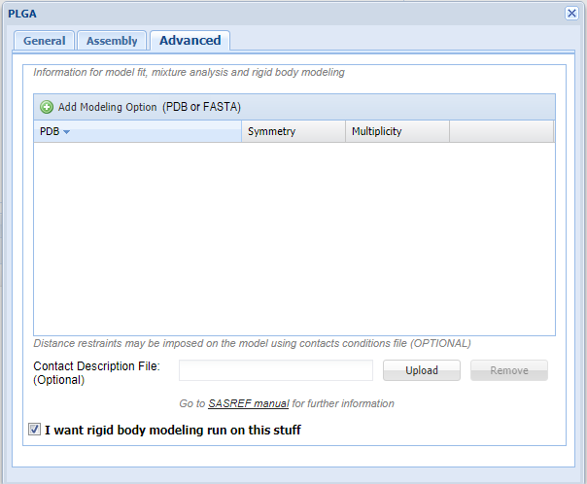
Prepare Experiment → Add Macromolecule → Advanced

Slide 10
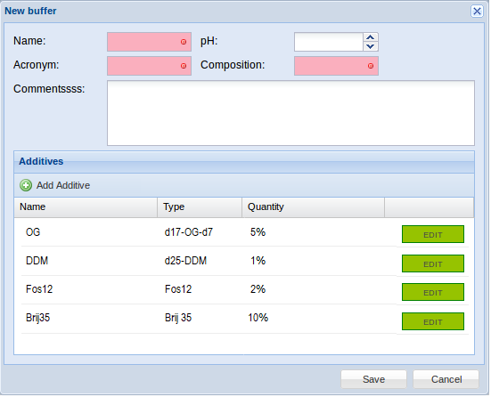
List of detergents (Breyton et al, 2013)

Slide 11
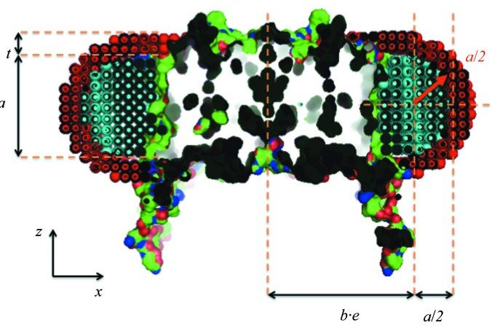
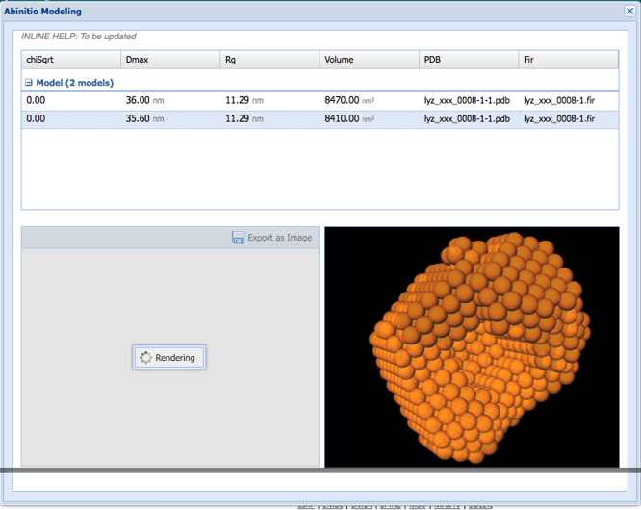
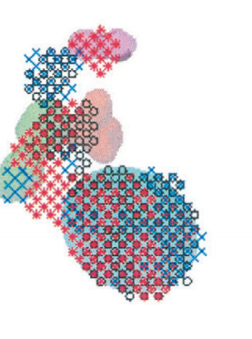
Modelling
MEMPROT
?
MONSA

Slide 12
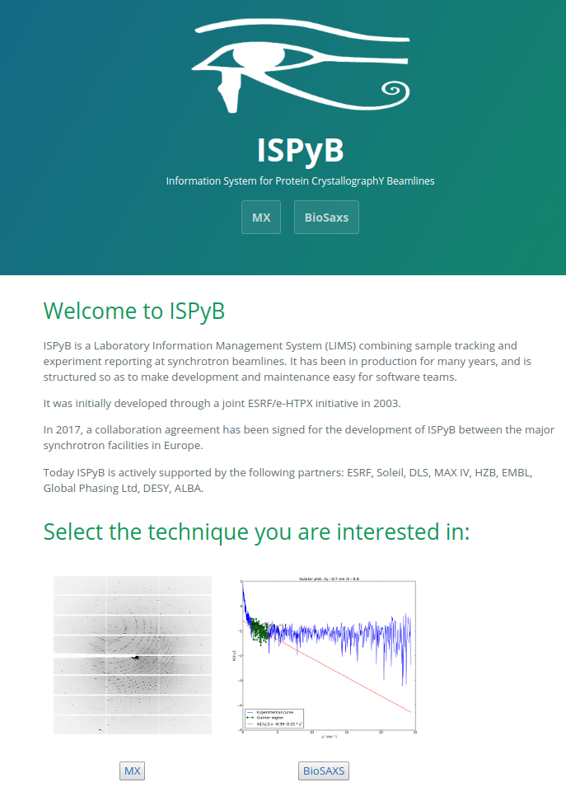
EXI?

Slide 13
THANK YOU!

Slide 14
Deliverable 5.5: Automated SAXS pipeline for
membrane proteins, integrated into ISPyB.
→ wishlist!

Slide 15
Becquerel Trivia
GUI: Qt4 based C++ application
SOAP Web Services via QtSOAP and QJSON
Total Number of external users in 2015/2016: ~350
Number of ISPyB users: <5 in 2015, 1 in 2016
No ISPyB development capabilities

