Slide 1
ISPyB Status Report
Marc Armenter
30/12/2023

Slide 2
How are we structured?
MIS section – Web applications development, service and maintenance.
No active contributor on ISPyB.
Controls section – Data acquisition with MXCuBE.
Scientific Data Management section – Data treatment.
Beamline scientists.

Slide 3
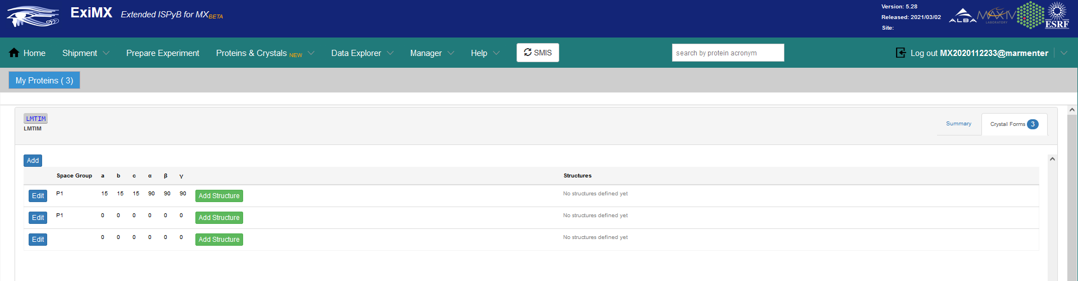
What’s new?
Focused on maintaining the Java implementation of ISPyB.
Effort was already invested
Users wanted EXI features
Solved EDNA plugins version issues.
Added the possibility to include new proteins and cristal forms with the collaboration of Alberto Nardella from MAX-IV.

Slide 4
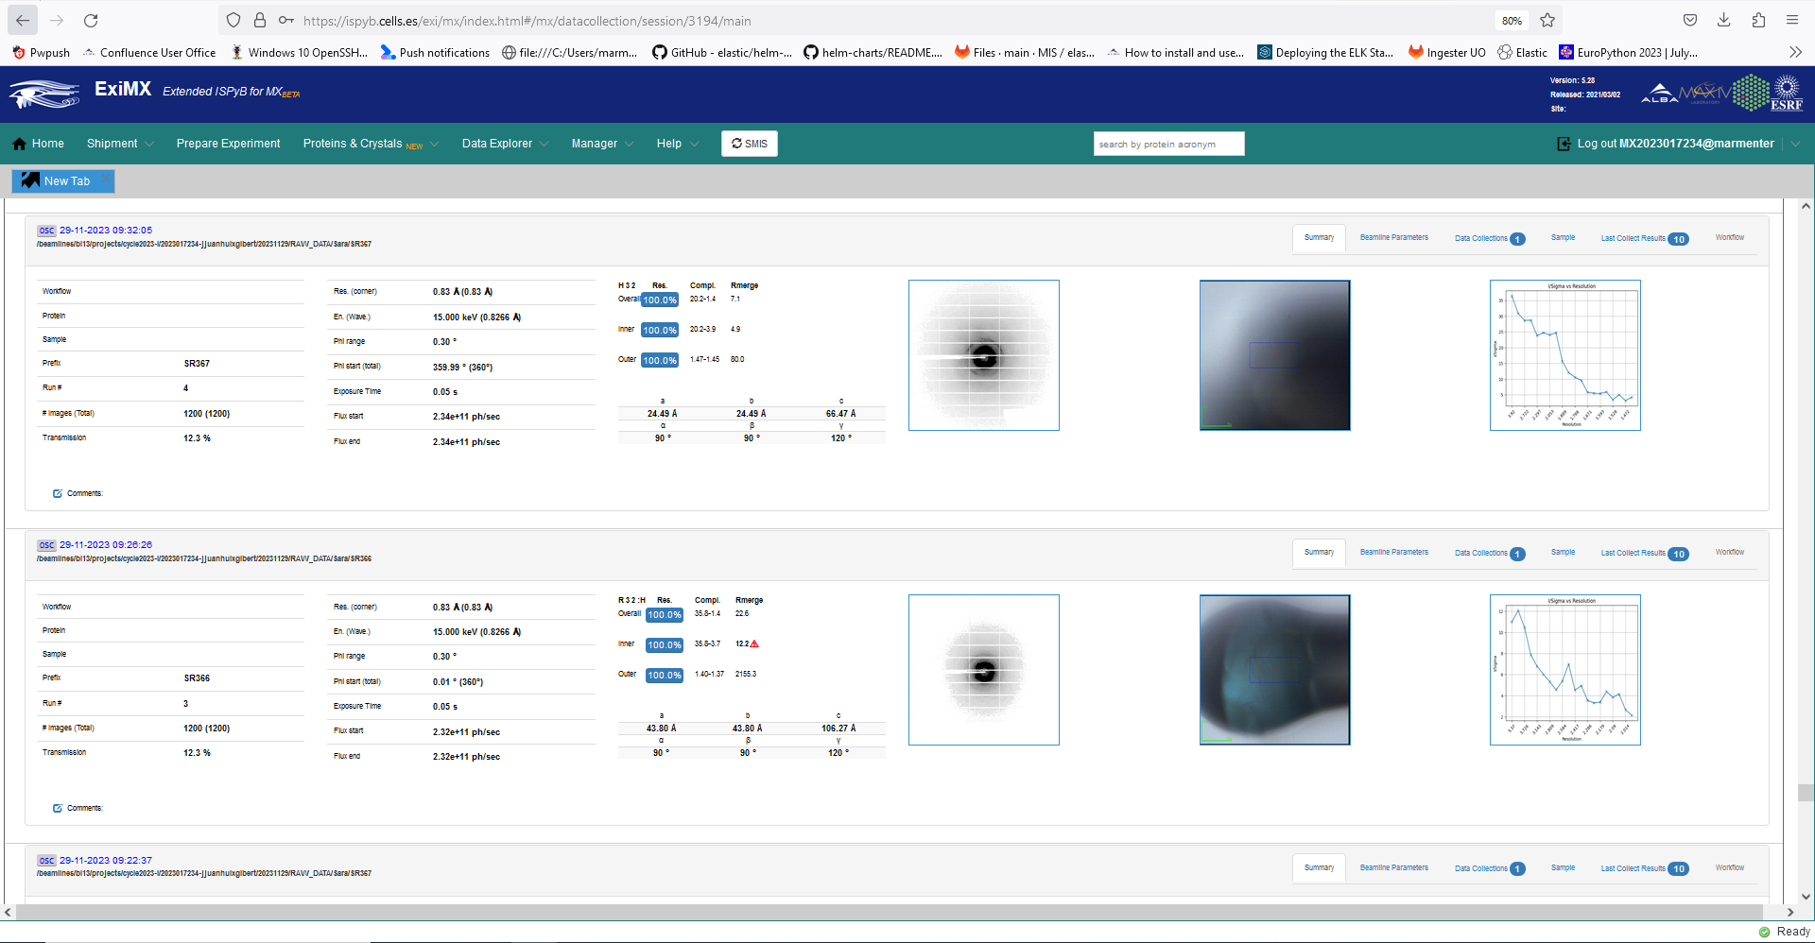
What’s new?
Deployed EXI (1) in production environment in 2022 and XALOC users are currently using it.
EXI 5.13.4 / ISPyB 5.8

Slide 5
What’s next?
Implement sample shipment notification workflow for ALBA in EXI/ISPyB.
Add BL06 – Xaira (SSX) to the ISPyB environment.
Install and test latest py-ISPyB implementation.
Evaluate the adoption of ICAT-ISPyB.

